Slide 1

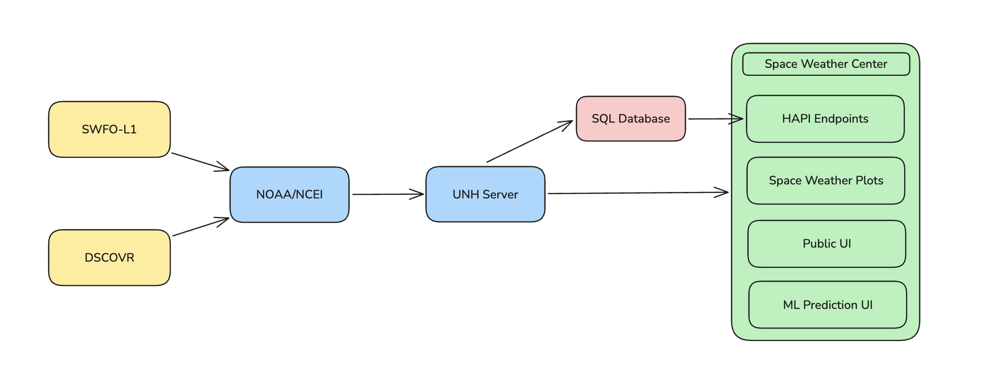
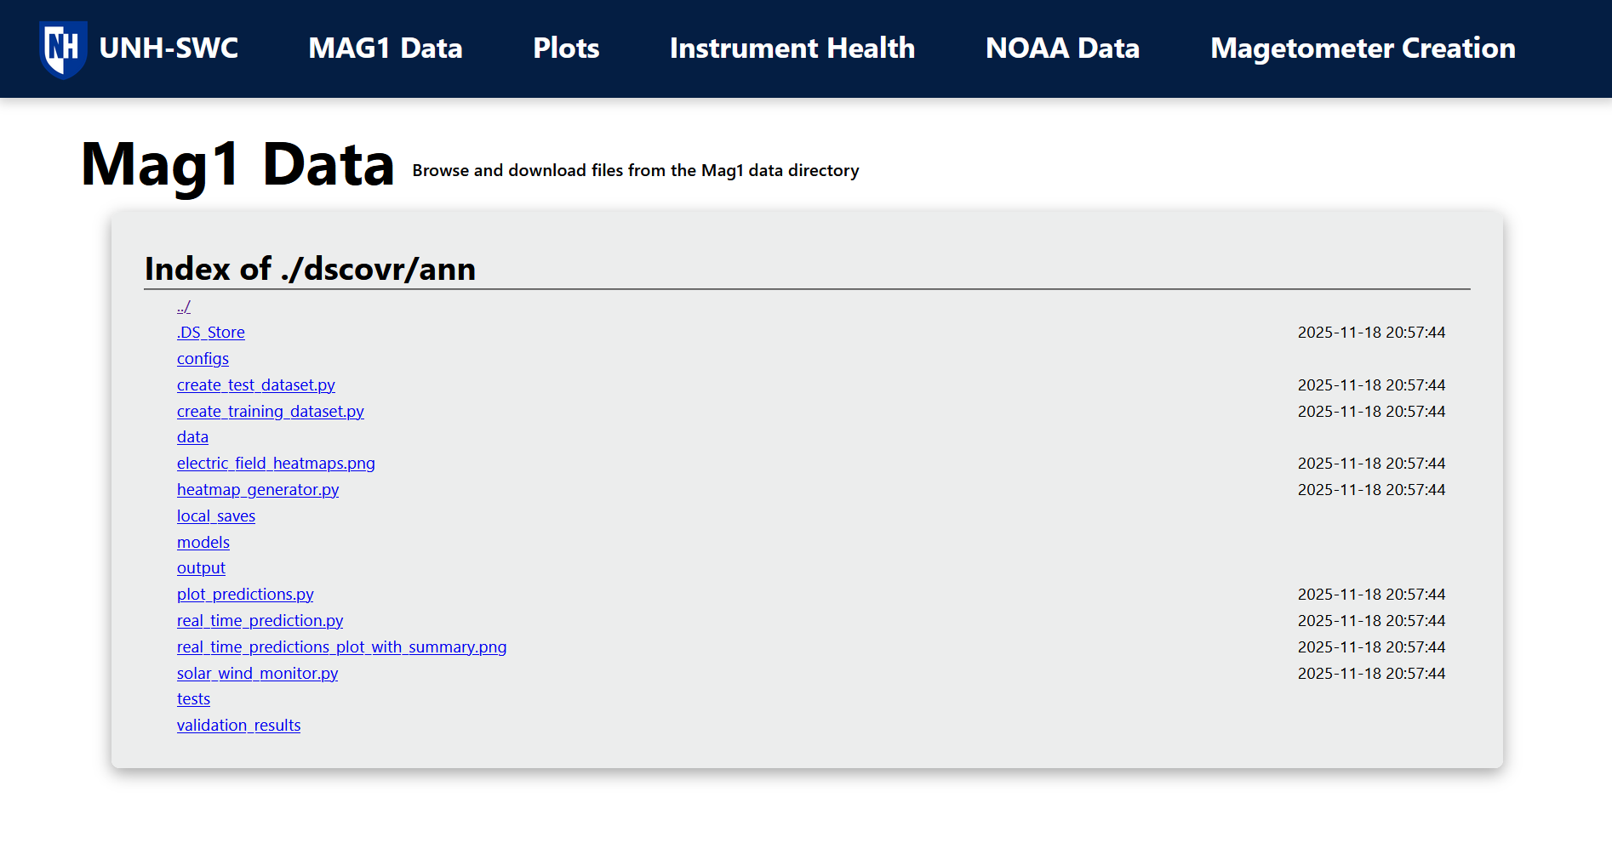
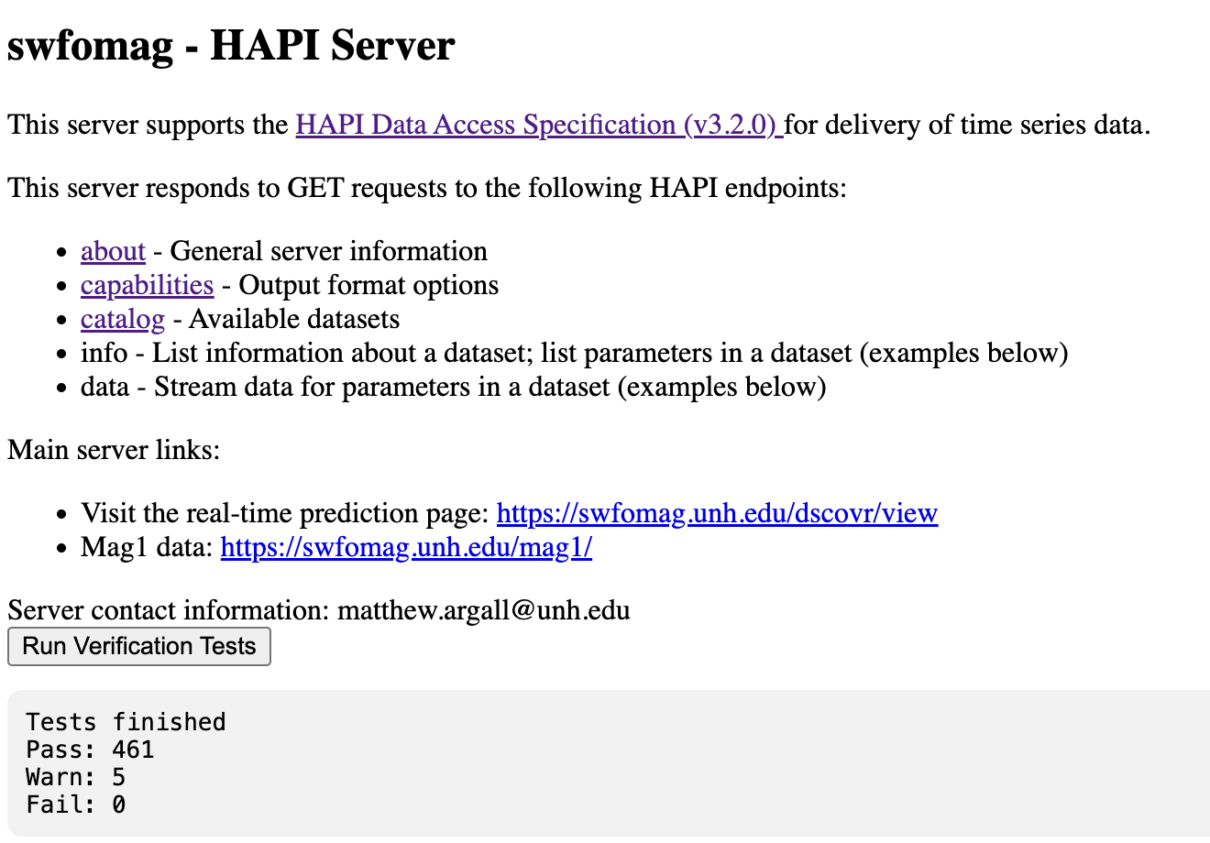
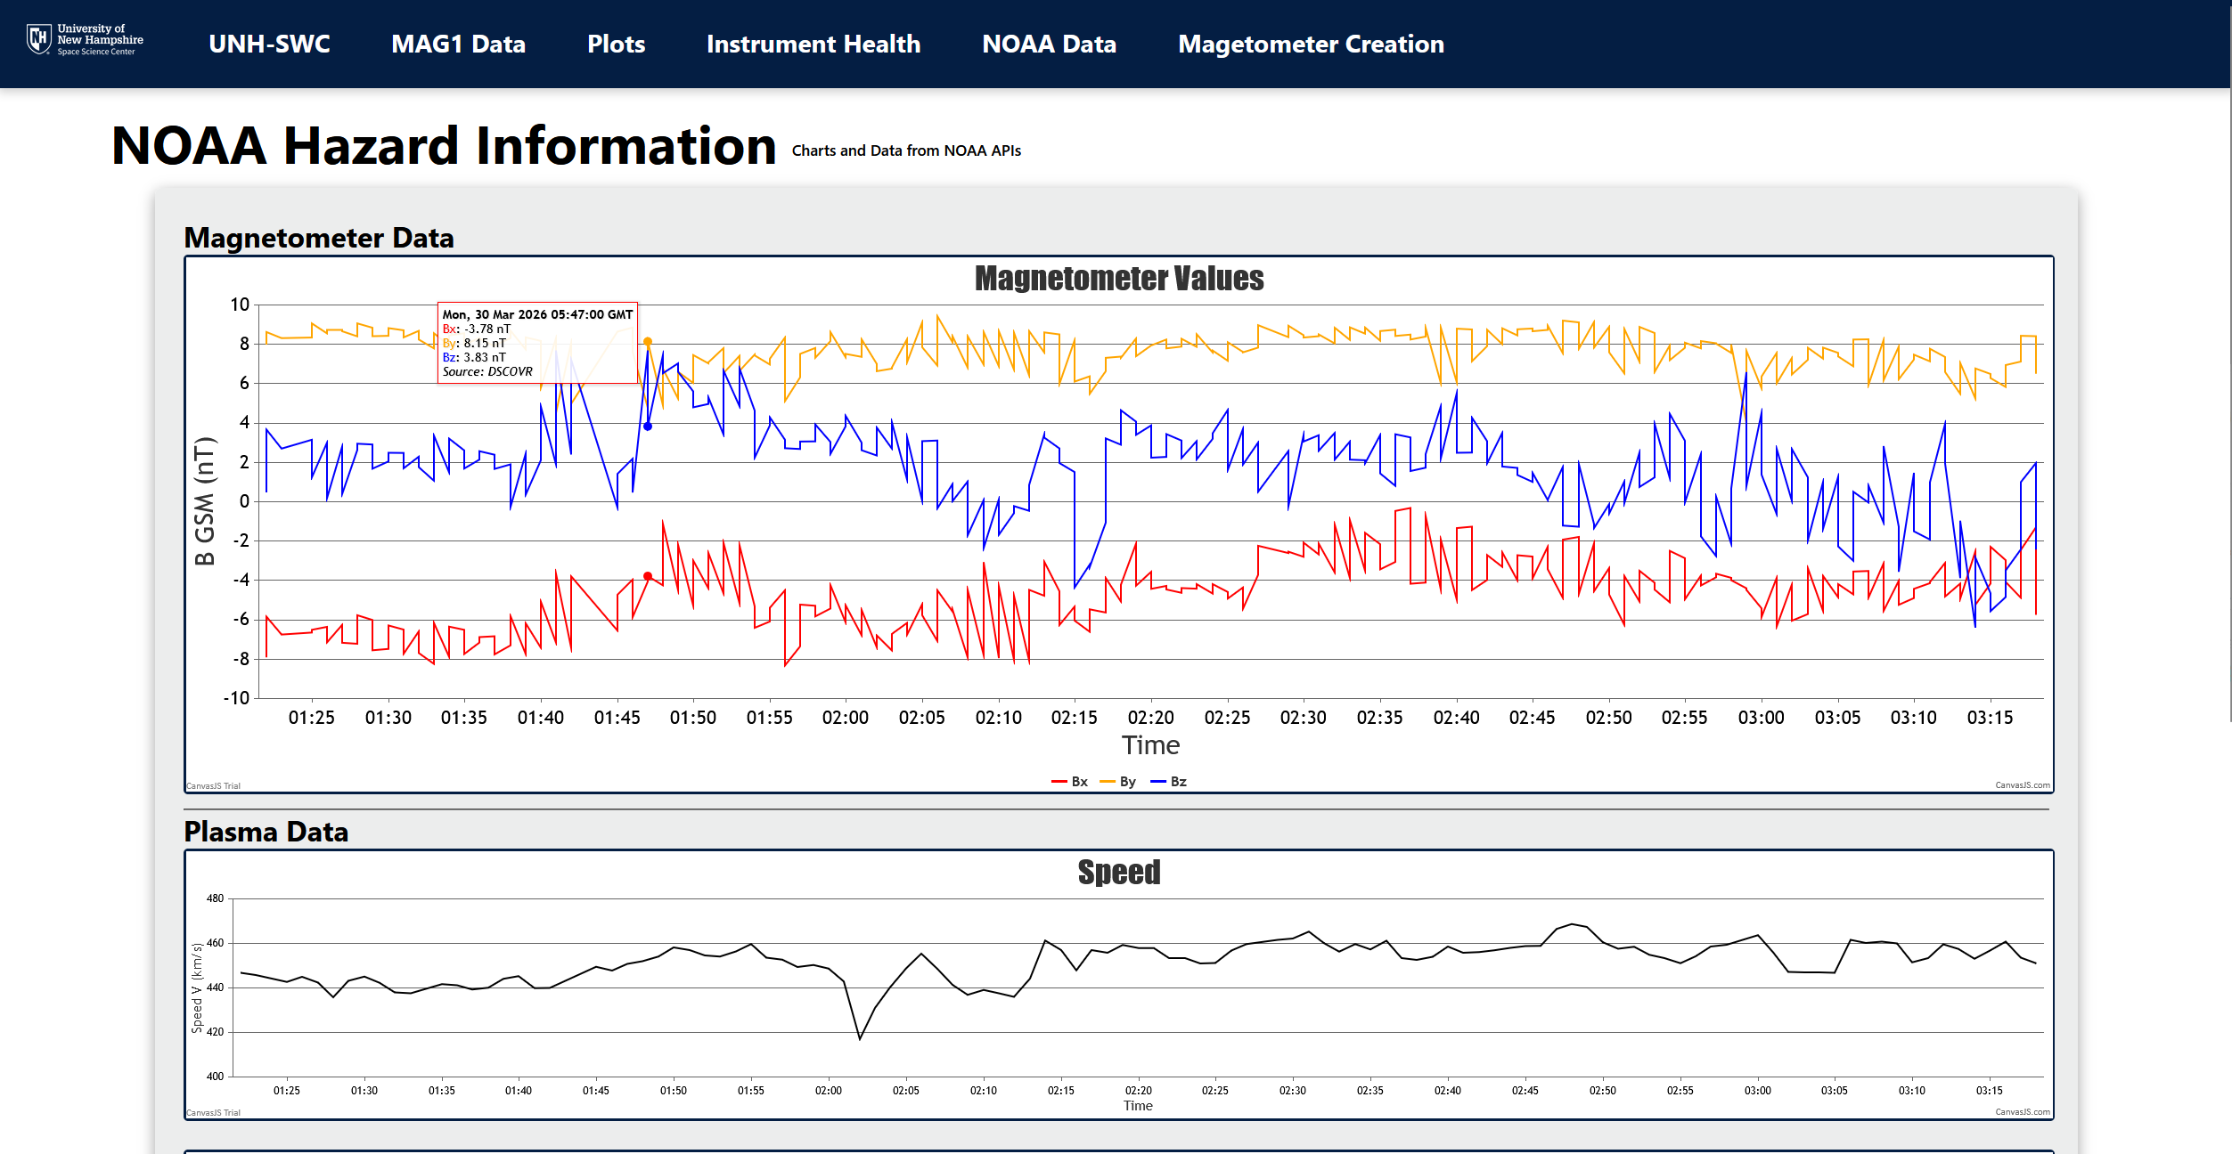
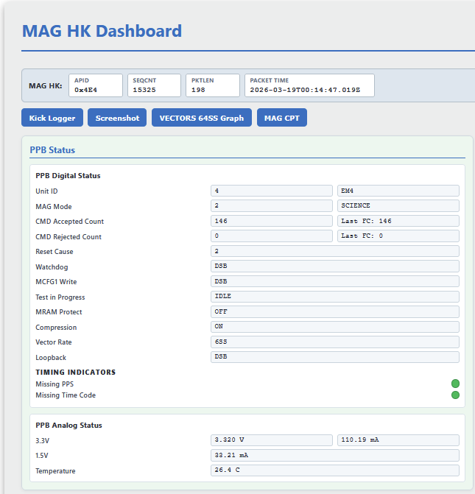
Space Weather Center
Ryan Laidlaw, Luke Rossel, Sam Harris, Alec Rydeen, Tamaralynn Shute
Department of Computer Science, University of New Hampshire, Durham, NH 03824
Introduction
Data Pipeline Flow Chart
Implementation
The UNH Space Weather Center processes real-time satellite data that supports scientific research and forecasting. With the addition of new satellites, such as SWFO-L1, the volume, velocity, and diversity of incoming data continues to increase.
Previous groups focused on real-time DSCOVR ingestion, predictive machine learning models, and interactive dashboards. But integrating SWFO-L1 required:
Expanded ingestion and preprocessing
Improved automation and service reliability
Modernized dependency management
A scalable architecture for future satellites
By improving the data pipeline, enhancing infrastructure reliability, and modernizing the repository we aim to create a maintainable, extensible foundation for future Space Weather groups to build from.
End-to-End Data Flow
Heliophysics Data API (HAPI)
Receives data directly from the SQL database
Extended from existing Flask routes to provide direct magnetometer data access
Server Reorganization
Leverages pyproject.toml file for increased portability for data processing logic
User Interface
Descriptive, public facing Flask/HTML pages
Magnetometer data analysis, Instrument Health Monitoring, and Data access
Machine Learning Framework
Uses an artificial neural network (ANN) model to predict non-linear short-term forecasts
Enhanced with Monte Carlo Dropout for predictive variance estimation
1. Data Sources:
DSCOVR · SWFO-L1
2. Data Ingestion:
Automated downloads (systemd)
3. Preprocessing & Validation:
NetCDF Generation · Metadata extraction
4. SQL Database:
Archived data storage · Fast access
5. Machine Learning Inference:
Model execution · Predictions
6. Serving & User Access:
HAPI · Dashboards · Research access
Figure 1. Comprehensive architecture of the space weather data pipeline, showing data acquisition from satellite sources, automated ingestion via systemd services, NetCDF preprocessing and validation, SQL-based storage, machine learning inference, and delivery through HAPI endpoints and user interfaces
System Requirements
Data Access Web Pages
Testing
Functional:
Ingest real-time satellite data automatically
Support multiple satellite formats (DSCOVR & SWFO-L1)
Generate standardized NetCDF outputs
Provide API-accessible processed datasets
Support ML-ready data pipelines
Non-Functional:
High availability and automation (systemd services & timers)
Robust failure handling and logging
Modular and maintainable repository structure
Dependency management and reproducible environments
Stakeholder:
Researchers require validated, comparable datasets
Infrastructure teams require reliable, observable services
Future developers require a documented and scalable design
HAPI
Open-source unit testing for endpoint functionality
Test scripts using SQLite for database testing
NetCDF Framework
Unit testing for verifying dimensions and metadata
Unit testing for data processing
Machine Learning Framework
Simulated CSV test and training datasets for model validation
Evaluated using mean squared error, root mean squared error, and R²
User Interface / User Experience
Regular check-in meetings with sponsor and stakeholders
User experience testing done with peers during development of pages
Figure 2. Mag1 Data Directory Page on the Space Weather Center site. Allows users to view and download data from the onboard magnetometer
Figure 3. HAPI landing page on the Space Weather Center site. Gives users information about how to query the server for raw magnetometer data
Design
Space Weather Center Web Pages
Evaluation and Conclusions
Modular Separation:
Data processing logic separated from operational services
API components isolated from ingestion/transformation logic
Clear boundaries between ingestion, processing, ML and serving layers
Infrastructure & Automation:
Background processing managed via systemd services
Failure recovery and logging mechanisms
Automated scheduled ingestion
Repository Modernization:
Transition from legacy setup configuration to pyproject.toml
Unified dependency management for reproducible env.
Removal of outdated configuration structures
Improved documentation and onboarding workflow
NetCDF Framework:
Implemented proof-of-concept empty NetCDF generation
Designed schema-driven structure for standardized outputs
Establishes scalable template system for future satellites
Our project completed its main success criteria of improving system maturity and user experience. Key evaluation metrics included system reliability, data accessibility, and interface usability. Reliability was improved through consistent pipeline output during data gaps, and data accessibility was improved through HAPI endpoints and structured storage.
User experience was intended to be evaluated through user feedback and usability testing of the updated UI. However, due to time constraints, we could not collect user reviews or quantitative metric. As a result, UI evaluation is currently based on internal validation instead of external feedback.
Overall, our system displays clear improvements in robustness and accessibility, but future work would be focused on collecting user feedback and expanding the interactive UI.
Acknowledgements
Figure 4. Graphs of Magnetometer data from NOAA APIs, displaying source spacecraft
Figure 5. Magnetometer housekeeping data dashboard, which depicts the status of different instruments and telemetry.
We would like to thank:
Dr. Matthew Argall - sponsor
David Benedetto - advisor

Slide 2
Abstract
The growing number of UNH space weather satellites and space weather data has simultaneously increased the need for enhanced data processing and organization, particularly as data volume, velocity, and instrument diversity continue to expand. In previous years, the space weather team focused on processing real-time data and using it to create predictive machine learning models for the DSCOVR satellite, as well as creating interactive visuals of solar wind and geomagnetic information for researchers.
However, the addition of its next generation satellite SWFO-L1 demanded a more dynamic data processing and user interaction system. We built off the work of previous groups by optimizing and fine-tuning their predictive models, extending the existing Flask-based interface with new publicly accessible pages documenting the magnetometer and its data, reorganizing project structure to align with modern software engineering best practices, and expanding documentation, including a Read The Docs implementation and pyproject.toml configuration, to improve collaboration, onboarding, and overall developer experience.
The work completed in this project will allow the Space Weather Center to deliver more accurate, and accessible insights for scientific research and industrial stakeholders. At the same time, the improved system architecture and documentation create a scalable foundation that supports continued innovation as new satellites, instruments, and analytical models are incorporated.

