Slide 1

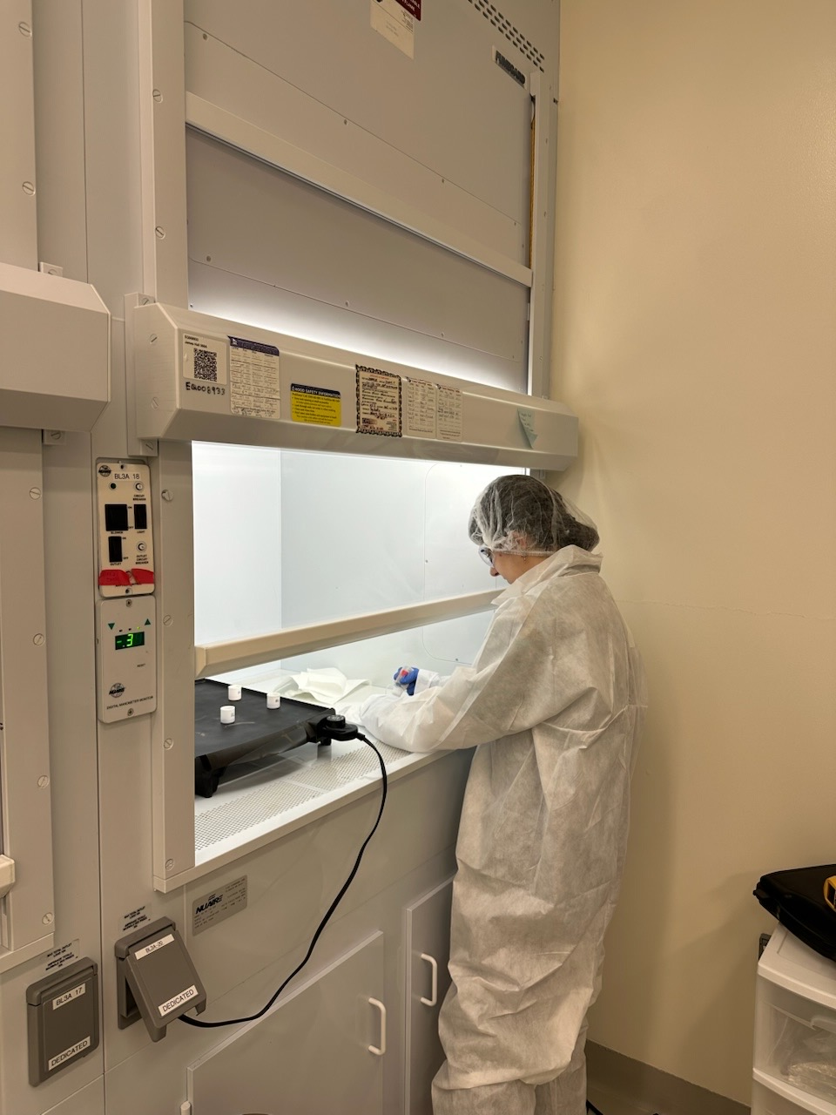
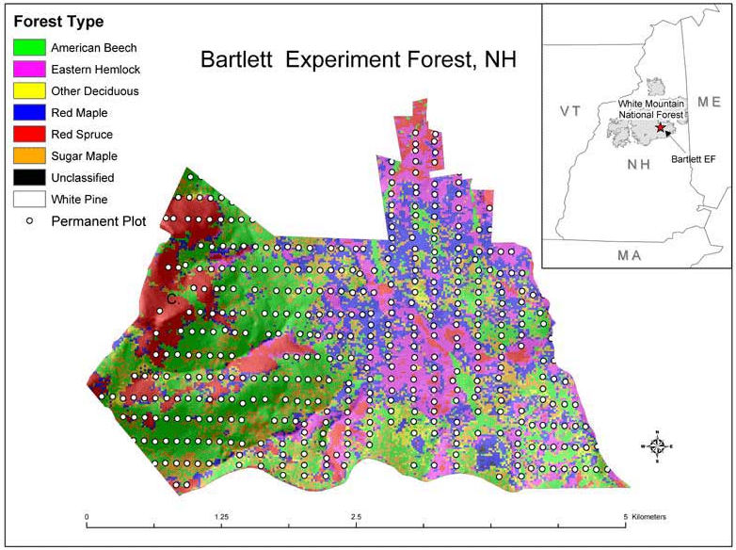
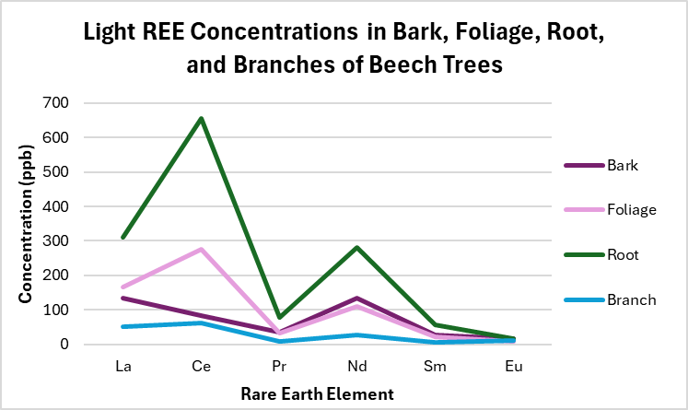
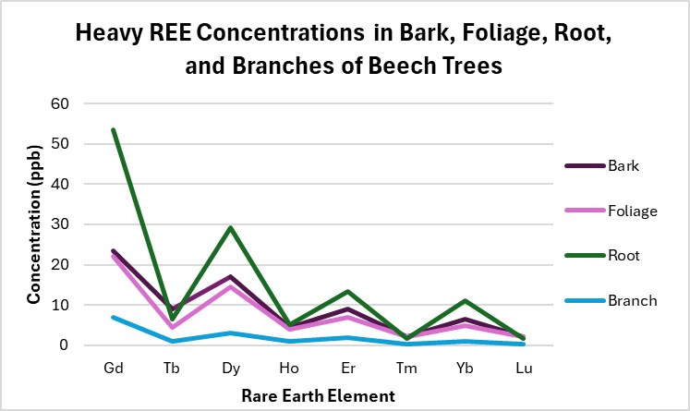
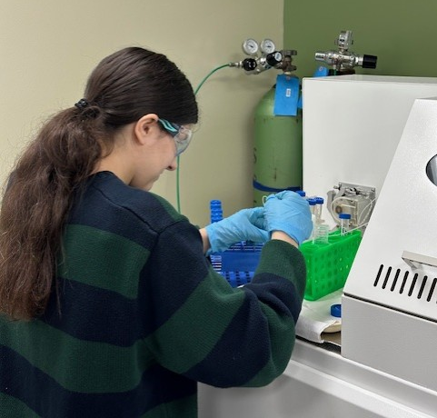
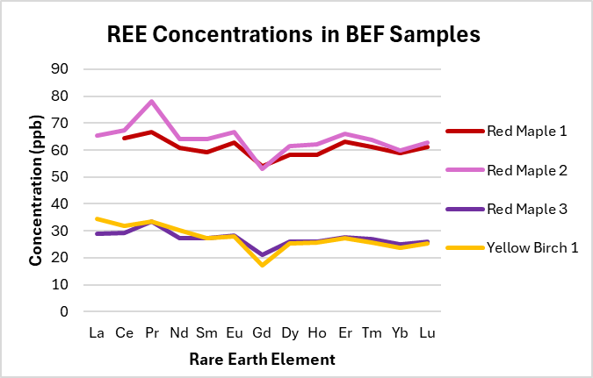
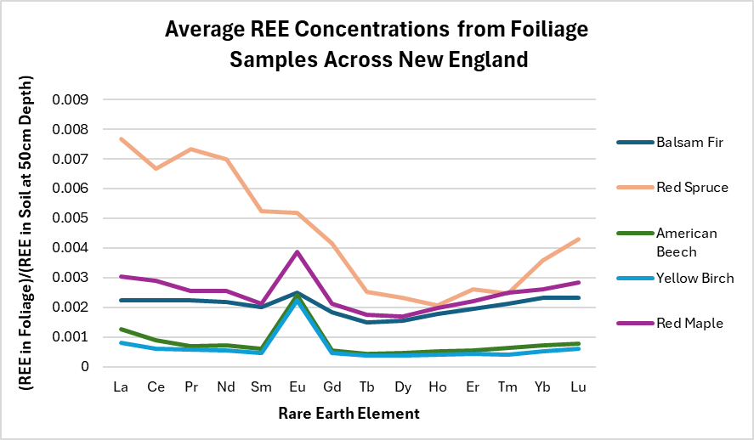
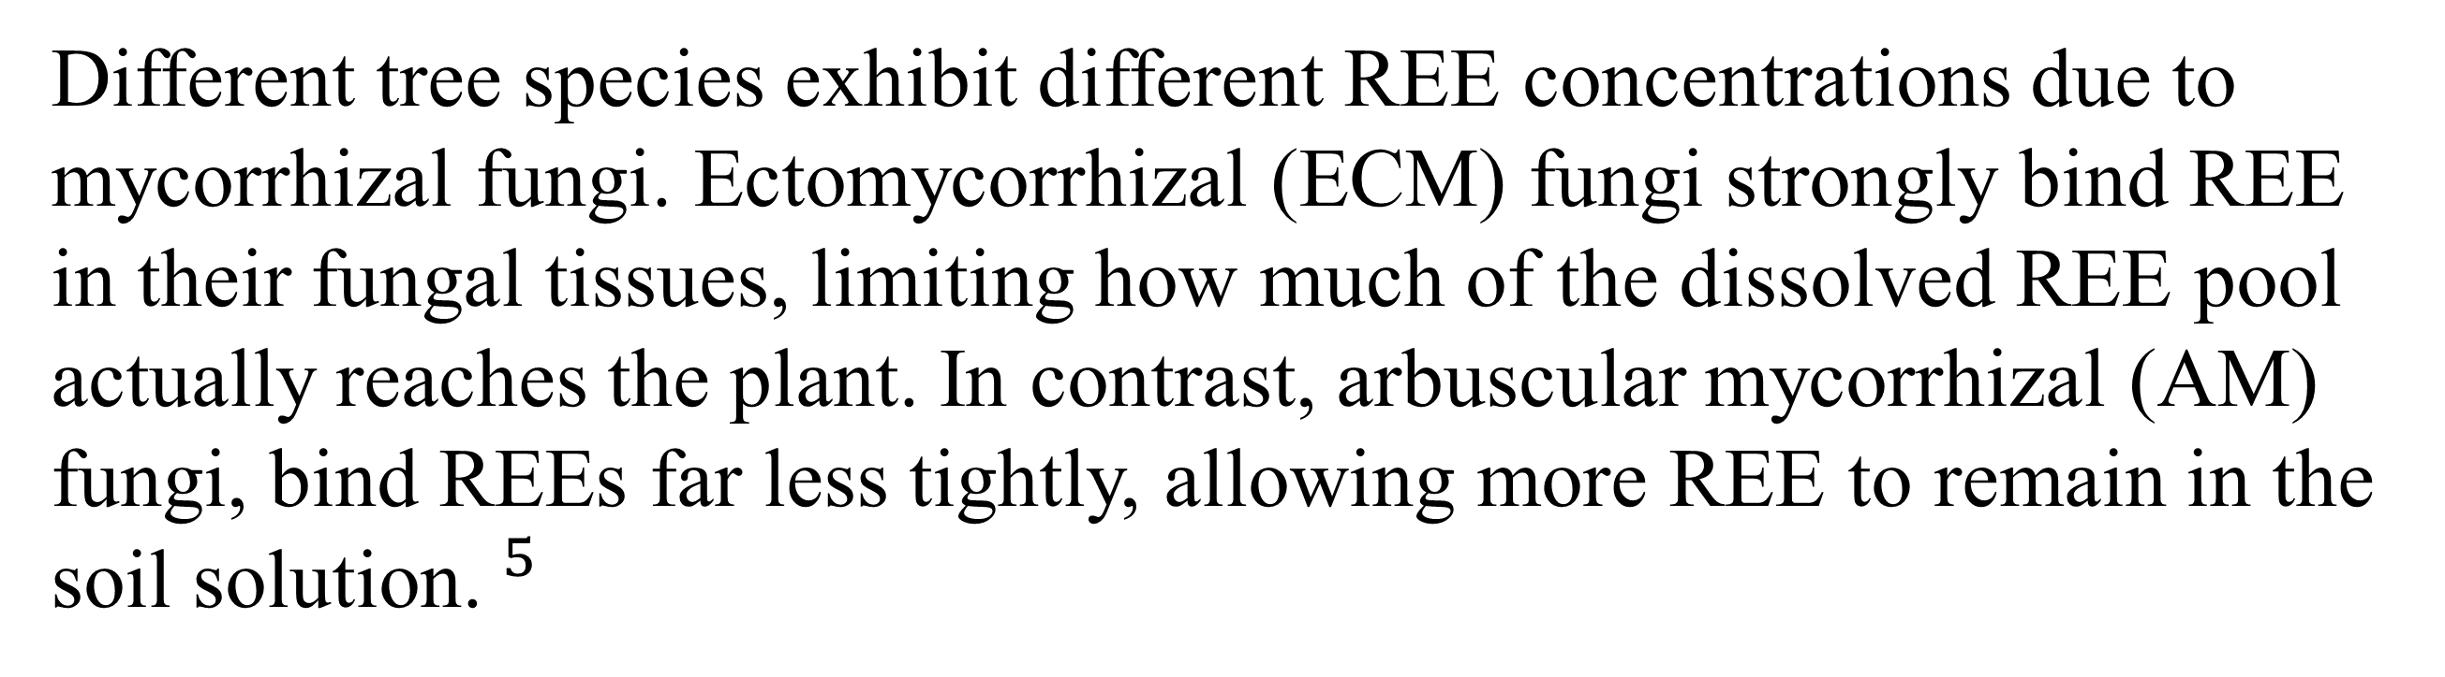
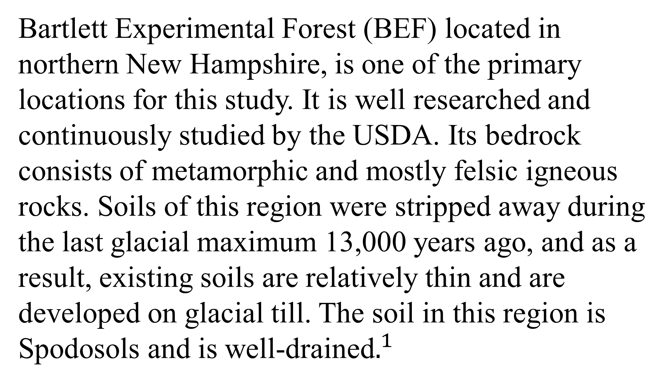
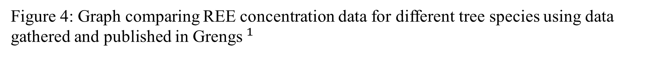

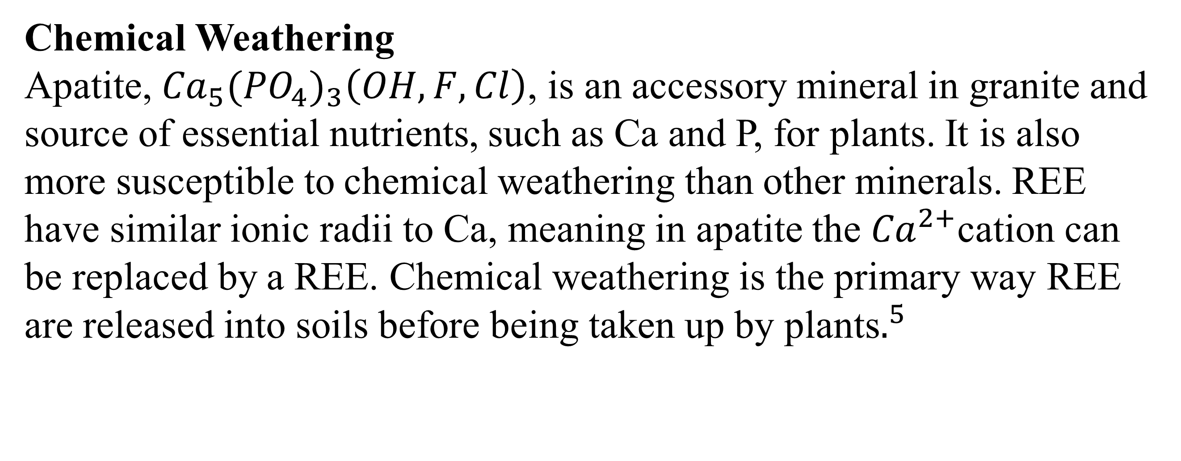
Rare Earth Elements in Foliage in Recently Glaciated Terrains
Bethany Cutter
Advisor: Julie Bryce
Department of Earth Sciences, University of New Hampshire
Background
Chemical Weathering
Apatite, ${Ca}_{5}{{(PO}_{4})}_{3}\left(OH, F, Cl\right)$, is an accessory mineral in granite and source of essential nutrients, such as Ca and P, for plants. It is also more susceptible to chemical weathering than other minerals. REE have similar ionic radii to Ca, meaning in apatite the ${Ca}^{2+}$cation can be replaced by a REE. Chemical weathering is the primary way REE are released into soils before being taken up by plants$.^{5}$
Methods
Rare Earth Elements (REE) occur in trace amounts throughout the Earth’s crust and, due to their association with phosphate minerals, are potentially useful for tracing weathering within an ecosystem.
Foliage samples gathered by Dr. Matt Vadeboncoeur from BEF were received in a homogenized state
Samples were weighed and dissolved with nitric acid in a clean lab environment
Some samples needed to be dissolved multiple times
Samples were diluted with 2% nitric acid before analysis
Samples were run using an ICP-MS along with known standards and blanks
REE Fractionation
During chemical weathering, REEs are released from minerals like apatite, and they fractionate because LREE are more easily mobilized while HREE tend to stay bound to clays, oxides, and organic matter. In BEF, plants often show slight LREE enrichment, while the residual soil becomes relatively HREE‑rich$^{3}$
Figure 5: Foliage samples being dissolved with nitric acid
Figures 2 and 3: Graphs of REE concentrations in different parts of beech trees taken from data gathered and published in Stille et al$^{4}$
Figure 6: Foliage samples being run in the ICP-MS
Results
Figure 1: Map of tree species in study site from the ${USDA}^{1}$
Bartlett Experimental Forest (BEF) located in northern New Hampshire, is one of the primary locations for this study. It is well researched and continuously studied by the USDA. Its bedrock consists of metamorphic and mostly felsic igneous rocks. Soils of this region were stripped away during the last glacial maximum 13,000 years ago, and as a result, existing soils are relatively thin and are developed on glacial till. The soil in this region is Spodosols and is well-drained$.^{1}$
REE in Different Tree Species
Research Question
Figure 7: REE concentrations for four samples measured by the ICP-MS. Concentrations were calculated from calibration curves using the slope and intercept of linear regressions for each isotope. Uncertainties are < than 10%
Future research and analysis of additional foliage, water, and soil samples will provide a more complete understanding of REE cycling in this ecosystem.
How do REE concentrations in foliage samples at BEF change over time as weathering dynamics change?
Figure 4: Graph comparing REE concentration data for different tree species using data gathered and published in Grengs$^{1}$
References
Approach
Different tree species exhibit different REE concentrations due to mycorrhizal fungi. Ectomycorrhizal (ECM) fungi strongly bind REE in their fungal tissues, limiting how much of the dissolved REE pool actually reaches the plant. In contrast, arbuscular mycorrhizal (AM) fungi, bind REEs far less tightly, allowing more REE to remain in the soil solution.$^{5}$
Grengs, Ashley (2023). Rare Earth Element Distributions in Forest Soils Across Bedrock Gradients in New Hampshire and Vermont. Master's Theses and Capstones. 1758. https://scholars.unh. edu/thesis/1758
Leak, William B.; Yamasaki, Mariko. 2011. The Bartlett Experimental Forest, Its first 75 years. NRS-INF-12-11. Newtown Square, PA: U.S. Department of Agriculture, Forest Service, Northern Research Station. 21 p.
Sager, M., & Wiche, O. (2024). Rare Earth Elements (REE): Origins, Dispersion, and Environmental Implications—A Comprehensive Review. Environments, 11(2), 24. https://doi.org/10.3390/environments11020024
Stille, P., Steinmann, M., Pierret, M.-C., Gauthier-Lafaye, F., Chabaux, F., Viville, D., Pourcelot, L., Matera, V., Aouad, G., & Aubert, D. (2006). The impact of vegetation on REE fractionation in stream waters of a small forested catchment (the Strengbach case). Geochimica et Cosmochimica Acta, 70(13), 3217–3230. https://doi.org/10.1016/j.gca.2006.04.031
Vadeboncoeur, Matthew A (2013). Mechanisms of nutrient limitation and nutrient acquisition in managed and unmanaged forest ecosystems. Doctoral Dissertations. 1. https://scholars.unh. edu/dissertation/1
Data from a variety of published papers was examined to better understand potential REE behavior at BEF. Select pilot samples were prepared for analysis

