Slide 1

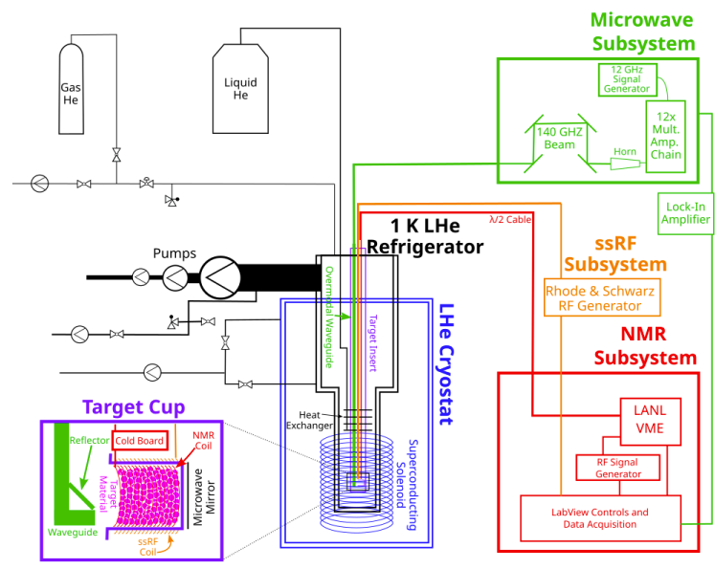
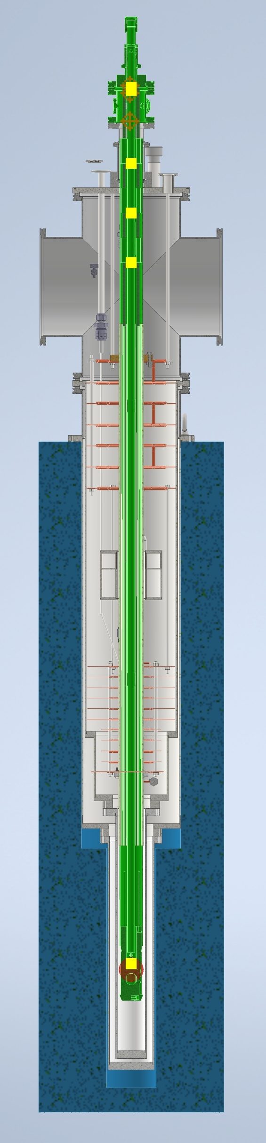
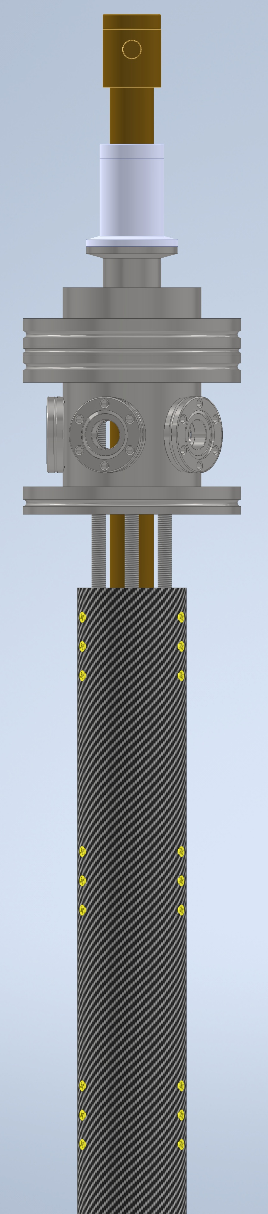

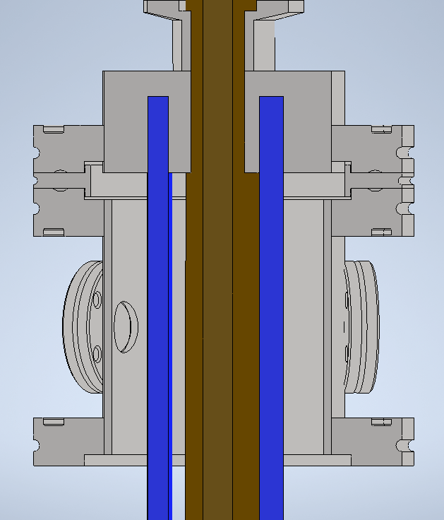
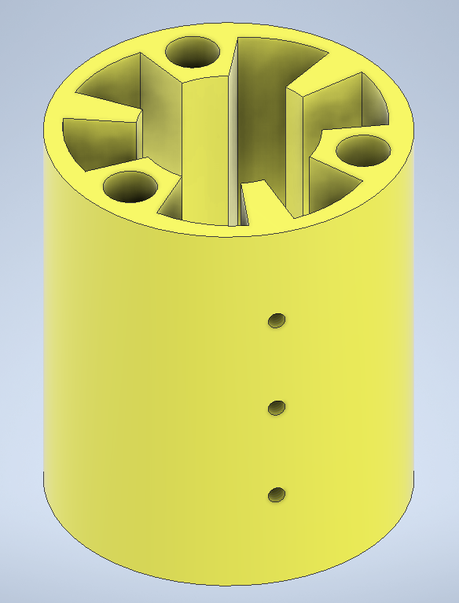
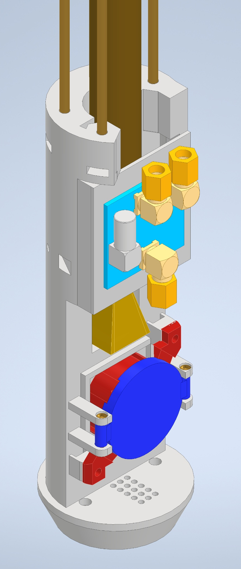
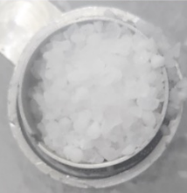
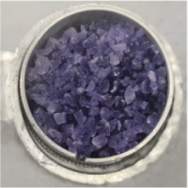
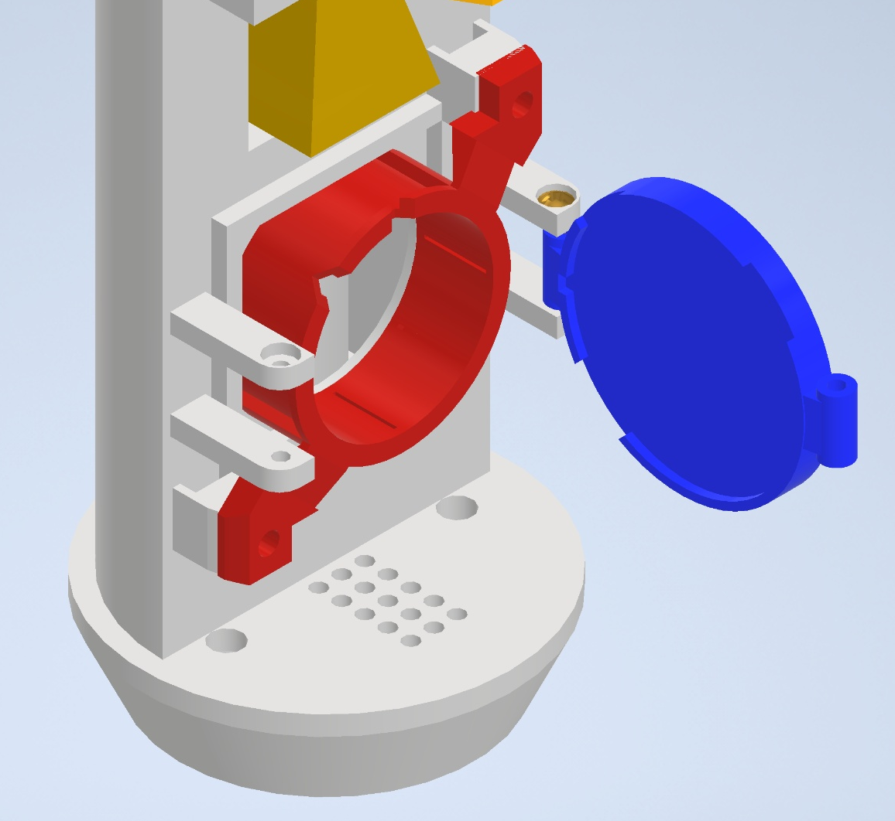
Designing a Target Insert: The Heart of a Dynamic Nuclear Polarization System
Alexandra Antar
Advisor: Nathaly Santiesteban
Department of Physics and Astronomy, University of New Hampshire, Durham, NH 03824
Introduction
3D Model of Insert
Breakthroughs in nuclear physics experiments have driven advancements in both medical imaging and particle physics. Dynamic nuclear polarization (DNP) enhances Nuclear Magnetic Resonance (NMR) signals by using microwave irradiation to transfer the polarization of electron spins to nearby nuclei. This process requires a strong magnetic field (5 Tesla), very low temperatures (~1 Kelvin), and microwaves (~ 140 GHz). I present the design of a material insert that aims to refine existing models to further the progress of these experiments.
Top Piece
Stainless steel “UFO”
Thermometry
Waveguide connection
2 NMR ports
1 spectral-spatial Radio Frequency (ssRF) port
Top Piece
Close-up of top piece with threaded rods highlighted in blue
Schematic showing various subsystems of the current DNP setup
Carbon Fiber (CF) Tube
Carbon Fiber Tube
~ 1.5 meters
Waveguide
Cernox temperature sensors
Threaded rods
3D printed support pieces onto which CF tube will be screwed
Support piece to hold target ladder
Future Work
Design Requirements
Finalize target ladder design
Send completed drawings of pieces to manufacturers
Construct target insert and perform tests
Optimize design to enhance NMR sensitivity, enabling real-time, faster metabolic imaging in future medical applications
Material that can withstand cryogenic temperatures
Resistance to radiation damage
Waveguide running through the center from the top piece down to the ladder
Maximum microwave transmission from waveguides to sample
Diameter should not exceed inner diameter of fridge (2.25 inches)
Smart and adaptable design allowing usage in different labs and experiments
Support piece with space for waveguide and cables, and with screw holes on the sides
Ladder
Holds target cup containing material sample
Cup is removable and replaceable
Durable material
Cold board
Cernox thermometry
NMR & RF coils
5T field in center
Target Ladder
Acknowledgements
Thank you to Professor Nathaly Santiesteban for her guidance and for giving me the opportunity to do this work. I would also like to thank Professor Elena Long for her expertise and advice. I am especially grateful for Zoe Wolters and Olaiya Olokunboyo for their mentorship and support.
Solidified ammonia (NH3) and deuterated ammonia (ND3) are widely used target materials
Design Process
Create 3D models for each component after discussing design criteria
Print components to test different prototypes
Revise and improve designs
References
Crabb, D. G., and W. Meyer. “Solid Polarized Targets for Nuclear and Particle Physics Experiments.” Annual Review of Nuclear and Particle Science, vol. 47, no. 1, Dec. 1997, pp. 67–109, https://doi.org/10.1146/annurev.nucl.47.1.67.
Zec, Allison. A Target Insert Design for the UNH Solid Polarized Target Lab. Sep. 2024. PowerPoint Presentation.
Slifer, Karl. Dynamic Nuclear Polarization Facility at UNH. Sep. 2024. PowerPoint Presentation.
Model of fridge showing location of target insert highlighted in green
Close-up of cap’s opening mechanism

