Slide 1

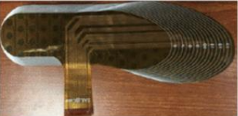
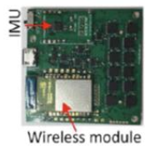
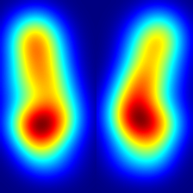
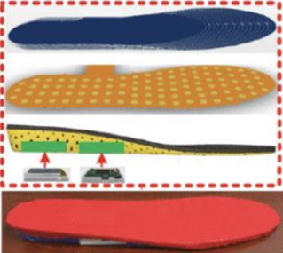
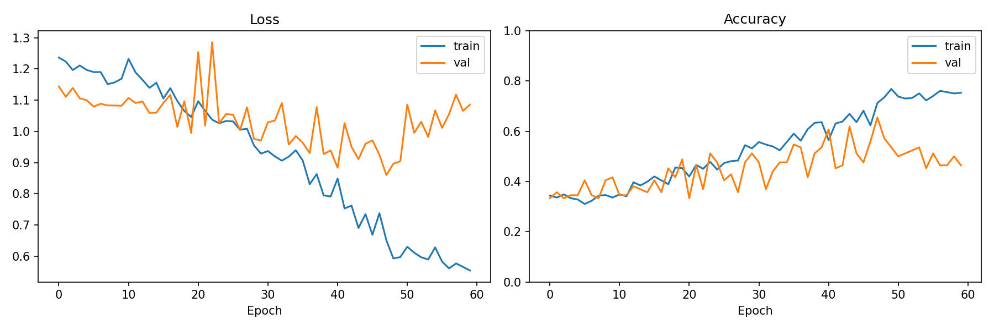
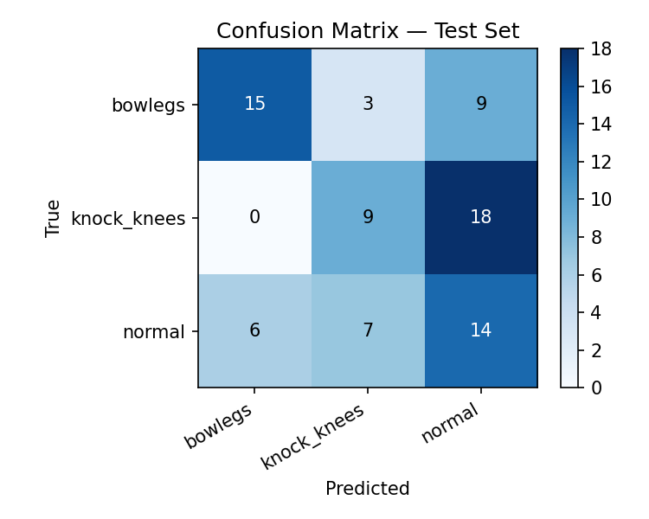
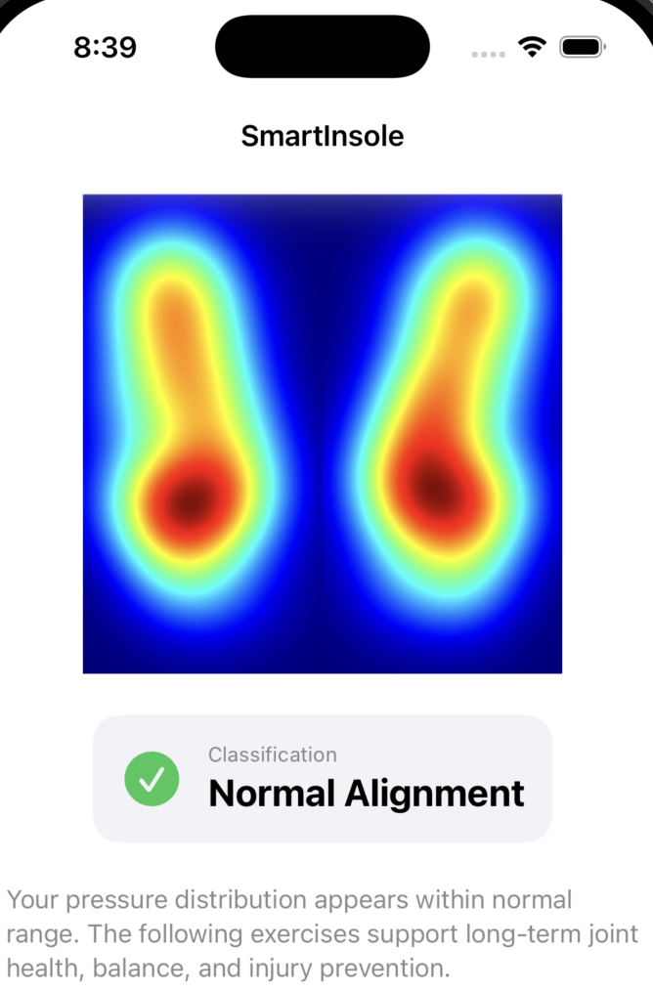
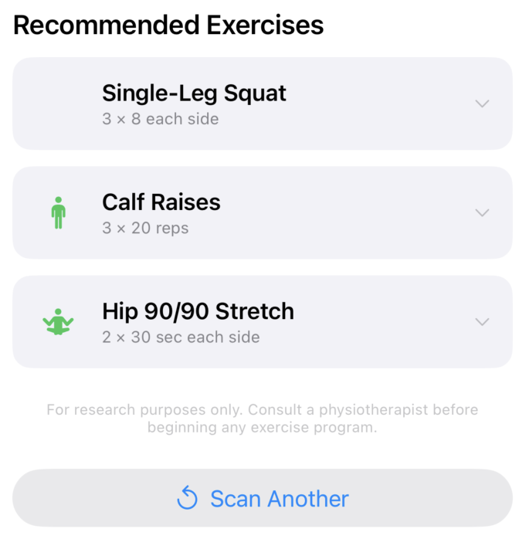
Smart Insole System for Detecting Lower-Limb Malalignment
Jordan Friedly, Diliang Chen
Electrical & Computer Engineering, University of New Hampshire, Durham, NH 03824
Introduction
Images
Results
Lower-limb malalignment, including overpronation and uneven gait distribution, can lead to chronic pain, joint degeneration, and long-term mobility issues. Current diagnostic methods rely on gait labs or clinical expertise, limiting accessibility and early detection.
This project presents a smart insole system that enables continuous, real-time gait analysis using plantar pressure data. Pressure data is transformed into heatmaps and analyzed using a convolutional neural network (CNN) to automatically classify gait abnormalities.
Results are delivered through a personalized iOS application that visualizes gait patterns and provides user-specific rehabilitation feedback.
Insole Hardware
Heatmap Output
• CNN classifier achieves 65% validation accuracy across three gait categories
• Bowlegs classification shows strongest performance demonstrating the system’s ability to detect lateral pressure asymmetry
• Proof of concept pipeline successfully converts raw 96 sensor insole data into spatially meaningful plantar pressure heatmaps
• Stance phase averaging across 33 frames per gait cycle produces anatomically accurate bilateral foot pressure maps
• Model trained on synthetically generated dataset of 558 images, real patient data would improve accuracy
Smart insole with embedded pressure sensors
Example plantar pressure heatmap used as CNN input
Methodology
Charts
Conclusions
• Embedded pressure sensors collect plantar force data during walking
• Sensor data is converted into 2D pressure heatmaps
• Heatmaps are used as input to a trained CNN model
• CNN classifies normal, bowlegs, and knock knee gait patterns
• Predictions are sent to a mobile application backend
• iOS app displays results and personalized corrective recommendations
Confusion Matrix
• A complete pipeline for gait analysis using wearable sensing and deep learning was developed
• CNN-based classification of pressure heatmaps demonstrates feasibility of CNN-based classification
• Integration with a mobile application enables real-time, user-friendly feedback
• System has potential for accessible, continuous biomechanical monitoring outside clinical settings
Training loss / accuracy curve
CNN training performance over epochs
Classification accuracy across gait categories
Data
sTAMD Simulations
Acknowledgements
IOS Application
• Plantar pressure data collected from insole sensor array
• Data sampled across multiple walking trials
• Heatmaps generated to preserve spatial pressure distribution
• Dataset labels synthetically generated via biomechanically informed pressure redistribution
• Preprocessing includes normalization and noise filtering
User Screen
Rehabilitative Actions
Diliang Chen
University of New Hampshire, Electrical and Computer Engineering
References
Bamberg et al., IEEE TBME, 2008
Razak et al., Sensors, 2012
Zhang et al., Sensing & Bio-Sensing Research, 2019
Tailor made rehabilitative steps for specific data points

