Slide 1
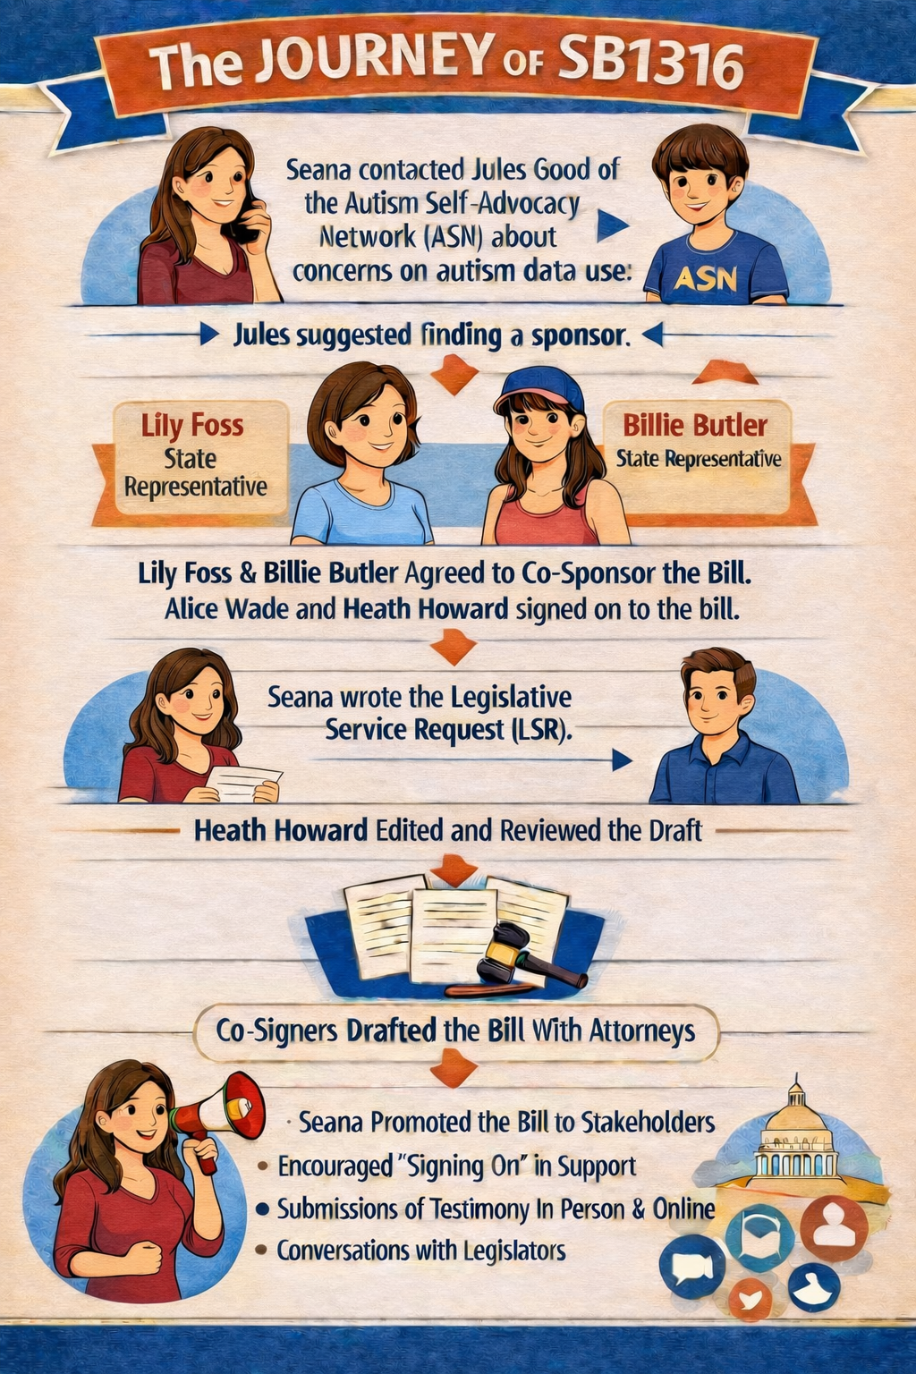
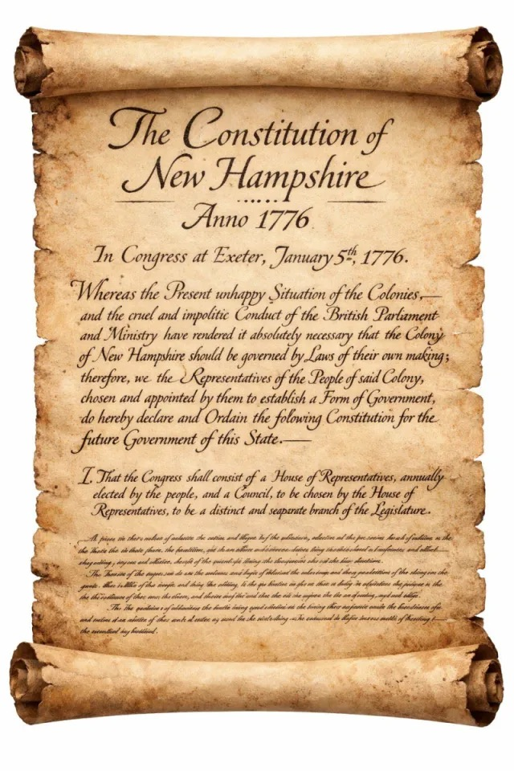
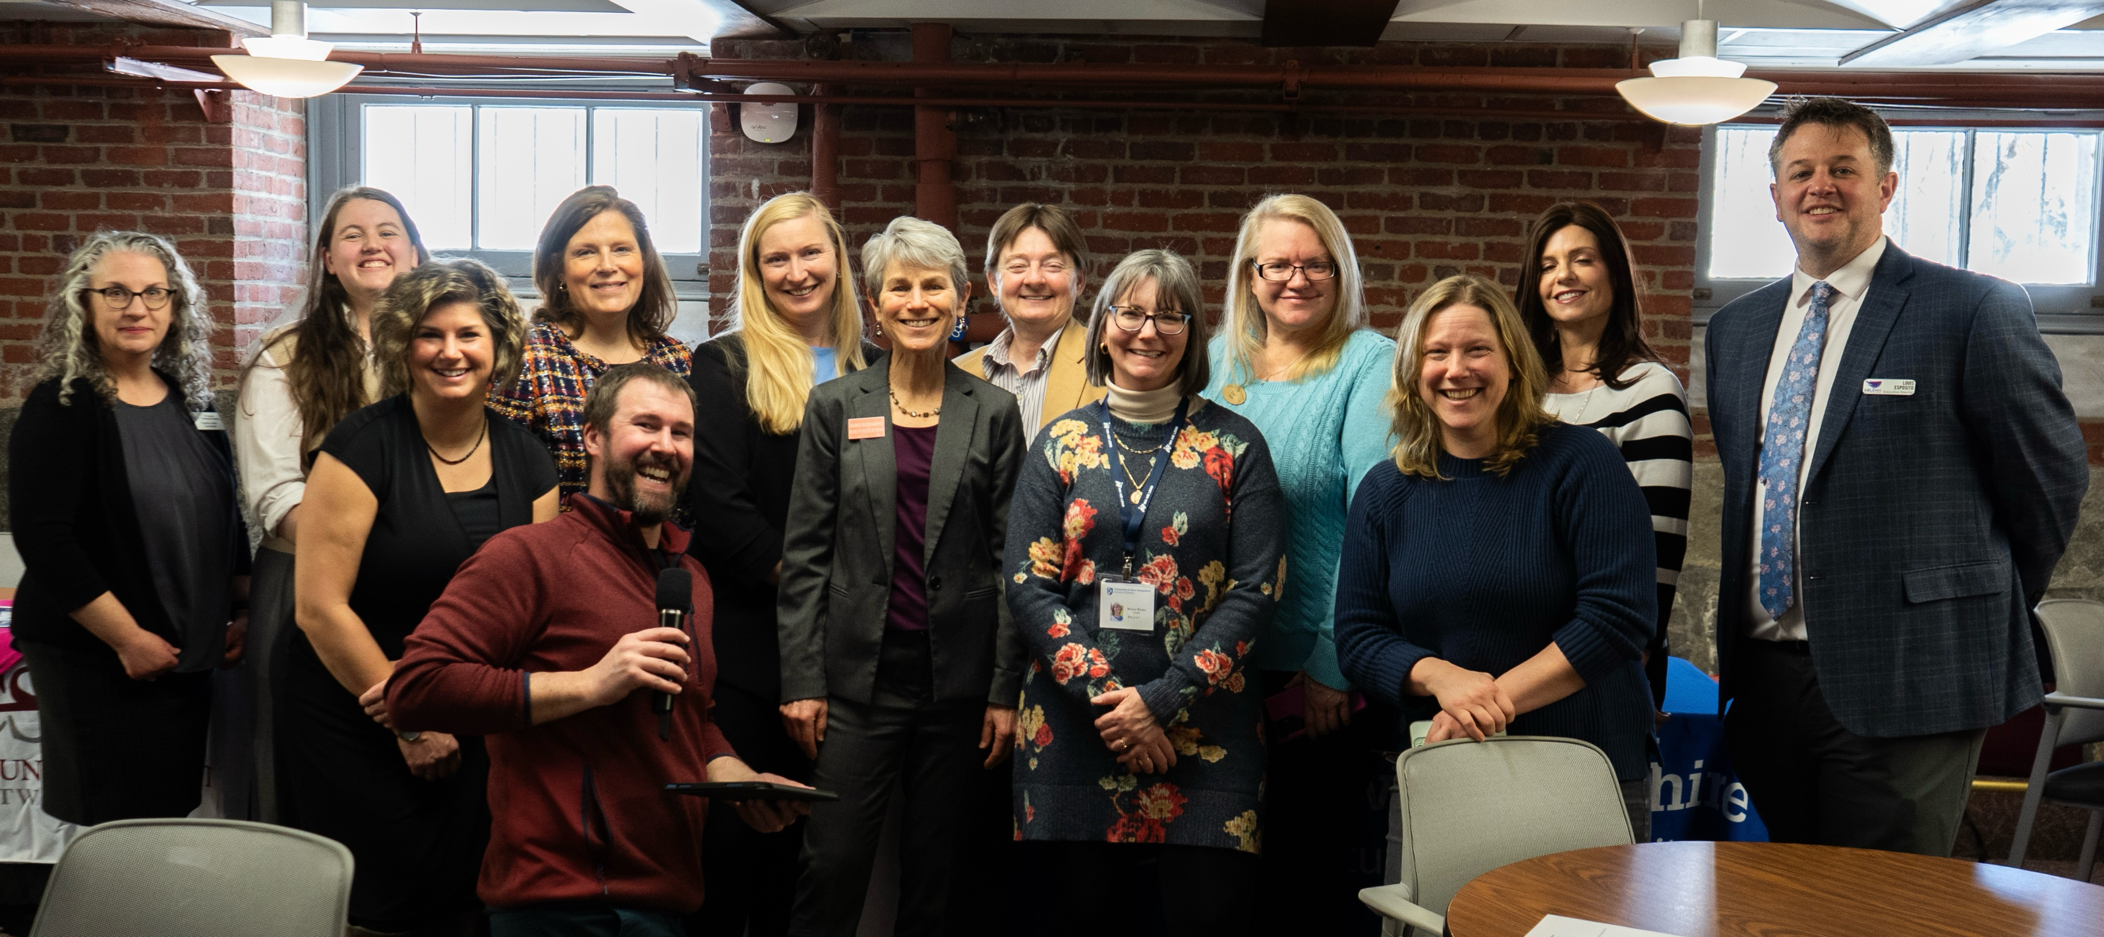
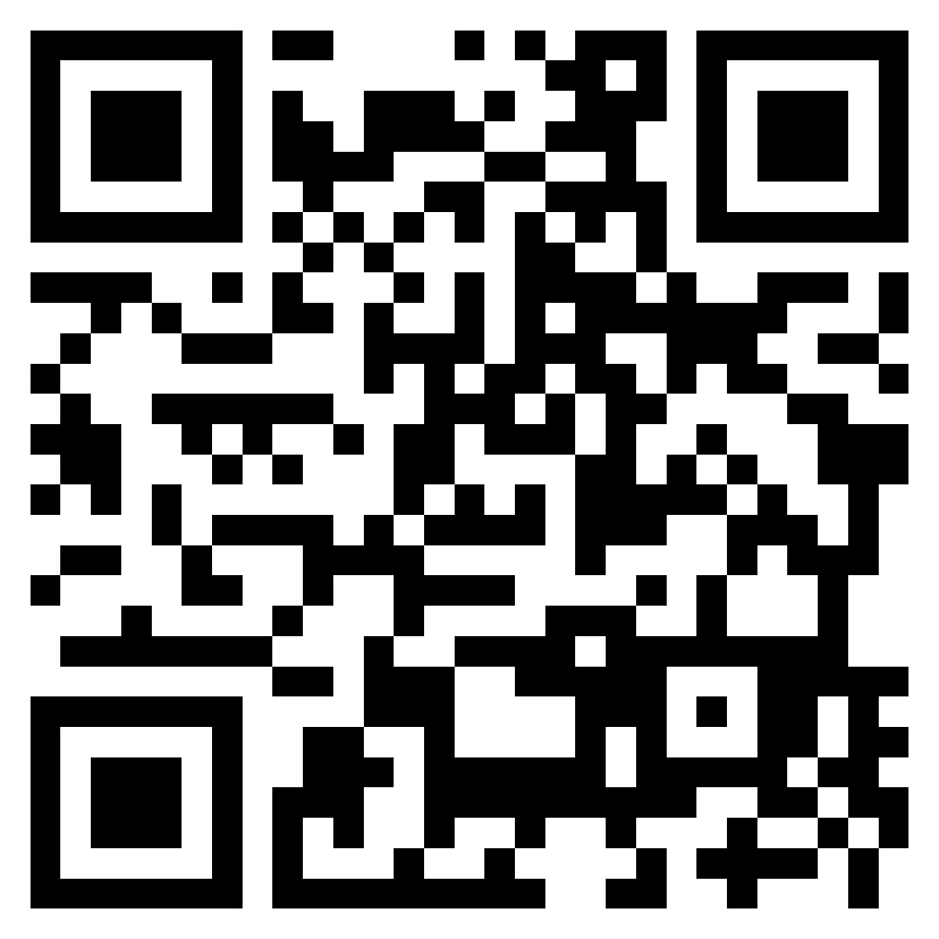

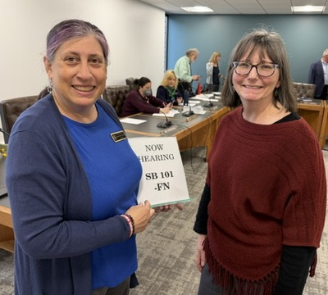
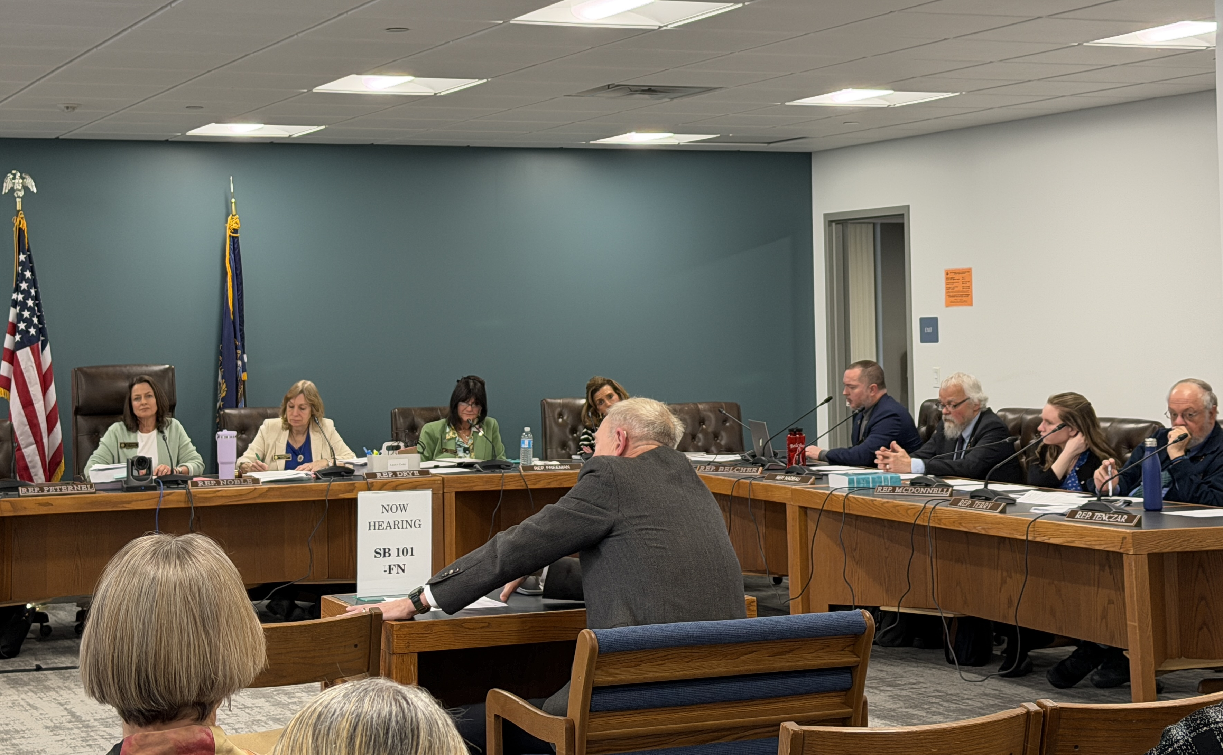
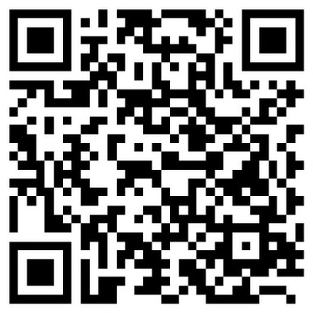
The Layperson’s Guide to Legislative Advocacy
Melissa Howe Whaley, M.Div., Family Trainee
NH-ME LEND, Institute on Disability, University of New Hampshire
New Hampshire’s Unique Legislature
A Roadmap to Legislative Advocacy
A Case Study Interview
New Hampshire’s legislature – The General Court – is rooted in a belief that broad-based representation encourages citizen engagement. While NH is proud of its large “citizen legislature," the common citizen may find stepping into this messy, democratic process more than a little intimidating. It can be exciting once you “get it” though!
A Brief History
In 1679, King Charles forced residents of NH to separate from the Bay Colony (Massachusetts) and to form its own government.
The new president, John Cutt, his Council, and the newly elected legislature sent a letter to the Bay Colony apologizing for no longer abiding within their jurisdiction and thanking them for favors received in their 38 years of affiliation. Seeds of distrust were sown.
Preceding even the Declaration of Independence,
New Hampshire created the first state constitution
on January 5, 1776.
Follow the QR to read a copy.
What to Know About the Current NH Legislature:
New Hampshire has the third largest legislative body in the English-speaking world, trailing only the U.S. House of Representatives and the British Parliament.
NH has ~1.4 million residents and ranks 41st in population among the 50 U.S. states.
NH has 400 House Representatives and 24 Senators who serve two year terms. Annual salary for legislators is a mere $100 plus mileage for travel.
All bills are assigned to a committee and must have a public hearing.
Committees deliberate and decide on laws in executive session. Then they issue reports to the Clerk of the Senate or House entitled “Inexpedient to legislate,” “Ought to pass,” Ought to pass as amended,” “Refer to interim study”, and “Re-refer to Committee.”
My leadership placement in public policy and legislative advocacy was daunting for a relatively new resident of NH! I learned how to navigate the system thanks to Karen Blake, my leadership partner and the Director of Community Partnerships at Community Crossroads in Atkinson. She is a fierce advocate in our state for disability rights and inclusion in all aspects of community life. This is what I have learned:
Disability rights is a non-partisan issue because disability affects everyone! Multiple avenues exist through which any lay citizen of NH may advocate for a disability issue to be heard and/or supported in the NH Legislature.
Find a person or organization that you can partner with at the state level.
Contact a legislator directly. Don’t give up. Start with your own, and keep searching until you find one interested in sponsoring legislation.
Work through a coalition or advocacy organization.
NH Disability Caucus Legislative Luncheon
State House in Concord
February 12, 2026
Seana Hallberg, former LEND trainee, wanted to be sure personal data about autism is protected in the future. She began by talking with a peer on a committee, and the journey unfolded.
The executive committee eventually deemed the law as ITL – “Inexpedient to legislate” – basing their decision on HIPAA protections despite testimonies from stakeholders indicating that all autism data does not fall under HIPAA guidelines. Seana noted that building bipartisan support would strengthen efforts to pass such legislation in the future.
Representatives from NH disability advocacy organizations educated Granite State policymakers about how their organizations work to create more inclusive communities for disabled persons in our state.
References
Decker, Jon. (2022, November 16). What are 'float' districts, and how and why are they created? The Laconia Daily Sun. https://www.laconiadailysun.com/news/local/what-are-float-districts-and-how-and-why-are-they-created/article_d8abc8f2-6129-11ed-b33b-2b2e8ae02fab.html
NH.gov. (n.d.). How a Bill Becomes a Law. 2026 State of New Hampshire. https://www.nh.gov/almanac/government/how-bill-becomes-law
State of New Hampshire Executive Council. (2026). History of the Executive Council. https://www.council.nh.gov/history-executive-council
The Avalon Project: Documents in Law, History and Diplomacy. (2008). Constitution of New Hampshire – 1776. Lillian Goldman Law Library of Yale Law School. https://avalon.law.yale.edu/18th_century/nh09.asp
Talking with Loren Selig, Durham Representative, (left) prior to second day of hearing testimony (right) on SB 101
Give testimony, and/or weigh in with your support or opposition to a bill.
Submit written testimony to House and Senate committees.
Give spoken testimony at a committee hearing.
The Disability Rights Center has created a detailed guide on this process, as well as how to watch livestream and recorded hearings and how to sign up for newsletters to inform you about important bills to watch.
For all of this, follow the QR code above or go to https://drcnh.org/policy-and-advocacy/testimony-how-to/

