Slide 1

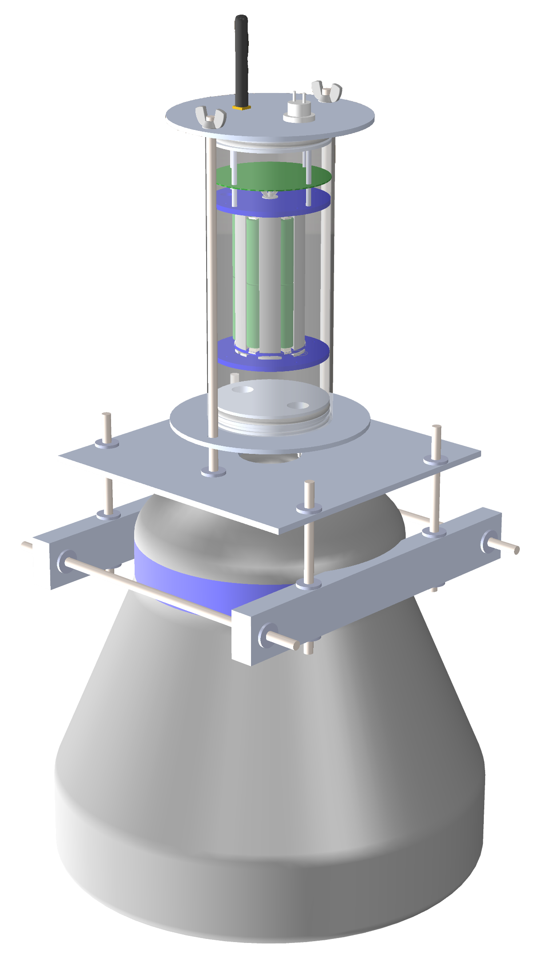
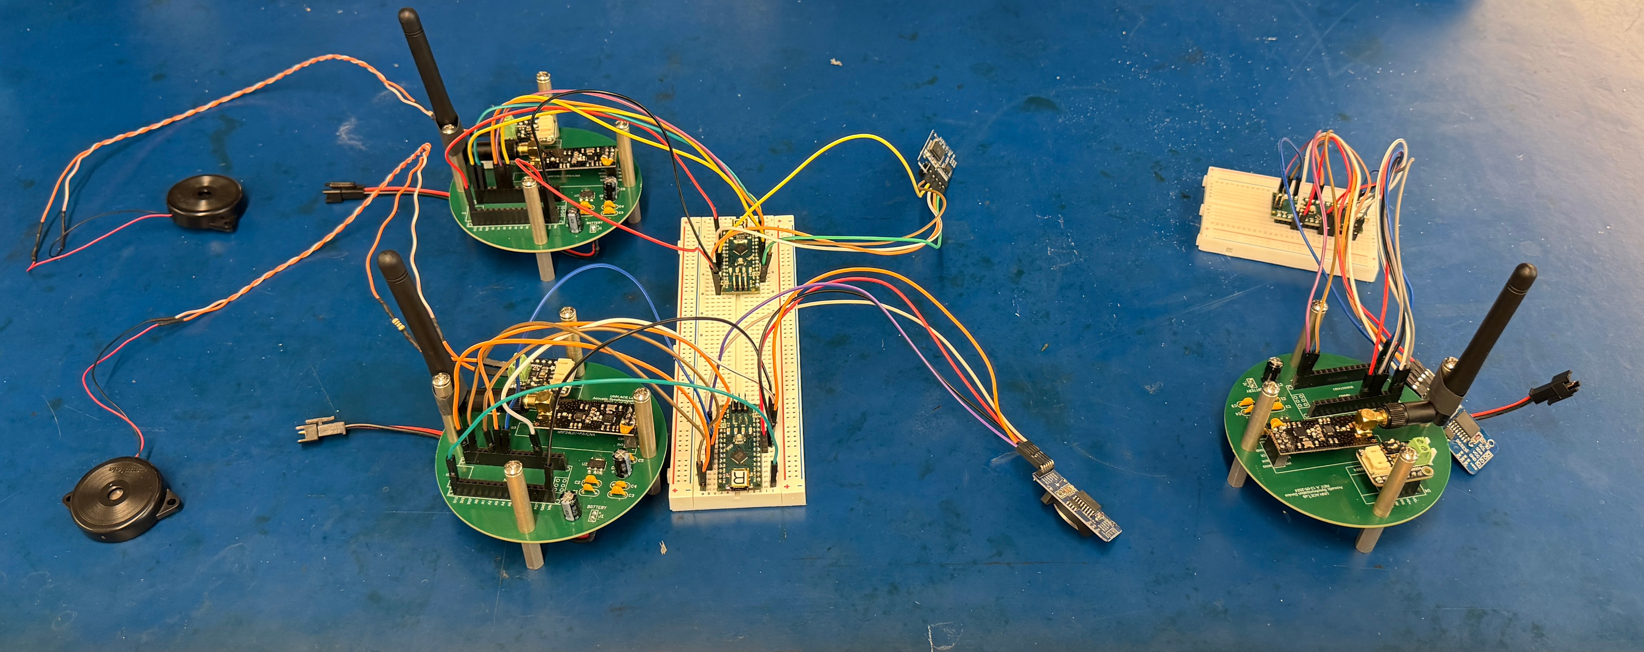
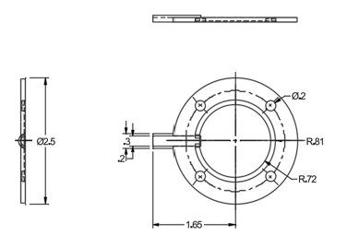
Creating a Floating Seagrass Detection System
John B. Cameron C. Wiley S. Micheal S. - Innovation Scholars Program, University of New Hampshire
background
IMAGES
results
We are part of the Ocean and Environmental Sensing cohort.
In our cohort, you get paired with a faculty mentor to assist with one of their projects.
We worked with Dr. Venegas on his Low-Cost Acoustic Seagrass Detection System.
We built from work previously done by Dr. Venegas and one of his graduate students.
Dr. Venegas’s original design had a few problems that he wanted us to work on:
  Deployment length
  Waterproofness
  Synchronization between buoys
Synchronization:
The transmitter and receiver module code was revised and updated.
A third module was added (Figure 3) to improve system accuracy.
A real time clock (RTC) unit was implemented (Figure 3) with code created to support it.
Hardware:
new wiring diagram was created
The on-board batteries running for 120 days in ideal conditions.
Solar panels were added to full in only 39 days
A new casing for the transducer ring was designed (Figure 2), and 3D printed.
Buoy Superstructure and Electronics Housing:
A SolidWorks model (Figure 1) was created using it, basic hydrostatic calculations were performed to ensure static stability.
Additionally, we worked with a machinist to revise the design around what was cost efficient to create.
Figure 1: 3-D model of buoy design
Conclusions
Over the course of this project, we learned about the processes of marine design - including waterproofing, corrosion prevention, and initial stability; as well as principals of electrical engineering; and how to design for practical manufacturing constraints.
While we were able to make good headway in the last three months, we still need to assemble the buoys, do some practical tests to ensure the system performance, and then deploy the system!
Figure 3: Picture of testing receiver and transmitter modules
Figure 2: Technical drawing of transducer ring

