Slide 1

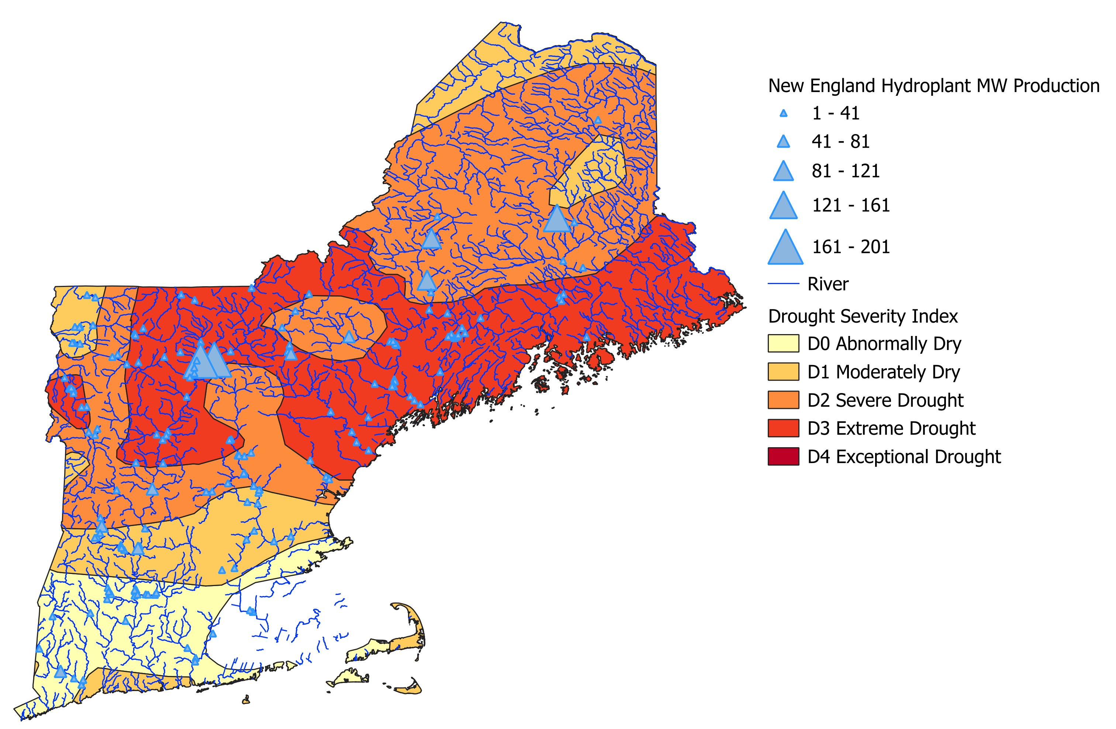
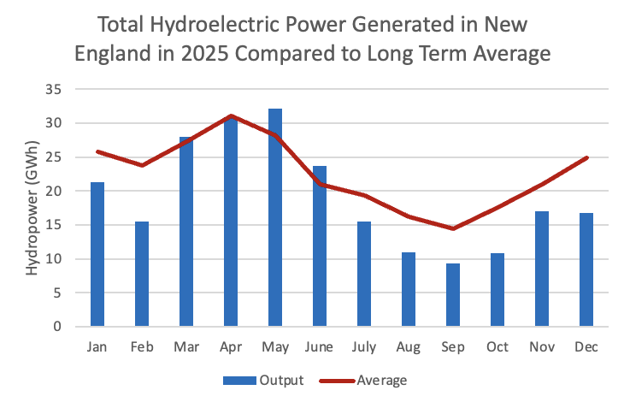
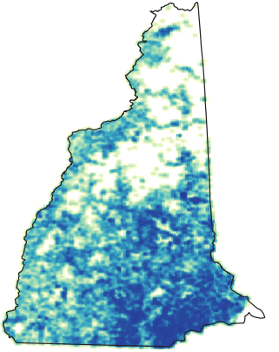
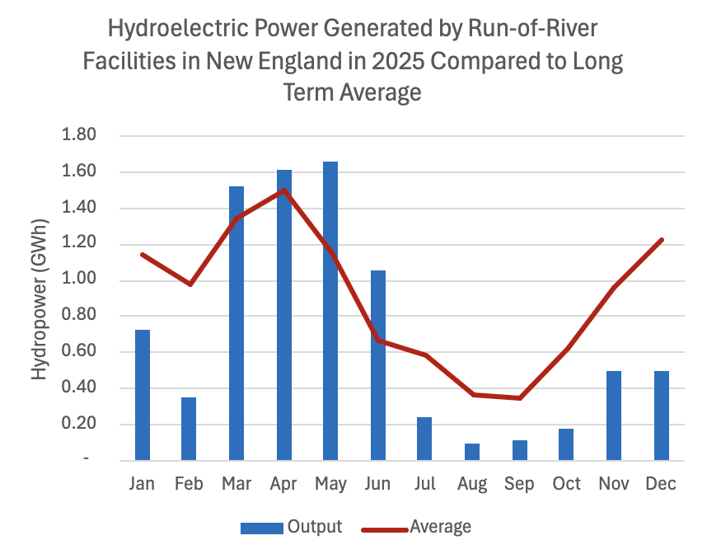
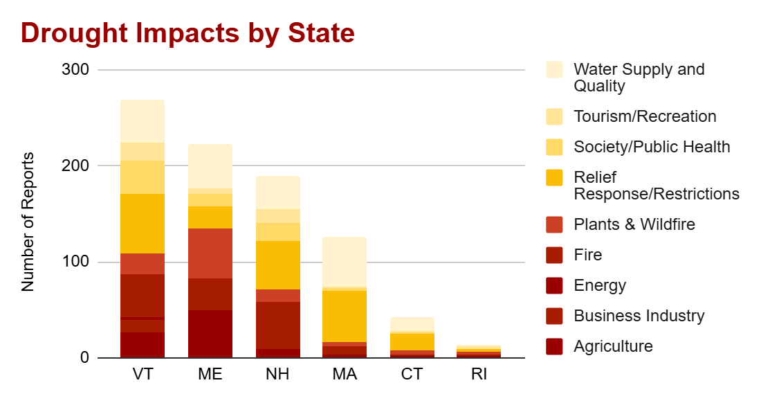
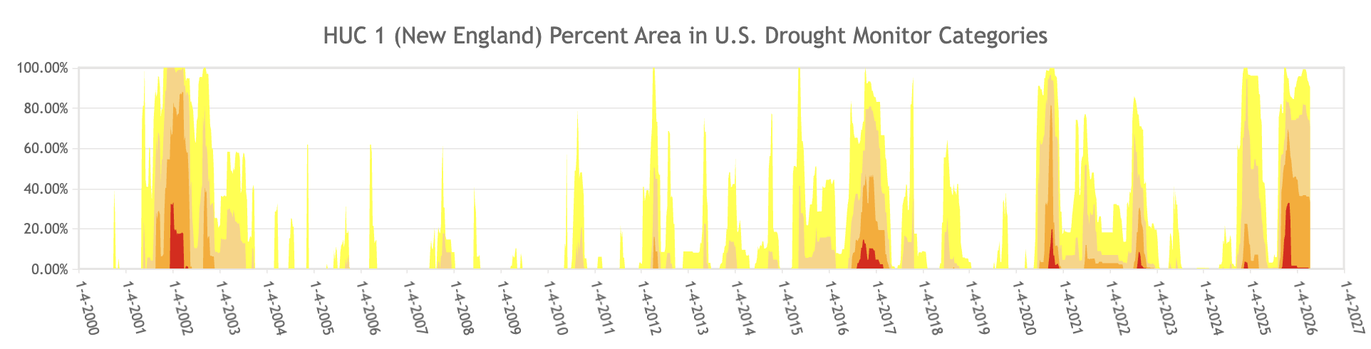
Impacts of the 2025 New England Drought
Vincent Bates, Allison Canatsey, Luke Grabowski Katelyn Whiteman, Sustainable Energy and Water System, University of New Hampshire
Introduction
Results
Beginning in August 2025, rainfall in the New England watershed region declined and caused the driest summer ever recorded in New Hampshire (NCEI, 2025). With such extreme drought, agriculture, tourism, hydro-electricity, and all businesses that rely heavily on water, were negatively affected. The goal of this project was to use data to evaluate the impacts and effects of the 2025 New England Drought using a GIS framework.
What is a Drought?
A drought is caused by weeks to months of a lack of rain, causing the availability of water to decline.
Drought Classifications
According to the U.S. Drought Monitor, droughts can range from None (Normal or Wet Conditions) to D4 (Exceptional Drought). Northern New England, facing the worst of the drought, lies in the D3 (Extreme Drought) category.
What is GIS?
GIS (Geographic Information Systems) is a system that analyzes data and uses it to make maps. It was one of the main methods to showcase the findings.
Figure 1 Shapefiles from USDM during peak drought overlaid with important regional stream work, and locations of significant hydroelectric facilities
October 28, 2025
Figure 2 Concentration of drilled wells in New Hampshire
Figure 3 Drought impact reports by state (National Drought Mitigation Center)
Research Questions
Figure 5 Output from hydropower facilities in drought affected areas compared to long term averages
Source: Essex Power Services and ISO New England
What were the impacts of the 2025 drought on New England?
How do extreme drought conditions impact the regular hydrologic cycle in this climate?
How was hydropower, which harnesses the energy of the hydrologic cycle, hindered by the drought?
What socioeconomic areas were impacted by this drought?
References
Drought Impact Reporter. (2026). Drought Impact Map. National Drought Mitigation Center. https://experience.arcgis.com/experience/8eb94624372e4aaca02951530bf5e
(2026). Hydroelectric Data 2025. ISO New England. https://www.iso-ne.com/
New Hampshire Department of Environmental Services. (2026). New Hampshire Dry Well Reports Dashboard. New Hampshire Geological Survey. Map. https://www.arcgis.com/apps/dashboards/32232fe277b74f66a89e9a4d72419370
National Centers for Environmental Information (2025) National Oceanic and Atmospheric Administration
https://www.ncei.noaa.gov/access/monitoring/climate-at-a-glance/statewide/time-series/27/pcp/3/8/1895-2025
Figure 4 History of drought occurrence and severity in HUC 1 New England (USDM)
Conclusion
In creating this GIS map and compiling data from hydroelectric facilities across New England, we were able to represent the relationship between climate extremities, such as this drought, and their effect on groundwater reserves throughout the winter and into the spring, as well as the effect of drought on pre-existing social and economic systems in New England.
The GIS maps in Figures 1 & 2 show exceptional drought conditions that were experienced in New England this fall, as well as the vast potential for dry well conditions in New Hampshire, Howley reported that, in New Hampshire, 229 wells went dry (M. Howley, personal comm, February 20, 2026). The hydroelectric data in Figure 3 shows the impacts that drought has upon larger and smaller scale hydroelectric facilities. The prolonged and more drastic impacts on the smaller facilities into the beginning of winter are indicative of the lack of hydraulic head from the normal levels due to decreased rainfall.
While conditions are normally drier in New England in the late summer and early fall, the length and intensity of this drought was abnormal. Historical data (Figure 4) suggests that droughts are becoming more common in New England, and we can expect to see more extreme droughts in this climate due to global warming and the shifting of normal wind and climate patterns across the globe.
Objectives
Acknowledgements
Create a GIS map relating hydroelectric generation to drought
Evaluate the economic impacts of drought
Determine the relative effect of drought on small versus large hydroelectric facilities
We would like to thank Madeleine Mineau (CEO at Essex Power Services and Michael Howley (Senior Geoscientist at NH Department of Environmental Services) for providing valuable information on power generation and water well data. Additionally, we would like to thank Professor Matt Davis for guiding us along this New England drought project, and for providing us with hydroelectric generation data.

