Slide 1

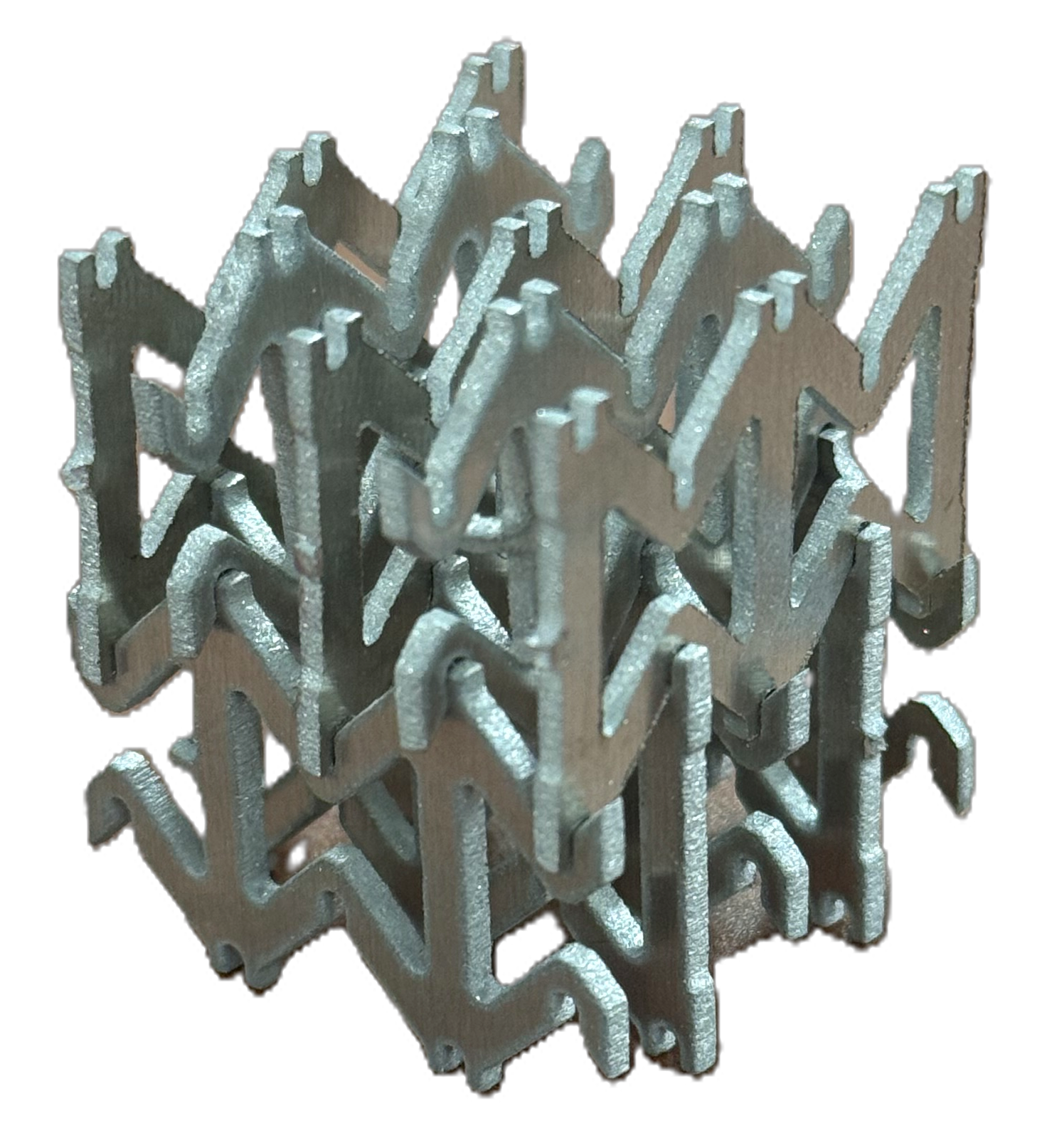
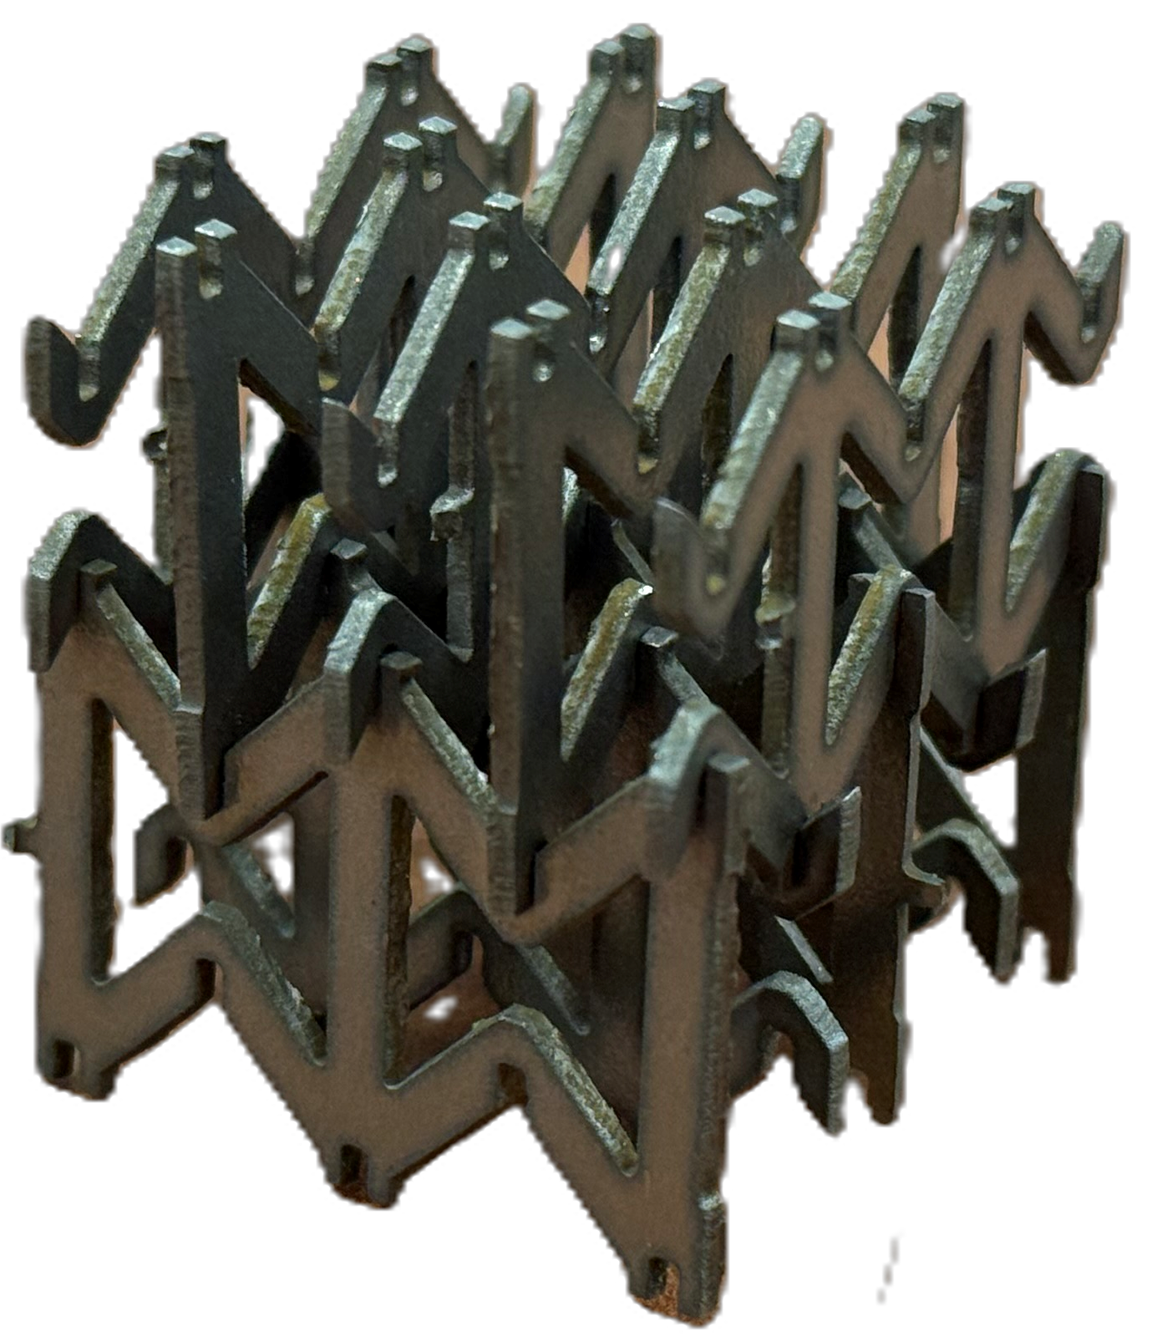
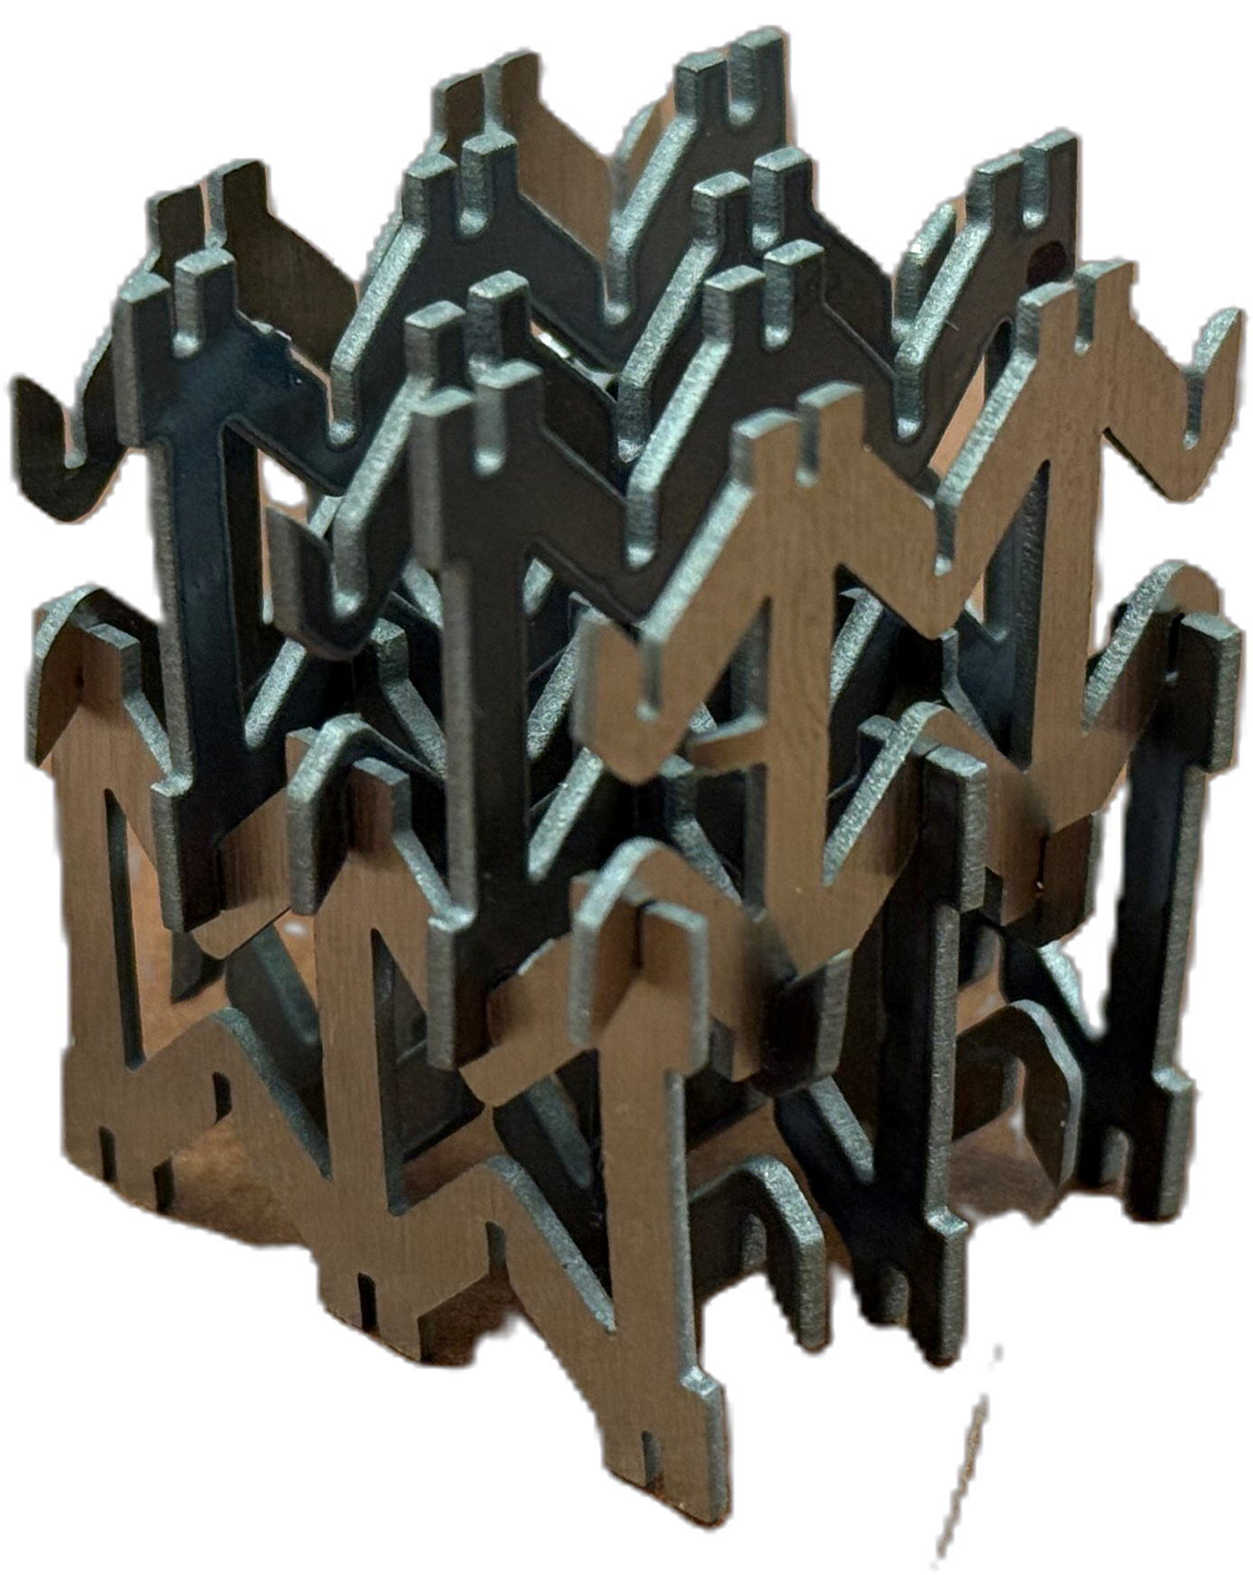
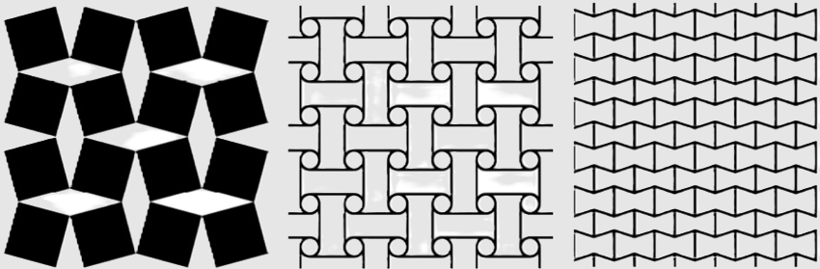
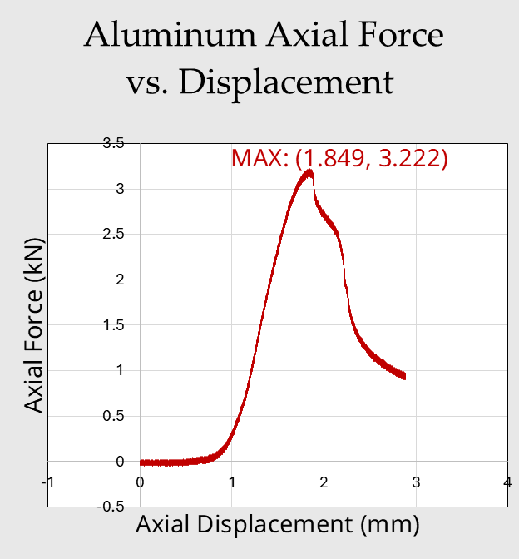
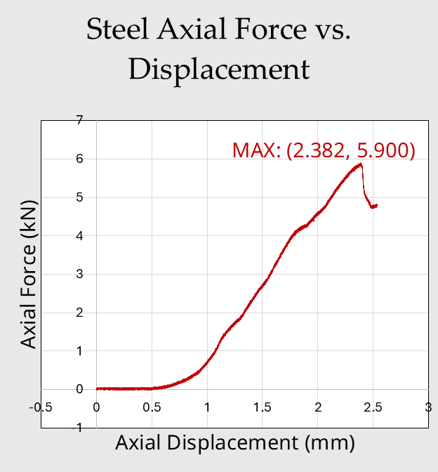
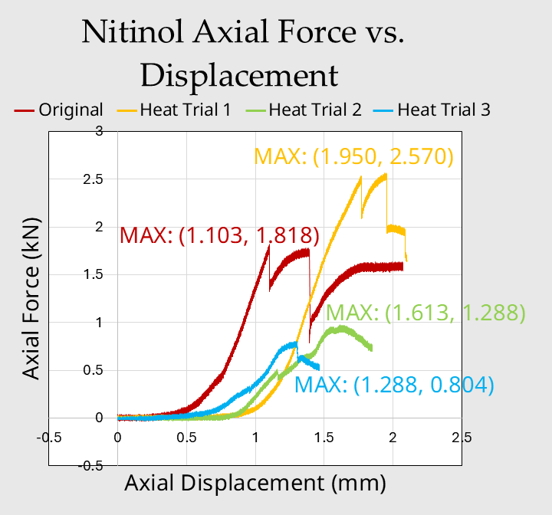
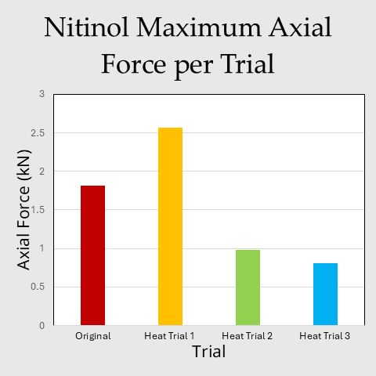
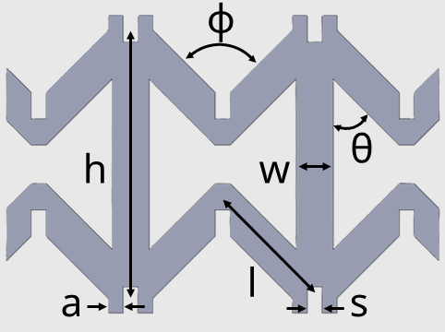
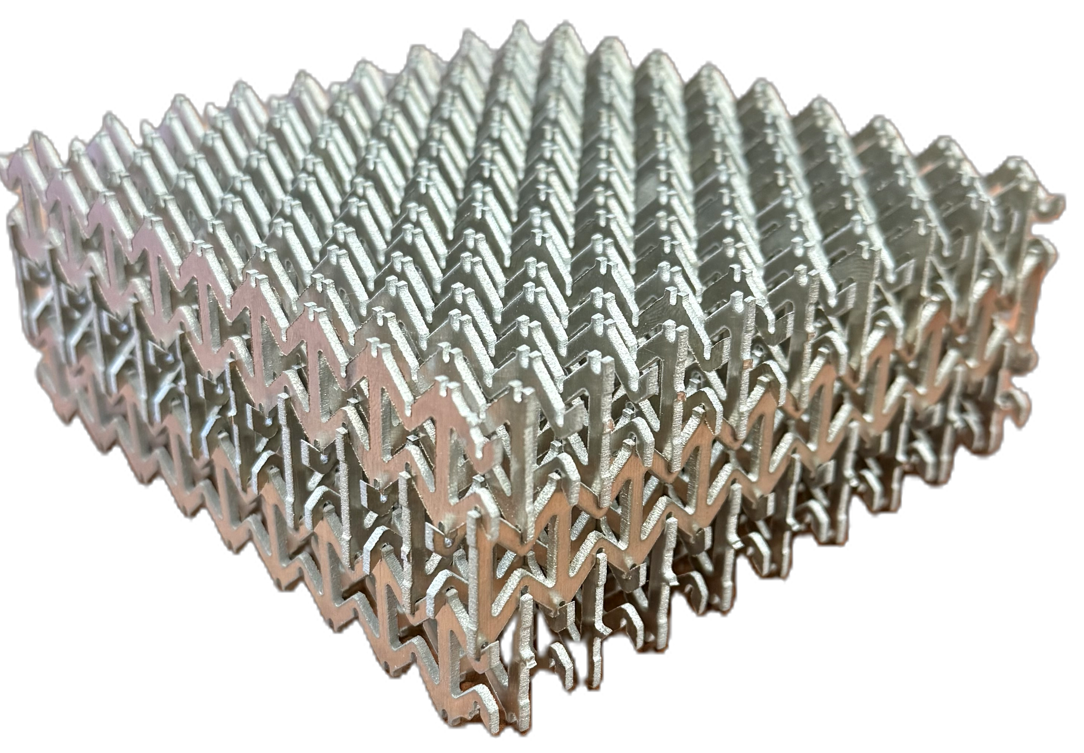
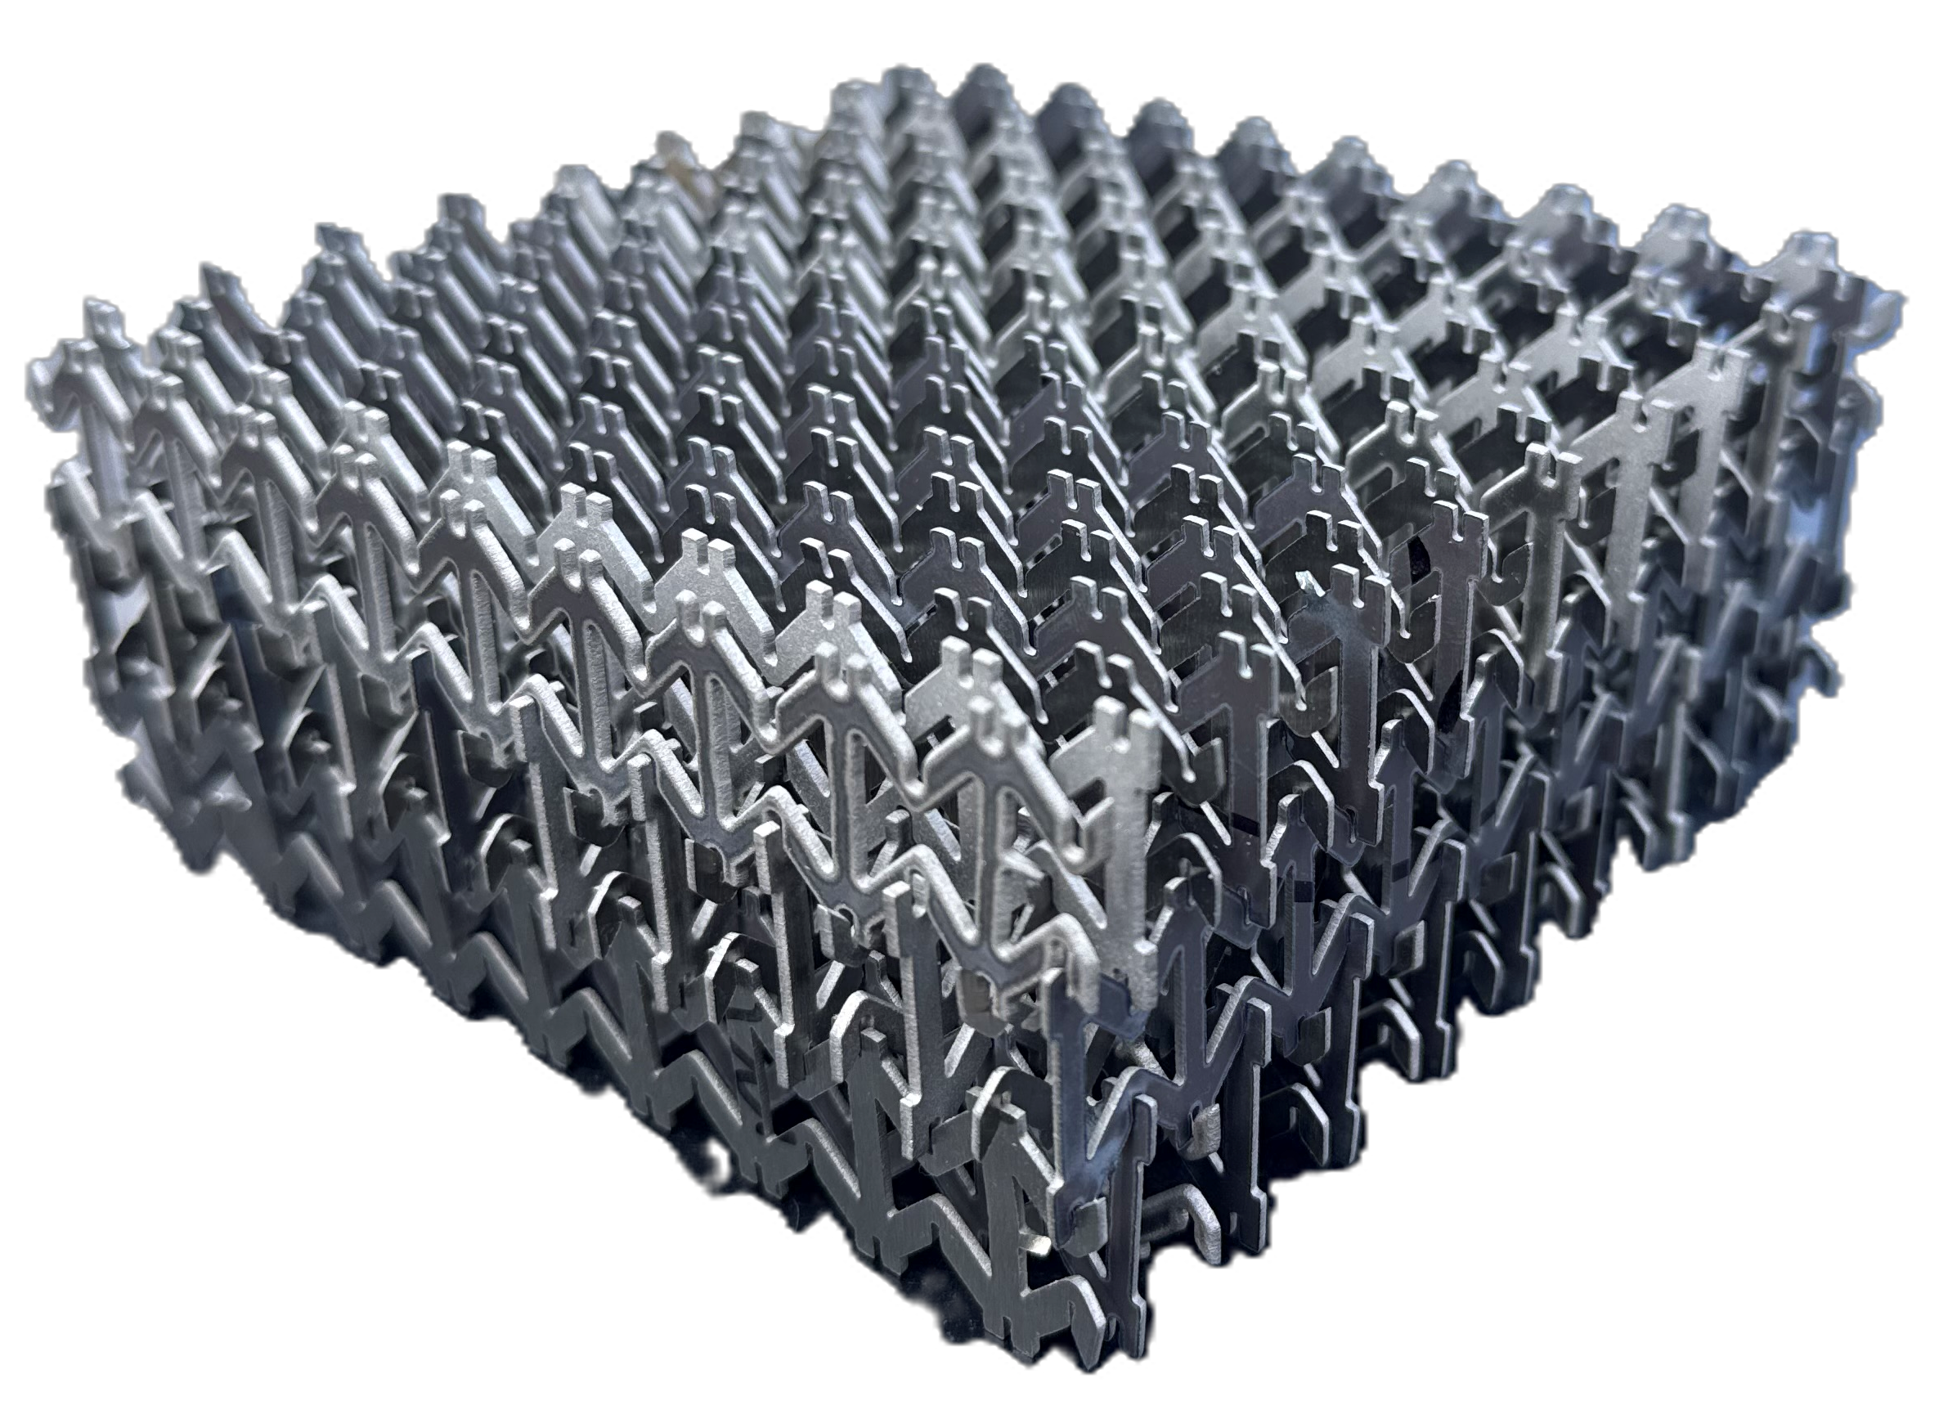
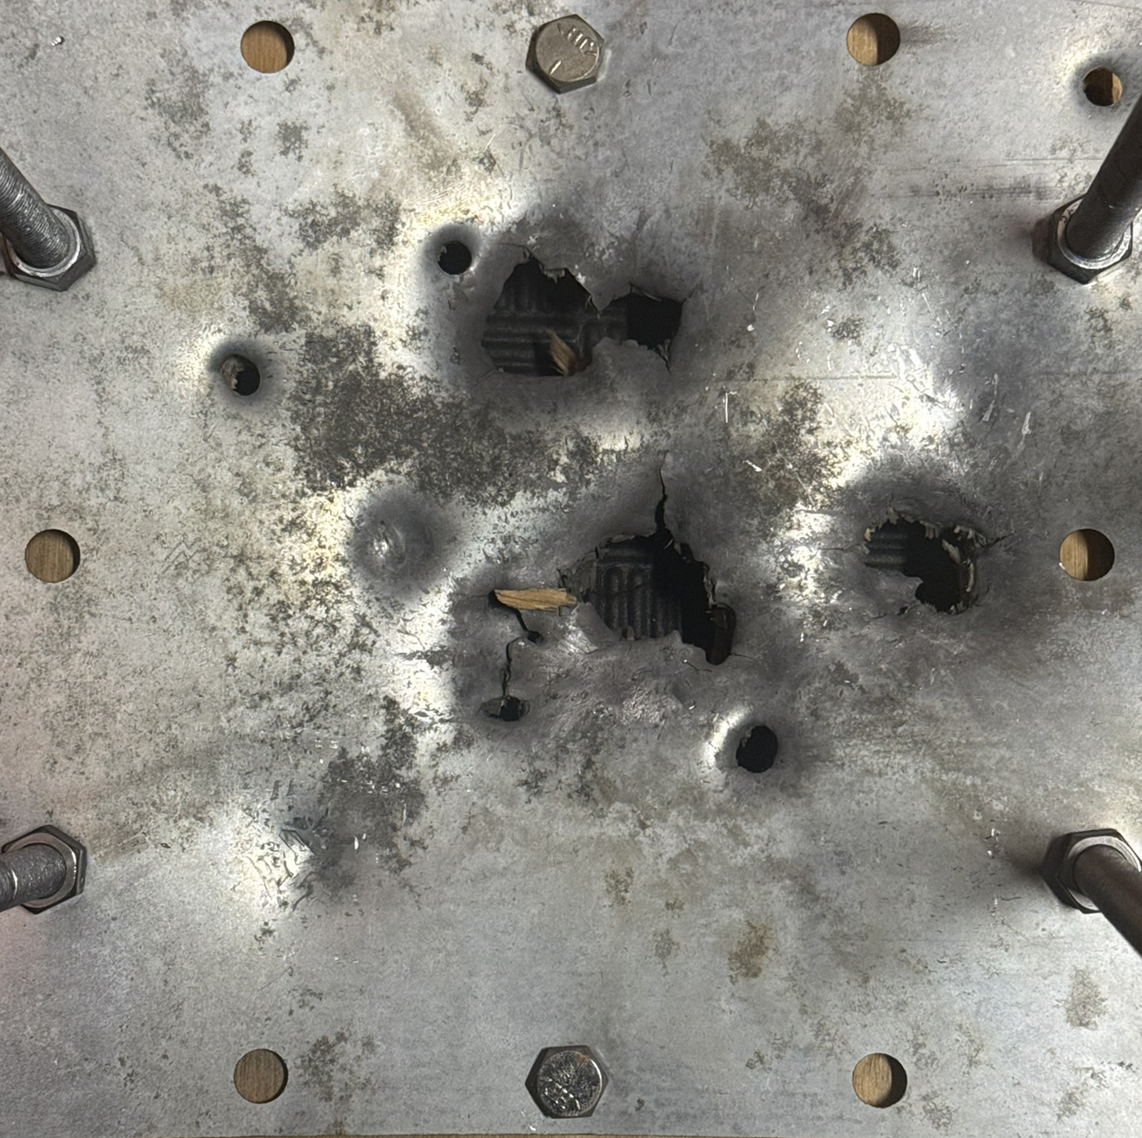
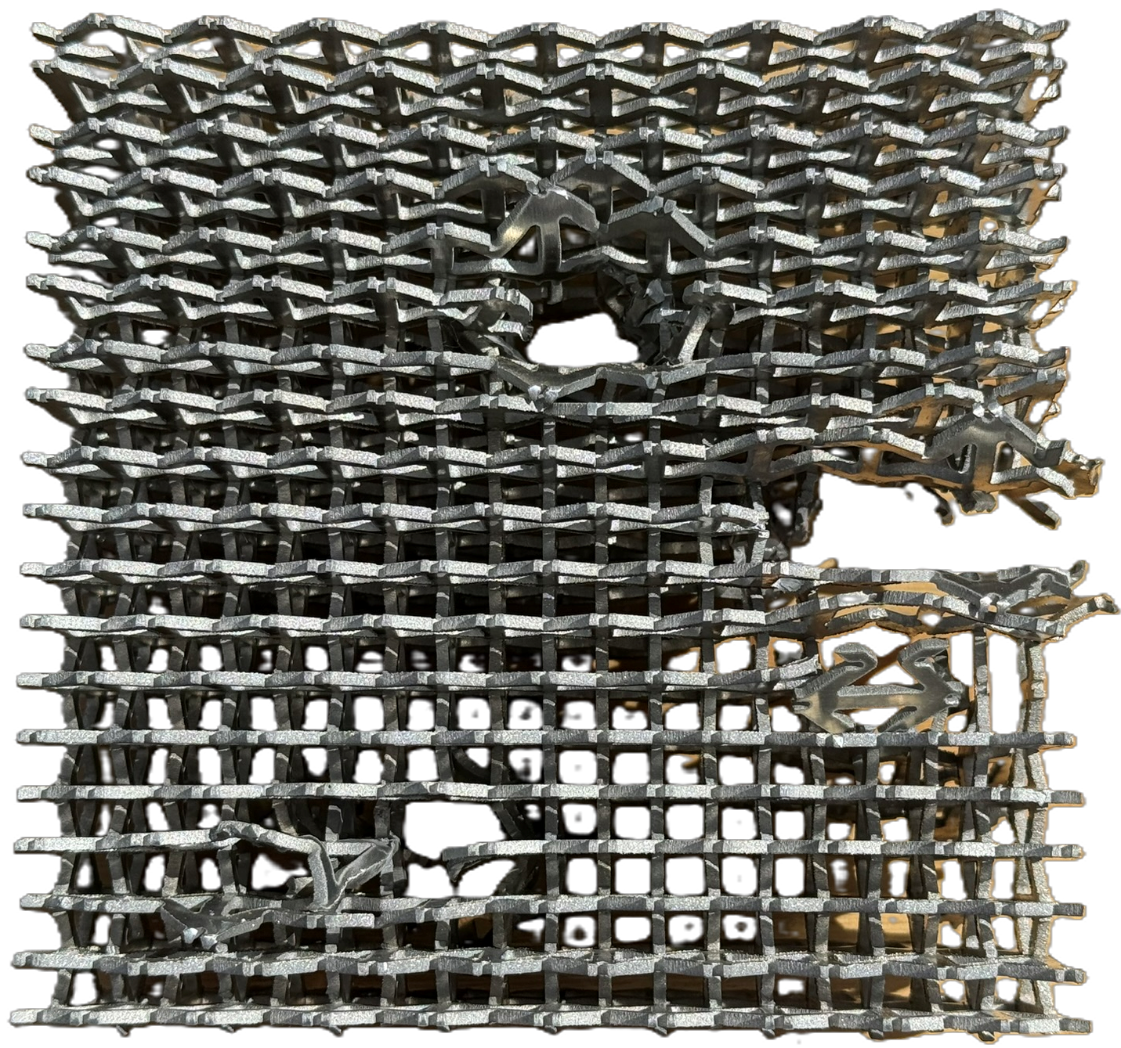
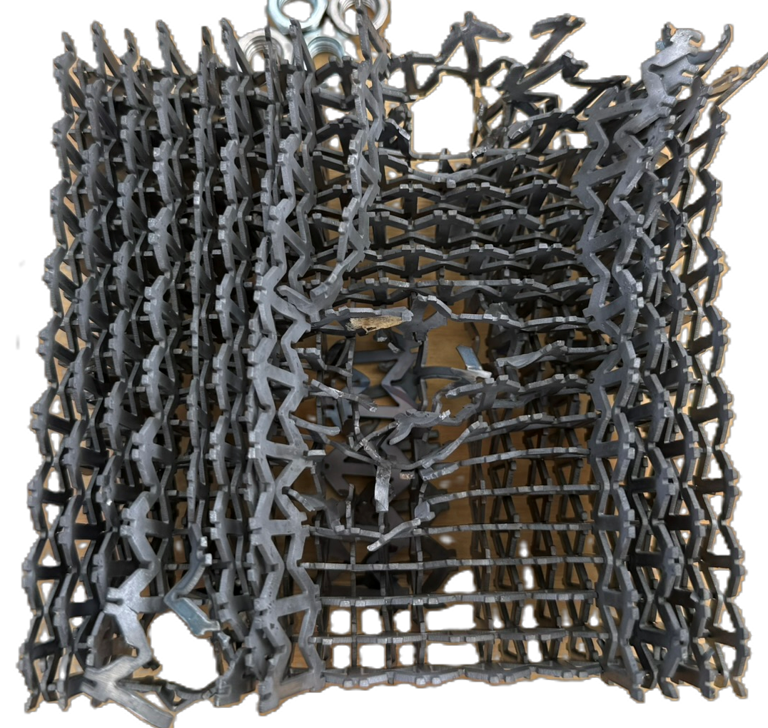
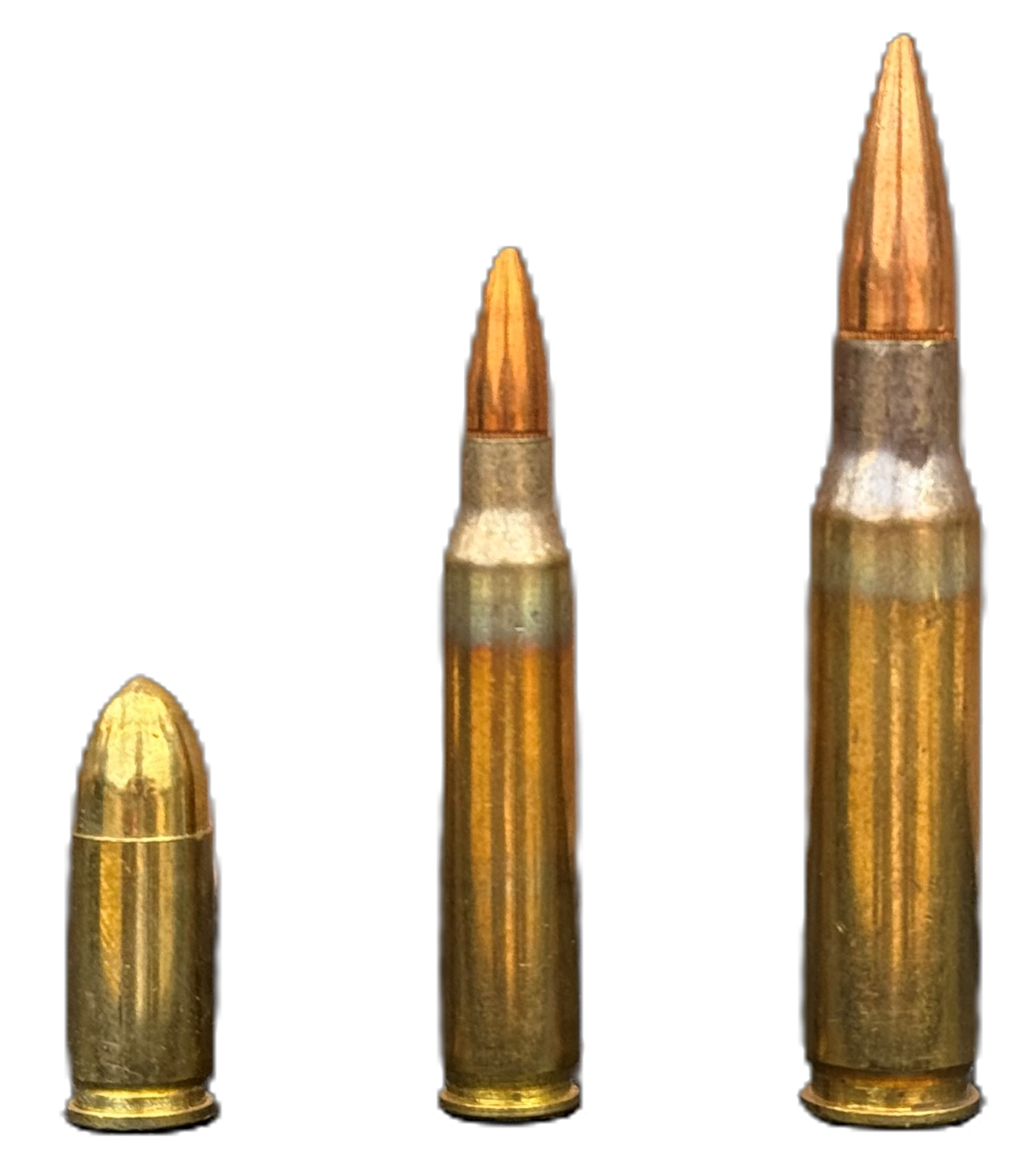
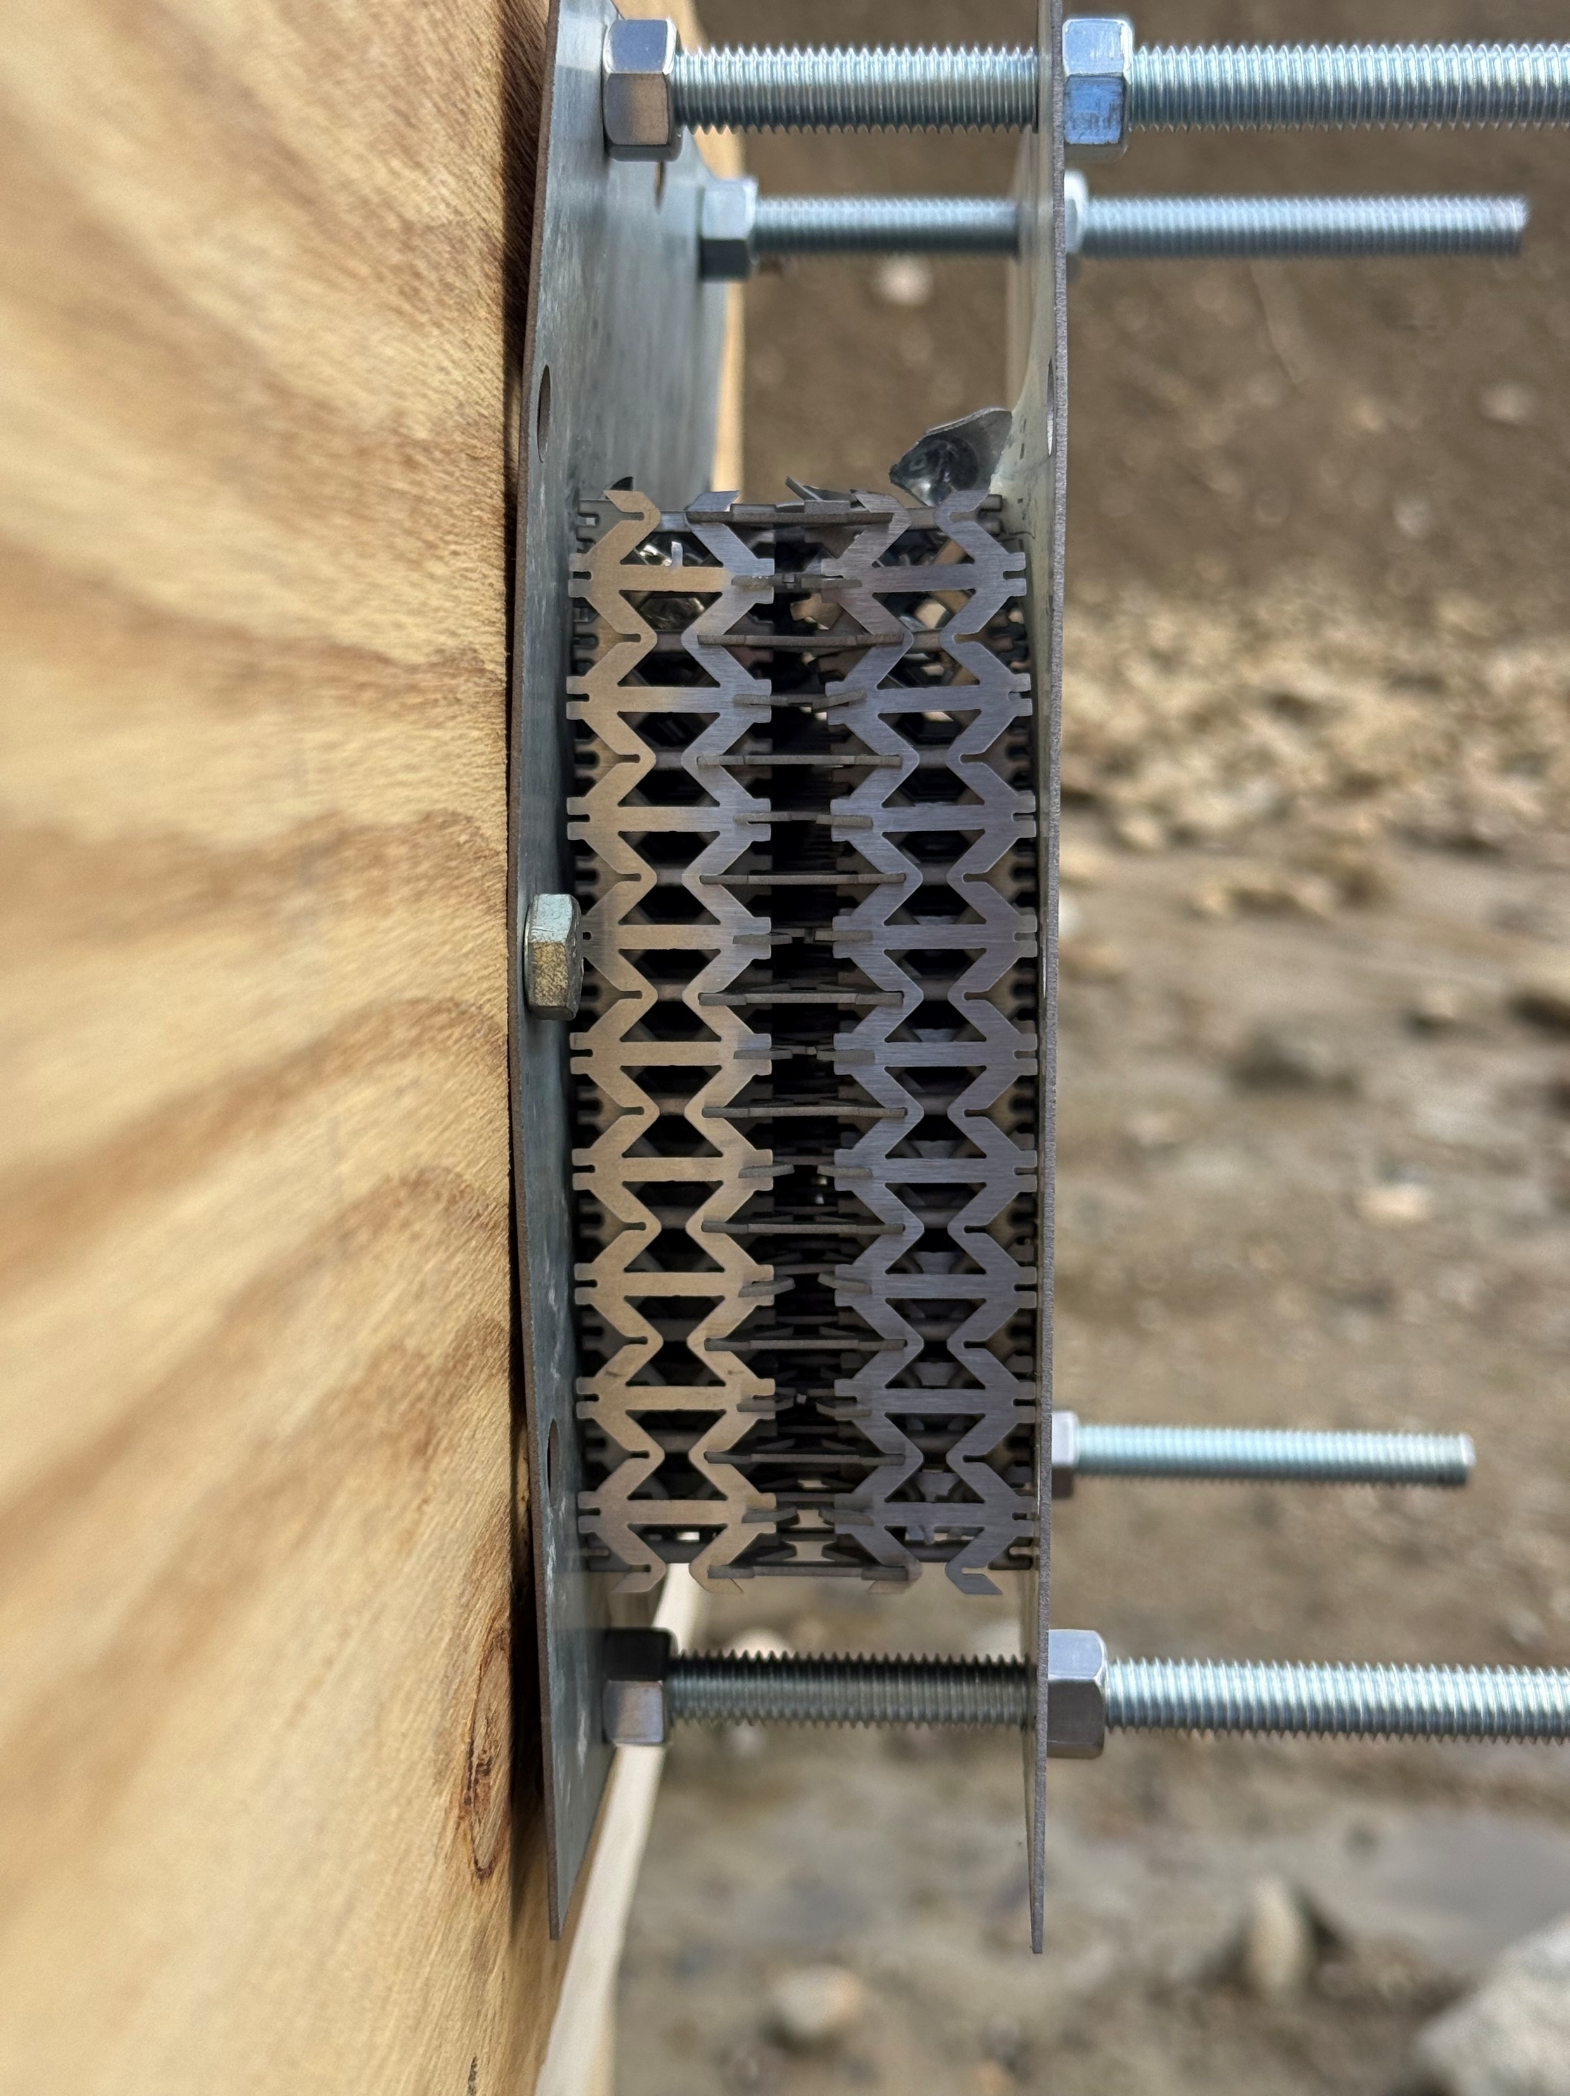

Evaluating Auxetic Metamaterial Structures in Nitinol and Conventional Alloys for High-Impact Applications
Will Donovan, Nate Doyle, Travis Fitzpatrick, Hunter Lambert, Caleb McCarthy, and James Puopolo
Mechanical Engineering Department, University of New Hampshire
Introduction:
The possible impact resistant qualities of nitinol as an auxetic structure makes it a potential protective material. Minimal research has been done on auxetic metamaterials and the nickel-titanium alloy, nitinol.
The goal of this project is to evaluate the impact resistance of auxetic structures made from nitinol and conventional alloys such as aluminum and steel. The alloys will behave as base cases to test if the combination of auxetic and nitinol is optimal.
Physical Results:
Additional Results:
Auxetic metamaterials were created to have properties such as a negative Poisson’s ratio, which is rarely seen in nature (2)
From research, the re-entrant honeycomb structure has a high energy absorption when compressed in any direction (3) – best option compared to other structures
Nitinol is a shape-memory alloy and returns to its original state when heat is applied
Nitinol can not be braised due to having a lower combustion temperature than melting point
Optimal dimensions on unit cells for this application were h=0.7500in, w=0.1071in, l=0.3750in, θ=45˚, φ=90˚, a=0.0430in, s=0.0430in
The small aluminum cube
weighed 11.55g followed
by nitinol at 22.35g and
then the steel at 25.39g
Heat was applied at 250℉
for a minute and a half to
return nitinol back to its
original shape between
compression trials
Aluminum:
Steel:
Nitinol:
Rotating Unit:
Chiral:
Re-Entrant Honeycomb:
Figure 1: Different Auxetic Structures (1)
Figure 4: Small Auxetic Cubes made from each Material for Unit Size Testing and Compression Testing
Method:
Preparation:
Research the different
types of auxetic
structures
Determine optimal
dimensions of auxetic
structure
Buy sheets, design units,
cut out units, and assemble structures
Testing:
Compression Testing using MTS machine
  Graph and video compression of each material
  Heat nitinol after each trial to test memory
Range Testing
  Set up target and start video
  Shoot target 2 times with
  each type of caliber
  Mark impacts, end video
recording, and take
photos of target
structure
  Replace material
Figure 7: Nitinol Maximum Axial Force per Trial
Figure 5: Compression Testing Results for each Material Type
Conclusion:
The nitinol underperformed in the compression testing compared to the other alloys. It also had a higher energy absorbance compared to the aluminum for the high-impact testing. The nitinol was able to reform after both tests. A more refined testing technique is required for future results.
Figure 2: Female Unit Cell
References:
9mm 5.56 cal 7.62 cal
Figure 3: Rounds and Testing Set-Up
Figure 6: Before and After Range Testing of Aluminum and Nitinol Auxetic Structures and Back Steel Plate
Acknowledgements: Special thank you to our instructors Dr. Mitchell, Shayan Darzi, and Abrar Ebrahim. Thank you to Mr. Kellogg for supplying us with the Nitinol sheet.
Contact: James.Puopolo@unh.edu

