Slide 1
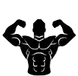


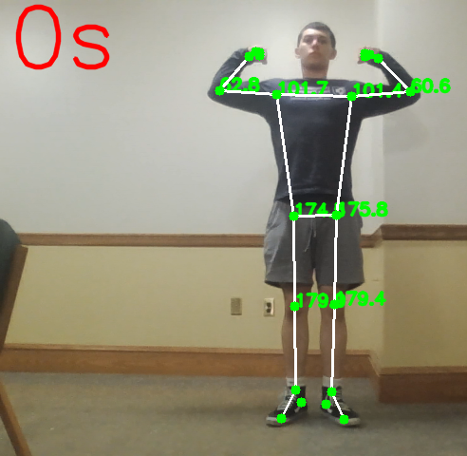

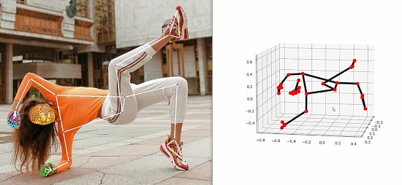
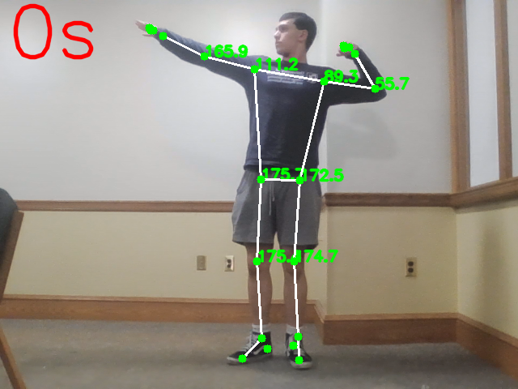
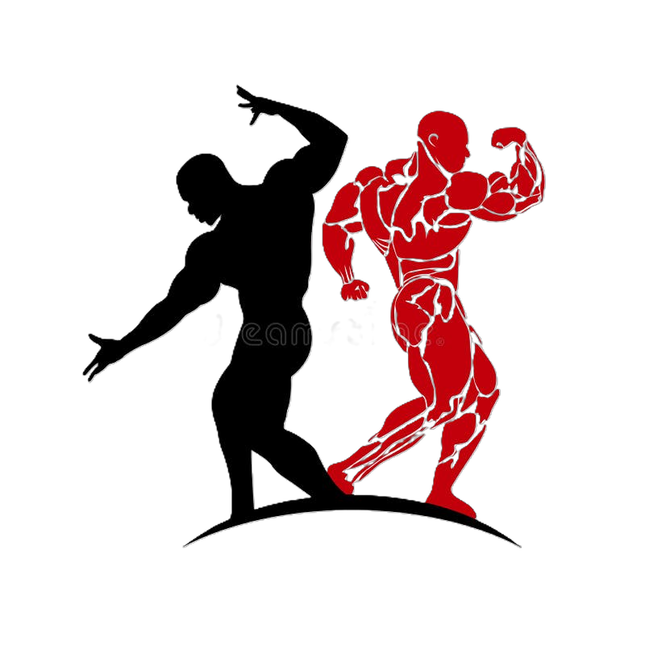
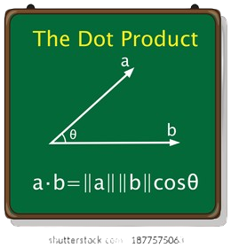

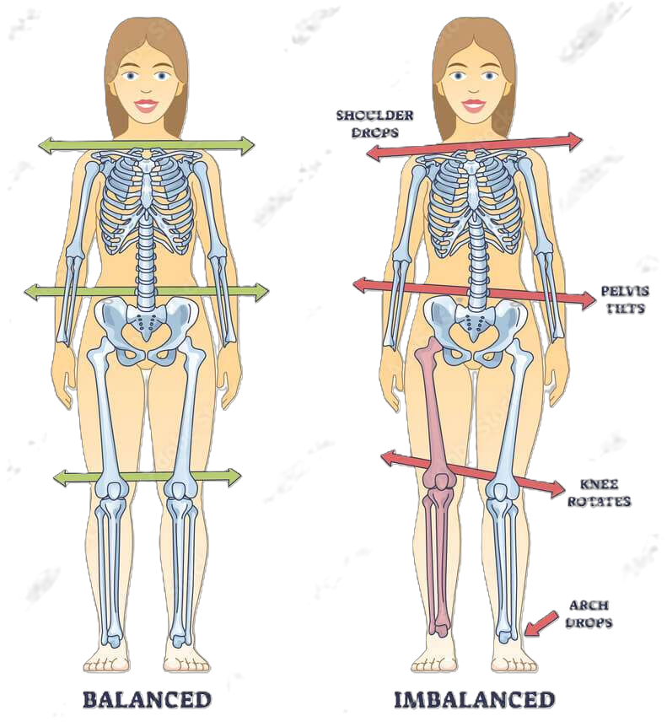



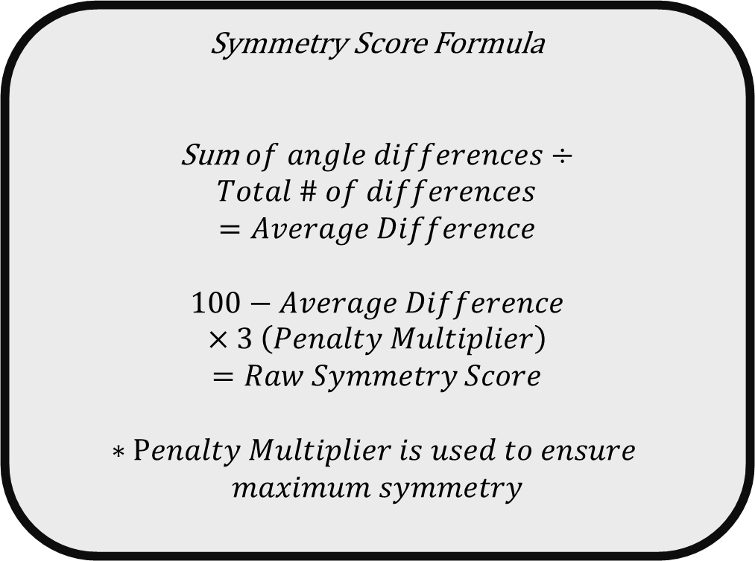
Sym-Body: Symmetry of Kinesiology
Anthony Lopez-Ortiz, College of Engineering and Physical Science, University of New Hampshire
Introduction
Structure
Results
As an aspiring bodybuilder, skillful posing is necessary. It is something that must be practiced but can be hard without a coach. My goal was to create a computer program to act as a substitute for a coach. It will analyze and grade the symmetry of one's limbs and the proportionality of their musculature.
=== Symmetry Analysis Report ===
Angles:
Right shoulder: 101.41
Left shoulder: 101.67
Right elbow: 60.61
Left elbow: 62.82
Right hip: 175.78
Left hip: 174.48
Right knee: 179.40
Left knee: 179.88
Differences:
Shoulders: 0.26
Elbows: 2.21
Hips: 1.29
Knees: 0.48
Symmetry Score: 96.81%
Start program and open camera
Overlay body landmarks and angles on screen via Mediapipe
background
=== Symmetry Analysis Report ===
Angles:
Right shoulder: 89.25
Left shoulder: 111.18
Right elbow: 55.66
Left elbow: 165.93
Right hip: 172.52
Left hip: 175.72
Right knee: 174.72
Left knee: 175.44
Differences:
Shoulders: 21.93
Elbows: 110.28
Hips: 3.20
Knees: 0.72
Symmetry Score: 0.00%
Bodily Symmetry – The balance of one’s limbs and joints about a particular axis
Posing – The artistic display of muscularity, symmetry, and conditioning on the bodybuilding stage
Set timer and take screenshot when “s” is pressed
Calculate angles of landmarks
Future APPLICATIONS
Methods
Posing app used by professional and amateur bodybuilders
Medical examiner to determine posture or skeletal imbalances
Calculate symmetry score based on angle differences
Symmetry Score Formula
Sum$of angle differences÷Total \# of differences$
$$=Average Difference$$
$$100−Average Difference×3 \left(Penalty Multiplier\right)=Raw Symmetry Score$$
$$∗Penalty Multiplier is used to ensure$$
$$maximum symmetry$$
Print report of visible angles, differences, and symmetry score

