Slide 1




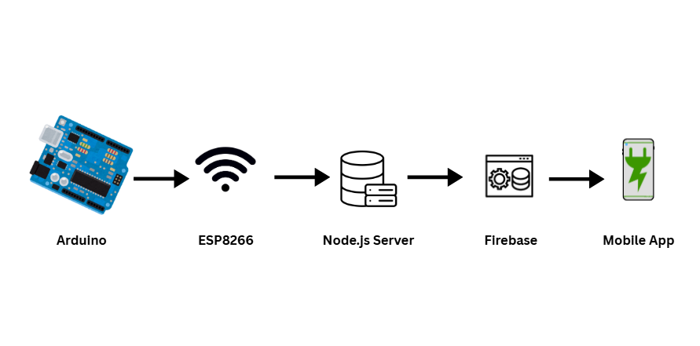




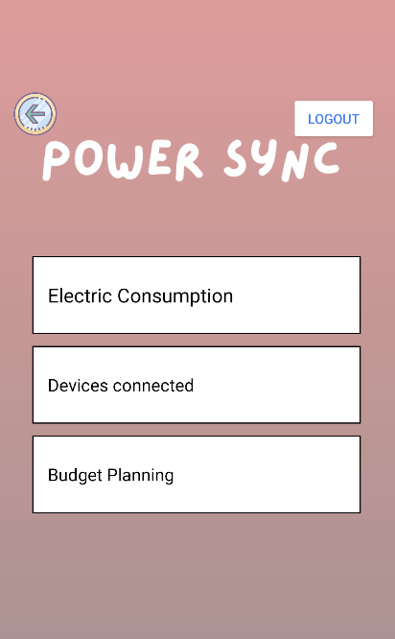

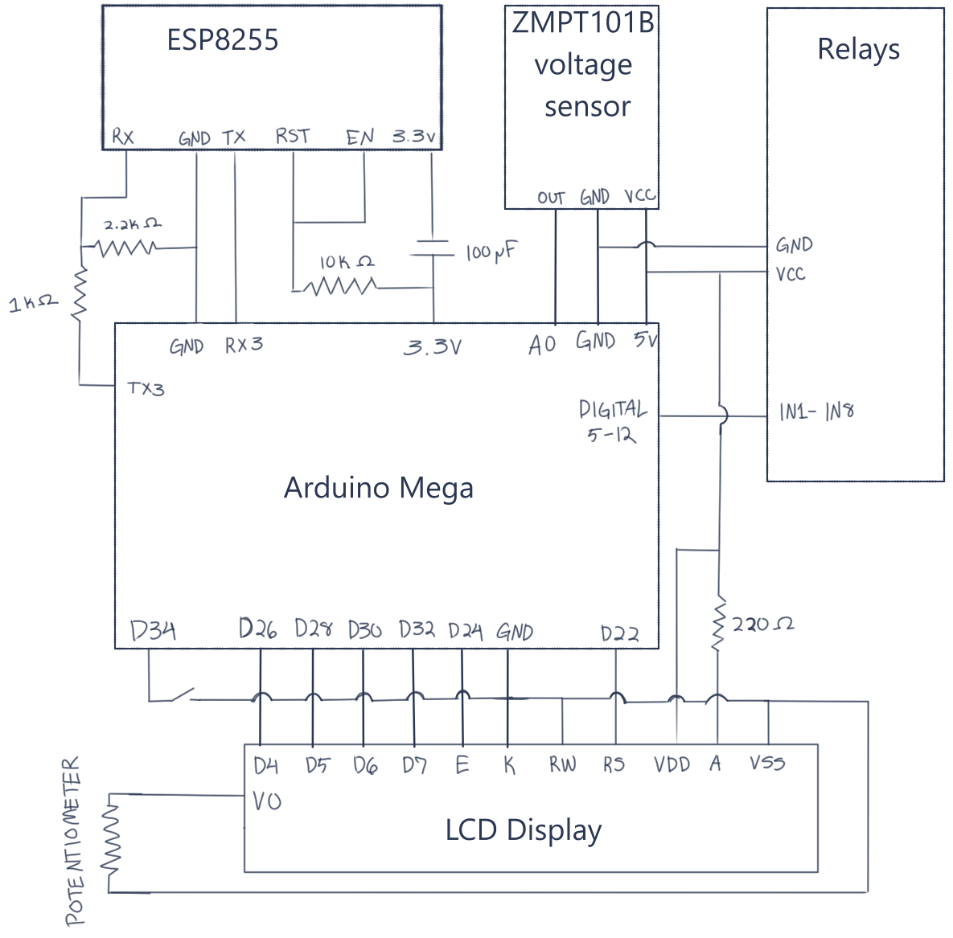

Ujjaini Shrestha
Ujjaini Shrestha
ECO Friendly Power Strip
Authors: Daisy LaPlante, Annie Lin, Ujjaini Shrestha
Advisors: Kyle Oullette, Dean Sullivan
INTRODUCTION
METHOD
HARDWARE
Energy costs in New Hampshire is higher than the national cost, at 23.33¢ per KWH compared to the national average of 16.73¢ per KWH.
Electricity consumption is high in New Hampshire both during summer-time and winter-time due to plug in heaters/AC units respectively.
Developing something that could help with monitoring this power consumption can help save on utilities bills at the end of the month.
Hardware
  Arduino equipped with an ESP8255 module for Wi-Fi communications
  3 AC voltage sensor modules
  8 channel relays allowing for the user to turn on and off outlets from the user interface
  8 outlets and wires to provide power to the power strip
  A 3D printed box to house the power strip components
Software
  Android application (user interface) equipped with a Firebase backend serving as the user interface
  Arduino code allowing for data collection, toggling relay switches, and communication to and from the user interface
  Node.js server that will act as an intermediate between the ESP8266 Wi-Fi module and Firebase backend data base
The figure below described the data flow from the power strip to the user interface.
Outlets
  Mains hot line to outlet hot line
  Mains neutral to outlet neutral
  Mains ground to outlet ground
Voltage sensor modules
  Mains hot line to sensor L to outlet hot line
  Mains neutral to sensor N
Relays
  Connects Mains voltage neutral to relays to outlet neutral
OBJECTIVES
  Our project Is:
  A power strip able to monitor power consumption
  Able to turn on/off each individual outlet remotely
  Be user-friendly to install
  Have a user-friendly interface that will display all collected data and controls
  Power strips that can measure voltage or allow for a timer to be set to turn off do already exist, but no product incorporates power monitoring, remote controls, mobile user interface, and at a lower cost.
  Our power strip features 8 outlets all wired together with 8-gauge wires allowing for higher amperage applications. `
Link to GitHub repo
BACKEND AND USER INTERFACE
ESP8266 Wi-Fi module
  Uses POST requests to send sensor data to a backend for it to be logged
  Uses GET requests to receive on/off commands for each individual outlet from the user interface
Node.js server (JavaScript)
  Creates web server using Express and enabling POST requests
  Sets up Firebase connection using a private key and the database URL
  When a POST request is sent from ESP8266 to the Node.js server, read data and save it to “sensors” in Firebase
  When a command changes in Firebase, the server will log it and return the command to the ESP8266 and Arduino when a GET request is sent
Device Connected page
CONCLUSION
CIRCUIT DIAGRAM
This project allowed us to
  Apply engineering and programming concepts to a real-world problem
  Gain experience in problem-solving, circuit design, 3D modeling, and user-focused development
  Further develop communication skills and self direction
Some difficulties faced include
  3D printed box not being the exact dimensions to fit all components in
  Time constraints, schedule conflicts, and trying to work on this project on top of school and other responsibilities
  Difficulties with setting up the Android app, needed to consult an upperclassmen in CS to help
  The mounting of the outlets aren’t very stable on the 3D housing
Firebase
A real time database where all the sensor data is sent and stored for the user interface to use for either displaying the data or calculations
Relay switch state is also stored here and accessed by the ESP8266 with GET requests
Android application (user interface)
Where data from the voltage sensor will be displayed
Able to send data through the entire system and back to the relays
Feature for budget planning available
REFERENCE
[1] “Arduino power strip: More enclosure & more wiring – Robert’s Blog,” Dec2b.de, 2020. https://dec2b.de/posts/2020-11-17-arduino-power-strip-more-enclosure-and-more-wiring.html (accessed Apr. 10, 2026).
[2] “New Hampshire Electricity Rates & Average Electricity Bills,” Find Energy. https://findenergy.com/nh/
[3] Stefan, “Arduino WiFi with ESP8266 NodeMCU - Complete Setup Guide - Make It Hardware,” Make It Hardware, Feb. 20, 2026. https://makeithardware.com/arduino-wifi-with-esp8266-nodemcu-complete-setup-guide/ (accessed Apr. 17, 2026).
[4] “Tutorials | Arduino Documentation,” docs.arduino.cc. https://docs.arduino.cc/tutorials/
Budget Planning page
UNH Innovation Scholars : Internet Engineering Cohort

