Slide 1

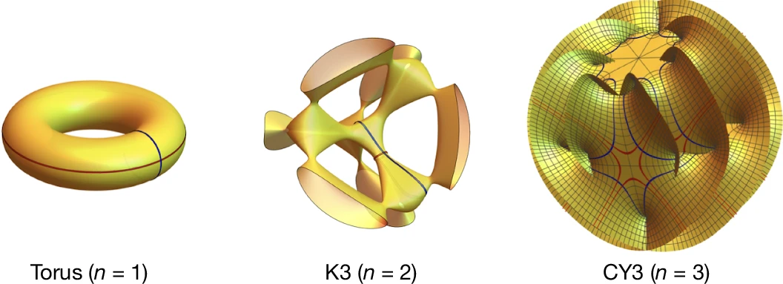
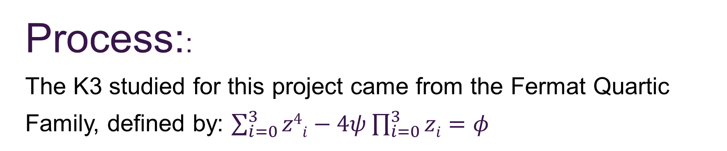
Machine Learning the Calabi-Yau Metric in the Large Complex Structure Limit
Machine Learning the Calabi-Yau Metric in the Large Structure Limit
Abigail Barto
Department of Physics and Astronomy, University of New Hampshire
Advisor: Per Berglund
Introduction
Figures
Methods
Background:
String theory suggests at least six “curled up” spatial dimensions, represented by complex geometric shapes known as Calabi-Yau Manifolds.
  Calabi- Yau Manifolds:
  Their properties describe the form of the additional six spatial dimensions.
    The spatial dimensions describe the sub-atomic physics of their corresponding universe.
      Determine the Calabi-Yau for our universe, launch experiments that could validate String Theory.
  Their Problem:
  Millions of configurations, impossible to compute with standard methods.
Objective:
Optimize the accuracy of a machine learning algorithm modeled on the K3 surface, a complex multidimensional object to solve the partial differential equations describing the K3’s properties using different values of psi.
Purpose:
The K3 model could eventually serve as the foundation for a similar model for Calabi-Yau Manifolds. Making the impossible computational task of determining our Calabi-Yau Manifold plausible.
Figure I: Torus, K3, Calabi Yau 3-Fold
Process::
The K3 studied for this project came from the Fermat Quartic Family, defined by: $\sum_{i=0}^{3}{z4i}−4ψ\prod_{i=0}^{3}{zi}=φ$
Used Cymyc to define the quartic and evaluate a loss function, returning the weighted loss (Sigma Measure).
A series of tests were conducted, varying either the Learning Rate or Structure.
Learning Rates
1e-2
1e-3
1e-4
1e-5
Structures
[48, 48, 48, 48]
[48, 48, 48, 48, 48]
[64, 64, 64]
[56, 56, 56, 56]
[96, 96]
Note: Visual representation of Tourus, K3, and Calabi Yau 3-Fold. Adapted from "Emergence of Calabi–Yau manifolds in high-precision black-hole scattering," by Driesse, M., Jakobsen, G.U., Klemm, A. et al., 2025, Nature, 641, p. 603–607. Copyright 2025 by Mathias Driesse et al
Figure II: Simplified Neural Network
Data was collected for three psi values: 0, 10, and 100.
  5 tests were conducted for each psi value, totaling 120 model runs with 1e5 sample points.
  The test with the lowest sigma measure determined the top performing run.
  The top 3 models for each psi value were run with 1e6 sample points to assess performance on a larger sample set.
Key:
Input
Hidden Layer
Output
Results
Psi 0
 | Structure | Learning Rate | Parameters | Sigma Measure
1 | [56, 56, 56, 56] | 1e-3 | 10585 | 6.82841e-4
2 | [32, 32, 32, 32, 32, 32] | 1e-3 | 5857 | 6.84025e-4
3 | [48, 48, 48, 48, 48] | 1e-3 | 10273 | 7.0427e-4
Conclusion
There were many challenges encountered gathering this data. The original code I worked with returned larger Sigma Measure values than expected. I had to redo my experiments with a different set of code. Due to the time constraints, the scope of my final data was reduced. In the future, Per Berglund and I have discussed further analysis into the parameters and calculation of various features of the Fermat K3 such as their Euler Characteristic value of 24. This would allow us to further assess the accuracy of the models and create visualizations of the singularities.
Methods
Computing:
This project utilized:
  CYMYC:
  a library for numerical differential geometry on Calabi-Yau manifolds written in JAX. Used for:
    Approximations of useful tensor fields;
    Computations of curvature-related quantities;
    Investigations of the complex structure moduli space;
  Premise High-Performance Computing (HPC) cluster:
  A central, shared HPC cluster at USNH supported by the Research Computing Center and PIs who have contributed compute nodes.
  All computational tasks were run through the Premise HPC to significantly increase testing efficiency.
Psi 10
 | Structure | Learning Rate | Parameters | Sigma Measure
1 | [48, 48, 48, 48] | 1e-3 | 7921 | 1.85445e-3
2 | [48, 48, 48, 48, 48] | 1e-3 | 10273 | 5.244536e-3
3 | [56, 56, 56, 56] | 1e-3 | 10585 | 5.244536e-3
Psi 100
 | Structure | Learning Rate | Parameters | Sigma Measure
1 | [48, 48, 48, 48] | 1e-3 | 7921 | 6.430896e-3
2 | [56, 56, 56, 56] | 1e-3 | 10585 | 6.5137698e-3
3 | [48, 48, 48, 48, 48] | 1e-3 | 10273 | 6.430896e-3
References
Notable Commonalities:
All top performing structures utilized a learning rate of 1e-3.
Each value of Psi shares at least one structure in common with the others
Psi 10 and 100 share the same top structures, ranked differently
Berglund, P., Butbaia, G., Hübsch, T., Jejjala, V., Mishra, C., Peña, D. M., & Tan, J. (2024). Cymyc -- Calabi-Yau Metrics, Yukawas, and Curvature. ArXiv. https://doi.org/10.1007/JHEP03(2025)028
Berglund, P., Butbaia, G., Hübsch, T., Jejjala, V., Mayorga Peña, D., Mishra, C., & Tan, J. (2023). Machine learned Calabi-Yau metrics and curvature. Advances in Theoretical and Mathematical Physics, 27(4), 1107–1158. https://doi.org/10.4310/ATMP.2023.v27.n4.a3
Driesse, M., Jakobsen, G.U., Klemm, A. et al. Emergence of Calabi–Yau manifolds in high-precision black-hole scattering. Nature 641, 603–607 (2025). https://doi.org/10.1038/s41586-025-08984-2

