Slide 1

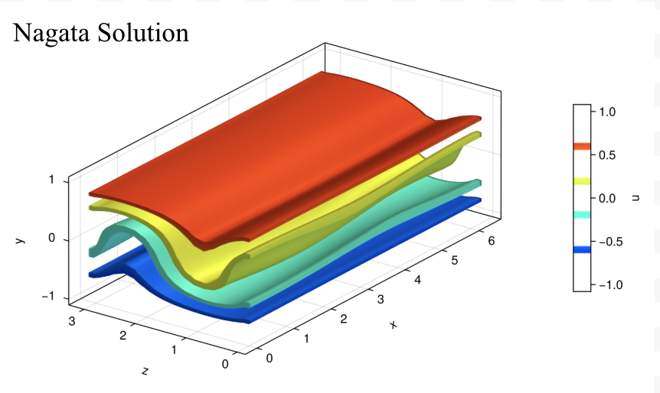
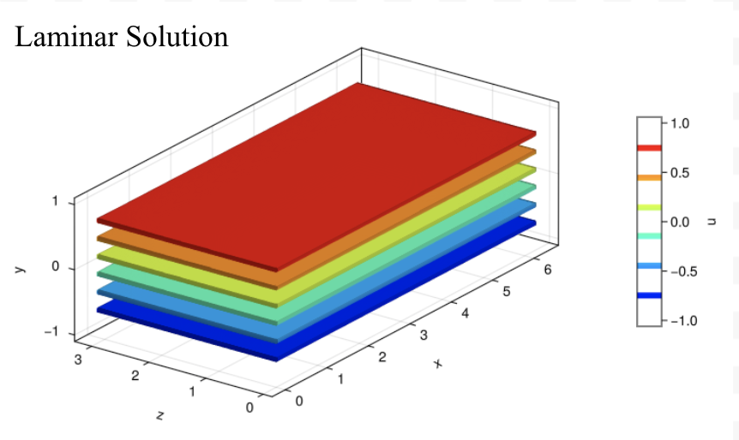

Visualizing Couette Flow – Understanding the Motion of Fluids
Sara Camargo, Fiona Ansbro, Duru Elbi
Advisor: John Gibson
University of New Hampshire Innovation Scholars 2026
In
Framework
The first part of understanding the framework for this project resides in the Laminar Solution. The Laminar Solution of fluid particles is the state where all the particles move in all straight parallel lines varying linearly from -1 at the bottom wall up until +1 at the top. Laminar solution shows steady state of fluids.
The next part of the framework for this project is the Nagata Solution, which is an unstable steady state where fluid particles move in a swirling pattern that does not change in time. This solution was the first known 3D non-linear solution of the Navier-Stokes Equations. The orbits in our project that show up later are all closely related to the Nagata Solution; they are nearby solutions that retain much of the structure of the Nagata Solution but wobble repetitively in time. The orbits concerning this project were found by taking small perturbations of the Nagata Solution and searching numerically for nearby states that repeat after finite time.
The final part of the framework looks into the fluid velocity field we are working with. A fluid velocity field is a vector field with 3 components (u,v,w) at each point in space. These velocity vectors change in time according to the Navier Stokes Equations. A periodic orbit, which is an example of a trajectory of a fluid velocity field, is a closed loop in state space that evolves in time but eventually returns to its initial state. Periodic orbits are good representatives of turbulent flow because they are finite, and we can analyze their stability.
Equilibria, traveling waves, and periodic orbits are invariant solutions that we look for when analyzing dynamical systems. Computing invariant solutions and using them to understand the dynamics of turbulence is an area of active research.
Introduction
The Navier-Stokes equations that describe the motion of fluids, including liquids and gases.
$\frac{∂\overset{⃑}{u}}{∂t}+\overset{⃑}{u}∙$ $\overset{⃑}{∇}\overset{⃑}{u}=−$ $\overset{⃑}{∇}p+\frac{1}{Re}∇^{2}$ $\overset{⃑}{u}$
$$\overset{⃑}{∇}∙\overset{⃑}{u}=0$$
These equations are fundamental to fluid dynamics because they explain how velocity, pressure, density and viscosity, interact to influence fluid flow. By modeling how fluids move under different conditions, the Navier Stokes equations help scientist and engineers understand complex behaviors such as turbulence, air flow over airplane wings, ocean currents, and weather patterns. Their applications extend to many real-world problems, including improving aircraft efficiency, predicting climate systems, designing medical devices, and optimizing industrial processes. Because fluid behavior is central to so many natural and engineered systems, studying these equations is essential for advancing technology, improving safety, and deepening our understanding of the flow.
Plane Couette flow is a simple fluid dynamics scenario with fluid between two parallel moving in opposite directions. This shearing motion drives the fluid to flow due to viscosity, making it an ideal example for applying the Navier-Stokes equation. Plane Couette flow becomes turbulent at low Reynolds numbers, making it ideal for theoretical studies.
Conclusion
Our team focused on building a deeper understanding of the Navier-Stokes equations and how they apply to Couette flow. We figured out how to take sequenced frames and convert them into videos that make fluid behavior easier to interpret. Using code, we took these visualized equations of velocity fields and put them together into a movie showing how the velocity components flow. These videos help us see the behaviors of fluids develop and show how they react with each other predictably in both steady and unsteady states. We observe the separate orbits within the respective vector components and see that even in their unsteady states, they react predictably. All the 3 orbit components are closely related to the 4th orbit; this allows us to see the clear relationships between separate vector components and the underlying physics of plane Couette flow.
References
-"Three-dimensional finite-amplitude solutions in plane {C}ouette flow: bifurcation from infinity", M. Nagata, Journal of Fluid Mechanics, vol 217, 519-527, 1990.
-Nagata, M. “Three-Dimensional Traveling-Wave Solutions in Plane Couette Flow.” Physical Review E, vol. 55, no. 2, 1 Feb. 1997, pp. 2023–2025, chaosbook.org/library/NagataPRE97.pdf, https://doi.org/10.1103/physreve.55.2023. Accessed 17 Apr. 2026.
‌‌
Method
Using Dr. Gibson’s data and previous work, we were able to produce and replicate visualizations for four orbits.
These visualizations uses the orbit datasets within the Julia ecosystem, including Makie (with GLMakie), NCDatasets, and FastChebInterp.
Velocity components (u,v,w) are loaded from NetCDF files. The data is originally defined on a non-uniform grid, so it’s converted onto a uniform grid using interpolation. The velocity data is reorganized so it can be plotted in 3D. A base flow can be added if needed. To make the visualization clearer, we skip some data points (using a stride) so the plot is less crowded.
Three-dimensional contour surfaces are generated for a selected velocity component, with color mapping used to represent magnitude.
Time-resolved visualization is achieved by iterating over sequential datasets and exporting each frame as an image, producing a series suitable for animation of the evolving flow field.
Project Goal​
Develop skills in computer programming and acquire an understanding of fluid dynamics and Couette flow. In addition, obtain an understanding of fluid flows in relation to movement in planes surrounding them. We plan on using these skills to help Professor John Gibson’s work in visualizing Plane Couette flow.
Acknowledgements
We would like to thank Professor John Gibson for teaching us about his research, this project would not have been possible without him and we learned so much.

