Slide 1


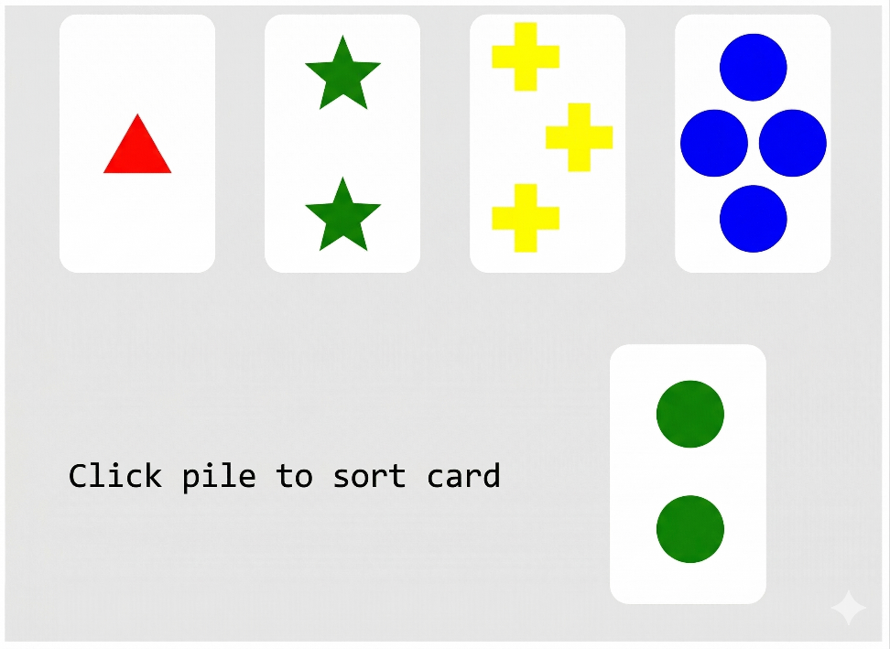
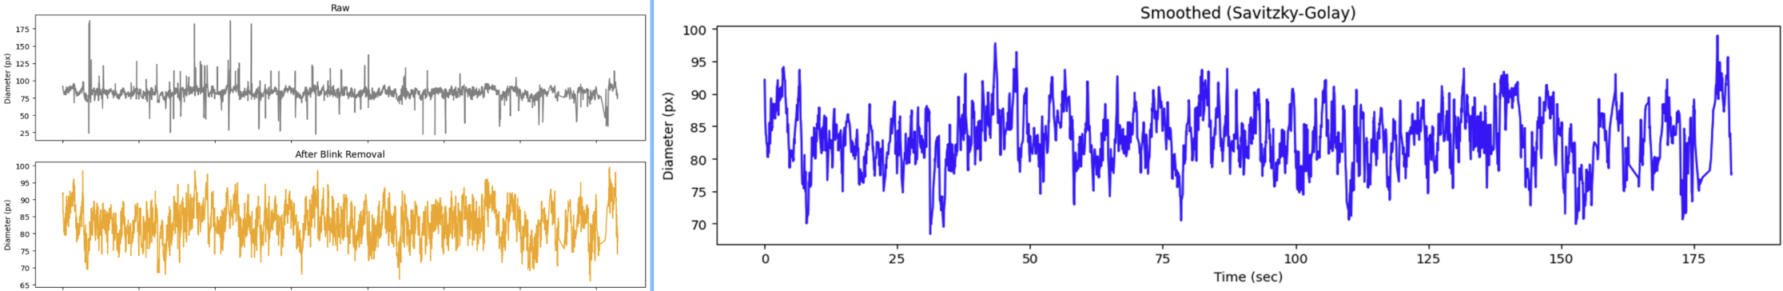
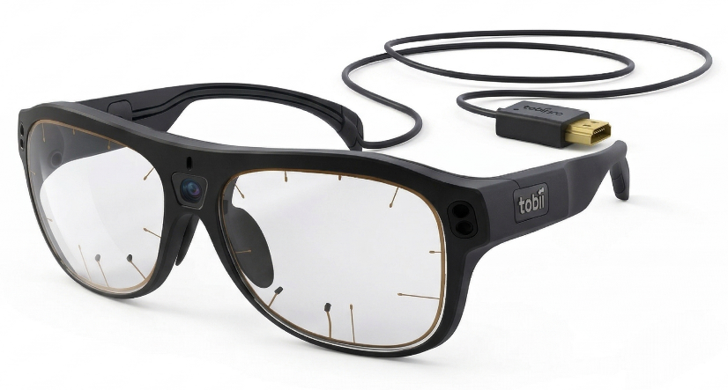
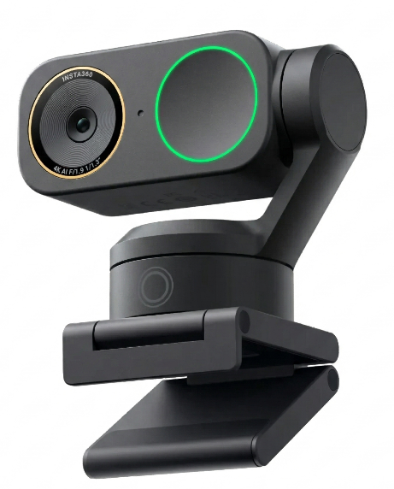
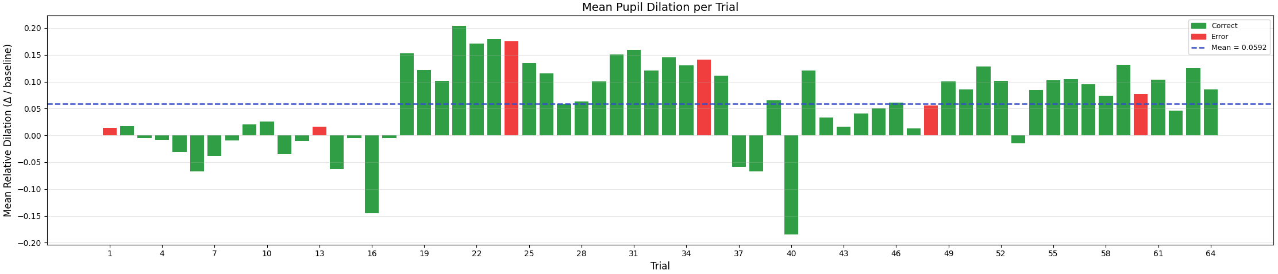
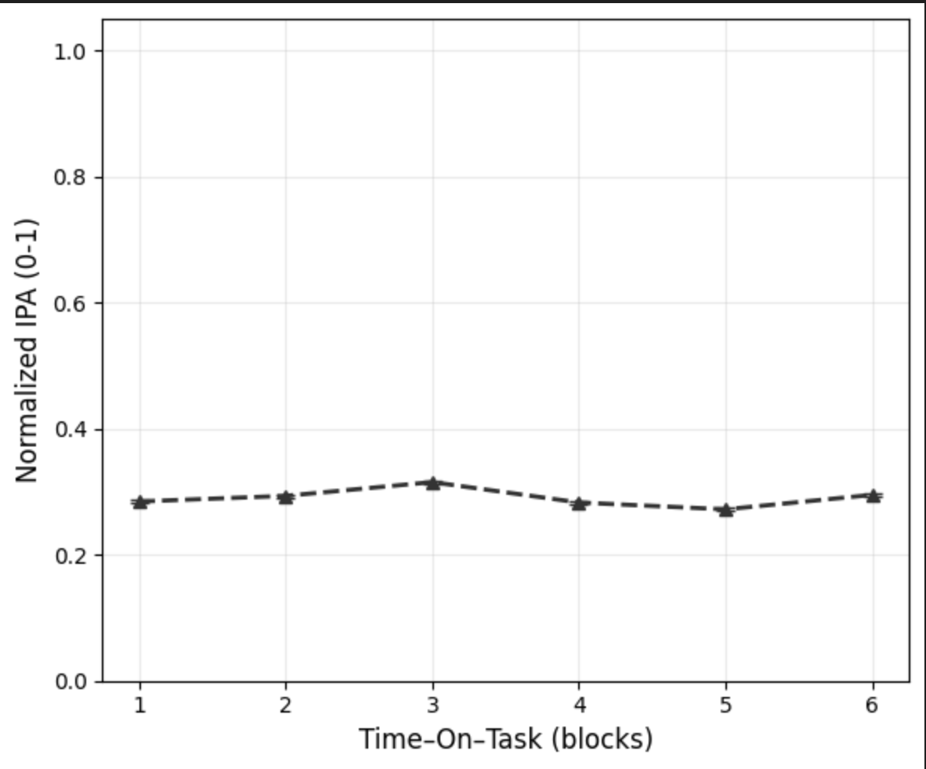
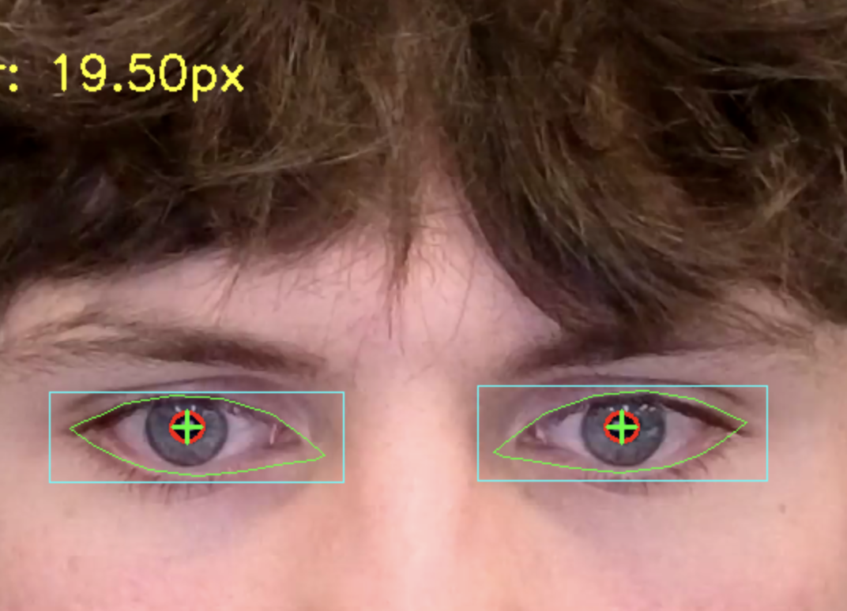
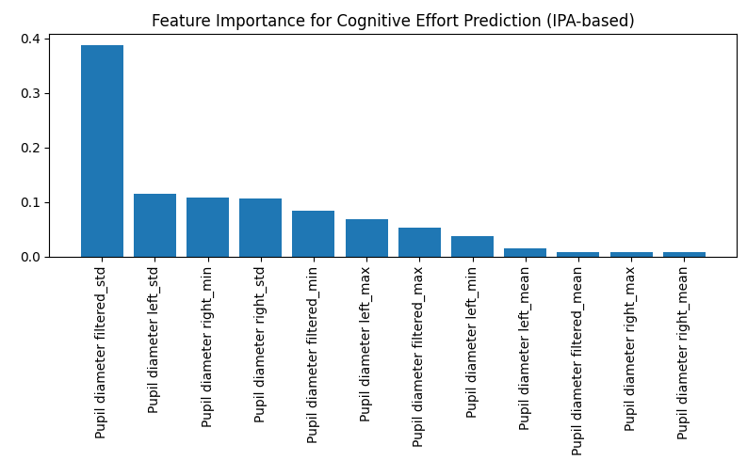
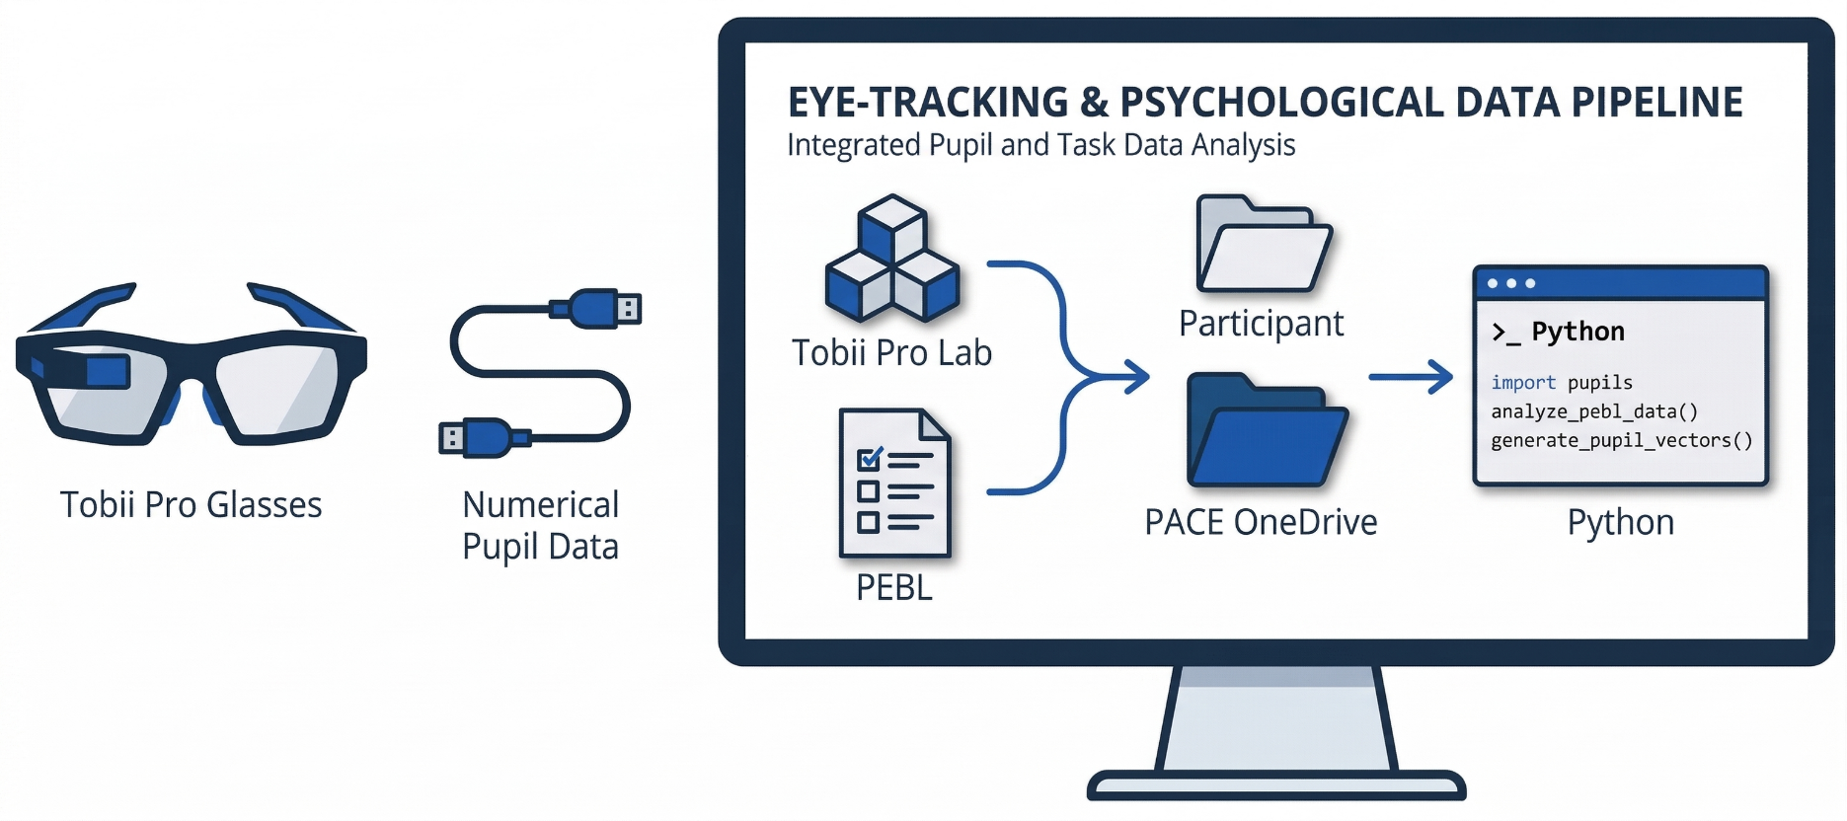
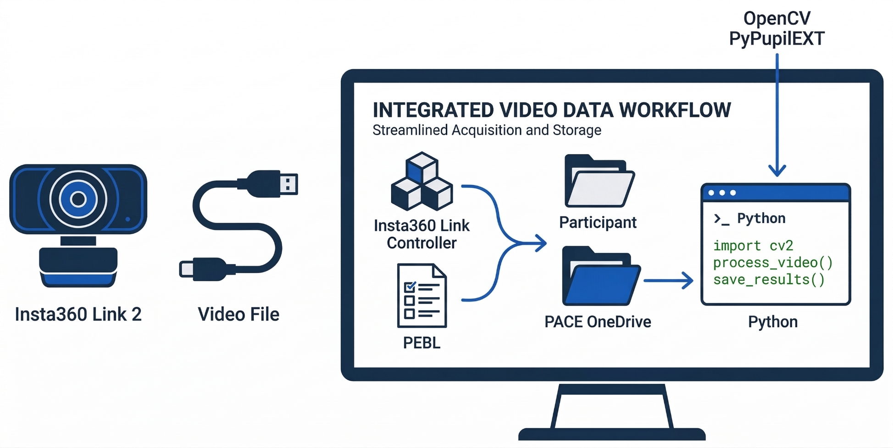
PACE: Pupillometric Analysis of Cognitive Effort
Maxx Berry¹, Evan Braley¹, Lauren Broadbent¹, Gordon Chau¹, Ariel Sousa¹, Max Vivino¹
Sanghee Moon (Sponsor)², Soomin Kwon (Graduate Assistant)², Lisa Henry (Advisor)¹
1. Department of Computer Science, University of New Hampshire; 2. Department of Kinesiology, University of New Hampshire
INTRODUCTION
Pupil dilation reliably tracks cognitive load during neuropsychological testing. This can be done affordably using standard webcams, not just expensive
eye-tracking hardware.
PACE investigates pupil dilation during neuropsychological tests as a cognitive load indicator for clinical pre-screening
Fall semester (2025): Tobii Pro Glasses 3 (Fig 1) + PEBL tests (Fig 3)
Spring semester (2026): Insta360 Link 2 webcam (Fig 2) + PEBL BCST (Fig 3)
Long-term goal: Affordable, real-time cognitive-load monitoring using low-cost eye-tracking
IMPLEMENTATION
System Implementation
Pupil extraction using OpenCV / PyPupilEXT
Random Forest trained on Tobii Pro features for cognitive prediction
Wavelet-based IPA
Signal Processing
Noise reduction (blink removal, Savitzky-Golay smoothing filter) (Fig 6)
Standardized frequency range (0–1 Hz) (Fig 10)
Improved signal isolation from eye region
Key Output
Model performance: R² = 0.64 (Fig 9) and IPA captures cognitive load trends over time
Fig 6: Webcam Pupil Preprocessing
Fig 1: Tobii Pro Glasses 3
Fig 2: Insta360 webcam
Fig 3: PEBL BCST Test
REQUIREMENTS
Functional Requirements
Tobii Pro Glasses 3/Insta360 camera track and capture pupil data during testing
PEBL tests induce varying cognitive load
Raw pupil data is pre-processed for downstream calculations
ML model achieves R² ≥ 0.60
Program accurately estimates the Index of Pupillary Activity (IPA) score
Non-Functional Requirements
System is low-cost and scalable
Results are easily interpretable
Lighting, glare, and shadows are minimized during testing
Fig 7: Trial-level Mean Pupil Dilation by Response Outcome
RESULTS
Key Findings
Detected rapid pupil fluctuation and estimated dilation spikes
IPA reflects changes in task difficulty
Observed Trends
Higher IPA values correspond to increased effort (Fig 10)
Time-on-Task reduces noise and reveals fatigue patterns (Fig 11)
Signal quality preprocessing reduces eyelid/skin interference (Fig 8)
Implications
Supports feasibility of low cost-eye-tracking enabling broader accessibility for cognitive assessment and potential for real-time applications
Low cognitive effort
0.25-0.4 Hz
Moderate cognitive activity
0.40-0.65 Hz
High sustained cognitive effort
>0.65 Hz
Peaking workload, maximum effort
<0.25 Hz
Fig 10: Standardized Cognitive-effort Frequency Range
DESIGN
SOP: Questionnaire, setup, test administration, file organization; updated for webcam
Pre-test: Demographics and factors affecting pupil dilation
Testing: Quiet environment, 30s baseline dilation before PEBL test
Tobii Pipeline: Filtered in Tobii Pro Lab → CSV export → Python analysis (Fig 4)
Webcam Pipeline: MP4 processed via OpenCV + PyPupilEXT, reformatted for existing IPA code (Fig 5)
Fig 8: Real-time Elliptical Pupil and Diameter Estimation
Fig 9: Feature Importance for Random Forest Model
Fig 11: Time-On-Task Blocks Revealing Changes in IPA
EVALUATIONS & CONCLUSIONS
Limitations
Lighting sensitivity (need controlled environment)
Reduced accuracy for darker irises
Future Work
Improve model accuracy
Develop real-time application for pipeline
Expand testing across diverse populations
Conclusion
Pupil dilation is a reliable indicator of cognitive load
Webcam-based approach achieved comparable performance
Demonstrates feasibility of a low-cost alternative to traditional eye-tracking
Fig 4: Tobii Pro Data Pipeline
Fig 5: Webcam Data Pipeline

