Slide 1

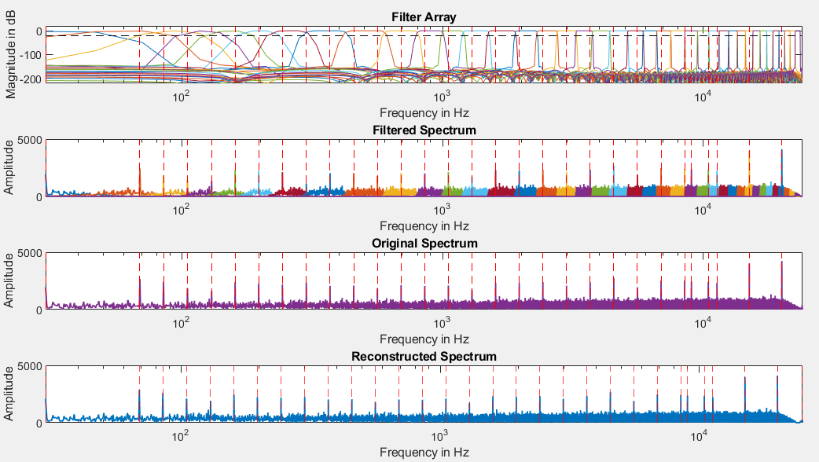
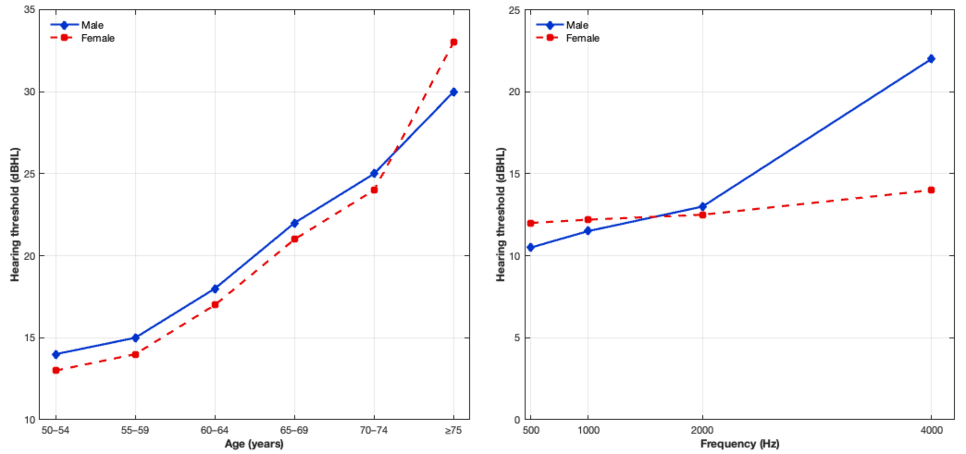
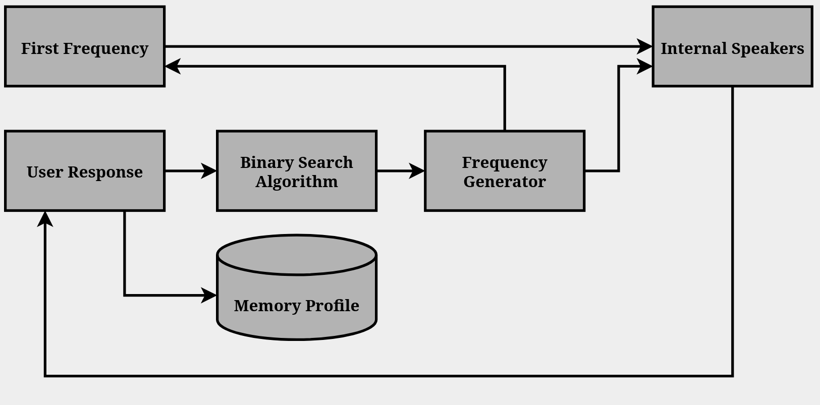
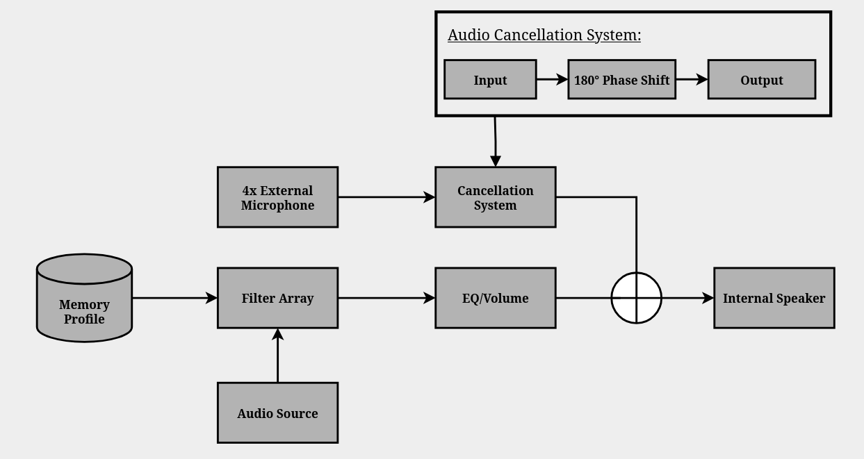
User Calibrated Frequency Mapping Headset
Colin Casey, Olivia McKay, Yash Patel
Faculty Advisor: Professor John R. LaCourse
Department of Electrical and Computer Engineering, University of New Hampshire
Introduction
Digital Filter System
Software Design
Goal: Design and develop a cost-effective headset capable of storing a custom user hearing profile.
Motivation: Improve audio quality for individual listeners by tailoring playback to their hearing response. This concept could also be extended beyond headsets to other audio systems.
Requirements:
Minimum sampling rate of 40 kHz
16-bit mono WAV file input
Adjustable frequency bands based on an individual’s hearing frequency spectrum
Written in C to interface the Espressif ESP32-S3-WROOM-1 Microcontroller (MCU)
Integrated ESP-IDF for hardware development and the ESP-DSP library for refined on-chip filter design.
MCU handles calibration. equalization, and playback:
  Calibration: Uses a binary-search tone test across 41 logarithmic frequency bands (30 Hz - 20 kHz) to identify user hearing thresholds.
  Equalization: A 41-band parametric equalizer utilizes peaking Finite Impulse Response filters to boost audible frequencies. This processing is applied in real time to .wav files stored within an external SD card.
  Playback: MCU will send the processed .wav file to the speaker driver
Preliminary Research
Rank (#) | Frequency (Hz) | Amplitude (dB) | Significance
1 | 1 | 10690.76 | DC Bias
2 | 68.67 | 9824.54 | Primary Bass
3 | 159.33 | 8440.02 | Upper Bass
4 | 84.67 | 8168.35 | Low-Frequency Body
5 | 104.67 | 7383.37 | Kick Range
Table 1. 5 Most Noticeable Frequencies
The 5 most influential output frequencies are shown in Table 1. This is data from an ESP32 sample that shows the transition to a low-frequency biased profile below 160 Hz. Table 1 prioritizes bass and sub-bass reinforcements.
Figure 3. Filter Array Response with Test Frequencies and Noticeability Threshold
Sound Region | Band | Frequency Range | Average Energy Ratio
Deep Sub-Bass | 0-1 | 33.5-51.0 Hz | 1.7 x 10⁹
Bass | 2 | 51.0-62.5 Hz | 1.8 x 10⁸
Lower Mid-Range | 3-9 | 62.5-271.5 Hz | 25.0
Mid-Range | 10-20 | 271.5-2.7 kHz | 8.0
Mid High | 21-30 | 2.7-9.7 kHz | 15.0
High-Range | 31-41 | 9.7-20.0 kHz | 23.0
The filter array illustrates each filter and its corresponding bandwidth, with each filter activated or deactivated according to the user’s response. The red lines mark the test frequencies, and the black dashed line shows the −20 dB point at which a frequency is noticeable. Each filter's bandwidth is then added and recombined into a reconstructed spectrum, based on the activated frequencies. Each filter is a 6000 tap FIR filter.
Figure 1. Hearing Threshold as a Function of Age for Male and Female Listeners
System Block Diagrams
Figure 4 is the how the data for the memory profile is gathered.
Function Generator plays a start frequency, at 400Hz
User indicates whether they can hear that tone or not, the user's response is then sent to the memory profile, and we use a binary search algorithm to select the next frequency.
These frequencies are responded to and recorded the same way to build a complete audio profile.
  The frequencies start from 400 Hz and continue playing higher increments until 20 kHz.
  Once the high band is completed it starts again at 400 Hz and plays the lower frequencies, ending at 30 Hz.
High end industry speakers are used for effective frequency range and clarity with minimal distortion.
Table 2. Key Frequency Region Energy
Table 2 summarizes the 32-band regions, highlighting the 1.7x10⁹ subbass amplification, alongside midrange and high-frequency gain.
Results
Prototype hardware signal flow was set up successfully on a breadboard.
MATLAB simulations verified the multi-band personalized filter response.
Calibration and active-use models were refined into an implementable 40k Hz DSP workflow.
Embedded software structure was developed for calibration, equalization, and playback.
The prototype remained within the project budget, supporting cost-effective implementation.
Figure 4. Calibration System
Figure 2. Hearing Threshold as a Function of Frequency for Male and Female Listeners
Figure 5 shows how the signal processing architecture is modeled.
Four individual external microphones detect ambient sound
The audio is resampled at 48 kHz, then passed through a 180° phase shift.
Concurrently, the Audio source is passed through the full filter array, based on the results of the hearing test
  Heard frequencies are amplified, unheard frequencies are dampened based on filter activation.
The output from the filter array is then passed through an equalization stage, where it can be controlled by volume for the user's preference.
These two signals get combined, and since the 180° phase shift cancels out external noise, the output is a clearer form of the input signal.
Conclusions
Preliminary research included background study in audio design, hearing response trends, MATLAB analysis, and component selection.
Figure 1 shows that hearing threshold increases with age for both male and female listeners, with a more noticeable rise in the older age groups.
The age-based trend in Figure 1 suggests that hearing sensitivity generally declines over time, supporting the need for a user-specific calibration process.
Figure 2 shows that hearing threshold increases with frequency more sharply for male listeners, while the female response remains comparatively more gradual across the measured range.
Together, Figures 1 and 2 support the need for frequency-dependent gain adjustment, particularly in the higher-frequency range where hearing differences become more pronounced.
This cost-effective prototype integrates a personalized frequency equalization profile with a hybrid dual-microphone Active Noise Cancellation (ANC) system.
The calibration process enables scalable customization for different hearing spectrums, while the hybrid ANC effectively reduces residual noise without interfering with the desired program audio.
The system utilizes high-speed sampling at 40 kHz and FFT-based spectral analysis to ensure precise real-time anti-noise generation and audio equalization.
The system supports multiple saved calibration profiles, enabling users to select and apply settings tailored to different environments.
Figure 5. Active System

