Slide 1



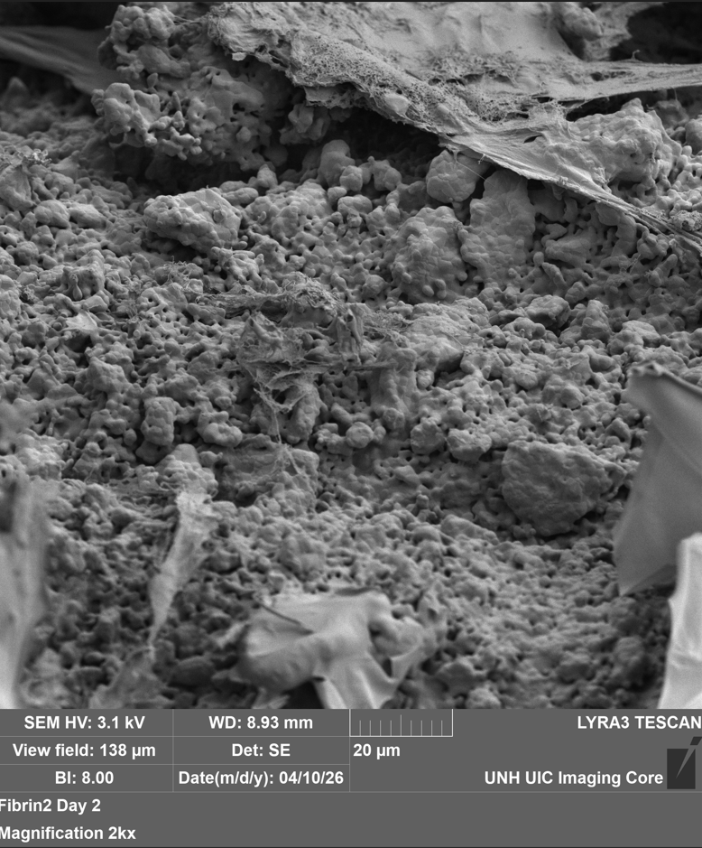
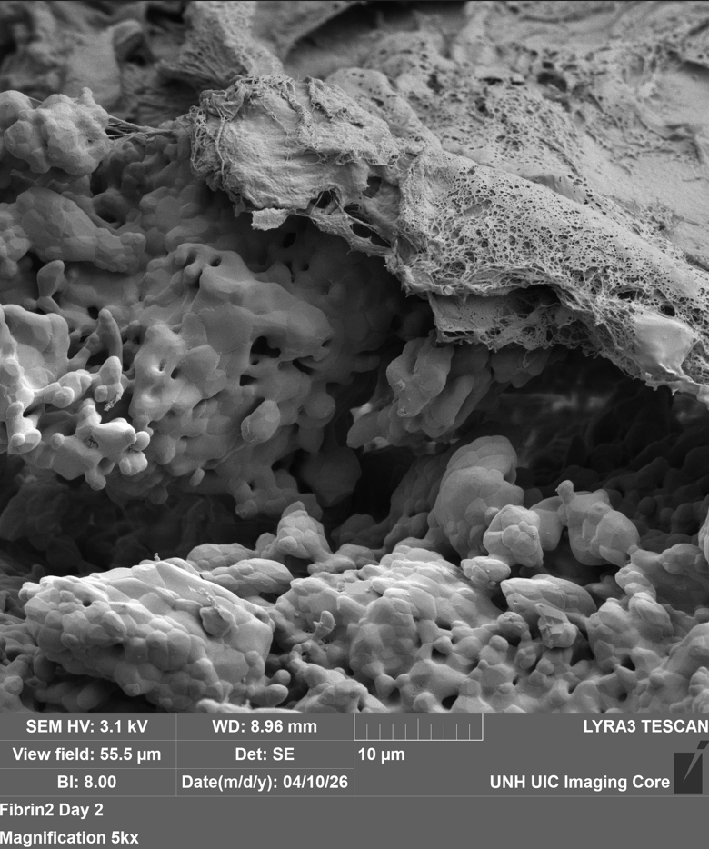
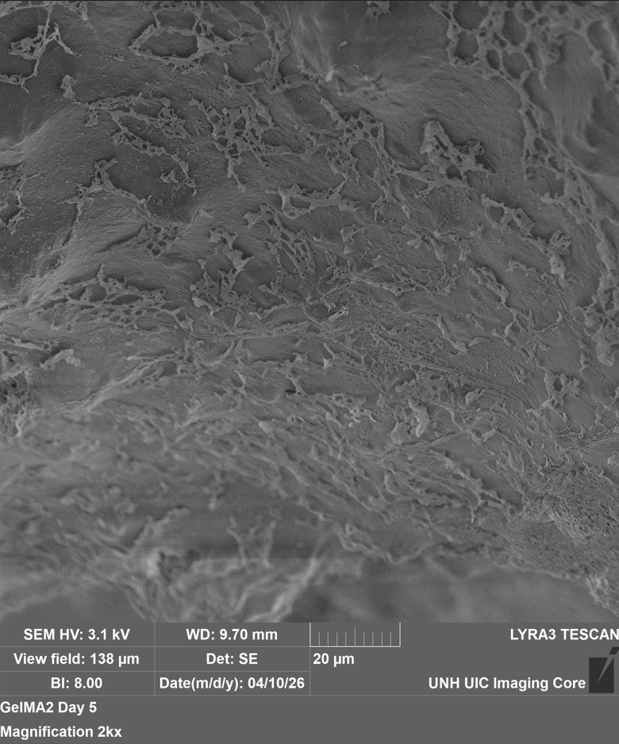
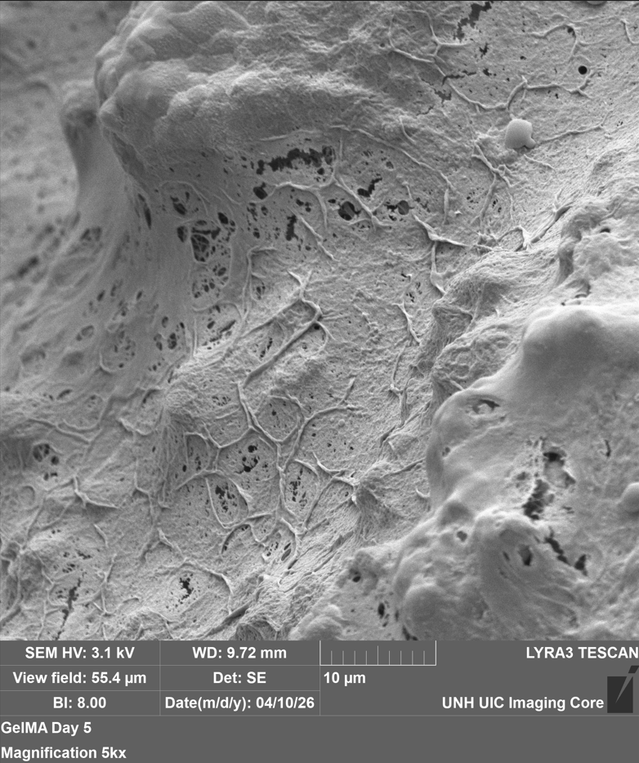
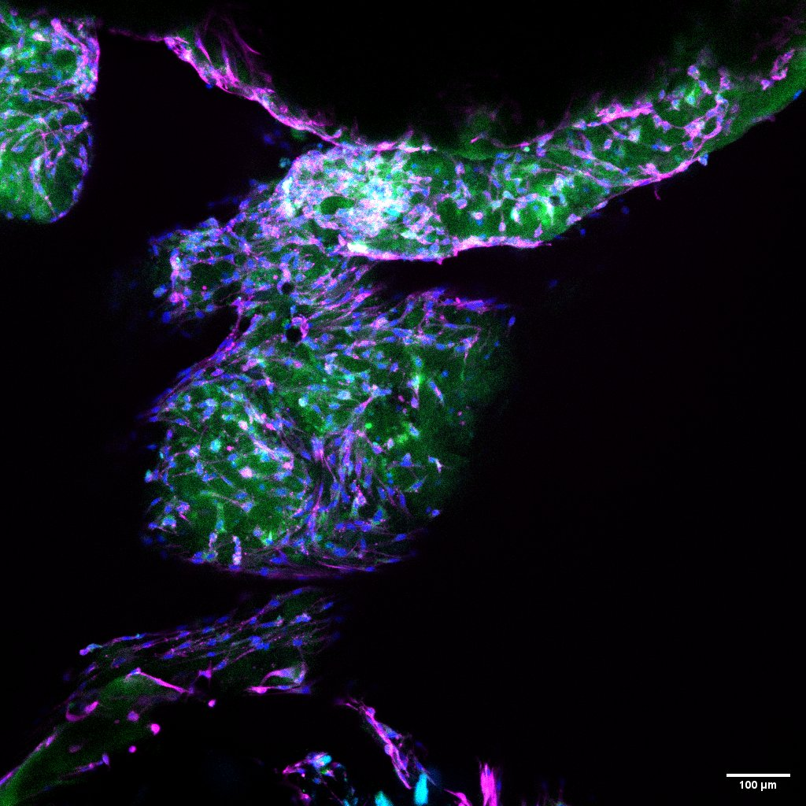
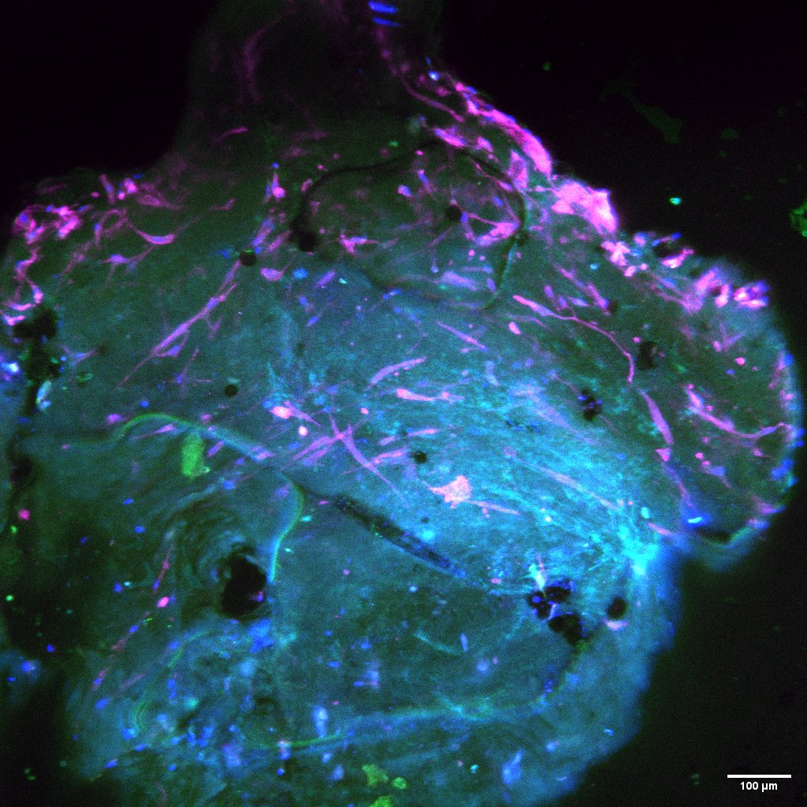
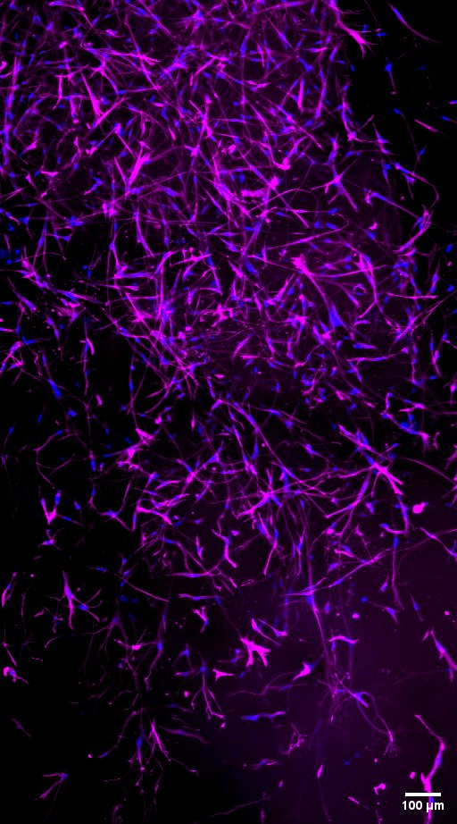
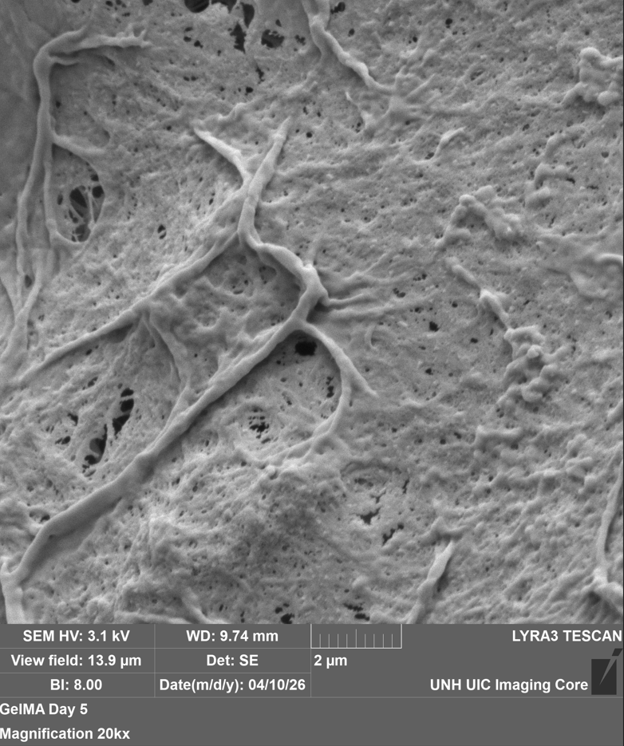
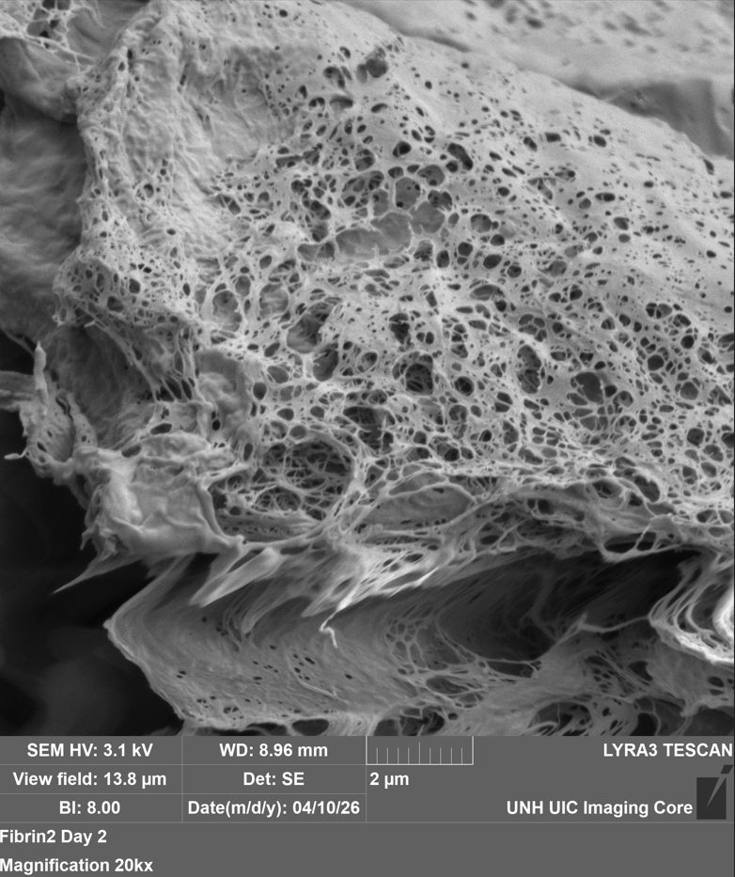
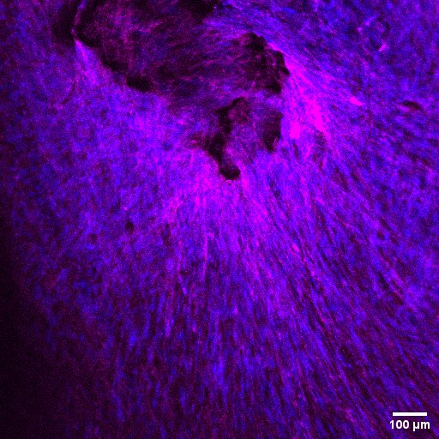
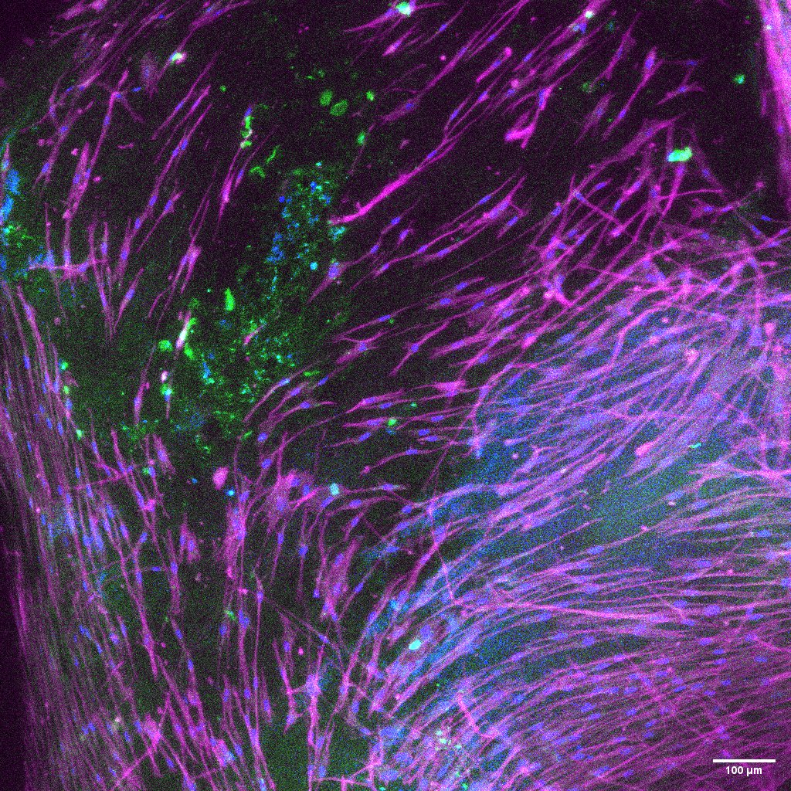
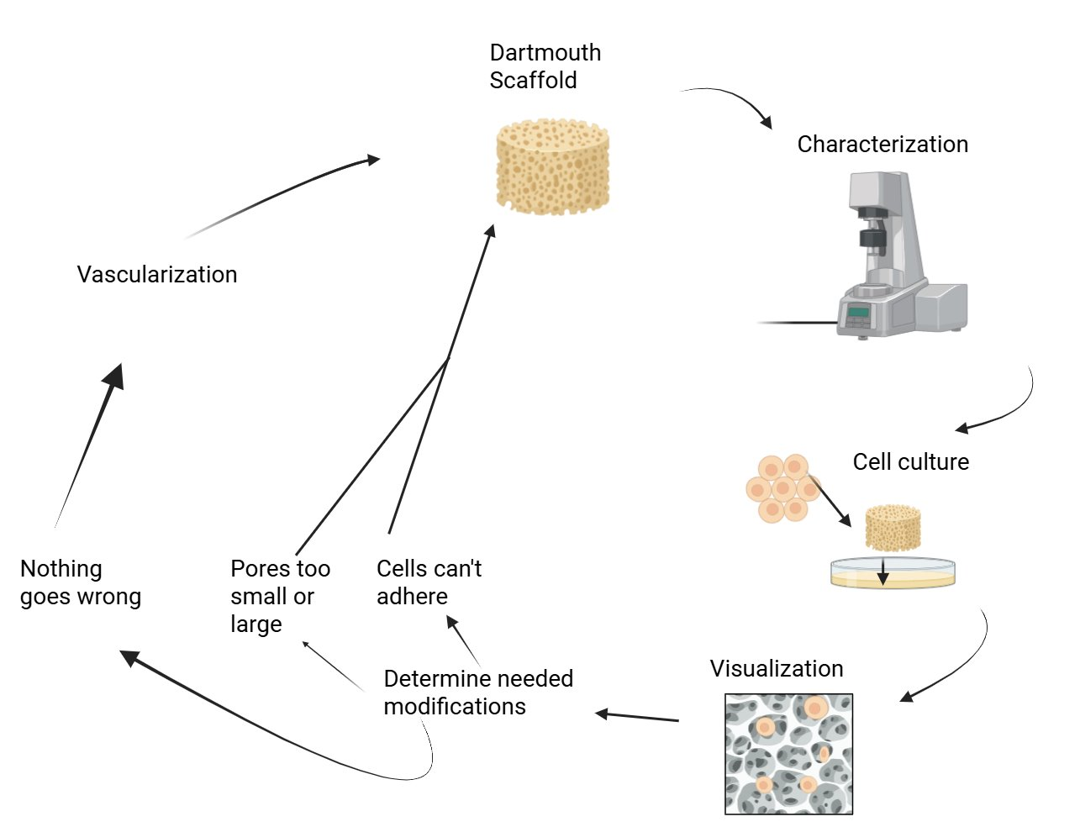
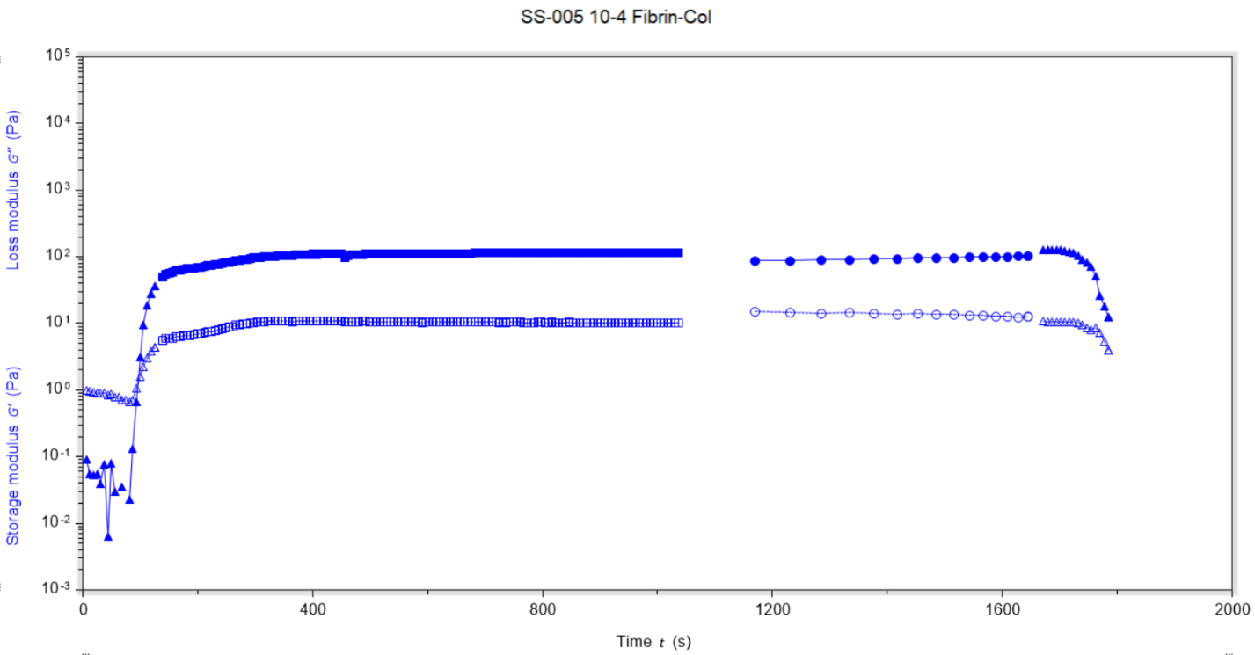
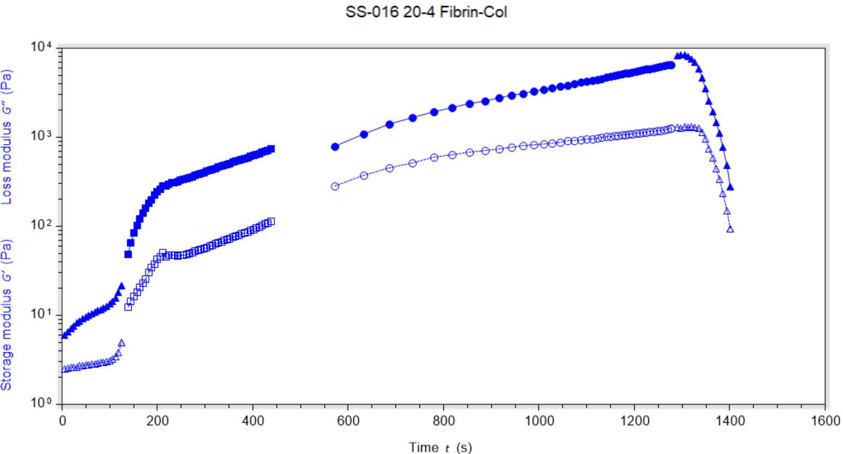
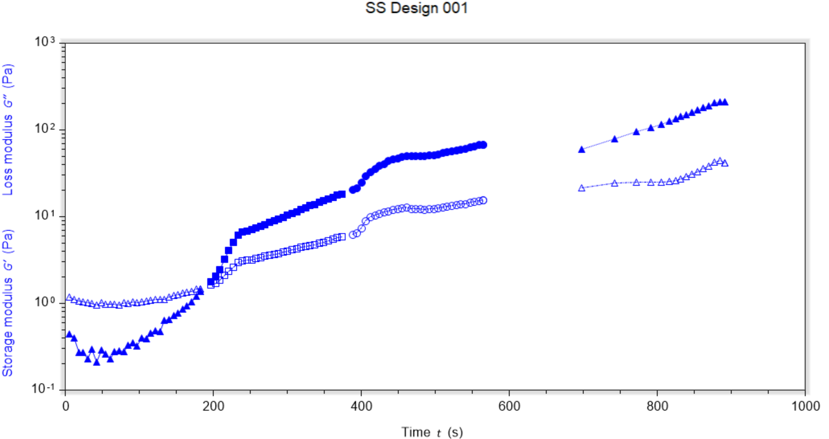
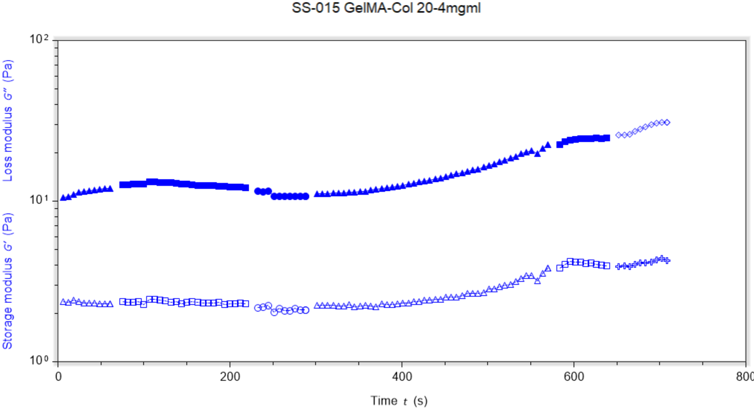
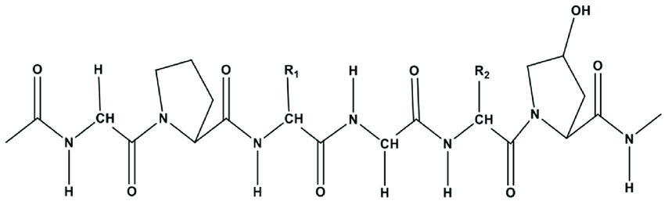
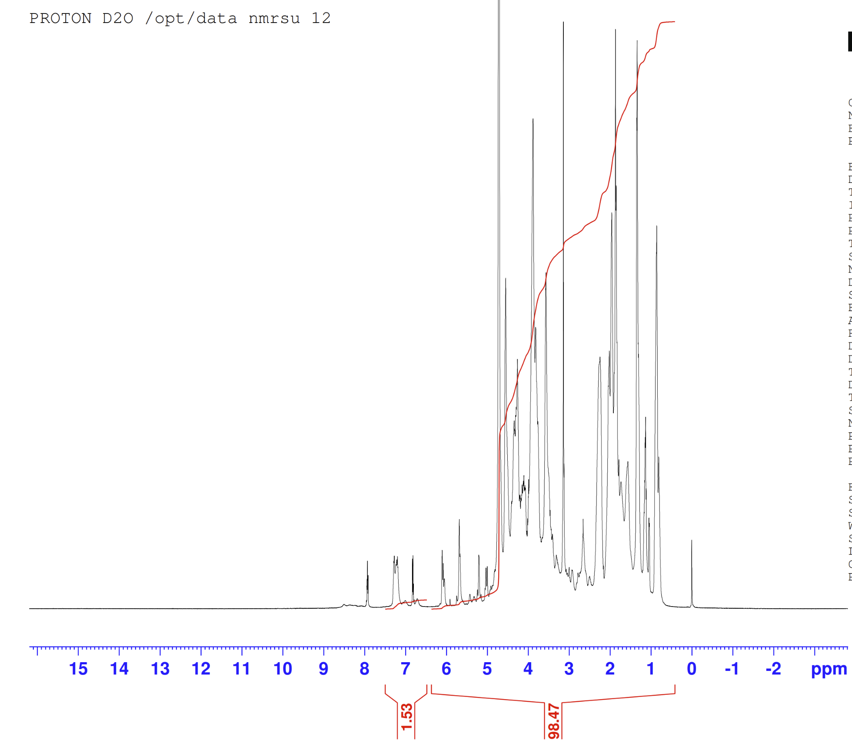
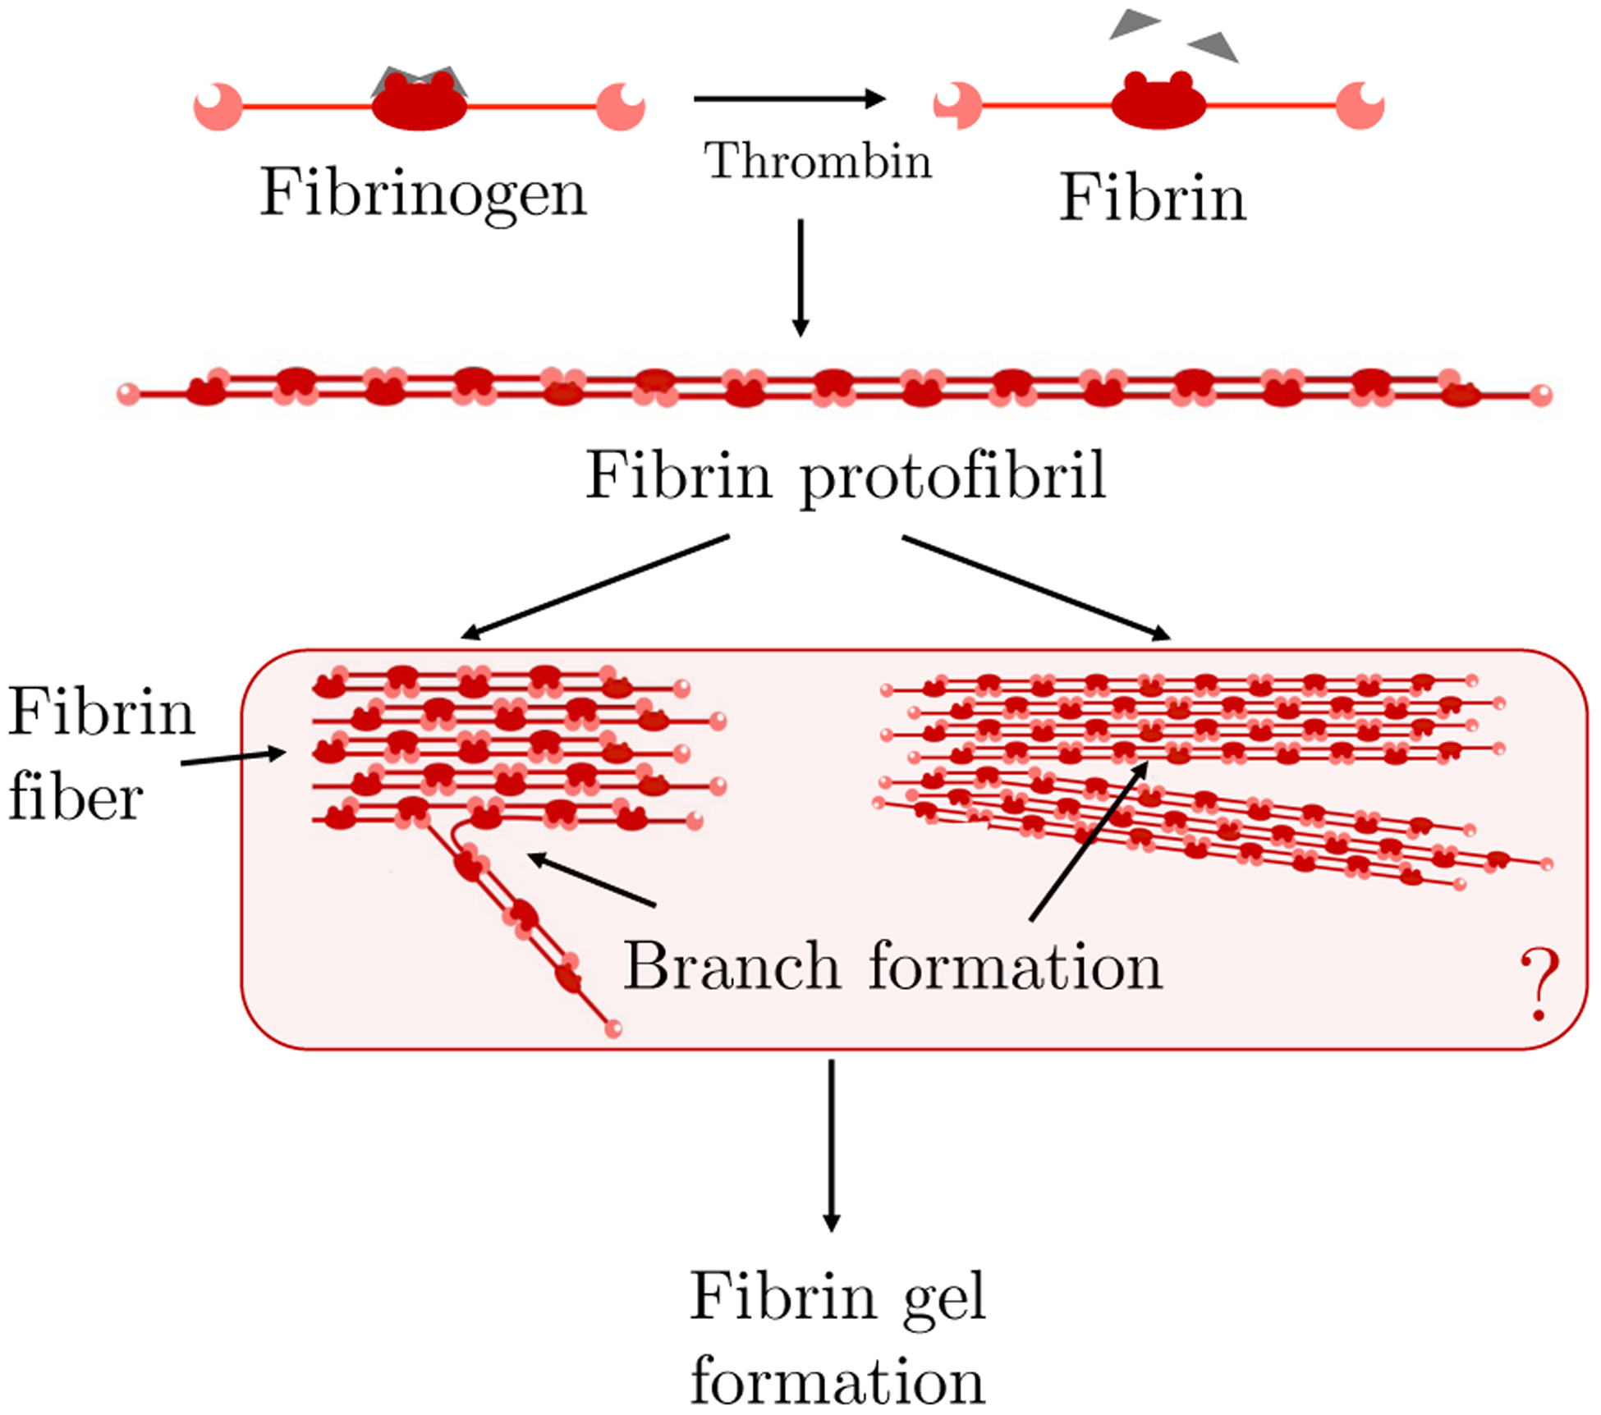
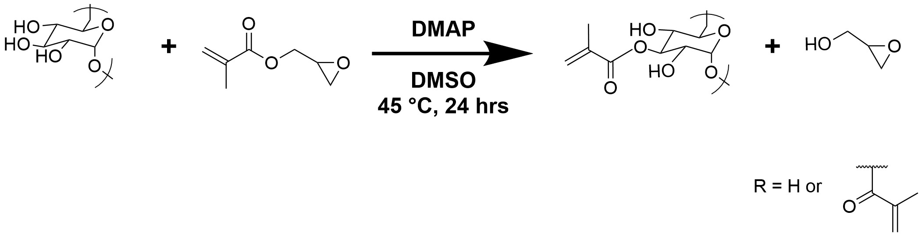
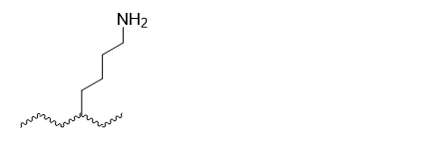
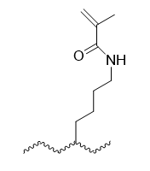
Protein Hydrogels for Cytocompatible Bone Scaffolds
Evan Kennedy, Peter Hyatt, Naya Leslie, Andrew Critides, Rachana Padamati, Linqing Li*
Department of Chemical Engineering and Bioengineering, University of New Hampshire, Durham, NH, USA
* Linqing.Li@unh.edu
1. Introduction
3. Material Characterization
4. Confocal
Bone defects remain a major clinical challenge and can result from diseases or trauma such as osteoporosis or surgical removal of damaged tissue.
The body can repair small fractures, however it’s unable to effectively heal larger or more complex bone defects
Bone tissue engineering is a promising solution by using scaffolds to restore both the structure and function of damaged bone.
An effective scaffold must be able to support bone formation, guide tissue growth, and promote vascularization to ensure proper nutrient delivery.
Current treatments on the market include, autografts, allografts, and metal implants. However, each option has limitations such as rejection, poor biological integration and limited availability.
SEM (Scanning Electron Microscope)
GelMA
Osteo 20mg/ml GelMA HAP 20mg/ml GelMA
BTCP 20mg/ml Fibrinogen
BTCP 20mg/ml GelMA
Day 7 20 mg/ml Fibrin
Rheology
5. Reflection
Achieved primary goal: successful cell growth and adhesion within scaffolds
Improvement over prior scaffolds that showed cytotoxicity and poor adhesion
Secondary goal is ongoing: formation of vascular structures
Key challenge: opposing gelation conditions of GelMA and collagen
Improved workflow enables consistent gel formation and parameter tuning for vascularization
2. Mechanism of Gel Formation
Structure of Collagen
F
Collagen forms into a gel when heated at a basic pH
  Multiple interactions cause collagen to fibrillate, mainly the attraction of charged amino acids
In the presence of thrombin, fibrinogen is converted to fibrin, which self-assembles into a gel
The Li Lab had protocols for synthesizing DexMA, but not GelMA
Under UV light (365 nm), the methacrylate groups of GelMA crosslink in a radical-dependent chain reaction initiated by Irgacure
6. Conclusions
NMR (Nuclear Magnetic Resonance)
Fibrin-collagen gel supported superior cell growth and infiltration (confirmed by confocal imaging)
GelMA-collagen was expected to enhance osteogenesis due to higher stiffness
However, GelMA-collagen showed minimal cell growth, possibly from limited pore size.
Future work: decrease degree of Methacrylation to increase pore size for improved cell growth in GelMA-collagen gels
Structure of Fibrin
F
Acknowledgement
NH BioMade IIA 1757371 and EPS-1101245
CIBBR (P20GM113131) at NIH
UNH Core facility and Instrumentation Center
UNH CHBE Department
Dr. Linqing Li’s Lab, UNH
Levi Olevsky, University of Dartmouth PhD Candidate, for the foundation of our work
Synthesis of gelatin methacrylate (GelMA)
Foundational Dextran Methacrylation
References
GelMA was synthesized in-house from Gelatin and Glycidyl Methacrylate
Methacrylate peaks (6.2 and 5.7 ppm) were compared to the Phenylalanine peak (7.2 ppm) to determine degree of methacrylation.³
Our Gelatin Methacrylation
Fogelson, Aaron (2022), Development of Fibrin Branch Structure Before and After Gelation; NIH National Library of Medicine; https://pmc.ncbi.nlm.nih.gov/articles/PMC9455619/
Collagen Formula. (n.d.). Retrieved April 21, 2025, from https://softschools.com/formulas/chemistry/collagen_formula/482
Claaßen, Christiane (2018), Quantification of Substitution of Gelatin Methacryloyl: Best Practice and Current Pitfalls, Biomacromolecules; https://doi.org/10.1021/acs.biomac.7b01221
Kan Yue (2015) Synthesis, properties, and biomedical applications of gelatin methacryloyl (GelMA) hydrogels; https://doi.org/10.1016/j.biomaterials.2015.08.045
Notes:
SEM – 20 um
Toxicity- 100 um
Gel- 100 um
Gel with cells- 50 um, 2D
The body can repair small fractures, however it’s unable to effectively heal larger or more complex bone defects.
Current treatments on the market include, autografts, allografts, and metal implants. However, each option has limitations such as rejection, poor biological integration and limited availability.
This approach has the potential to improve healing, reduce major complications, and enhance patient quality of life.
This approach has the potential to improve healing, reduce major complications, and enhance patient quality of life.
This approach has the potential to improve healing, reduce major complications, and enhance patient quality of life.
The hypothesis that the fibrinogen gels would produce a better matrix for cellular growth seems to be supported with our present testing.
Individual Gel components tested to assess G' and G" contribution
Hybrid gel shows synergistic interactions between fibers
20 mg/ml gels resulted in G' and G" closest to other Bone Hydrogels, and showed consistent cellular growth
Fibroblasts will continue to produce, deposit, and reorganize ECM to improve mechanical properties

Slide 2
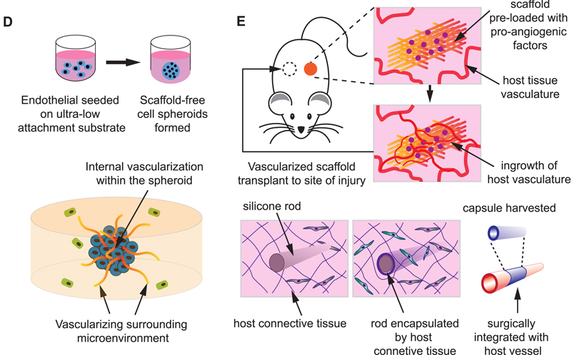
(D) The scaffold free, 3D EC spheroids may act as individual vascular units to vascularize internally, as well as pre-vascularize the surrounding tissue, and thus enhance the survival, homing and functionality of other impregnated cells within the construct. (E) Scaffolds that present angiogenic factors or resembles blood vessel morphology can be pre-implanted in a vascular site to be conditioned/vascularized in vivo through vessel ingrowth or encapsulation by host tissue, and then harvested and transplanted to the site of injury.
https://pmc.ncbi.nlm.nih.gov/articles/PMC8302186/
with the stiffness of dextran and the cell signaling and cell support of collagen.
The Dextran-Collagen hydrogel combines the structural stiffness of dextran with the cell signaling and support properties of collagen, providing a firm matrix that maintains integrity while promoting vascularization.

Slide 3
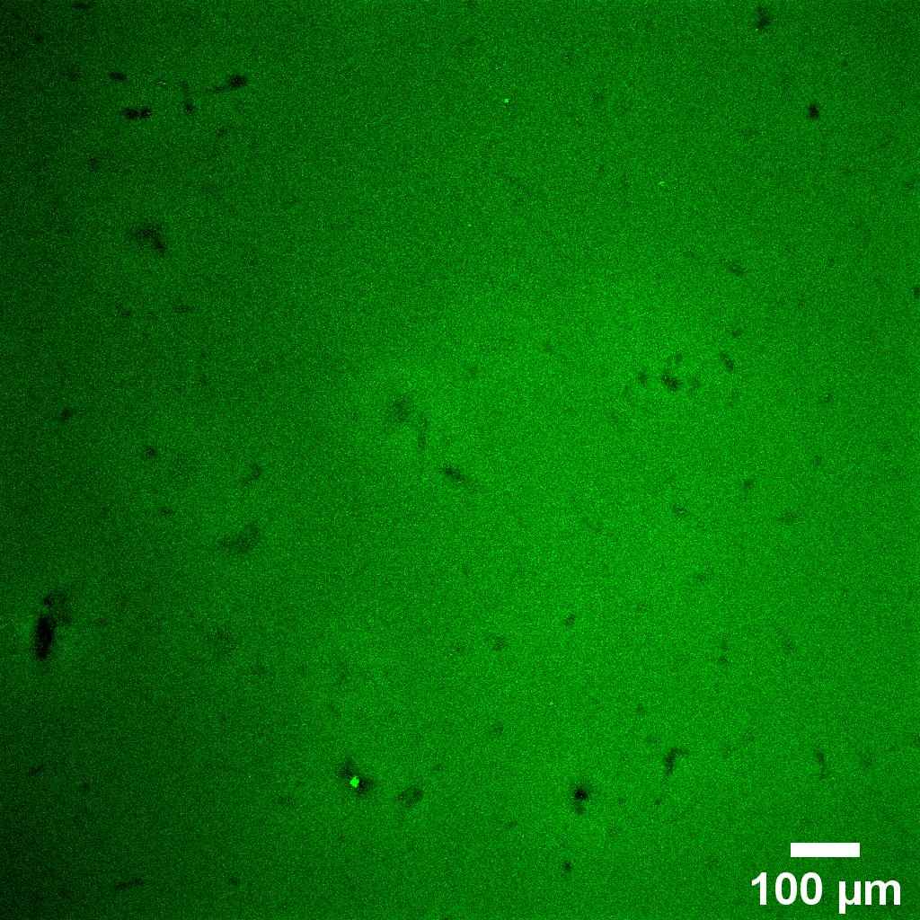
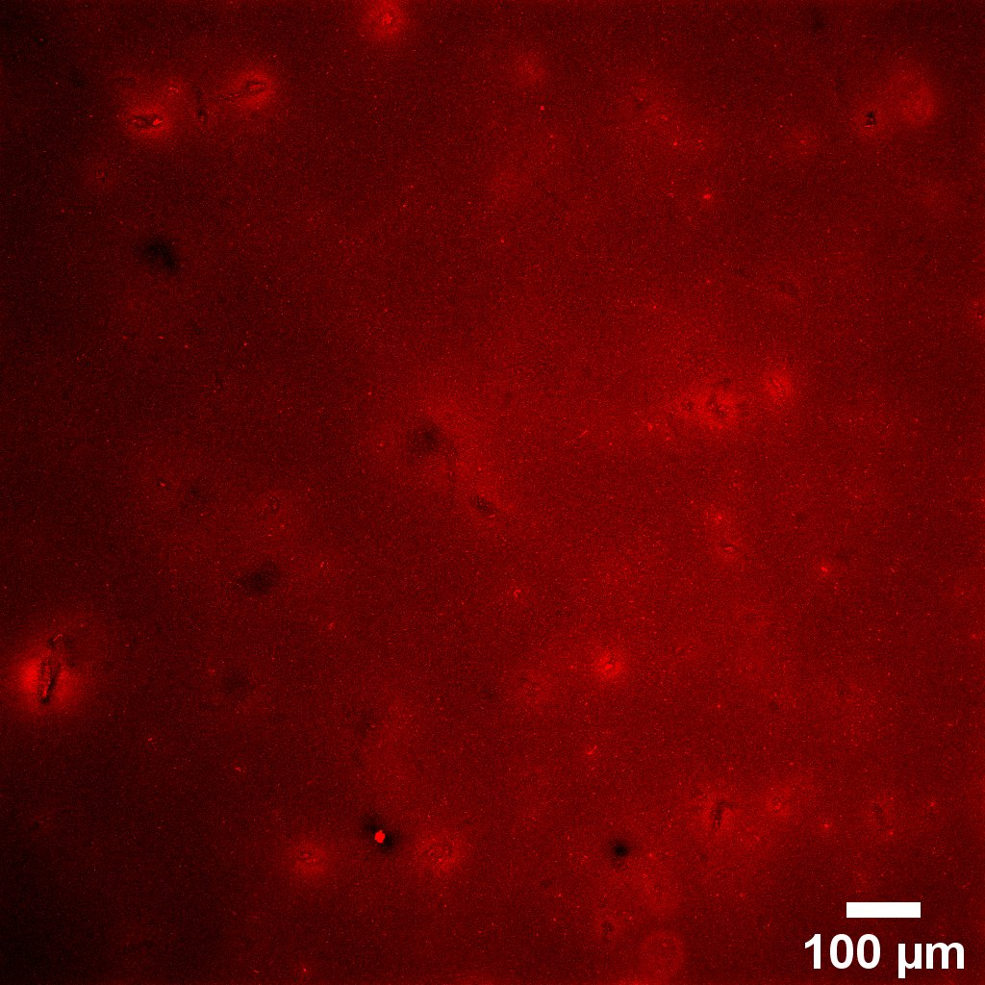
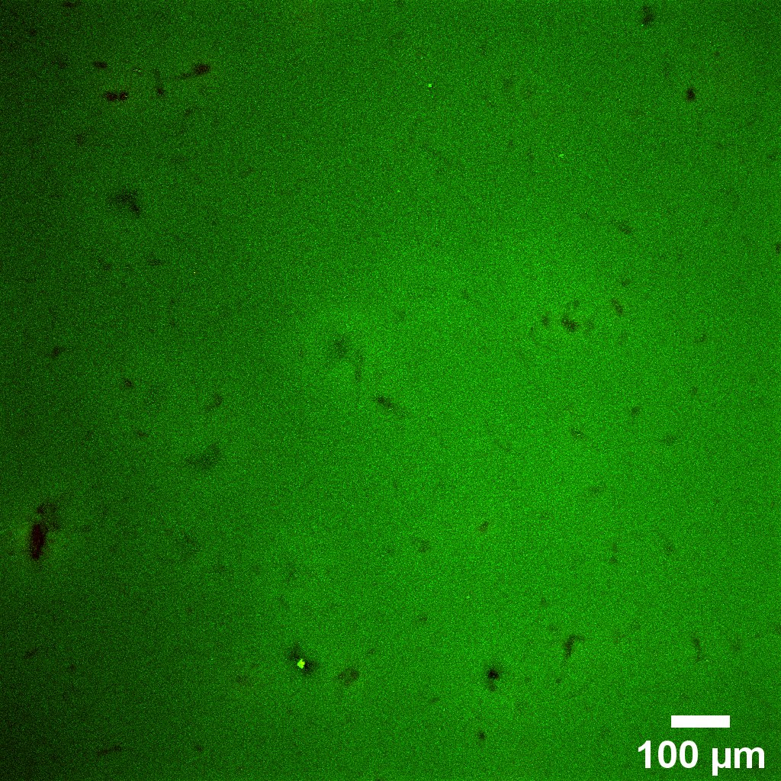
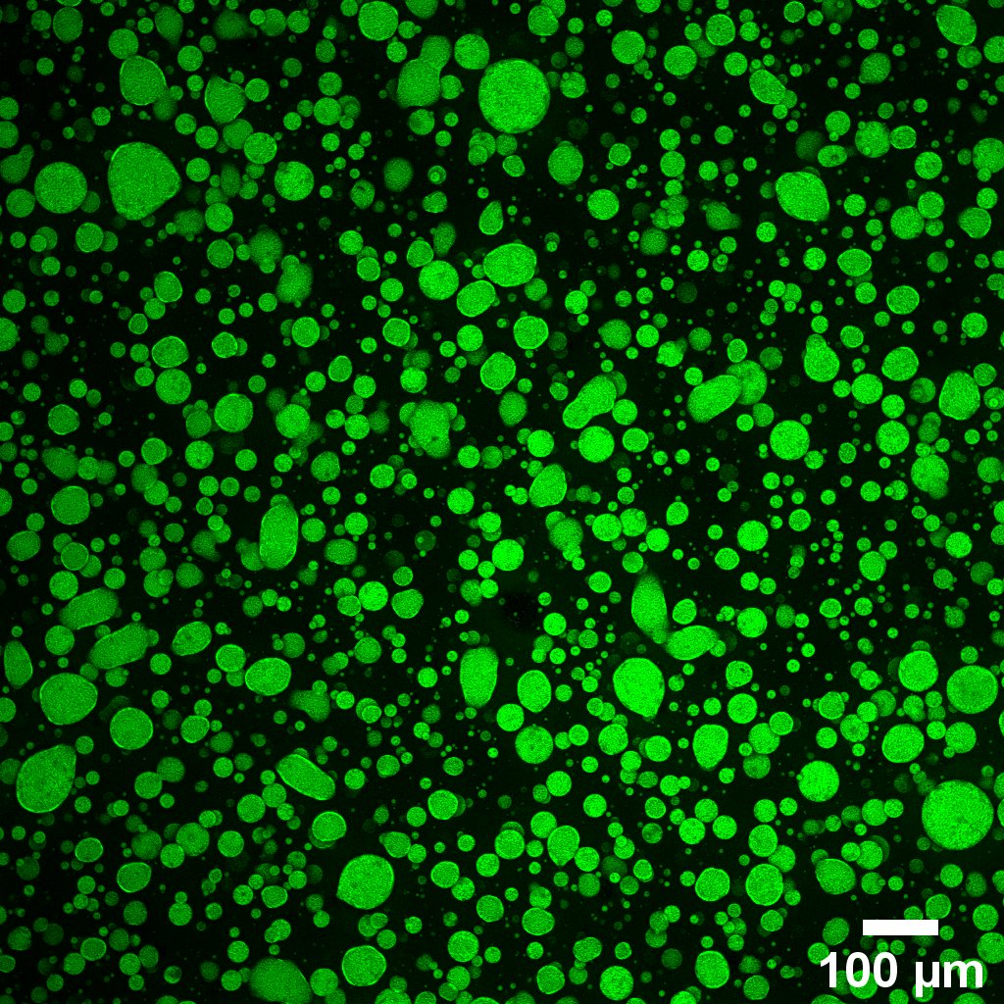
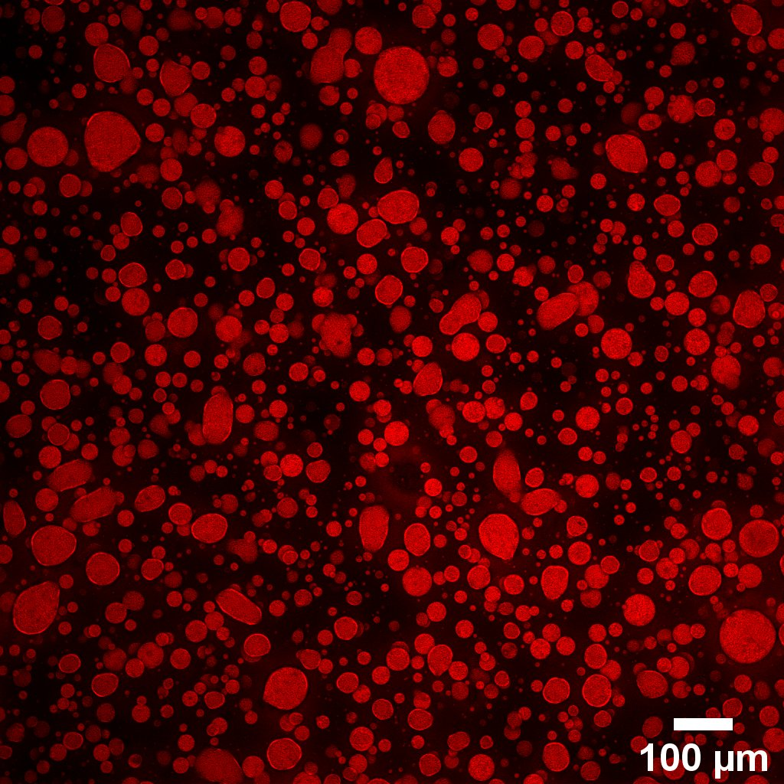
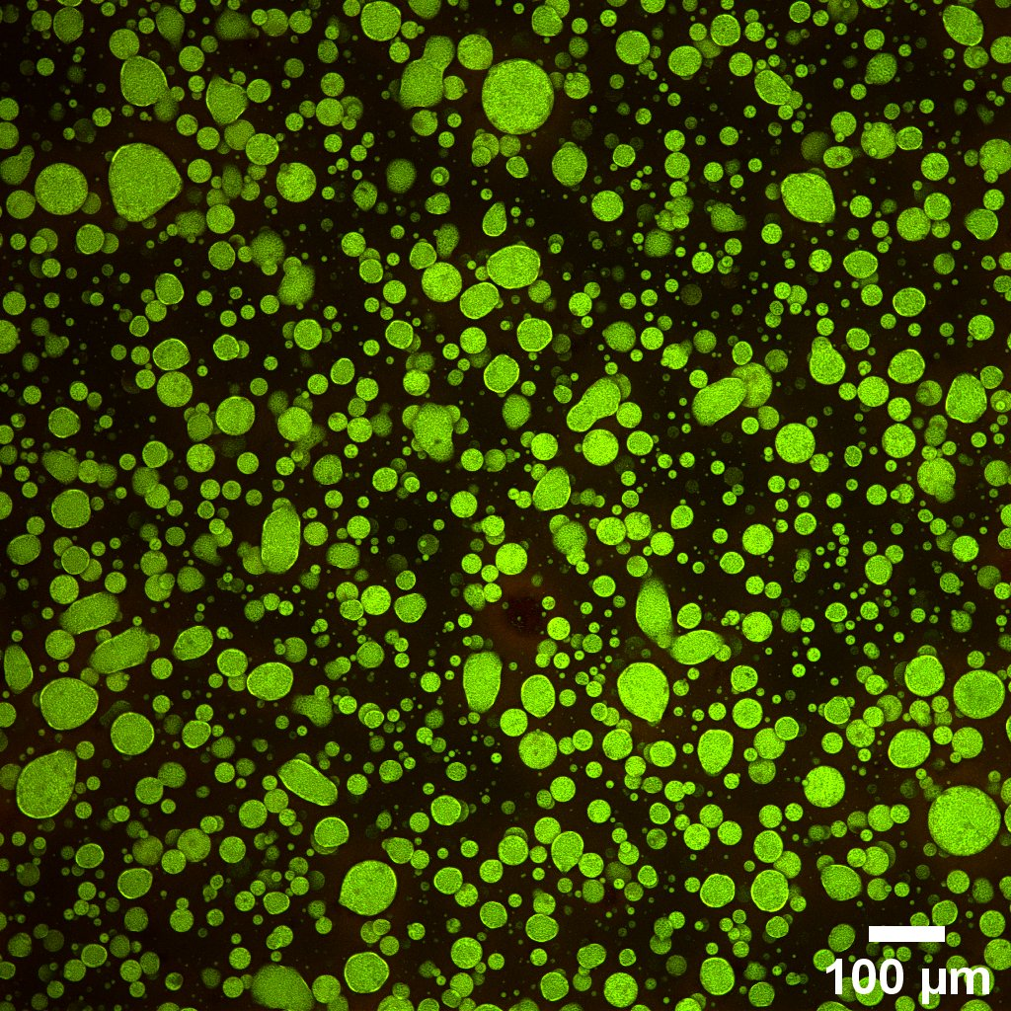
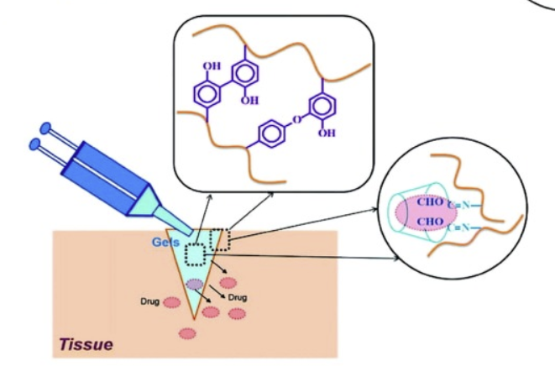
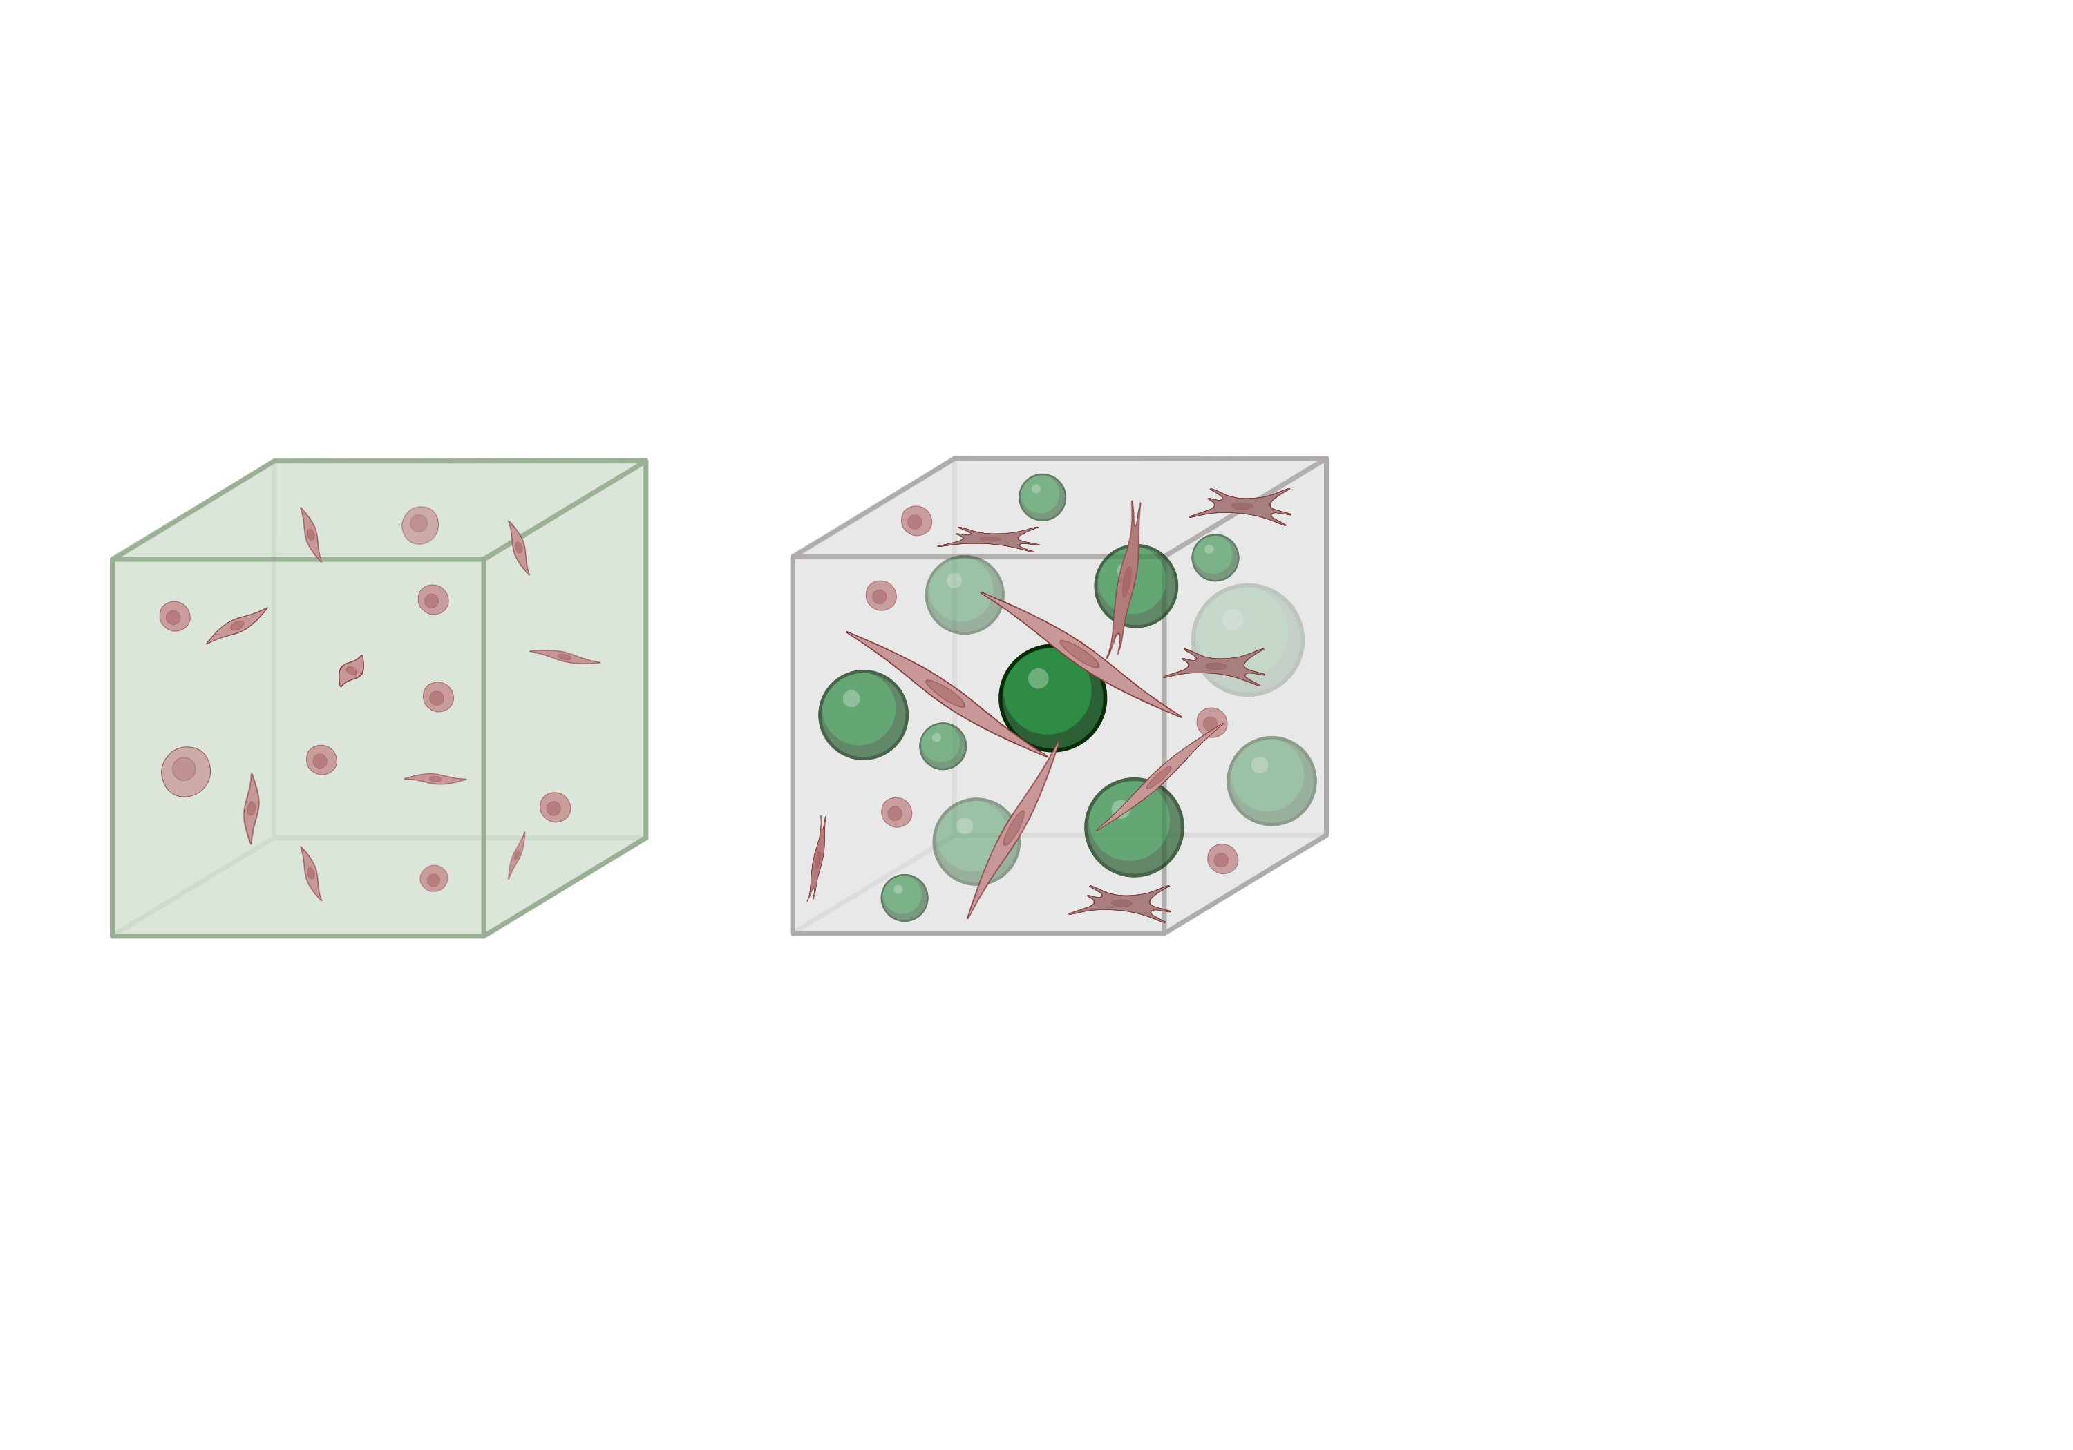
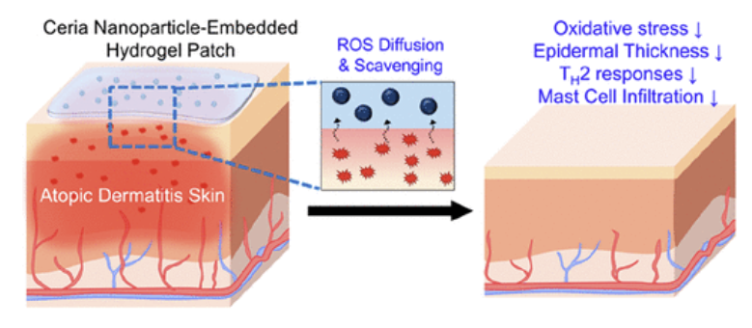
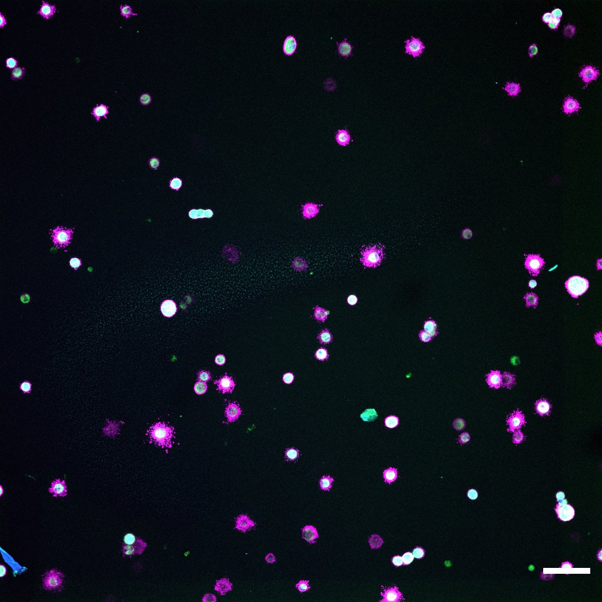
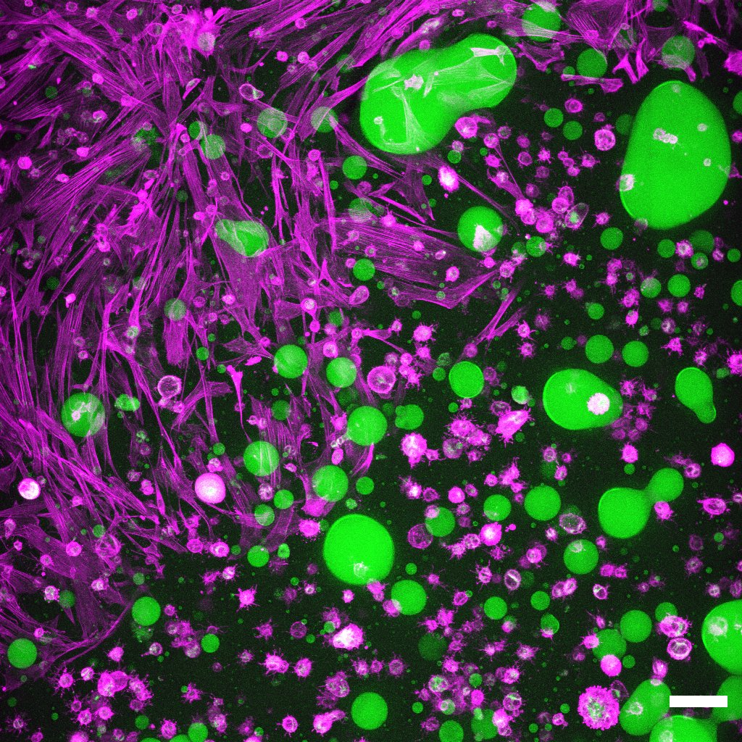
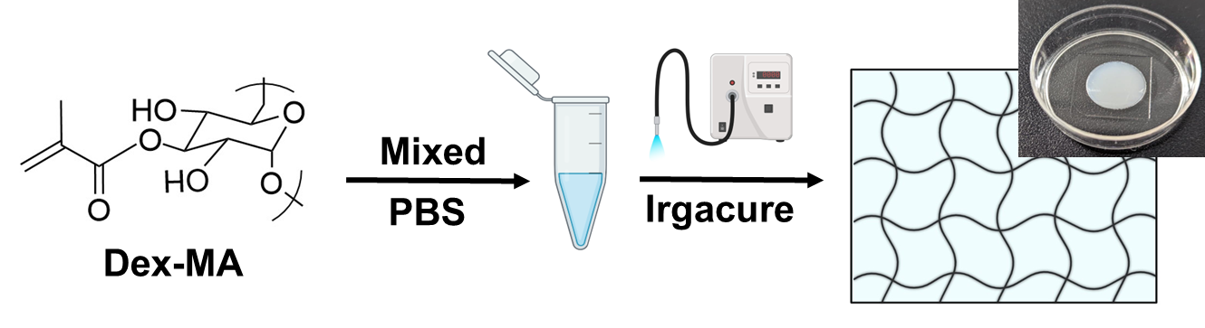
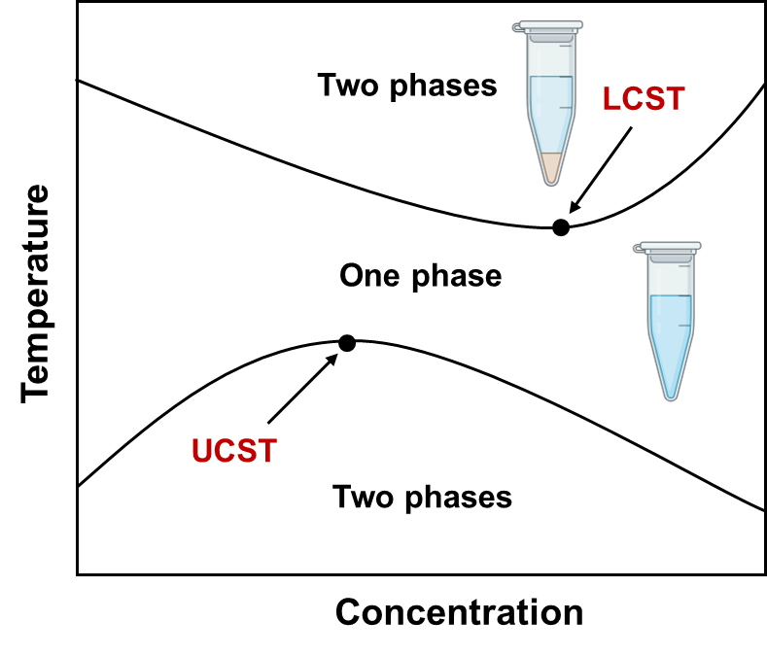
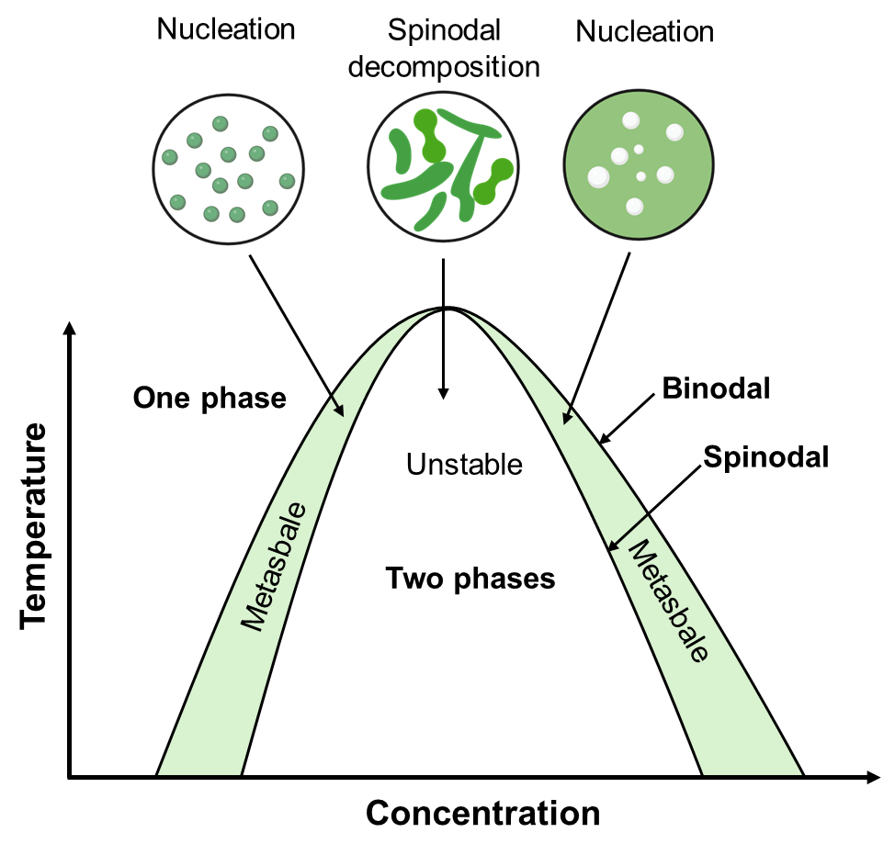
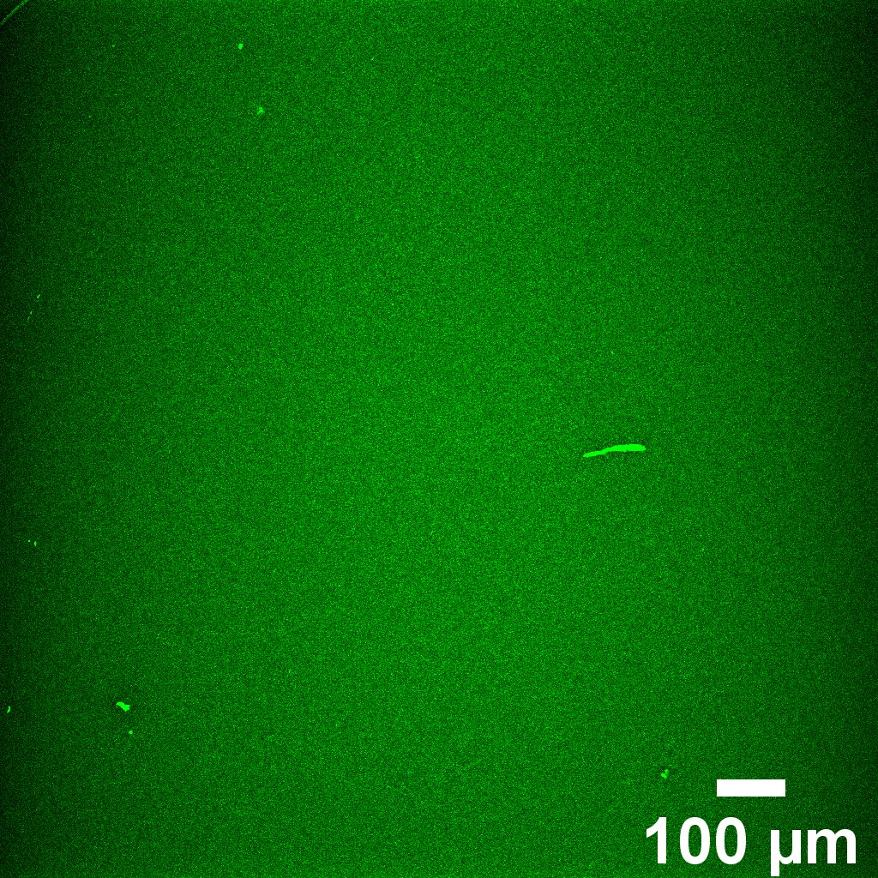
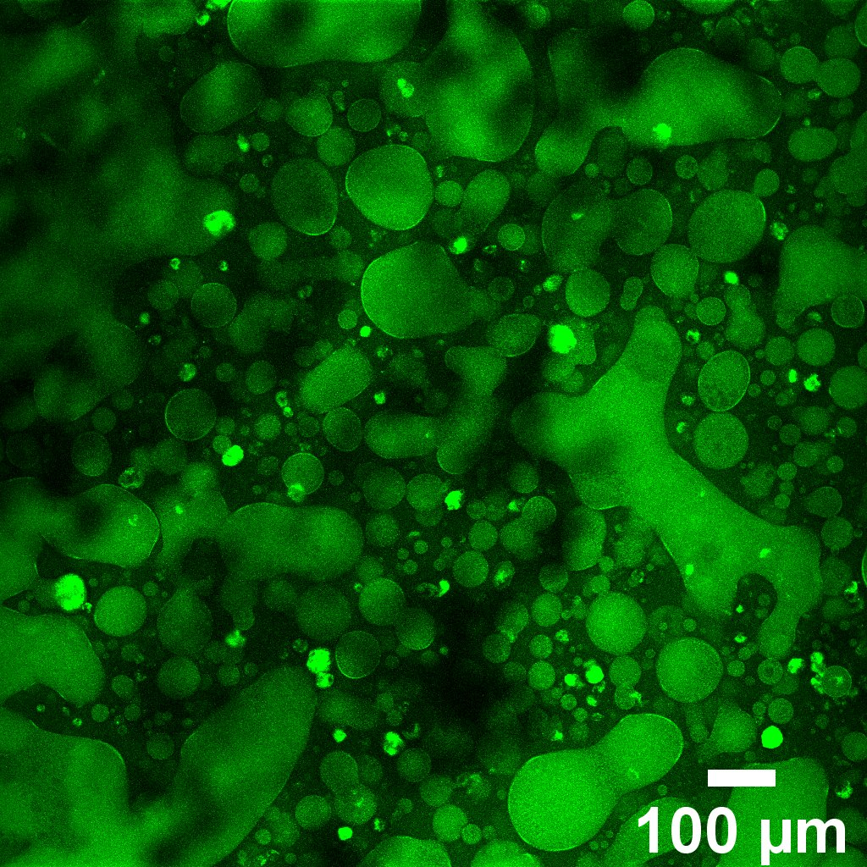
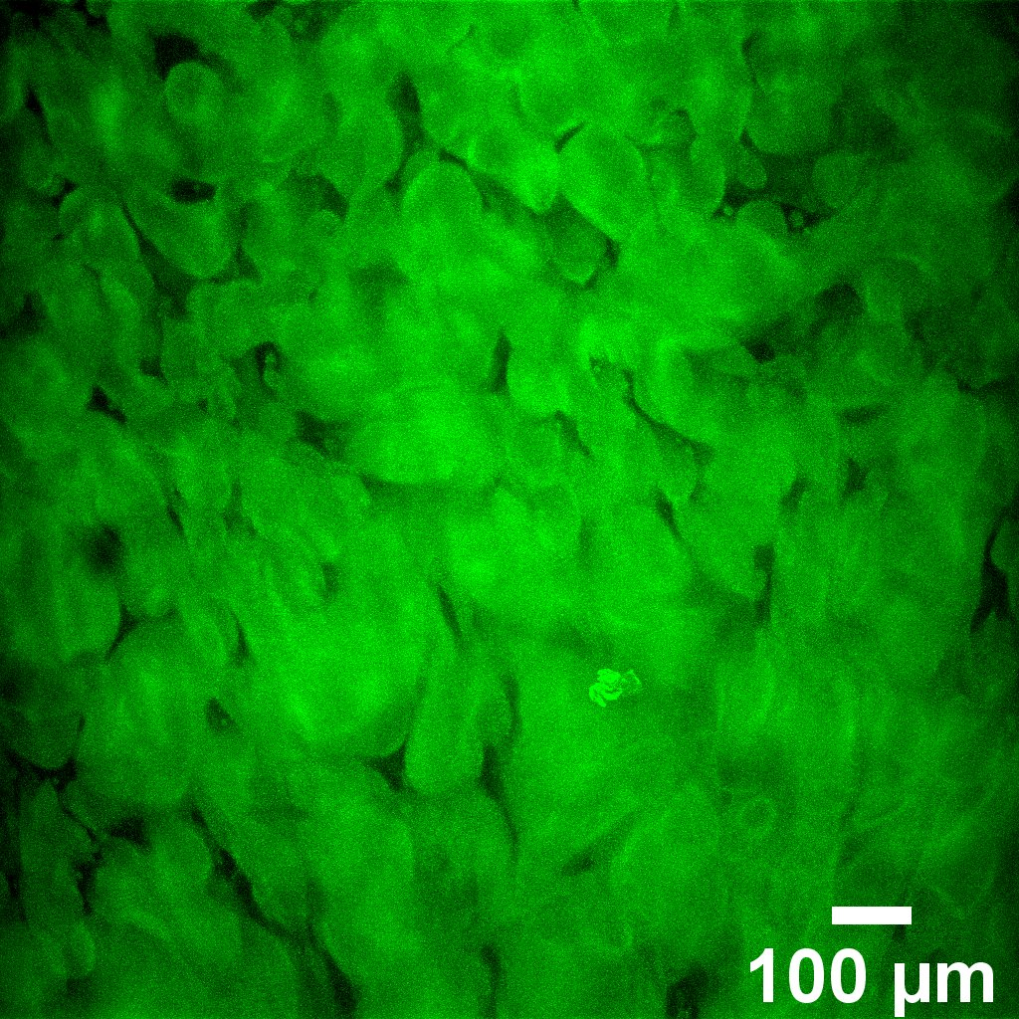
Leveraging Phase Separation to Engineer Microstructures and Cell Encapsulation in Biomaterials
Evan Kennedy, Saniya Yesmin Bubli, and Linqing Li*
Department of Chemical Engineering and Bioengineering, University of New Hampshire, Durham, NH, USA
* Linqing.Li@unh.edu
1. Introduction
3. Addition of Hydrophobic Modifications Allows for Phase Transition
5. Hydrogel Microstructures Regulate the Rate of Drug Release
A fluid containing hydrophilic and hydrophobic parts may phase separate, resulting in the aggregation of hydrophobic-rich regions.
Polymer solutions are photo-crosslinked into non-phase-separated and phase-separated hydrogels containing well-defined microdomains.
Cargo can be encapsulated into hydrogels if introduced to the precursor solution at the time of phase separation.
Hydrogel crosslinks disassociate over time, degrading the hydrogel structure. Controlling the degradation rate allows for a controlled, continuous release of encapsulated cargo.
By dictating synthesis parameters, dextran-based polysaccharide hydrogels can be generated with controlled morphologies.
Morphological control is useful in materials and biomimicry, and cargo delivery and uptake is useful for drug administration or toxin removal.
Synthesis of dextran methacrylate (DexMA)
Non-phase-separated
Dextran is an uncharged hydrophilic homopolysaccharide and FDA-approved material.
The hydrophilic backbone can be modified with hydrophobic residues (methacrylate) to induce phase separation.
Phase-separated
Absorbance graphs illustrating the reversibility and concentration dependance of the phase transition of DexMA-PBS solutions³
Methacrylate Drug Merged
Autofluorescence Autofluorescence
Drugs are encapsulated as the gel phase separates and crosslinks, and are released as the gel degrades
Release rate dependent on gel’s crosslinking density and microstructures
6. Hydrogel Microstructures Regulate Cellular Behavior in 3D
Hydrogel injection for Drug Delivery¹
Hydrogel Patch for Selective Absorption²
Human dermal fibroblast cells in hydrogel matrix
Microstructures provide a scaffold for cells to migrate across
Lack of microstructure results in lack of cell migration
Excessively dense microstructures trap cells in place, also inhibiting migration
“Goldilocks” microstructures provide cell attachment points
4. Photocrosslinked Microstructured Hydrogels with Distinct Morphology
Non-phase-separated
Phase-separated
Hydrogel Synthesis Procedure³
Phalloidin;
Phase-separated domains
2. Phase Separation in Macromolecules
7. Conclusions
Phase Diagrams of Polymer Solutions³
 | Gel 1 | Gel 2 | Gel 3
Precursor Solution: | Non Phase Separated | Phase Separated | Phase Separated at high concentration
Morphology | No Structure | Droplets | Continuous Phase
Auto-fluorescence Gel Image
Hydrogel microstructures can be tuned by controlling polymer concentration and solution temperature
Hydrogel microstructure morphology affects the ability of cells to migrate and proliferate and the release rate of drugs
Future plans involve varying crosslinking density to control drug release; using rheological testing to quantify gel stiffness as a function of multiple parameters; and designing multi-functional hydrogels.
Acknowledgement
NH BioMade IIA 1757371 and EPS-1101245
CIBBR (P20GM113131) at NIH
UNH CHBE Department
Dr. Linqing Li’s Lab, UNH
UNH Core facility and Instrumentation Center
Solutions exhibit phase separation according to a “transition temperature”
At the transition temperature, nucleation occurs, leading to the formation of a new phase
Factors that affect the transition temperature include solute concentration, the presence of surfactants, and more.
This phase transition is reversible
References
Hydrogels were crosslinked via UV-initiated radical polymerization.
As the degree of the solution’s polymer aggregation increases, the resultant microstructure proceeds from no structure to condensed spherical domains to continuous phase
No defined structures in non-phase-separated gels.
1. Narayanaswamy R, Torchilin VP. Hydrogels and Their Applications in Targeted Drug Delivery. Molecules. 2019 Feb 8;24(3):603. doi: 10.3390/molecules24030603. PMID: 30744011; PMCID: PMC6384686.
2. Ye Eun Kim, Seung Woo Choi, Min Kyung Kim, Thanh Loc Nguyen, and Jaeyun Kim
Nano Letters 2022 22 (5), 2038-2047
DOI: 10.1021/acs.nanolett.1c04899
3. Bubli, S. Y. et al. Inducing an LCST in hydrophilic polysaccharides via engineered macromolecular hydrophobicity. Sci. Rep. 13, 14896 (2023).
Notes:
SEM – 20 um
Toxicity- 100 um
Gel- 100 um
Gel with cells- 50 um, 2D

