Slide 1
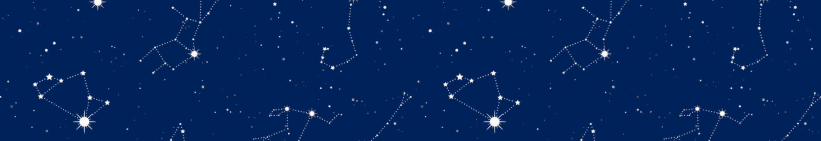

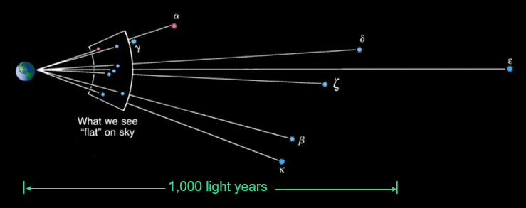
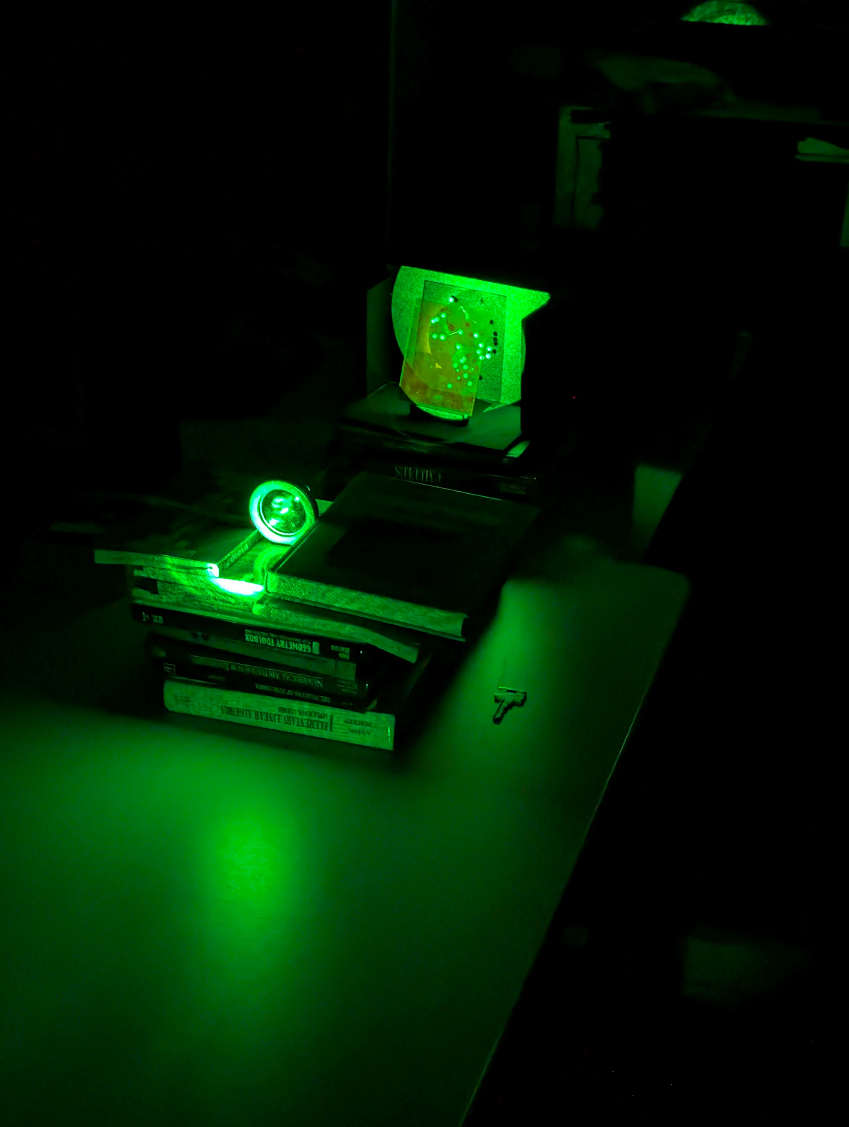
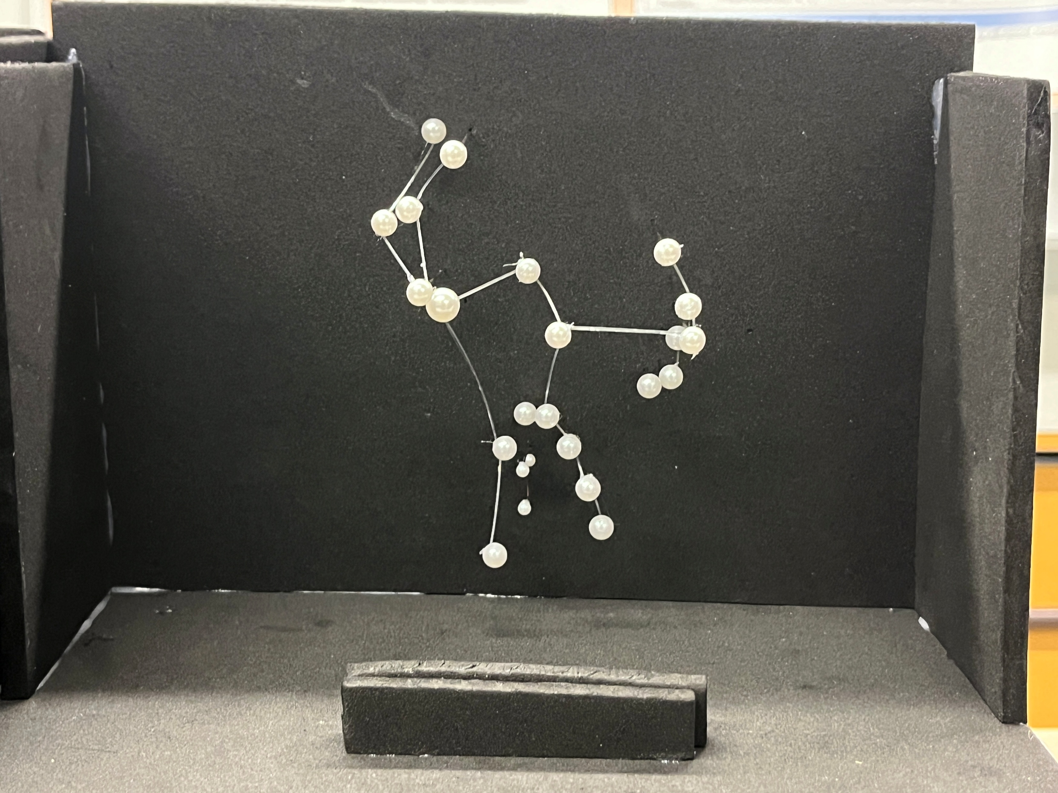
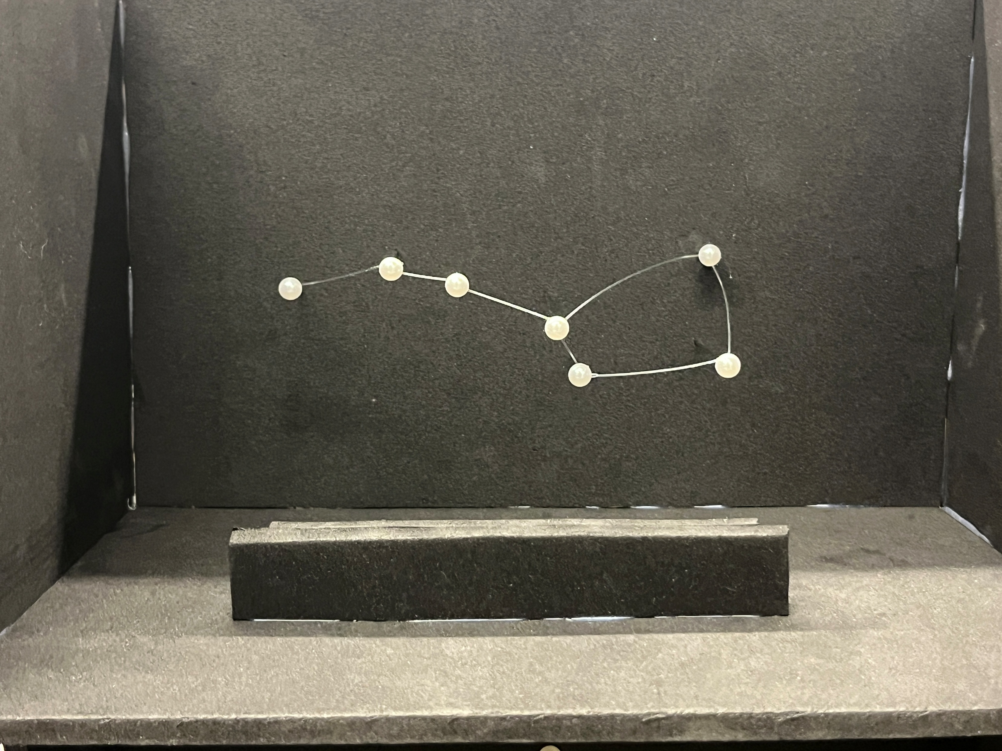
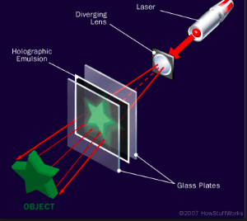
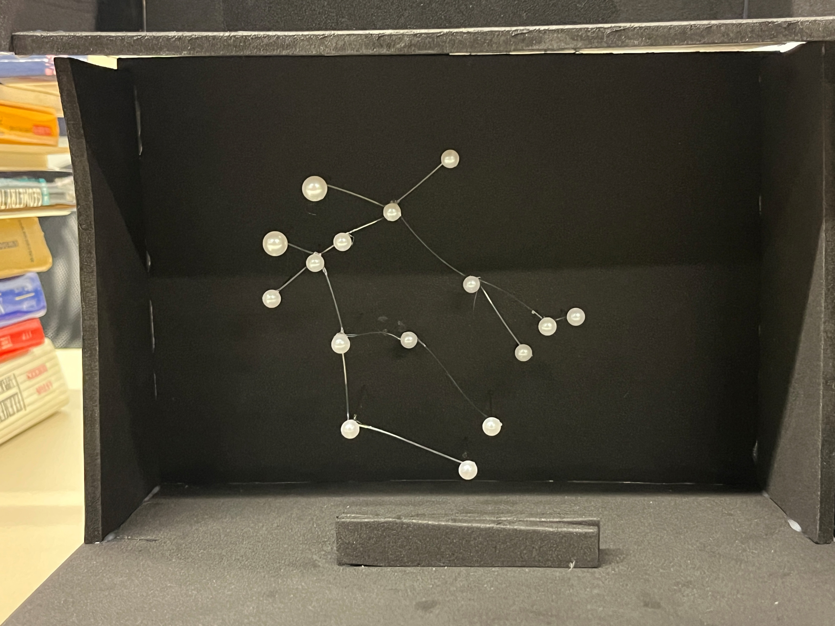
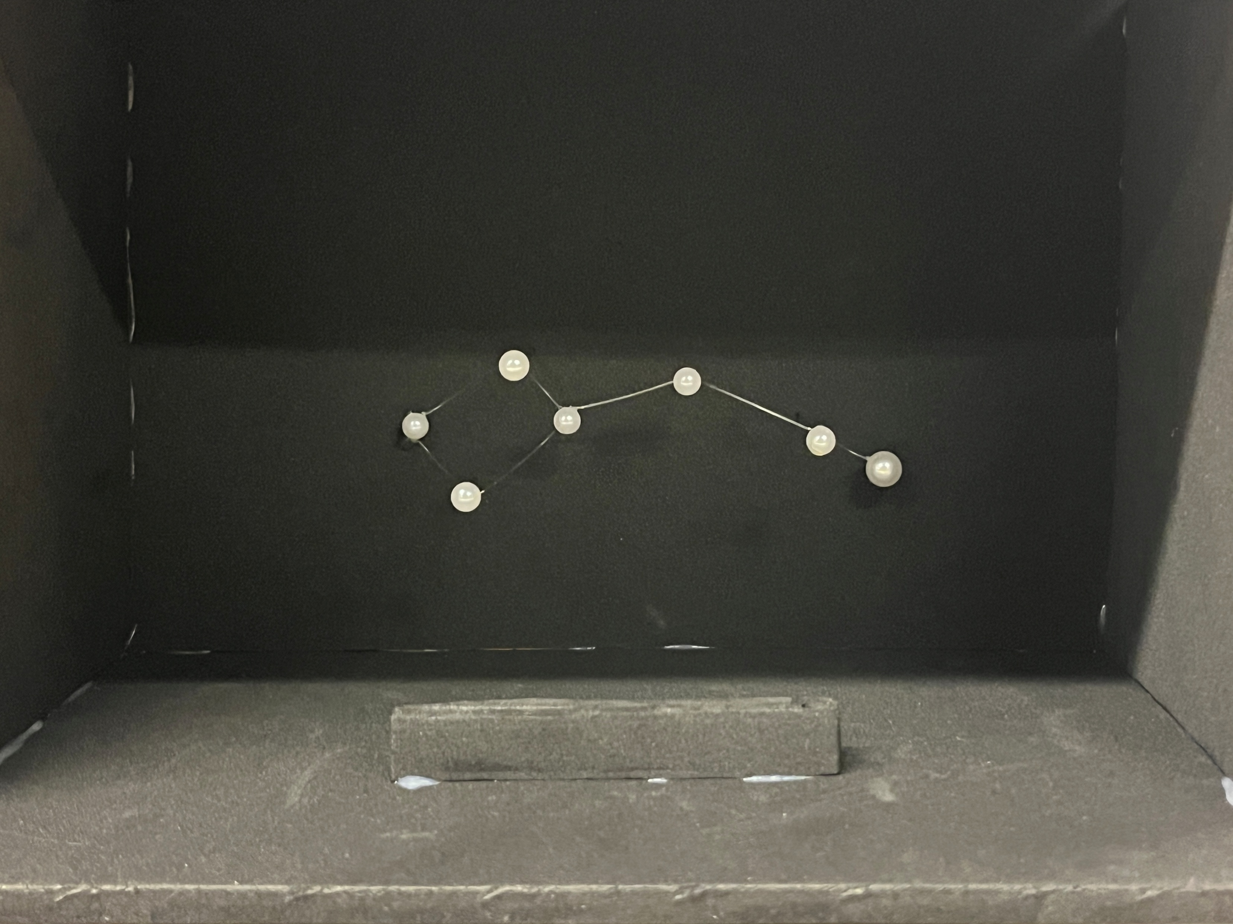

Holographic Visualization of Astronomical Structures
Matthew Anderson & Ryad Ouhhabi
Innovation Scholars, Patterns and Symmetry
Purpose
Results
Methodology
Problem
We were unable to make holograms in time due to equipment error. The main OSRAM PL-530 laser suffered heat damage while in use, the backup 5mW red laser diode failed to work for unknown reasons, and the backup 1mW laser also failed due to unknown reasons. Finally, we used a 5mW green laser but it did not have the necessary properties to create the hologram and failed. New lasers were reordered online, however due to the long shipment time they didn't arrive in time for another attempt at creating the holograms.
Models for Holography
Most people do not consider the fact that constellations are 3D structures, or they assume the stars are in roughly the same 2D plane. That is due to these objects often being depicted as such, when viewed on paper or on screen.
In reality, constellations do not lack depth, but the case is that the stars that form them can be nowhere close to being on the same plain, of course, when viewed from Earth that information is lost, which is why there is need for a visual aid that captures the “3D-ness” of constellations.
To produce accurate maps, we used astronomical data about the distance and luminosity of the stars, we then used a scale to convert it to something that can be modelled.
For close-by stars we used this formula to combine their brightness.
$$m_{f}=−2.5\log_{10}\left({10}^{−0.4m_{1}}+{10}^{−0.4m_{2}}\right)$$
The models were made using dark foam to reduce glare, with pins as stars, and clear fishing line between the pins to represent the common shapes seen in the constellations.
Solution
Creating Holograms
Holograms are excellent tools for compressing 3D information into a 2D plane. That occurs ,through the use of interference patterns on a holographic plate, which essentially encode the view of the object from each angle.
Therefore, holography is a perfect visual and educational representation of what constellations truly are; 3D structures that look 2D.
Applications
Holograms require a laser, holographic plates, and the object that will be imprinted. The laser that was used was an OSRAM PL-530 which is a green laser that requires 2.2V of power. Wires had to be soldered onto the laser to use alligator clips to deliver power using a variable DC power supply.
We used self-developing plates from LitiHolo, to lower costs, save time, and be flexible with laser color since they are sensitive to the full visible light spectrum.
These holograms serve as a novel physical educational aid, that helps children and adults alike to envision the depth of the universe that surrounds them, looking straight at them will mimic the shape of the night sky, but physically turning them or looking at an angle produces an exact view of what they’d look like from the side, it will even trick your eyes into a sensation of depth that can’t be replicated on a screen.
These holograms will be presented in the New England Fall Astronomy Festival, to help children and adults learn about the structure of the night sky.
References:
https://www.youtube.com/watch?v=EmKQsSDlaa4
https://www.geola.com/online-exposure-calculator/
https://www.directed-energy.net/laser/pl530.html
https://www.litiholo.com/hologram-film.html
https://en.wikipedia.org/wiki/List_of_stars_in_Orion
https://en.wikipedia.org/wiki/Sagittarius_(constellation)
https://en.wikipedia.org/wiki/Ursa_Major
https://en.wikipedia.org/wiki/Ursa_Minor
https://en.wikipedia.org/wiki/Gemini_(constellation)

