Slide 1
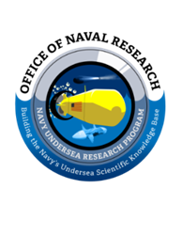

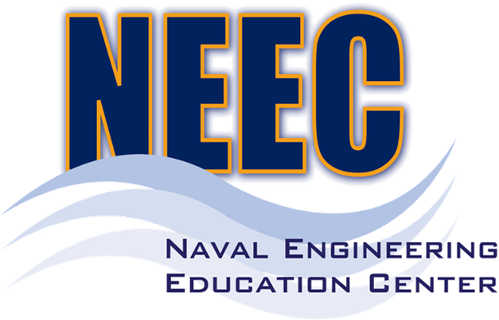
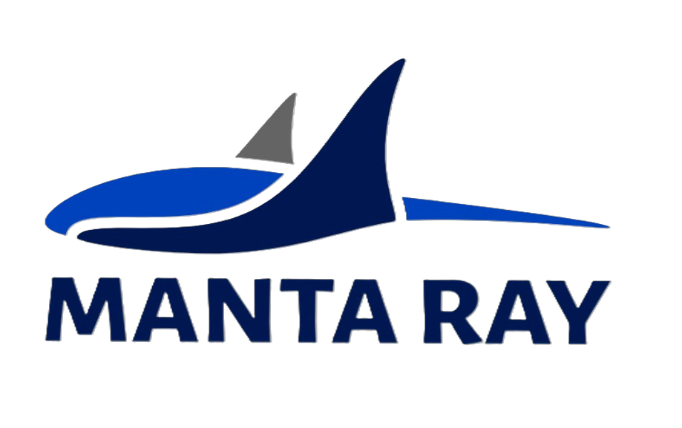
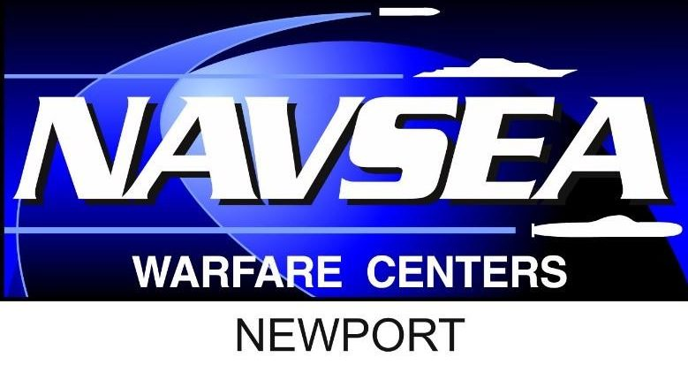

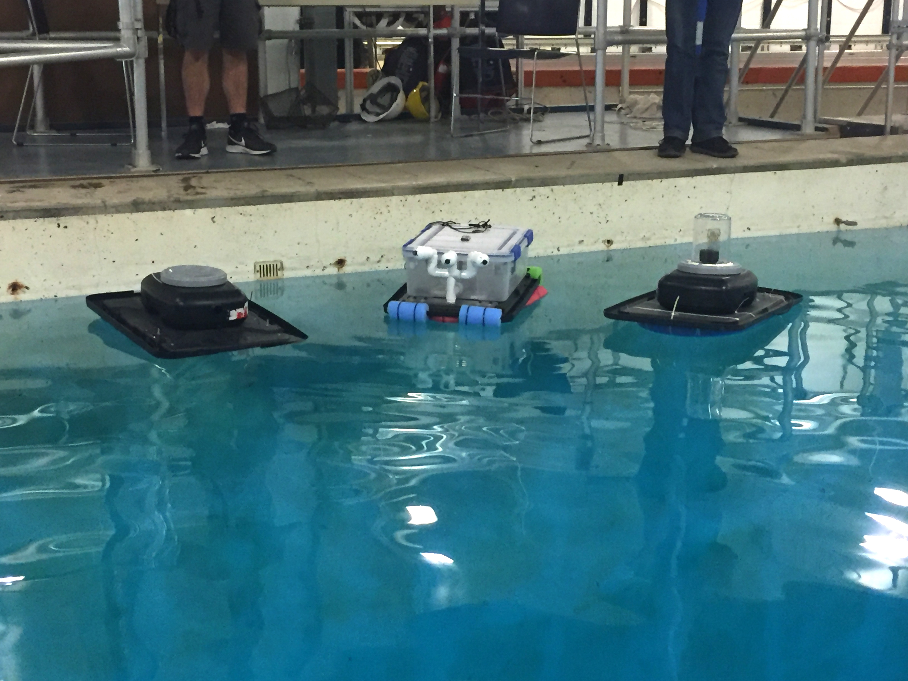
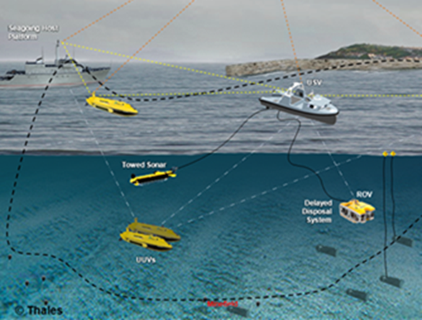
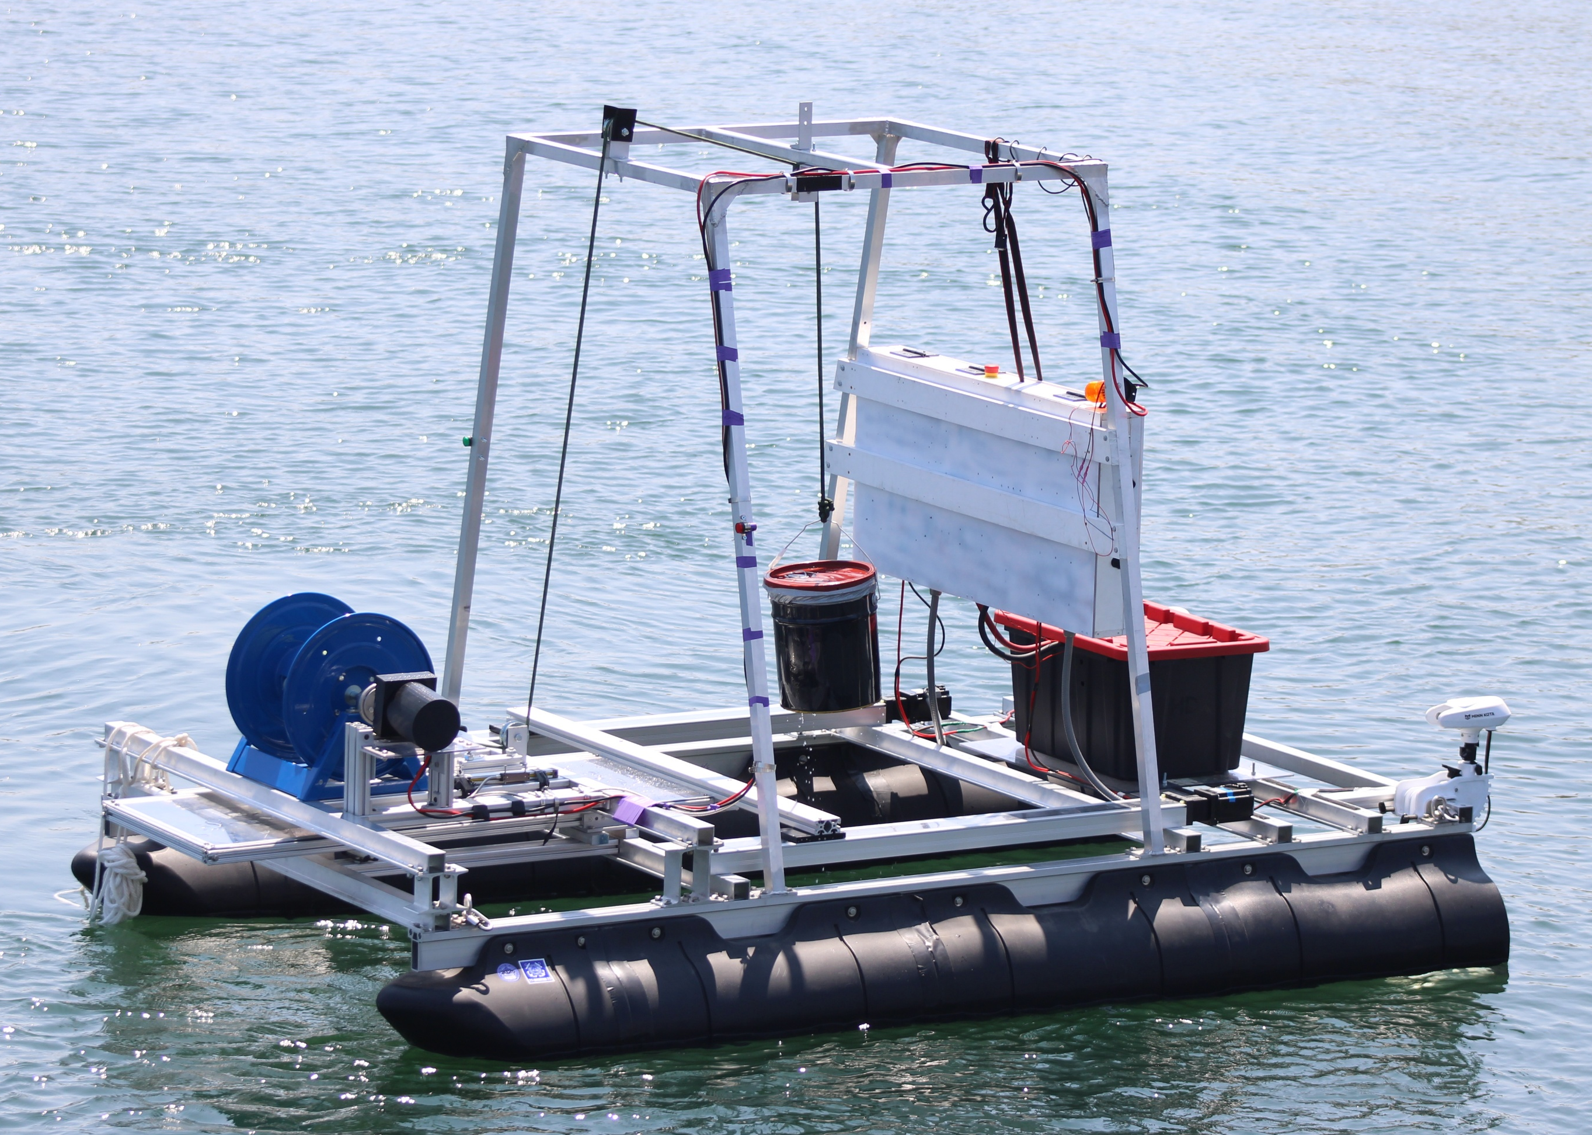
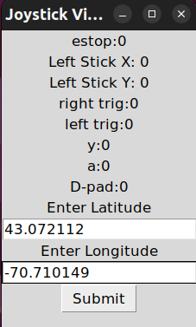
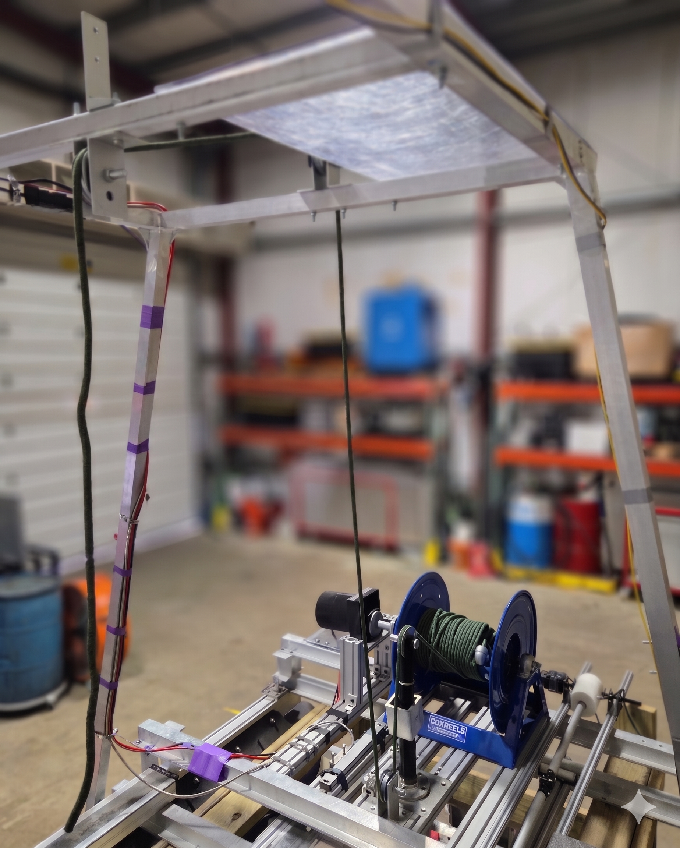
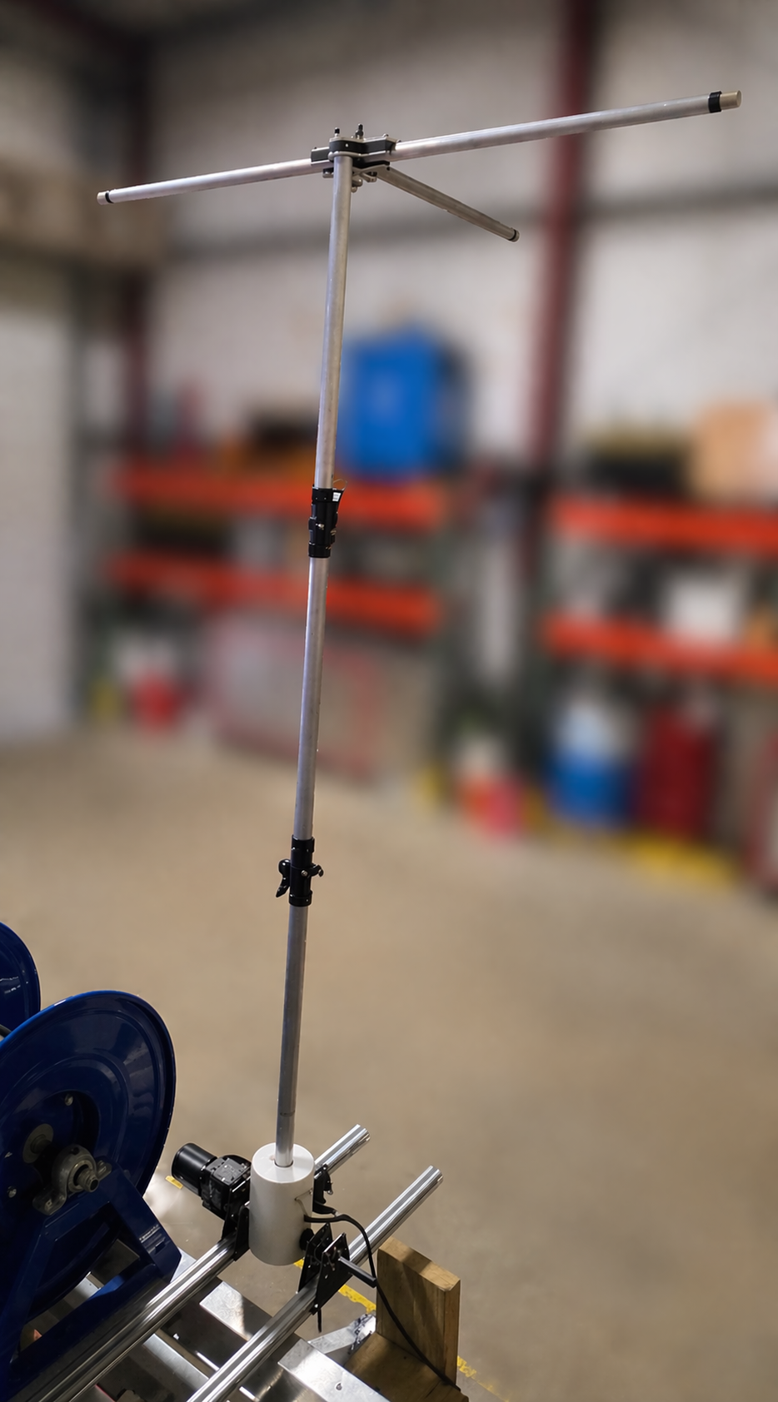
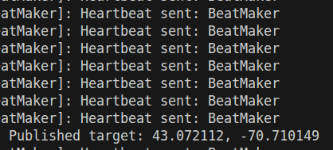
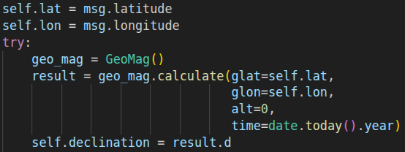
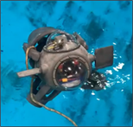

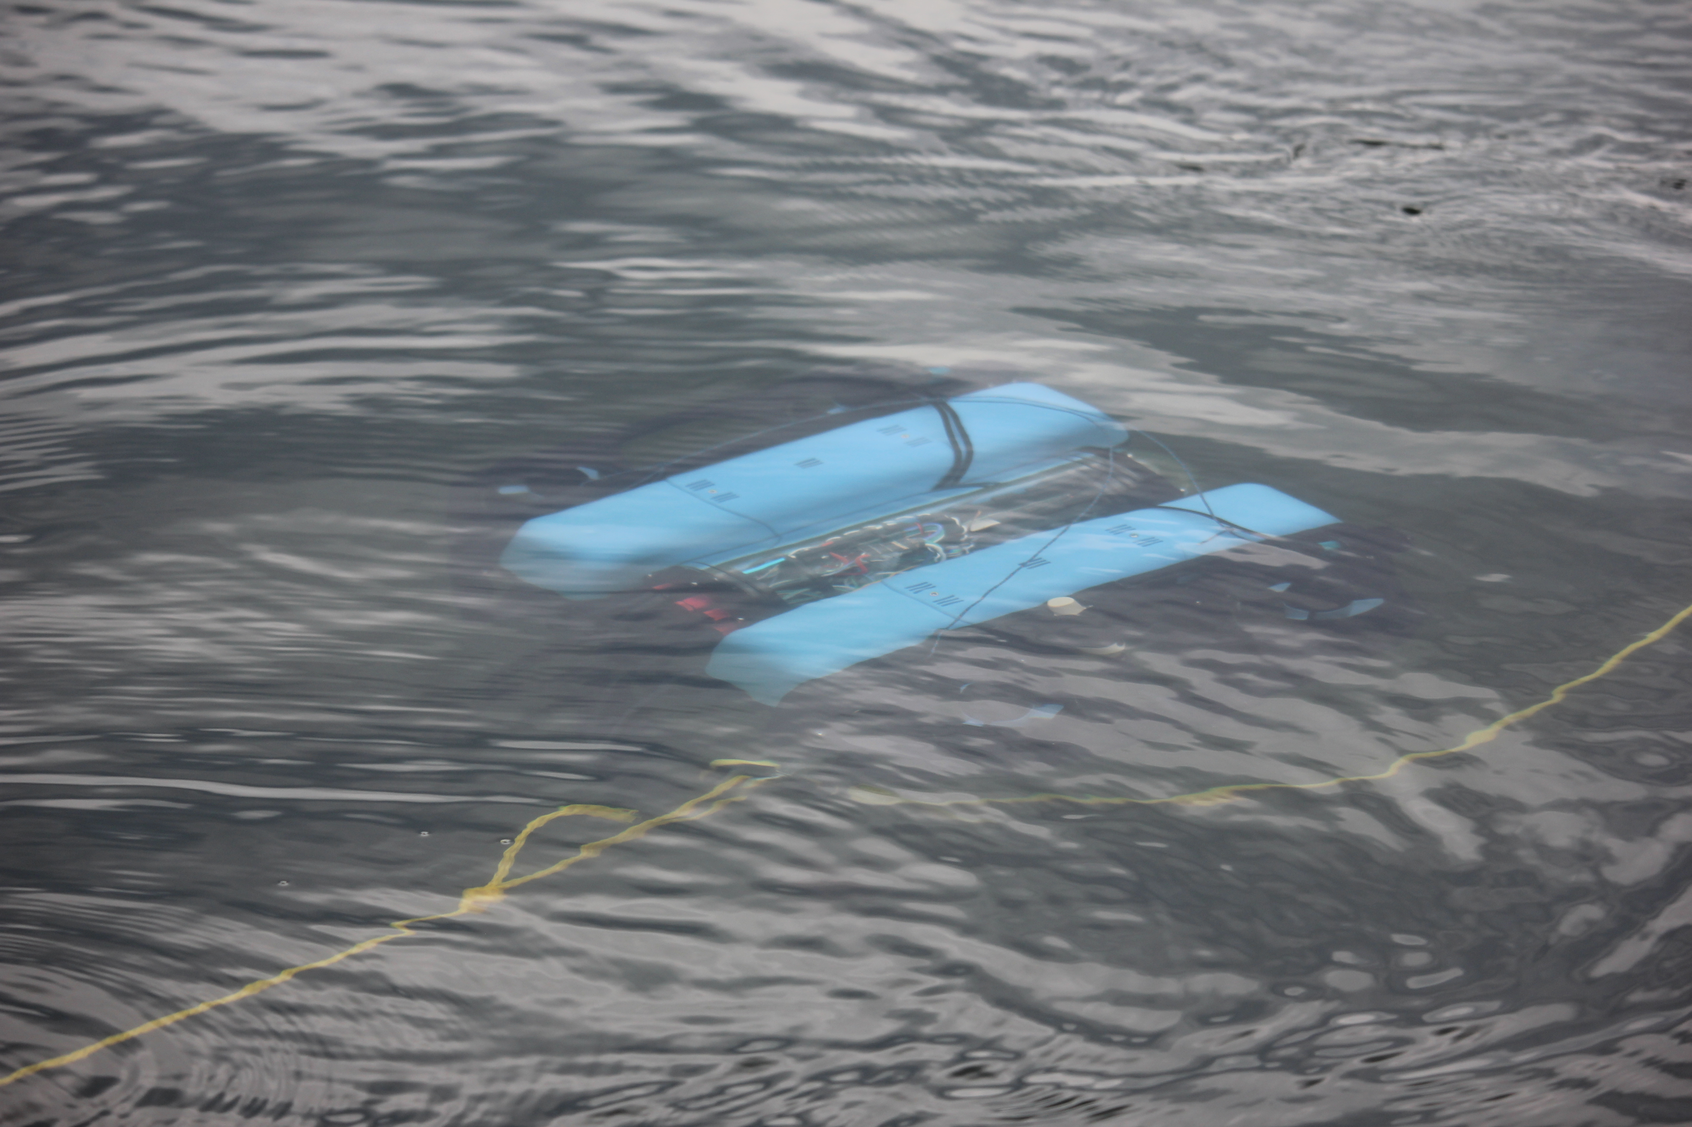
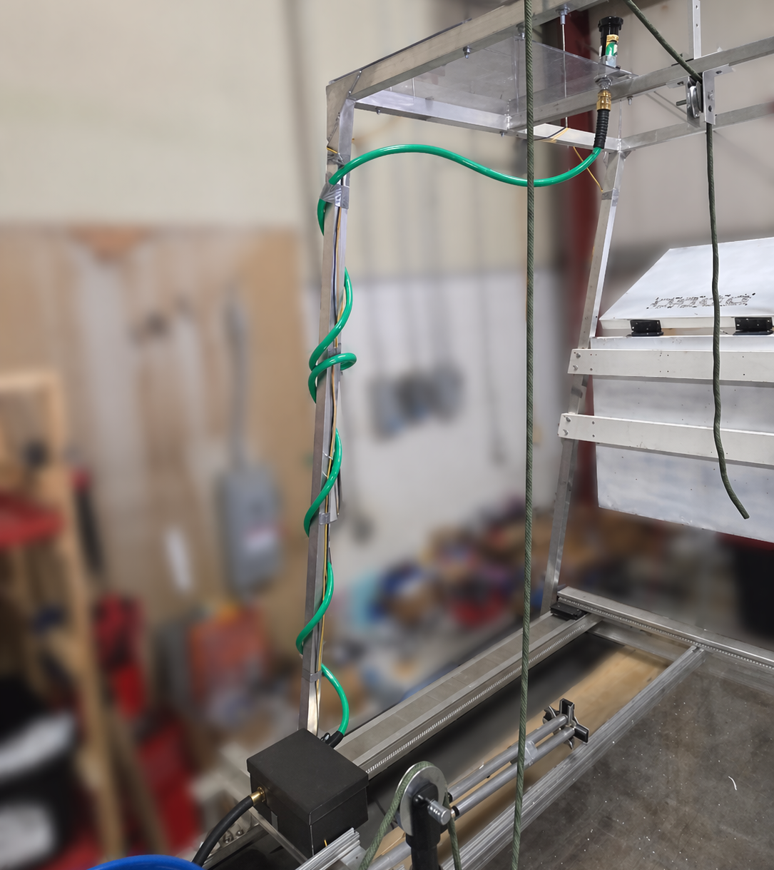
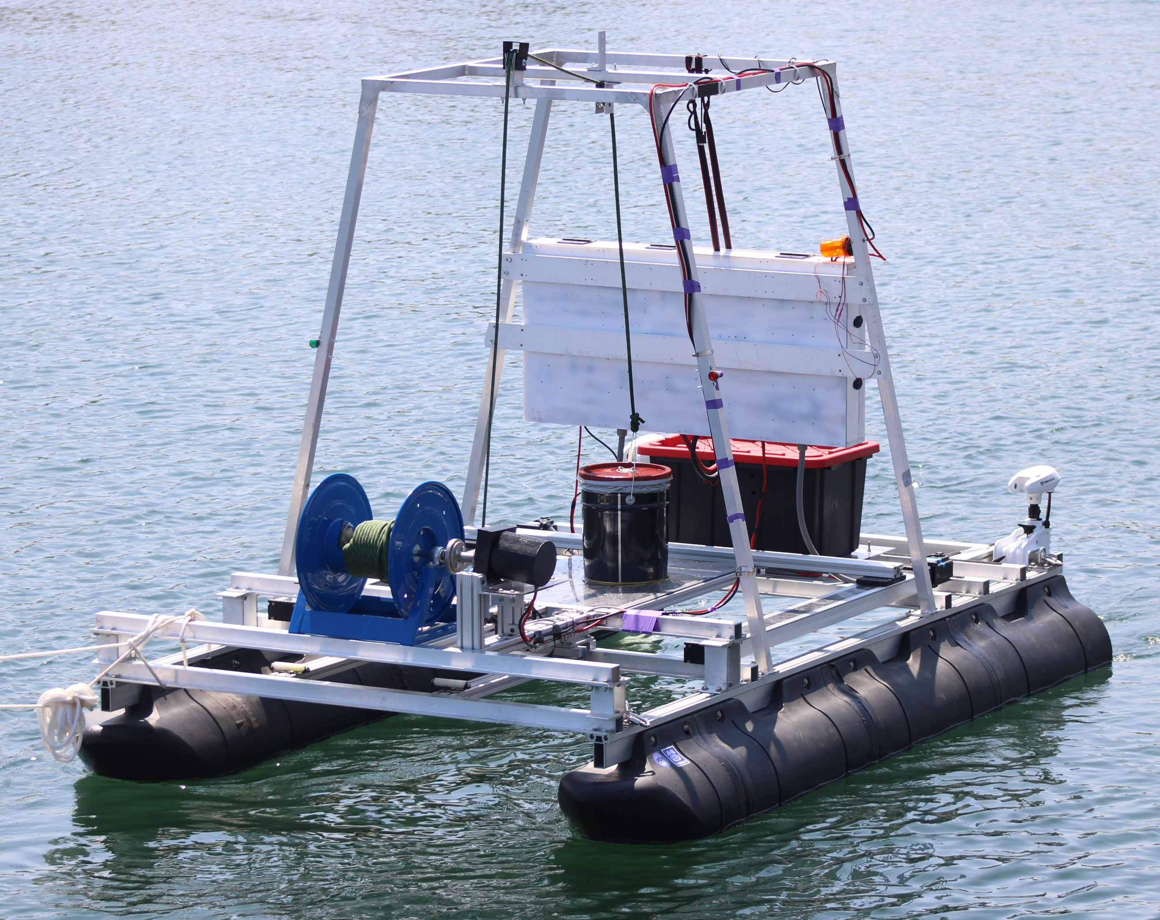
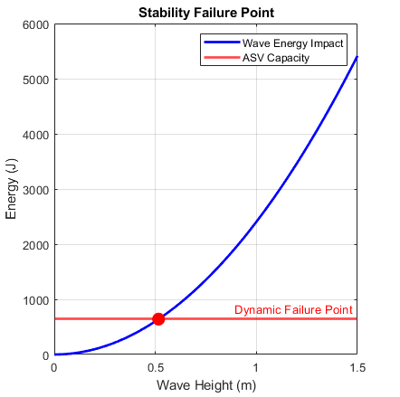
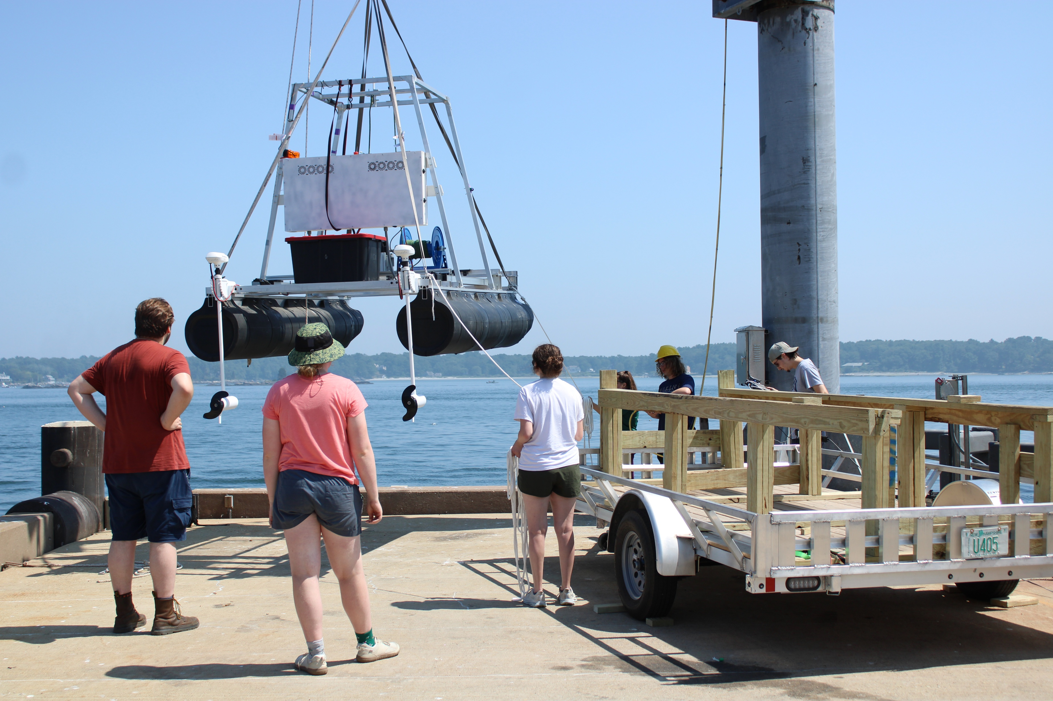
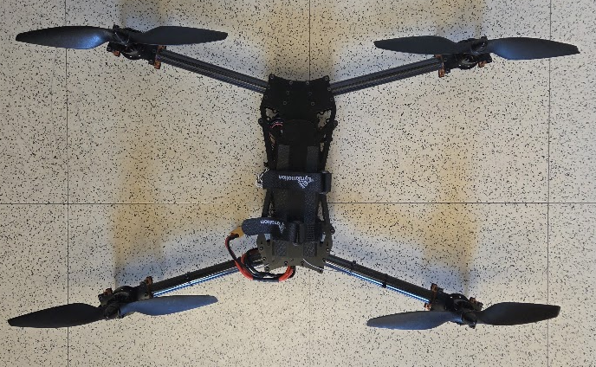
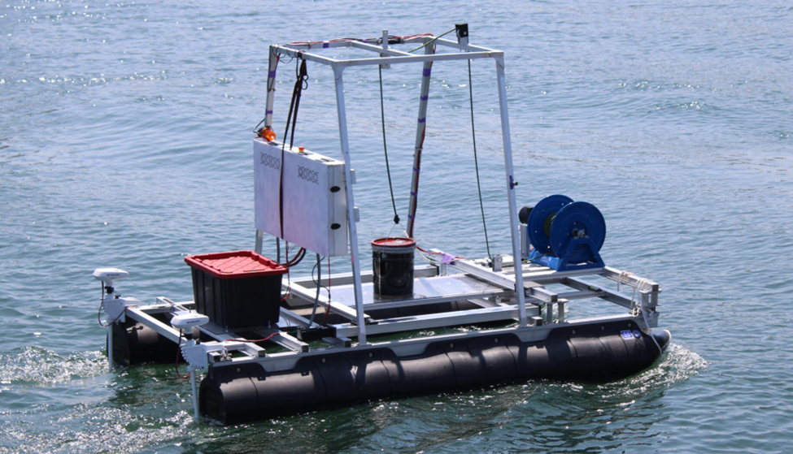
MANTA RAY - Marine and Naval Technological Advancements for Robotic Autonomy
Operational Robot for Control and Autonomy (ORCA)
Project Advisors: Dr. May-Win Thein, Dr. Yuri Rzhanov
Graduate Advisors: Hannah Arnholt, Derrek Perham, Daniel Lavoie
Engineering Team Members: Josie Crotty, David Denslow, Pedro Doukas and Victor Kapostas
Computer Science Team Members: Nicholas Pratte, Haley Stewart
Team MANTA RAY Mission
Subsystems
Autonomous Control
Team MANTA RAY is an interdisciplinary marine robotics project focused on seafloor mapping and underwater perception. As shown in Figure 1, the project emphasizes inter-vehicle communication, autonomous behavior, and mechanical system improvements to increase precision and performance.
Tether Tensioning System (TTS)
Underwater GPS (UGPS) Deployment
Unmanned Ariel Vehicle (UAV) Defense System
All data (GPS position, sensor data, operating modes, etc.) published through Robot Operating System (ROS) topics.
Onboard Raspberry Pi sends commands over ROS to the Arduino microcontroller.
Arduino controls subsystems based on the ROS commands received from the Pi
Navigates ORCA to user specified GPS waypoint.
Opens moonpool door and deploys UUV upon arrival at destination.
The tether tensioning system maintains 5–20 lbs of tension between the UUV and ASV. A linear encoder measures tether tension, while a winch adjusts length to maintain it. The system can be tuned to different tension ranges by changing a linear spring.
The UGPS uses acoustic nodes to triangulate the underwater 3-DOF UUV position and provides real-time tracking data to the shore station. Deployment is achieved by rotating the arm 180° into the water.
A rooftop landing platform is equipped with a UAV defense system to deter unauthorized landings. The system uses an automated sprinkler, powered by a pump that draws water from beneath the hull and distributes it across the platform. Approaching UAVs must pass an encrypted password authorization check; if incorrect, the sprinkler activates, providing a simple, non-destructive deterrent while still allowing authorized UAV operations.
TUPPS
ASV
KRILL
GUPPS
UUV
Figure 1: MANTARAY Mission
Figure 10 and 11: User Interface & Backend
Figure 12: Declination Logic
ORCA Mission
Integrates RTK GPS (provides real-time ORCA latitude and longitude) and BNO055 IMU (orientation of ORCA with respect to magnetic North).
Applies magnetic declination correction to IMU to ensure consistency among data collected by the GPS and IMU.
Computes distance from ORCA starting point to target waypoint using Euclidean distance formula.
Commands ORCA to travel in direction of waypoint for a time period estimated using ORCA's average speed.
The ORCA mission for the 2025–26 academic year is to further develop an autonomous surface vehicle (ASV) capable of operating in sea state 1. It will deploy, localize, and recover MANTA RAY uncrewed underwater vehicles (UUVs), support a paired uncrewed aerial vehicle (UAV) with a Friend or Foe (FoF) defense system, and act as a communication relay between all vehicles and the shore station.
Figure 4: TTS Assembly
Figure 5: ORCA UGPS System
Power and Propulsion
Moon Pool Bay Door
Twin trolling motors on the rear of ASV2 are powered by a 24V 230ah LiFePO4 battery and secured with collars to reduce flexing. LiPo batteries are used to power the additional subsystems and their corresponding motors.
  A linearly retractable Moon Pool bay door, driven by two 1400 mm ball-screw actuators, supports UUV deployment. It stays closed during transport for support and opens once the TTS lifts the UUV for deployment.
Future Works
Design & Construction
Integrate a motion-detecting camera to distinguish UAVs from non-threat objects before authentication.
Integrate RF fingerprinting with a machine learning classifier to analyze transponder signal characteristics and identify known UAV signatures.
Implement collision detection and adjustment using OpenCV.
Leverage linear encoder to create autonomous tethering functionality, actively monitoring tension on the tether.
Implement anti-tangling spooling mechanism for the tether tensioning system.
Create wireless remote deployment software to facilitate on-site testing.
Design Requirements:
Figure 6: ORCA UAV Defense System and ORCA UAV
Support payload UUVs up to 40" × 36" × 42" and 150 lbs.
Maintain center of buoyancy to prevent tipping or rocking.
Achieve propulsion speed of 3 knots.
Autonomously deploy and retract payload UUV.
Support onboard underwater localization system deployment.
Modular design to support current and future MANTA RAY UUVs.
Provide a defensible UAV landing platform.
Buoyancy and Testing Data
Buoyancy Calculations
Open Water Testing
Stability and buoyancy analyzed using MATLAB model and Excel-based mass distribution
Verification that total system weight within 500 kg limit
Determination of center of gravity
Calculation of roll moment of inertia
Use of pontoon geometry to compute:
Open water testing of ORCA was conducted at UNH Judd Gregg. Results showed a top speed of 2.7 knots and stable operation in waves up to an estimated 1.5 ft.
Conclusion
Figure 2: ORCA Design 2026
The ORCA Team’s main goal this year was to establish the foundation for full autonomy, supporting MANTA RAY’s broader aim of improving cohesion, reliability, and user experience in marine research. While further development is still needed, progress over the past two semesters demonstrates the project’s potential.
Mechanical Specifications:
Twin pontoon catamaran style body 15’ x 6’.
Welded aluminum superstructure to support UUV and elevate electronics above the waterline.
Center moon pool for UUV clearance.
Winch motors rated 2000lbs.
TTS winch motor assembly made from Aluminum and modular sliders.
    Draft
  Static list and trim
  Natural roll period
Comparison of incoming wave energy to system restoring energy capacity
Determination of critical wave height leading to capsize
Ensures deployment conditions that maintain stability and prevent structural or operational failure
Acknowledgements
Figure 7: Failure Point
This work was funded in part by New Hampshire Sea Grant's Workforce Development Project E/WFD-2, pursuant to National Oceanic and Atmospheric Administration Award No. NA22OAR4170124. This work was also funded by NUWC Keyport NEEC (Grant N00174-20-1-0006) and NURP Sponsors (Grant N0014- 23-1-2451)
Special thanks to Dr. Martin Renken, Eric Seeley, and Sam De Lano from NUWC Keyport. Dr. Chris Hixenbaugh, Jack Groeneveld-Meijer, Dr. Kaelyn Gamel and Dr. Elizabeth Magliuli from NUWC Newport. Dr. Tom Lippmann, Karin Whiting, and Maddie Dwyer for their support at the Chase Ocean Engineering building, and use of its facilities.
We would like to thank the Olson Center and CEPS Makerspace for their manufacturing support.
Buoyancy Results
Draft: 0.2m
List: 0.02 deg
Trim: 0.08 deg
Failure Angle: 12.79 deg
Failure Wave: 0.52m
Figure 3: ORCA’s UAV
Figures 8 and 9 : Water testing

