Slide 1


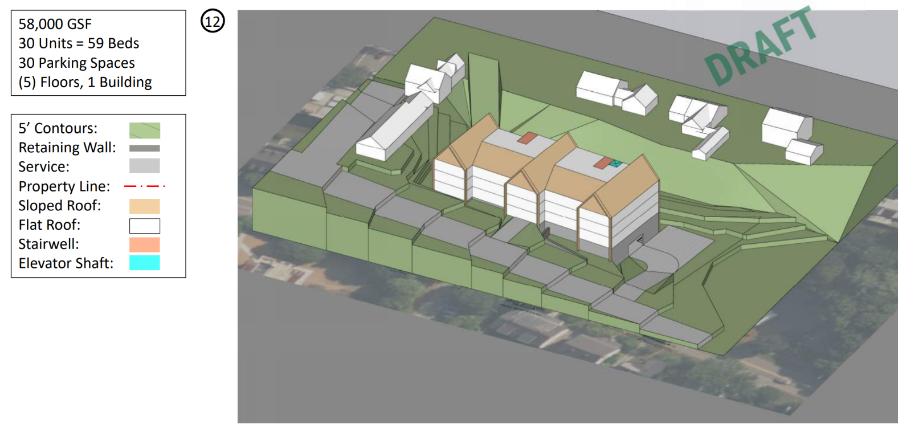
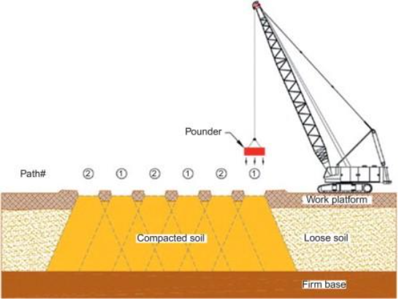
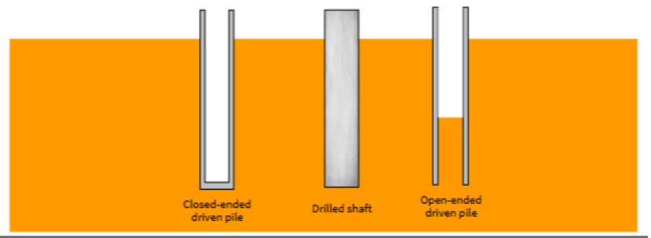
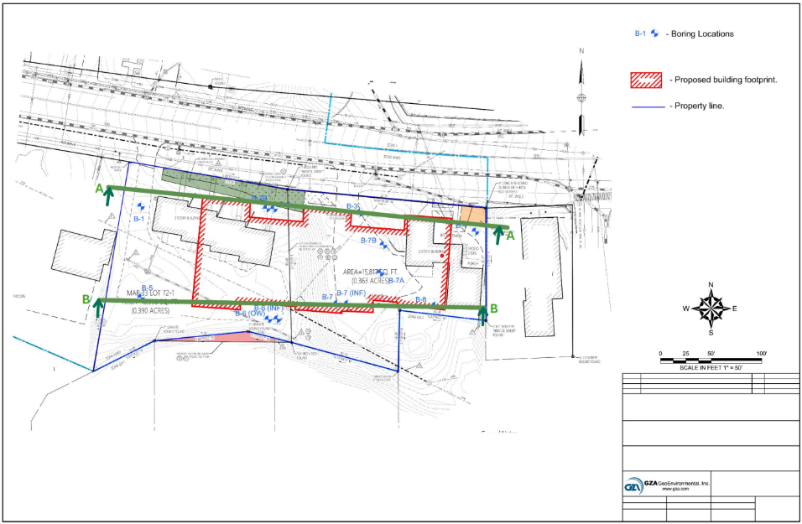
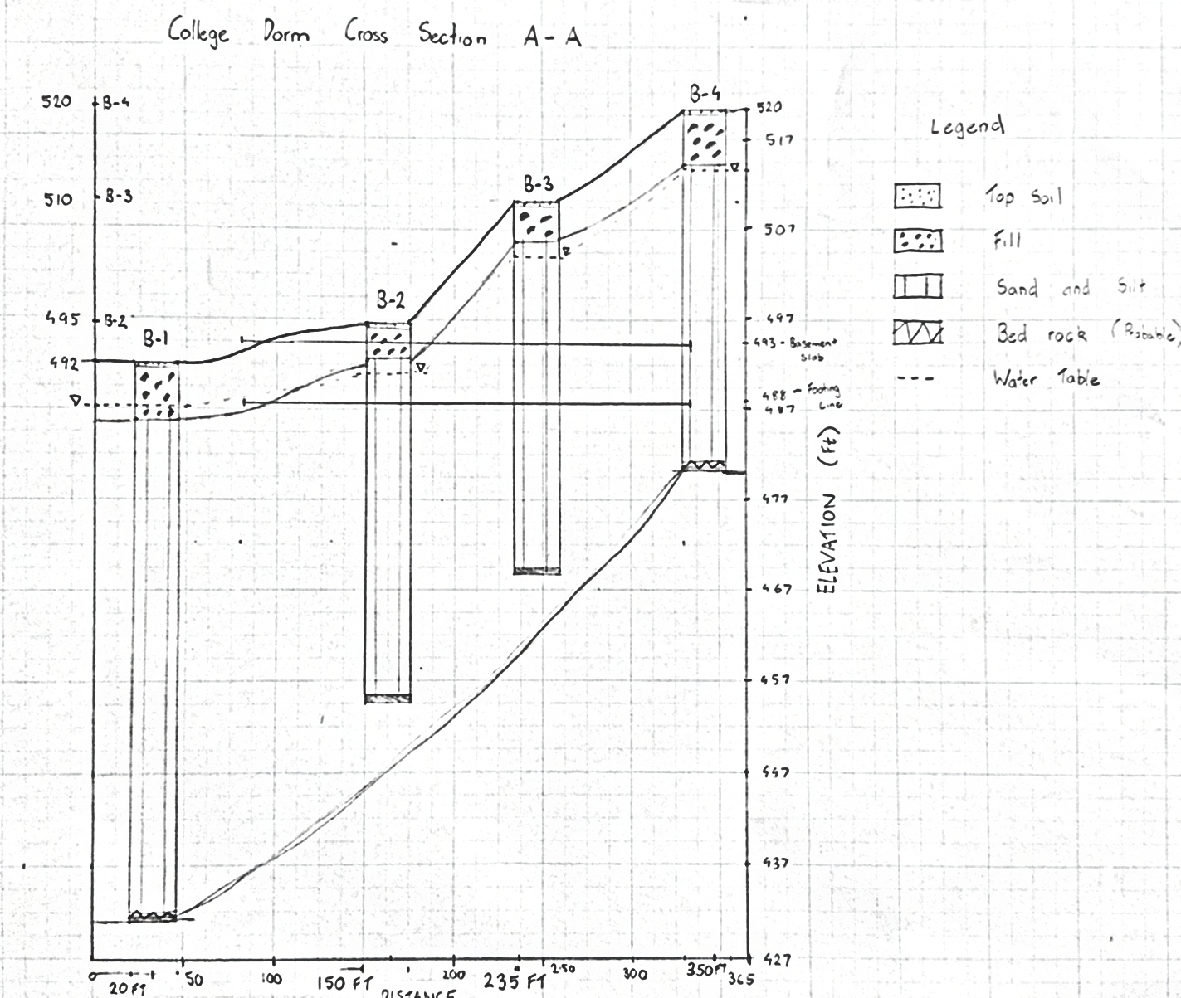
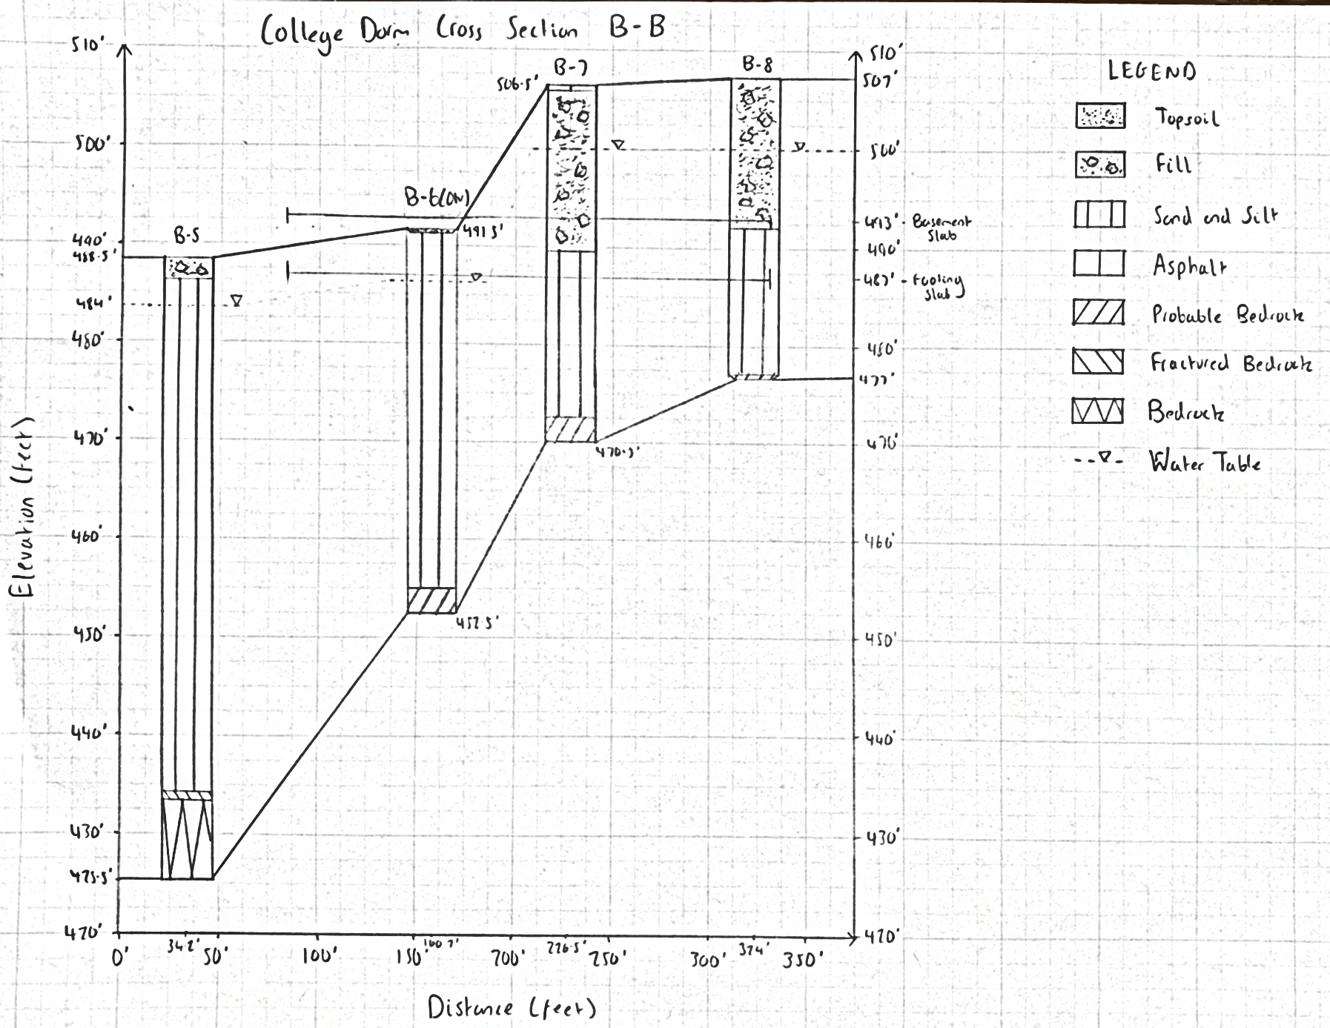
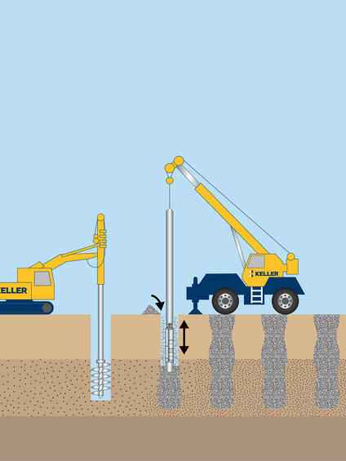
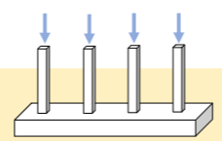
Geotechnical Investigation into a College Dorm on Troubled Ground
Oliver Haigh, Zach Forfar, Patrick Browning, Ben Milburn
Isaac Colcord, Jay Hodkinson, Project Sponsors ● Dr Majid Ghayoomi, Faculty Advisor
Department of Civil and Environmental Engineering, University of New Hampshire, Durham NH 03824
Introduction
Subsurface Conditions
Alternatives Investigated
Preliminary geotechnical assessment for a 5-story dormitory with basement garage (58,000 GSF)
Site presents challenges: steep topography, existing infrastructure, and retaining walls
Subsurface conditions: fill, loose sands, and silts to ~60 ft depth
Shallow groundwater (4.5–6.8 ft) influencing design and construction
Key risks: settlement, low bearing capacity, construction instability
The subsurface investigation performed by GZA indicates that the site is generally underlain by two primary soil strata: general fill and a silty sand mixture. While this represents a generalized interpretation of the borehole data, these materials were encountered consistently across the site.
Probable bedrock was encountered in five of the boreholes; however, the material was not cored. The depth to this refusal layer varied between approximately 30 and 60 feet below the ground surface. As such, the presence and elevation of bedrock should be considered approximate.
Ground Improvement Methods
Compaction methods (static, vibratory, dynamic) to densify loose soils
Engineered fill replacement to create a stable founding layer
Aggregate piers (vibro & RAPs) to increase bearing capacity and reduce settlement
Deep Foundation Types
Driven piles (open/closed-ended) for end-bearing and friction resistance
Drilled shafts (caissons) for high load capacity in deep soils/rock
Micropiles for constrained sites and difficult ground
H-piles for efficient load transfer in weak soils
Sockets (rock/soil) used to enhance capacity where required
Shallow Foundation Design
Shallow foundations were initially assessed as they are typically the most cost-effective and simplest foundation solution where near-surface soils can adequately support structural loads. Based on the building load of approximately 26,600 PLF, the original shallow footing design was not feasible under the existing site conditions, as the bearing pressures exceeded the allowable capacity of the original soils. To make shallow foundations viable, ground improvement was considered to increase the bearing capacity of the near-surface soils. With the use of vibro piers, the improved ground provides a higher allowable bearing capacity of about 4000 PSF, making it possible to support the structure using shallow foundations with a designed footing width of 7 ft. This demonstrates that while shallow foundations may be feasible if appropriately sized, their suitability is highly dependent on-site soil conditions.
Methodology
Reviewed existing site data (boreholes, lab tests, site plans)
Analyzed 13 boreholes (SPT data) to define soil stratigraphy and strength
Identified key challenges: loose fill, sand–silt layers, shallow groundwater
Evaluated foundation options: shallow footings, deep foundations, ground improvement (e.g. RAPs, compaction)
Compared options based on performance, feasibility, and cost
Developed final recommendations considering constructability, risk, and cost efficiency
Geotechnical Recommendations
To improve the weak near-surface soils and make shallow foundations feasible, vibro (aggregate) piers are recommended as the preferred ground improvement method. By densifying the loose sand-silt soils, the vibro piers increase the bearing capacity of the foundation soils and reduce settlement potential. With this improvement, a new allowable bearing capacity can be achieved that permits the use of shallow foundations at a designed footing width of 7 ft. This provides a practical and cost-effective solution for the site by allowing the structure to use shallow foundations while maintaining adequate bearing resistance and overall performance.
Site Cross Section
Acknowledgements & References
Thank you to Isaac and Jay at GZA, Dr Majid Ghayoomi. Please do not hesitate to contact oh1048@usnh.edu with any questions. References available upon request.

