Slide 1


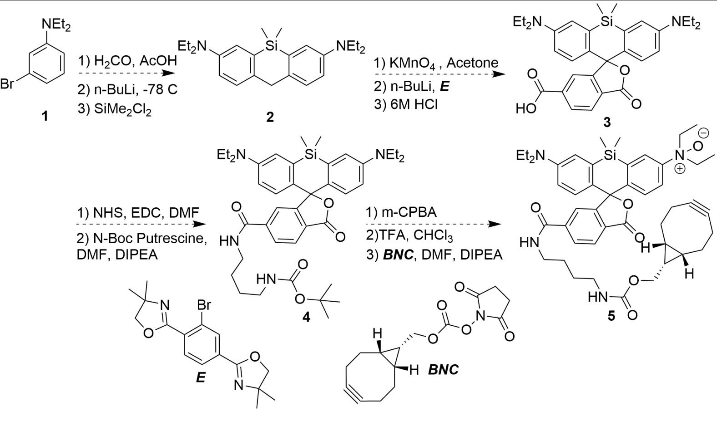
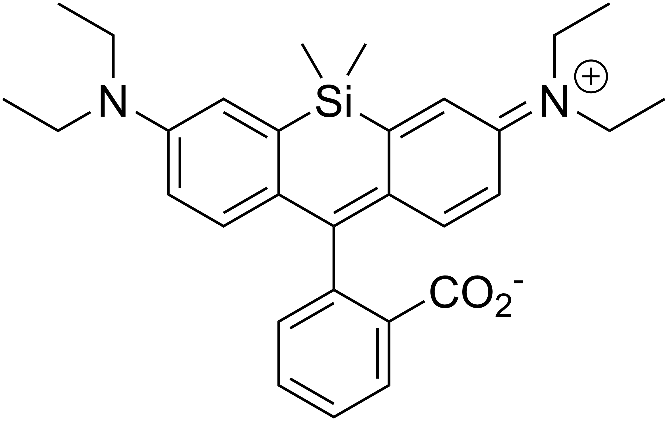

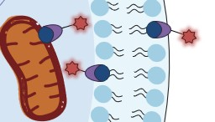

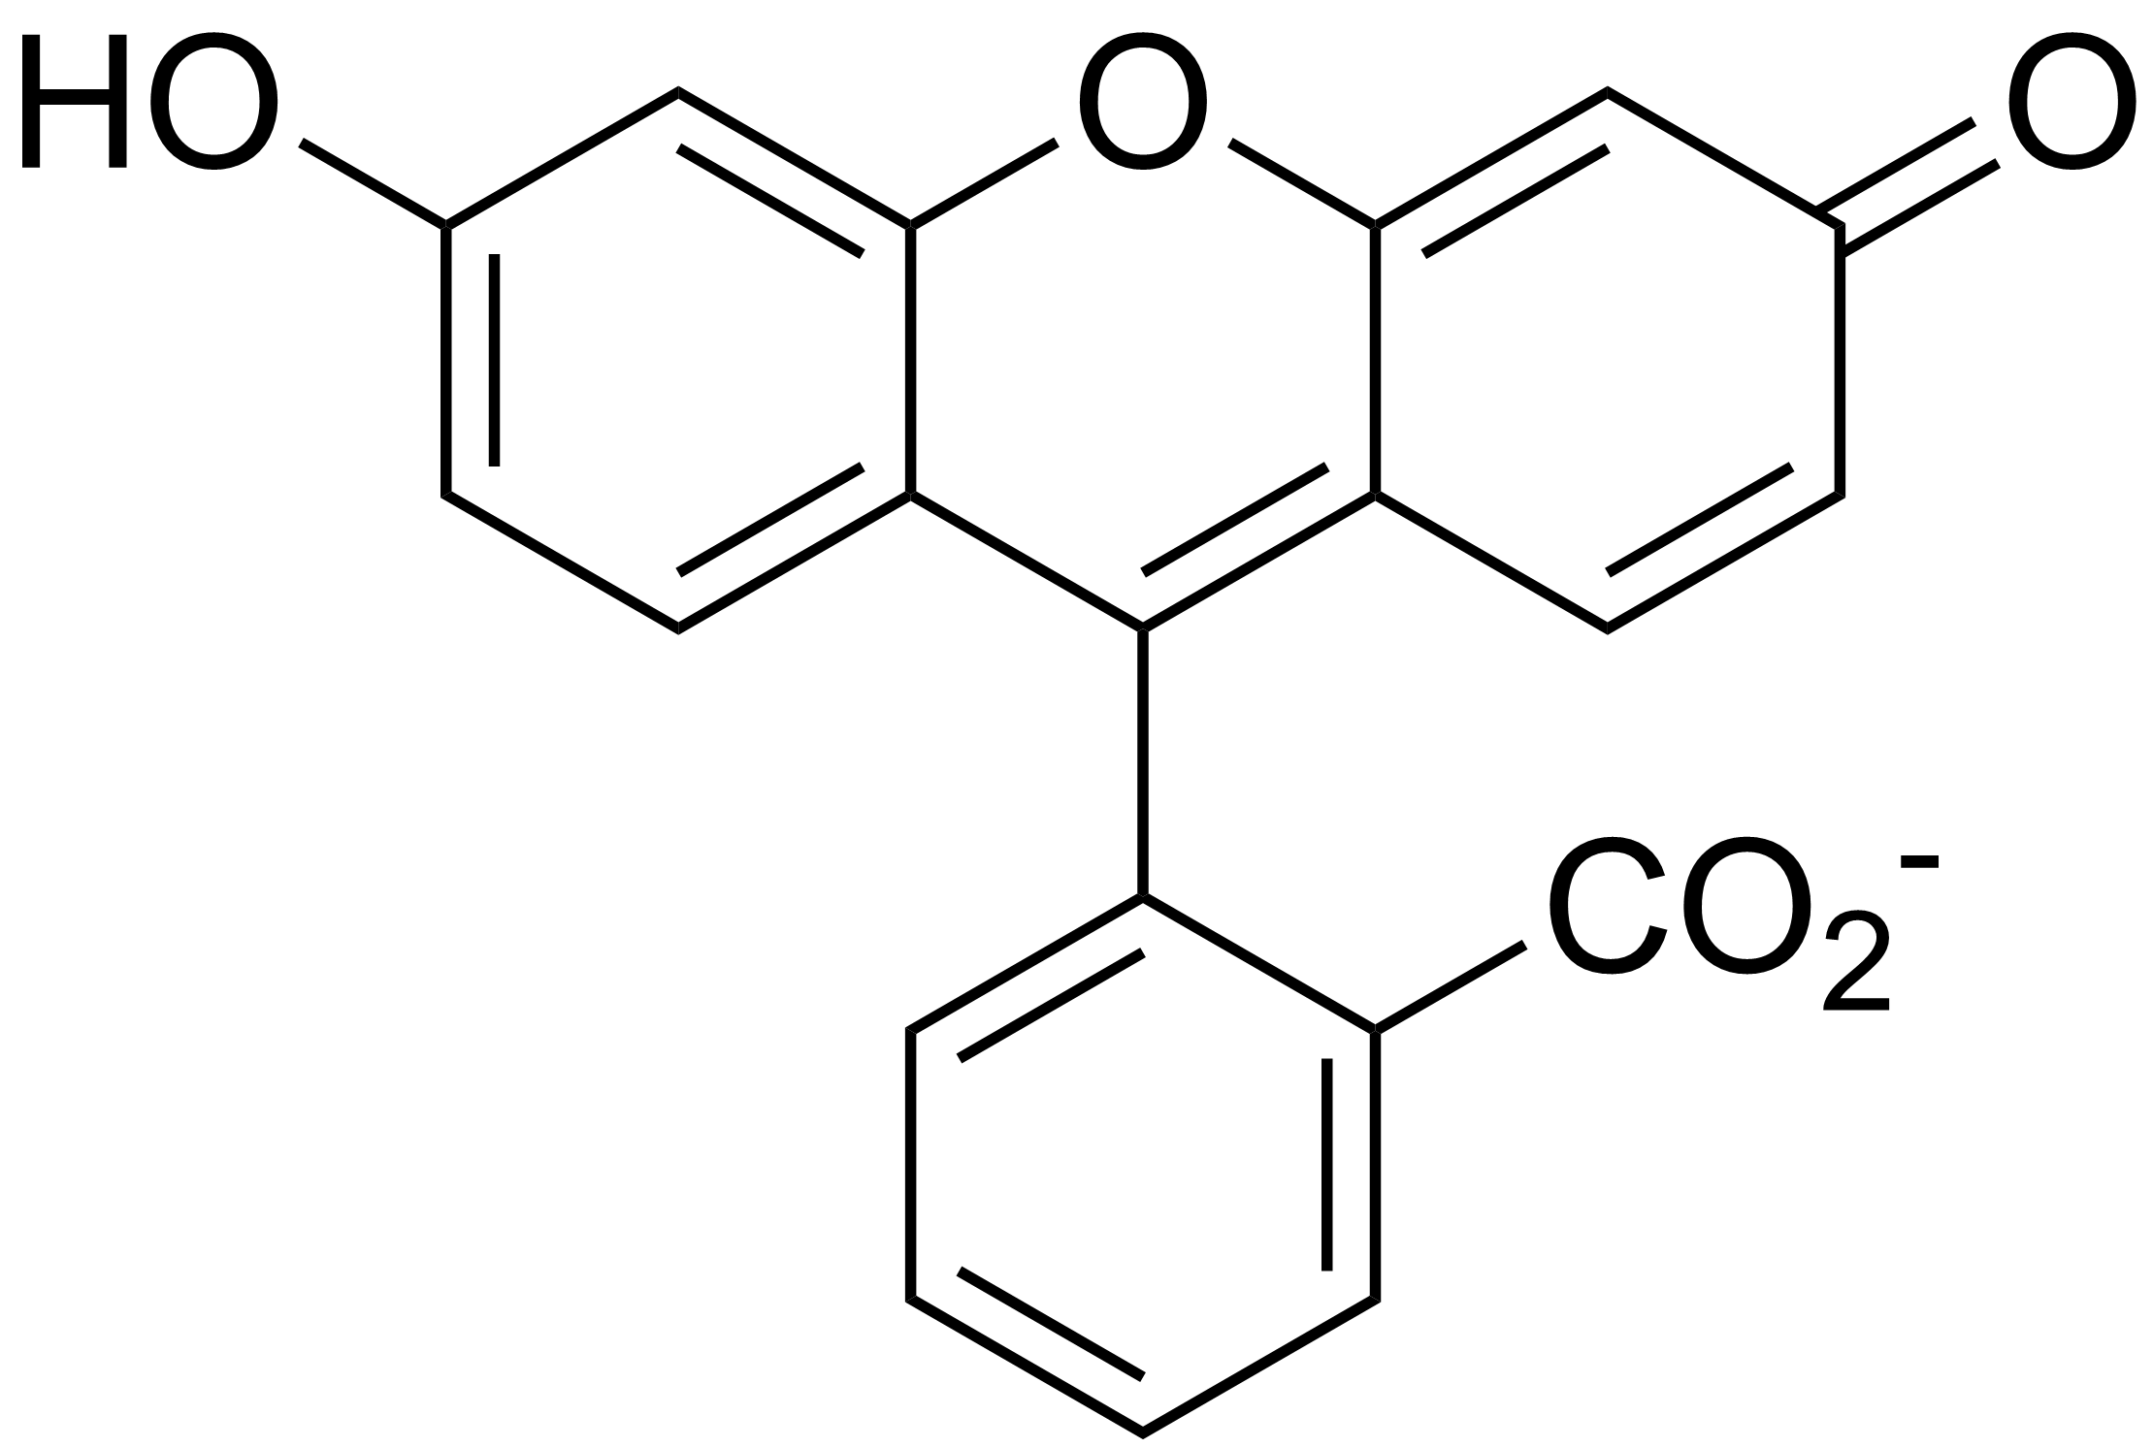
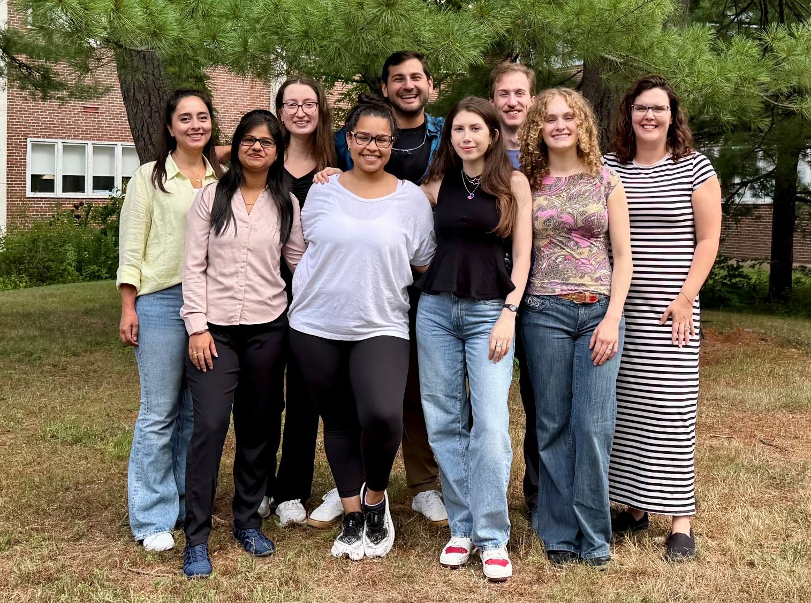
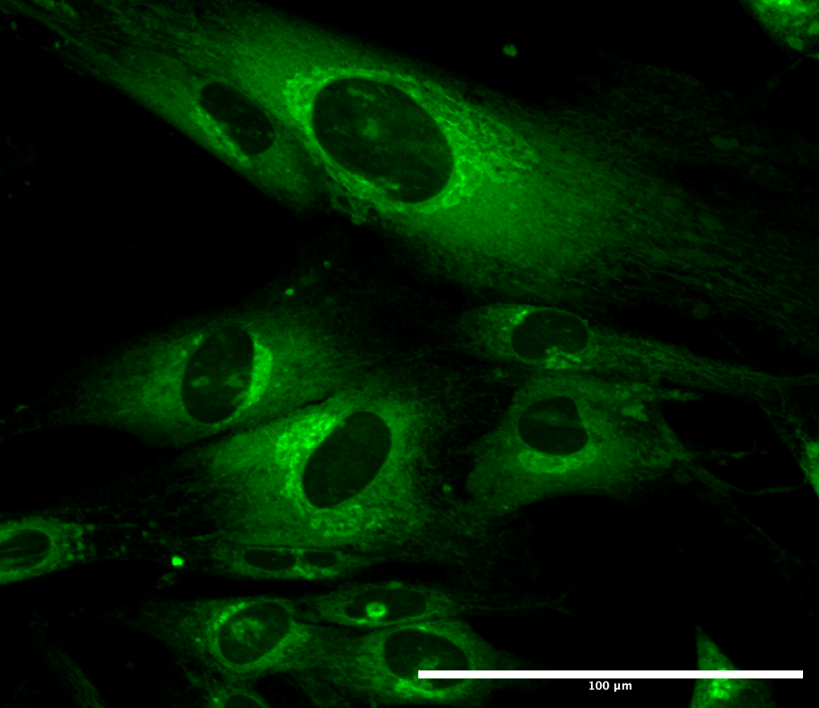

Outside looking in: Cellular Membrane Visualization for Labile Iron Detection
Mason Russell, Thomas DiPhilippo, Brittany White-Mathieu
University of New Hampshire
Department of Chemistry
Background
Clickable Activity-Based Sensor (ABS)
Fe²⁺ Visualization via ABS
Multicellular organisms achieve ordered compartmentalization of organelles by using semi-permeable membranes composed of phospholipids. The most abundant lipid being phosphatidyl choline (PC) found in all cellular membranes.
Research Goal 1: Synthesize an activity based fluorescent sensor to detect labile Fe⁺² and allows for SPAAC chemistry to “click” to a modified choline head of membrane lipids.
The fluorescence of the Fe²⁺ ABS is quenched through the formation of the N-oxide group. Labile iron is expected to exhibit a “turn on” fluorescent response through N-oxide reduction.
Phosphatidyl Choline (PC)
PC is formed through the naturally occurring Kennedy pathway and relies on exogenous choline.
Hydrophilic Head
Endoplasmic Reticulum
Smooth ER
Hydrophobic Tail
Plasma Membrane
Future Work
Nucleus
= N₃PC
Labile Iron is not the only analyte that is implicated in the generation of ROS. Hydrogen Peroxide is required for the Fenton reaction in the formation of hydroxyl radicals.
Peroxisome
= BCN
= 3
Mitochondria
A Parallel Approach
Strain-Promoted Azide-Alkyne Cycloaddition (SPAAC), a Nobel prize winning technique.
Research Goal 2: Utilize a fluorophore with similar structural motifs to the proposed Fe⁺² ABS to develop a membrane fluorescent tag and verify the proposed synthetic pathway.
Golgi Apparatus
By developing dual activity-based sensors and leveraging confocal microscopy, global multicolor visualization of ROS production and subsequent morphological changes can be observed for various forms of regulated cell death.
Lysosomes
Regulated Cell Death
Fenton Reaction
Regulated cell death (RCD) is a process where dying or mutated cells are killed to maintain homeostasis. However, it can also occur through the build up of reactive oxygen species (ROS). The formation of ROS occurs when Labile Fe⁺² and hydrogen peroxide undergo the Fenton Reaction.
Acknowledgements
White-Mathieu Group Members
Principle Investigator
Brittany White-Mathieu
Undergraduates
Nicholas Mixon
Muriel Lubelczyk
Sam Moreau
Maddie Pageau
Aliyah Krestalica
Postdoc
Dr. Aakriti Garg
Graduate Students
Tom DiPhilippo
Paige Ring
Saghar Jarollahi
Yağmur Altunsoy
Arpan Ghosh
Prasanna Ganesh
By introducing a clickable fluorophore and applying confocal microscopy, cellular membrane visualization can be achieved. This work adds the ability to monitor ROS formation as well as subsequent morphological changes.
In vitro labeling and visualization of when and where ROS factors are being produced as well as the subsequent morphological changes in membranes will enhance our understanding of ferroptosis and other forms of RCD.
100 $μ$M
(1)Hirayama, T.; Okuda, K.; Nagasawa, H. A Highly Selective Turn-on Fluorescent Probe for Iron(II) to Visualize Labile Iron in Living Cells. Chemical Science 2013, 4 (3), 1250–1256. https://doi.org/10.1039/C2SC21649C.
(2)Grimm, J. B.; Brown, T. A.; Tkachuk, A. N.; Lavis, L. D. General Synthetic Method for Si-Fluoresceins and Si-Rhodamines. ACS central science 2017, 3 (9), 975–985. https://doi.org/10.1021/acscentsci.7b00247.
Funding Provided by UNH

