Slide 1


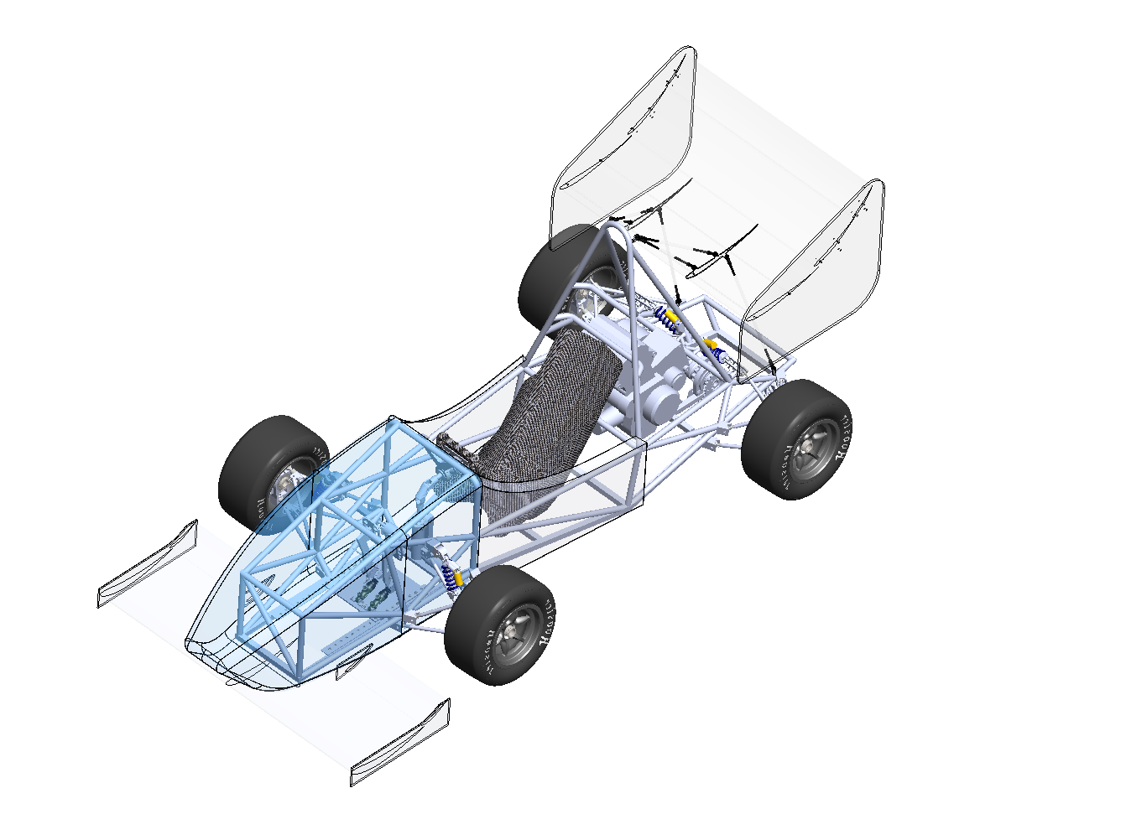
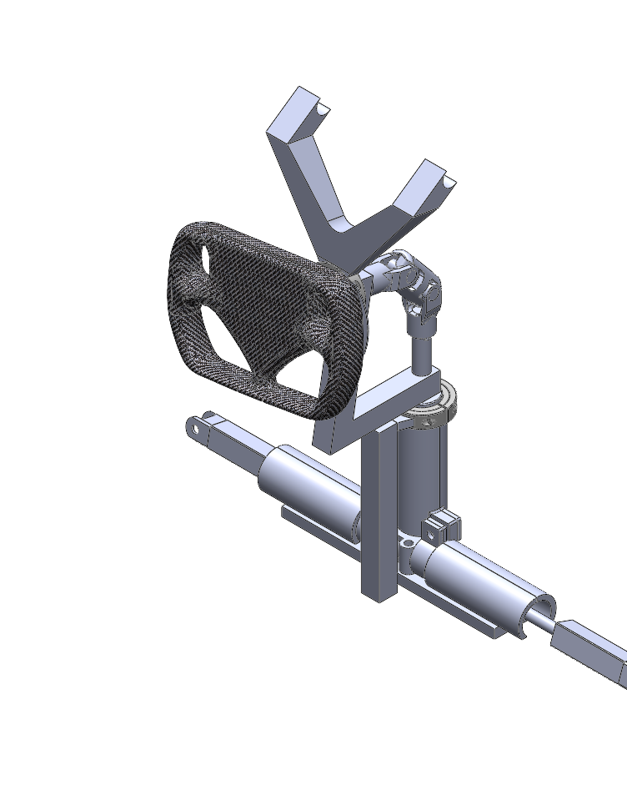
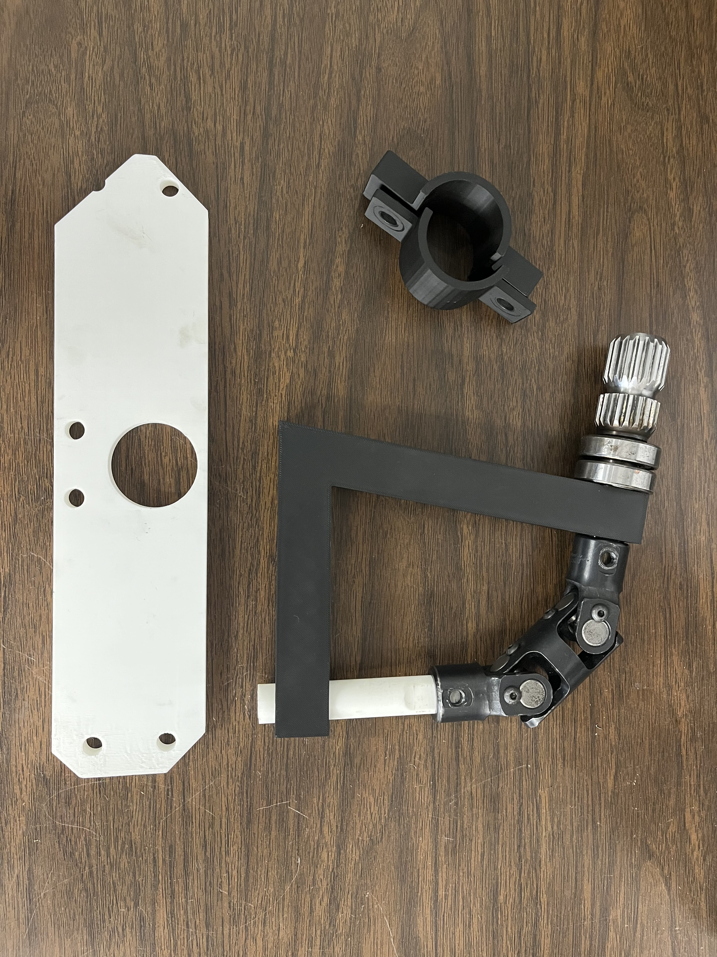
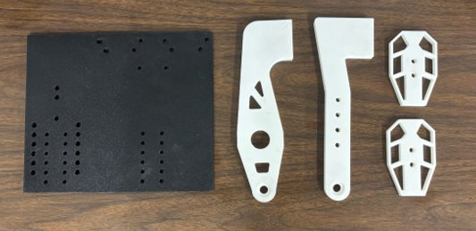
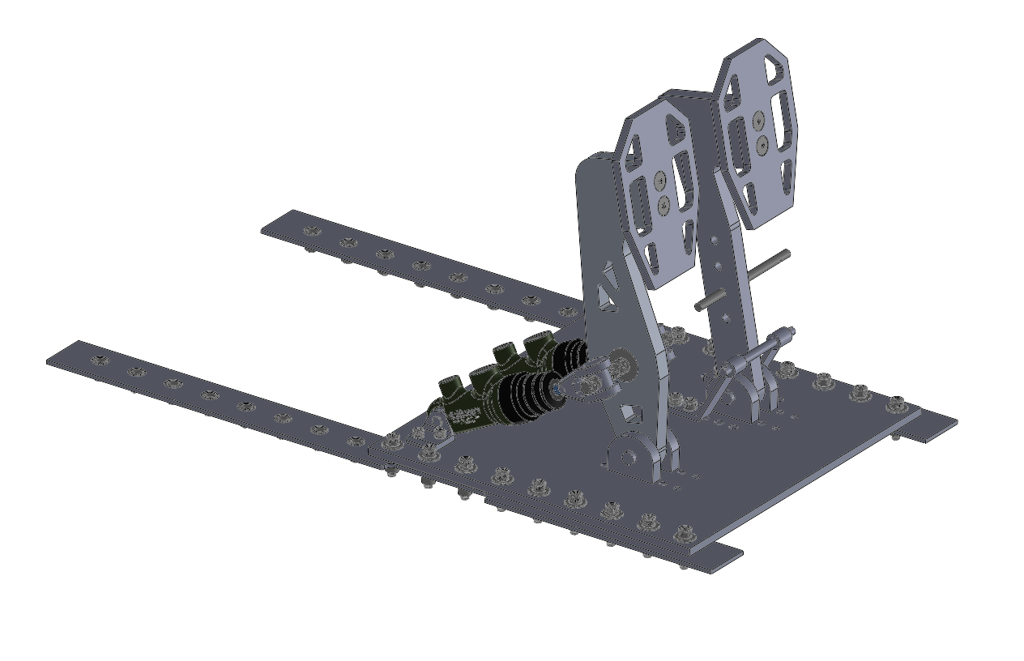
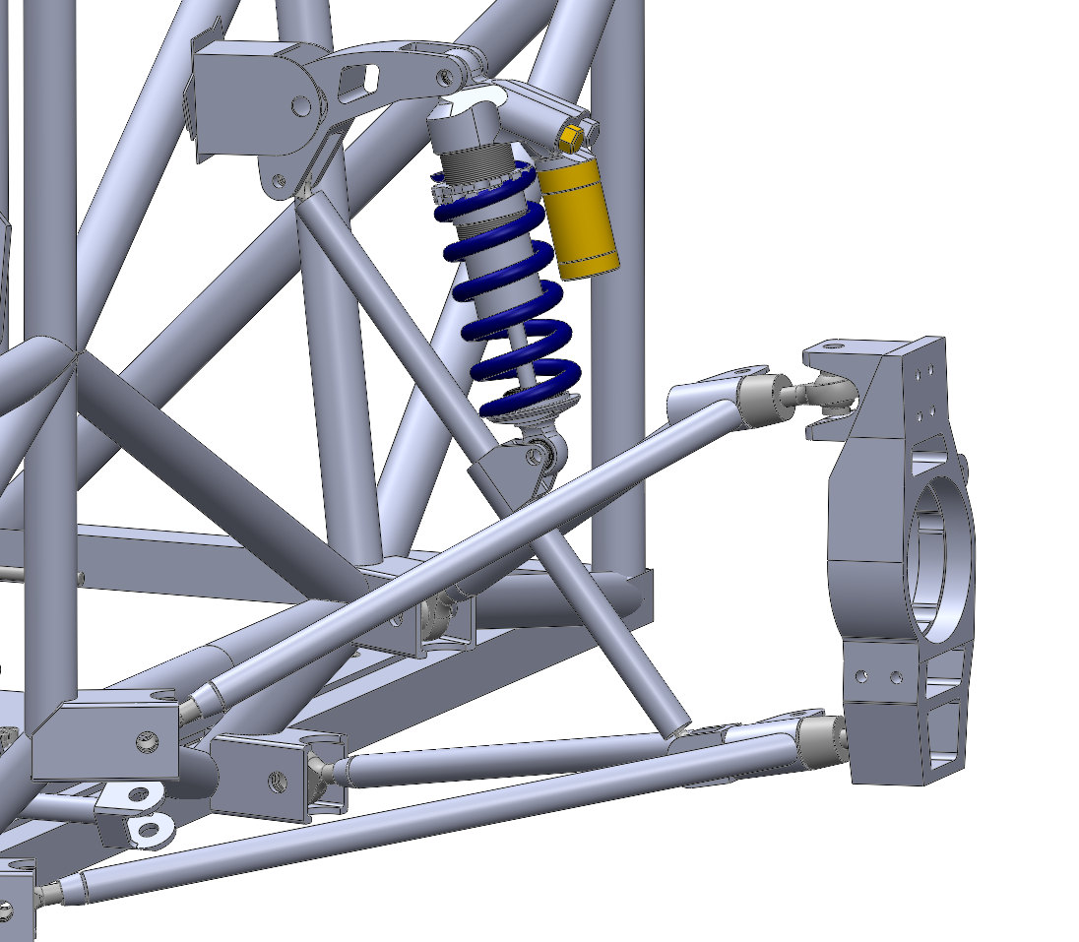
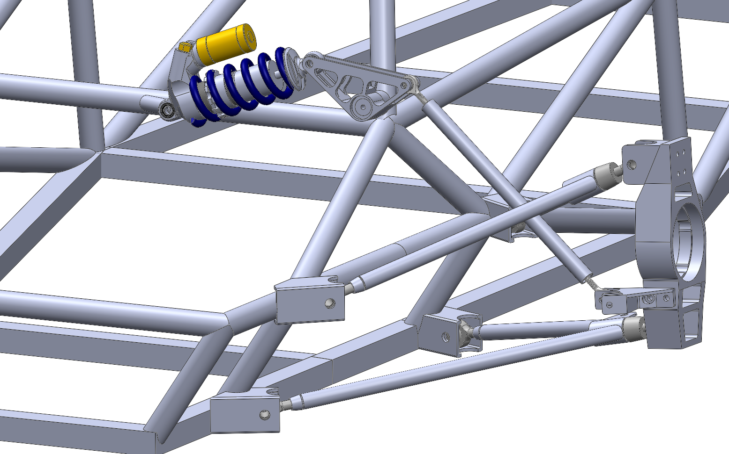
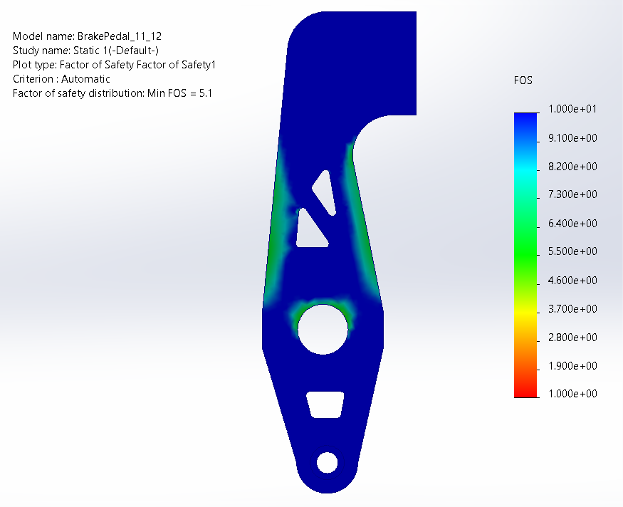
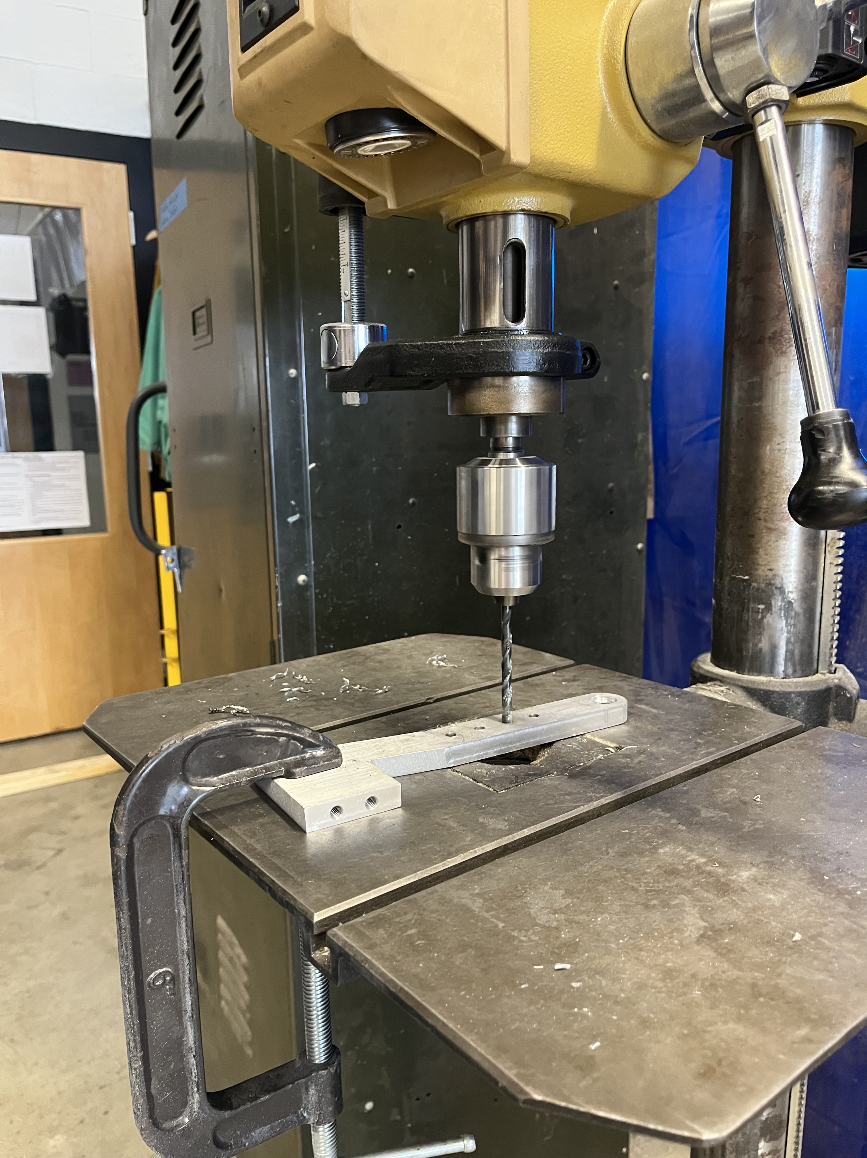
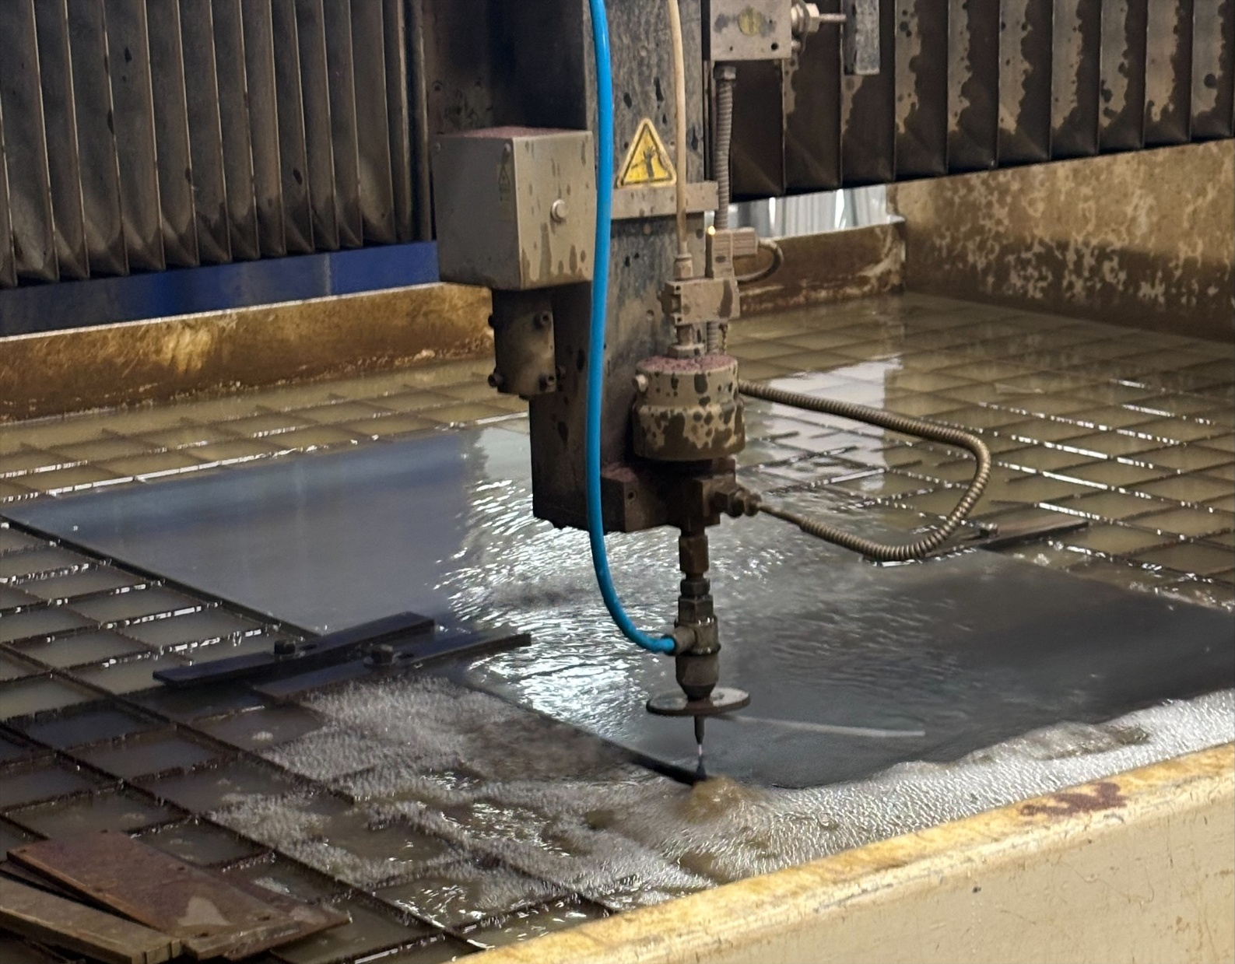
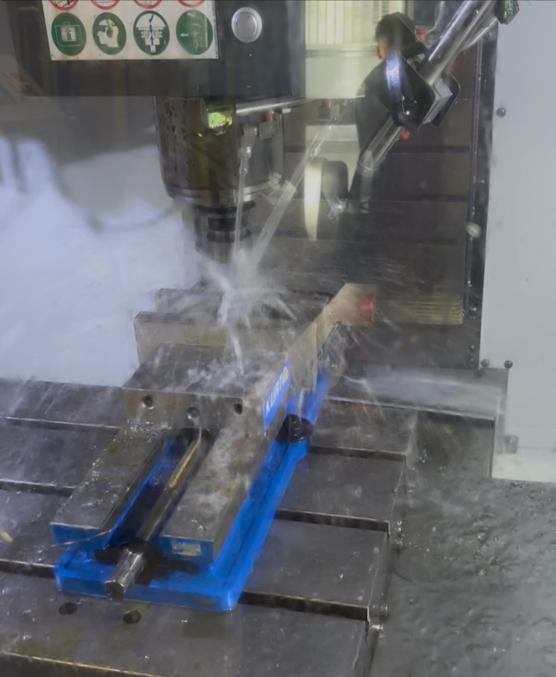
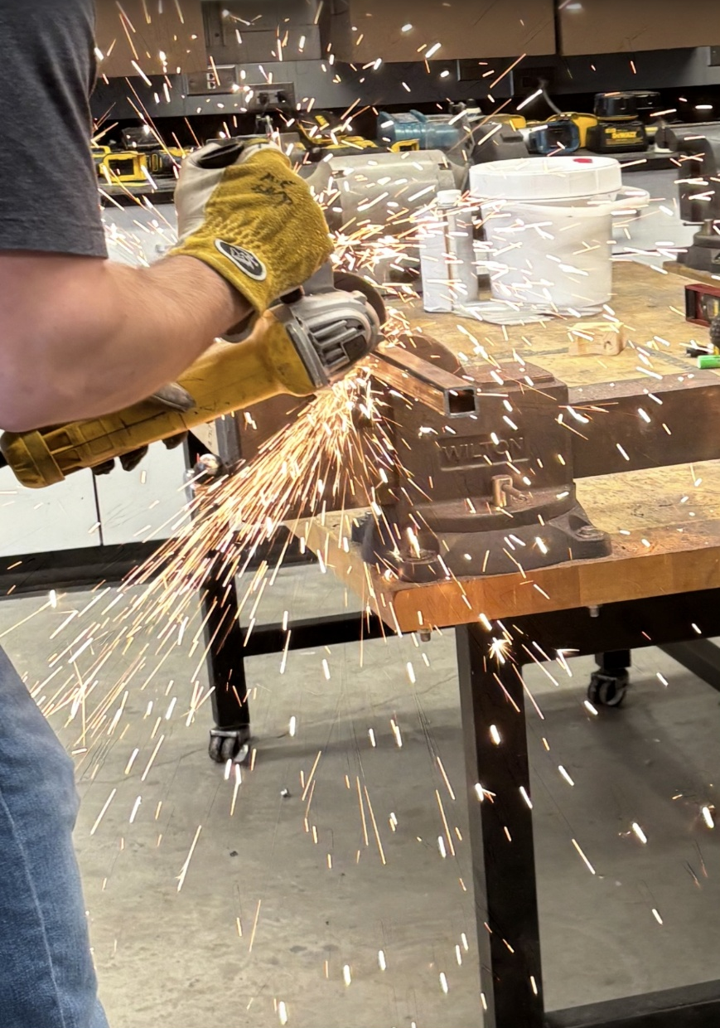



FSAE Controls System
Connor Bernard, Ryan McShan, Nick Beane, Sam Fauteux
College of Engineering and Physical Sciences, University of New Hampshire, Durham, NH 03824
Project Overview
Control System
Prototyping
The controls subgroup is responsible for designing and manufacturing the pedal assembly, steering system, suspension, and related mounting structures of the formula SAE racecar. The goal of this project is to have all components rule compliant and competition ready for May 13th, 2026.
Steering Assembly
3D Printed Steering and Pedal Box Components
Rack and pinion style system designed to maximize the space within the cockpit while providing a smooth steering response.
Methodology
Specifications Considerations - FSAE rules, driver ergonomics, and performance targets.
SolidWorks model for assembly integration, and to perform linear static FEA.
Optimized for strength and reliability by targeting stiffness, stress distribution and FOS goals.
Machined, assembled, and integrated systems into the vehicle and performed functional evaluation.
Pedal Box Assembly
Rear Suspension (Left) Front Suspension (Right)
Analysis
The pedal box integrates throttle and braking inputs into a compact, lightweight, and adjustable structure.
Smooth integration with frame featuring full adjustability while meeting all competition requirements.
Brake Pedal - Linear Static Study
Results
Manufacturing
Pedal Box Refinement: Improved functionality, manufacturability, strength, and adjustability.
Steering System Evolution: Reverse engineered previous steering design improving ergonomics, functionality, and chassis fitment.
Suspension Geometry Overhaul: Reworked inherited, error filled designs resulting in a more accurate and reliable assembly.
Outcome: Established a strong foundation for competition-ready subsystems.
The results of the final linear static analysis of the brake pedal are shown above, indicating a minimum safety factor of 5.1.
Acknowledgements
Sponsorships
Acknowledgements
Juan Carlos Cuevas Bautista – Advisor
ME Department – Funding/Ordering Support
Noah MacAdam, Scott Campbell, Sheldon Parent – Shop Support
Will Donovan, Mattias Allen – Underclassmen Support
Waterjet cutting, 3-axis CNC milling, 5-axis CNC milling, lathe operations, and finishing operations
Waterjet for quick 2D cuts to create the pedal box baseplate, pedal arms, and mounting brackets
3-axis and 5- axis milling were necessary for complex tool pathing and high dimensional accuracy, as well as completing surface finishes

