Slide 1
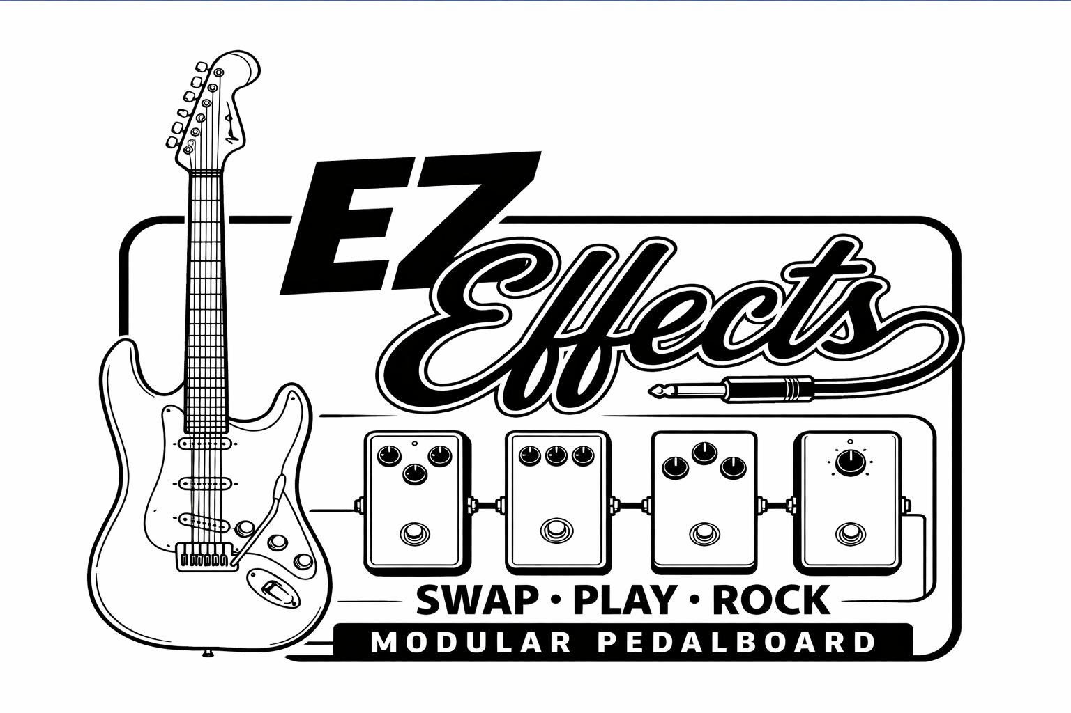

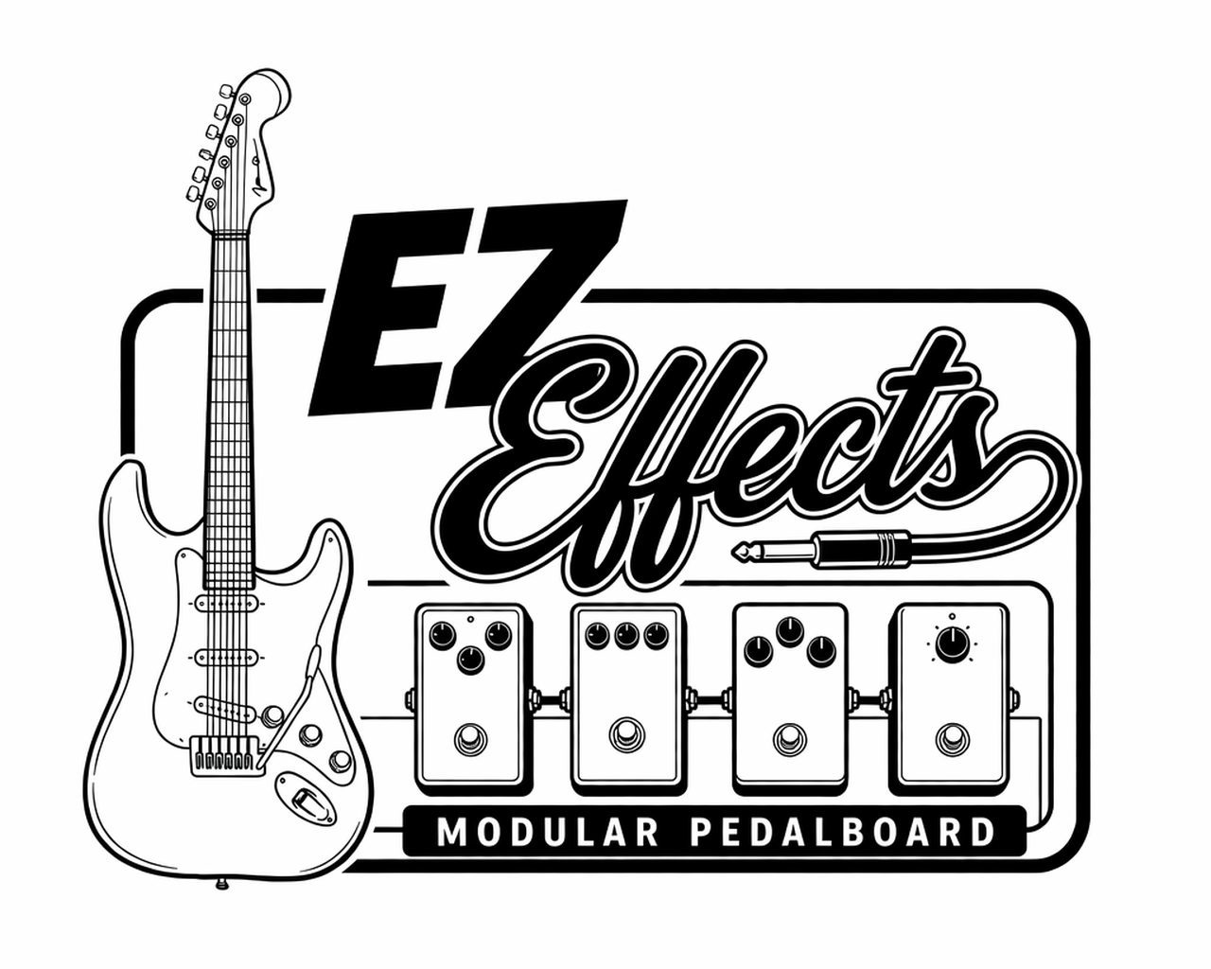
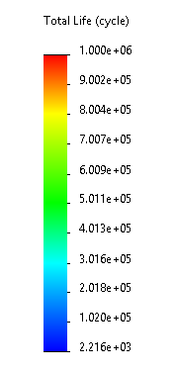
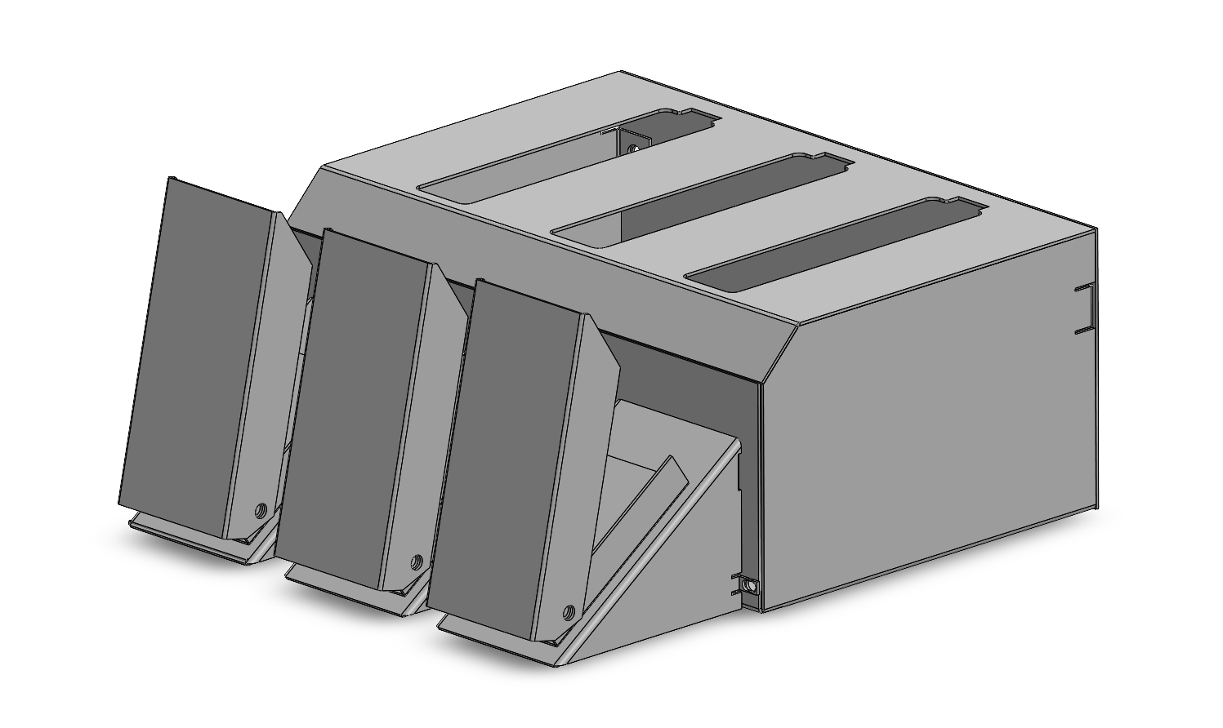
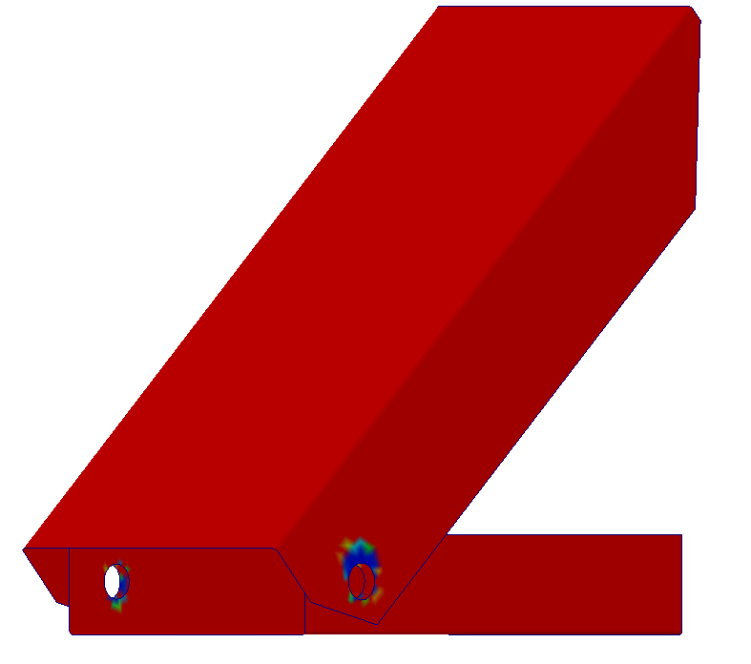
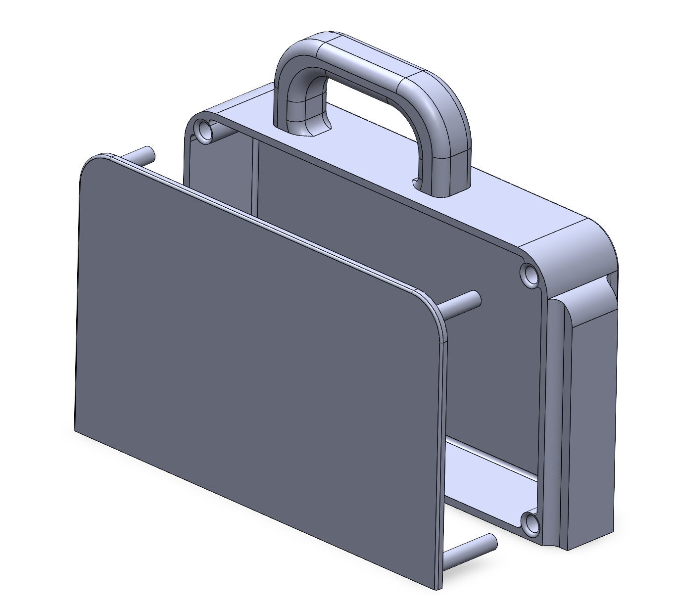
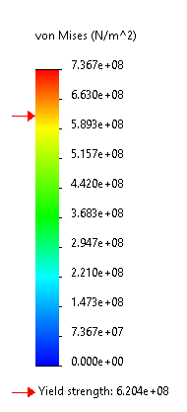
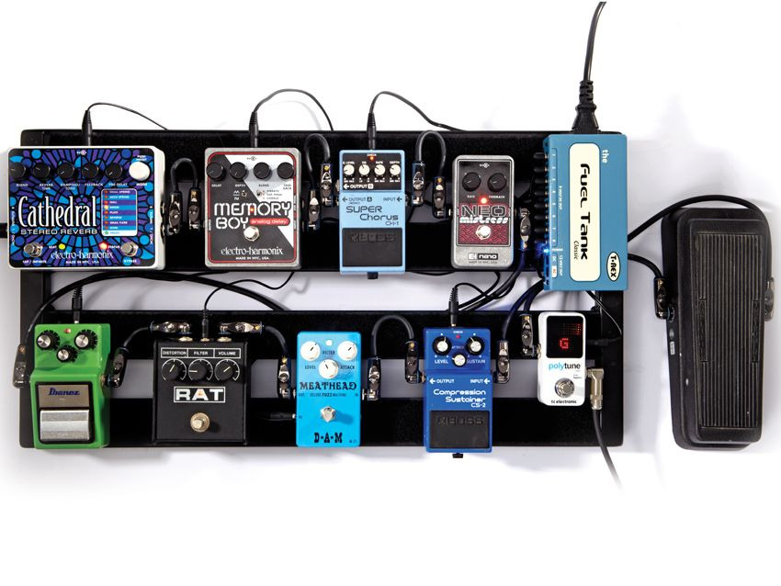
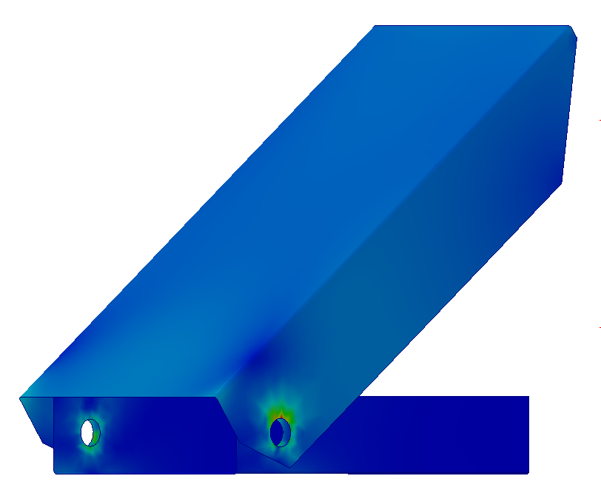
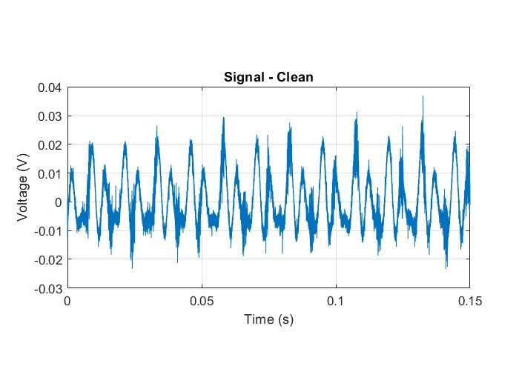
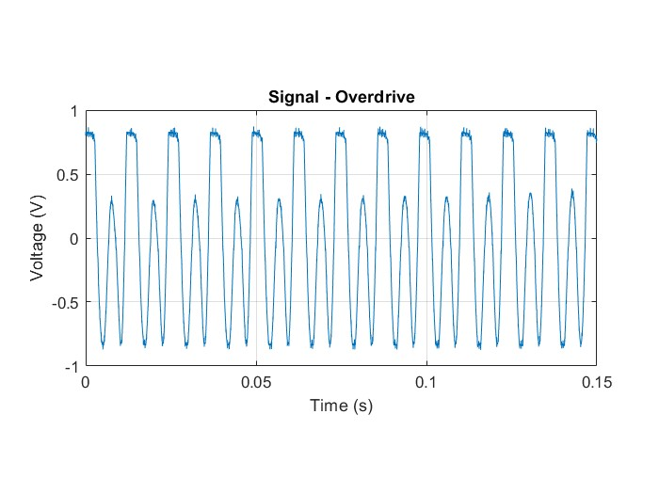
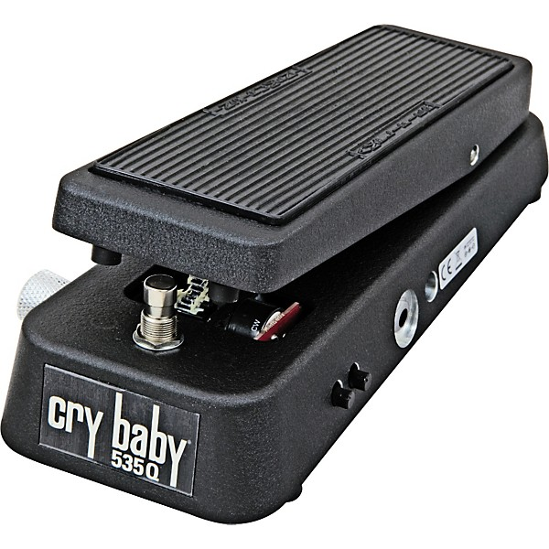
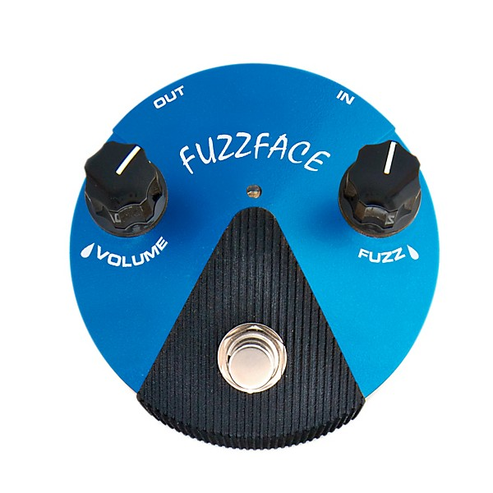
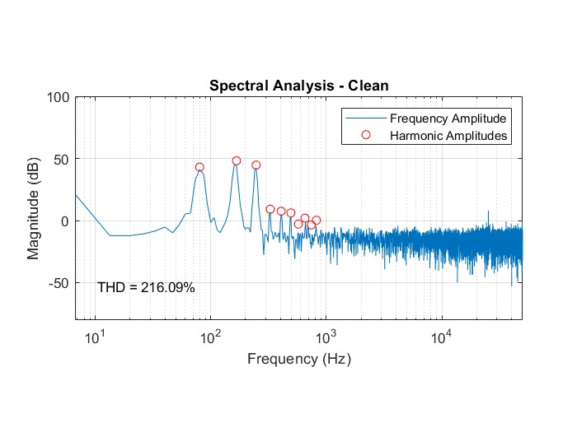
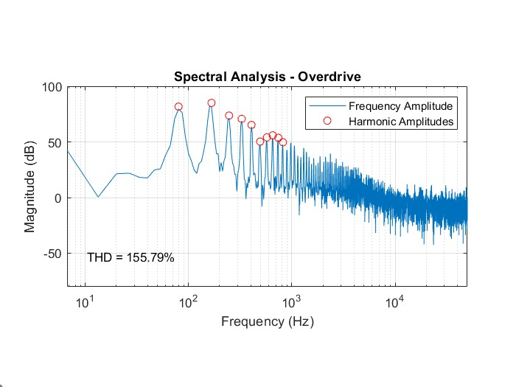
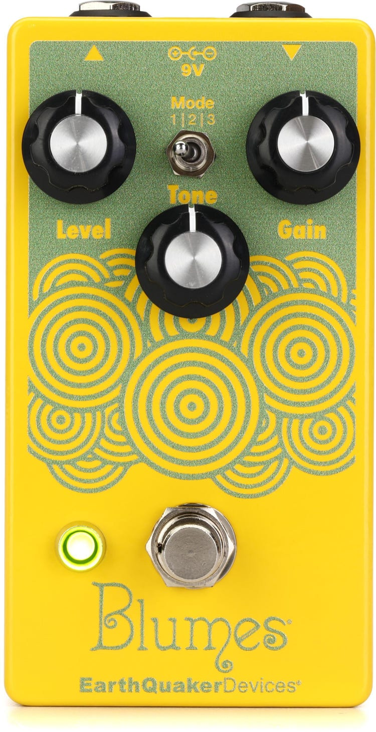
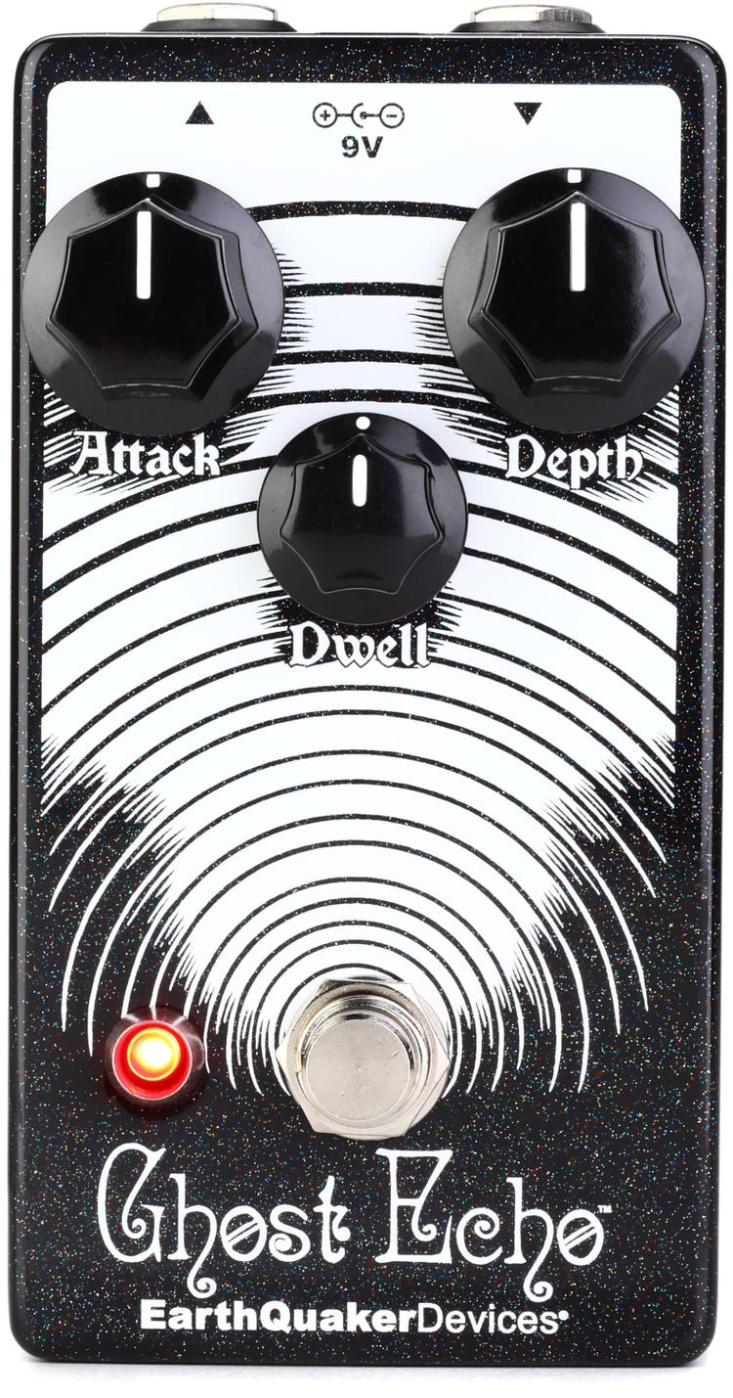
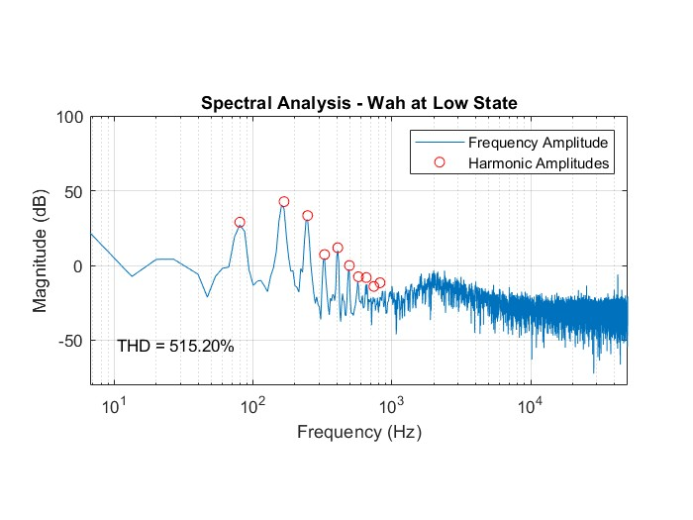
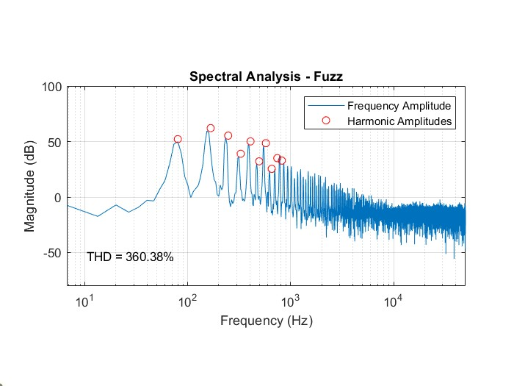
Modular Pedalboard System
David Desfosse, Christopher Giovanni, Samuel Hilts, Maxwell McCabe
College of Engineering and Physical Science, University of New Hampshire, Durham, NH 03824
Our Mission
Product Schematic
FEA Analysis
Our goal is to make guitar playing a hobby, not a chore.
Learning to play the instrument is hard enough, players don’t need the added stress of:
Messes of wires
Learning digital pedalboard software
Spending exorbitant amounts of money
Each pedal has two distinct functions
On/Off control
Dynamic effect sweep control
Cartridges can be slotted in any slot to be played
Magnetic pins are placed at the bottom for a good, durable connection
Stress concentrations around the pins give estimated life of ~2200 cycles
Product life will be improved as stress concentrations are mitigated
Cartridge offers handle for easy swapping
The Beginner Experience
Analog pedalboards are created by wiring individual effects directly into each other
Requires knowledge of how chaining effects change sound
Experimentation becomes costly and time-consuming
Final Product will have pin holes rounded to mitigate failure
No other areas exhibit concerning levels of stress
Housing Schematic
Digital solutions exist, but require learning software and can cost $1000+
Cartridge Schematic
Effect Verifications
Market Comparisons
Design Choices
6061 Aluminum was chosen as the housing material for being the most cost effective, durable option
Torsional springs were chosen over linear springs due to the degree of rotation in the pedals
Magnetic pogo pins were chosen over options like gold fingers as a simple, prototype friendly connection style
Commercial Off The Shelf (COTS) PCBs were chosen as a cheap, simple way to prove our concept of pedalboard
Dunlop Cry Baby 535Q Multi-Wah Pedal -
$179.99
Dunlop FFM1 Silicon Fuzz Face - $159.99
Signal coming from pickups is noisy and unrefined
“Soft clipping” transforms signal into symmetric square waves
EarthQuaker Devices Blumes Low Signal Shredder Overdrive Pedal -$119.00
EarthQuaker Devices Ghost Echo V3 Reverb Pedal - $199.00
Product Future
For our product to allow users to increase their collection cheaply over time, we will be working to increase our available library of effects
Future Effects:
Delay (In Progress)
Reverb
Gain
Loop
Total $657.98
Has noticeable noise from guitar pickups
Sound primarily comes from fundamental frequency
Amplifies harmonics to create distortion
Creates a classic, bluesy sound
Our Cost Analysis
Effects/PCBs | $177
Electrical Components | $74
Housing/ Connectors | $101
Total Cost | $352
Shelf Cost | $460
Acknowledgements
Advisor: John Roth
Department Chair: Christopher White
UNH CEPS Dean: Cyndee Gruden
Manufacturing and Design Assistance: Michael Giovanni
Applies a bandpass filter that shifts as pedal is pressed
Emphasizes treble or bass frequencies (as circled in red)
Amplifies harmonics, emphasizing odd harmonics, to create asymmetric distortion
Creates a “grainy” or “fuzzy” sound
*Shelf Cost Selling Direct-to-Customer with 30% Markup
*Delay analysis in progress, not pictured

