Slide 1

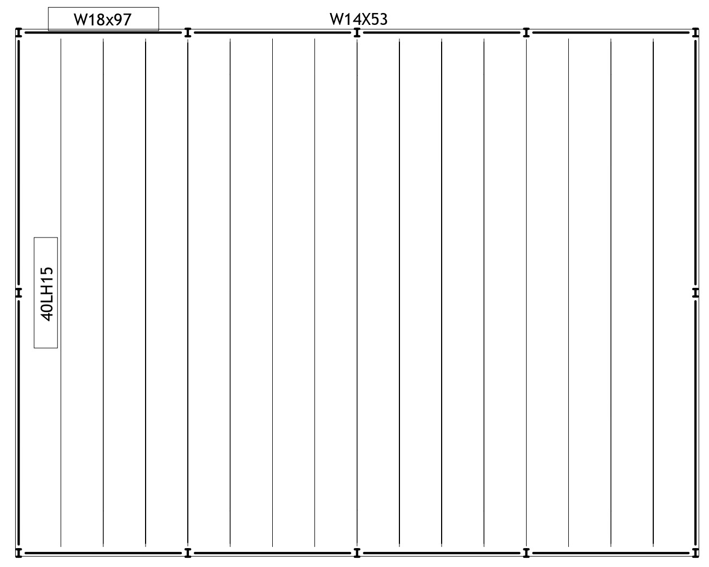
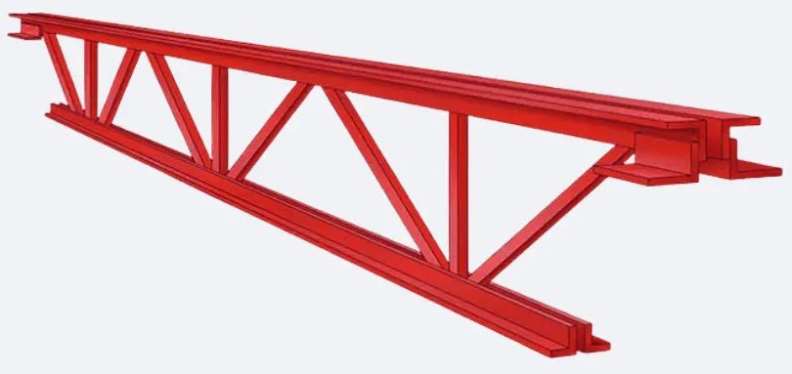
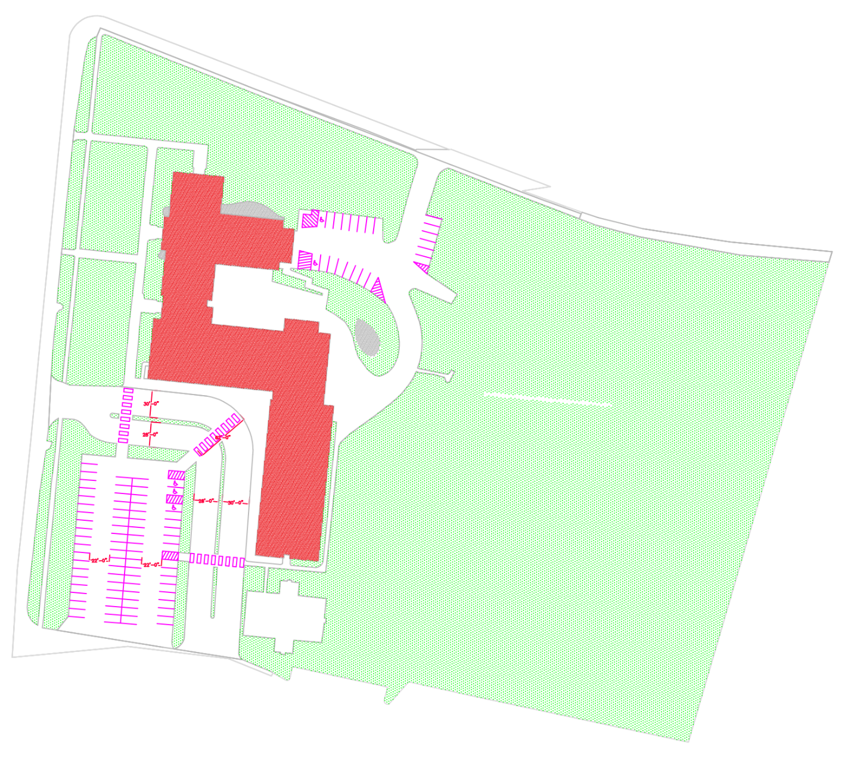
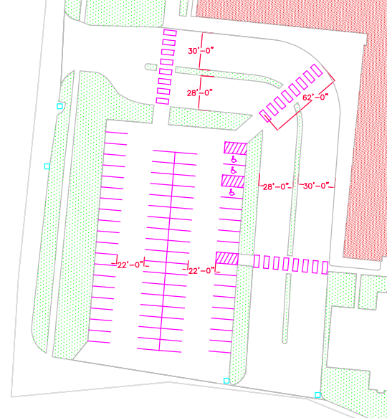
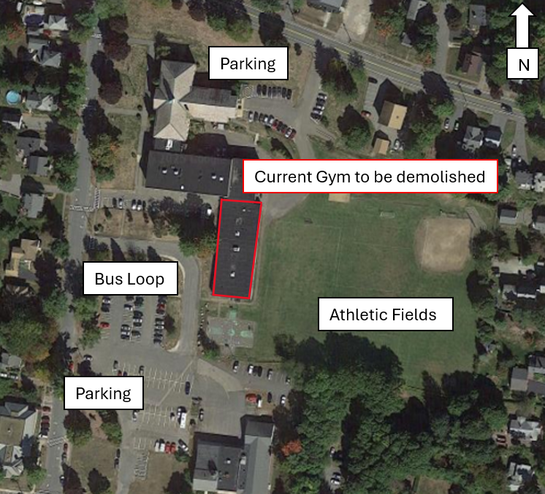
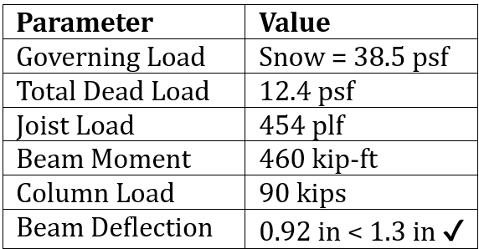
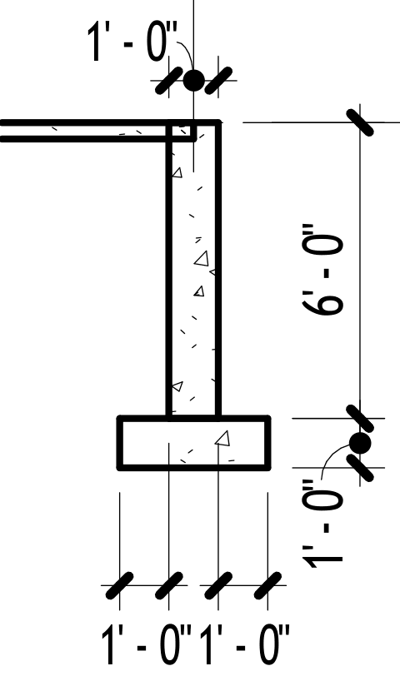
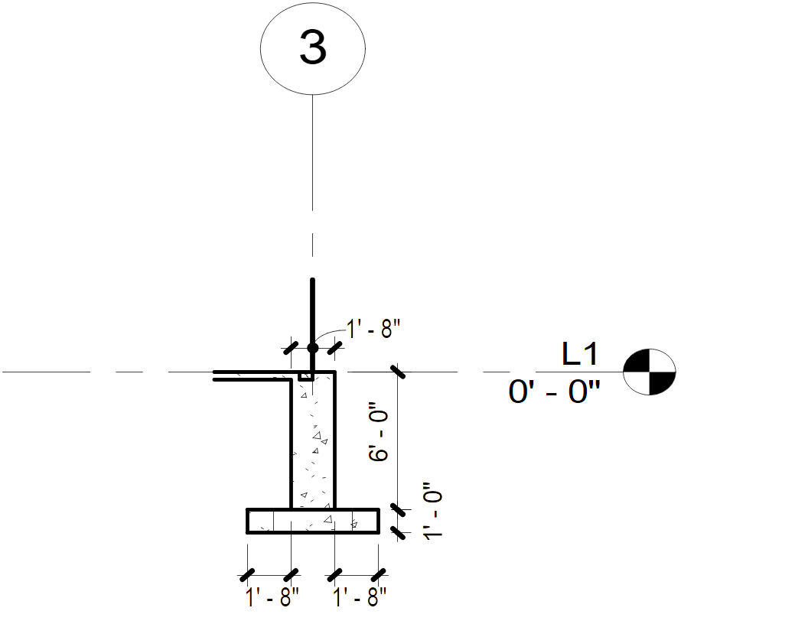
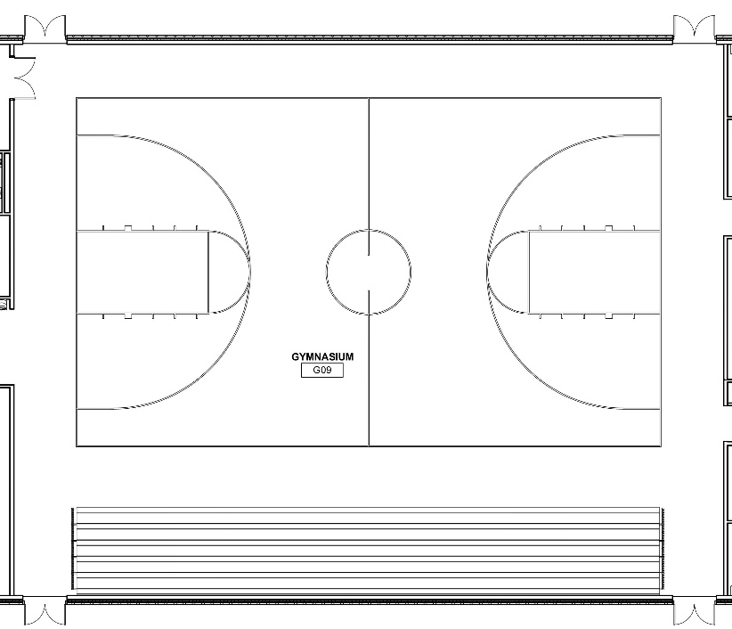
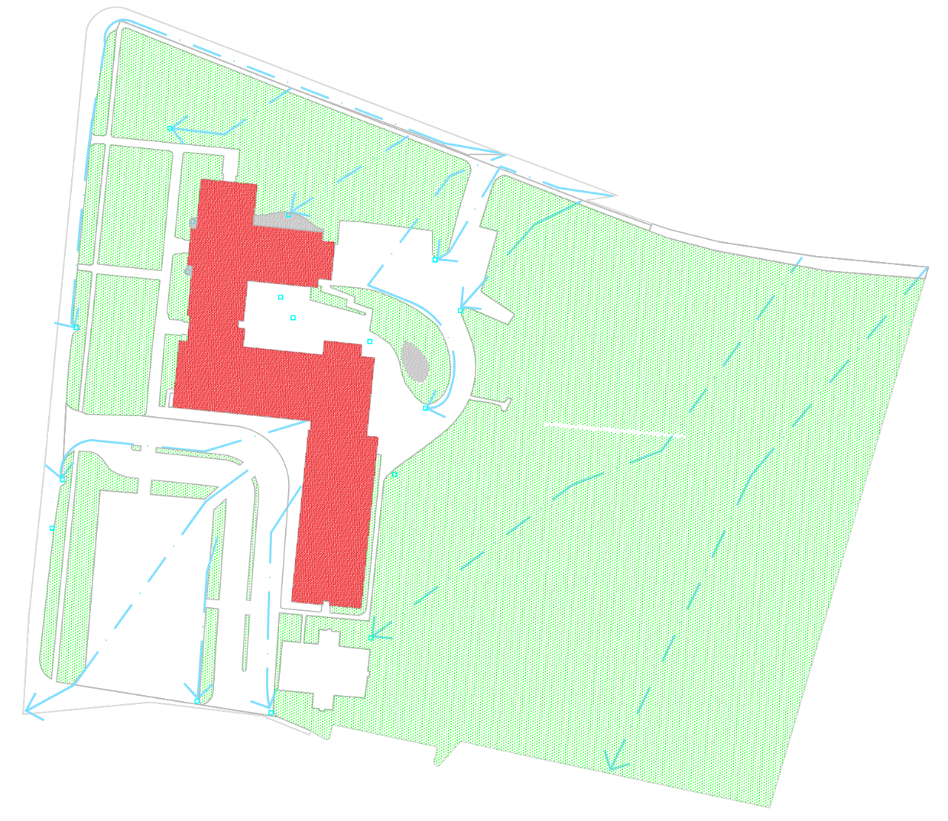
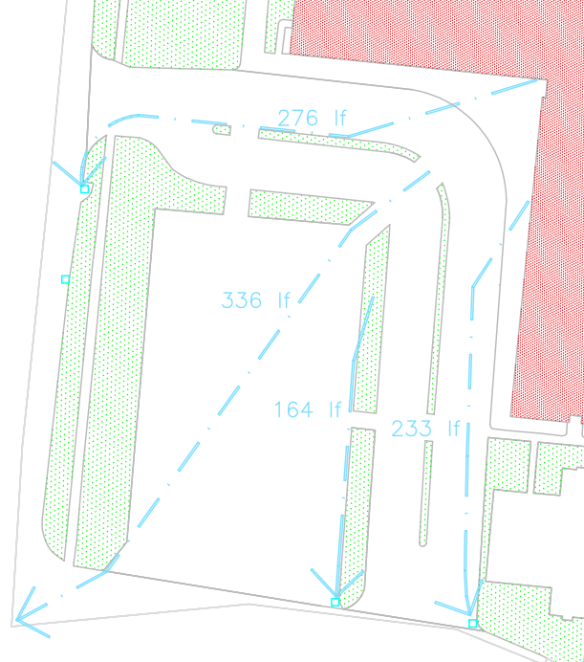
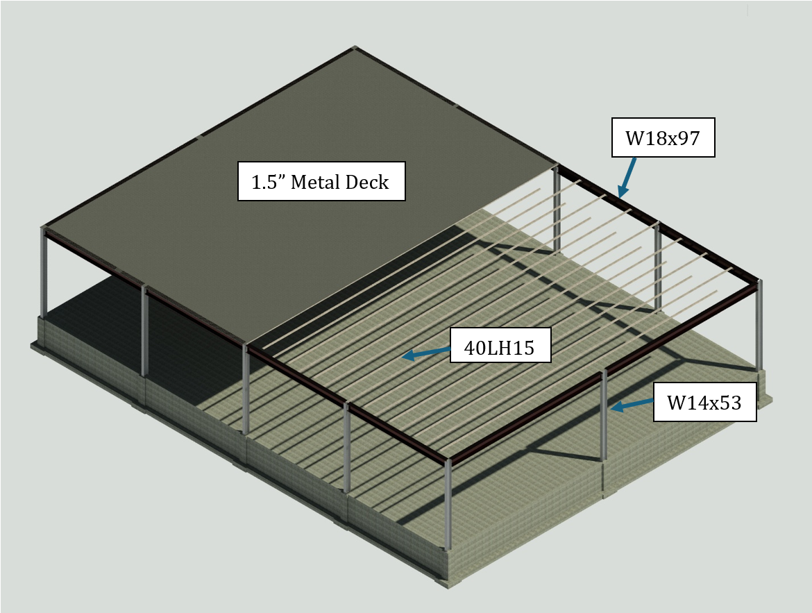

Hampton Academy Gymnasium and Site Improvements
Evan Perkins, Lindsey Beck, Mitchell Berry, Alexia Garcia, Dylan Nutting
Civil and Environmental Engineering, University of New Hampshire, Durham, NH 03824
Project Overview
Structural
Site Design
Hampton Academy Middle School located in Hampton, NH
Original building constructed in 1940
Long-span open web joist (40LH15)
(additions in 1963 & 1975)
Proposed addition: 8,320 sf gym (104’ x 80’)
Designed for 80 ft clear span and 20 ft clear height
Parent Loop has 28 ft total width (two 12-ft lanes) and a curb return radius of 30 ft
Bus/Emergency Vehicle loop has 30 ft total width (two 12-ft lanes) and a curb return radius of 62 ft.
69 standard parking spaces and 3 ADA-compliant spaces
Objectives
Geotechnical
Provide column-free athletic space
Improve traffic circulation (bus vs parent)
Increase parking + ADA compliance
Subsurface conditions evaluated using borings
Near-surface soils consist of loose sand at gym footprint
Loose material to be removed and replaced with compacted engineering fill
All footings satisfy bearing capacity requirements(90 ksf < 457 ksf) ​
Settlement to remain within allowable limits
Typical column footing: 5 ft x 5 ft
Perimeter wall supported by continuous 3 ft wide strip footing
Enhance pedestrian safety
Design efficient structural + foundation systems
Architectural rendering of new gymnasium
Strip footing design
Pier design
Total drainage area of 498,931 sf (11.45 ac)
Impervious area: 34.34%
Pervious area: 65.66%
Longest hydraulic flow path of 605 ft
Total runoff volume of 108,500 cf (10-yr, 24 hr storm)
Peak discharge of the entire site is 26.23 cfs
Peak Discharge of the parking lot is 8.55 cfs
Structural
Final Design
Benefits of Steel:
Long-span capability (80 ft clear)
High strength-to-weight efficiency
Fast construction
Member Selection
40LH15 Joists
W18x97 Beams
W14x53 Columns
1.5” type B LH-Series Metal Roof Deck
(15) 40LH15 @ 6.5’ spacing spanning 80’ clear span
(12) W18x97 beam system w/ 26’ span
(12) W14x53 columns w/ 20’ height
Spread footing + Pier foundation design
20” x 20” x 6’ Pier with 5’ x 5’ x 1’ footing underneath each steel column
6’ deep wall with 3’ x 1’ footing around entire gym
Acknowledgements
The project team would like to thank our sponsor The Turner Group and our Faculty advisor Dr. Azam
References
ASCE 7-16
IBC 2021
AISC Steel Manual 16th Ed.
AASHTO Guidelines

