Slide 1

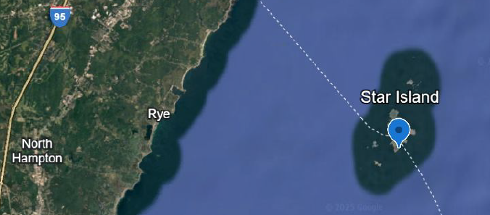
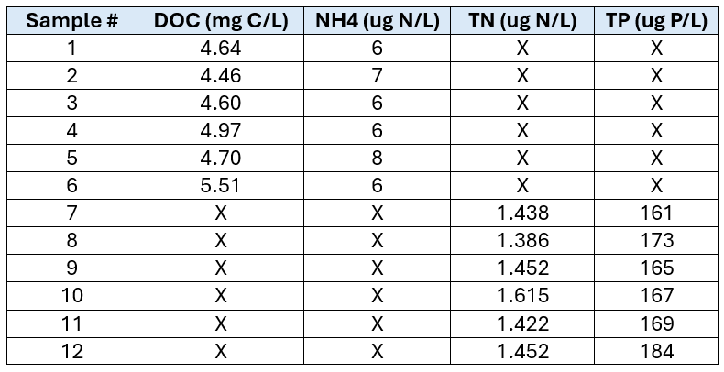
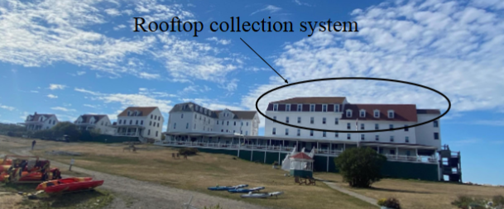
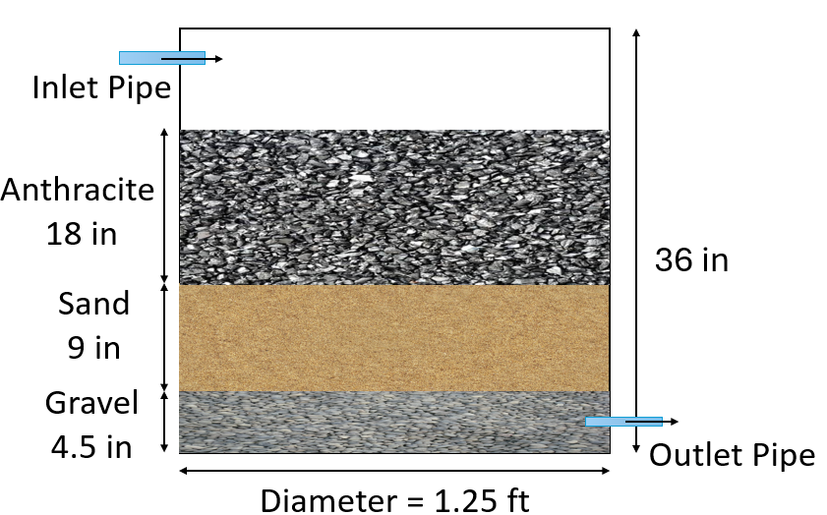
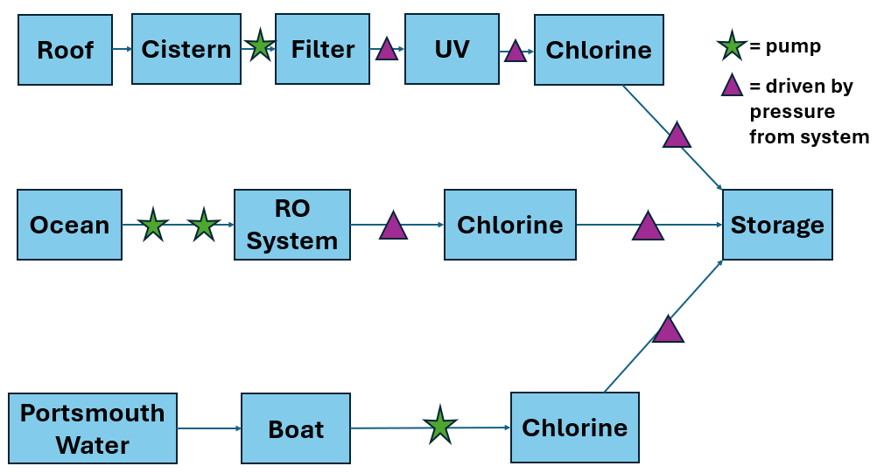
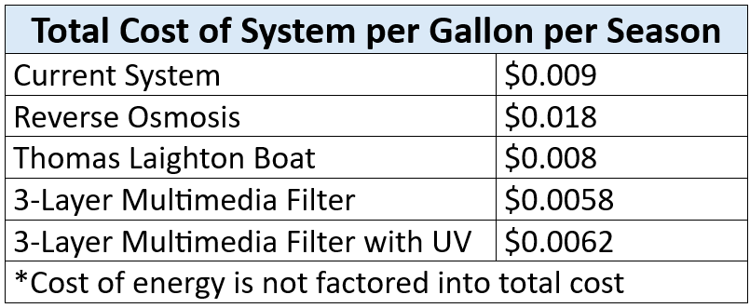
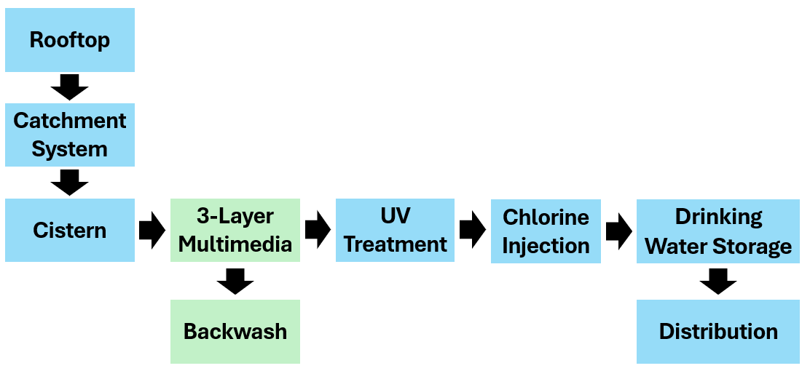
Rainwater Filtration System for a Remote Island
Emma Doyle, Isabella Dee, Aiden Tripaldi, Elizabeth DelGiudice
Department of Civil and Environmental Engineering, University of New Hampshire, Durham, NH 03824
Introduction
Water Quality
Alternatives Decision Matrix
 | 3-Layer Multimedia | 7-Layer Multimedia | GAC + Micron | Current
Project costs | Best | Better | Good | Fair
Energy Usage | Best | Better | Fair | Good
Operational Complexity | Better | Fair | Good | Best
Clients Goals | Good | Better | Best | Fair
The alternatives considered for this project were a 3-layer multimedia filter, a 7-layer multimedia filter, and a combination GAC and Micron filter. Using the decision matrix to assess our alternatives based on client needs we found that the 3-layer multimedia filter was the best fit. This system will work to treat rainwater to drinking water and alleviate pressure on current systems.
Star Island, located off the coast of Rye, New Hampshire in the Isles of Shoals, runs a seasonal water system (June–October) for about 300 people and plans to upgrade its rainwater harvesting system to improve reliability and water quality.
Treatment Requirements
Final Design
Giardia | 2.29-gal Pipe | 1500-gal Tank | 1750-gal Tank | 2100-gal Tank
Baffling Factor 0.1
Log Credit | 0.02 | 1 | 1 | 1
R.T (min) | 175 | 1747
Baffling Factor 0.3
Log Credit | 0.02 | 3* | 4* | 4*
R.T (min) | 175 | 582
Both
A.T (min) | 0.9 | 617* | 720* | 864*
Design Specs
Operational flow is 3.7 gallons per minute, based on operational hours of 5 P.M. to 9 A.M., with a total of 3,500 gallons per day delivered. The ideal service flow for the filter is 3 gallons per minute per square foot. The filter has a circular area of 1.23 square feet. Using Darcy’s equation, the filter sand resulted in a head loss of 0.13 feet.
Currently on the Island there are two main sources of water, the Thomas Laighton and the reverse osmosis (RO) system. Historically, a rainwater treatment system was used but due to efficiency issues an upgrade is needed.
Virus | 2.29-gal Pipe | 1500-gal Tank | 1750-gal Tank | 2100-gal Tank
Baffling Factor 0.1
Log Credit | 0.5 | 31 | 36 | 43
R.T (min) | 8 | 80
Baffling Factor 0.3
Log Credit | 0.5 | 93* | 108* | 130*
R.T (min) | 8 | 26.7
Both
A.T (min) | 0.9 | 617* | 720* | 864*
Cost
With further testing of the filter using a pilot study additional log removal credits can be awarded to the system. With this potential addition as well as a determined baffling factor of 0.3 further inactivation through UV may not be required.
Water usage on the island rises from June, peaks in mid-August, then declines into September. The demand of water on the island has been increasing with every season highlighting the need for an efficient system to relieve pressure on the current systems.
The 3-layer multimedia filter is the least expensive option at $0.0058 per gallon, followed by the version with UV at $0.0062 per gallon. The Thomas Laighton Boat system and the current system cost $0.008 per gallon and $0.009 per gallon, respectively, while reverse osmosis is the most expensive at $0.018 per gallon. Energy costs are not included.
Giardia = 3-log (99.9%) requirement Viruses = 4-log (99.99) requirement
* = meeting requirements
R.T = Required time water must spend in tanks
A.T = Actual time water spends in tanks
Design Constraints
To meet Surface Water treatment requirements of 3-log removal for Giardia and 4-log removal for viruses, contact time requirements were compared to actual system performance. To obtain the required log removal credits the contact time in the tanks needs to exceed the required time. With a baffling factor of 0.1 the current system does meet the required time for Viruses but does not meet the required contact time for Giardia, requiring more inactivation methods (UV). With a baffling factor of 0.3 the current system does meet the required time for both Viruses and Giardia requiring no further inactivation methods (UV).
Cost efficiency is important since Star Island operates as a non-profit.
The system must fit a limited space under the hotel on a remote island.
Available water sources include deliveries from the Thomas Laighton and the existing RO system.
The system should be quiet and simple to operate, with consideration for repairing the existing ultraviolet (UV) system if used.
Acknowledgements
References
We would like to thank our sponsors Kristen Simard and Dr. John Durant, from Star Island Corporation and Tufts University. As well as our advisors, Dr. Paula Mouser and Dr. Matthew Ferby from the University of New Hampshire
EngiRoss, T., et al. “Simple and Effective Filtration System for Drinking Water Production from Harvested Rainwater in Rural Areas.” Journal of Environmental Management, vol. 356, 2025, p. 121582.
Samuel, M. “Drinking Water through Rainwater Harvesting: Development and Performance Evaluation of a Novel Filtration System.” International Journal of Research in neering and Technology, vol. 4, no. 23, 2015, pp. 95–100

