Slide 1


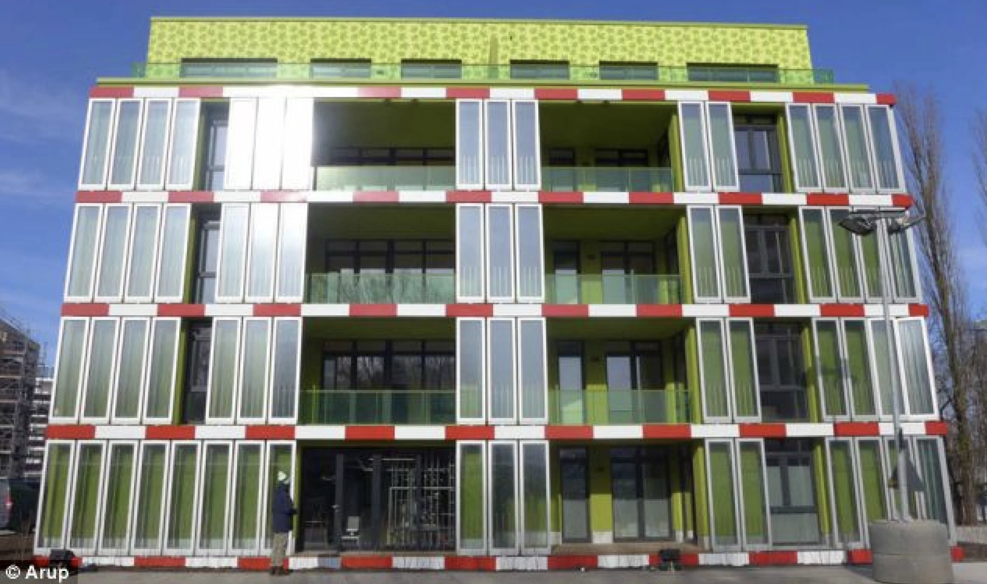
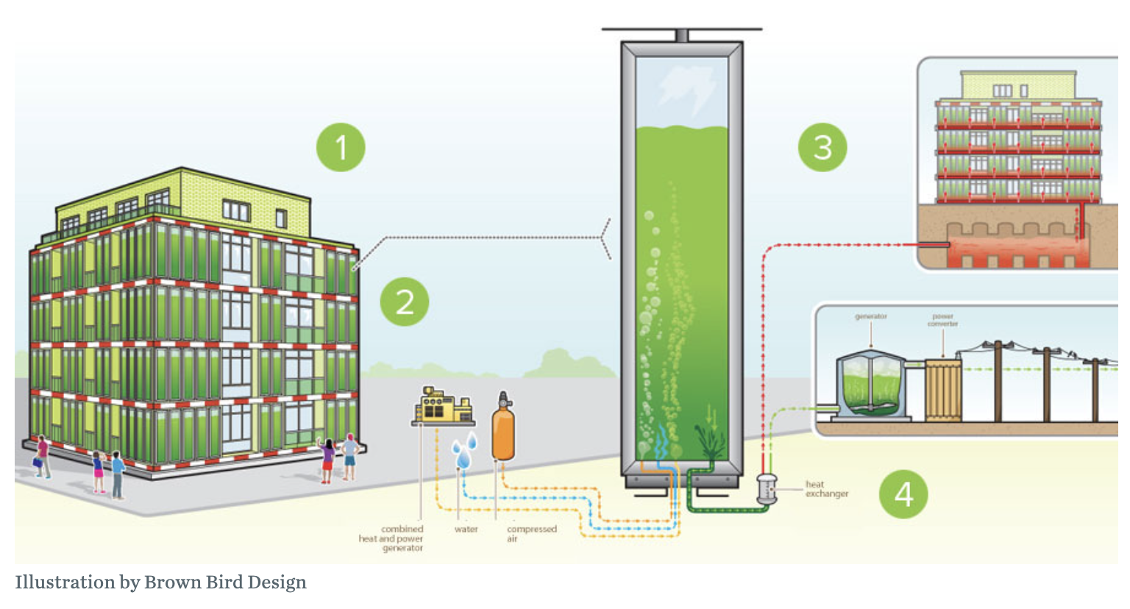
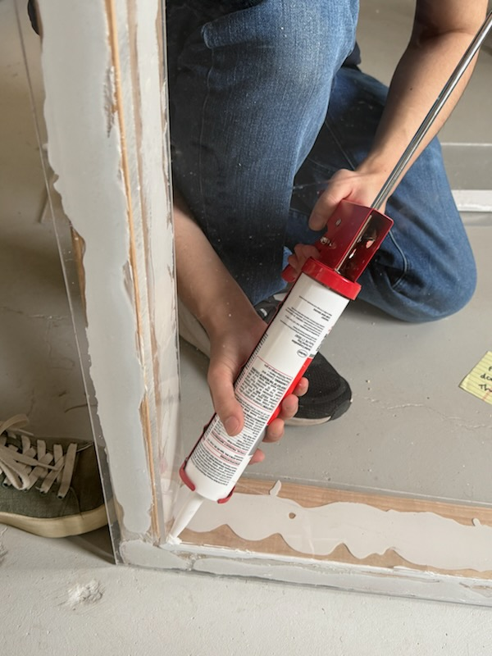
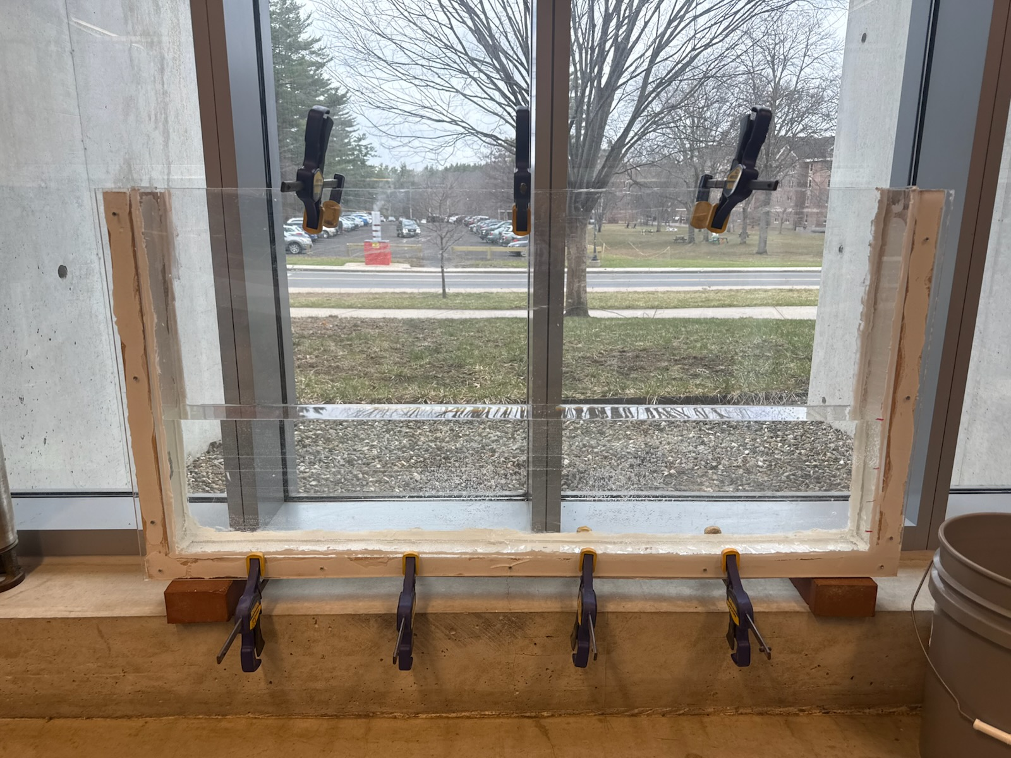
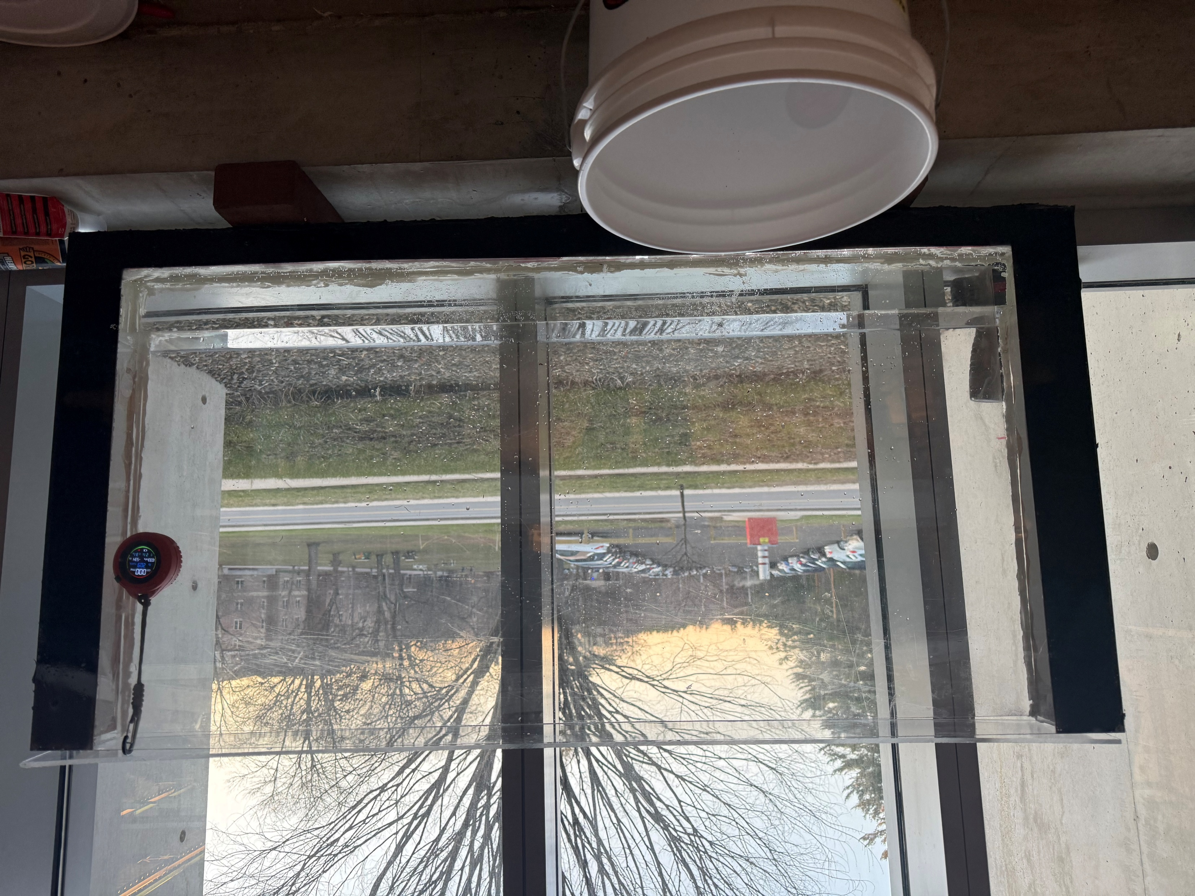
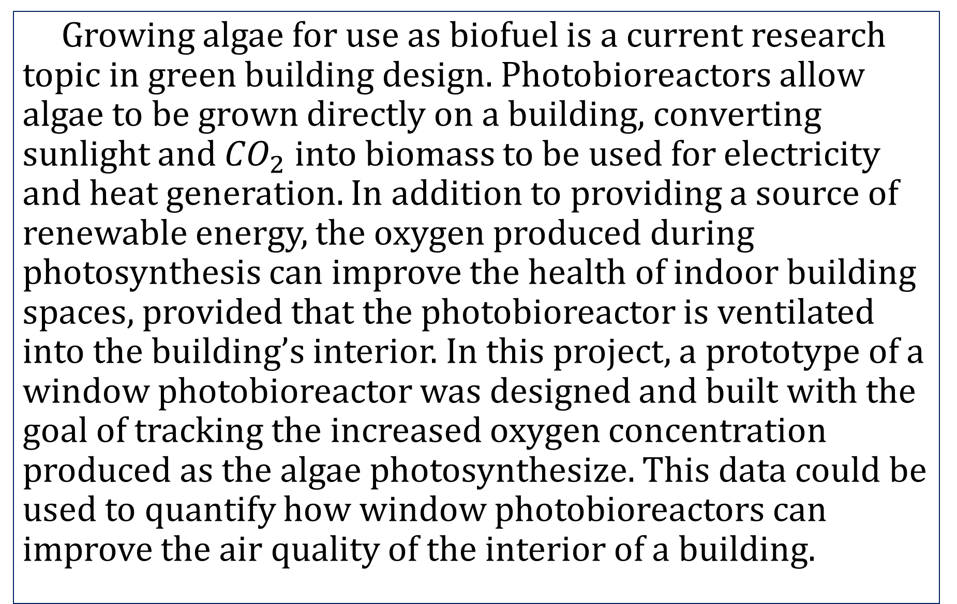

Experimental Window-Type Photobioreactor to Grow Algae
Madeline Eaton, Edward Evans, Vivian Oliver, Sebastian Roberts
Advisors: M.D. Sazan Rahman (Agriculture, Nutrition, and Food Systems) and M.S. Felix DeVito (Civil and Environmental Engineering)
Earth and Environmental Sciences, University of New Hampshire, Durham, NH 03824
Introduction
Motivation
Error Analysis
Growing algae for use as biofuel is a current research topic in green building design. Photobioreactors allow algae to be grown directly on a building, converting sunlight and ${CO}_{2}$ into biomass to be used for electricity and heat generation. In addition to providing a source of renewable energy, the oxygen produced during photosynthesis can improve the health of indoor building spaces, provided that the photobioreactor is ventilated into the building’s interior. In this project, a prototype of a window photobioreactor was designed and built with the goal of tracking the increased oxygen concentration produced as the algae photosynthesize. This data could be used to quantify how window photobioreactors can improve the air quality of the interior of a building.
During the construction of the Window-Type Photobioreactor several errors occurred which affected performance and reliability.
Performance errors included significant difficulty containing the water. The water, when about a quarter foot deep, imposes about 7.76lbs of force on each side wall. This causes the acrylic to bulge out and create small cracks between the wood, acrylic, and sealant. To prevent this from happening clamps were used as a temporary solution. Then additional fasteners were applied with washers to better distribute force from the acrylic to the wood.
The water used in the photobioreactor came from the Piscataqua River, which has a salinity of 2.5% to 3.4% or about 20 ppt to 35 ppt. The optimal salinity for growth of tetraselmis is 25% to 35% salinity. Tetraselmis are still able to grow in low salinity, although the results may be reduced.
BIQ Building in Hamburg Germany
“Algae-powered” building opens in Germany. (2013, April 17). New Atlas. https://newatlas.com/algae-powered-building/27118/
Author, T. (n.d.). Algae haus | sierra club. Retrieved April 15, 2026, from https://www.sierraclub.org/sierra/2013-6-november-december/innovate/algae-haus
Methods
Photos
Acknowledgements
Materials used in this project included wood, acrylic plates, two different types of silicone sealant, construction adhesive, screws, brackish water, tetraselmis, a light sensor, and an oxygen meter. The general process involved trying several photobioreactor designs and making necessary structural changes before a final enclosure was achieved.
Initially, a vertically oriented tank was created out of acrylic pieces and sealant without any structural supports.
This was adjusted to include a wooden frame and stronger adhesive in addition to horizontally orienting the tank to reduce the pressure on the acrylic plates.
The tank was tested several times and additional sealant, and screws were added to increase its structural integrity.
Once the photobioreactor was completed with an acrylic cover, it was inoculated with algae with the intent of measuring the concentration of oxygen above the waterline over the period of an algae growing cycle.
We thank M.S. Felix DeVito and M.D. Sazan Rahman for their substantial contributions to all phases of this project. Their guidance and hands-on support were critical, especially during the planning and construction process.
References
1. Algae-Powered Buildings: A Review of an Innovative, Sustainable Approach in the Built Environment. Sustainability, 15(4), 3729. https://doi.org/10.3390/su15043729BIQ
2. “Algae-powered” building opens in Germany. New Atlas. https://newatlas.com/algae-powered-building/27118/
3. ÇELEKLİ, A., YEŞİLDAĞ, I., & ZARİÇ, Ö. E. (2024, April 19). Green building future: Algal application technology. Journal of Sustainable Construction Materials and Technologies. https://dergipark.org.tr/en/download/article-file/3355000
4. Ferris, D. (2014, May 2). Algae Haus. Sierra Club. https://www.sierraclub.org/sierra/2013-6-november-december/innovate/algae-haus
5. Fakhiri, Muhammad, et al. Effect of Salinity and Photoperiod on Growth of Microalgae Nannochloropsis sp. and Tetraselmis sp. Nature Environment and Pollution Technology. University of Brawijaya. Malang: University of Brawijaya, 2015. Website. 15 4 2026. <https://www.researchgate.net/publication/281457074_Effect_of_Salinity_and_Photoperiod_on_Growth_of_Microalgae_Nannochloropsis_sp_and_Tetraselmis_sp_Nature_Environment_and_Pollution_Technology#pf2>.
6. Hotos, George N. “The Effect of Various Salinities and Light Intensities on the Growth Performance of Five Locally Isolated Microalgae [Amphidinium carterae, Nephroselmis sp., Tetraselmis sp. (var. red pappas), Asteromonas gracilis and Dunaliella sp.] in Laboratory Batch Cu." 2021. Website. 15 April 2026. <https://www.researchgate.net/publication/356054511_The_Effect_of_Various_Salinities_and_Light_Intensities_on_the_Growth_Performance_of_Five_Locally_Isolated_Microalgae_Amphidinium_carterae_Nephroselmis_sp_Tetraselmis_sp_var_red_pappas_Asteromonas_grac>.
7. Hydrostatic force on plane surface. (n.d.-a). https://c23434.net/resources/SEMM2313/Note-for-2313/0-Note-for-hydrostatic-force-plane.pdf
8. M., Melissa. The Piscataqua River: A description. n.d. 15 April 2026. <https://gaudet.info/LEARNIN1/WHRYWEB/DEADWOOD/MONK/PISCATQU.HTM#:~:text=The%20salinity%20in%20the%20river,river%2C%20the%20lower%20the%20salinity.>.
9. Patrinou, V., Daskalaki, A., Kampantais, D., Kanakis, D. C., Economou, C. N., Bokas, D., Kotzamanis, Y., Aggelis, G., Vayenas, D. V., & Tekerlekopoulou, A. G. (2022). Optimization of Cultivation Conditions for Tetraselmis striata and Biomass Quality Evaluation for Fish Feed Production. Water, 14(19), 3162. https://doi.org/10.3390/w14193162
10. Sedighi, M., Pourmoghaddam Qhazvini, P., & Amidpour, M. (2023).
Applying sealant to the photobioreactor.
The photobioreactor during construction.
The completed prototype with algae.
Calculations
Conclusions
Tetraselmis growth rate is represented by equation 1 below.
µ=$\frac{(ln\left(\frac{N_{2}}{N_{1}}\right))}{t_{2}−t_{1}}$ (1) $N_{2} and N_{1} are the cell concentrations at times t_{2}$
$and t_{1}.$
Expected specific growth rate in 25% salinity is about 0.41 to ~1.51 doublings per day in 12 hours of light.
This is in a Walne Medium.
Walne medium is made up of $NaNO_{3} and NaH_{2}PO_{4}$
In the 2mL sample there were about 1.3 x ${10}^{6}$ cells of tetraselmis.
After ~ a week 2.22 x ${10}^{7} cells$ are expected.
Total Pressure = $ρgh$ (2)
P = 784 Pascal = 0.1 lbs/${in}^{2}$
The inspiration for this project was the BIQ Building in Hamburg Germany, which was built to be a fully self-sustaining building, using energy provided from the photobioreactors built into the exterior walls of the building. In this project a similar photobioreactor was built that could be placed in a window and used to quantify the oxygen input into the living space. Once developed further, this model was designed to be an aesthetically pleasing, environmentally healthy way to bring biofuel production into office buildings and work as a display for future projects. The introduction of biofuel in buildings would reduce fossil fuel use, ultimately increasing the sustainability of the building and decreasing long-term costs.
Expected Results
The final result of this project was a completed photobioreactor tank that functioned with passive airflow. The tank successfully held 8963.25 cm³ of tetraselmis-inoculated water sourced from a local estuary during the algae’s growing cycle. These results show that the photobioreactor was able to withstand the pressure imposed by the water volume, shown in equation 2. Collecting data on the concentration of oxygen in the tank’s airspace is likely to show an increase in percent by volume as the algae grows, due to the fact that higher concentrations of algae yield greater oxygen output during photosynthesis.

