Slide 1
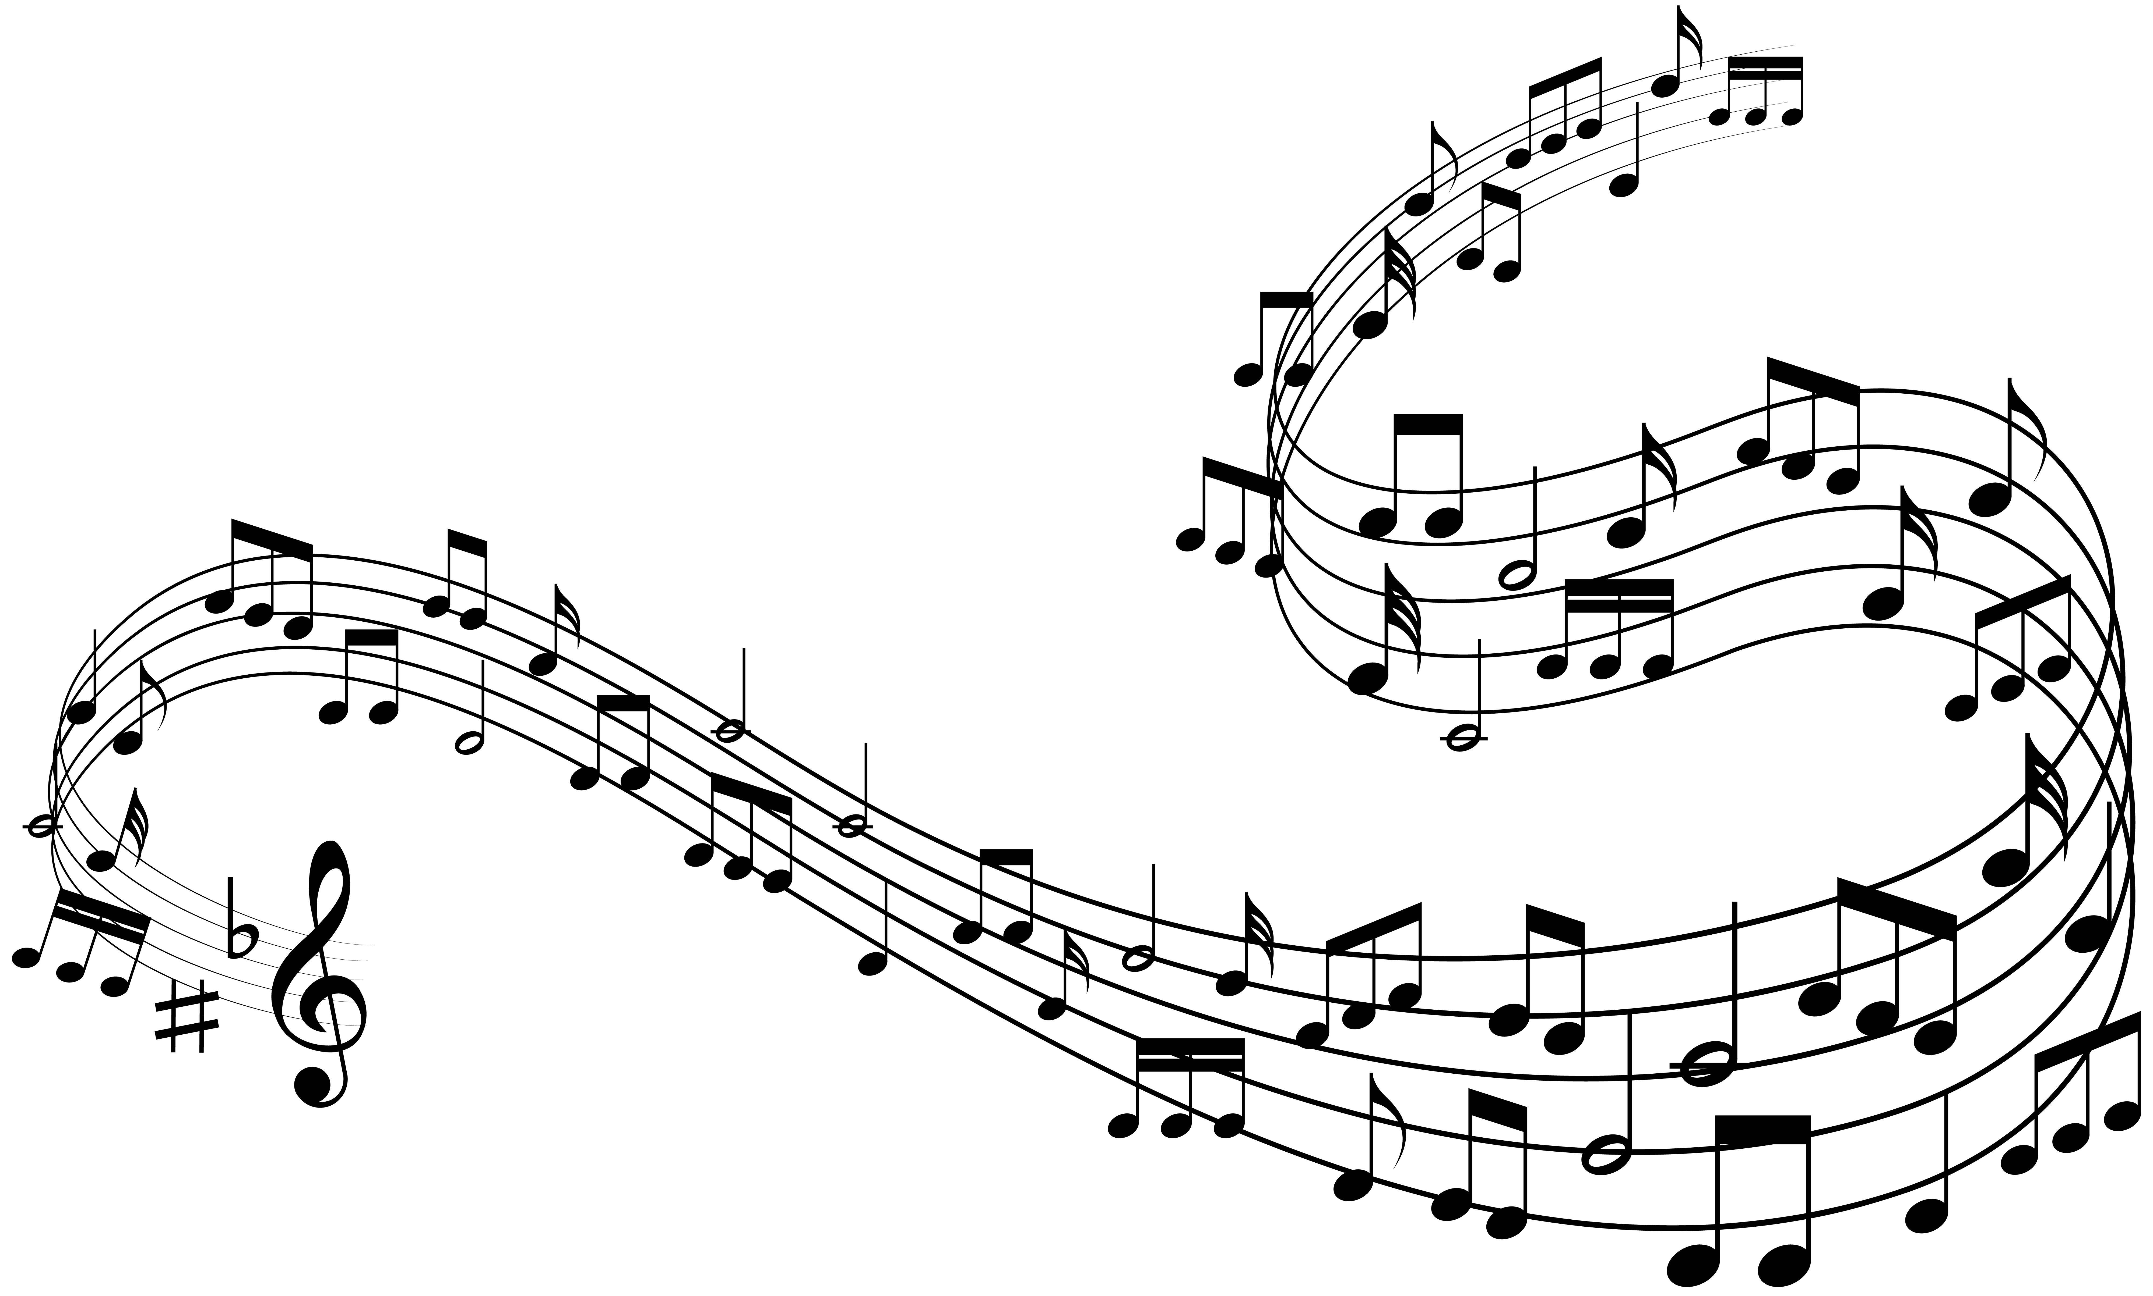


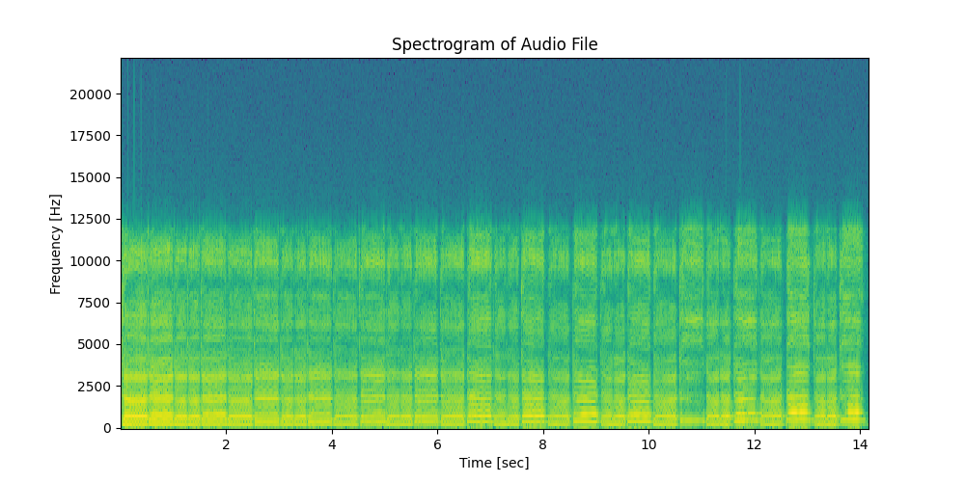
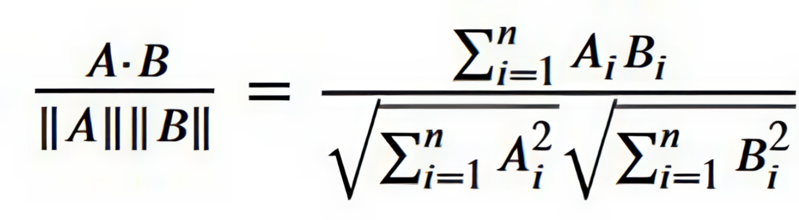

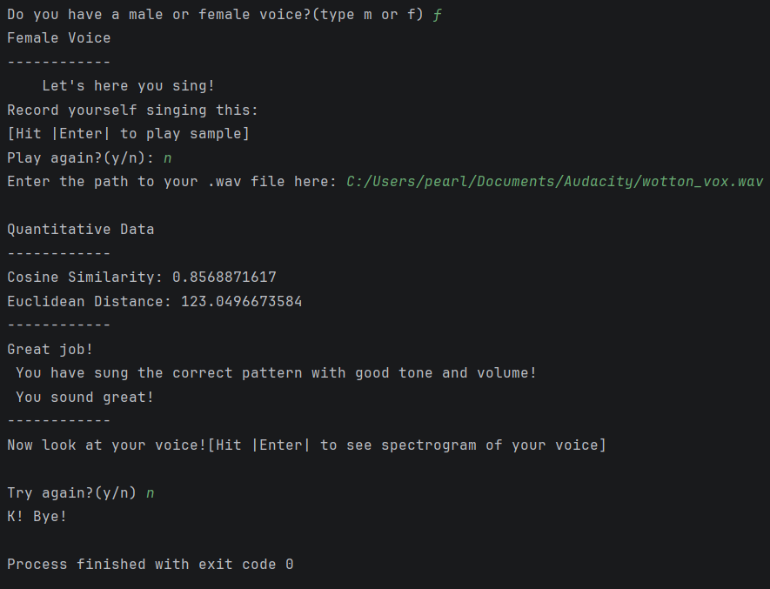
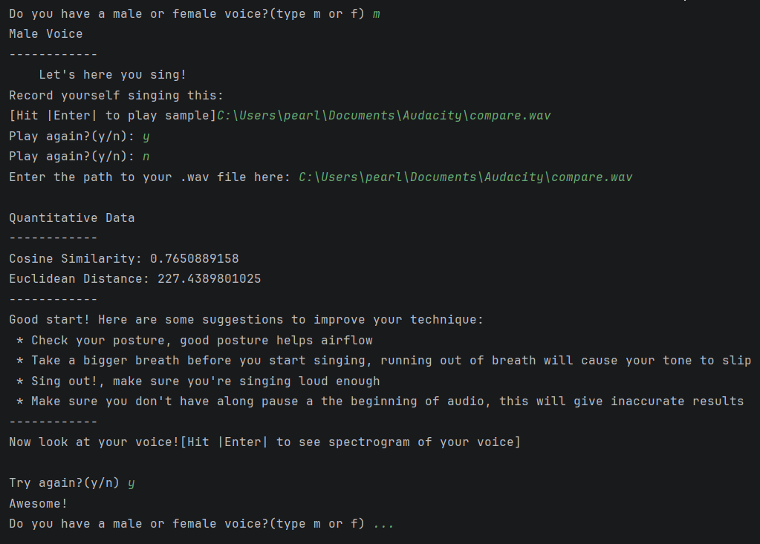
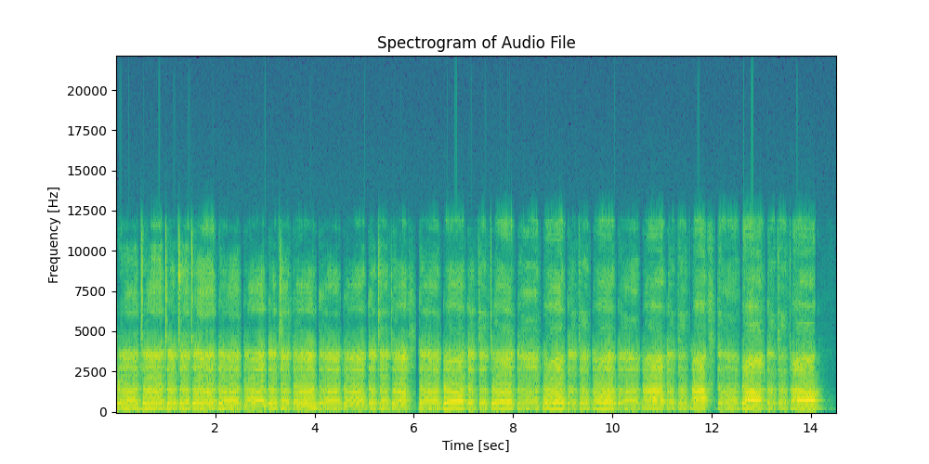
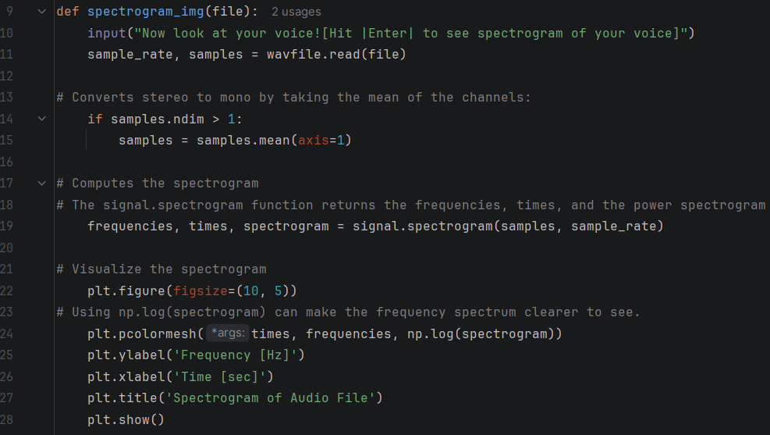
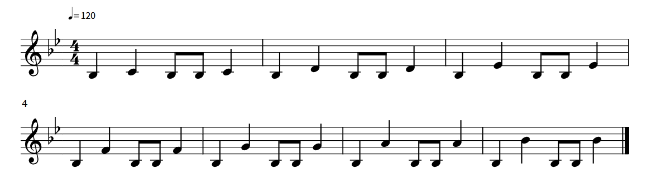

Quantitative Analysis of Voices to Improve Singing Technique
Pearl Hoekstra & Seamus Gustafson
Dr John Gibson, PhD
Background
Visual Aids
How do we analyze the audio files?
Cosine Similarity: The measurement of the cosine between two non-zero, n-dimensional vectors in an inner product space. A score of 1 means the two vectors are identical, a score of 0 means the two vectors are unrelated, and a score of >1 means the two vectors are dissimilar.
Euclidian Distances: The measurement of the distance between two points in an n-dimensional space.
Feedback on technique is essential to improving one’s singing ability. Singers can struggle with staying in tune, keeping tempo, and supporting their sound. Traditional vocal lessons are often inaccessible for many. Using a program to compare voices to an amateur singer’s can be used to give guidance in a more accessible way.
Cosine Similarities
Euclidian Distance
Results
Figure 1. A spectrogram showing the audio the programs compares female voices to
Objectives
Find and test different algorithms to determine which one(s) work best for comparing audio
Use cosine similarities, Euclidian distances, and spectrograph imaging to compare vocals
Interpreting those comparisons into something understandable to the user
Figure 4. Output code example for a female voice with good tone.
Figure 5. Output code example for male voice that needs improvement.
Figure 2. A spectrogram showing the audio the programs compares male voices to
Future Goals
How do we produce the images?
In the future, we would plan to use machine learning to compare voices more efficiently than traditional computing techniques can manage. Specifically, a convolutional neural network would be trained on a wide variety of data points to correctly identify desirable and undesirable aspects of a users’ voice. Pre-generated responses would then be given based on what the program detects, giving pointers on what to change.
Matplotlib.pyplot: MatLab library used to make plots, used to make spectogram
scipy import signal: Used to get the function to construct spectograms
scipy.io import wavfile: Used to read imported .wav files
numpy: Used to make frequency spectrum clearer in the image
librosa: Used to extract MFCCs from audio files
scipy.spatial.distance import
cosine, Euclidean: Used to compare extracted information from audio files
playsound3 import playsound: Used to play prerecorded sound
Python Libraries Used
Figure 3. Index tone to be sang into the program
Acknowledgements
Thank you to:
Professor Kevin Short, PhD, Eben Quenneville,
Nathan Wotton,
Portsmouth Music and Arts Center,
and various article writers from IBM
Figure 6. Program to produce a spectrogram from a given .wav file

