Slide 1

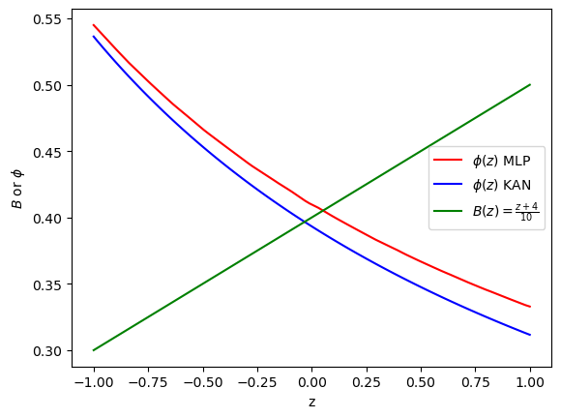
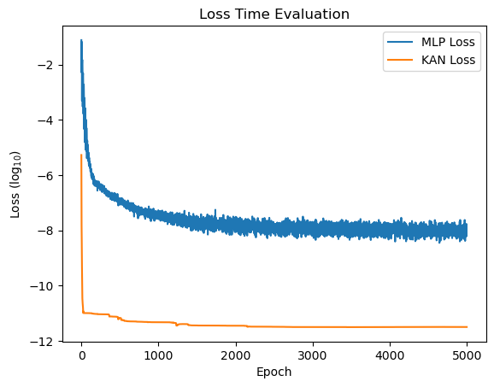
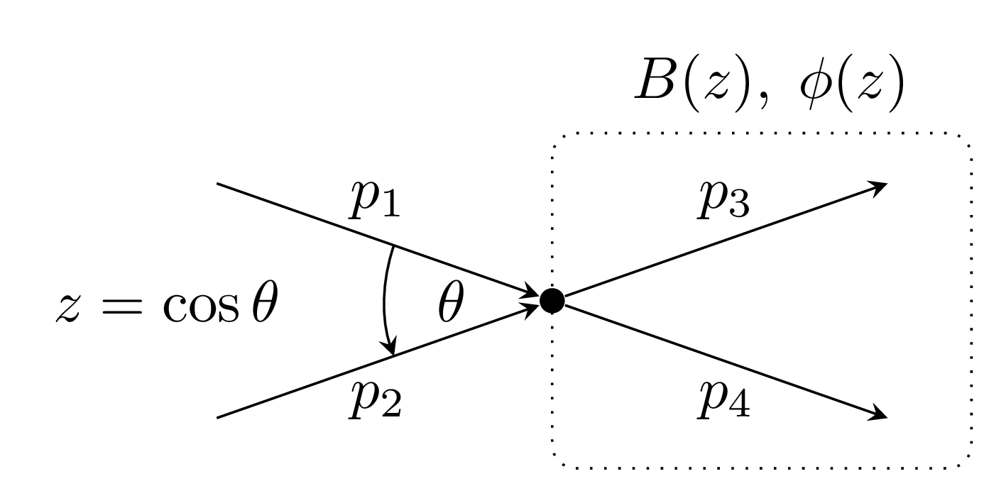
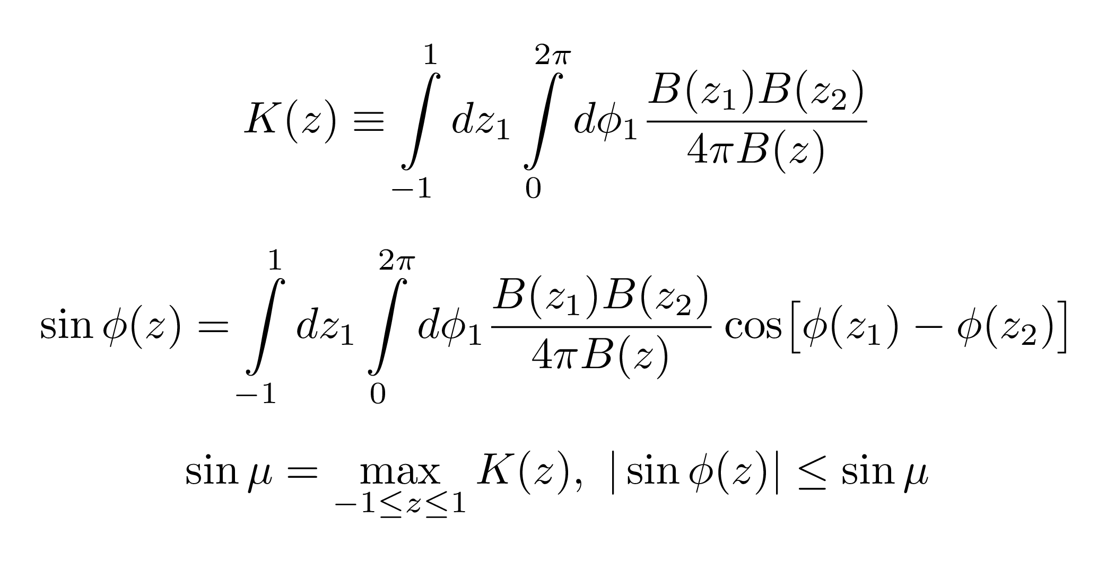
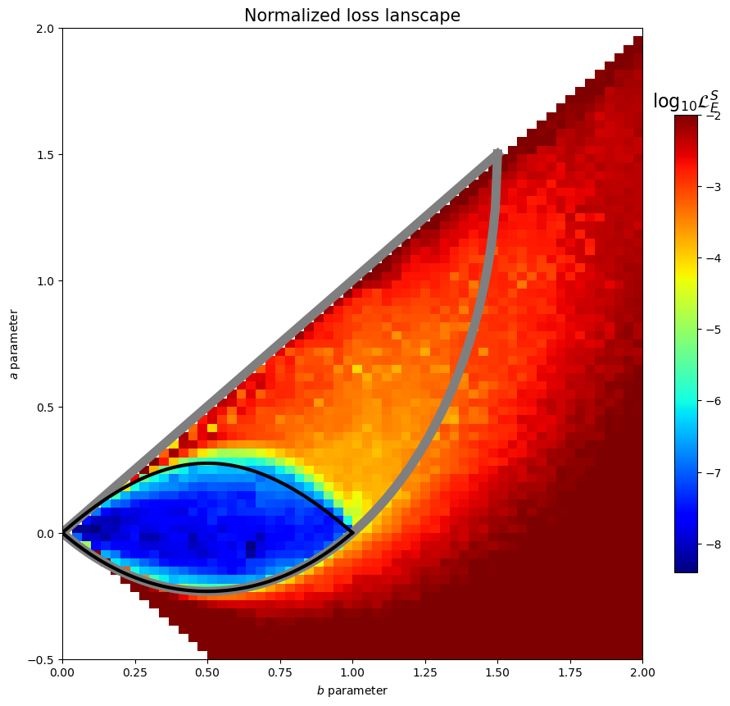
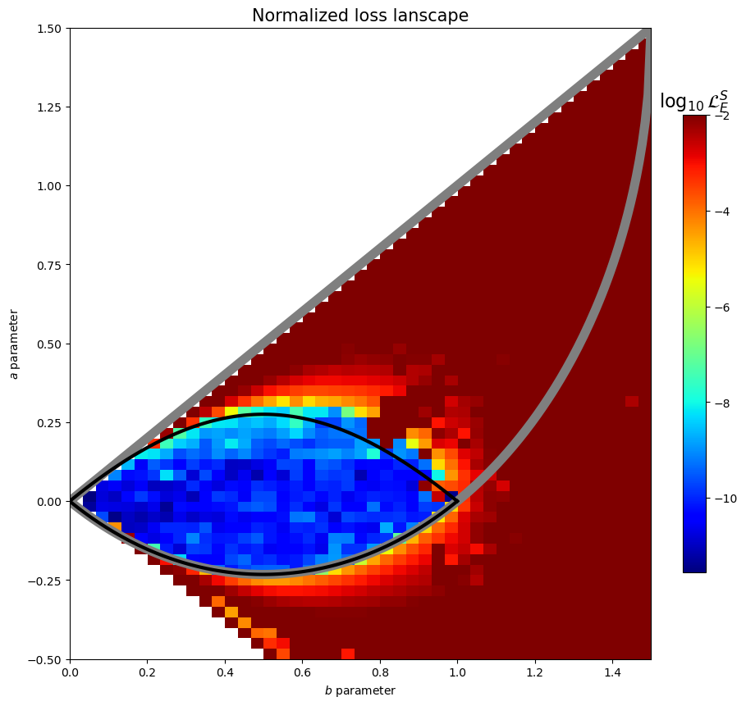
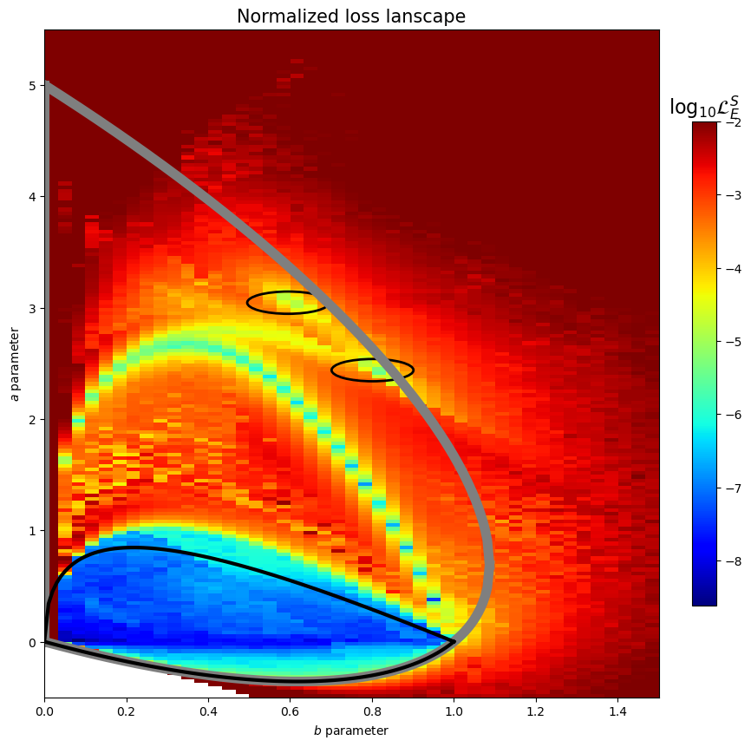
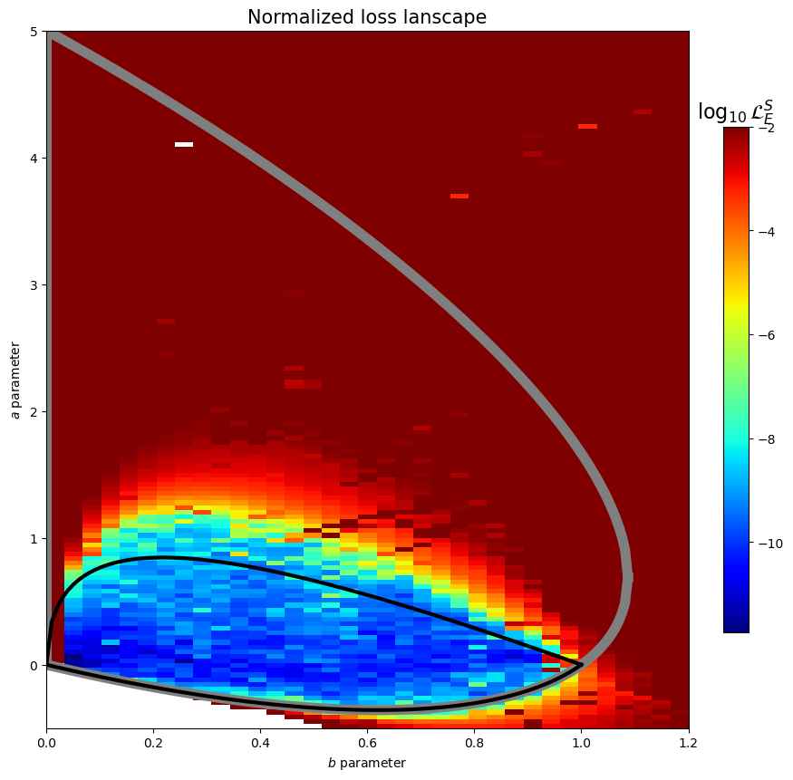
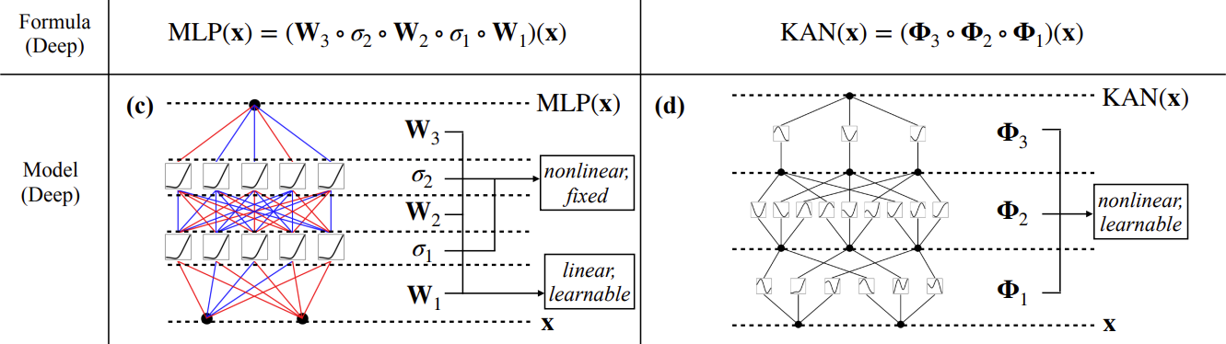

Improving Accuracy of Scattering Predictions with Machine Learning
Michael Wentzel, Advisor: Prof. Per Berglund
Department of Physics, University of New Hampshire, Durham, NH 03824
Introduction
Training Comparison
Data & Results
The Scattering Matrix (S-Matrix) is a matrix representation of the probability amplitudes of particles scattering off each other
The S-Matrix is a fundamental part of Quantum Field Theory
The S-Matrix contains all possible ways that particles can scatter off each other
In the 1970’s D. Atkinson solved for families of solutions with nontrivial phase shift ambiguities [1]
Atkinson solved for a parameter called sinμ, which determines if solutions have ambiguous phase shifts
Atkinson solved for a lowest sinμ value of 2.15, which remained the low until 2023 [2]
In 2023 Dersy, Schwartz, and Zhiboedov published a paper using machine learning to solve for a new lowest sinμ value of 1.67
Dersy et al. published their S-Matrix Bootstrap program with their paper [2]
Last year, we were able to modify the S-Matrix Bootstrap to achieve a lower value of 1.447, and were able to achieve overall better results using more integration points in the integral estimation and Adaptive Fourier Features
We have continued to try to improve results using Kolmogorov-Arnold Networks
Learned Phases φ(z)
Loss Comparison
On the family of linear and quadratic B(z) we have a been able to improve results for solutions to φ(z) for sinμ < 1
sinμ < 1 (black loop in Figs. 4-7) is of interest because we are guaranteed a single-phase solution to φ(z)
Inside the black loop for the KAN model our solutions are generally 2 orders of magnitude lower
Original MLP has smoother results, Figs. 4 & 6 show less variation as you move to the boundary
The original MLP (Fig. 6) had low loss in two small regions where possible solutions existed that were not found by the KAN
Time to get solutions is much quicker
For a single solution using MLPs it takes about 2-2.25 minutes
Using KANs solutions were reached in about 45-50 seconds
With KANs we are able to use better optimizers
The original MLP uses the Adam optimizer, which can iterate quickly and is memory efficient, but takes more iterations
With KANs we were able to use LBFGS, which is more memory intensive, but is can achieve results in fewer iterations
We tried using LBFGS with the original MLP, but it couldn’t reach solutions
Figure 2: Learned φ’s for a Given B(z) Modulus
Figure 3: Loss Evolution of MLP vs KAN Models
Loss Landscape Comparison
Original Results
KAN
Conclusions
KANs can reach solutions with lower overall loss in shorter amounts of time
In areas where we are guaranteed to have a single solution KANs are able to learn said solution with lower loss
Where more than one solution is expected the KAN model loses accuracy very quickly
After many weeks of attempts we were unable to implement a KAN model that was able to effectively learn both the B(z) modulus and two-phase solutions φ(z)
Future work could include finding a way to implement two-phase solutions and solving for the B(z) modulus to compare the efficiency of KANs vs. MLPs at solving this problem, and compare the solutions for the sinμ value
KAN Model
Figure 4: Loss Landscape Using MLPs for the Solution Family B(z) = az + b [2]
Figure 5: Loss Landscape Using KANs for the Solution Family B(z) = az + b
Kolmogorov-Arnold Networks (KANs) are based off Kolmogorov-Arnold Representation Theorem and fit splines to data instead of weighted activation functions
Kolmogorov-Arnold Representation Theorem – if f is a multivariate continuous function on a bounded domain, then f can be written as a finite composition of continuous functions of a single variable and the binary operator of addition [3]
$$f\left(x\right)=f\left(x_{1}, …, x_{n}\right)=\sum_{q=1}^{2n+1}{Φ_{q}\left.\left(\sum_{p=1}^{n}{φ_{q,p}\left(x_{p}\right)}\right.\right)}$$
Acknowledgements
Thank you to Professor Per Berglund with help throughout the course of this project, and Giorgi Butbaia for introducing me to this project originally.
References
[1]Atkinson, D., et al. “Crichton Ambiguities with Infinitely Many Partial Waves.” Physical Review D, vol. 17, no. 9, 1 May 1978, pp. 2492–2502.
[2]Dersy, Aurélien, et al. “Reconstructing S-Matrix Phases with Machine Learning.” Journal of High Energy Physics, vol. 2024, no. 5, 16 May 2024, https://doi.org/10.1007/jhep05(2024)200.
[3]Liu, Z., et al. “KAN: Kolmogorov-Arnold Networks.” arXiv, 30 April 2024, https://doi.org/10.48550/arXiv:2404.19756
[4]Crichton, J H. “Phase-Shift Ambiguities for Spin-Independent Scattering.” Il Nuovo Cimento A, vol. 45, no. 1, 1 Sept. 1966, pp. 256–258.
Figure 1: Comparison of how MLPs and KANs Work [3]
Figure 6: Loss Landscape Using MLPs for the Solution Family B(z) = cz² + d [2]
Figure 7: Loss Landscape Using KANs for the Solution Family B(z) = cz² + d

