Slide 1


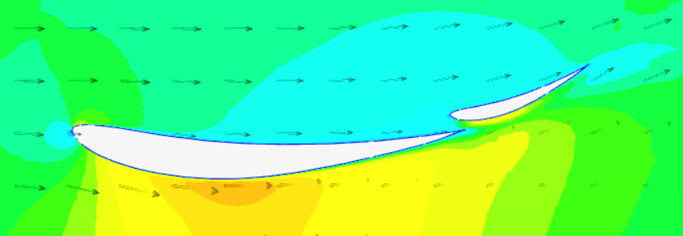
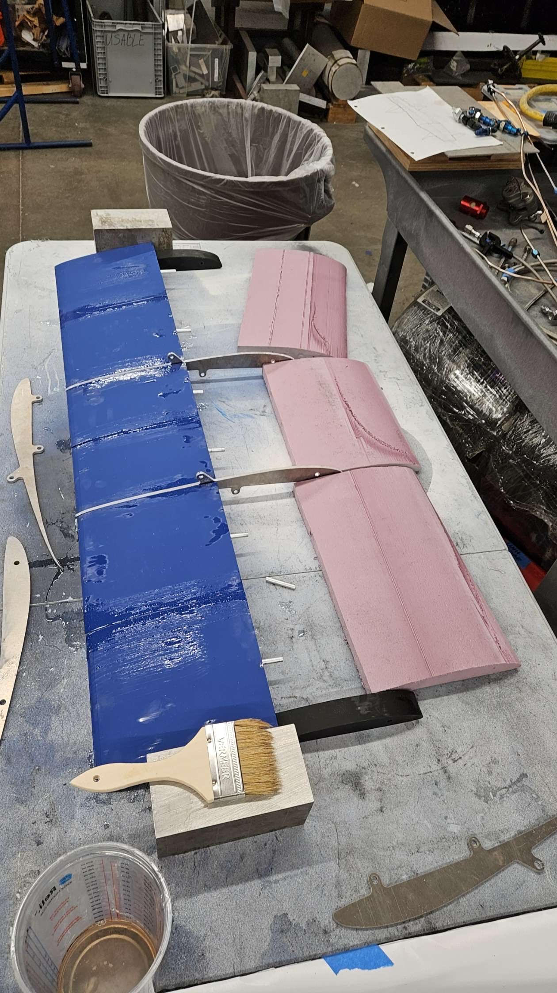
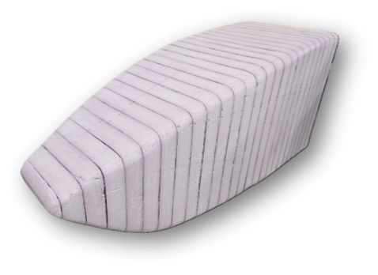
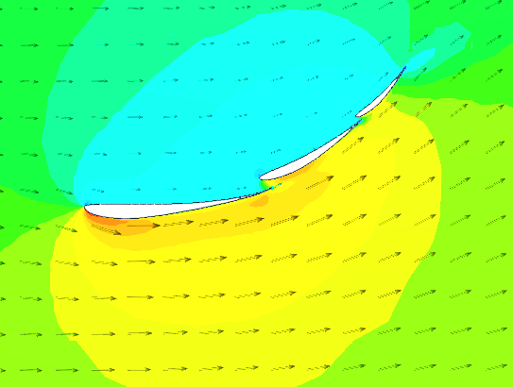
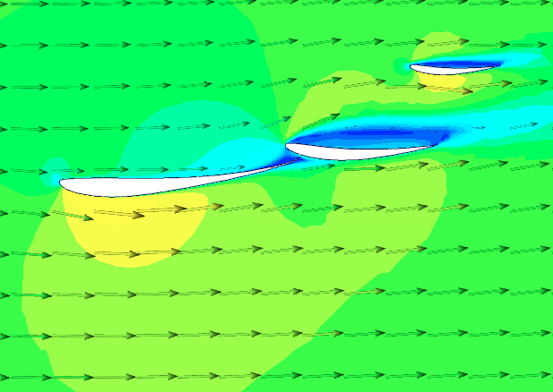
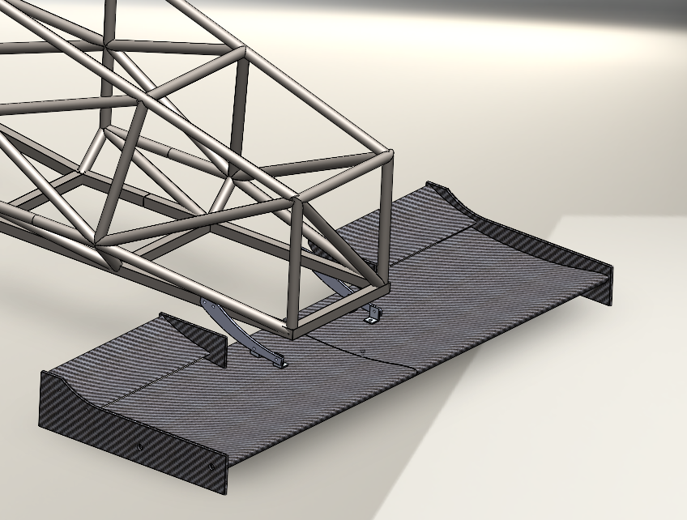
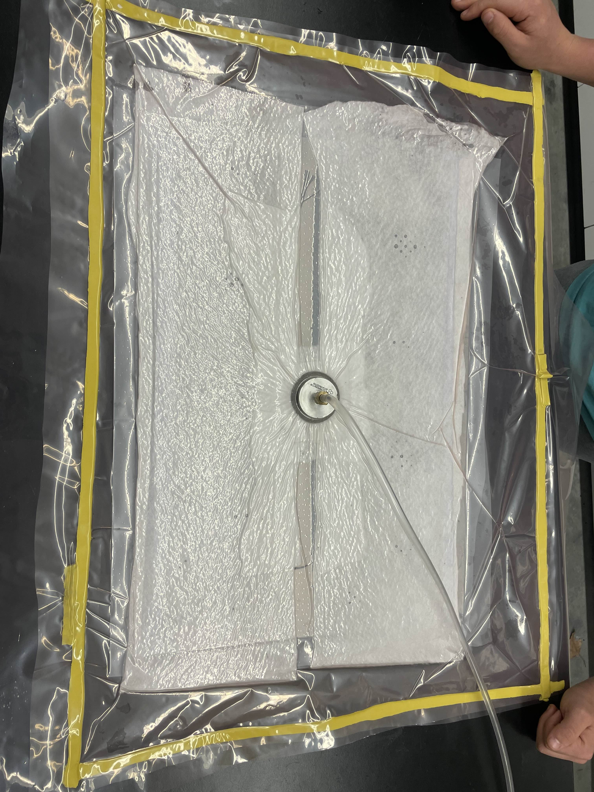
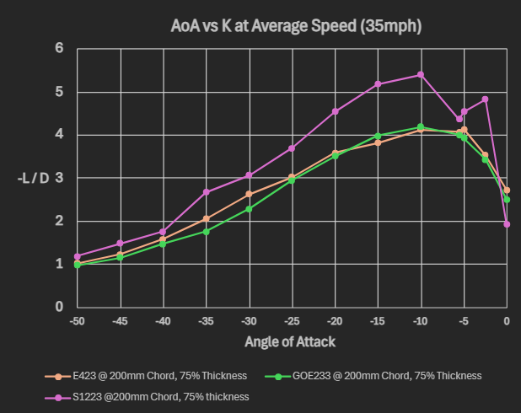
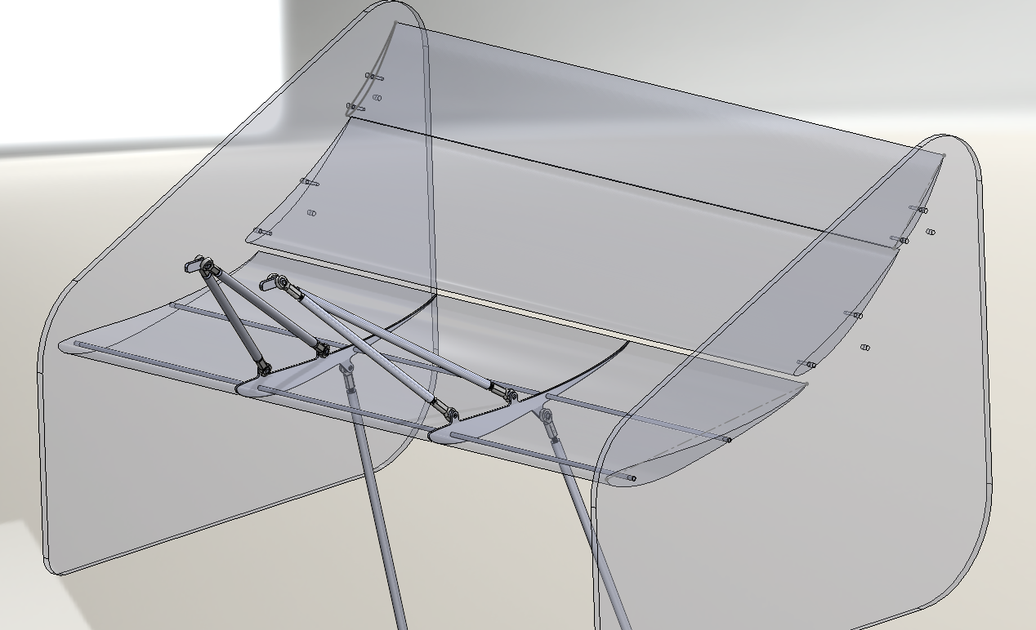
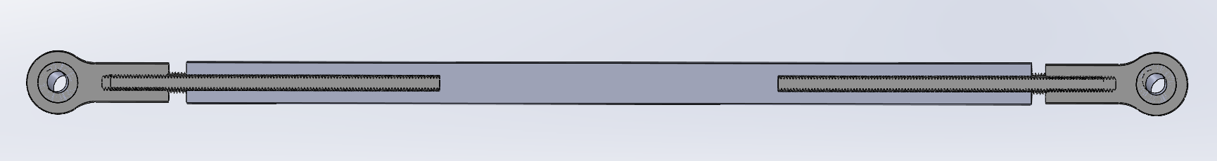
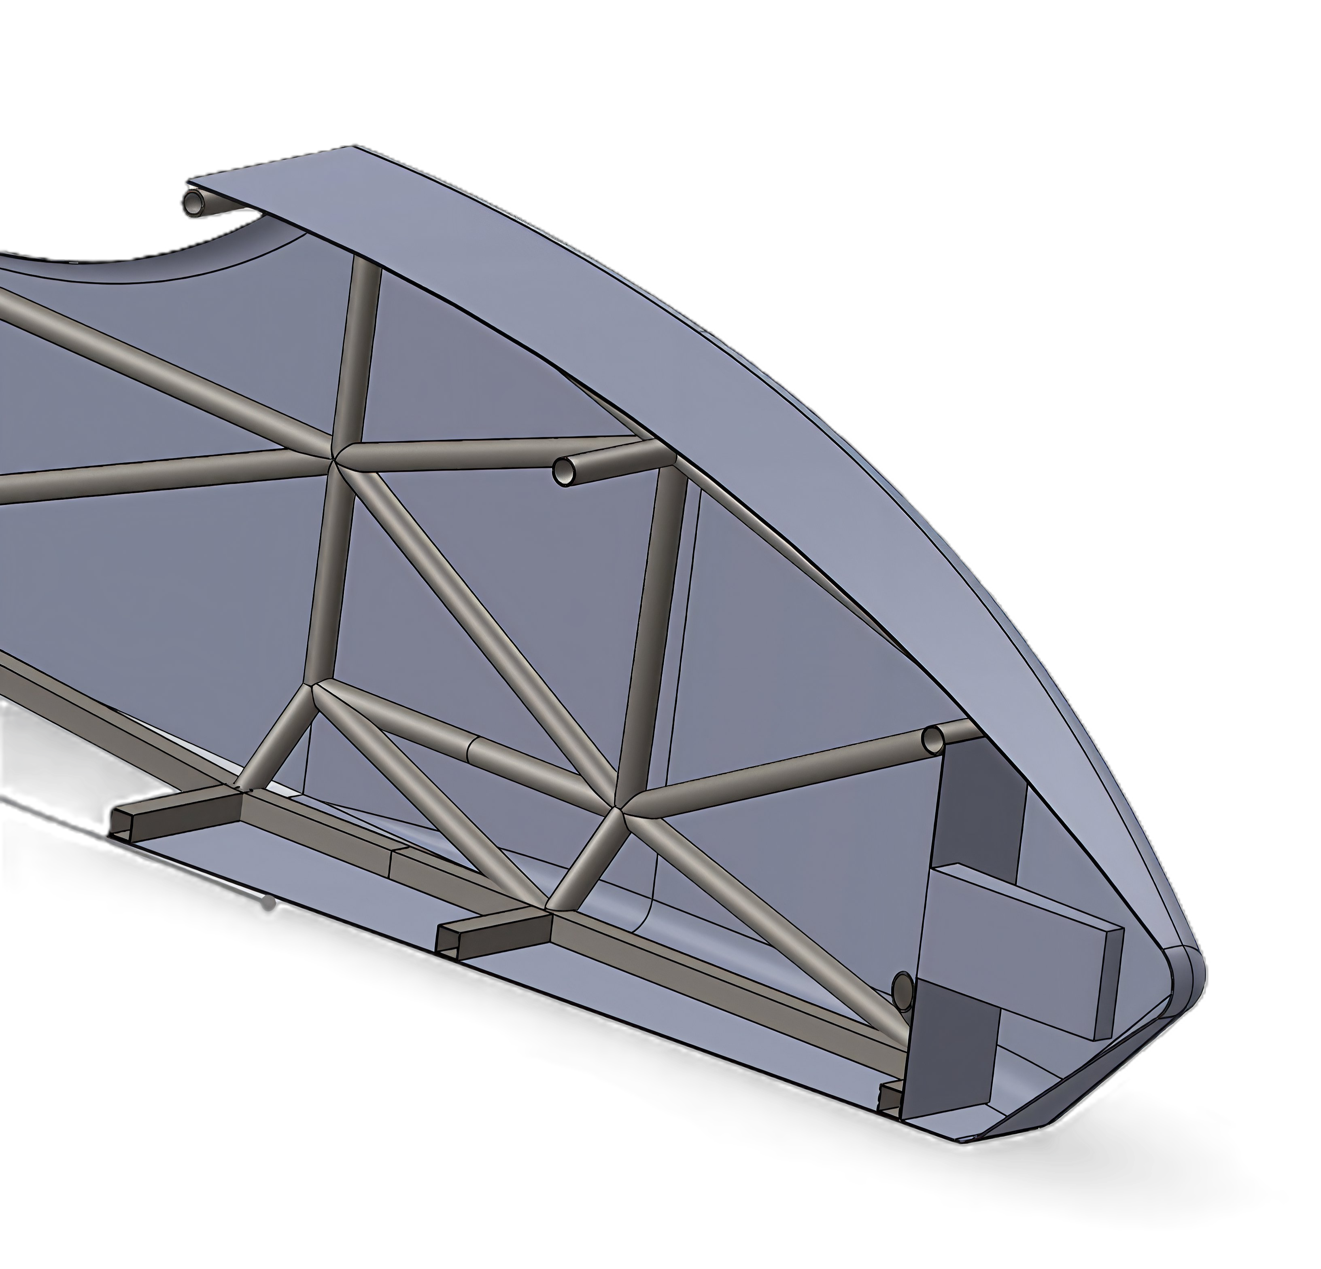
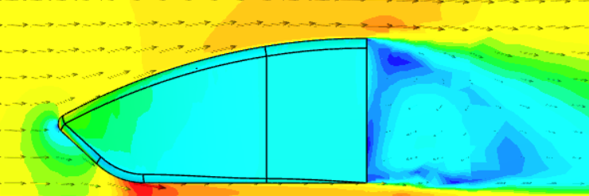
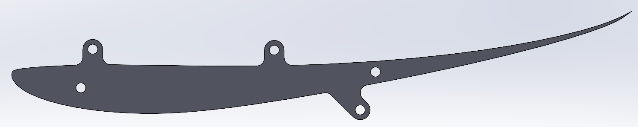
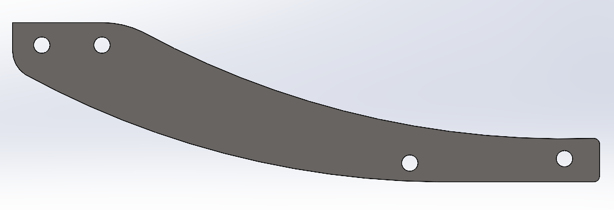
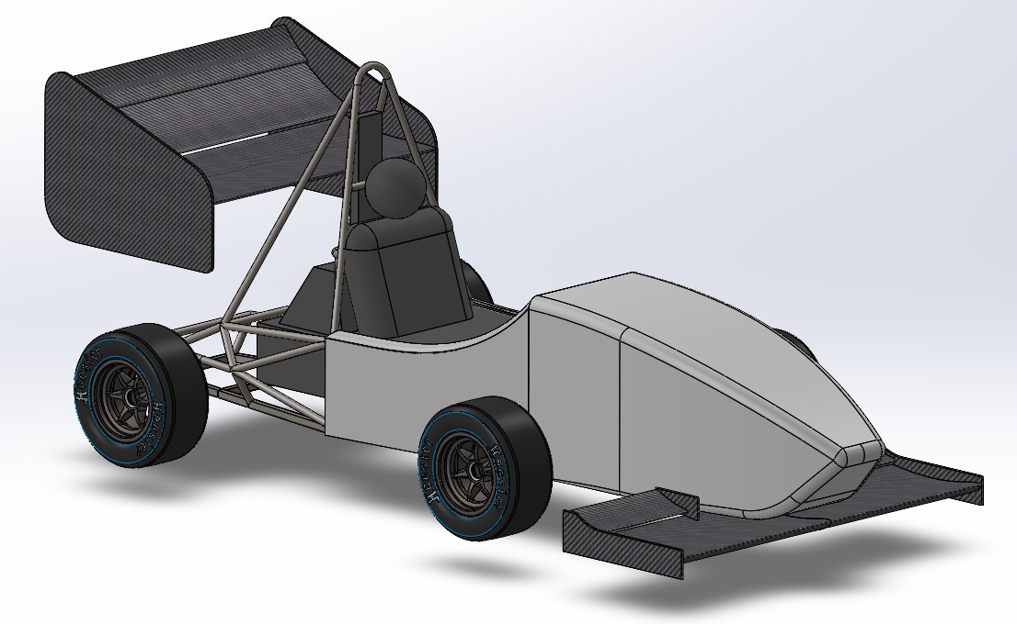
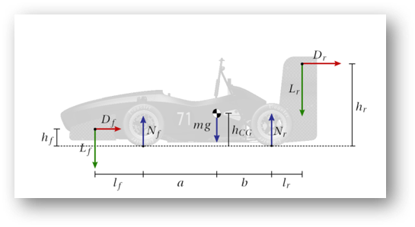
UNH Formula Student Aerodynamics
Kyle Foster, Jack Hamlin, Jake Mueller, Will Sherts
Department of Mechanical Engineering, University of New Hampshire, Durham, NH 03824
Introduction
Rear Wing
Front Wing
Manufacturing and Fabrication
UNH Precision Racing competes in an international collegiate design competition hosted by the Society of Automotive Engineers (SAE). The aerodynamics sub-team designs external components including the front wing, rear wing, and bodywork, improving vehicle performance by increasing downforce, allowing for higher cornering speeds. The team has not had front and rear wings in several years so their inclusion will help to the team make a large performance step over recent years.
Designed with overall dynamic car behavior
3-element wing design
6 nodes of contact mounting assembly
250 N of downforce at averaged track speed
Endplate design decreases induced drag and improves efficiency
2 configurations for varying dynamic events
3.8x more efficient than rear wing
Design inspired from 2014 FSAE team
2-element wing design
Average ride height of 50mm
Ground effect is heavy contributor
Main wing plate hotwire-cut from XPS foam
Rear flaps 3D printed in PLA (5 sections each)
Parts bonded with adhesive
Water-jetted aluminum spars for alignment and strength
Carbon fiber layup (1 layer + sanded epoxy recoat) per element
Endplates: 2-layer carbon sandwich, vacuum-bagged
Male mold: XPS foam sections from SolidWorks, then sanded
Lift and Drag coefficients for front wing
C_{L} | C_{D} | K (C_{L}/C_{D})
-1.62 | 0.20 | -8.10
Lift and Drag coefficients for rear wing
C_{L} | C_{D} | K (C_{L}/C_{D})
-2.37 | 0.67 | -3.54
Front wing configuration
Analysis and Optimization
Research and analysis was done on each aerodynamic wing profile, accounting for low speeds and high downforce. Four airfoils were simulated at the average FSAE vehicle speed (15.7m/s). CFD simulations calibrated with results.
Flaps in maximum downforce configuration
Flaps in minimum downforce configuration
Front wing mounting to frame
Holes cut through bottom of nosecone for brackets
Allowable Angle
adjustments:
Mid Flap:
30° & 0°
Top Flap:
45° & 0°
Bodywork
Designed to provide a smooth surface over the frame
Protects driver and controls from debris
Shape stays close to frame while making sure the car is rule compliant
Nose tip adheres to 38 mm min. radius specified in rules
Conclusions & Future Work
Mounting
We plan to document our findings from this year to pass down to future teams to allow them to improve it year on year. This will enable future teams to:
Design additional components such as an undertray and side pods
Improve ease and speed of manufacturing processes
Be able to conduct more real-world testing such as in the UNH wind tunnel
Improve overall car performance, leading to better competition results
Heim joint and rod assembly for mounting the rear wing to the roll hoop
Overall dynamic downforce goals were based on a 45:55% ratio on the front and rear wheels for overall downforce metrics.
Rear wing cross section gives points for the Heim joints to attach to the rear wing
Full Aero Package Model
Acknowledgments
We would like to thank Sheldon Parent for setting up our ANSYS software, as well as Seth Chartier for helping us with MTS machine use and water jetting at the Olsen Center. We also want to acknowledge Ivaylo Nedyalkov and Juan Carlos Cuevas Bautista.
Front wing mounting bracket
References
Mounting Specs:
Water-jetted and lathe
6061-T2 Aluminum
Factor of Safety for mounting brackets:
3.5 at 15.7m/s with 5x expected force
[1] Airfoil Tools: Airfoil database and analysis tools. http://airfoiltools.com/
[2] SimScale: Cloud-based CFD simulation platform. https://www.simscale.com
[3] McBeath, S.: Competition Car Aerodynamics, 3rd Edition. Veloce Publishing, 2017.
[4] JKF Aero: https://www.jkfaero.com/about/

