Slide 1

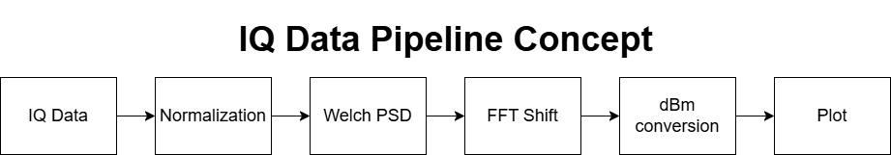
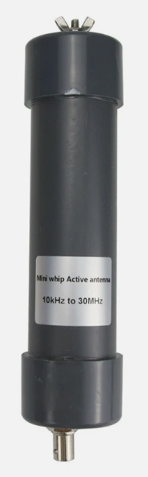
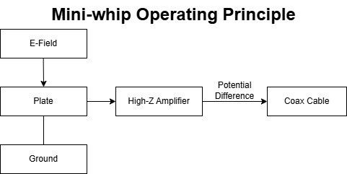
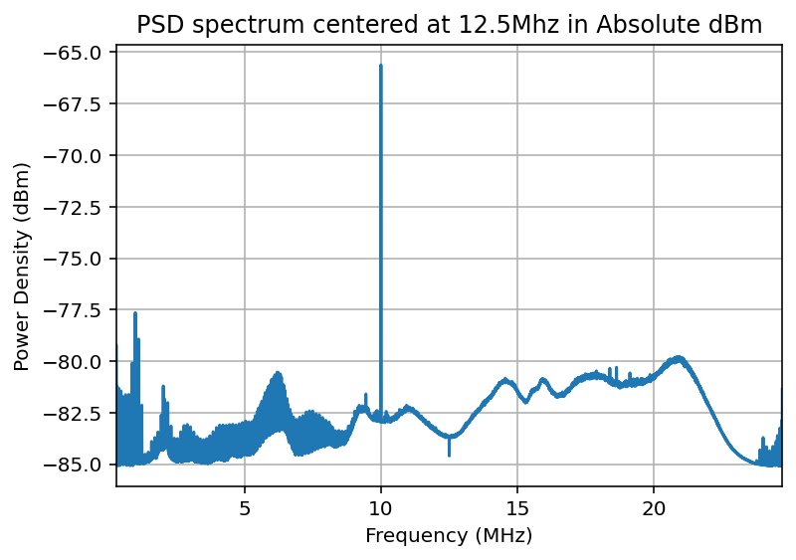
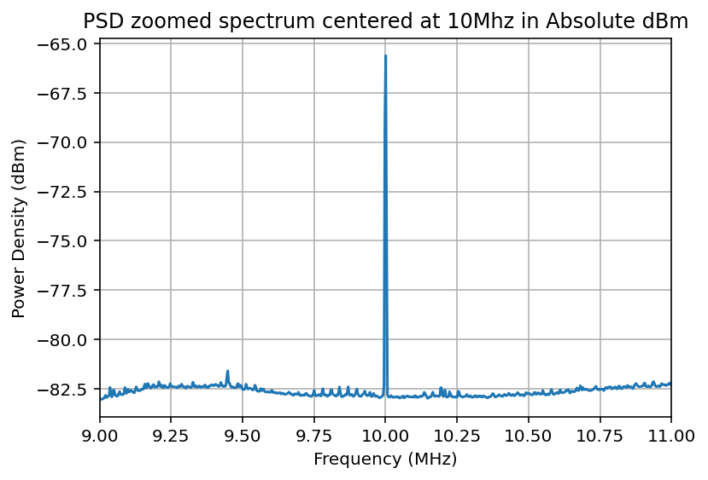
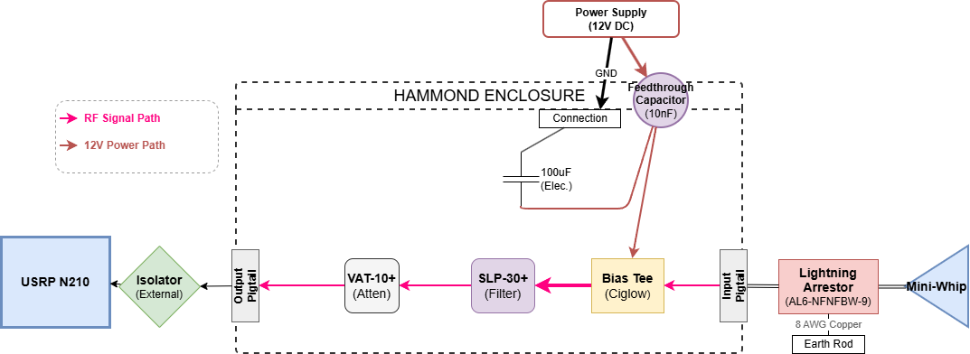
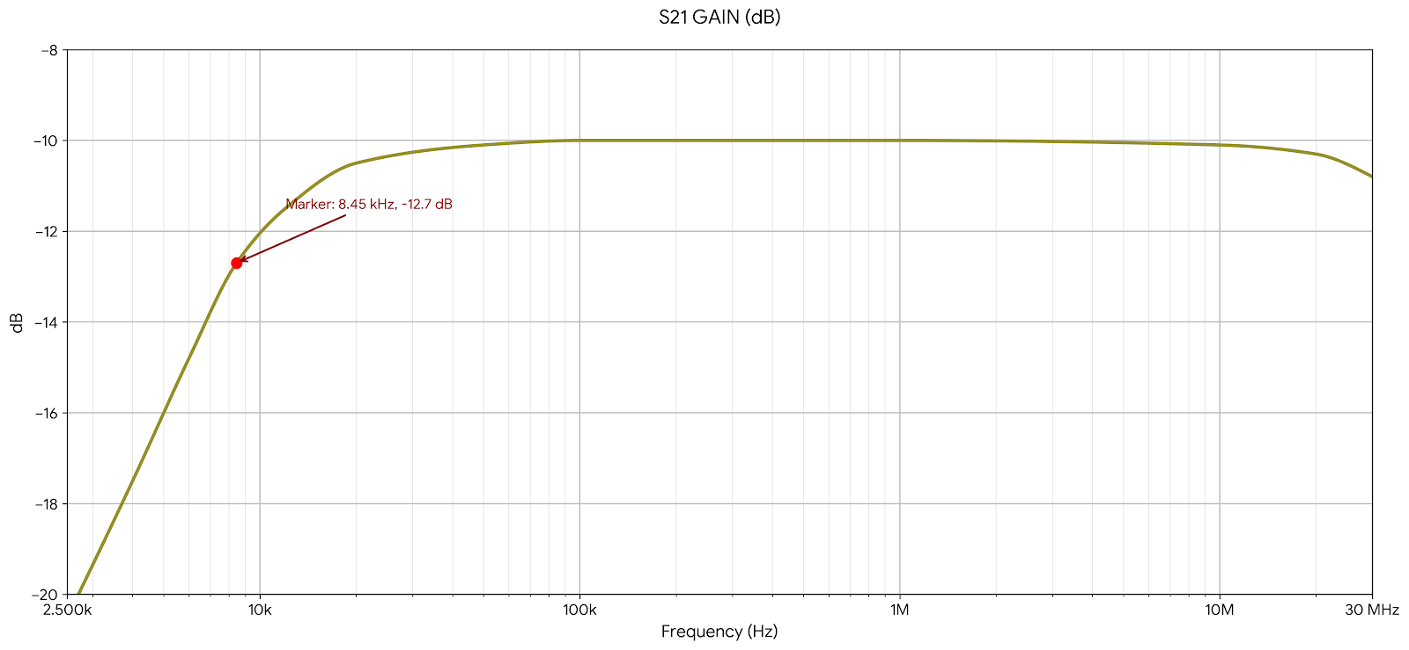
Detecting Transient Lightning Electric Field with a Mini-whip Antenna System
Jake Volovar, Stephen Horn, Dr. Ningyu Liu, Department of Physics and Astronomy, University of New Hampshire
Background
Pa0rdt Mini-whip Antenna
N210 - results
Lightning is a common natural phenomenon, yet its underlying physics are still not fully understood. Key questions remain:
            Initiation
            Propagation
            Development in thunderclouds
Improving this understanding is important for atmospheric modeling, weather prediction and electromagnetic studies.
This research is supported by the Radio Interferometer for Thunderstorm Studies (RIFTS), a collaboration between the University of New Hampshire, Massachusetts Institute of Technology, and New Mexico Institute of Mining and Technology.
Active electric field antenna operating from 10kHz to 30MHz, sensing potential difference between the antenna plate and ground.
Internal High-impedance amplifier buffers and drives signal onto coax.
Performance is highly dependent on grounding quality, as ground noise directly impacts signal integrity.
The IQ data pipeline was built in Python using NumPy, SciPy and Matplotlib to generate the plots.
A 10MHz signal was sent to the Mini-whip System connected to a USRP N210, which digitalized the 10kHz – 25MHz band into IQ data files.
We can see the 10Mhz signal clearly stands above the noise floor in the full spectrum.
Motivation
Fast (wideband) antennas enable detection of weak, transient RF signals over large areas, critical for lightning and atmospheric studies.
The Mini-whip was selected for its low cost, simplicity, and proven use within the amateur radio community despite limited commercial options.
Front-end System
A zoomed in graph from 9-11MHz showing the 10MHz signal centered.
Goals
This project focuses on the development and evaluation of an RF sensing system using a Mini-whip antenna integrated with a USRP N210 software defined radio platform.
The primary objectives are to:
  Capture and process RF signals in the LF-HF spectrum.
  Achieve a low system noise floor for improved signal detection.
  Implement robust Power Spectral Density (PSD) analysis for signal characterization.
Filtering and attenuation protect the receiver while maintaining signal integrity.
Feed Through capacitor provides high-frequency noise suppression, while bulk capacitor stabilizes voltage.
System successfully captured LF-HF signals with a stable, observable noise floor, enabling usable data for atmospheric modeling, and other research applications.
The effective cutoff frequency is defined relative to the passband, occurring where the response drops 3dB.
References
de Boer, P.-T. (2015). Grounding of MiniWhip and other active whip antennas.
de Boer, P.-T. (2014). Fundamentals of the MiniWhip antenna.
Lichtman, M. (n.d.). A guide to SDR and DSP using python.
Grayhat. (2020). How to properly install a mini whip antenna in an noisy urban environment.

