Slide 1

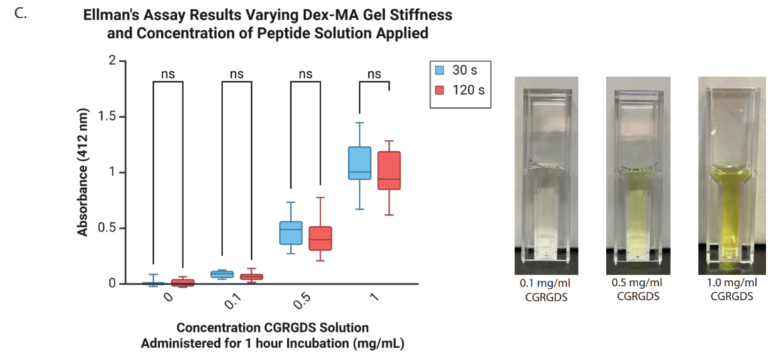
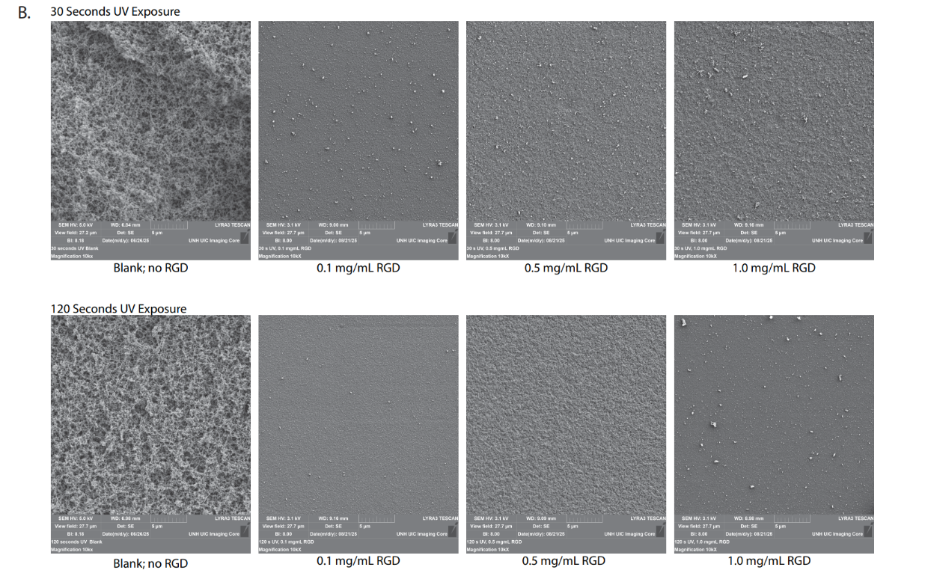
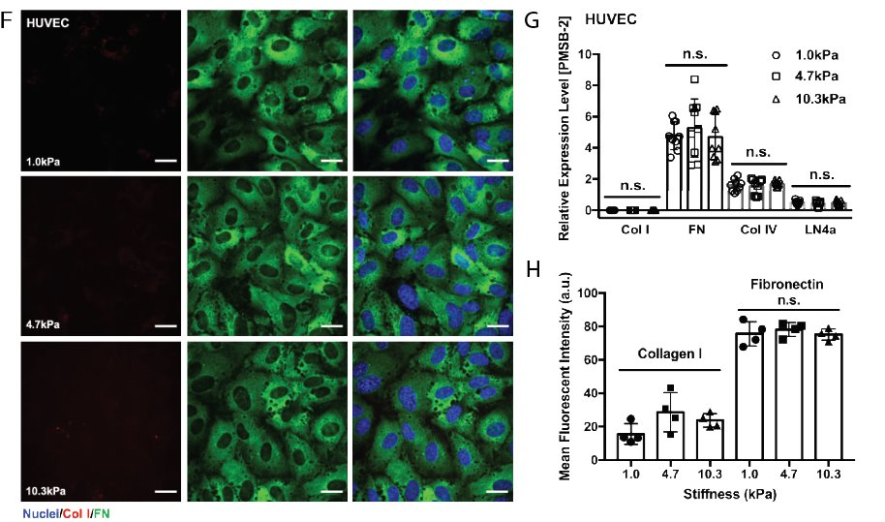
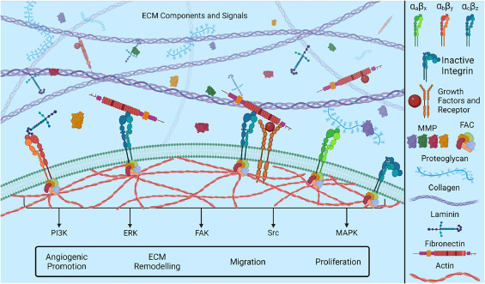
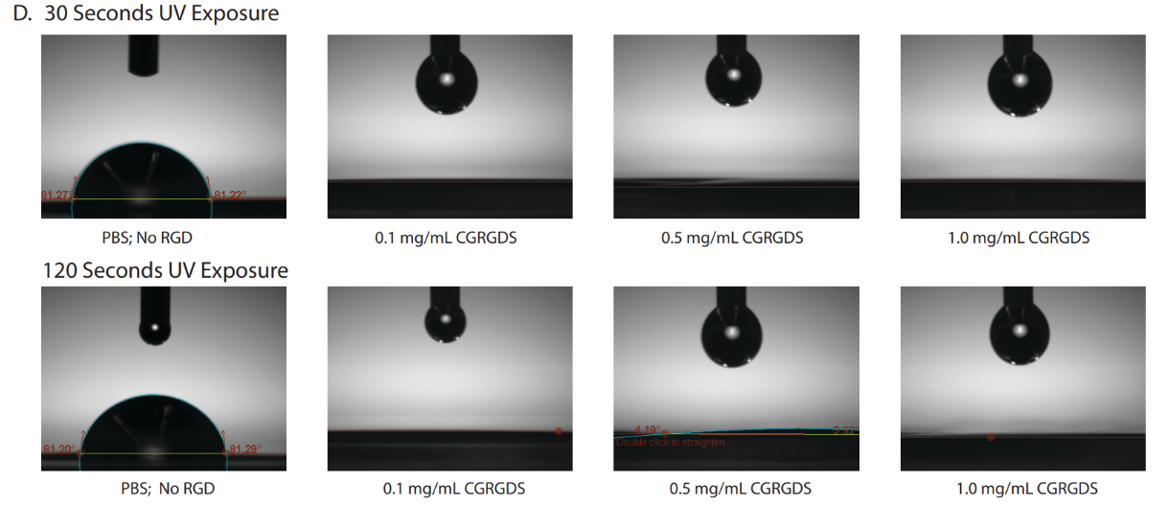
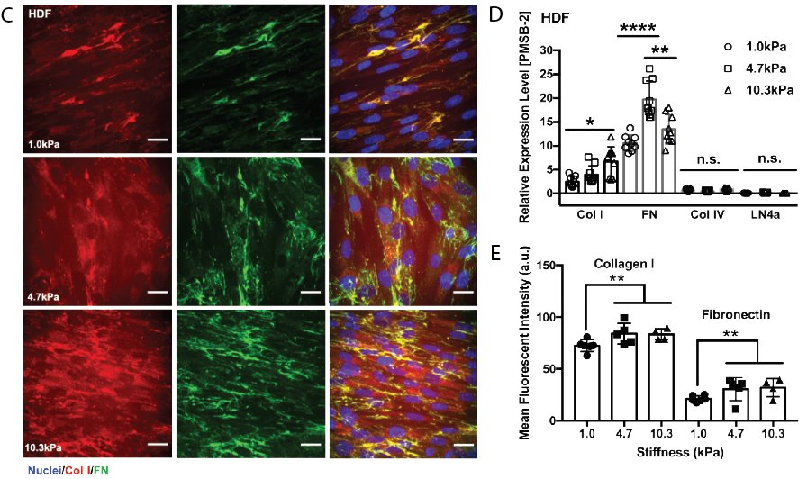
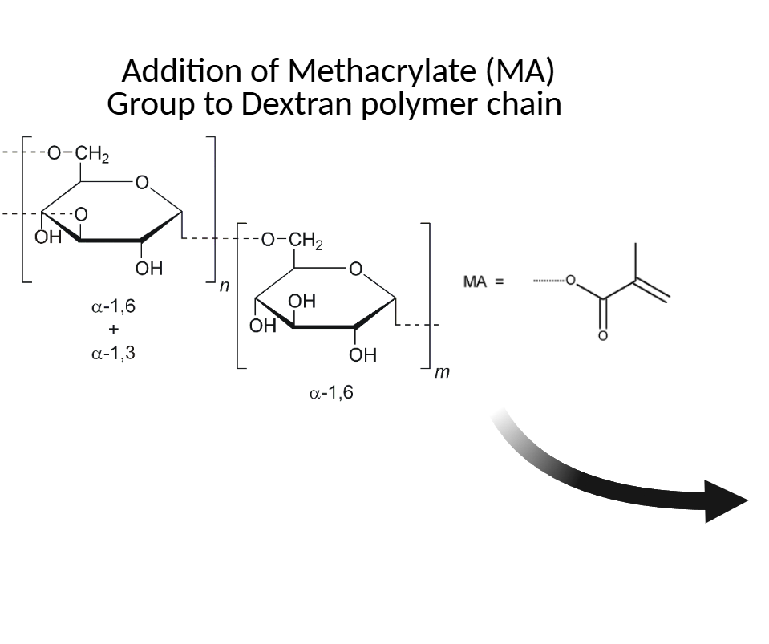
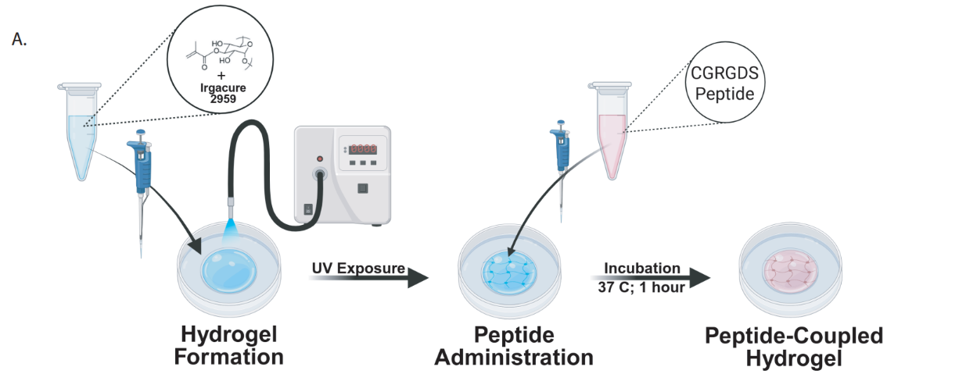
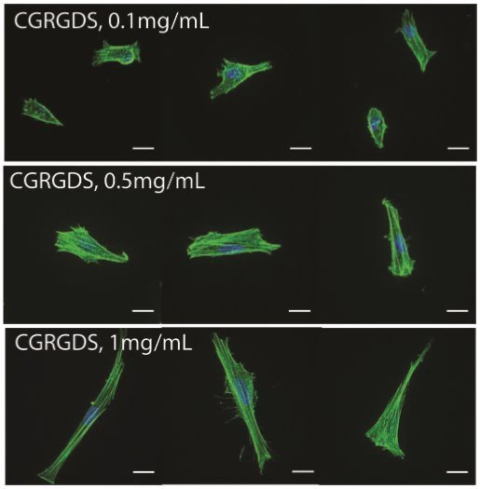
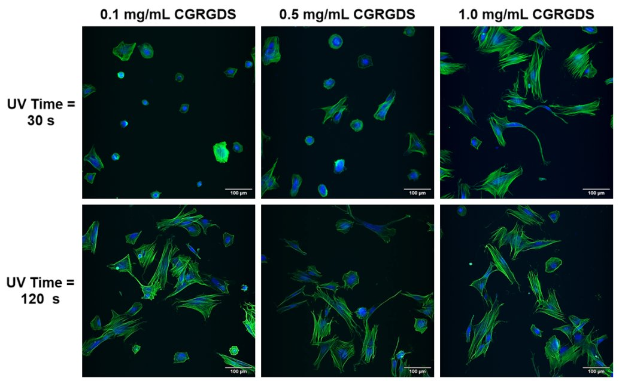
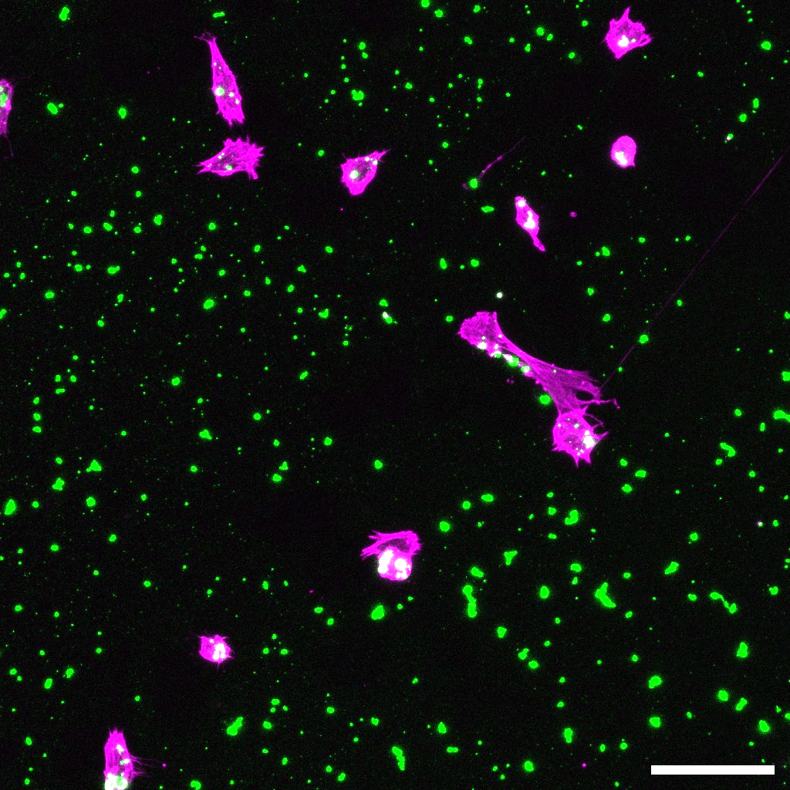
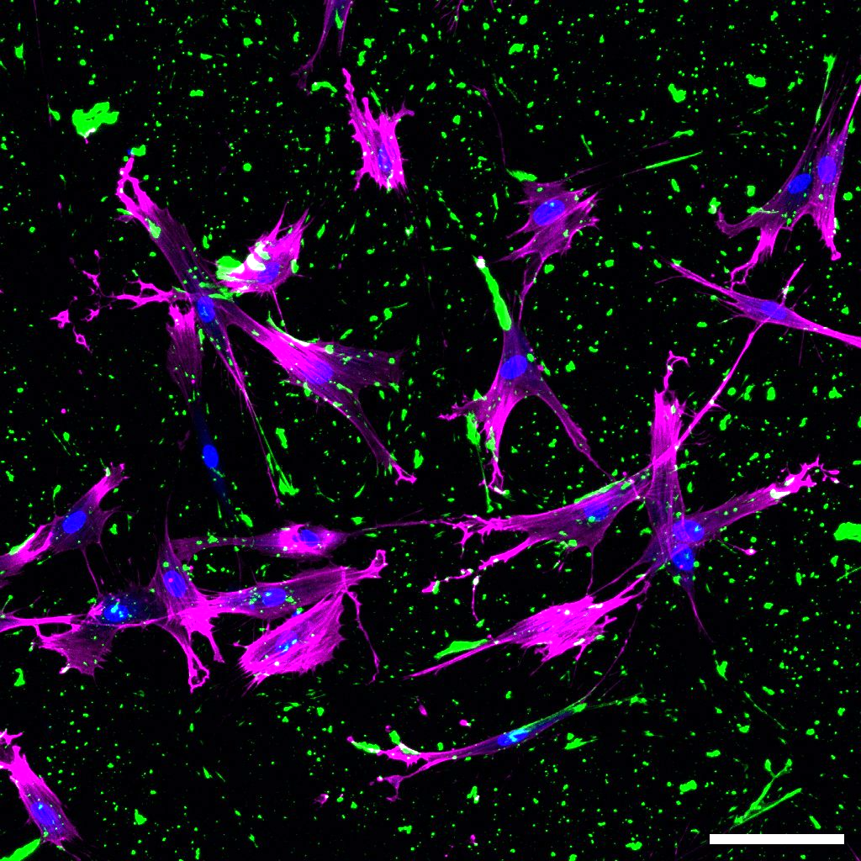
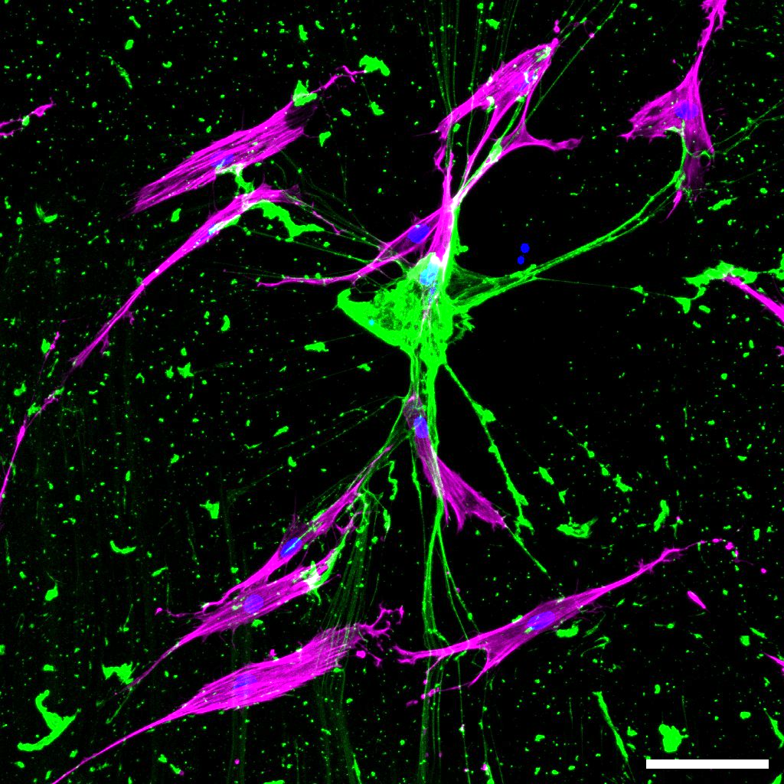
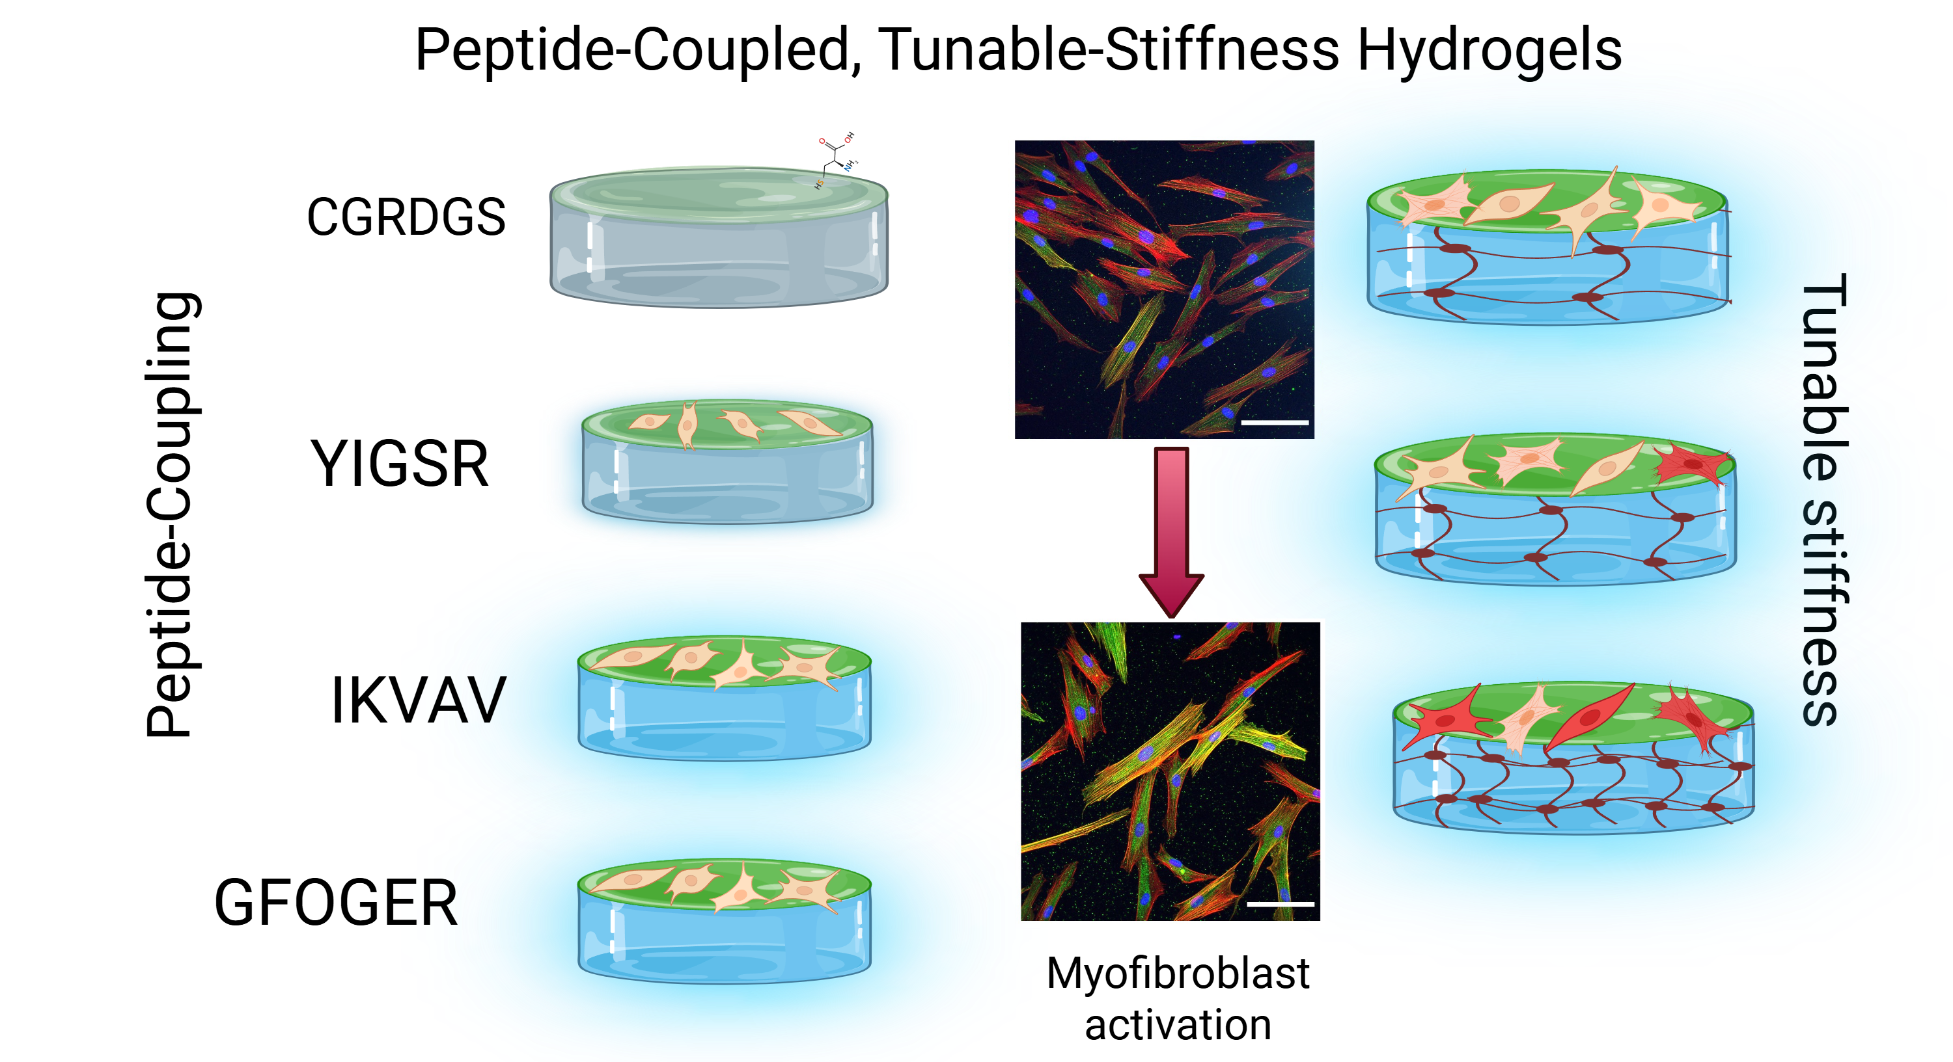
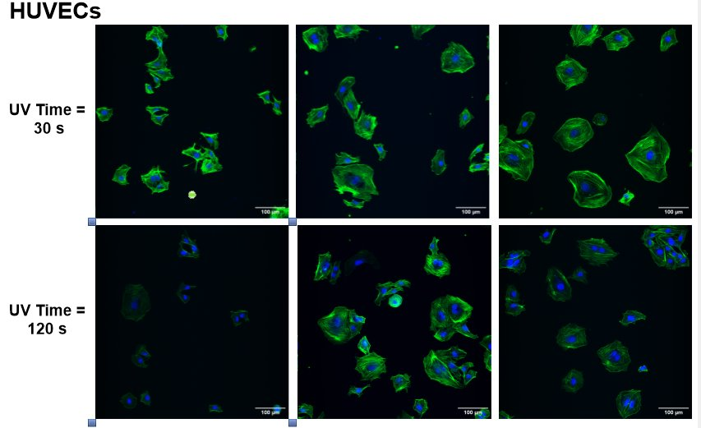
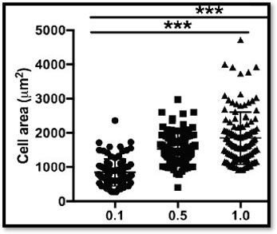
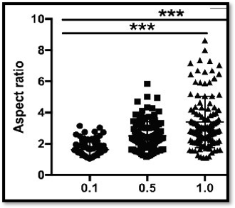
Mechanically Tunable Hydrogels with Adhesive Peptides for Cell Culture
Claire Komar, Haley Royce, Linqing Li
Department of Chemical and Bioengineering, University of New Hampshire, Durham, NH 03824
Background
Peptide Surface Modification
Wound Healing Applications
FDA Modernization Act 2.0: Incentivizes use of New Approach Methodologies (NAM) to reduce use of animal models for testing
Act 3.0 requires use of NAMs: including organ-on-a-chip, ex vivo tissues and organoids
Peptide adherence verification was achieved by quantifying the amount of peptide using Ellman’s assay, as well as observing changes in surface topography and hydrophobicity
Higher levels of fibronectin present in HUVECs show potential for adhesion promotion
Higher levels of collagen I show stronger structural cues for wound healing
ECM Coupled Biomaterials
Biomaterials are biocompatible materials which can be integrated with biological organizational cues from a cell’s extracellular matrix (ECM) to promote cell growth and adhesion
This can lead to confluent sheets of cells, creating tissues useful for skin grafts, wound healing and clinical testing applications
Figure 4. Ellman’s Assay quantifies amount of peptide not absorbed by gels
Figure 5. SEM detects peptide changes to surface of hydrogel
Figure 9. ECM proteins released by confluent HUVEC Cells across varying stiffnesses
Figure 1. Organization of extracellular matrix proteins
Mechanically Tunable Scaffolds
Hydrogel scaffolds are biocompatible materials which mimic native tissue structure
The combination of modified polymers and UV light photo crosslinking allows for the production of 3-D hydrogel matrices, where light exposure affects crosslinking density, therefore affecting matrix stiffness
Figure 6. Tensiometry data shows addition of peptide increases hydrophilicity
Cell Studies
Matrix stiffness and peptide concentration influence cell spreading and adherence
Figure 10. ECM proteins released by confluent HDF Cells across varying stiffnesses
Future Directions
HDFs
Modulating stiffness and ECM coatings influences integrin binding leading changes in actin stretching
Investigation of HDF’s ability to remodel fibronectin in interplay of cell behavior, ECM and material properties
Figure 2. DexMA hyrdogel production and peptide integration
Extracellular matrix derived peptides can be used along with tunable matricies to induce better cell adhesion and proliferation
Different ECM proteins serve different functions for tissue repair, certain sequences will influence cell behavior accordingly
Figure 11. 1.0kpa vs 4.7kpa vs 10.3kpa fibrous morphology of HDFs
Acknowledgements and References
Haley Royce, Linqing Li, Darcy Silver, UNH department of Chemical and Bioengineering, Innovation Scholars Program
Royce, H, Komar C, Li L, Mechanically Tunable Hydrogels with Adhesive Peptides for Cell Culture
Figure 3. Addition of various peptide sequences to influence cell properties
Figure 7. Cell stretching based on peptide concentration
Figure 8. Cell stretching based on peptide concentration across varying matrix stiffnesses

