Slide 1



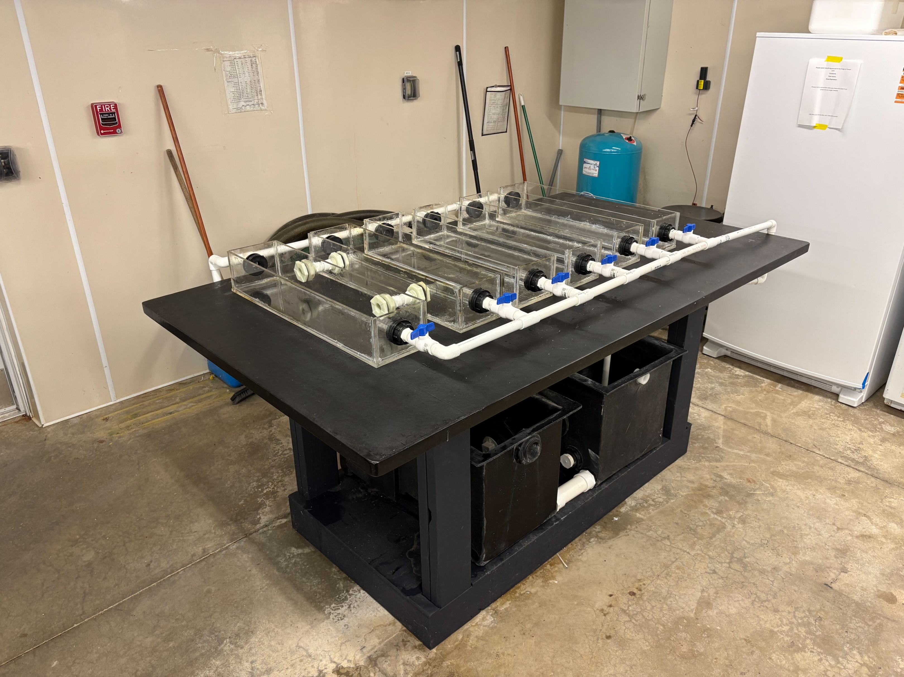
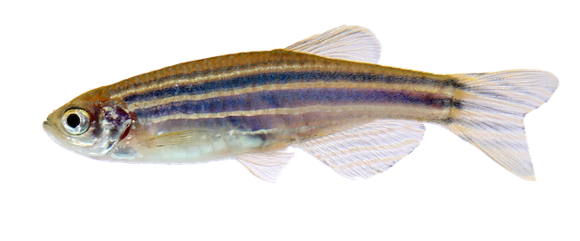
Construction of a Controlled Multi-Flow Recirculating Aquatic System for Behavioral and Growth Studies in Juvenile Fish
Milo H. Sheffield¹, Nicholas Caporale², and Kyler Tremblay³
Advisors: Adam Brockett², and Karolina Kwasek²
¹Department of Natural Resources and the Environment; ²Department of Biological Sciences; ³Department of Ocean Engineering
University of New Hampshire, Durham, NH
Background
Model Evolution
Since the 1970s, neuroscientists have shown that environmental enrichment (exercise + social interaction + agency) is a key driver of brain health. However, the impact of choice, specifically, a fish’s ability to choose its own swimming velocity, has never been tested.
Key Unknowns
  Do fish need a certain amount of exercise to thrive?
  Does voluntary exercise affect growth, metabolism, behavior, and flesh texture?
  Can giving fish choice enhance welfare in lab and aquaculture settings?
Engineering Outcomes
  Build a housing unit with six tanks with independently controlled water velocities
  Track individual fish locations over time
Biological Questions
  Do teleost fish show stable or changing velocity preferences?
  Does voluntary exercise improve growth performance and brain health?
Conceptual Design
Constructed System
a)
Fast Velocity (BL/s)
Alternate I Velocity (BL/s)
Alternate II Velocity (BL/s)
Standard Velocity (BL/s)
Fast Velocity (BL/s)
Standard Velocity (BL/s)
b)
c)
b)
a)
c)
iii)
ii)
iv)
i)
Continuous velocities
Alternating velocities
Exercise decisions executed by human
Alternating velocities
Exercise decisions executed by fish
Legend:
Control Tanks (continuous slow/fast)
Alternating slow/fast tanks
PVC-coupled/choice tanks
Figure 2. Preliminary conceptual design provided to the team, defining the broad design direction and requirements prior to detailed system development. Shows early six-tank setup. Left-to-right layout of the six-tank RAS: a) Tanks 1-2 (continuous slow/fast), b) Tanks 3-4 (independently alternating slow/fast, switched manually every few hours), c) Tanks 5-6 (PVC-coupled to allow freedom of choice in fish, slow in tank 5, faster in tank 6).
Model Species
CAD Model
a)
Figure 4 . Photograph of fully constructed six-tank recirculating aquaculture system. The physical build realizes the layout first outlined in the conceptual design (Figure 2) and refined in the CAD model (Figure 3). Key features of the CAD model, including tank dimensions, pipe diameters, valve placements, and the supporting table, are all visible in the completed system. Locations of future modifications are labeled i-iv.
b)
Future Modifications to System Design
c)
iii)
Substitute ball valves with globe valves to achieve finer flow control (i).
Addition of third connecting tube between choice tanks (ii).
Installation of mesh barrier to restrict fish movement to areas of ideal flow.
Swap to larger PVC piping at outlet or modify the design to instead utilize a trough to catch outflow of water (iii).
Integration of mechanical and biological filtration system to accommodate for live fish in the system (iv).
Evaluate long-term structural integrity of warped tanks and the feasibility of their replacement.
Figure 1. Adult Zebrafish (Danio rerio), the model species for the aquaculture system designed in this study. Size: 3-4cm. Preferred swimming speed: 0.4 m/s or ~13 BL/s (Palstra, A et al., 2010). Optimal temperature: 26°C to 28°C. Physiological model selected for its small size, rapid regeneration time, and well-documented physiology.
Benchmarks for Success
ii)
Safe for fish to inhabit
  Opted for laser cutting of plexiglass components to remove risk of jagged edges.
  Utilized aquarium-safe acrylic cement, silicone sealant, PVC cement, et cetera.
  Flow diffuser to distribute water evenly and prevent direct, harsh flow.
Can hold water for extended periods of time under constant water velocity.
Flow rate can be freely modified as needed.
i)
References
Palstra, A et al., (2010). PloS one, 5(12), e14483
Kumai, Y et al., (2015). PBZ, 88(2), 137–145.
iv)
Acknowledgments
Legend:
Control Tanks (continuous slow/fast)
Alternating slow/fast tanks
PVC-coupled/choice tanks
Figure 3. Final CAD model of the recirculating aquaculture system, evolving from the conceptual layout shown in Figure 2. Key additions include precise tank dimensions, pipe diameters, valve placements, and support table built to house the system, while keeping the left-to-right functional progression of continuous, alternating, and choice flow tanks. Locations of future modifications are labeled i-iv.
We thank Patrick Breen for his contributions to this project, as well as the UNH Department of Ocean Engineering for providing support financing our work. This work was funded in part by New Hampshire Sea Grant's Workforce Development Project E/WFD-3, pursuant to National Oceanic and Atmospheric Administration Award No. NA24OARX417C0037.

