Slide 1




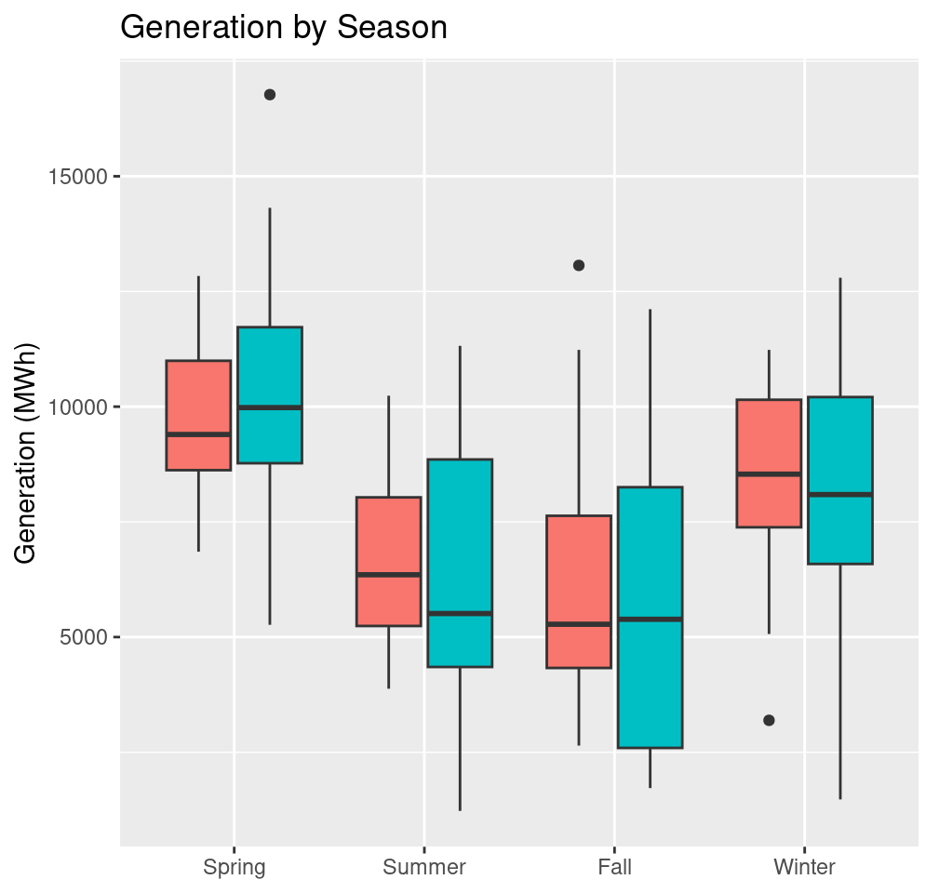
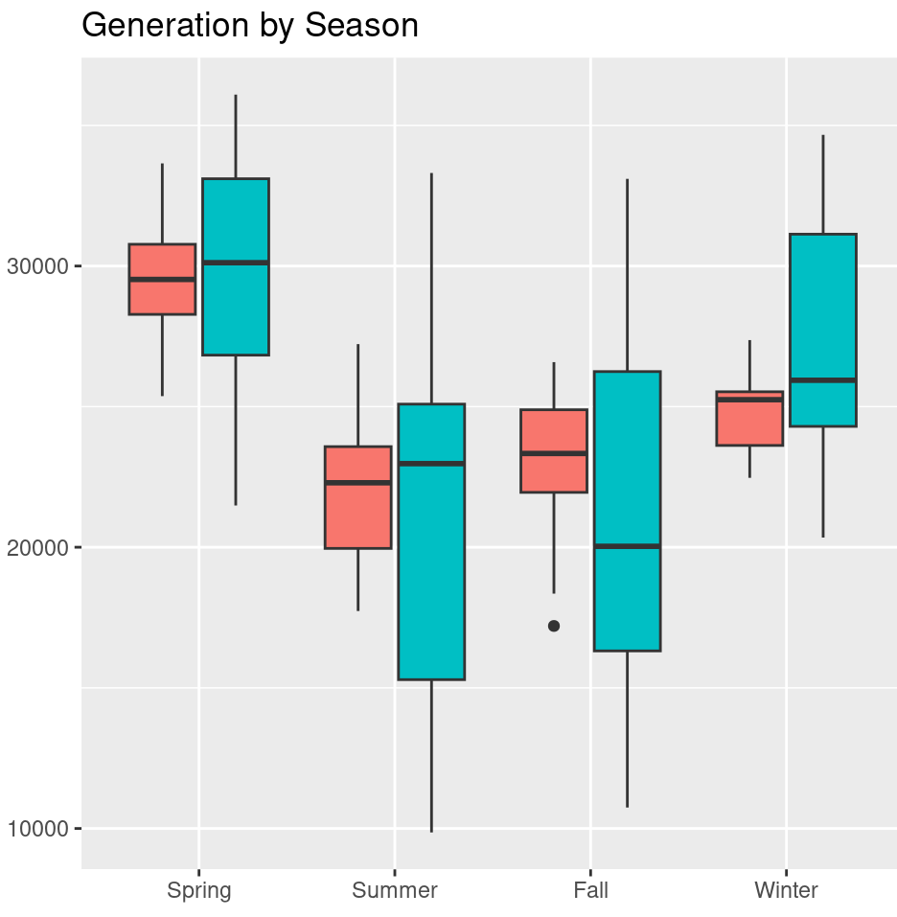


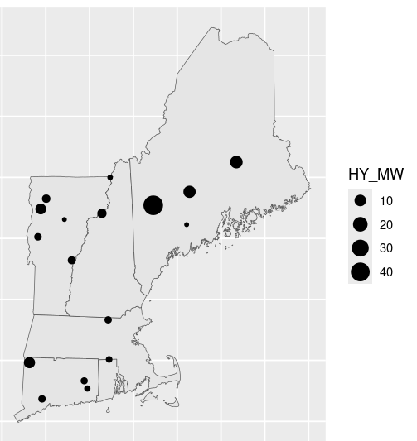
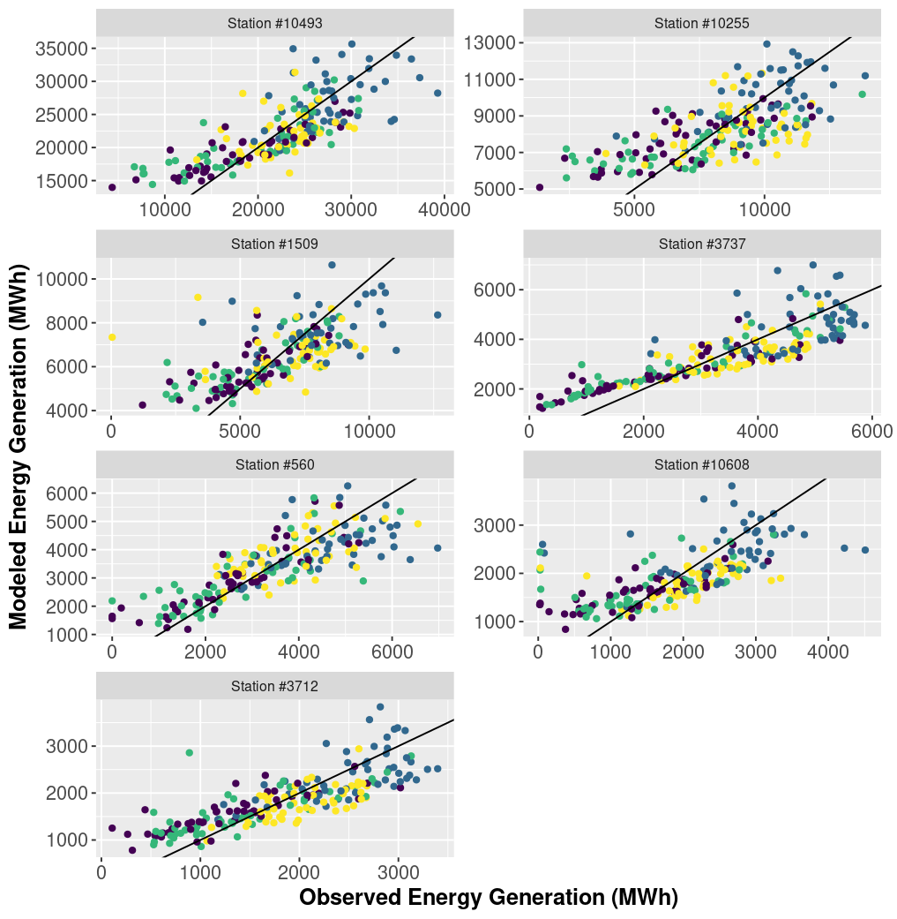
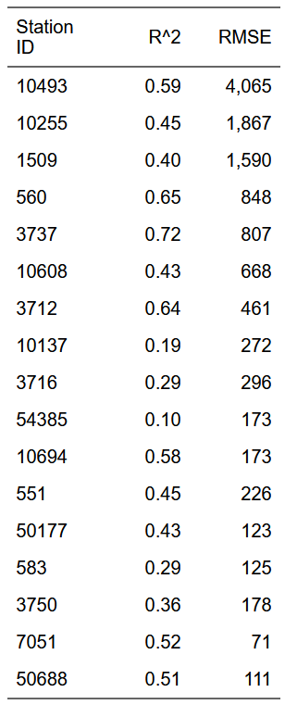

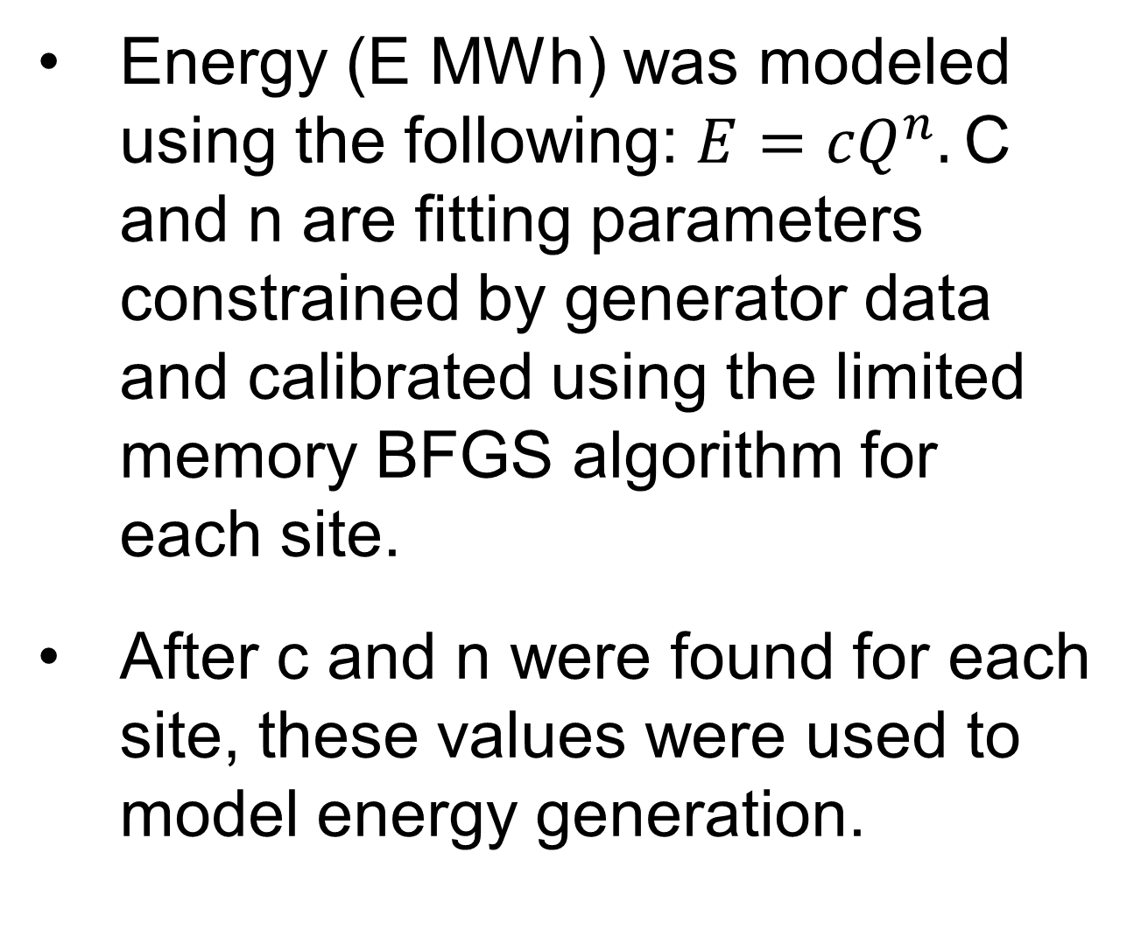
Run of River Hydropower in New England: Using River Flow as a Predictor for Generation
Becker Gibson
Water Systems Analysis Group, University of New Hampshire, Durham, NH 03824
Introduction and Driving Question
Seasonality of Energy Generation
Seasonal hydrological patterns have been and are continuing to change, bringing an earlier and less pronounced spring peak flow, drier summers, and wetter winters.
Run-of-river (ROR) hydroelectric power is a flexible, low-carbon source of energy that relies on river flow.
ROR accounts for ~37% of hydropower facilities, hydropower as a whole accounts for roughly up to 10% of total generation within New England.
How could changes in seasonal flows affect run-of-river hydropower production?
Station # 559
Station # 10255
Data and Methods
Combining information from the Oak Ridge National Laboratory Existing Hydropower Assets dataset and the Energy Information Administration’s (EIA) API, a subset of ROR facilities with at least five years of monthly energy generation data was created.
Monthly data was filtered using the EIA’s Inventory of Operable Generators to exclude months where generators were down for maintenance.
Daily river discharge (flow) (Q m3 s-1) was retrieved from USGS gauges immediately upstream/downstream of ROR facilities.
Seventeen of the ROR facilities across New England with adequate data records were selected.
Spring Summer Fall Winter
Spring Summer Fall Winter
Modeled Generation
Observed Generation
The seasonal means and ranges are generally similar between the observed and modeled energy generation. Variance may be due to neglecting time-varying demand. With adjustment, this model will adequate for projecting future trends in seasonal mean generation.
Energy (E MWh) was modeled using the following: ${E=cQ}^{n}.$C and n are fitting parameters constrained by generator data and calibrated using the limited memory BFGS algorithm for each site.
After c and n were found for each site, these values were used to model energy generation.
Next Steps
Power Capacity (MW)
Refine model – test if overprediction is related to relatively low demand compared to typical demand. If it is, temperature may be used as a proxy variable for future projections.
Calibrate model to historical hydrological simulation using an expanded subset of sites.
Run hydrological simulation for the future up through 2100 and use the energy model to project potential seasonal shifts in generation capability.
Compare high and low emissions scenarios, is there a significant difference?
Model Results
Acknowledgements
Supported by the National Science Foundation REU program,, Award #2244092 and the U.S. Department of Energy, Office of Science, Biological and Environmental Research Program, Earth and Environmental Systems Modeling, MultiSector Dynamics under Cooperative Agreement DE-SC0022141.
Any opinions, findings, and conclusions or recommendations expressed in this material are those of the author(s) and do not necessarily reflect the views of the US Department of Energy.
Modeled Energy Generation (MWh)
References
DeCicco L, et al. dataRetrieval: R packages for discovering and retrieving water data available from U.S. federal hydrologic web services. (2025). doi:10.5066/P9X4L3GE.
Johnson, et al. (Jun 9 2025). Existing Hydropower Assets (EHA) Unit Database, 2025. Oak Ridge National Laboratory (ORNL) doi:10.21951/eha_fy2025/2568752
Leonawicz M, Hoff M (2025). eia: API Wrapper for U.S. Energy Information Administration ('EIA') Open Data. https://github.com/ropensci/eia.
Miller, et al. The future role of hydropower in the Northeastern United States: May 2020-May 2022 (2022). doi:10.2172/1864718
Pierce, et al. Future increases in North American extreme precipitation in CMIP6 downscaled with Loca. Journal of Hydrometeorology 24, 951–975 (2023).
Observed Energy Generation (MWh)
Model performance varies, and while not all dynamics are captured river flow appears to be an important predictor. Some of the variance may be attributed to energy demand and market dynamics, as the model tends to overpredict during months with little observed energy generation.

