Slide 1

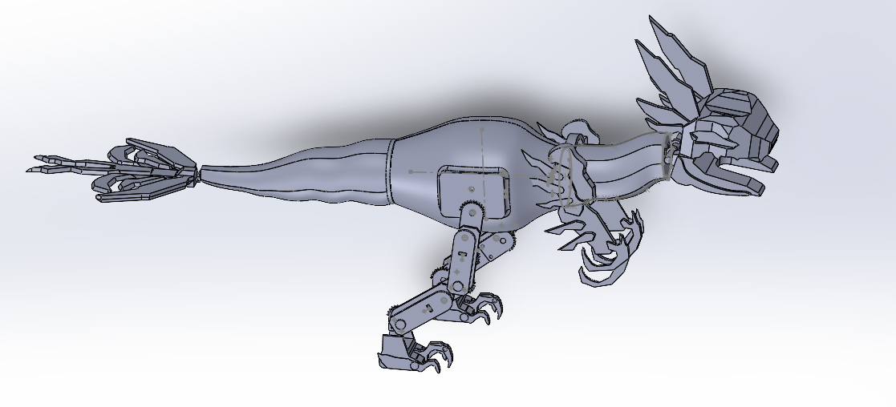
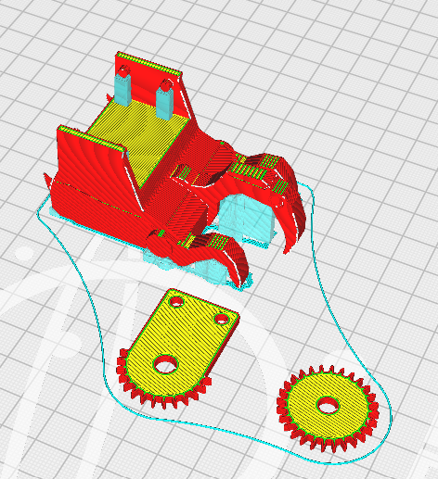
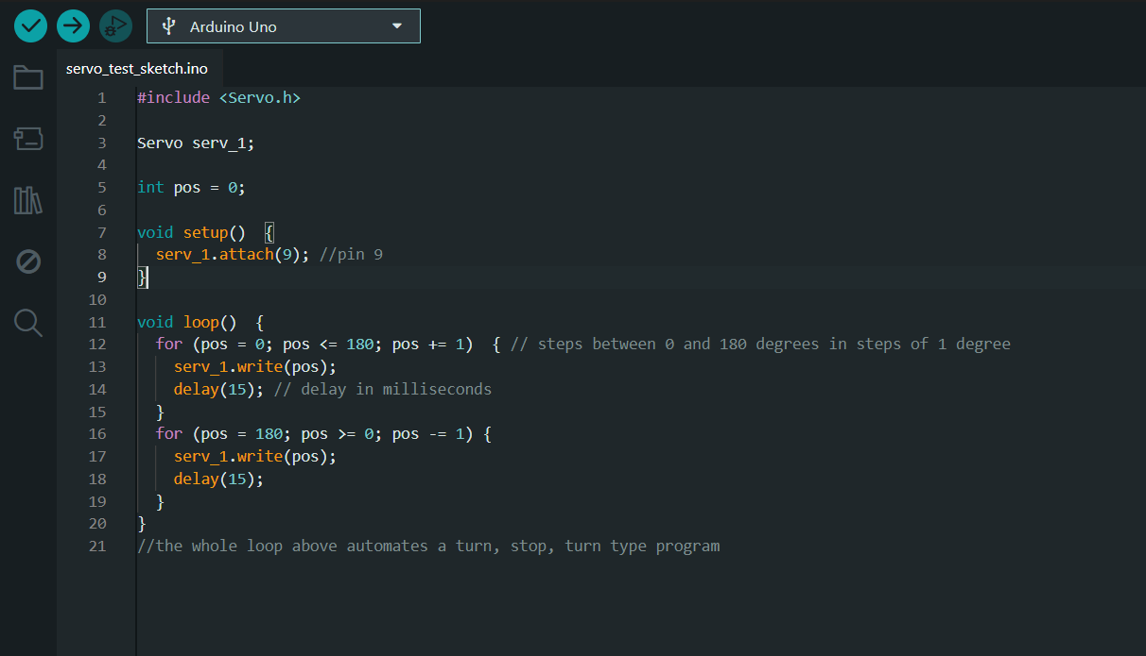



Arduino-Controlled Action Figure
(Sustainable Scale-model Prototyping)
Author: Allie Fratini
Advisors: Benjamin Mitchell, Shayan Darzi
Department of Mechanical Engineering, University of New Hampshire, Durham, NH, USA
Introduction
SolidWorks Model of the Finished Product
Results
Have you ever encountered technology in a video game or film and wondered what it would be like if it existed in reality? This project investigated the process of translating fictional designs into functional, real-world systems, with a particular emphasis on maintaining sustainable design principles.
The primary objective of this project was to manufacture a scaled-down version of the robot as a foundation for developing a full-scale model.
The result closely replicated the original source material in both form and detail
Sustainability goals were achieved, with reliable battery operation and durable performance of PLA components
The success of the scale model demonstrates strong potential for translation into a full-size prototype
Process
Replicated a Clawstrider inspired by the Horizon video game series
Leg gear design drew from a mechanism demonstrated by @DanMakesThings, utilizing an interlocking, linked motion system
Evaluated static versus kinetic gear systems for individual joint functionality
Designed each leg joint with an independent servo to emulate biological joint movement
Implemented an Arduino-based control system to program and coordinate precise servo motion
Modeled and 3D-printed all mechanical components independently
Elegoo Slice of Print
Basic Arduino Code for Single Servo Array
Conclusion
As this was my first experience building a robot, the project required extensive research to understand fundamental robotic systems and their operation.
Future iterations could include additional articulation incorporated into more joints, such as the head, tail, and arms.
Sustainability Efforts
This project used PLA (Polylactic Acid), one of the few 3D printing materials that biodegrades
Rechargeable NiMH batteries were used to power the servos, reducing waste and supporting more sustainable testing of the system’s movement.
The project was designed with cost efficiency in mind; PLA was selected as the primary material due to its lower cost and relatively more sustainable properties
Acknowledgements
John Olson Manufacturing Center
SONY Interactive Entertainment and Guerrilla Games
University of New Hampshire
DanMakesThings

