Slide 1

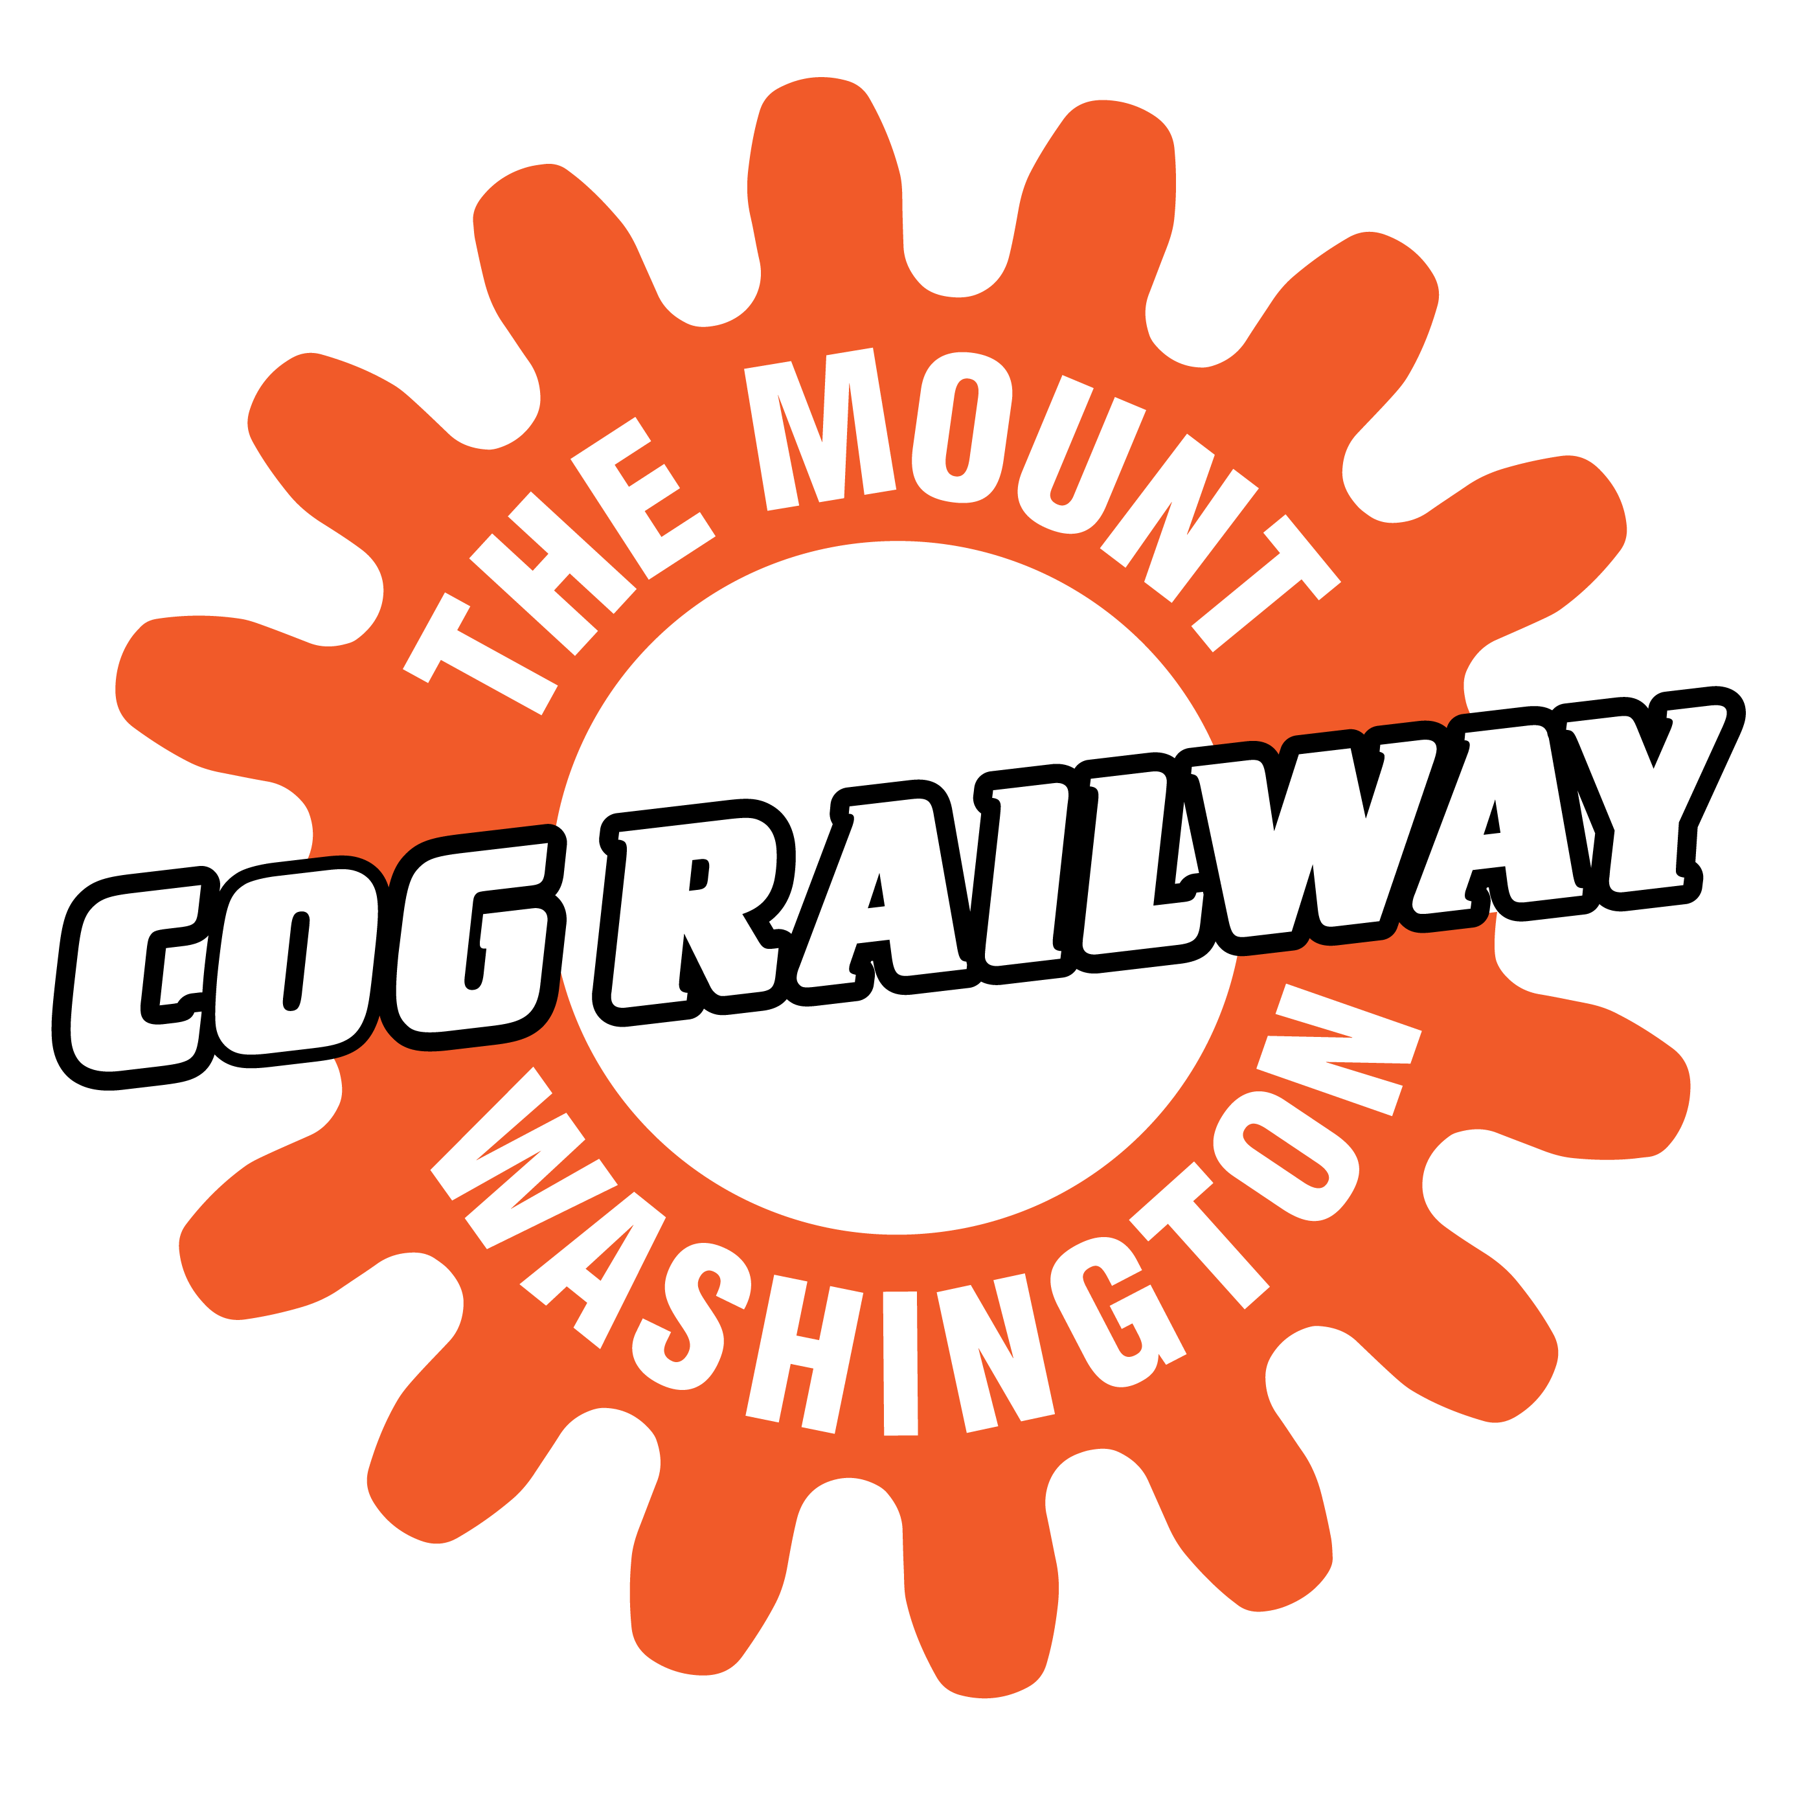
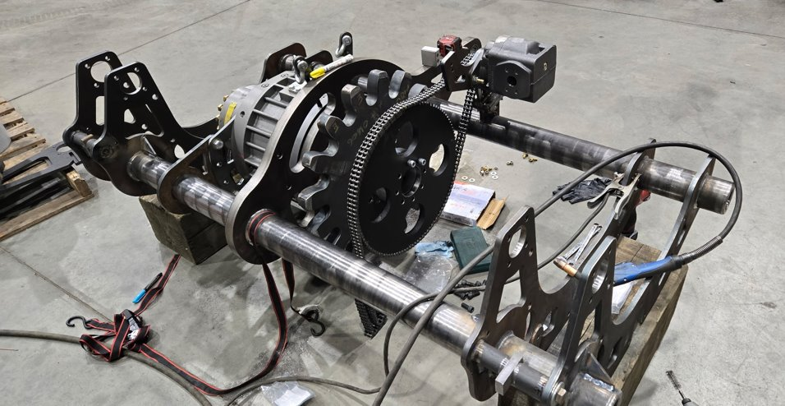
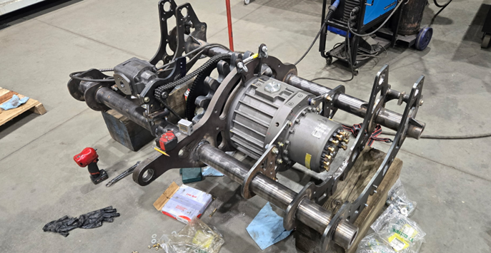
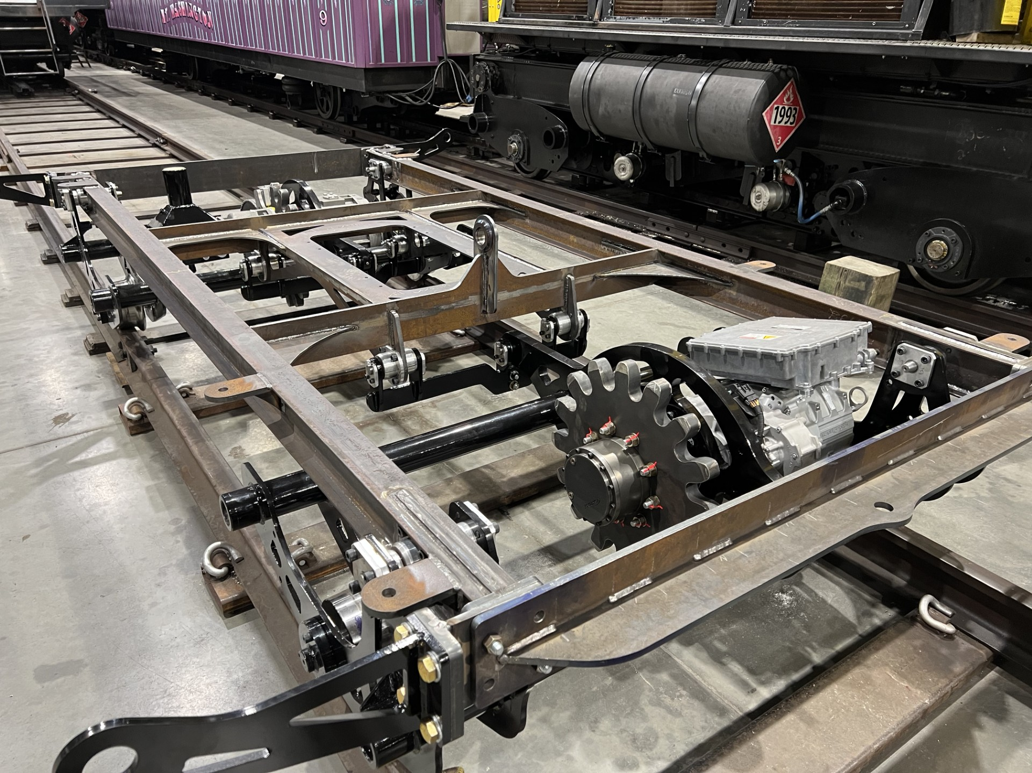
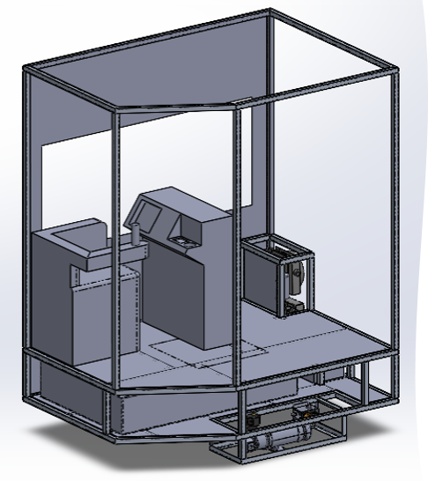
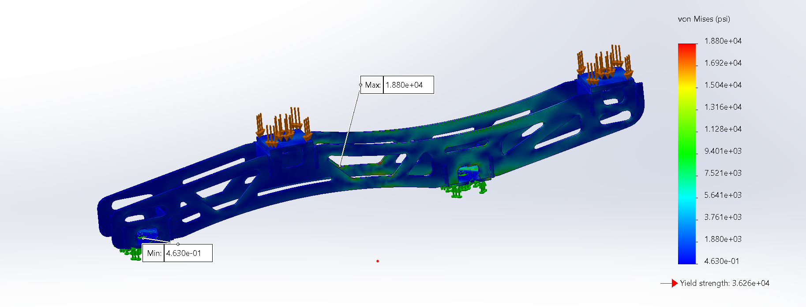
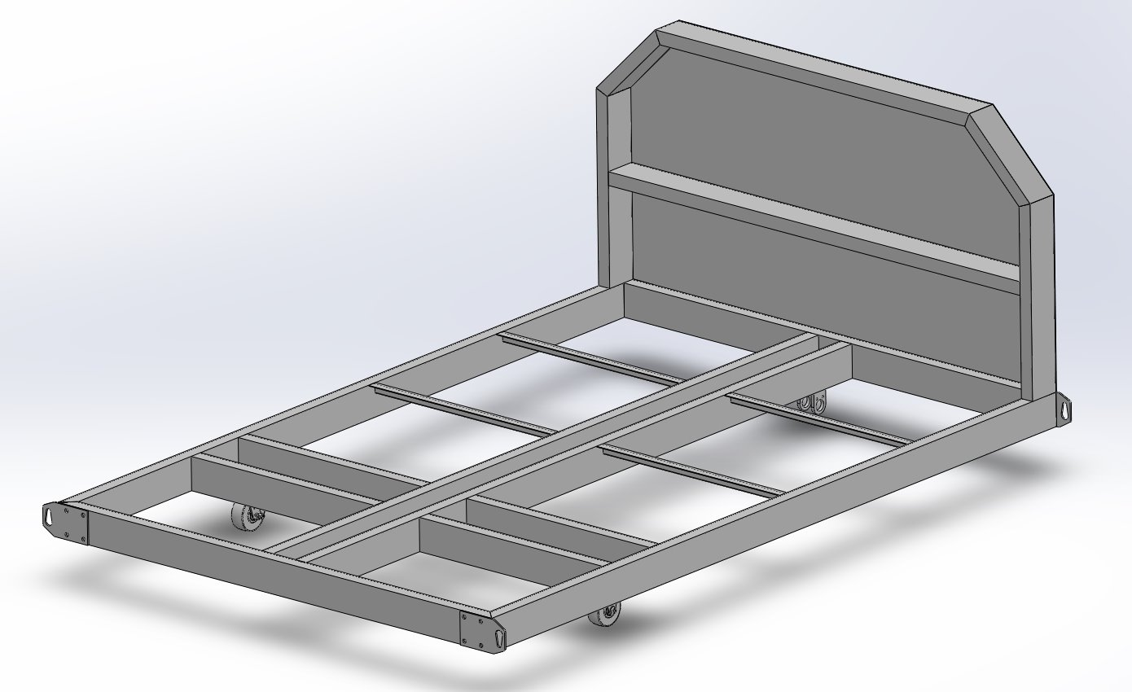
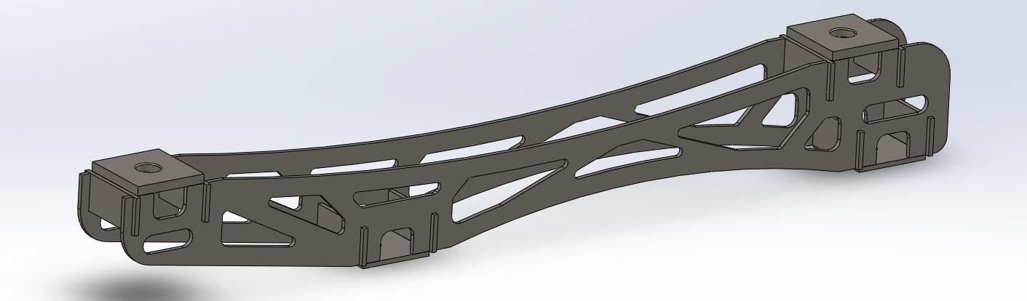
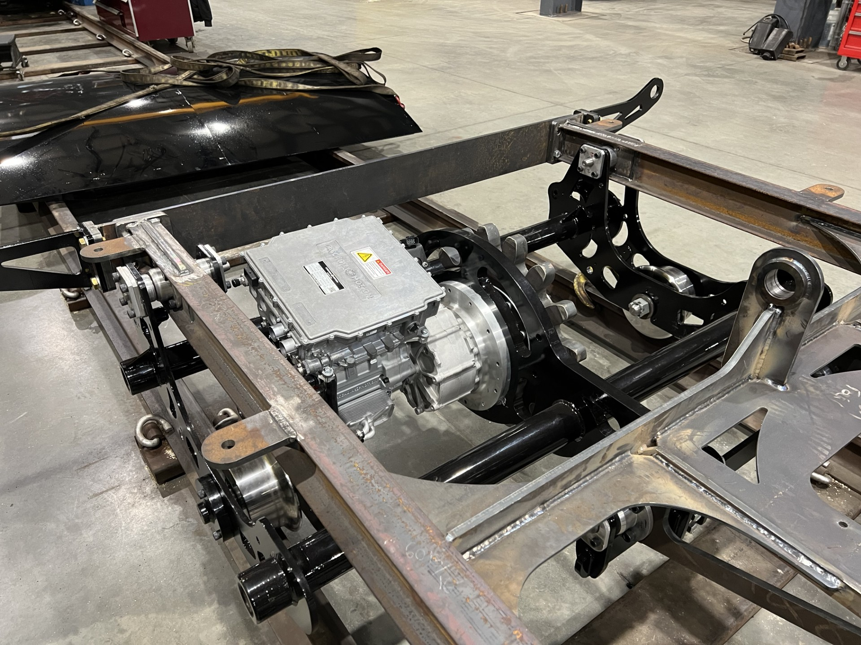
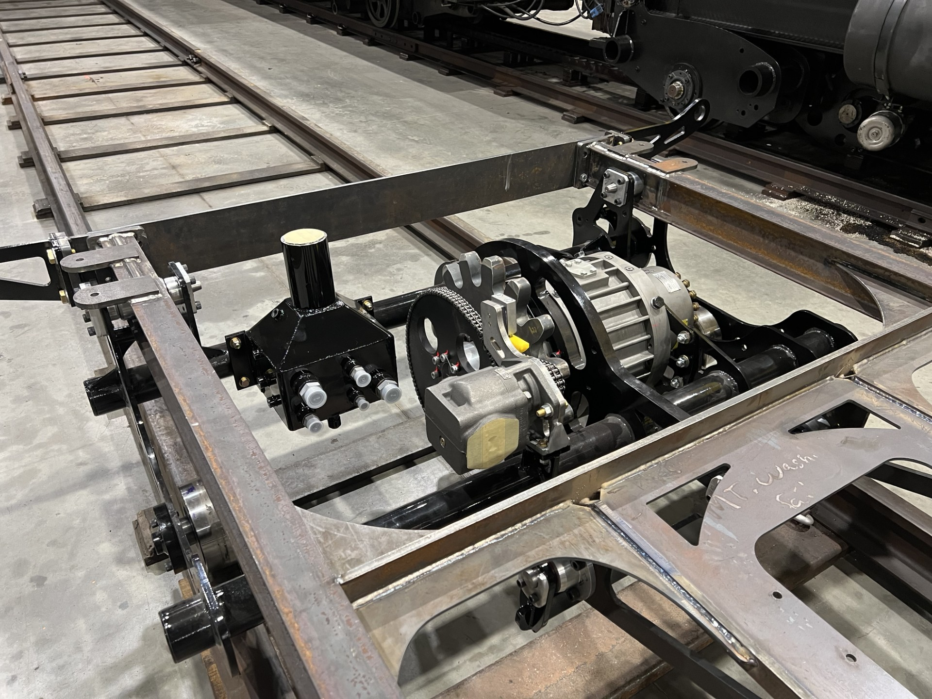
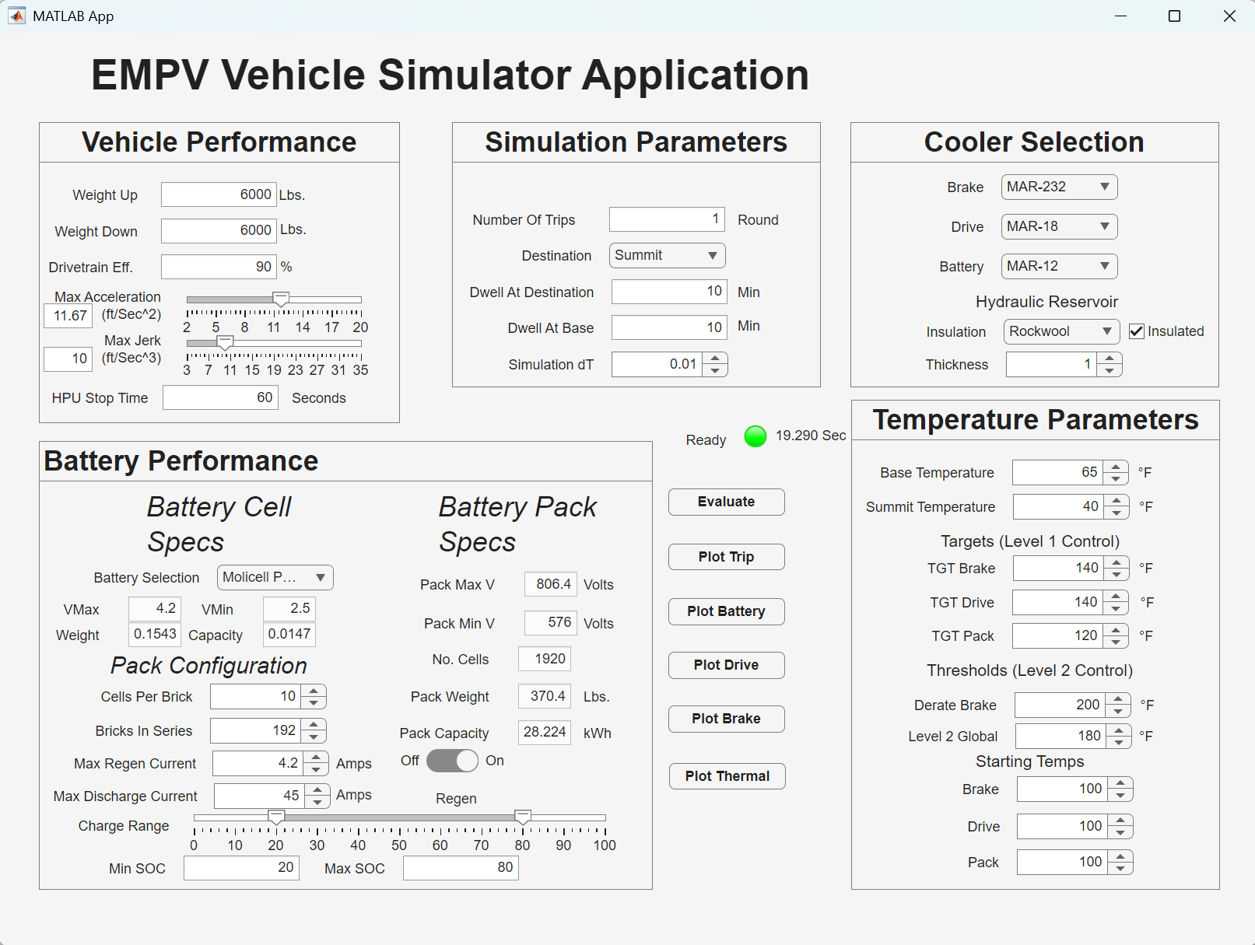
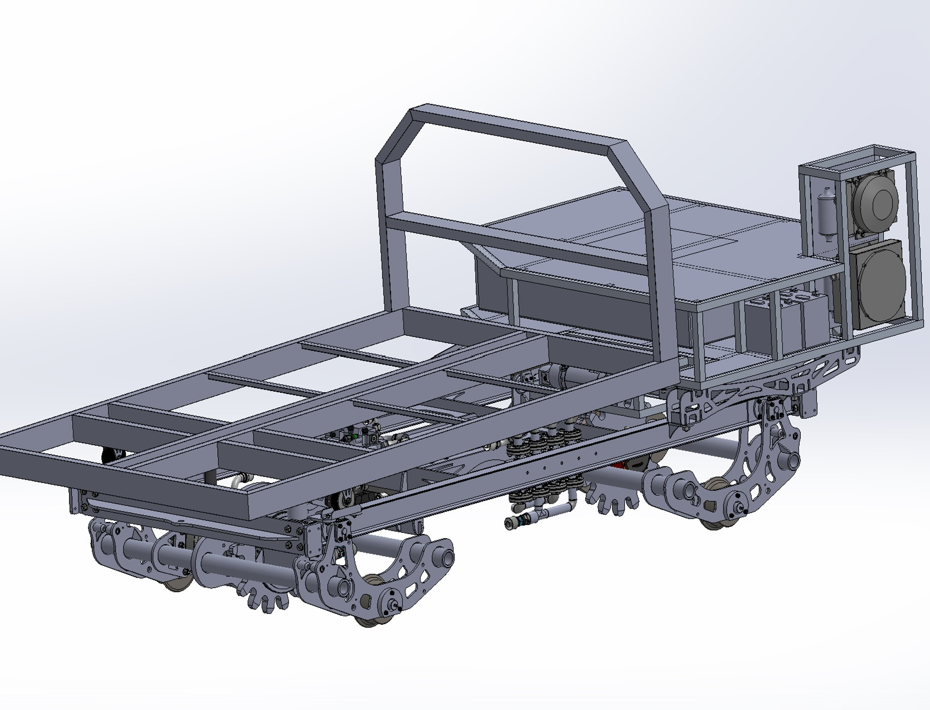
COG Railway Electric Multipurpose Vehicle
Matthew Yates, Wyatt M^{c}Laughlin, Jesse Franklin, Zach Beardsley, Mitch Hauser
Project Manager: Caleb Gross UNH Advisor: Professor Ivaylo Nedyalkov
Department of Mechanical Engineering, University of New Hampshire, Durham, NH 03824
Introduction
Mechanical Design Highlights
Project Status and Future Work
Design and validate the world's first fully battery-powered cog-driven vehicle.
With grades of up to 37%, Mount Washington is home to the second-steepest cog railway in the world, as well as some of the coldest and windiest weather conditions on earth, presenting a uniquely demanding environment for electric vehicle development.
Vehicle metrics:
Vehicle weight under 6,000 lbs dry
12 mph to full stop in under 1.5 seconds
Ascent time under 15 minutes
Weather resistant components and structure
Down-Mountain Drive Truck
Up-Mountain Brake Truck
Major subsystems have been designed and integrated into the EMPV architecture
The UM and DM truck assemblies have been designed, drafted, and fabricated
The MATLAB simulator is guiding future battery, thermal, and performance decisions
Rolling chassis and truck assemblies have been fabricated and stand on Cog infrastructure
Future work will include integration of control and subsystems for a service-ready vehicle
Electric drive truck for uphill propulsion
Assembly of traction motor, gear reduction hardware, and cog-drive components
Capable of 227 HP @ 145 ft-lb of torque
Custom Force Control oil-shear brake
Utilizes the fluids viscosity to create a shearing force between the friction discs and drive plates
Chain-driven flushing system providing 30 GPM cooling flow
Fabricated Components
New Cab and Subframe Design
Flat-bed Superstructure
Project Long-Term Goals
Reduce emissions and noise compared with diesel equipment Support the railway’s long-term electrification goals
Provide a multi-use platform for maintenance and emergency response
Demonstrate the feasibility of battery-electric operation on extreme grades
Redesigned cab structure for improved packaging, visibility, and operator protection
Integrated with the vehicle subframe and overall EMPV chassis layout
Reduced subframe weight with Solidworks Simulation
Flatbed design for maintenance, transport, and multipurpose service
Modular superstructure mounting on the main vehicle frame
Open payload space for tools, equipment, and operational flexibility
Current Rolling Chassis on Shop Rails
MATLAB Vehicle Simulator
Current Solidworks Model
CAD model of the EMPV platform, combining the truck assemblies, chassis, cab, and flatbed superstructure into a single vehicle layout
Critical in determining the mechanical interactions of components and visualization of final prototype
DM Drive Truck (Electric motor/ inverter and gear reduction system)
UM Brake Truck (Oil shear brake, hydraulic reservoir, and flushing pump)
Acknowledgements
Calculates accurate physics of mountain trip with real-world track data.
Models speed control, motor torque demand, and direction-dependent loading on the drivetrain.
Supports multiple battery chemistry options and allows for implementation of test data.
Mount Washington Cog Railway Management
Caleb Gross for project support, and design collaboration
University of New Hampshire Department of Mechanical Engineering, Ivaylo Nedyalkov.
Industry partners and suppliers who contributed technical input to battery and subsystem development, including Notchland Energy and Lion Technologies

