Slide 1


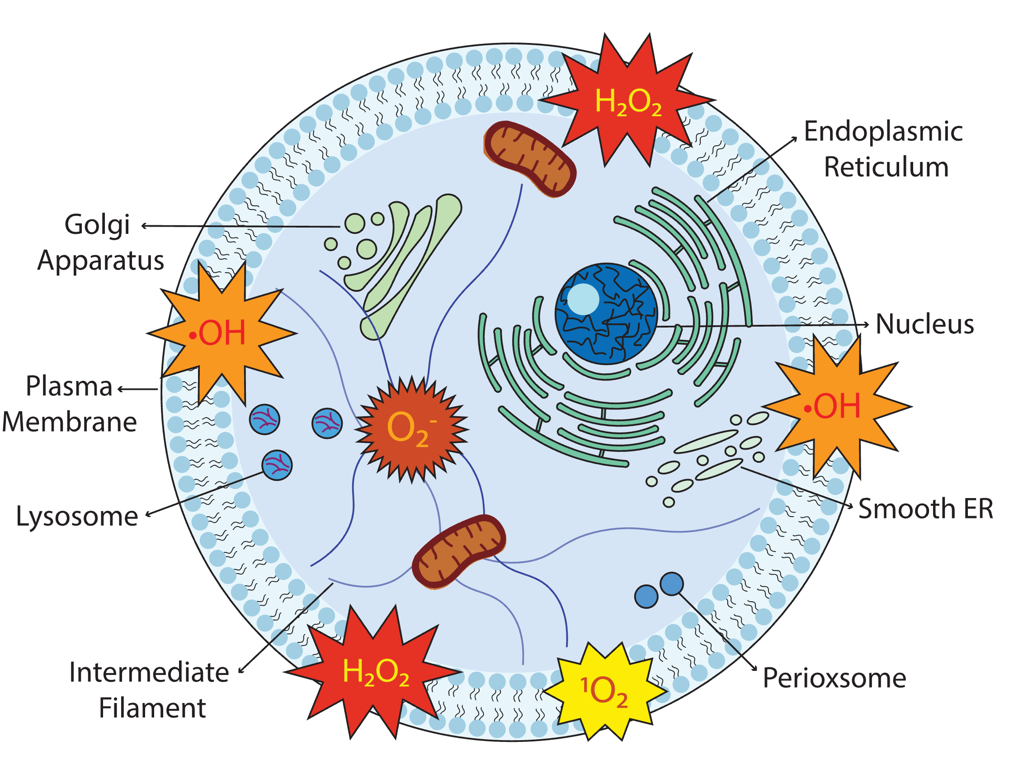
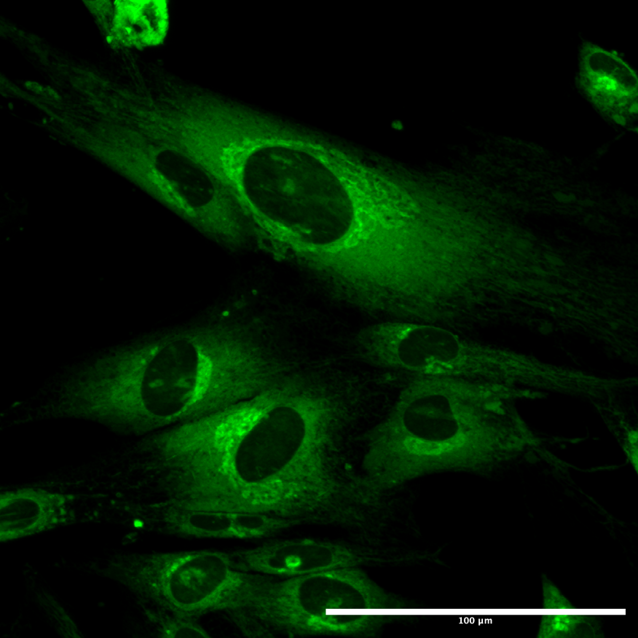
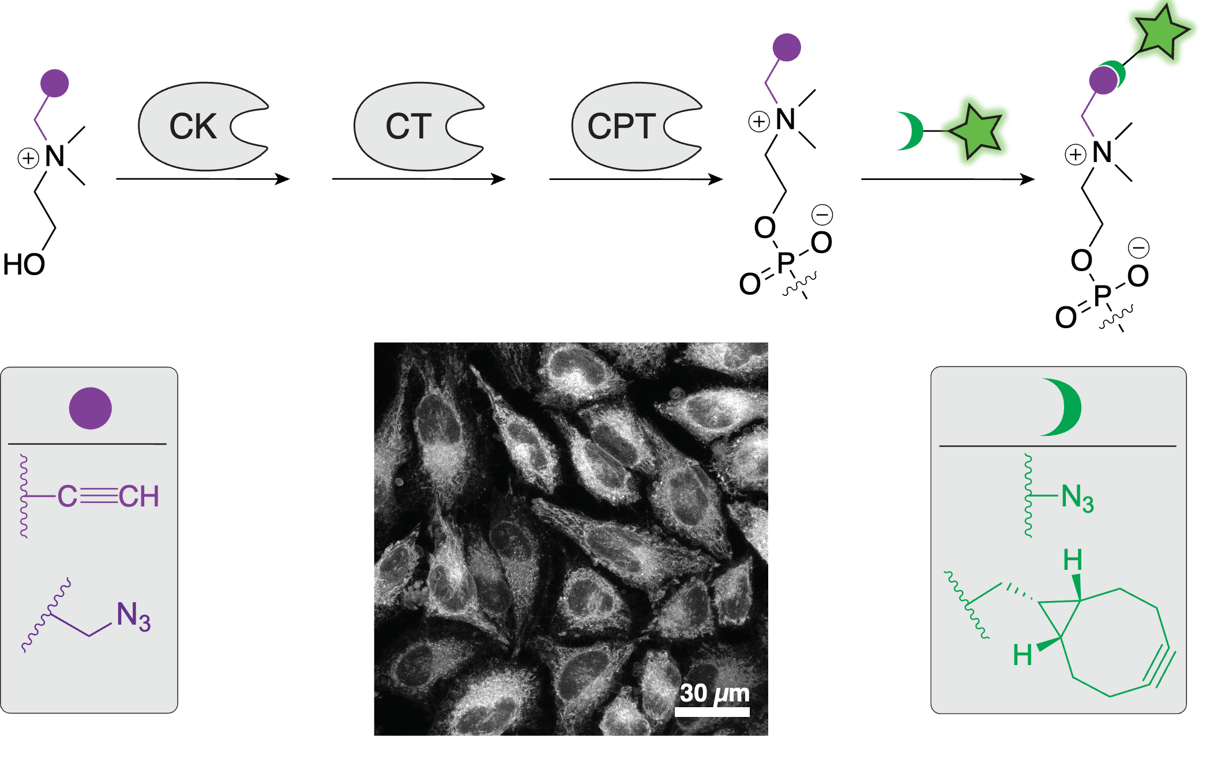
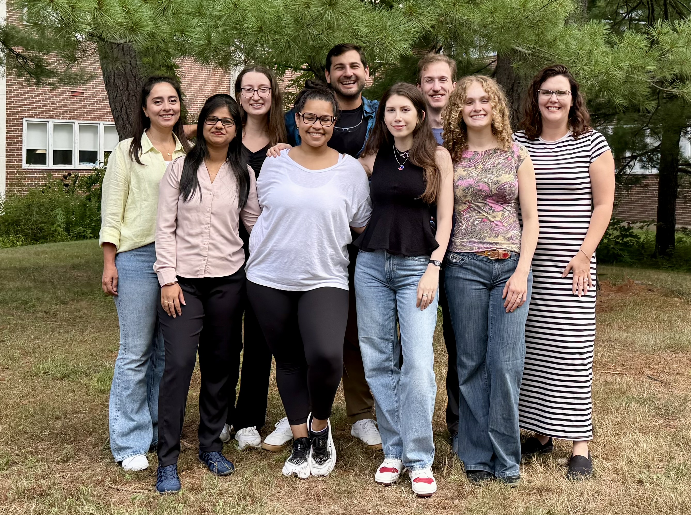


Investigations of Optical Properties: Sensing Hydrogen Peroxide using Activity-Based Sensors
Madison Pageau, Paige Ring, Brittany White-Mathieu
University of New Hampshire
Department of Chemistry
Introduction
Methods
Future Work
Cellular membranes enable biochemical processes to occur through organelle compartmentalization; making transport, signaling, and interaction with the cell's environment essential to the cell's morphology.
​
A functionalized H₂O₂ sensor has been prepared that can attach to membranes using SPAAC
Regulated cell death (RCD) facilitates changes in membrane morphology and disrupts cell membrane function. Reactive Oxygen Species initiate RCD through oxidation of lipids and appear in different forms including H₂O₂, •OH, O₂•–, and ¹O₂.
The H₂O₂ sensor will be functionalized using click chemistry to more accurately represent the clicked compound in cells. This compound will be tested in an analyte screening assay
ABS Reagent
Analyte H₂O₂
Fluorescence Turn-on
Additional in vitro ROS studies will ensure the functionality and selectivity of the probe in ongoing live cell experiments
Measurable spectroscopic increase in fluorescence should be observed when the functionalized H₂O₂ sensor is exposed to H₂O₂
Peroxisome
100$μ$M
Results​
References
Metabolic Labeling leverage’s the cell’s natural machinery to incorporate azido choline through the Kennedy pathway
(1)Cell Membrane (Plasma Membrane). https://www.genome.gov/genetics-glossary/Cell-Membrane-Plasma-Membrane (accessed 2026-03-20).
(2)Peng, F.; Liao, M.; Qin, R.; Zhu, S.; Peng, C.; Fu, L.; Chen, Y.; Han, B. Sig Transduct Target Ther 2022, 7 (1), 286.
(3)Schon, E. A.; Area-Gomez, E. Molecular and Cellular Neuroscience 2013, 55, 26–36.
(4)Leonard, A. P.; Cameron, R. B.; Speiser, J. L.; Wolf, B. J.; Peterson, Y. K.; Schnellmann, R. G.; Beeson, C. C.; Rohrer, B. Biochimica et Biophysica Acta (BBA) - Molecular Cell Research 2015, 1853 (2), 348–360.
(5)Jao, C. Y.; Roth, M.; Welti, R.; Salic, A. Proc Natl Acad Sci U S A 2009, 106 (36), 15332–15337.
100$μ$M
Acknowledgements
Group Members
Principle Investigator
Brittany White-Mathieu
Postdoc
Dr. Aakriti Garg
Graduate Students
Paige Ring
Thomas DiPhilippo
Saghar Jarollahi
Yağmur Altunsoy
Prasanna Ganesh
Arpan Gosh
Undergraduate students
Nicholas Mixon
Muriel Lubelczyk
Madison Pageau
Aliyah Krestalica
Mason Russell
Increased absorption and fluorescence emission upon addition of H₂O₂ with functionalized H₂O₂ sensor indicates H₂O₂ specificity to measure ROS production at membranes
Funding

