Slide 1


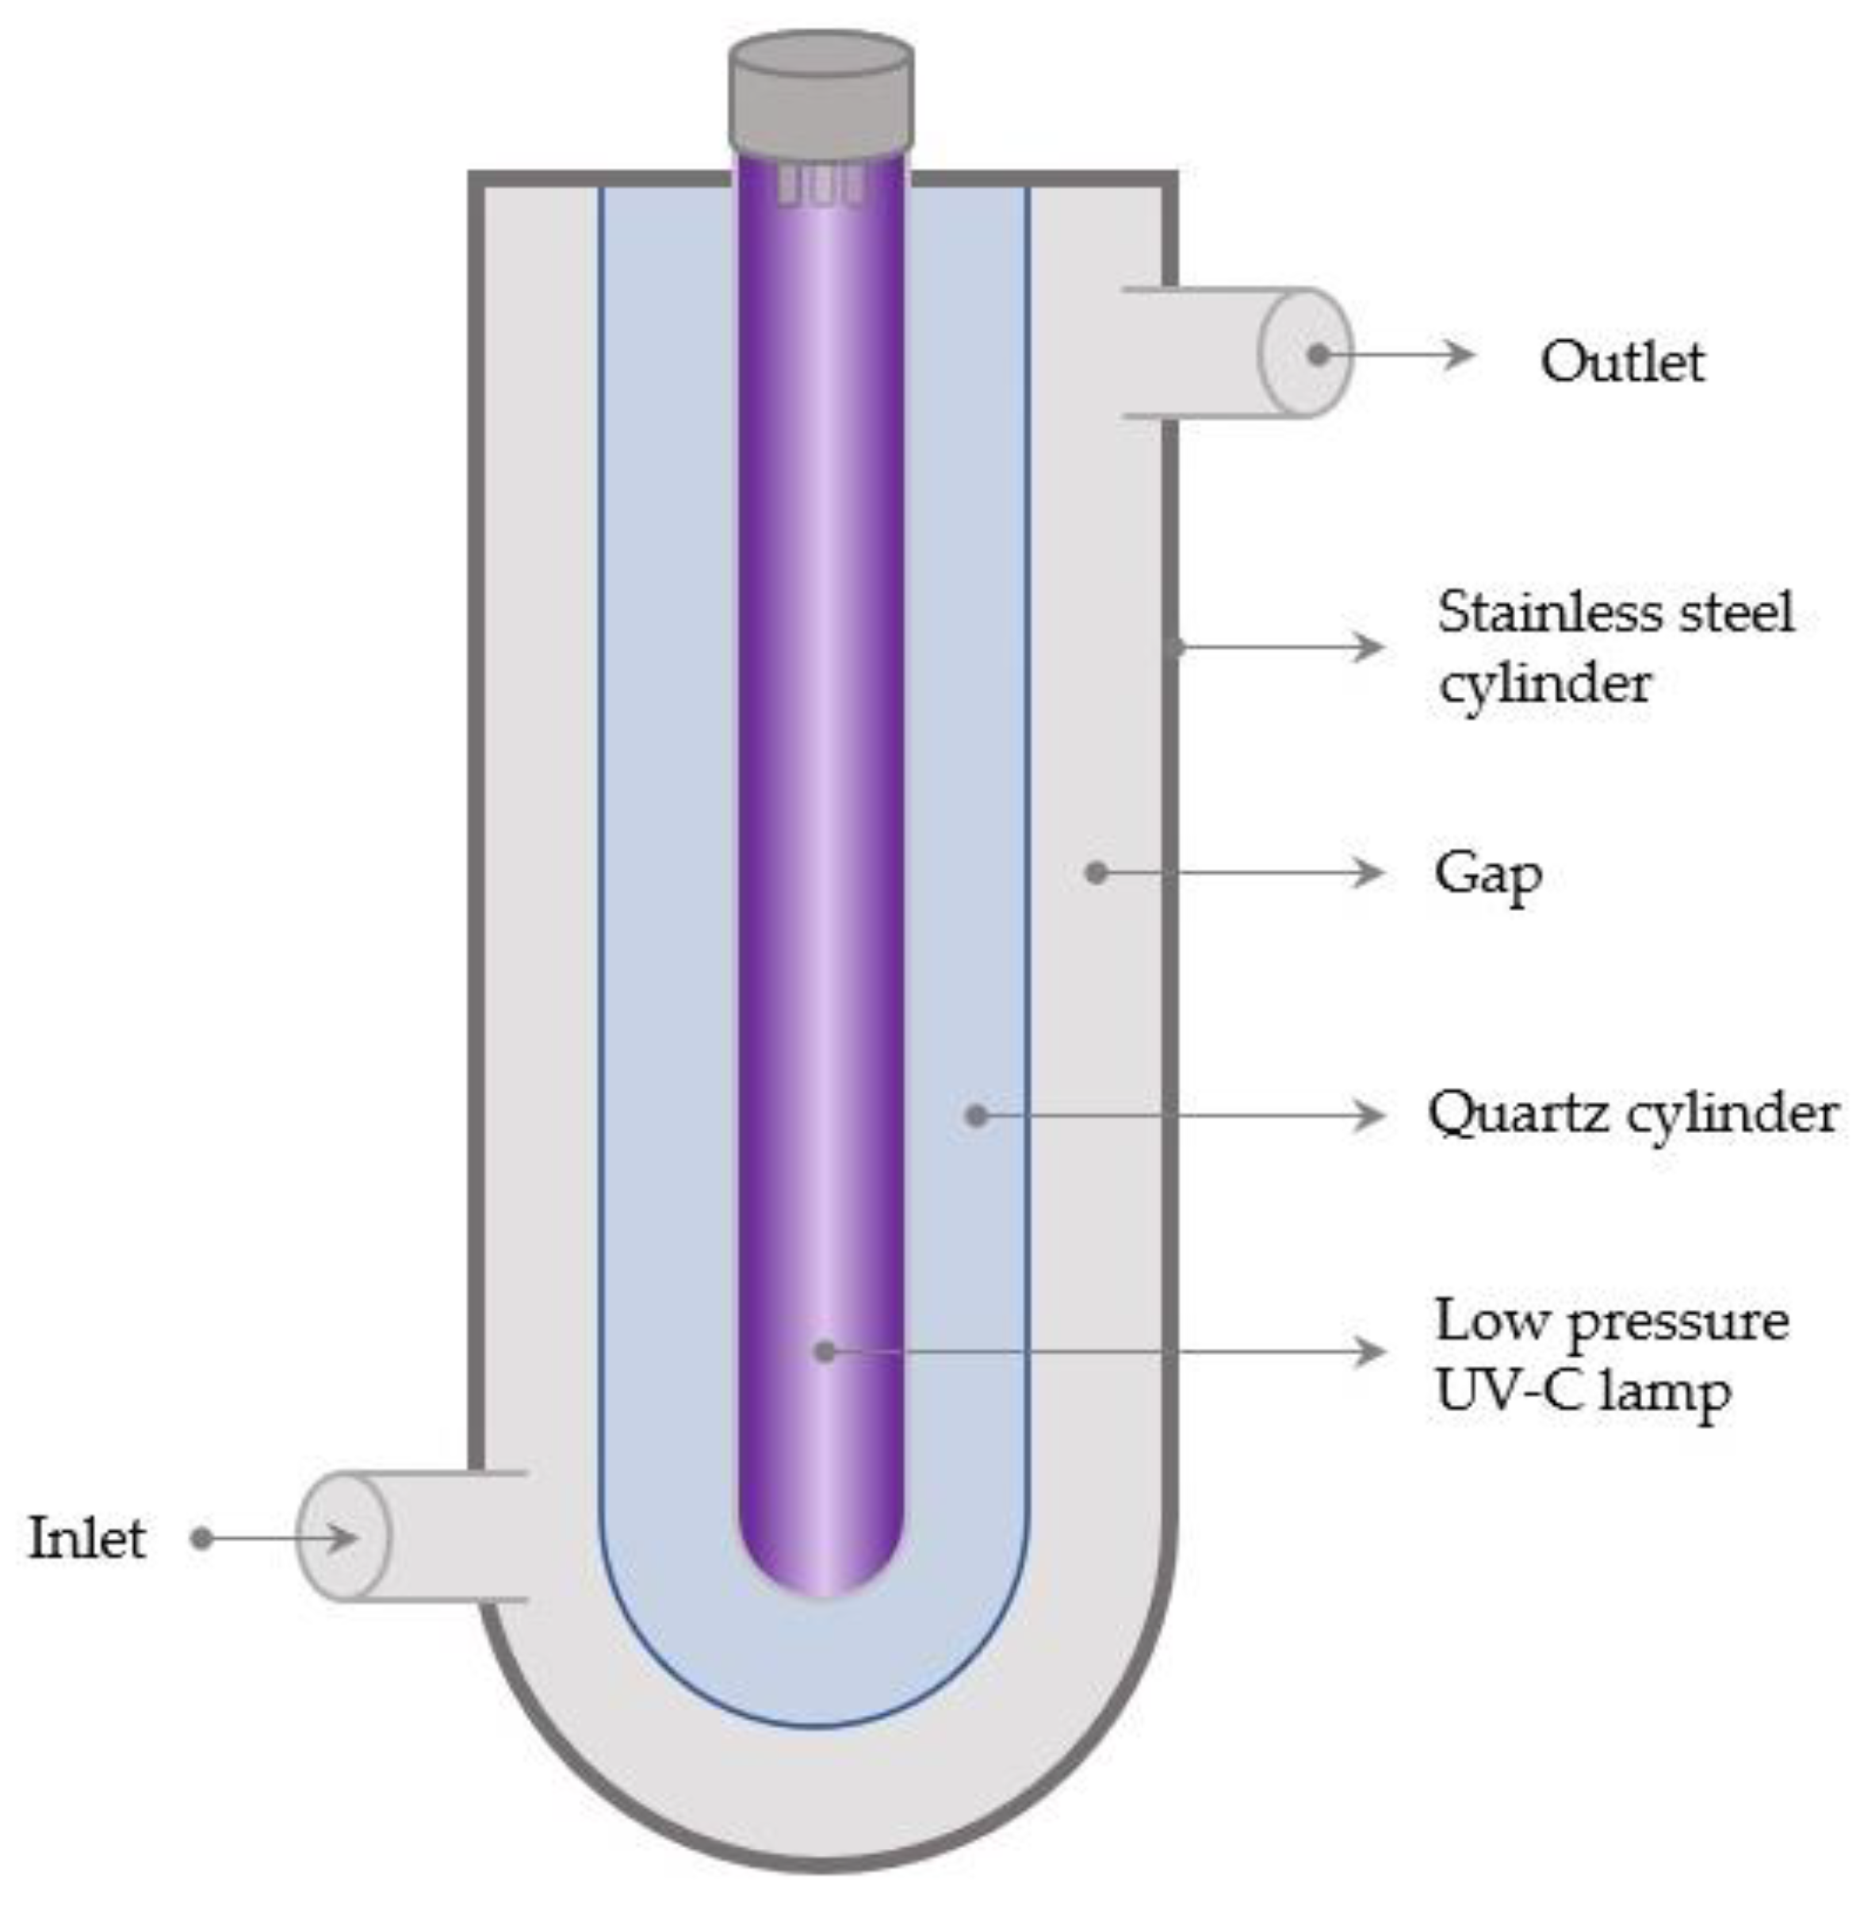
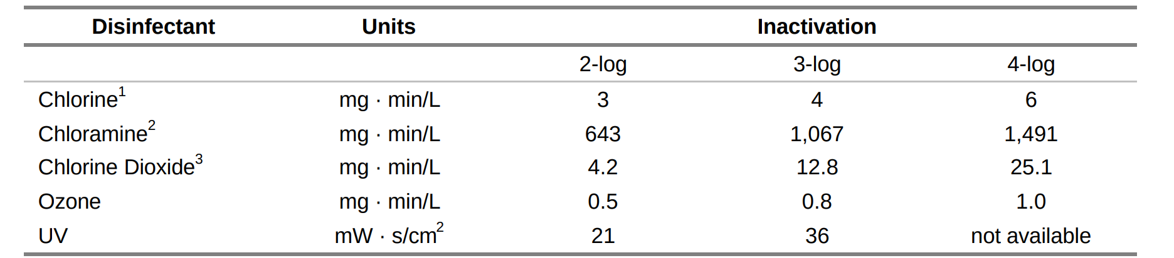
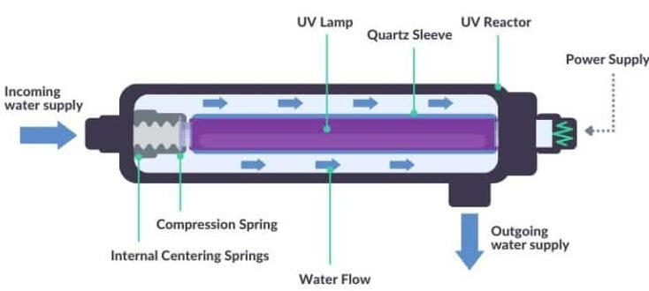
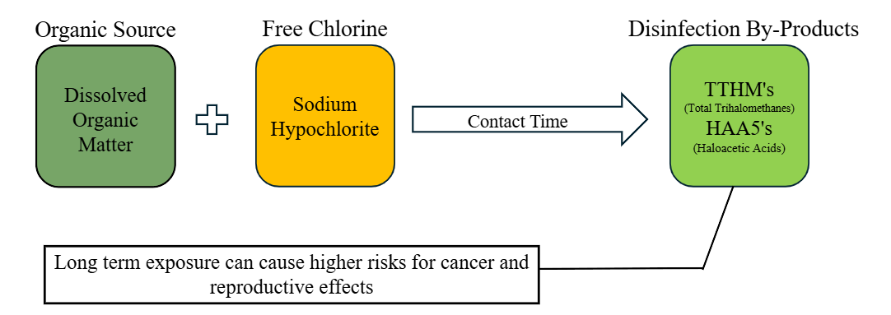
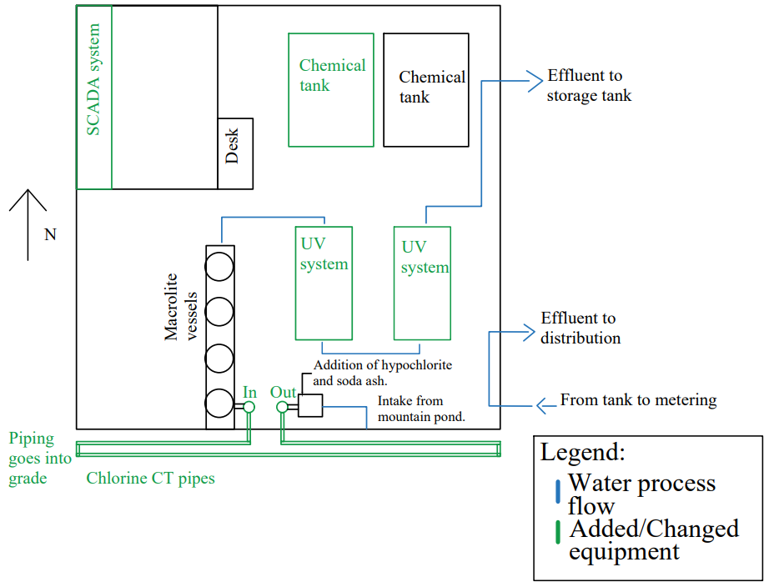
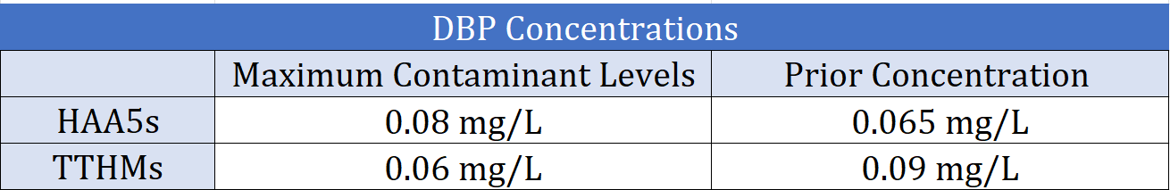
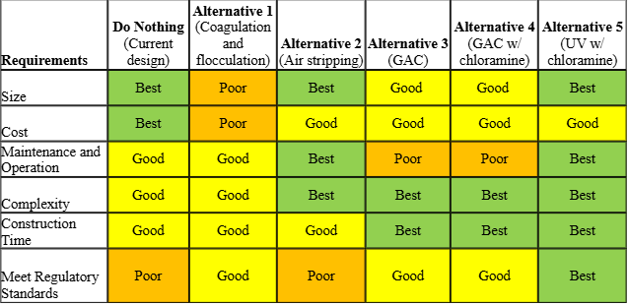
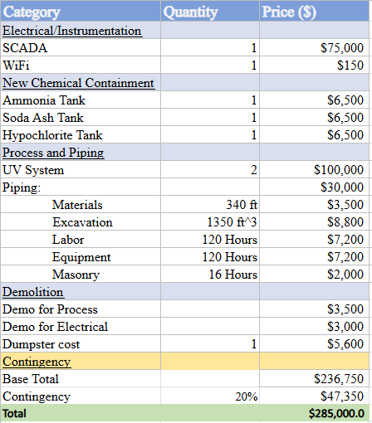
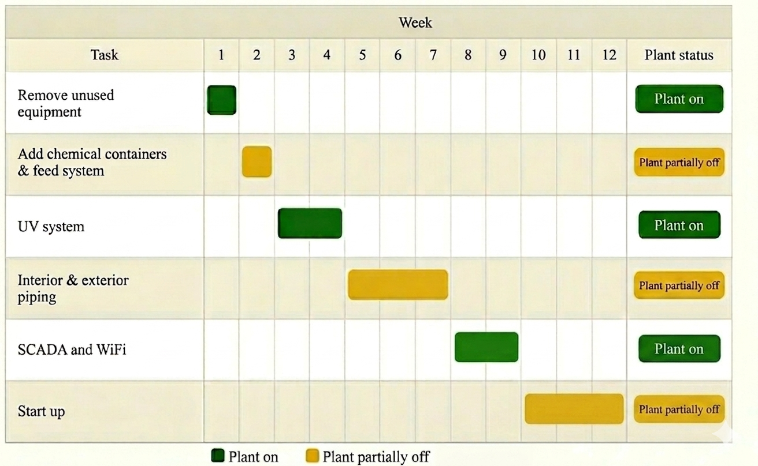




DBP Reduction in a Rural Small-Scale Surface Water Treatment System
Elisabeth Drakatos, Briana Shaw, Quincy Burger, Ava Chretien, Ethan Cutler
Civil and Environmental Engineering, University of New Hampshire, Durham, NH 03824
Introduction
UV Treatment
Chloramine
For the past 30 years, New Hampton Village Precinct’s (NHVP) surface water treatment plant has had difficulty meeting state water quality standards. Over the course of the plant’s life, it has received multiple notices as well as an administrative order of consent from NHDES about high DBP concentrations in their treated water. During the past two semesters, our team has found a treatment solution that can accommodate New Hampton’s surface water treatment plant’s challenges. With a limited budget and a small existing building, UV treatment with chloramines was the chosen process. This was decided using a decision matrix that considers both NHDES water quality standards and implementation into the building.
Mercury | Category | LED
 | Established Method
 | Instant On/Off
 | Mercury-Free
 | Low Energy
 | Compact Design
Less reactive than chlorine → Fewer DBPs.
Requires much higher concentrations to achieve same disinfection level.
Ammonia added to water stream just before distribution, chloramine forms instantly.
Chlorine (${Cl}_{2}$)
Ammonia (${NH}_{3}$)
Chloramine (${NH}_{2}Cl$)
UV-C LP Mercury
UV-C LED
Disinfection By-Products (DBPs)
Bench Scale Results
Final Design and Future Considerations
A bench scale test was performed to determine how flowrate, % UV transmittance (%UVT), and temperature would affect log inactivation (LogI) using UV-C LED, which is a newer technology.
A known concentration of f-amp E. coli was mixed with reverse osmosis water (1:10) to make the influent, and IDEXX tests were used to estimate the maximum probable number (MPN) of cells per 100 mL in the effluent.
The table below shows the range of values considered during these tests.
Looking at the graph to the left, you can see there was an average LogI of 2.5-3.5, which meets project requirements.
Trial | Flowrate (gpm) | %UVT | Temp (Celsius)
1 | 0.1 | 28 | 31
2 | 0.3 | 24 | 10
3 | 0.5 | 16 | 4
Alternative Designs
Cost Estimate and Construction Sequencing
Equipment Cost Estimate
Construction Sequencing
Acknowledgements
Thank you to Dr. Mouser, Kai Kleyensteuber, Dr. Ferby, and Dr. Malley for advising us on this project.
References
AquiSense. (2025, October). AquiSense PearlAqua Kilo UV-C LED achieves gold standard UVDGM & NSF 61 certification. Water Today Magazine.
GUIDANCE MANUAL FOR COMPLIANCE WITH THE FILTRATION AND DISINFECTION REQUIREMENTS FOR PUBUC WATER SYSTEMS USING SURFACE WATER SOURCES. (1991)
Please scan the QR code for a full list of references.
The chosen alternative was to add a UV reactor during primary treatment and to change to chloramines as a residual disinfectant.
Notes:
Intro (quincy)
Where plant is, limitations of plant, history of plant, brief introduction, dbp overview
2. DBP (quincy)
3. Alternative Design (Ethan)
4. UV (Ava)
5. Bench Scale (Briana)
5. Cost Estimate and Construction (Elisabeth)
For the cost estimate we honed in on the equipment and installation costs. Our first items were the electrical instrmenetaion, the town currently has a manual operating system which is out of regulation with the APPA, so will update to a SCADA system and Wifi. This will cost about $750000. New chemical containment was added including an ammonia tank, a soda ash tank, and a hypochlorite tank, installiton of these totalled a
6. Chloramine (Ethan)
7. Final Design and Future Considerations (Briana)
9. Acknolwedgements and References (Elisabeth)

