Slide 1




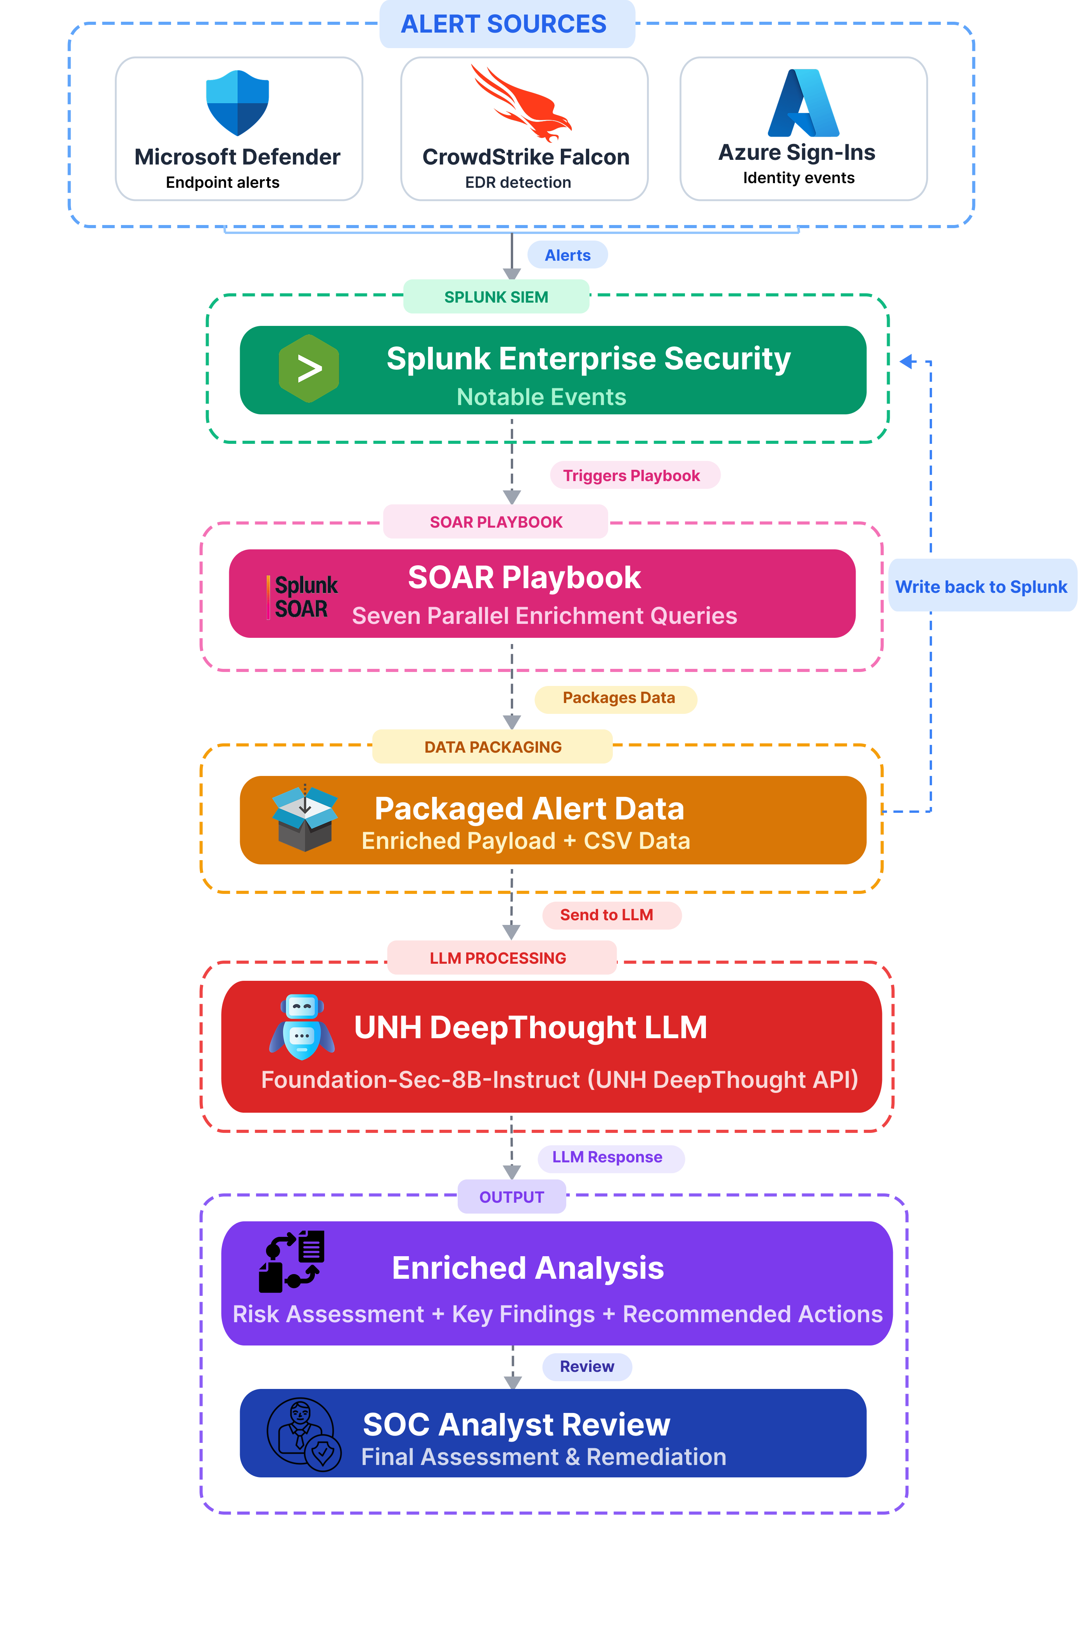
Data-Driven Retrieval-Augmented AI for Security Operations
Abigail Miller · Ben Spiller · Caleb Rockwell · Dean Marx · Dylan Royle · Michael Vinciguerra · Rishal Khatri · Sam Strange · Tyler Geffrard
Project Advisor: Prof. Lisa Henry | Sponsor: Joseph Gray
OVERVIEW
SYSTEM ARCHITECTURE
IMPLEMENTATION & TESTING
USNH cybersecurity team receive high alert volumes from Microsoft Defender, CrowdStrike, and Azure Sign-Ins. This leads to analyst fatigue and delayed responses due to manual triage. Investigating a single suspicious login can take up to 2 hours, and missed incidents can result in an expense in excess of $50K.
Project Mimir develops an AI-Enhanced Alert Triage System that adds identity context to alerts using Splunk ES, Splunk SOAR, and UNH’s DeepThought AI to expedite alert remediation.
Integration primarily focuses on reducing Mean Time to Triage (MTTT) and improving analyst adoption and feedback across the USNH cybersecurity team.
5
MTTT
Alert types covered
Primary success metric
2h
$50K
99%
On-prem
RAG
Investigation Time
Potential missed incident cost
Target accuracy
Data stays local
Context retrieval approach
REQUIREMENTS
Alert types:
Impossible Travel · Anomalous Token · Malicious IP · Anomalous Login · 20 Failed logins in 5 minutes
Functional
Testing was conducted using resolved notables to verify the accuracy of threat intelligence, disposition classifications, and remediation recommendations.
Classify 5 alert types
at 99% accuracy
Generate clear, human-readable
reports
EVALUATIONS & CONCLUSIONS
Maintain data privacy
& compliance
Integrate with existing
USNH platforms
Non-Functional
Project Mimir reduces analyst fatigue by automating alert enrichment and classification, not the final decision. With RAG-based retrieval and LLM-driven analysis, analysts get faster, more informed starting points for investigations.
Faster than human analyst
Clear, readable output
✓
Automates enrichment and classification,
analysts stay in control of final decisions
Easy to maintain and document
Cost-effective at scale
99.63%
✓
RAG + LLM results in faster, more
informed analyst decision-making
✓
Built on existing USNH infrastructure,
scalable and cost-effective
PROJECT DESIGN
Reduction in MTTT
Alerts come from Splunk Notables and Azure authentication logs. By following analyst workflows, we identified the key fields and organized them into a structured format for the RAG pipeline.
TOOLS USED
✓
Ingest: Pull alerts from Splunk Notables and Azure Authentication logs
Splunk ES
Alert aggregation and analysis
Splunk SOAR
Automation and playbooks
✓
Enrich: Attach relevant context from stored RAG data
Alerts from Microsoft Defender, CrowdStrike, and Azure Sign-Ins are ingested into Splunk ES, where correlation and risk scoring happen. A SOAR playbook then runs enrichment queries and packages the data before sending it to DeepThought with RAG-based context. The final output provides a clear risk assessment, key findings, and recommended actions to help analysts reduce investigation time.
✓
Deliver: Package enriched alerts into the analyst workflow for final decision-making
DeepThought AI
LLM-based alert analysis
Python
Data cleaning and processing
University of New Hampshire | Interdisciplinary Science & Engineering Symposium 2026 | Project Mimir

Slide 2
Abstract
The University System of New Hampshire (USNH) faces growing alert volumes, placing analysts at increased risk of alert fatigue and delayed remediation. To address this, we designed and implemented a Retrieval-Augmented Generation (RAG) alert triage system that enriches alerts with contextual user information, device metadata, and behavioral indicators, enabling faster alert response while allowing analysts to prioritize threat hunting. Guided by analyst workflows, we collected raw security logs from Microsoft Azure and Notables within Splunk, normalized and cleaned the data, and integrated them into a unified data framework. Upon alert creation, relevant contextual data is automatically delivered to USNH’s Deep Thought AI, which generates an analyst-facing report. Initial deployment confirms immediate alert triage while adhering to regulatory data constraints. These results demonstrate that retrieval-augmented architectures are a viable approach for enhancing security operations workflows while retaining human-in-the-loop decision-making.

