Slide 1

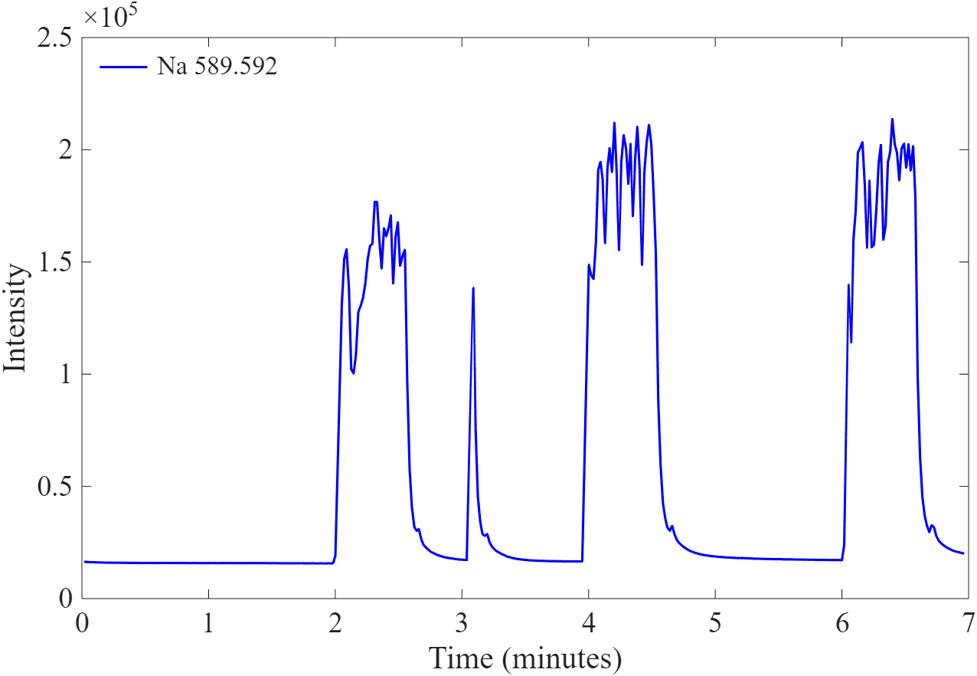
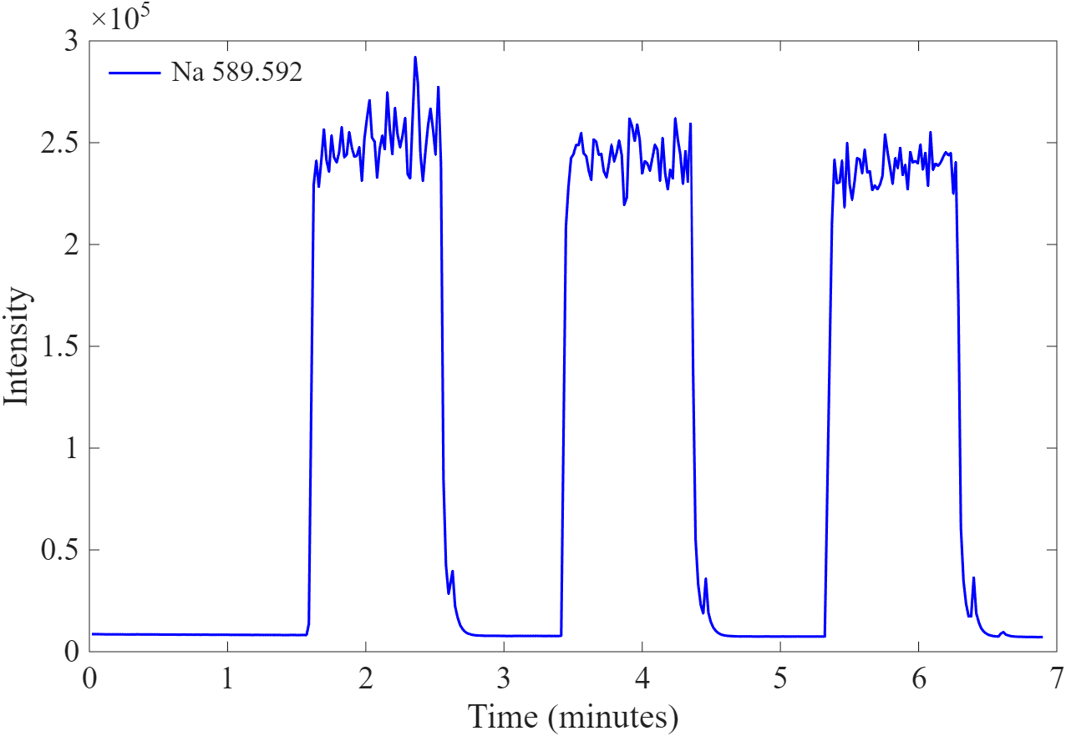
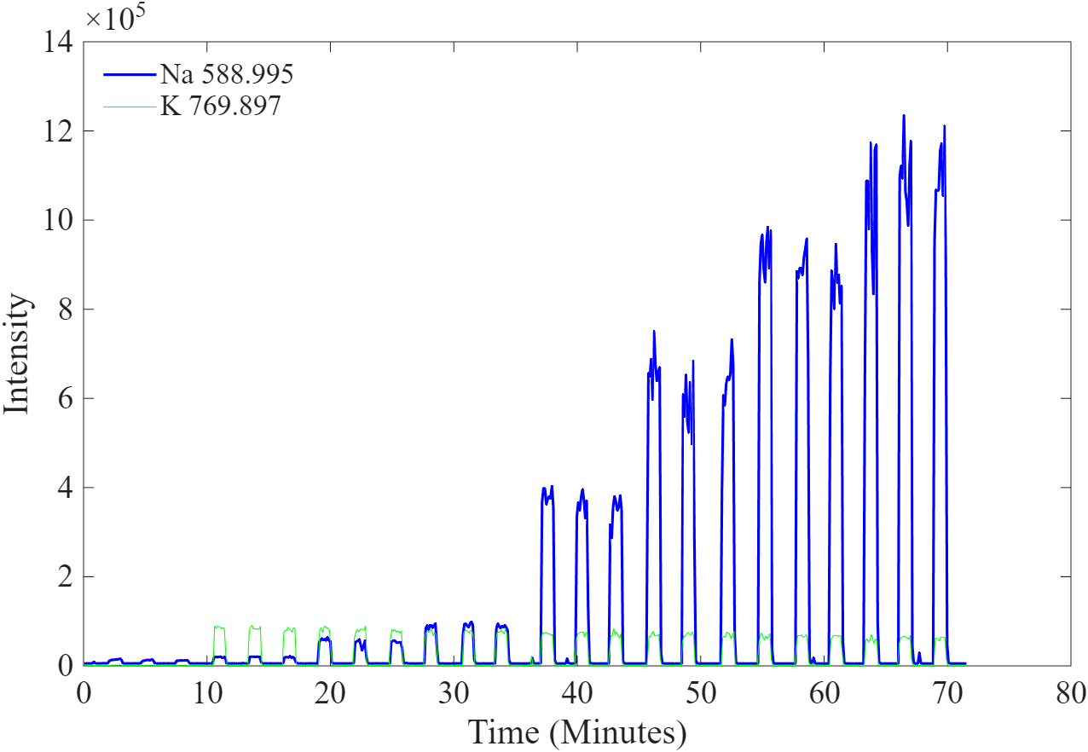
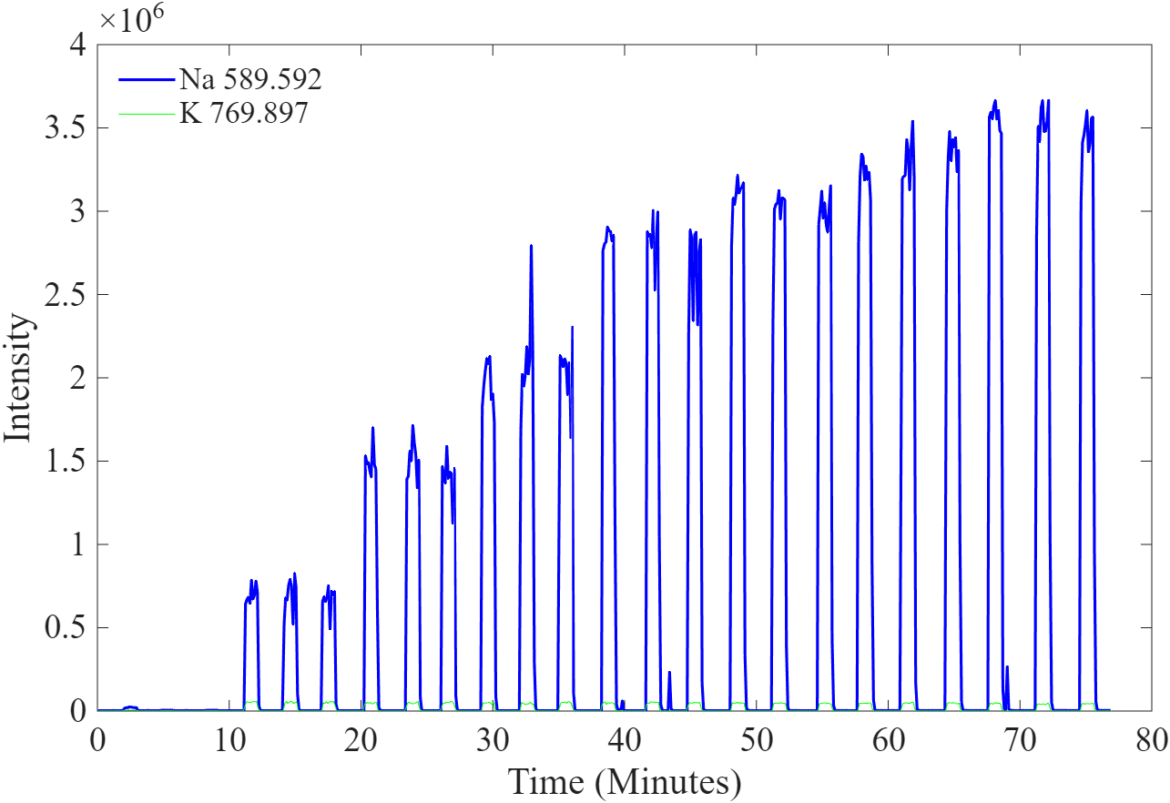
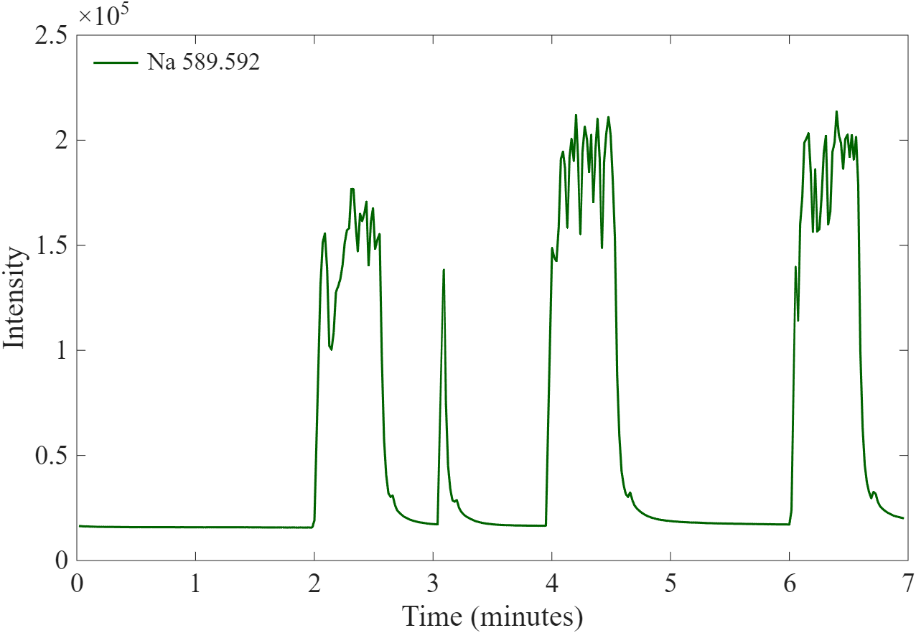
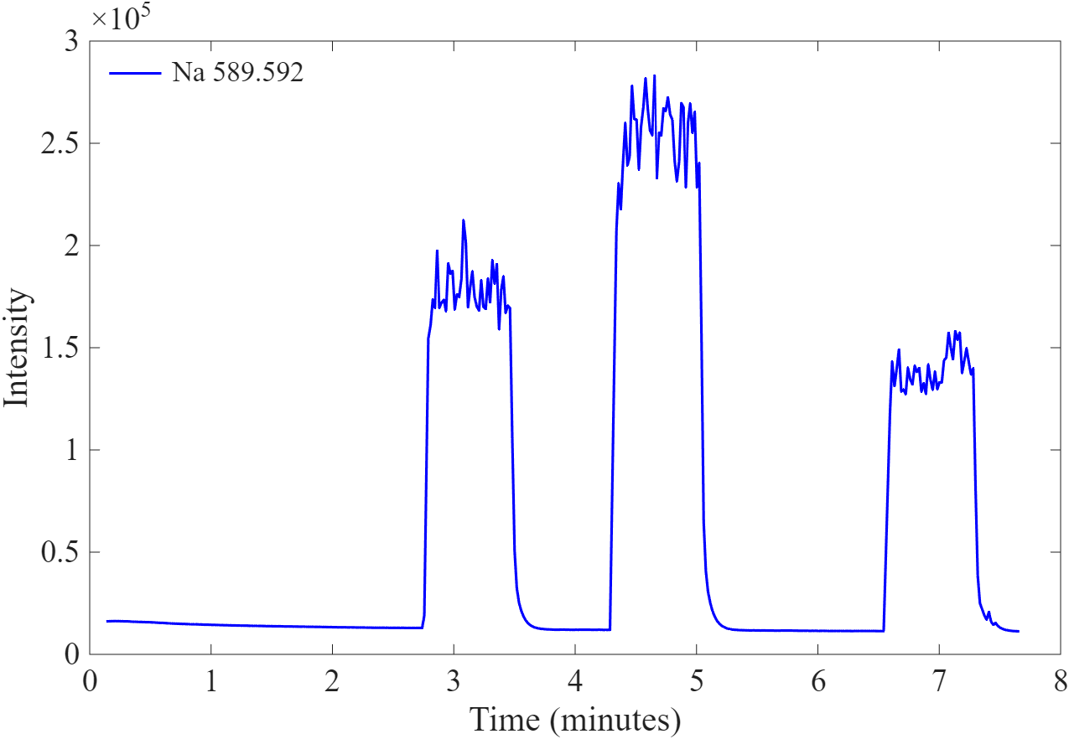
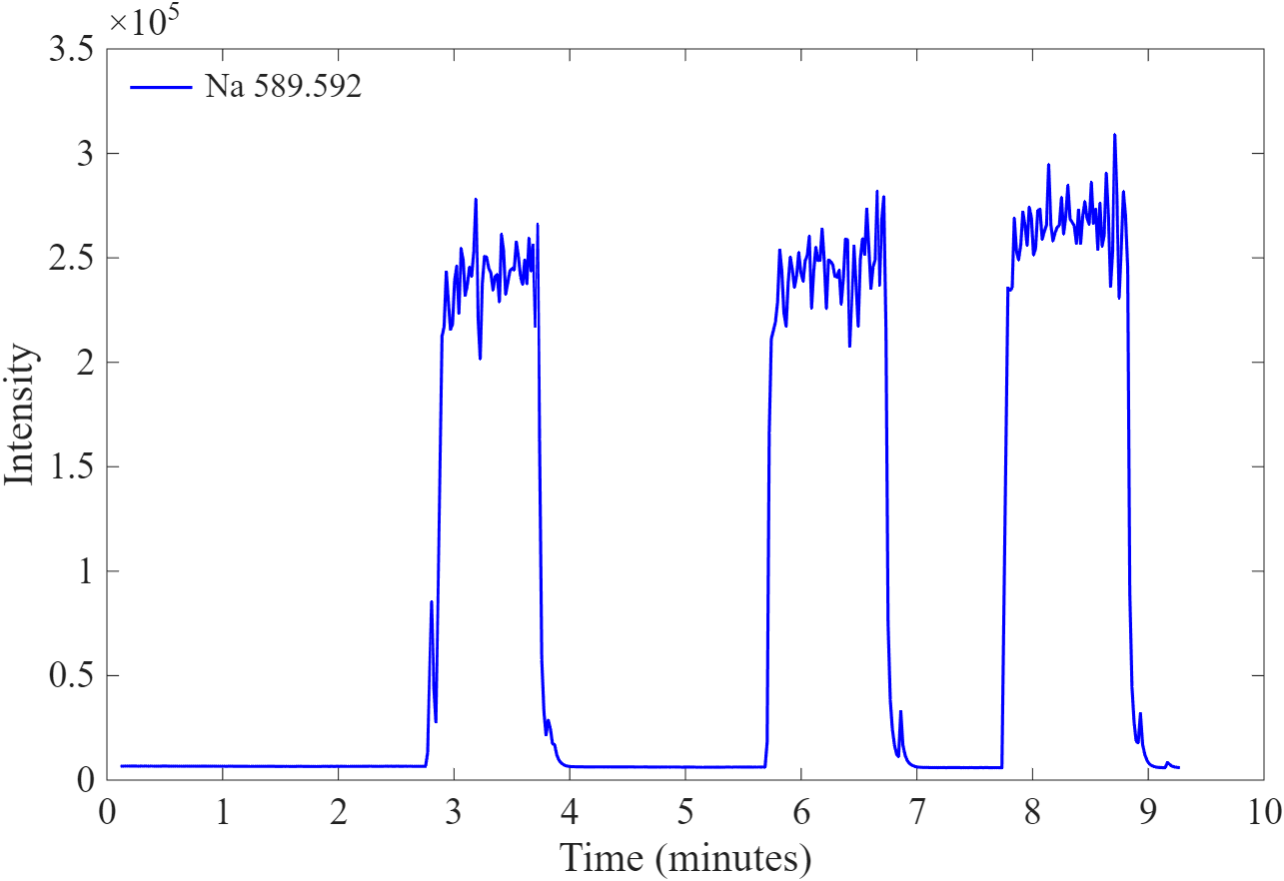
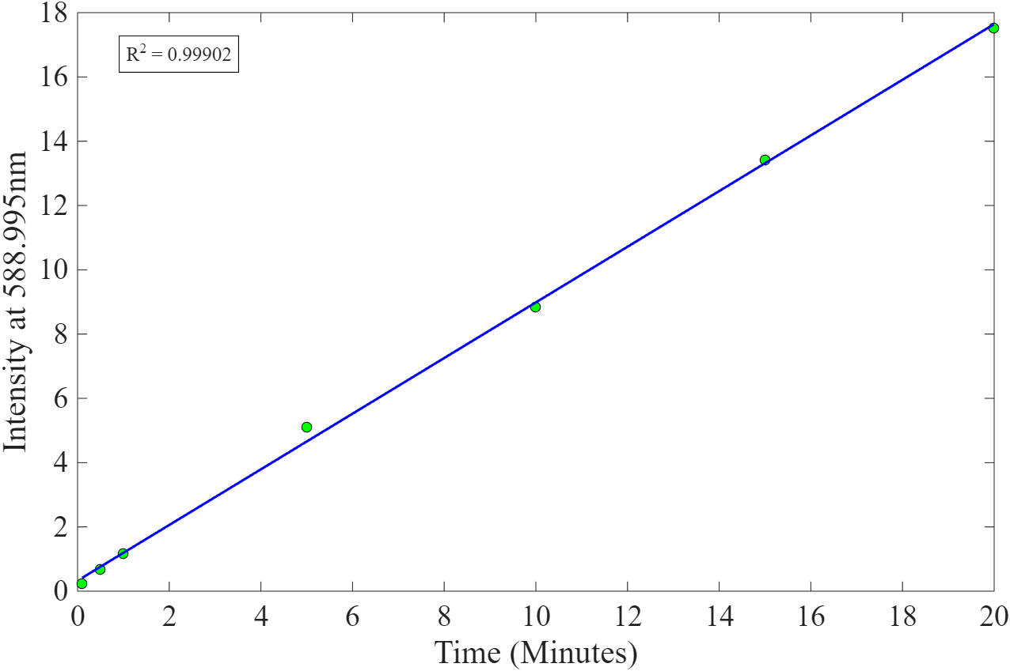
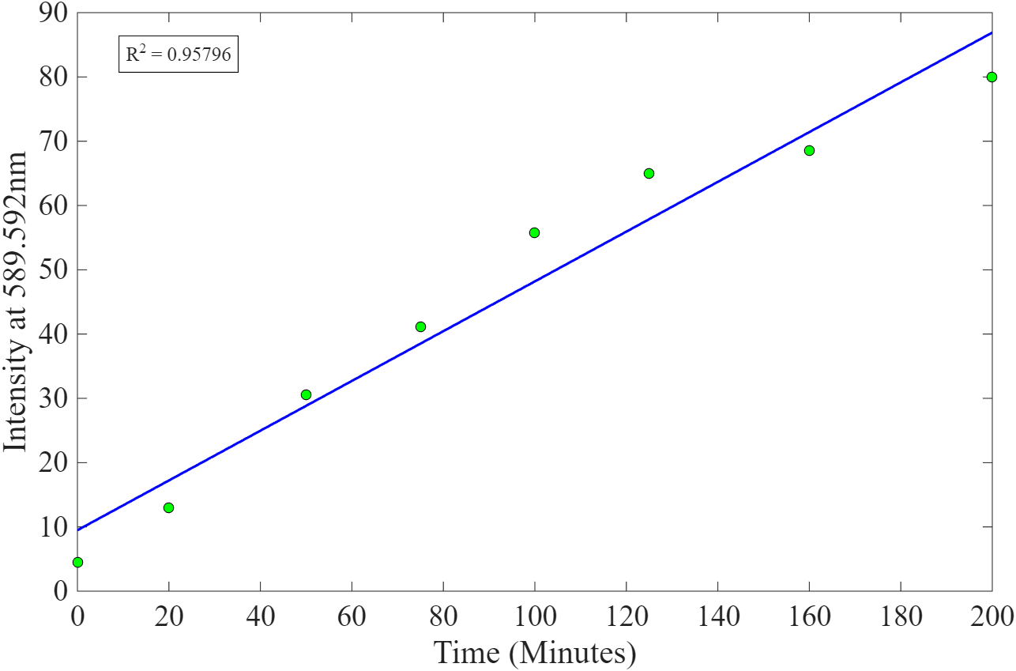
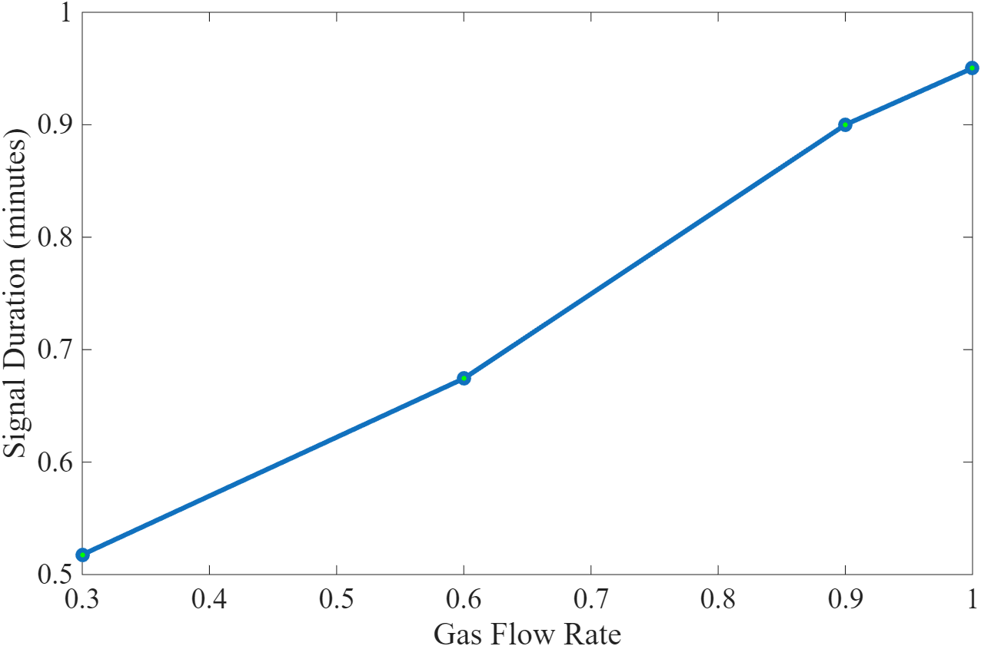
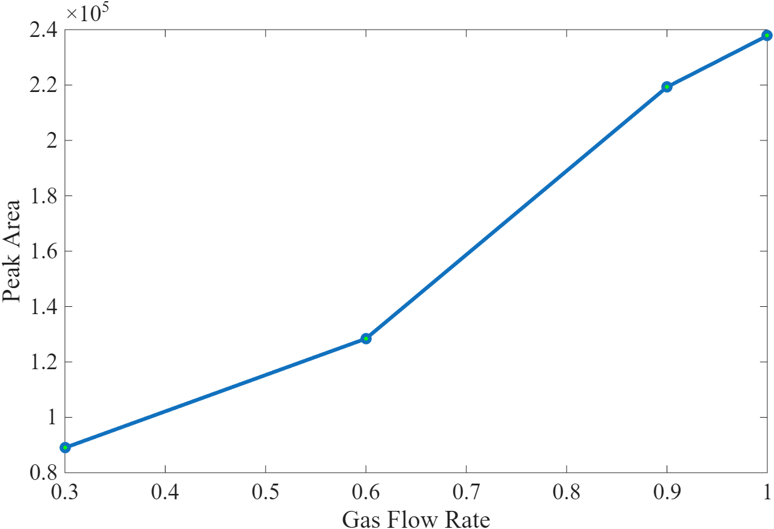
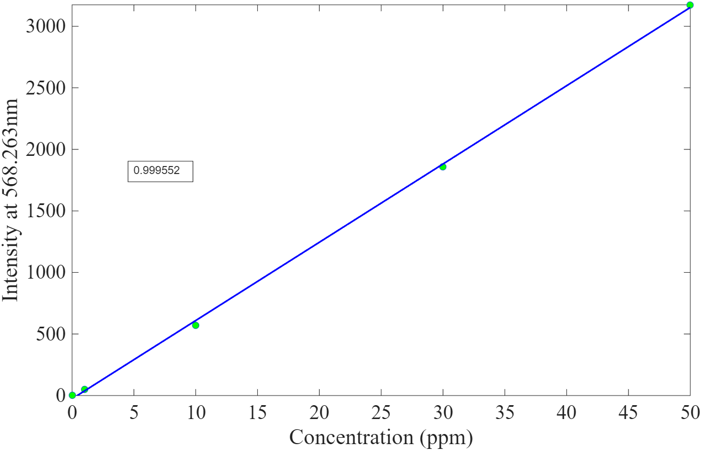
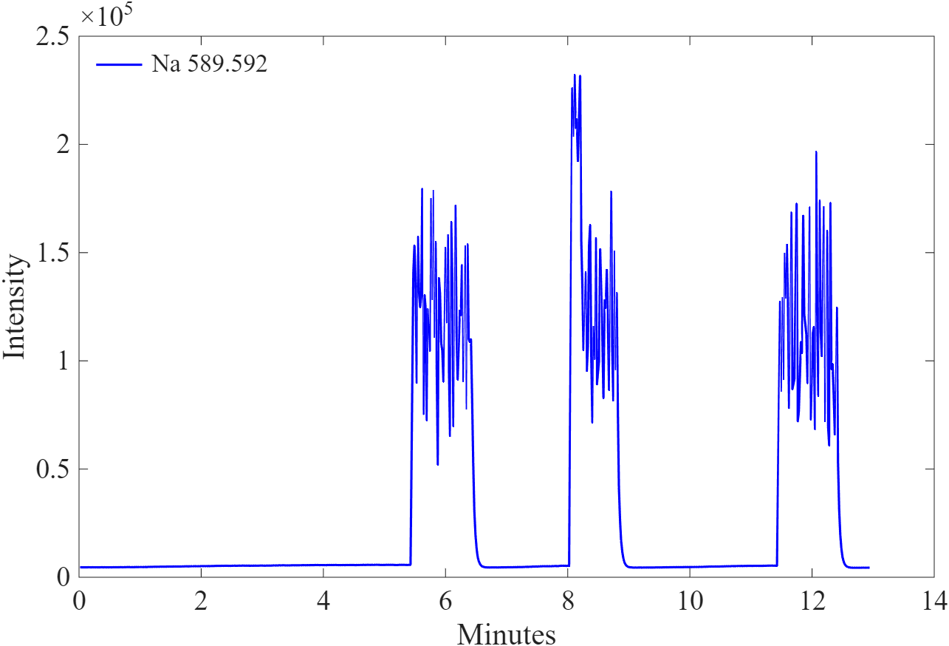
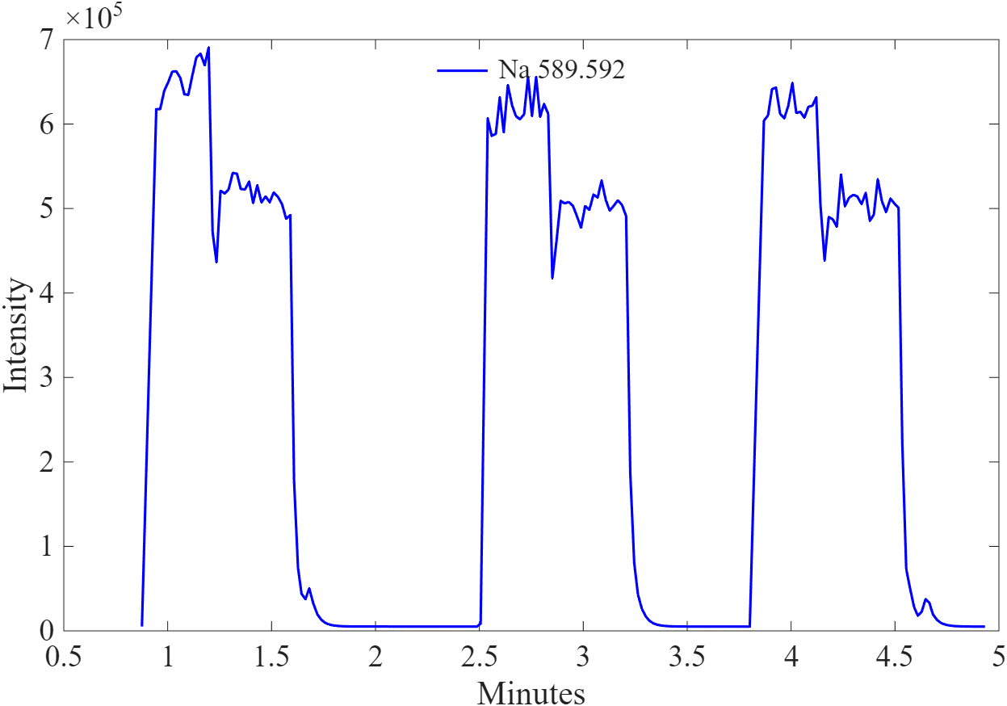
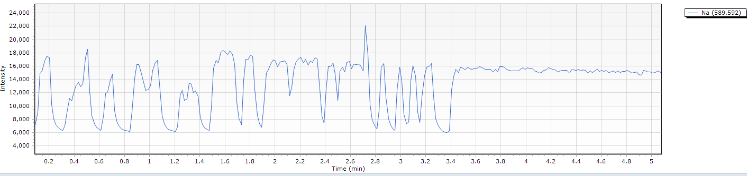
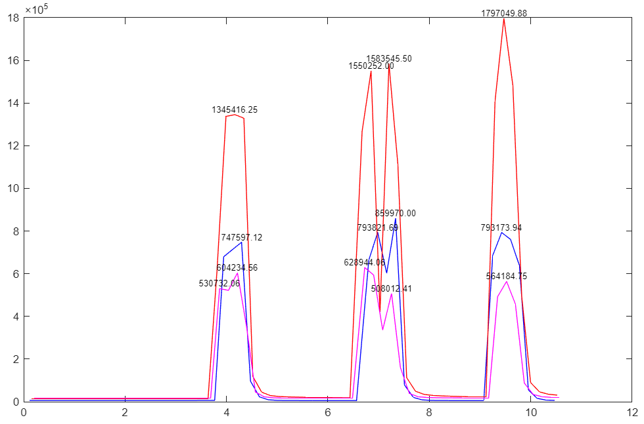
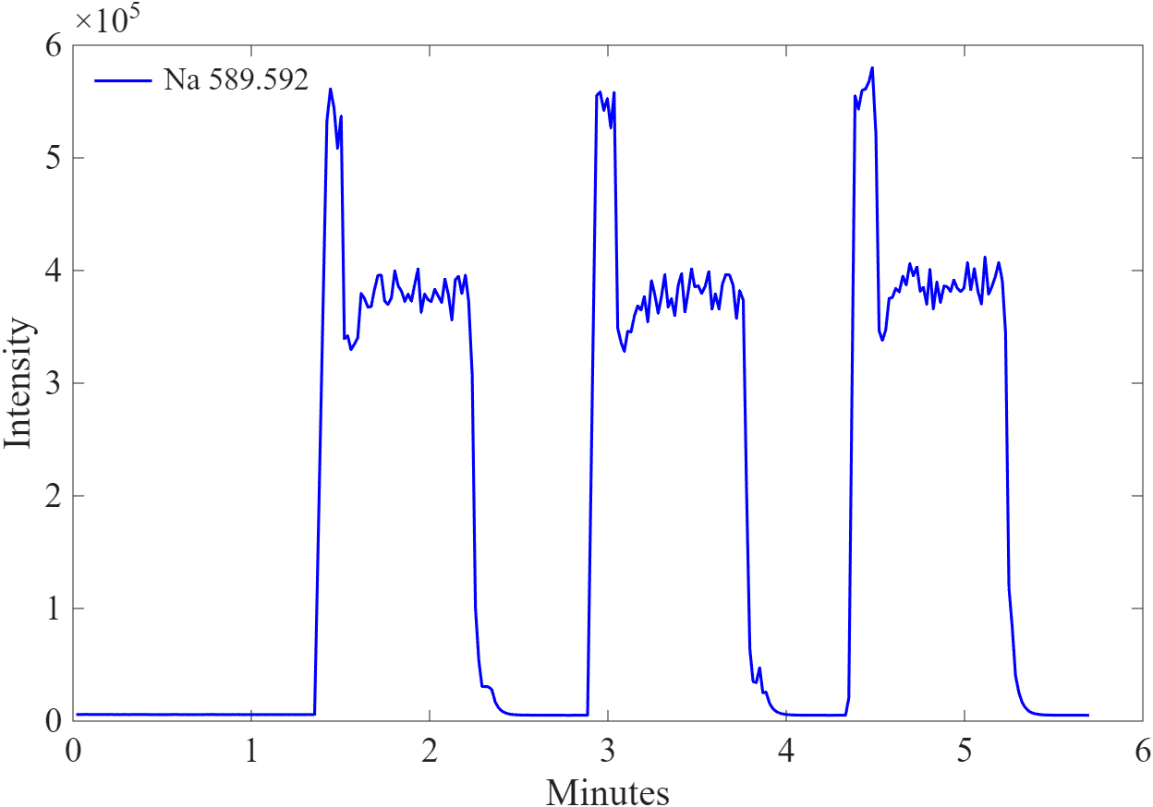
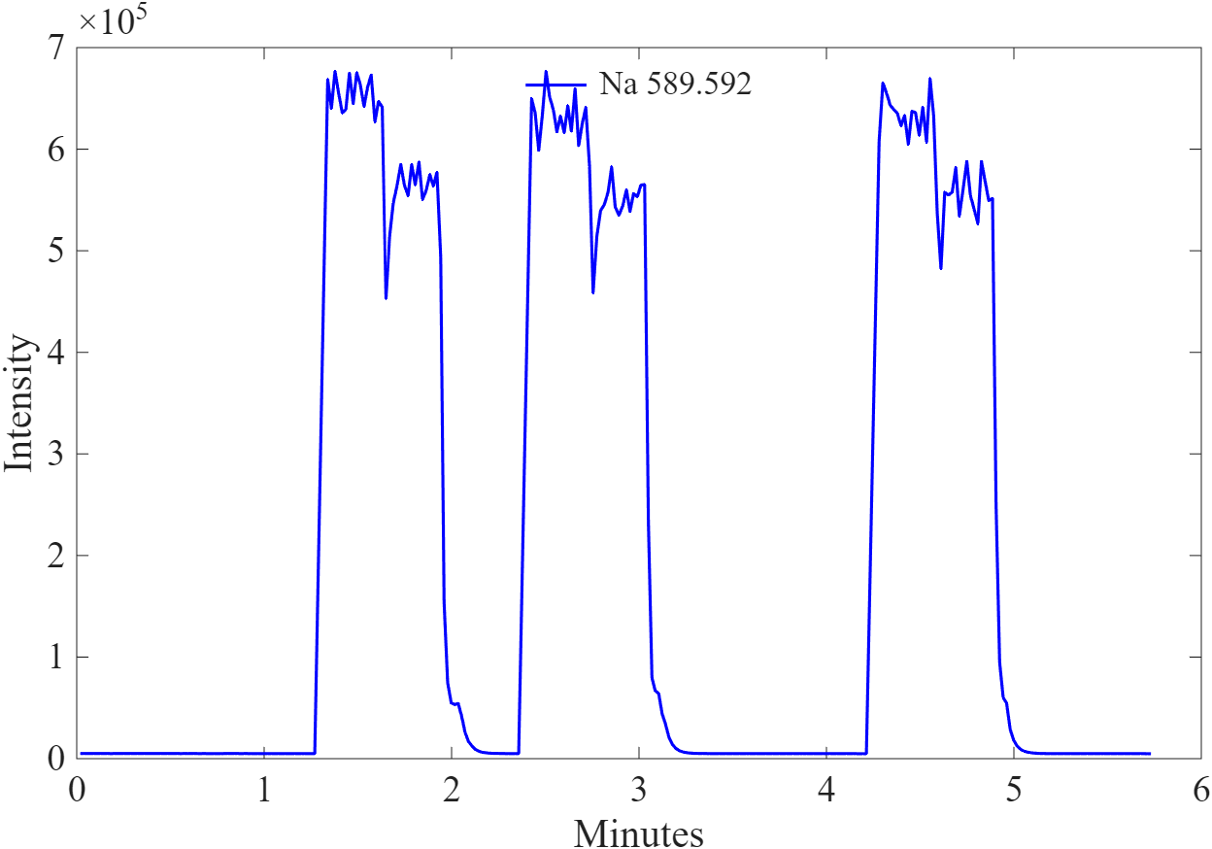



Ultra-Low Volume Pulsed Sample Injection for Elemental Analysis with Atomic Emissions Spectroscopy
Hunter Nordin ª, Kanwal Jeet ^{a,*}, Anyin Li ª
ª Department of Chemistry, University of New Hampshire, 23 Academic Way, Durham, NH 03824
Introduction
Results 1: Effect of Nebulizer Gas Flow Rate on Signal Duration
Results 3: Calibration Curve for 100uL Sample
The AES (Atomic Emissions Spectrophotometer) is a cornerstone technique frequently used for the identification, quantification of elemental composition in environmental monitoring, metallurgy and forensic analysis. The major limitation identified and addressed in this study is that it consumes milliliters of liquid sample solutions under default operation mode. This prevents its use for the study of precious biological, geological, or catalyst samples, which are typically in the volume of microliters. The goal of this research is to develop a novel operation mode that consumes <10 times less volume of the sample, to study metal ion partition in the preparation of therapeutic proteins.
Flow Rate = 0.3L/min
ASD = 39.93 seconds
Flow Rate = 0.9L/min
ASD = 60.858 seconds
Intensity (au)
Intensity (au)
Intensity (au)
Intensity (au)
Time (minutes)
Time (minutes)
Time (minutes)
Time (minutes)
Instrument Configuration:
Flow Rate = 0.6L/min
ASD = 44.142 seconds
Flow Rate = 1 L/min
ASD = 65.058 seconds
Agilent MP 4210
4
5
Intensity (au)
Intensity (au)
Intensity (au) at 588.995nm
Intensity (au) at 589.592nm
3
4
1
2
N2
Time (minutes)
Time (minutes)
Fine Mist
Mist
Sample
Signal Duration vs. Gas Flow Rate
Peak Area vs. Gas Flow Rate
Time (minutes)
Air
Peak Area
Time (minutes)
Time (minutes)
1) Peristaltic Pump | Rotational speed can be adjusted 1–100 rpm. Default configuration utilizes 80 rpm (~1.06 mL/min) to replenish and 15 rpm (~228 𝜇L/min) to stabilize each for 30 seconds.
2) Tubing | The internal diameter is 0.38mm and outer diameter is 1.6mm. The dead volume of tubing was found to be ~261 𝜇L.
3) Nebulizer | Gas flow rate to the nebulizer can be adjusted from 0.1 to 1 L/min
4) Plasma | Microwave Induced Plasma (MIP) is generated in quartz torch.
5) MP Expert Software | Allows to select elements and their emission wavelengths. Default method takes average of scans with continuous flow. The intensity vs. time chromatogram is usually not visible by the operator.
Signal Duration (minutes)
100µL sodium standards were used and must be consistent because intensity scales with volume
Lower concentration range has greater accuracy, but the accuracy of the higher concentration curve could be improved.
Addition of an internal standard creates less over all data points per element but accounts for fluctuations.
Gas Flow Rate (L/min)
Gas Flow Rate (L/min)
Comparison of Default vs. Modified Methods
Timed 30 second injections of a sodium spiked standard were used
The highest flow rate was found to be ideal for maximum signal duration and peak area.
Traditional Method using >1mL
New Method Using 100µL standards
Results 2: Effect of Peristaltic Pump Speed on Signal Duration
Method and Assessment:
Pump Speed = 5RPM, ASD = 54.54 secs
Pump Speed = 60RPM, ASD = 40.302 secs
Intensity (au) at 568.263nm
Intensity (au) at 588.995nm
Default Method:
Time Chromatogram of Continuous Flow
Intensity (au)
Intensity (au)
Detector
Intensity (au)
Concentration (ppm)
Concentration (ppm)
Blue= Na 589.592
Low volume method is just as effective in the 0-20 ppm range with a 0.05% R² difference in favor of the traditional method.
Time (minutes)
Time (minutes)
Time (minutes)
Pump Speed = 30RPM, ASD = 54.402 secs
Pump Speed = 80RPM, ASD = 38.46 secs
Conclusions and Future Directions:
Modified Pulsed Injection:
Time Chromatogram of 30 Second Pulsed Injections
R squared values of 99.902% and 95.8% for low and high concentrations respectively show 0.01% and 4.2% error. Quantification with error <0.5% is excellent quality but an error <5% is generally considered accurate and acceptable by EPA guidelines
Elemental concentrations in an unknown 100uL sample can
be quantified using this method.
It is theoretically possible to further decrease the sample
volume using the same technique.
Detector
Intensity (au)
Red= Na 589.592
Blue= Ca 396.847
Magenta= K 766.491
Intensity (au)
Intensity (au)
Sample 3x
Air
Time (minutes)
Time (minutes)
Time (minutes)
Default method alternates between fast 80 rpm and slow 15 rpm pump speed with continuous liquid flow.
Time read mode is ideal to see how intensity varies overtime, spiked intensities show the sample.
Time (minutes)
Acknowledgements:
Signal duration is inversely proportional to pump speed.
5 rpm speed creates inconsistent aerosol, and 80 rpm gives most stable but shortest signal duration.
15 rpm pump speed was found to be optimal for signal duration and stability
This poster is based upon work supported by the National Science Foundation under Grant CHE-2203289 and NSF-EPSCoRz
Li⁺ Group Site

