Slide 1

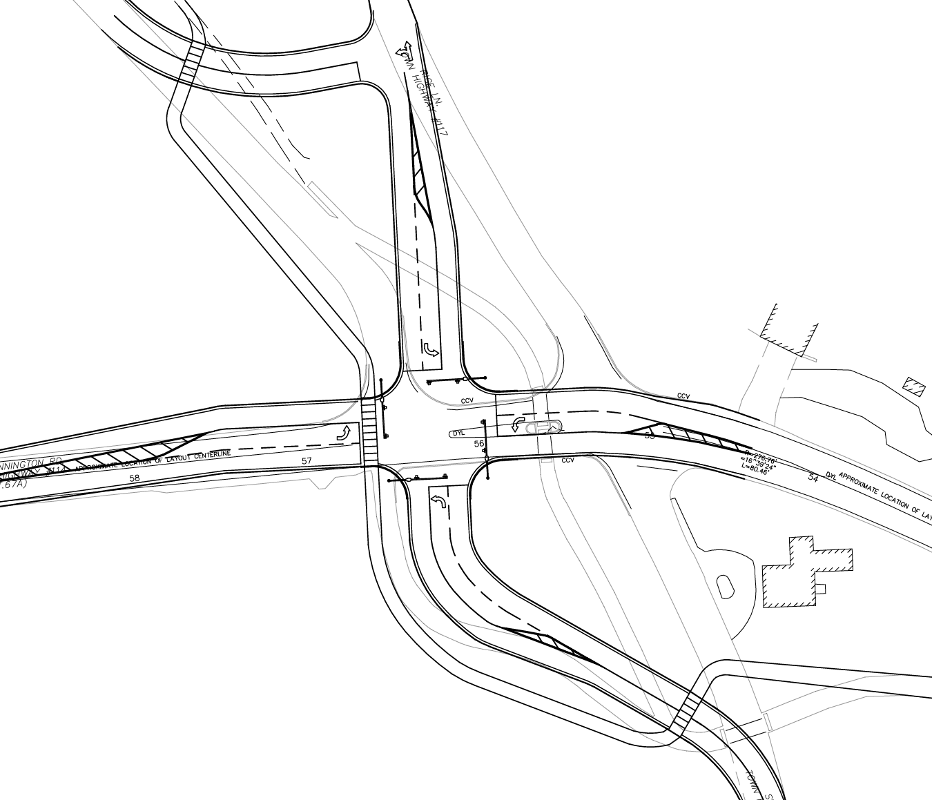
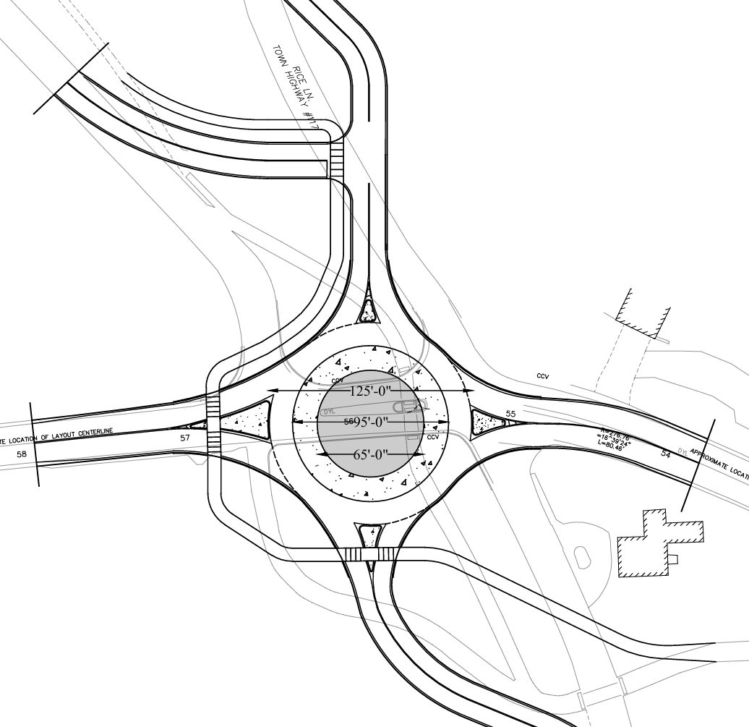
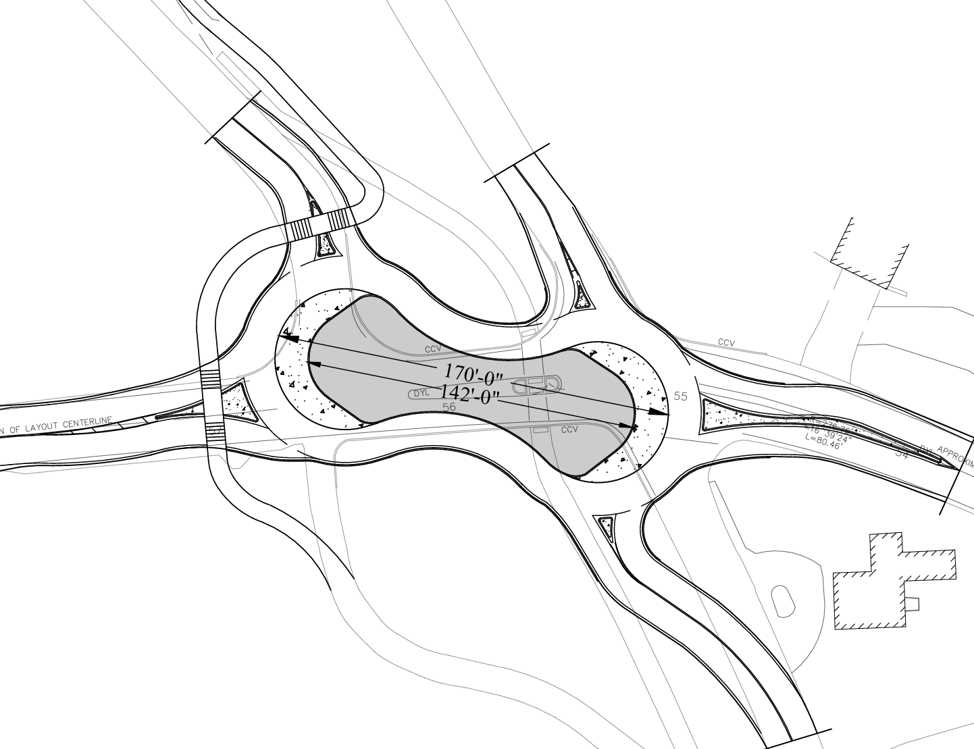
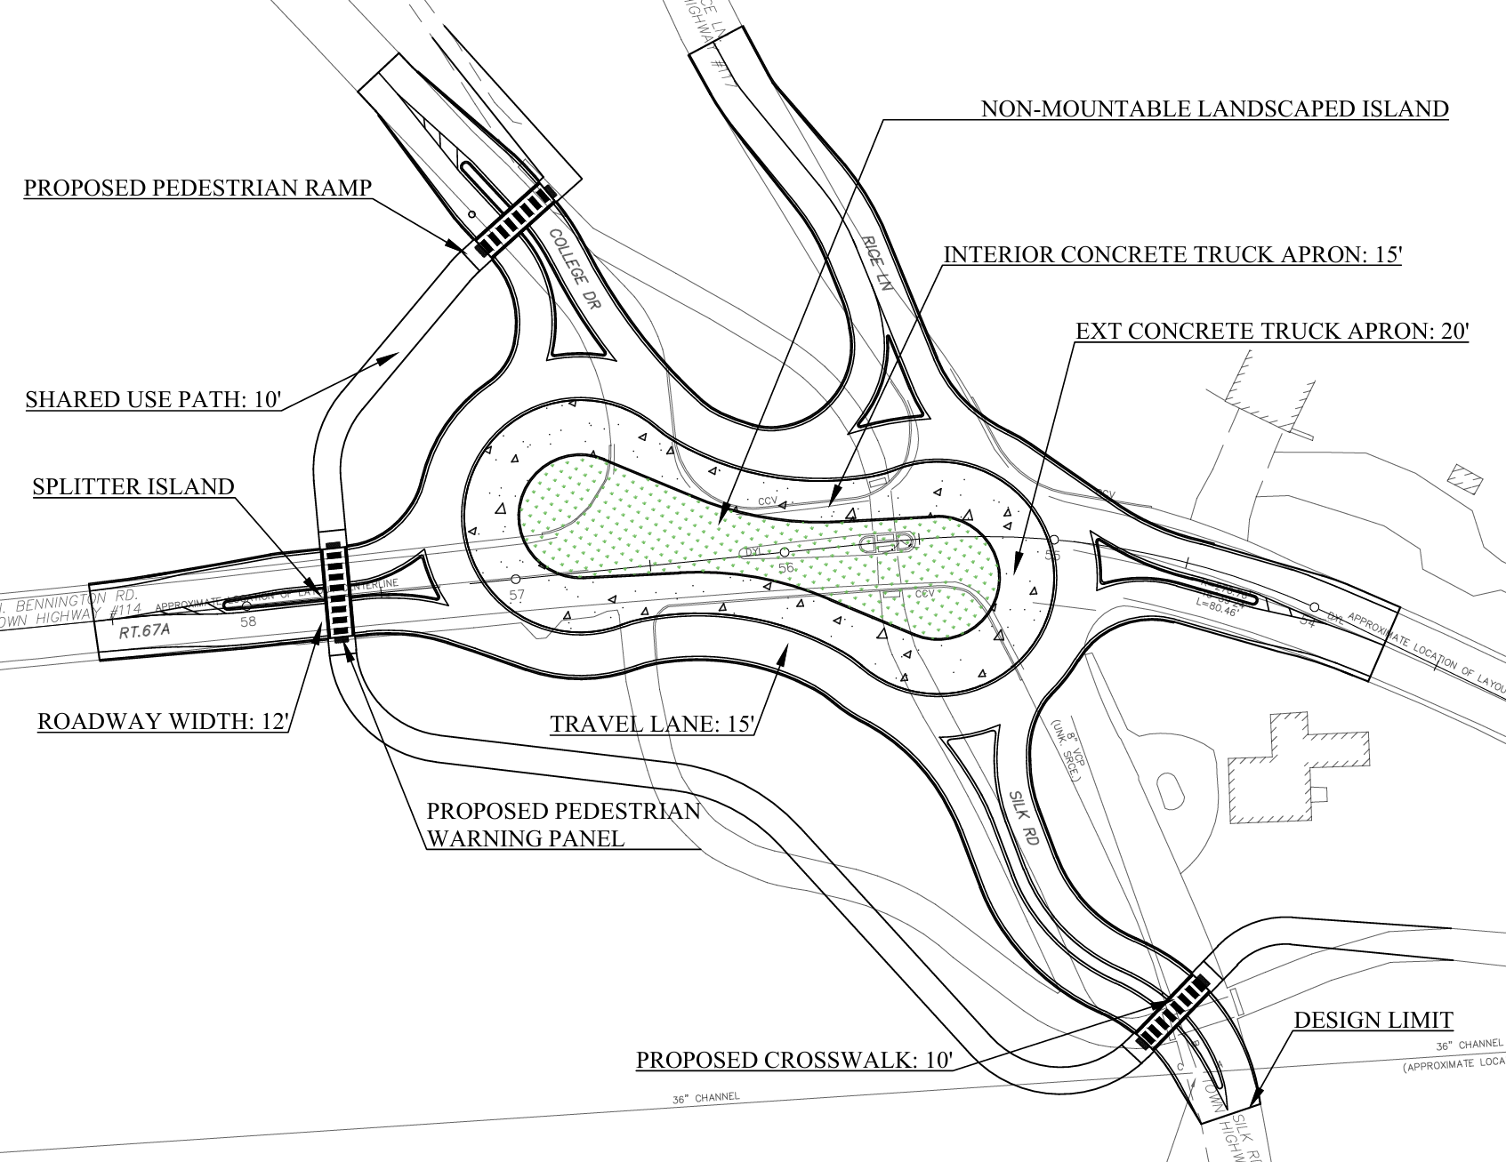
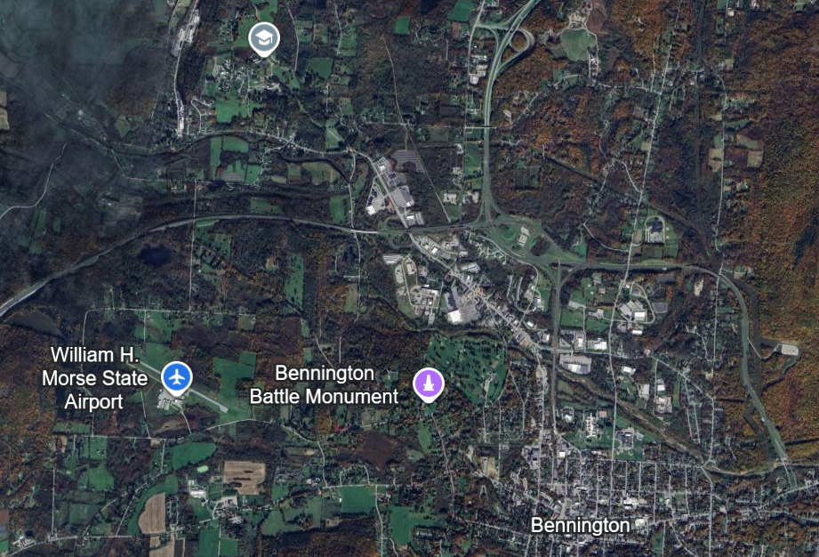
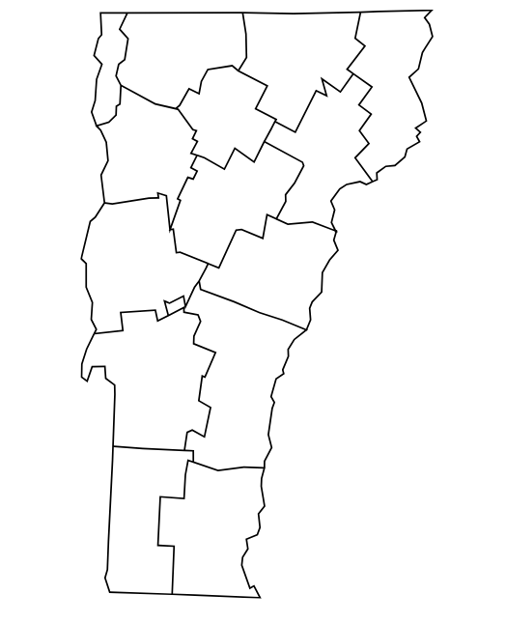
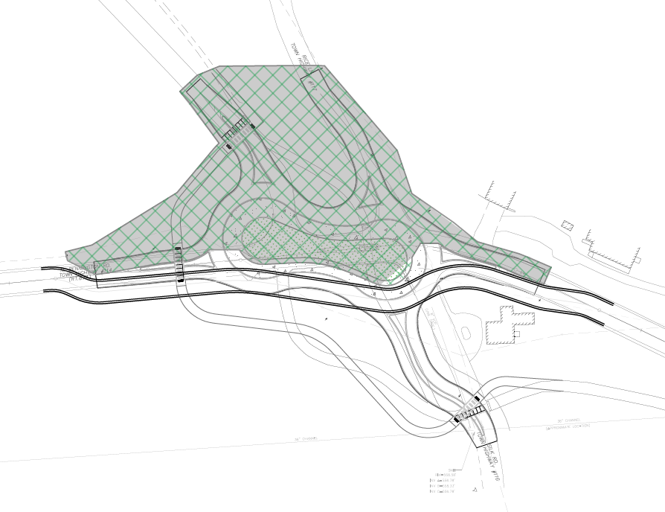
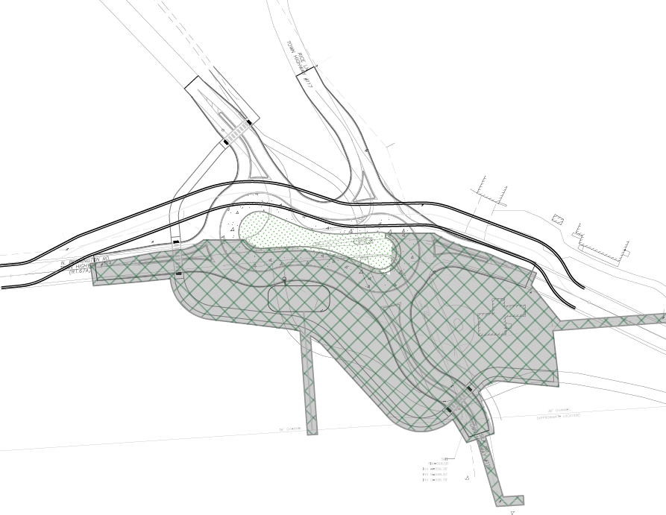
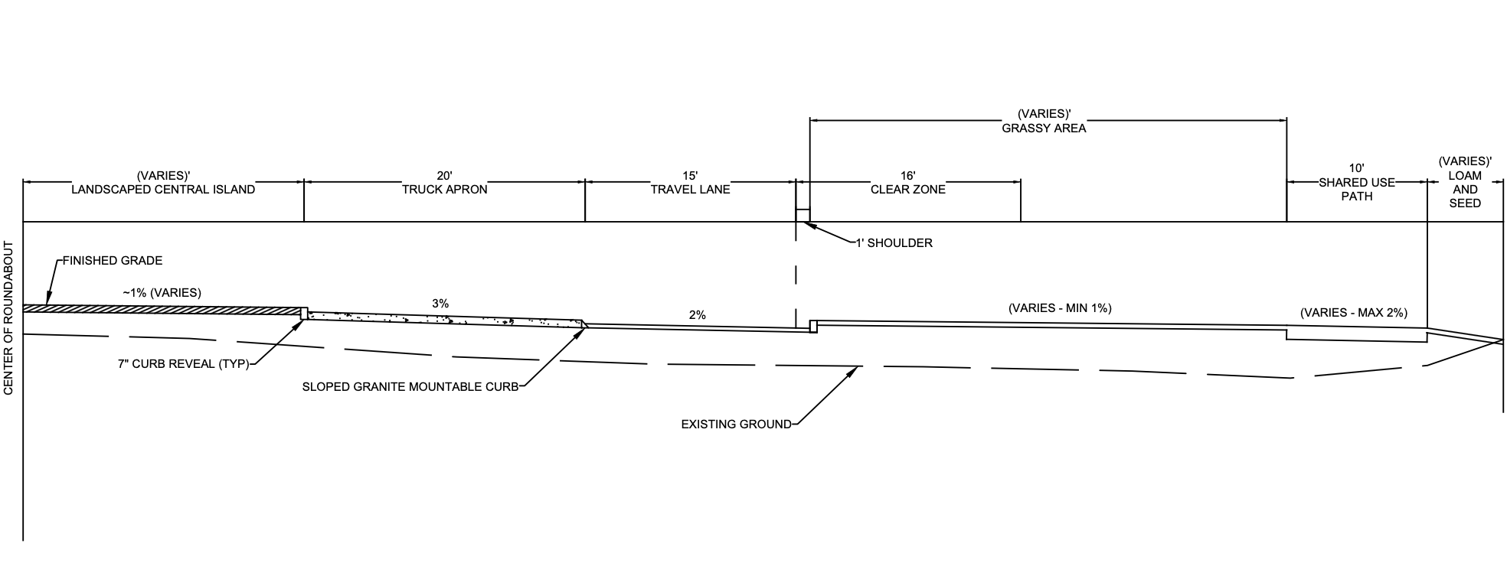
Bennington Intersection Improvement on VT Route 67A
Emily Lima, Greer Merrill, Madeline DuBosque, Noah Matthews
Civil and Environmental Engineering, University of New Hampshire, Durham, NH 03824
Introduction
Design Alternatives
Cost Analysis
The purpose of this project is to improve traffic flow, safety and pedestrian accommodation.
Project Scope:
The existing site includes a skewed 4-way intersection with a fifth approach that comes from Bennington College. VT Route 67A runs east-west, with Rice Ln to the north, Silk Rd to the south, and College Dr to the northwest. Site constraints include a historic house and adjacent private property. Design alternatives, including a traffic signal, full-size roundabout, and peanut roundabout, were evaluated using a decision matrix. The peanut roundabout was refined using AutoTURN analysis, utility relocations, grading and drainage design, typical sections, and construction phasing.
Traffic Signals
Full-Size Roundabout
Peanut Roundabout
The estimated project cost is $2.67M including a 30% contingency for design uncertainty, resulting in $3.47M.
Preferred Alternative: Peanut Roundabout
Location
The preliminary design did not accommodate WB-67 vehicles and was refined using AutoTURN.
Design Refinements:
Enlarged peanut geometry to accommodate WB-67 trucks
Continuous truck apron
Expanded pedestrian path to 10 ft (shared-use)
Reduced island deflection to improve vehicle maneuverability
Key Dimensions:
Travel lane: 15 ft
Truck apron: 15 ft (interior), 20 ft (exterior)
Approaches: 12 ft
Site Location
Construction Phases
Phase 1: North Construction
Plan
Phase 2: South
Construction
Plan
Decision Matrix
Alternatives were evaluated relative to each other. The weighted scores are shown below (scored 1-5).
Criterion | Weight | Traffic Signals | Full-Size Roundabout | Peanut Roundabout
Level of Service | 5 | 20 | 25 | 25
Traffic Safety | 4 | 12 | 16 | 20
Pedestrian Accommodation | 4 | 20 | 12 | 16
Cost | 3 | 12 | 9 | 6
Constructability | 3 | 6 | 9 | 9
Cultural Resources | 2 | 8 | 6 | 6
Aesthetics | 1 | 2 | 4 | 5
Total: | - | 80 | 81 | 87
Roundabout Typical Section
Acknowledgements
Joseph Labrecque, E.I.T – Green International Affiliates
Tony Puntin, P.E. – University of New Hampshire
References
The typical section shows the roundabout grades used for drainage and roadway design.
FHWA – Roundabouts ; MUTCD – Manual on Uniform Traffic Control Devices
VTrans - Design Standards/Drainage Manual

