Slide 1


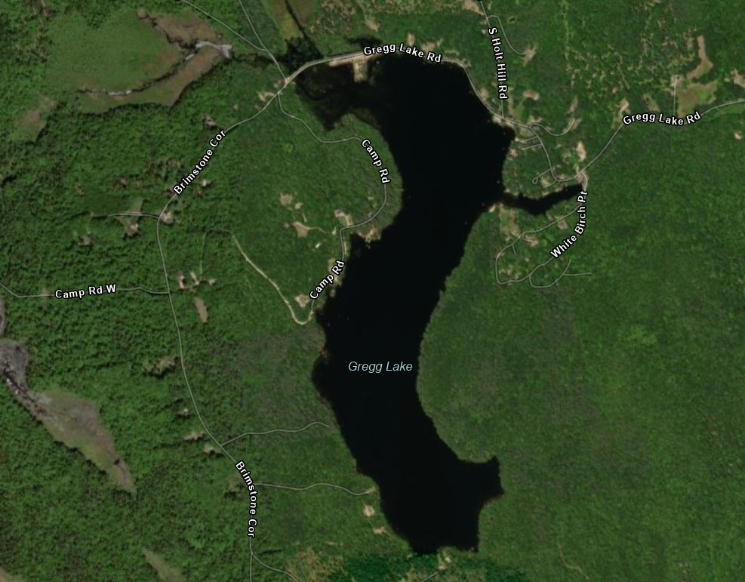
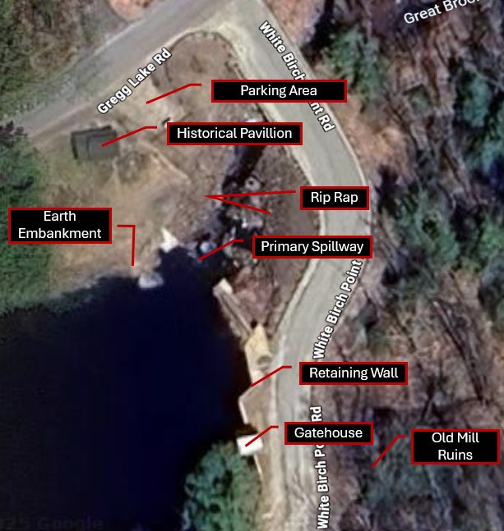
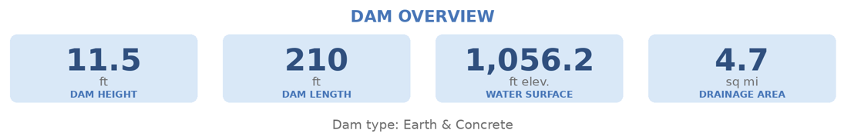
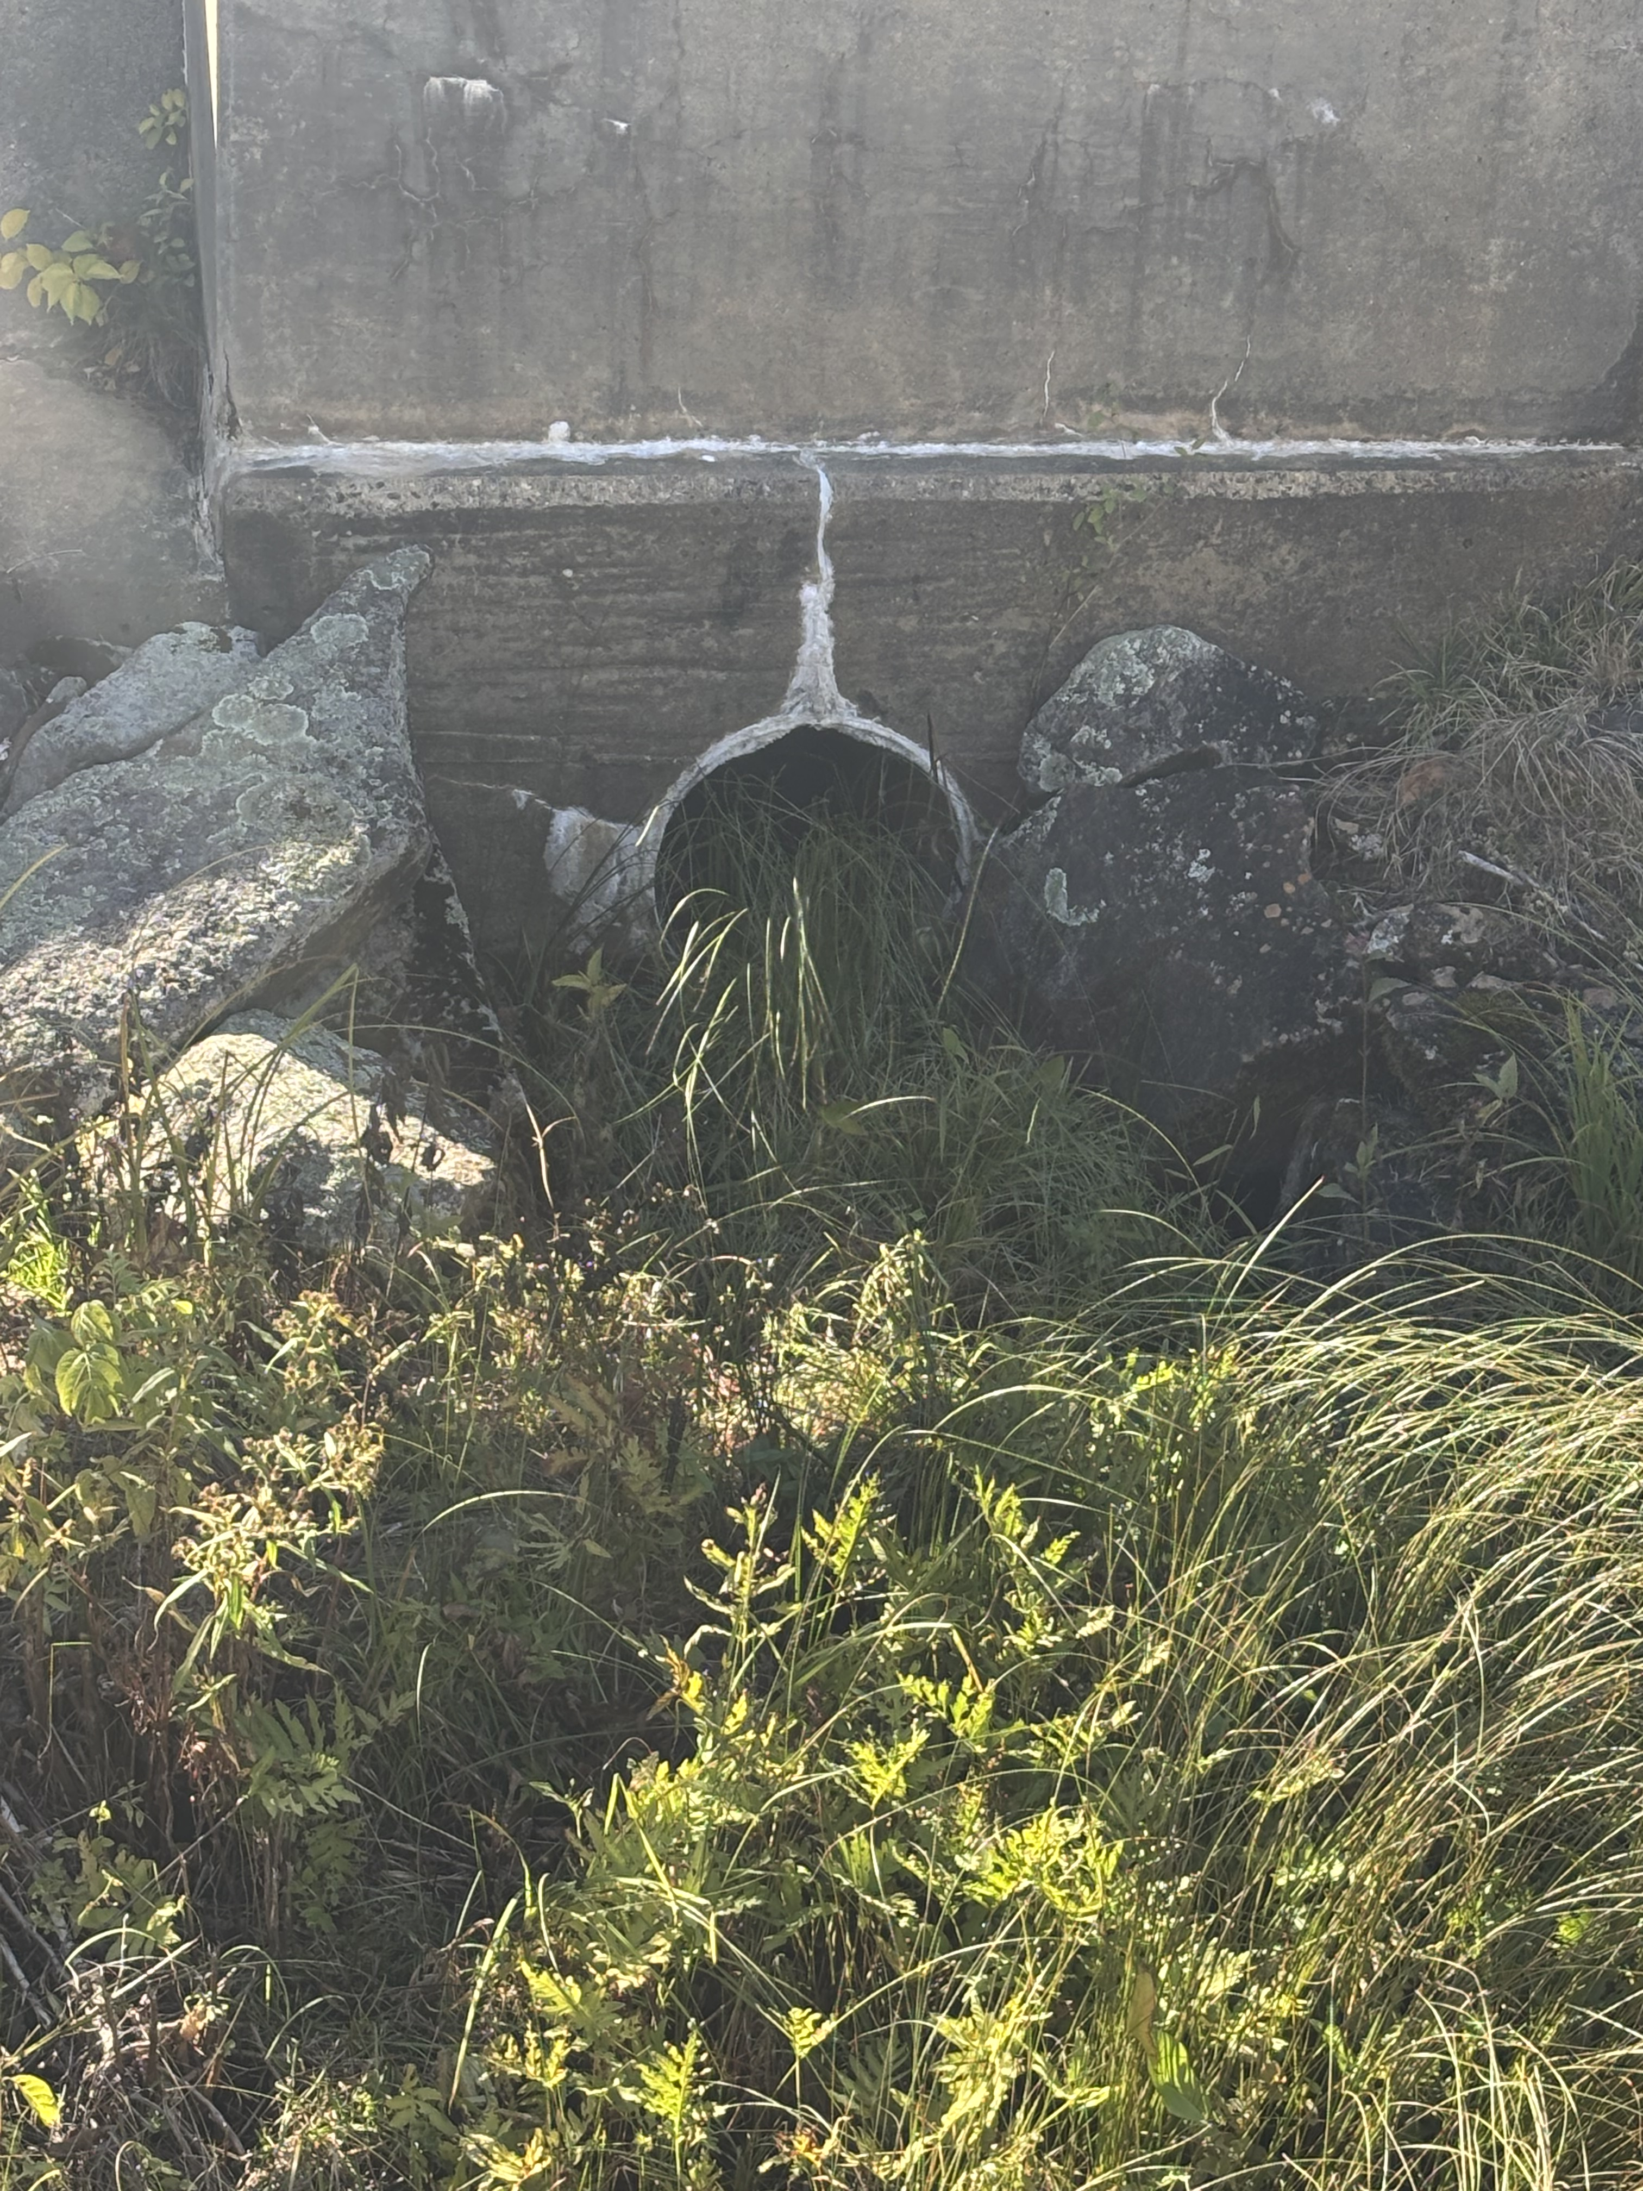

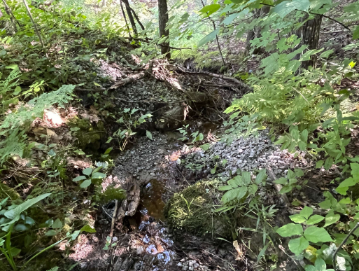
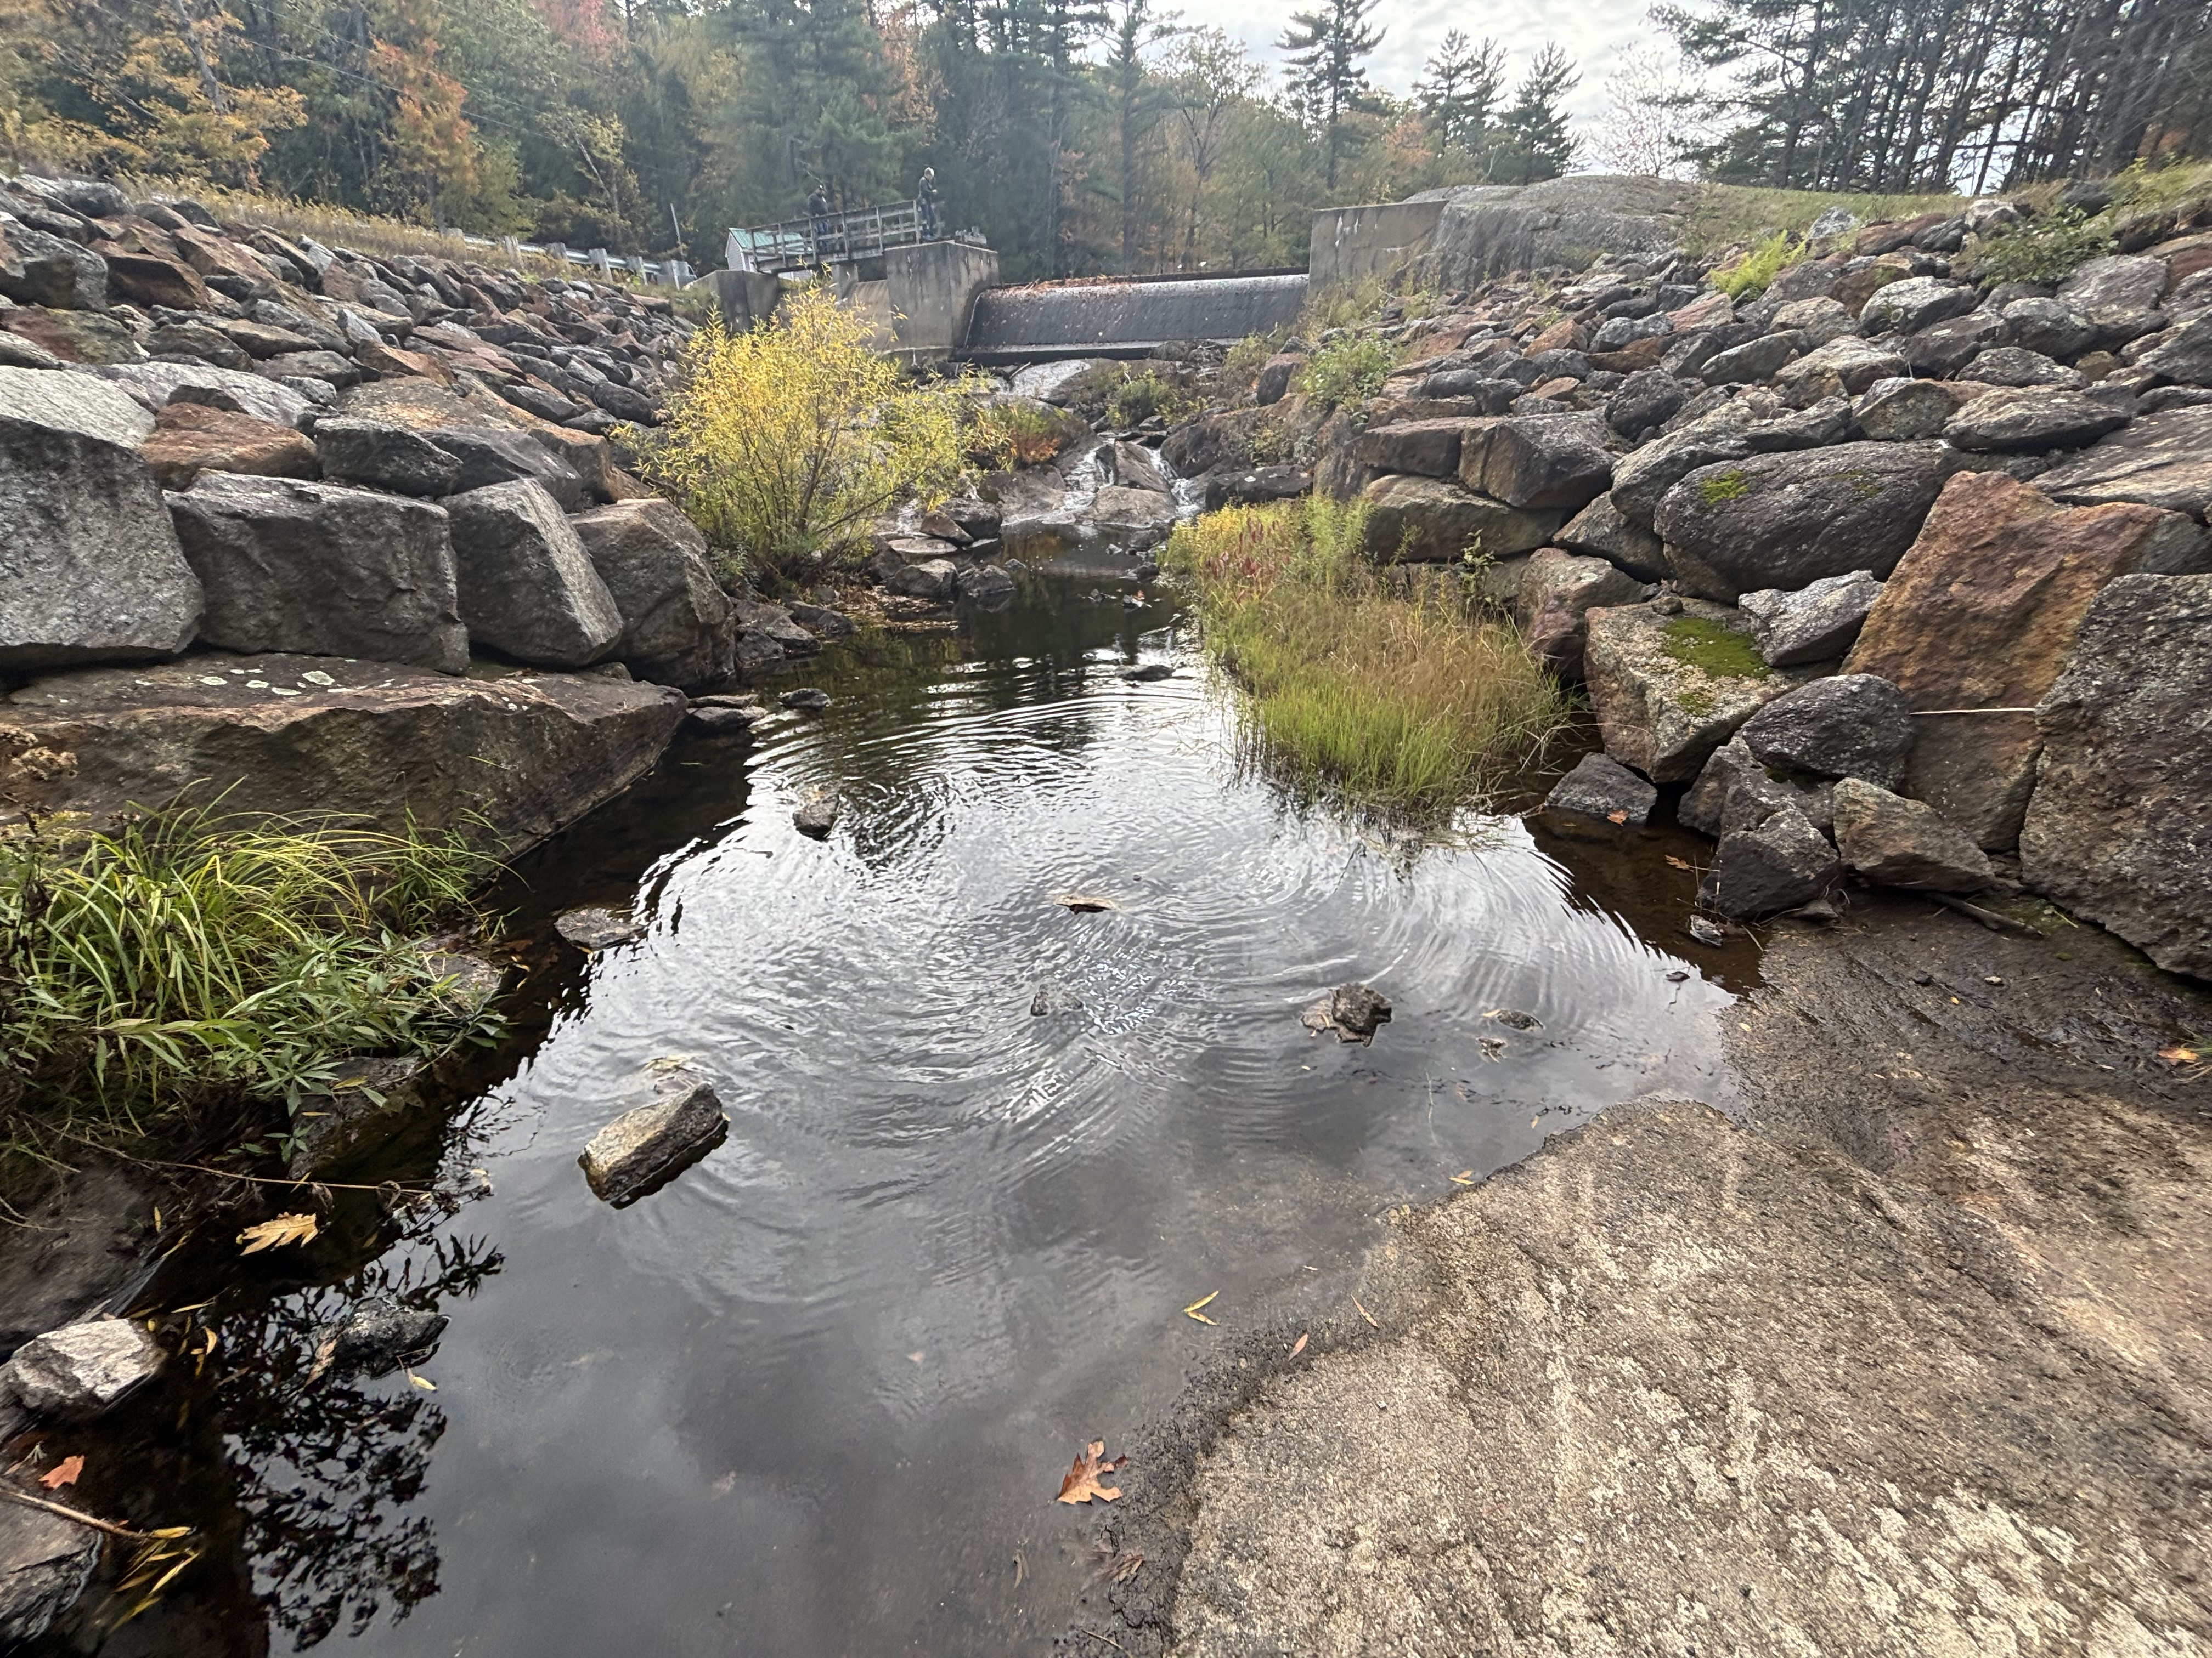
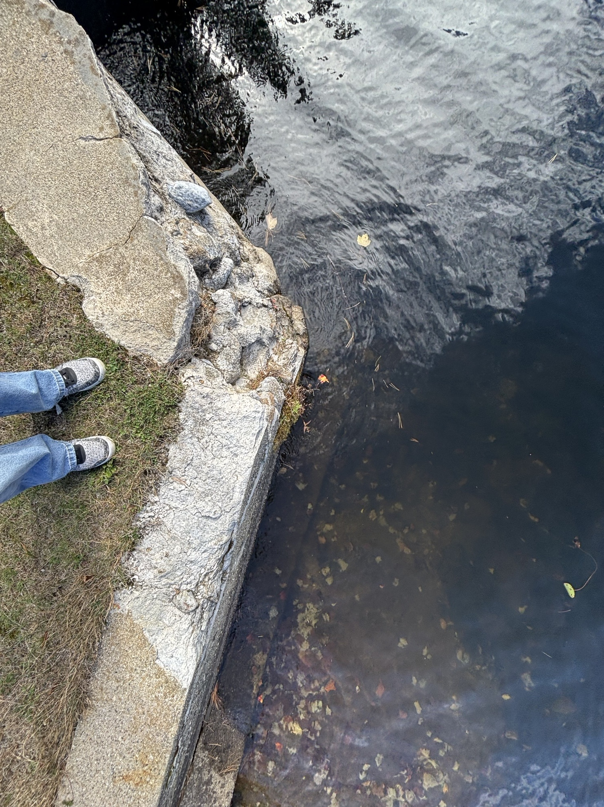
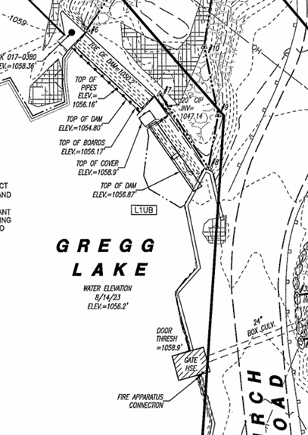
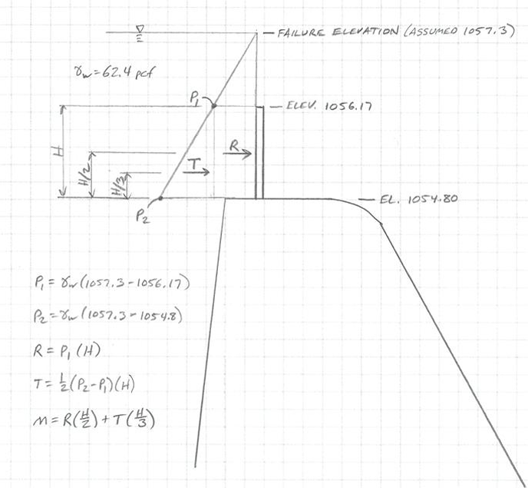
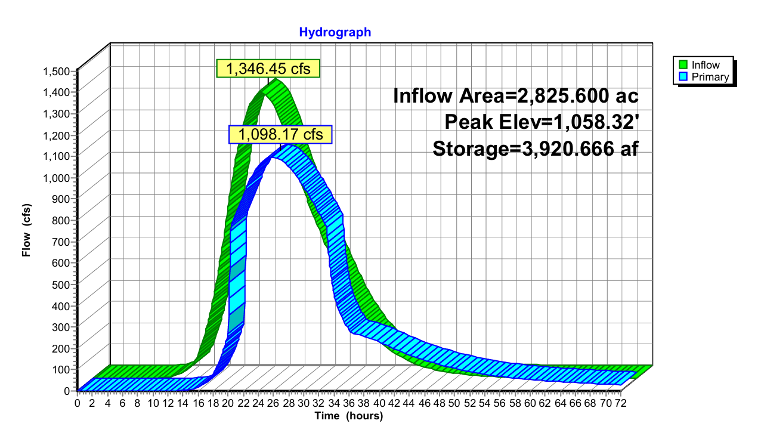
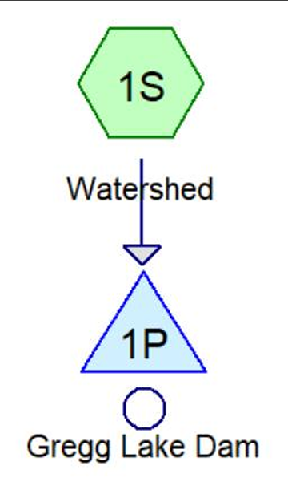
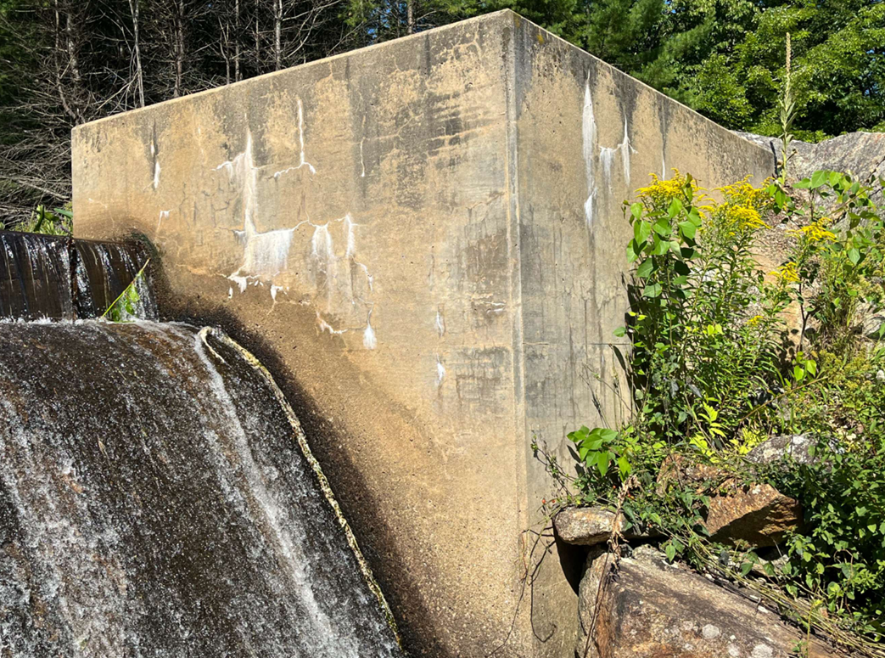
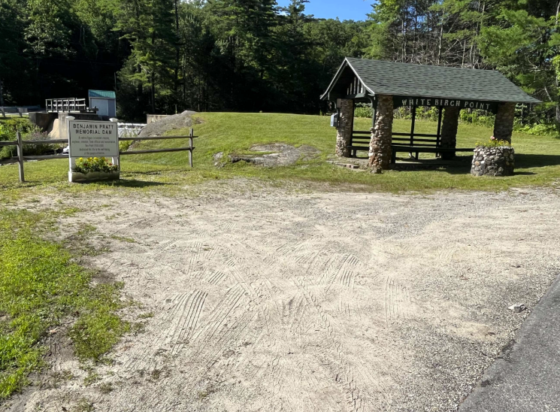
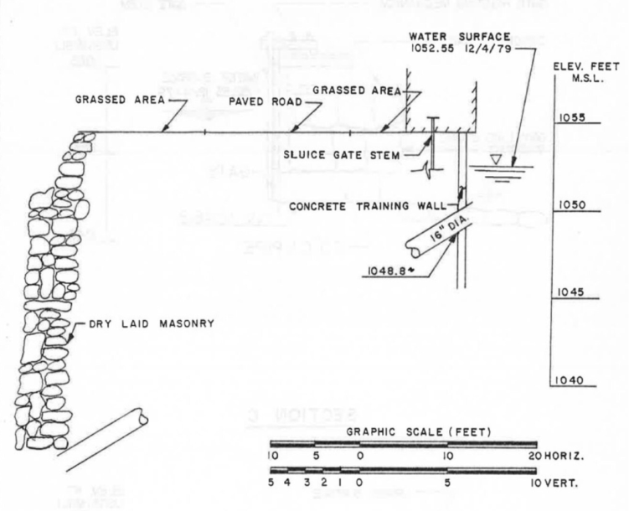
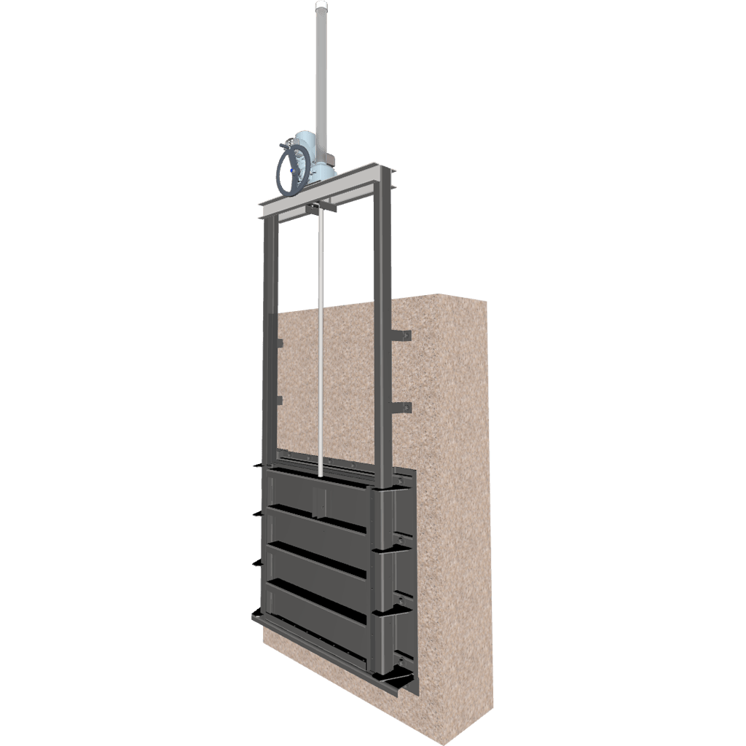
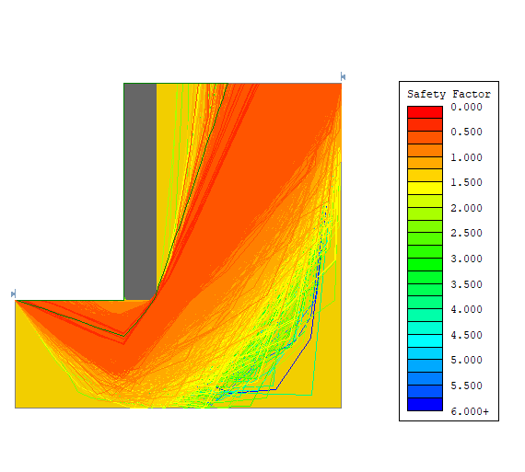
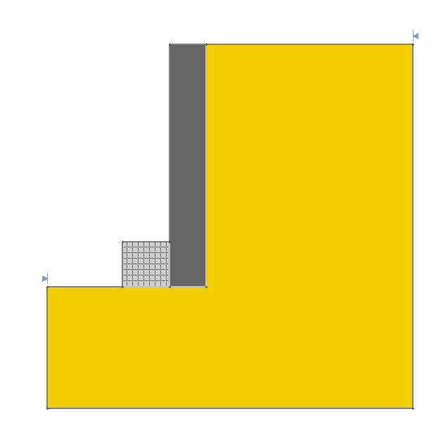
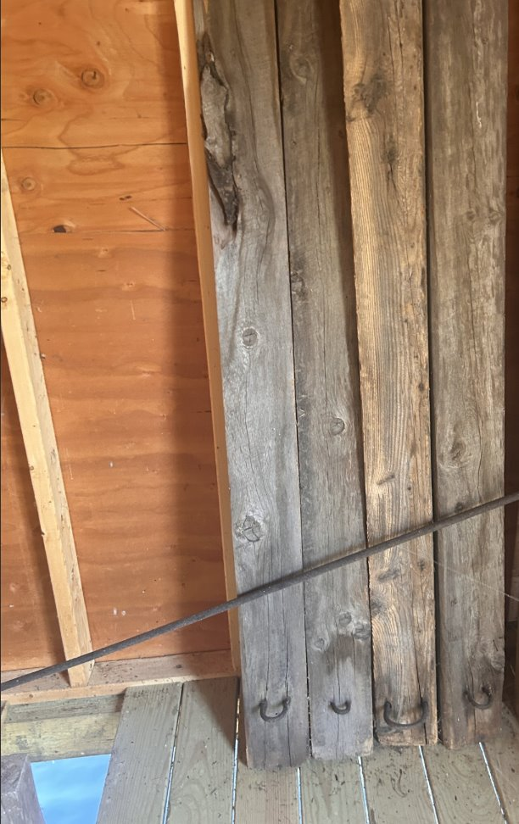
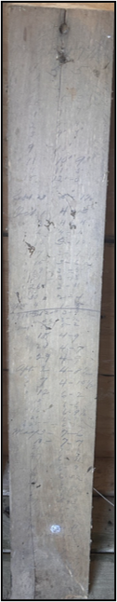
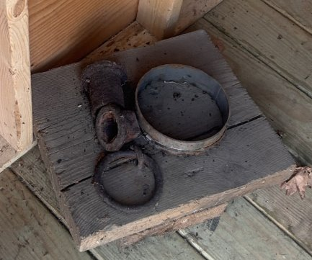
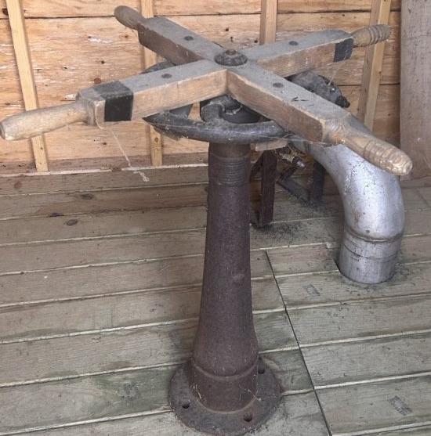
Gregg Lake Dam Rehabilitation
Appalachia Kunz, Diana Eliasson, Nathan Nesbit, Nick Swanson
Civil & Environmental Engineering, University of New Hampshire, Durham, NH 03824
Introduction
Site Location
Site Analysis
Gregg Lake Dam (Antrim, NH) is an earth embankment dam with concrete and stone masonry structural components. The dam was originally built in 1908 and was later reconstructed to its current dual spillway system in 1982. The NHDES Dam Bureau identified several deficiencies regarding the condition and adequacy of the dam and has requested that the Town of Antrim procure consulting services to address the following issued.
Less than 1 ft of freeboard during design storm event
Inoperable spillway conduit gate
Verify adequate function of flashboard design
Encroaching trees and brush, surface erosion, and insufficient ground cover
Deteriorated concrete, spalling, and joint sealant failure
Unknown embankment stability
Encroaching Brush & Observed Erosion
Vegetation root intrusion creating potential seepage pathways
Erosion undermining concrete spillway base
Regrading of the eroded area with an engineered fill is needed
Stormwater controls required: compost filter socks, silt fence, rip rap, rock filters
Vicinity Map – Antrim, NH
Site – Layout
Structural Analysis
HydroCAD Model
Final Recommendations
Deteriorated Wall Segment (Above)
Abutment Erosion &
Efflorescence
(Left)
Flashboard Pins
1000-year Design Storm Event
Site:
Remove encroaching vegetation (manual: chainsaw/brush saw)
Install erosion and stormwater controls (compost filter socks, silt fence, rip rap, rock filters, wood chips)
Repair and regrade eroded areas with engineered fill
Geotechnical:
Upstream: Install sized gabion baskets at the base the water side of the concrete retaining wall.
Downstream: Masonry restoration, increasing base width of the dry laid masonry wall with existing salvaged stones.
Regrade riprap of downstream section
Structural:
Spillway repair: Remove and dispose any damaged concrete. Patch with high strength, water resistant mortar.
Efflorescence and Crack Repair: Clean crack with masonry cleaner or power wash.
Seal cracks with grout injection for leaking. Patch dry cracks with mortar.
Wall Repair: Remove all loose and deteriorated concrete to a sound base. Installing reinforcing dowels into the concrete to tire new concrete form. A formed repair of concrete will be placed to restore the damaged section.
New Gradation: Extending dam abutments upward with a reinforced concrete cap tied into the existing structure for all walls and abutments.
Map of Dam
A delayed rating curve based on calculated pin failure height was used to model a user defined outlet in HydroCAD
Hydrograph for 3/4” pin replacement and 5’ primary spillway extension into auxiliary spillway with flashboards. Pins are designed to fail for the 100-year storm.
Sounding tests were performed on site. All sections of dam proved to be sound except for the deteriorated wall section.
Node Diagram
Historical Considerations
sTAMD Simulations
Geotechnical Analysis
Current Conditions
Analyzed Concerns – Right Embankment
Historical gate house
Preservation of historical pieces
Benjamin Pratt Memorial Dam 2023
Antrim Historical Society Concerns
  Preserving items during construction
  Recording any information on the older upstream dam
Inadequate Factor of safety for sliding and overturning.
Critical slip surface and high-risk for undermining
Assumed no footing or connection to bedrock.
Most critical when; low water table in reservoir and saturated soil behind wall
Downstream
Hydraulics:
Replace flashboard pins with ¾” std. steel pins and extend primary spillway by cutting 5’ into auxiliary spillway. New primary section will have same specifications, including pin spacing and flashboard height.
Seal mill-side conduit gate and replace center gate with model 954 Whipps top seal gate.
Raise concrete abutments and right-side dam to elevation 1059.3 FT. This will extend lifetime of rehabilitation.
Outflow increases from 1070 CFS to 1098 CFS and there are no anticipated impacts due to the small increase in outflow.
Concrete Wall
FoS=0.473
Gabion Basket
Upstream
Acknowledgements
Historical materials will be preserved for use by Antrim Historical Society
Historic Gate Wheel
Old gate opening, flashboards, and Historic water level record
Cross section – Right Embankment
Slip Surface – Upstream
Stabilization – Gabion Basket
Project Sponsor: The Turner Group: Philip Brogan & Sam Cheney
Project Advisor: Fei Han
Thanks to Antrim Historical Society representative Helen Newbold and Tyler Tommila of the Public Works Departments!

