Slide 1



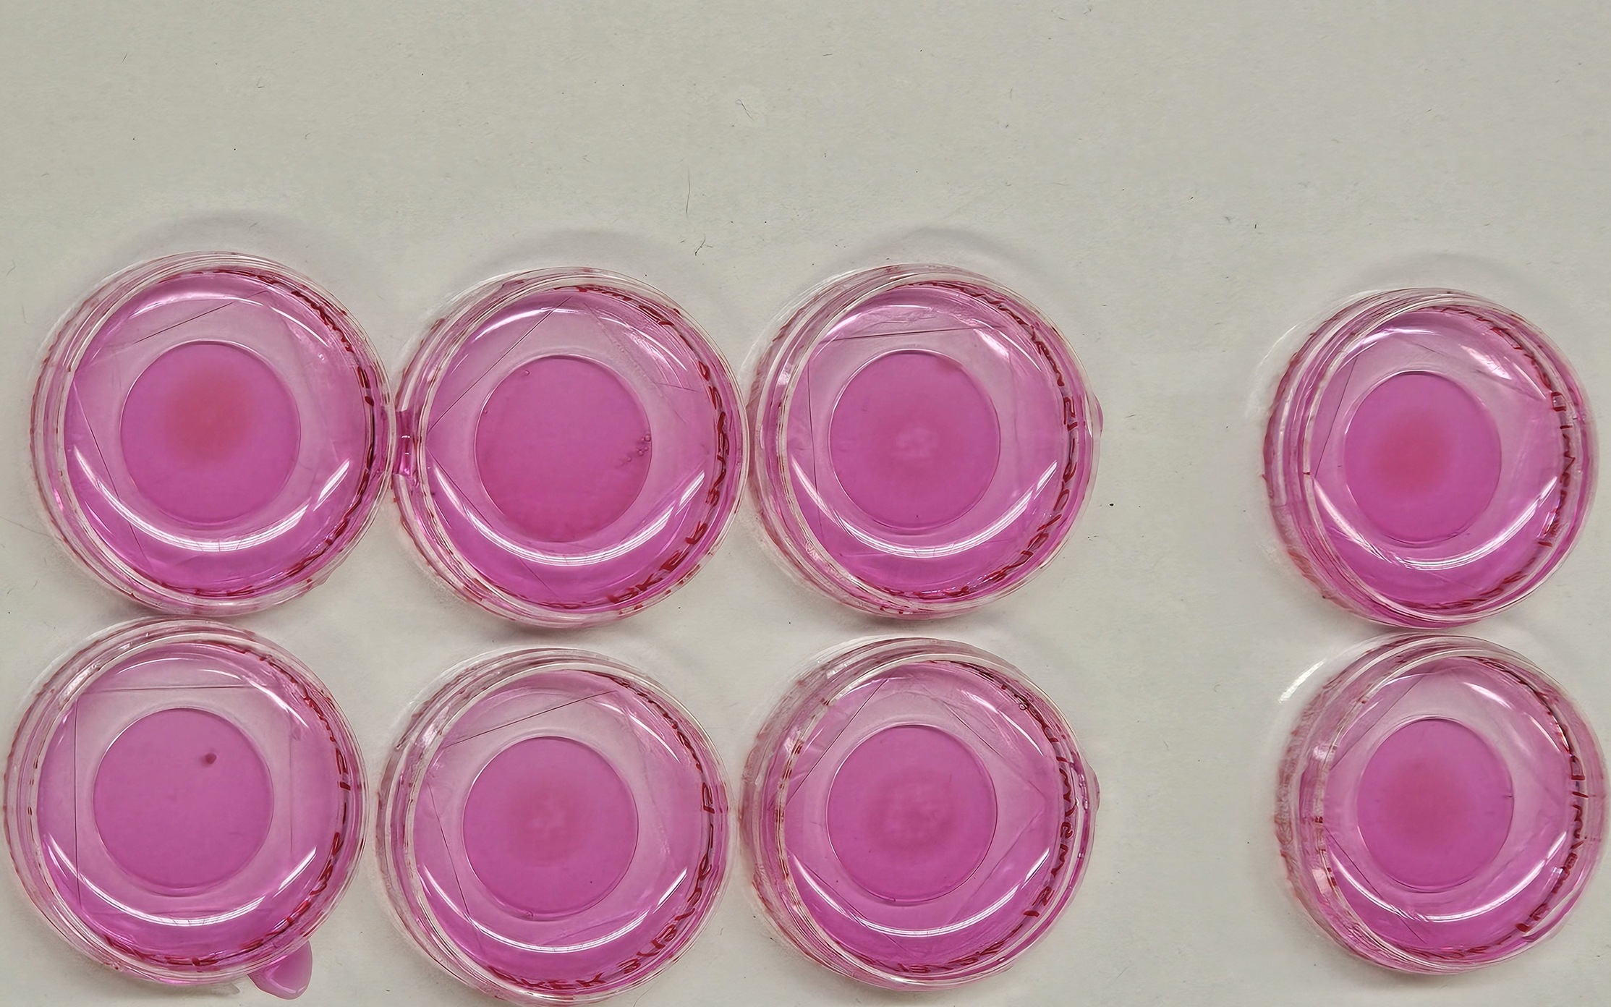
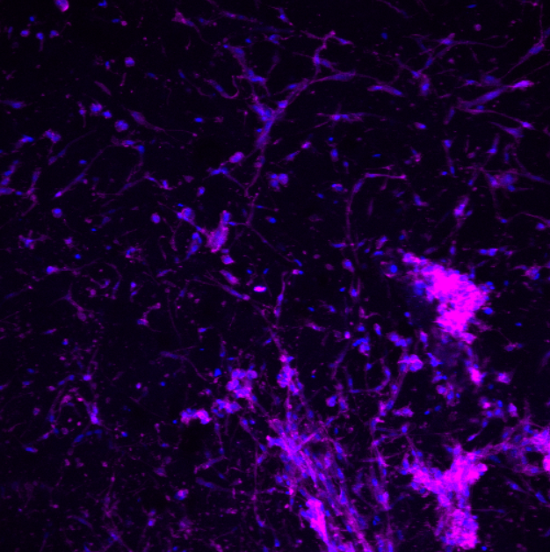
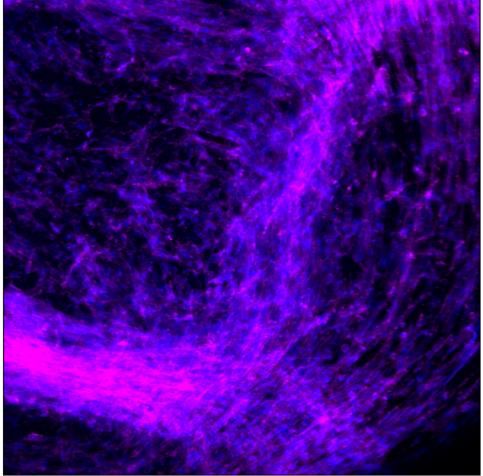
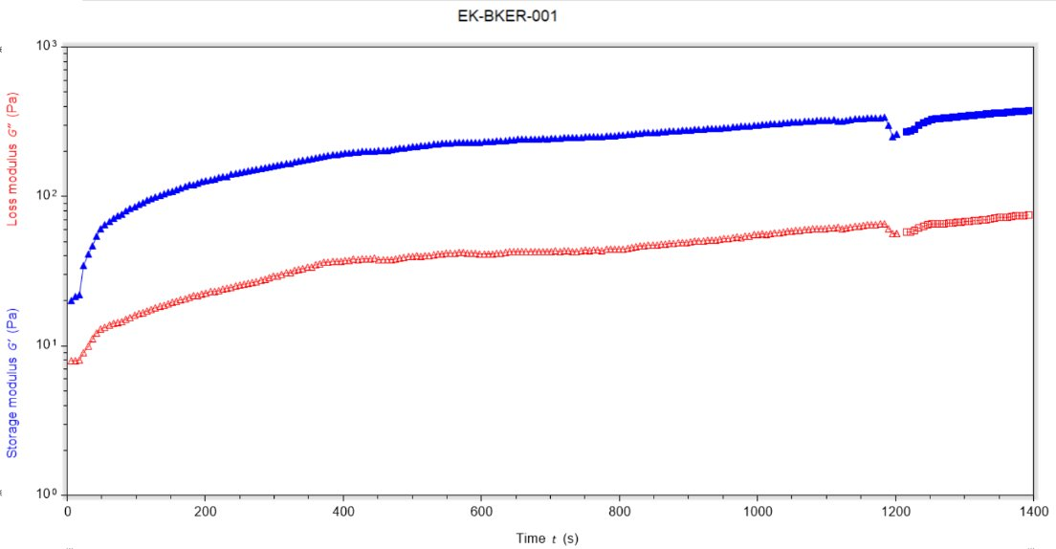
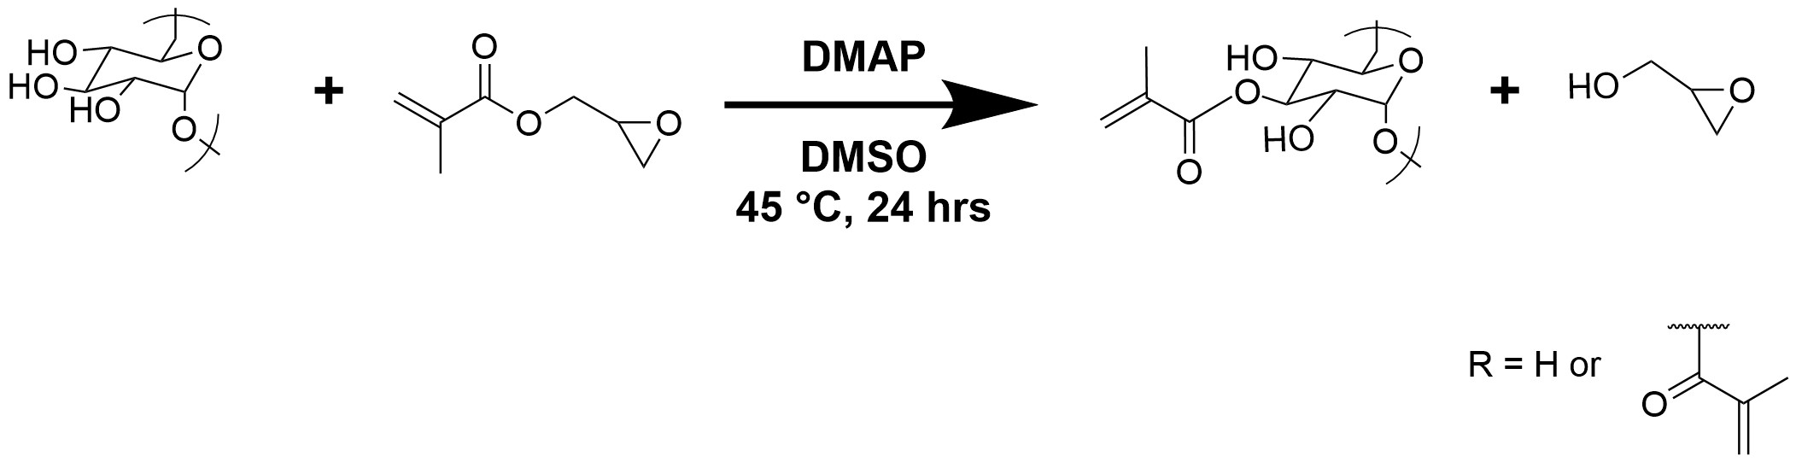
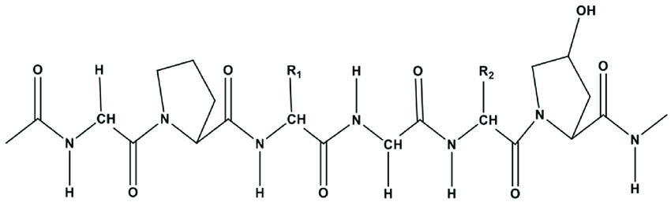
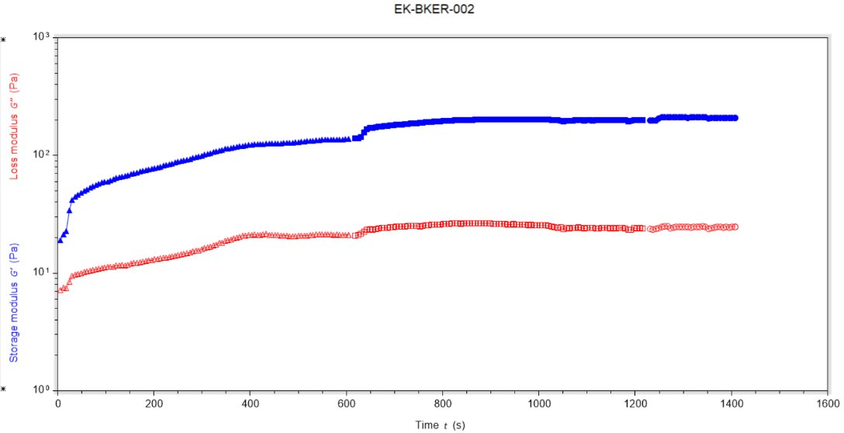
Tuning Collagen-DexMA Ratio and Stiffness for the Vascularization of Cells
Briana Killarney, Elsa Rogers, Evan Kennedy, and Linqing Li*
Department of Chemical Engineering and Bioengineering, University of New Hampshire, Durham, NH, USA
* Linqing.Li@unh.edu
1. Introduction
3. UV
4. Confocal HUVECS
UV time
Overall Goal
Use collagen hydrogels as a dressing for chronic wounds
Benefits:
Biocompatibility
Moisture Balance
Conformability
Faster Healing
Hydrogel Mixture
Collagen
Mimics the ECM
Protein
Dexma (Dextran Methacrylate)
Adds structure with stronger bonds when crosslinking
Sugar
Cells
HDFs
Human Dermal Fibroblasts
Secrete proteins that promote cell signaling and help build ECM
HUVECS
Human Umbilical Vein Endothelial Cells
Allows potential for vascularization
Crosslinking
UV
Irgacure (cures under UV)
Photo initiator that when exposed to UV turns into free radicals that start the polymerization chain
UV kills cells
Minimize the UV time and exposure while still reaching max gel formation
Collagen
  Gels under heat
Rheometer
Tests stiffness of gel
Helps us see how much incubation and UV time is necessary before it becomes redundant and just kills cells
Parameters we varied
Dexma-Collagen Ratio
UV time
Seconds Exposed to UV Light
3mg/ml Col, 15mg/ml DexMA day 7
10 Seconds + 10 Seconds
20 Seconds + 20 Seconds
30 Seconds + 30 Seconds
30 Seconds + 0 Seconds
Dapi- Blue Phalloidin- Pink
Stains Nucleus Stains Actin Filaments
To lessen DNA damage from UV light, the hydrogels were exposed to UV light in different time intervals, and a rheometer was used to test the stiffness, viscosity, and elasticity of the gel. The data from the rheometer identified the max stiffness. To find the optimal time of when to stop the UV light during the experiment, the rheometer was run to the point where the gel reached its maximum stiffness. This was also done because the gels that were used to test the UV in the rheometer didn’t have any cells. By doing this, it was found that for future experiments, when the gel reaches maximum stiffness, the UV light should be stopped so that the damage to the cells is minimized. The optimal UV time found in the experiment was 0 seconds before incubation and 30 seconds after incubation.
The Confocal images show that the cells can at least survive, not thrive however as there isn’t any signs of vascularization among them.
6. Reflection
We didn't find any signs of vascularization in our gels, however we did find a ratio of dexma to collagen, and UV time that should increase the chances in the future. We had issues with reaching the ratio of cells we wanted as it was too diluted this could be because the cells weren't confluent enough,or were in the tube for too long before it was put in the gel. Collagen gels easily with heat, and while pipetting it's taken off ice, which led to us losing a small amount in transferring the protein. Our cells had a hard time living, some reasons could be from UV light from gelling, and bacteria. As first year students we improved our lab skills and got the opportunity to learn about cell culture.
4. Rheology
Rheology is the study of the deformation and flow of matter. We used a rheometer measure the stiffness of our dexma-collagen gel under different UV times. We were trying to find the minimum amount of UV exposure that would still form a structure which can support the our HDF and HUVECS because UV damages the DNA of the cells. A study from University of California says "UV emitting devices for just one 20-minute session led to between 20 and 30 percent cell death[.]"
7. Conclusions
The Dexma-Collagen hydrogel has shown that it can support the HDF and HUVEC cells. We compared cell growth on different ratios of the dexma-collagen hydrogel and found 3 mg/ml is best for balancing the imitation ECM component of the collagen with the structure of the dexma. After we found the optimal UV time of 30s +0s to limit cell death, and still reach max gel formation.
To expand on this project, finding a ratio of the HDFs and the HUVECS that consistently show expansive growth, and or vascularization. Balancing the HDFs that synthesize and maintain the ECM and the cell signaling, and the HUVECs the cells that will hopefully vascularize.
2. Mechanism of Gel formation
Synthesis of dextran methacrylate (DexMA)
Structure of Collagen
F
Acknowledgement
30 sec UV, 37°C 20 min, UV 30 sec, 37°C 3 min
Storage modulus corresponds to the level of elasticity in our gel, and the loss modulus is the viscosity.
NH BioMade IIA 1757371 and EPS-1101245
CIBBR (P20GM113131) at NIH
UNH CHBE Department
Dr. Linqing Li’s Lab, UNH
UNH Core facility and Instrumentation Center
If the gel has too much dextran then it will not able to vascularize, and if the gel has too much collagen then the gel will not have enough support.
Collagen is a protein, and its structure allows it to be elastic. The structure of collagen can also act like the extracellular matrix because of collagen's cell signaling capability.
The collagen that is in the hydrogel is crosslinked when it gets hot. Collagen cross-links with covalent bonds which are not as permanent a bond as a chemical bond. Irgacure, which is found in the hydrogel, is crosslinked when exposed to UV light. Irgacure chemically bonds in the hydrogel which is a mostly permanent bond.
References
1. Narayanaswamy R, Torchilin VP. Hydrogels and Their Applications in Targeted Drug Delivery. Molecules. 2019 Feb 8;24(3):603. doi: 10.3390/molecules24030603. PMID: 30744011; PMCID: PMC6384686.
2. Ye Eun Kim, Seung Woo Choi, Min Kyung Kim, Thanh Loc Nguyen, and Jaeyun Kim
Nano Letters 2022 22 (5), 2038-2047
DOI: 10.1021/acs.nanolett.1c04899
3. Bubli, S. Y. et al. Inducing an LCST in hydrophilic polysaccharides via engineered macromolecular hydrophobicity. Sci. Rep. 13, 14896 (2023).
4. Wang, Y., Kankala, R. K., Ou, C., Chen, A., & Yang, Z. (2022). Advances in hydrogel-based vascularized tissues for tissue repair and drug screening. Bioactive Materials, 9, 198–220. https://doi.org/10.1016/j.bioactmat.2021.07.005
5. Hydrogel—An overview | ScienceDirect Topics. (n.d.). Retrieved April 21, 2025, from https://www.sciencedirect.com/topics/chemistry/hydrogel
6. Collagen Formula. (n.d.). Retrieved April 21, 2025, from https://softschools.com/formulas/chemistry/collagen_formula/482
7. Connor, K. (2023, January 19). UV-emitting nail polish dryers damage DNA and cause cell mutations. University of California. https://www.universityofcalifornia.edu/news/uv-emitting-nail-polish-dryers-damage-dna-and-cause-cell-mutations
‌8.Learn When You Should Apply a Hydrogel Dressing. (2020, September 30). WCEI. https://blog.wcei.net/wound-care-dressings-hydrogels
‌
15 sec UV, 37°C 10 min, UV 15 sec, 37°C 3 min
Notes:
SEM – 20 um
Toxicity- 100 um
Gel- 100 um
Gel with cells- 50 um, 2D

