Slide 1


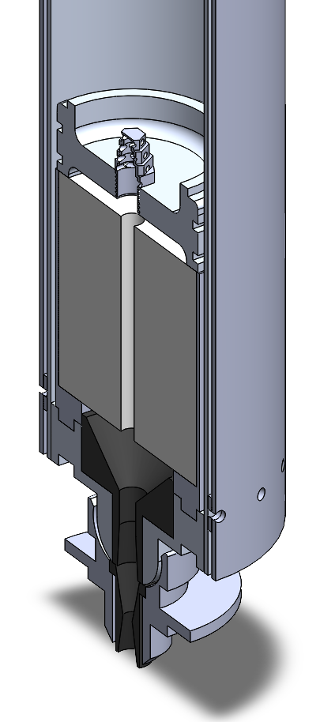
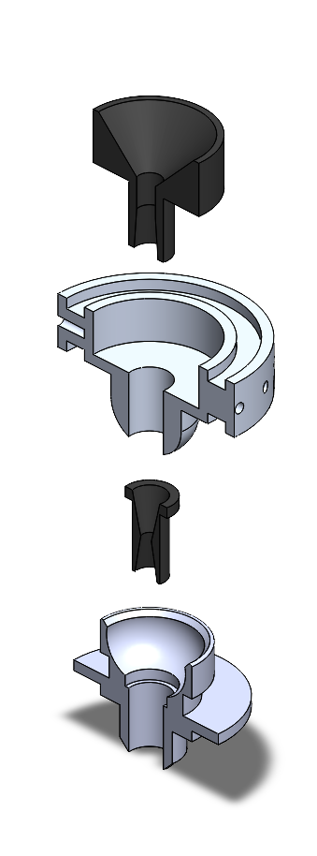
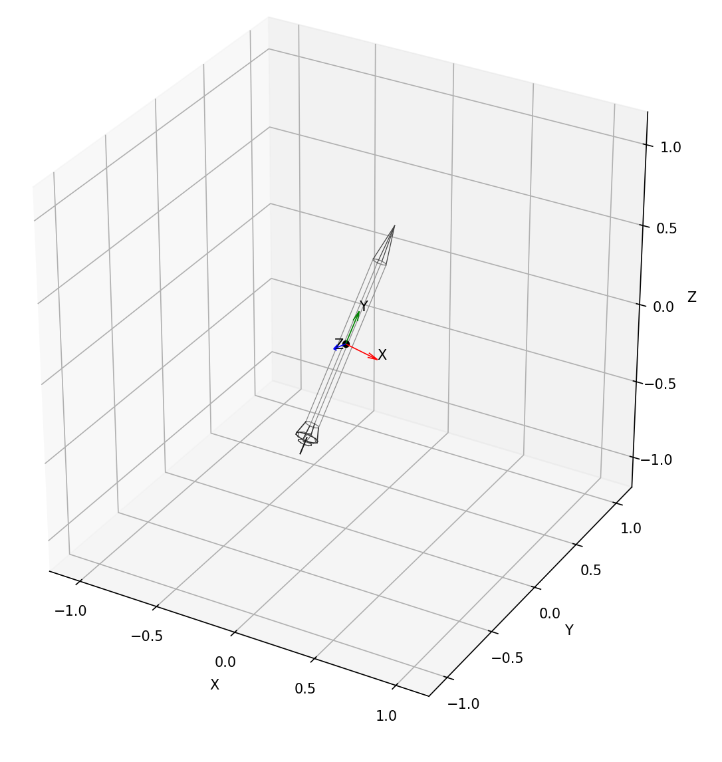
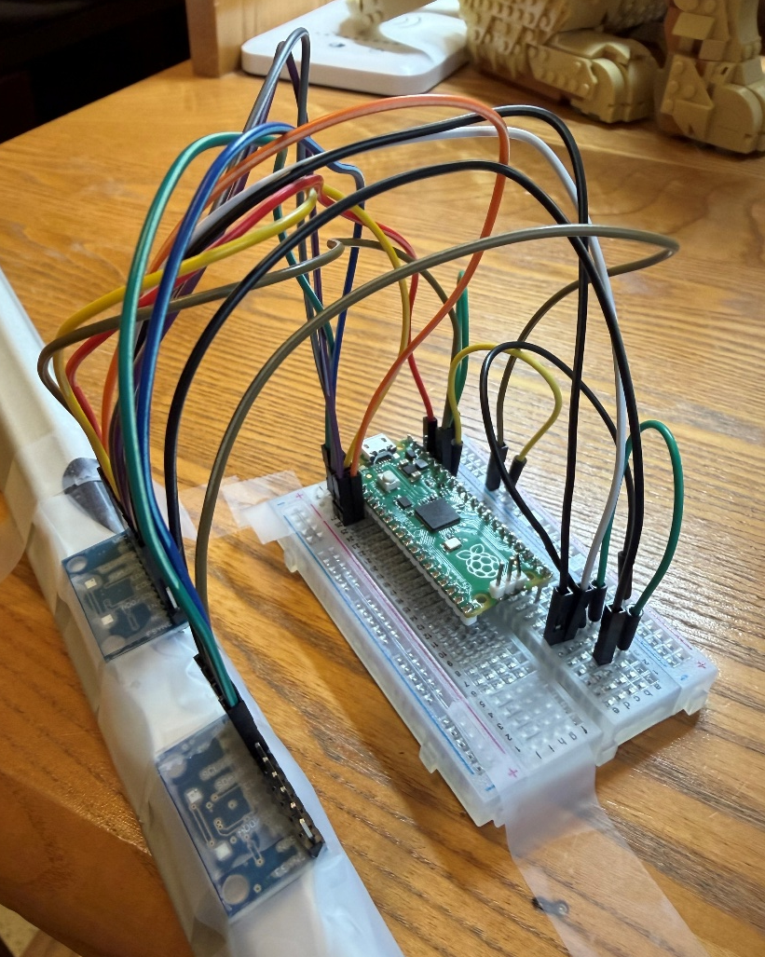
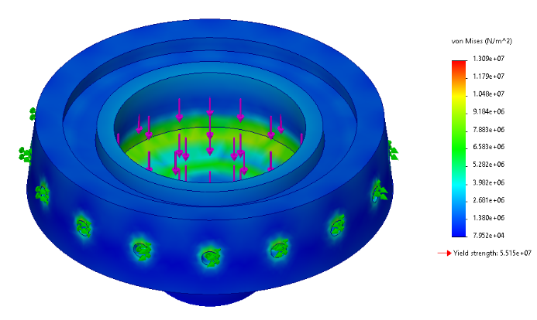
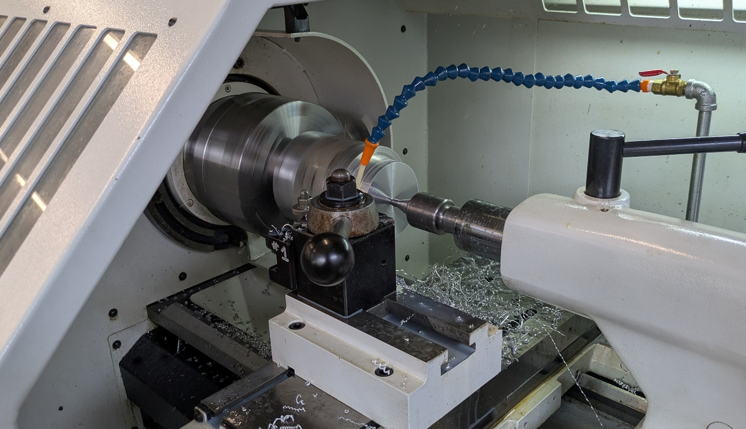
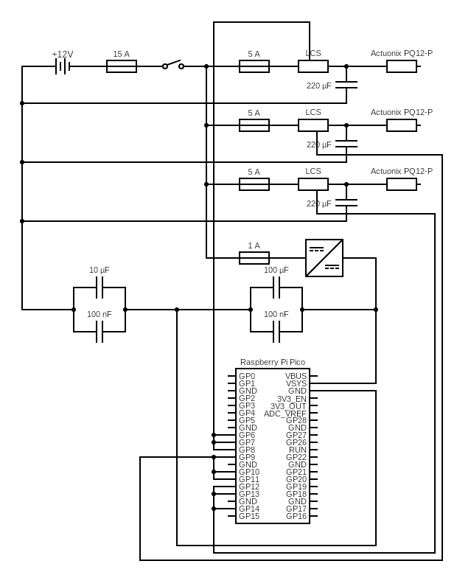
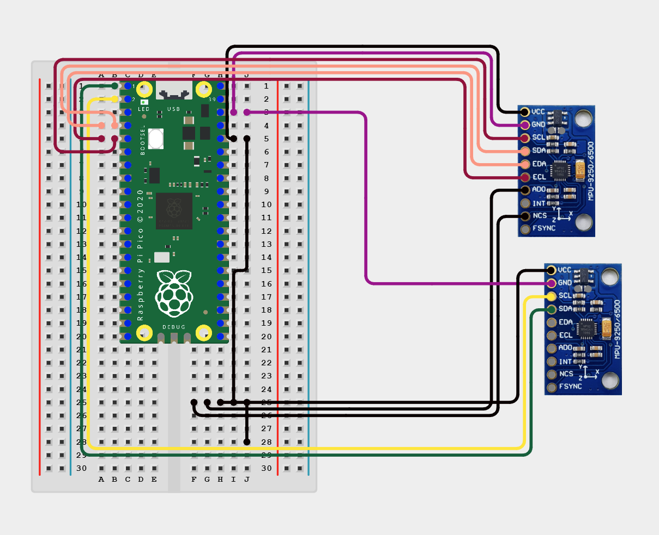
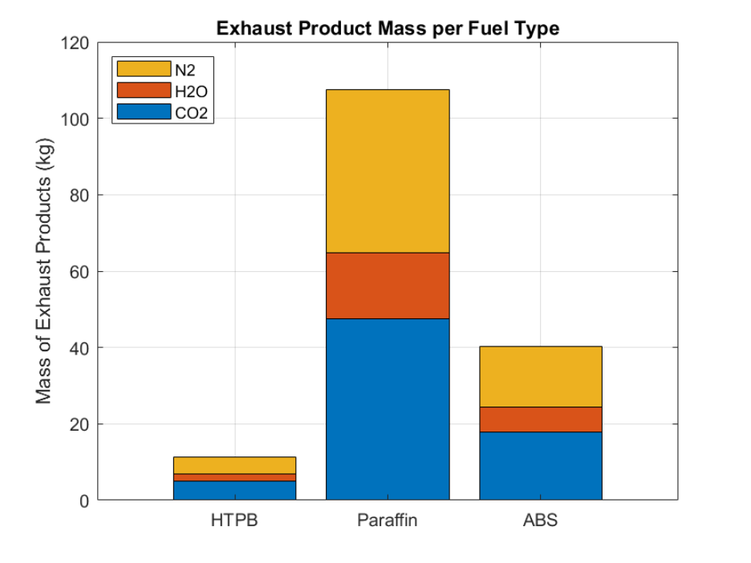
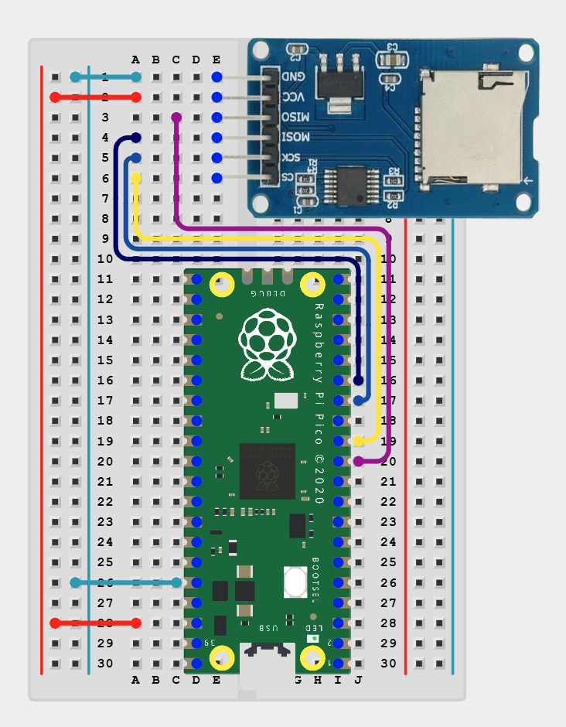
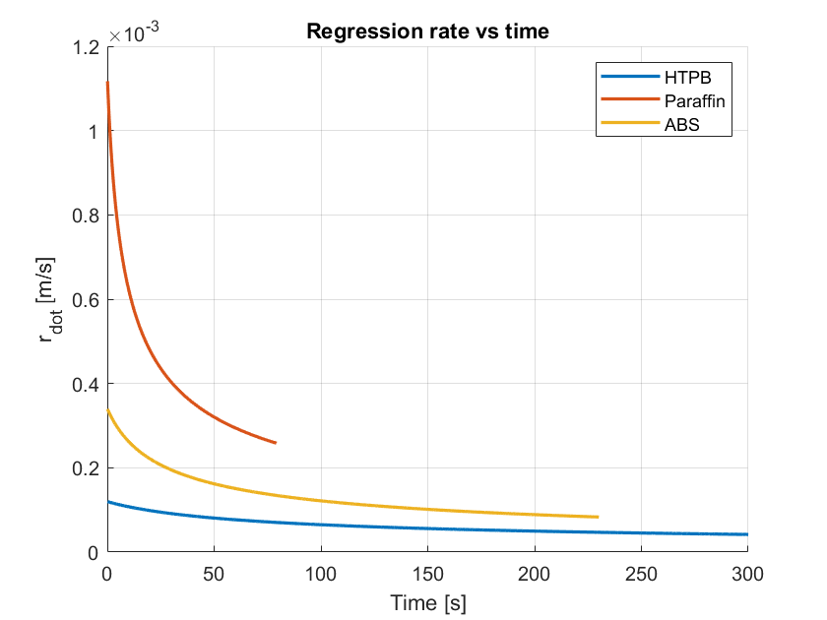


Deployable Hybrid Rockets for High Altitude Data Collection
Anthony Bilodeau, Mechanical Engineering, University of New Hampshire
Randall O’Neil, Engineering Physics, University of New Hampshire
Advisor: Dr. Marc Lessard, University of New Hampshire
Project Overview and Background
System Architecture
Methodology – Gimbal
Mission Objective:
The objective of this project is to develop a hybrid rocket engine that supports NASA Wallops and Space Science Center for the scientific development and understanding of ionospheric data
The DHR-HADR aims to be deployed from a sounding rocket, which are key for ionosphere research
Hybrid rockets:
The hybrid engine system has improved safety due the physical separation of the fuel and oxidizer
They offer partial throttleable capabilities, which enables better control over thrust profiles
Hybrid systems are lower cost and simpler to manufacture, making them perfect for iterative testing and research
Current limits: payload deployment and propulsion control
Mechanical Design
A two-axis gimbal system with spherical joint was designed to enable controlled thrust vectoring in yaw and pitch directions
Handles are ~1000 lbf thrust (½ ton of force), with load distributed through mounting plates to ensure structural integrity
Actuation
Three linear actuators are arranged 120° intervals along upper interface, enabling coordinated multi-axis control of the engine body orientation
Analysis
SolidWorks static simulation, load distribution, and structural validation
Thermal and mechanical considerations incorporated to ensure reliability during in-flight operations
Control
Microcontroller based components using a Raspberry Pi Pico coded to command actuator motion
IMU sensor feedback for Raspberry Pi Pico to give real time measurement data
12-volt battery with onboard regulation to support control electronics and actuation components
Introduction
Goal: Develop a controlled hybrid rocket engine system capable of supporting formation flight through reliable propulsion and an active guidance.
System includes:
Hybrid engine utilizing HTPB fuel and nitrous oxide (N₂O) oxidizer to provide a safe, throttleable, and efficient propulsion source
A gimballed thrust vector control (TVC) system that enables dynamic adjustment of the thrust direction for in-flight error correction and stabilization
Focus:
Achieve a plausible, reliable, and consistent propulsion performance (simulated)
Precise attitude control after deployment, ensuring accurate orientation and trajectory correction during formation flight operations
Figure 3: Engine Assembly
Figure 4: Gimbal Assembly
Methodology - Engine
Figure 10: 3D IMU Visualization
Figure 11: Dual-IMU Testing Apparatus
Propulsion
Fuel: HTPB (hydroxyl-terminated polybutadiene)
Oxidizer: N₂O (Nitrous Oxide)
Plasticizer: Isodecyl Pelargonate
Insulation: CHAMBERSAFE
Stable, predictable burn, easy to manufacture (HTPB, Aluminum, Graphite)
Design
The motor features cylindrical HTPB grain (controlled radial burn area), isomolded graphite nozzle, modular casing
Development Focus and Theory
Fuel comparison (HTPB vs ABS vs Paraffin), thermal, ablation analysis, and optimization
Simulated mass flux, regression rate, fuel mass flow, and burn time from test variables defined by the engine part geometries and properties
Figure 5: SolidWorks Analysis of Gimbal Section
Figure 6: Gimbal Section Being Machined
Areas for Further Study
Gimbal Circuit Design
Perform nozzle ablation and increased thermal analysis for material
Further optimize fuel grain geometry for efficiency improvements
Conduct full-scale static testing of engine
Conduct full-scale test of engine with gimbal system integrated
Refine engine for throttling capabilities
  Needed for formation flying
Minimize diameter to maximize number per sounding rocket
Create “black box” for data collection during tests
Figure 8: Dual-IMU Calibration Circuit
Acknowledgements
The authors would like to thank Dr. Marc Lessard for his advising on this project. They would also like to thank Dr. Ivaylo Nedyalkov, Dr. John Roth, Dr. Juan Carlos Cuevas Bautista, Joshua Yacobucci, Cathy Hesh and Dr. Ningyu Liu for their support during the year.
Contact Information
Anthony Bilodeau Randall O’Neil
Figure 1: Evaluating HTPB, ABS, and Paraffin Regression Rates vs. Time
Figure 2: Evaluating HTPB, ABS, and Paraffin Exhaust
Figure 7: Gimbal System Circuit
Figure 9: Micro-SD Card Calibration Circuit

