Slide 1

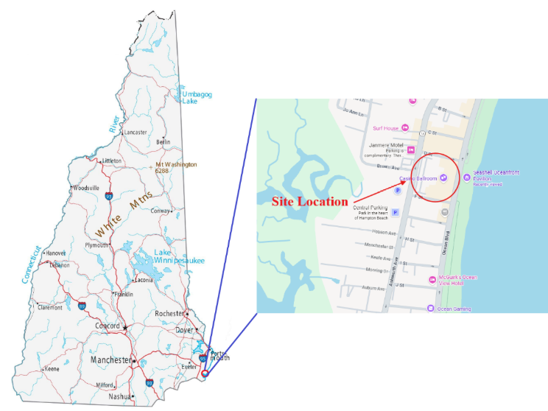
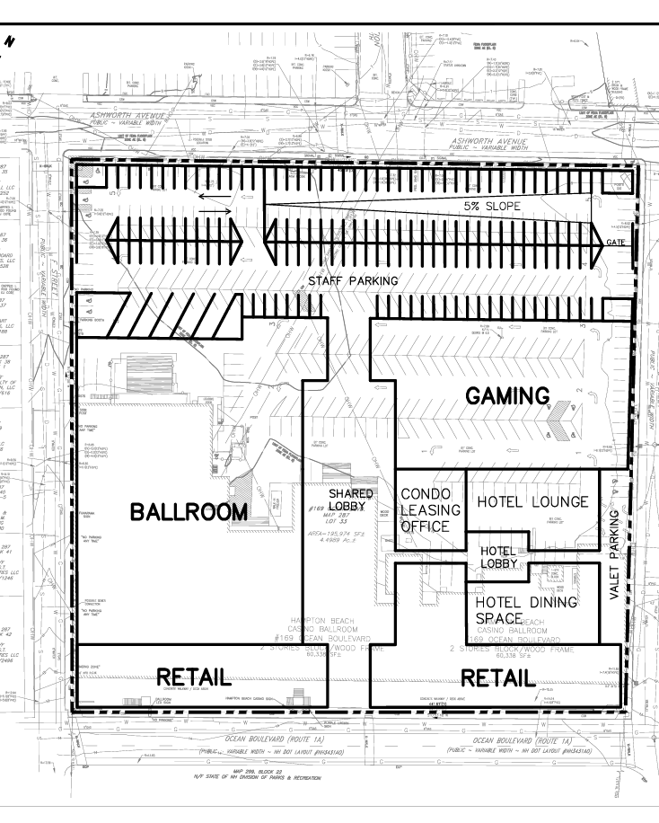
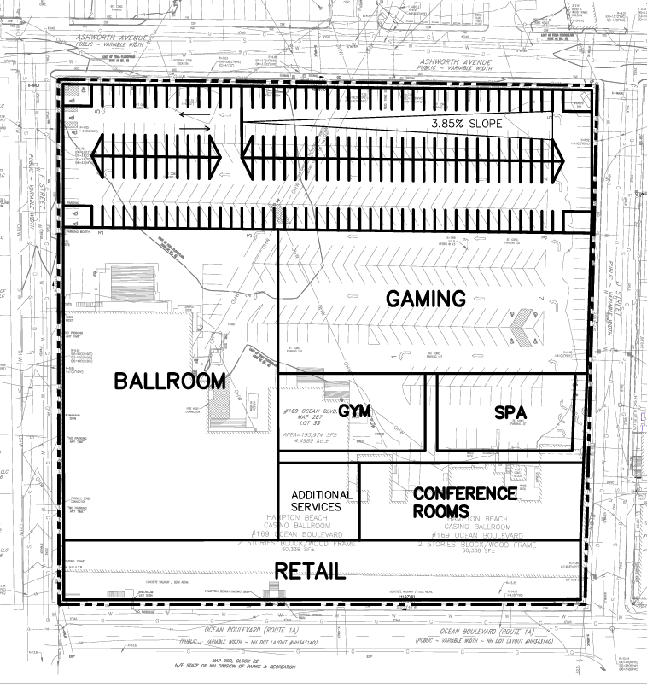
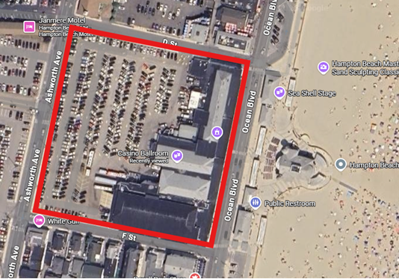
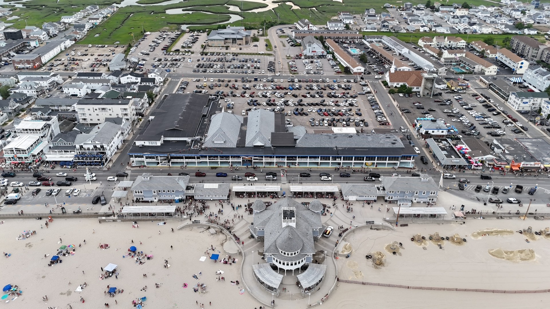
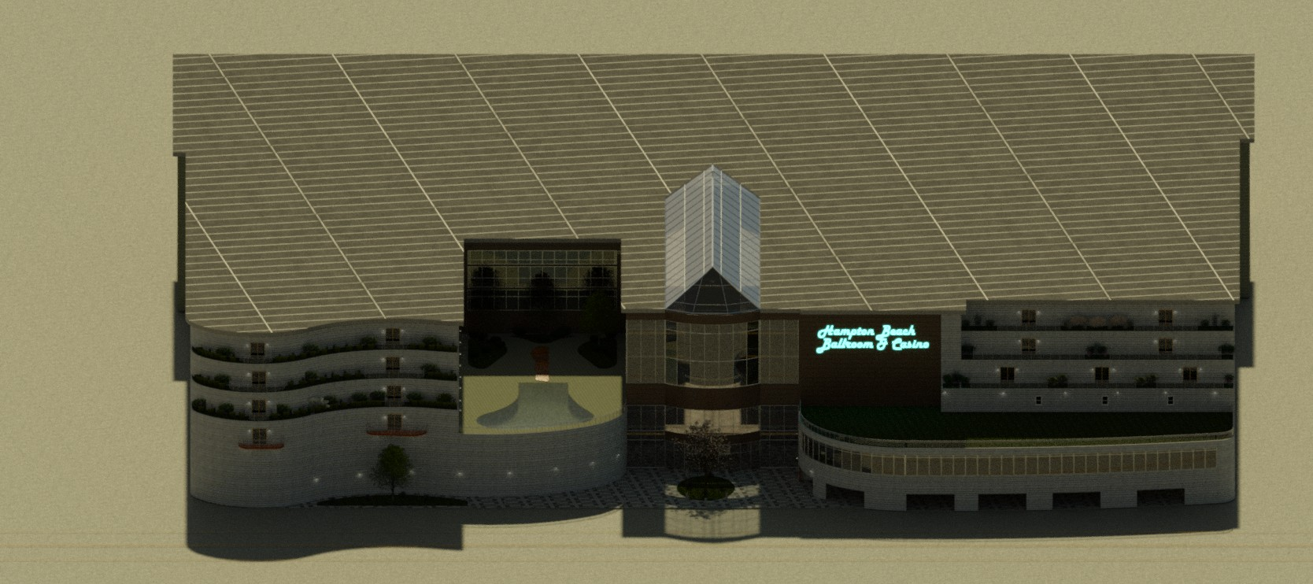
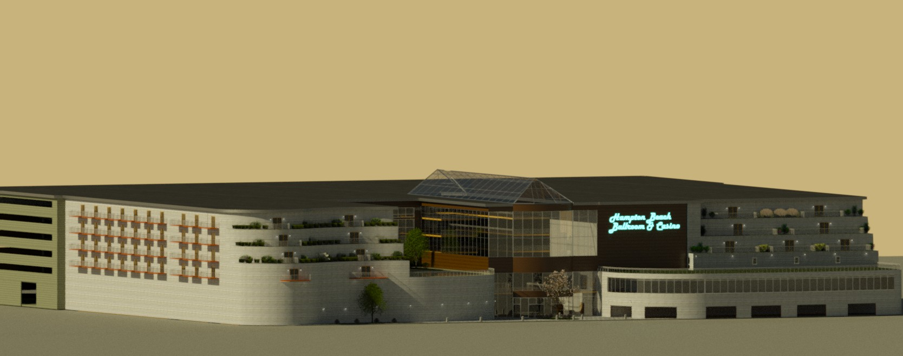
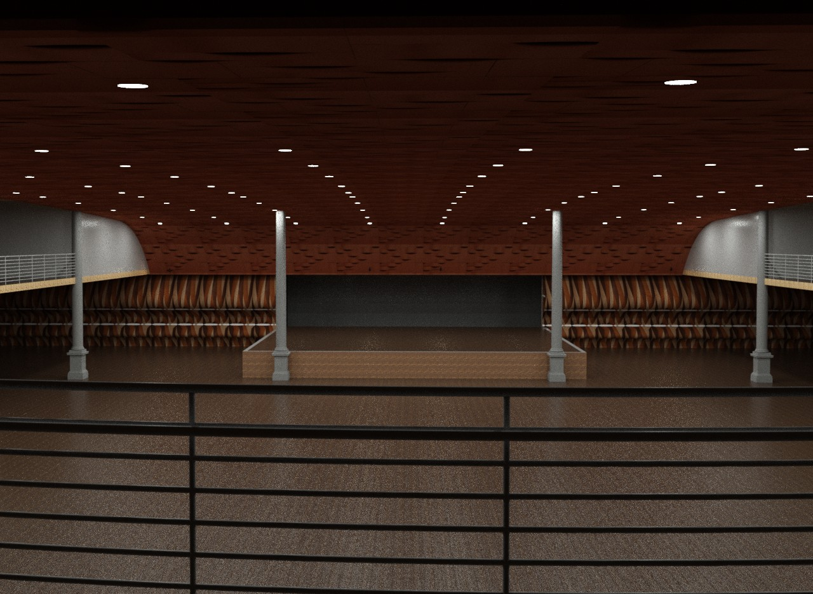
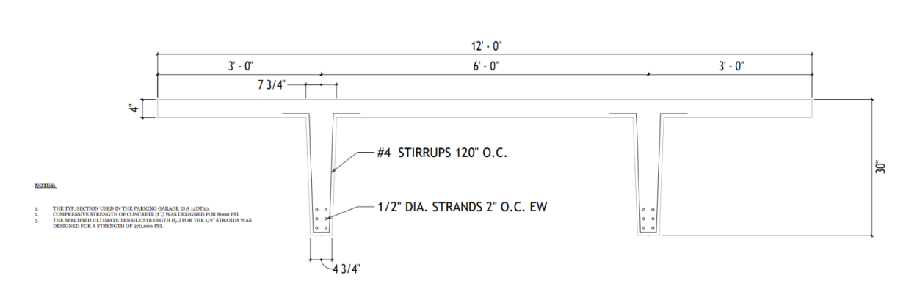


Hampton Beach Casino Ballroom Redevelopment Project
George Nigro, Angelo Cedrone, Cam Holbrook, Jason Sathananthan, Michael Vougias
Department of Civil & Environmental Engineering, University of New Hampshire, Durham, NH 03824
Location
Site Design
Additional Elements
Organization critical
  Pedestrian friendly
  ADA requirements
Retail along front
  Pedestrian presence
Parking in rear
  Via D & F Street
Shared lobby for ballroom and gaming
Floors 3-6 for hotel and condo uses
  10ft step-back
Foundation Design
Fill and alluvial deposits over glacial soils and bedrock
  High level groundwater
Recommended foundations:
  Driven PPC Piles
  Spread Footings & Ground Improvement
Stormwater Management
Reduction of impervious surface
Drainage systems in accordance with NH Stormwater Manual
Project Locus Map
42°54'34.0"N 70°48'39.4"W
Floor 2
Floor 1
Architectural Renderings
Permitting & Codes
State Permits
  NHDOT ROW on NH-1a
  NHDES Wetlands Permits
Hampton Town Building Codes
  Height limit of 70ft
  4ft setbacks
Site Aerial View
Cost Estimate
Background & Program
Using RSMeans:
Total Estimate: $147 million
  Hotel: $80 million
  Condo: $30 million
  Parking Garage: $18 million
  Music Venue: $8 million
  Gaming: $8 million
  Retail: $3 million
Historic Site, Built in 1899
Prominent to Hampton Beach
  Between Ocean Blvd and Ashworth Ave (NH-1a N & S)
Many issues currently:
  General deterioration
  Total impervious lot coverage
Seeking total site redevelopment:
  45,000 SF Music Venue
  40,000 SF Restaurant/Retail
  50,000 SF Charitable Gaming
  200 Room Boutique Hotel
  100 Residential Condo Units
  Parking availability for all uses
  Pedestrian-Integrated
Parking Garage Structural Design
Member in Parking Structure
ASCE 7-10, AASHTO BDM, ACI 318-25, and PCI DHB
Structural Double Tee Beam, 12DT30
  (12) 0.5-in strands prestressed to 185ksi
  (4) #4 stirrups every 120in (10ft)
Acknowledgements
Anthony Puntin
Prof. Kalmogo
Christopher Raymond
Michelle Thibault
Notes:
General Order of Talking for URC
Introduction: George (Friendly greeting, introduce ourselves, our project, sponsors & advisors, and location)
Background & Program: Mike (Explain the history of the site, build date, current issues and concerns with the site, importance to the community but need for redevelopment, program by TEC to completely overhaul site, program info and such)
Site Design: Cam (Explain last semester’s general work, the logic in why 5 separate site designs were first made, then analyzed and combined into a better pref alternative, explaining logic of the pref alternative, retail along Ocean Blvd, shared main lobby, parking in the rear, etc)
Architectural Renderings: Angelo (Talk about this semester’s architectural work, general design logic behind choices made, items like column spacing in ballroom, ADA accessibility, general aesthetics)
Structural Design: George (Talk about structural design, focus on garage by advice of sponsors and academic background, logic of choosing PSC for garage because of environment and logistics, choosing beam to analyze by observation as critical section, loadings (cred. Angelo), and then the flexural, vertical shear, and deflection check of design)
Add’l Elements: Jason (Explain the additional elements that went into the site, briefly touch on Foundation design which was NOT conducted due to time constraints, stormwater management improvements by increasing pervious ground and implementing NH Stormwater Design systems, as well as the permitting and codes by the state of NH and the town of Hampton)
Cost Estimate: Angelo (Briefly explain how RSMeans used to estimate costs, is not wholly accurate to this semester yet as still working on finishing architectural and structural design, but good estimates by general space usage)
End: George (Thank you and questions)

