Slide 1



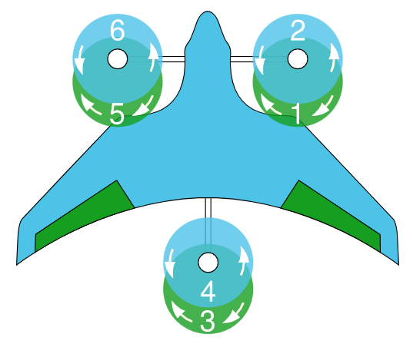
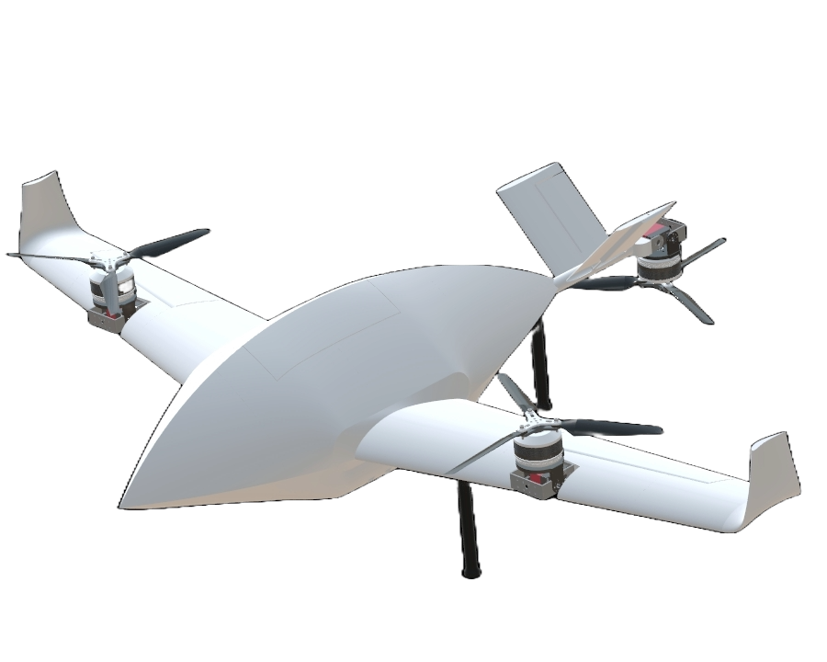
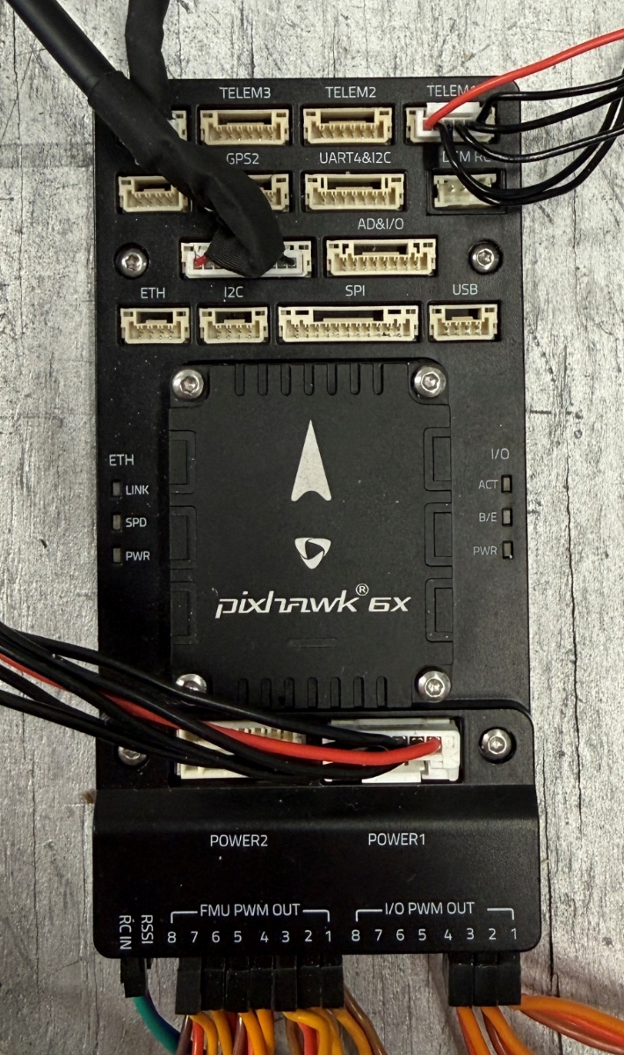

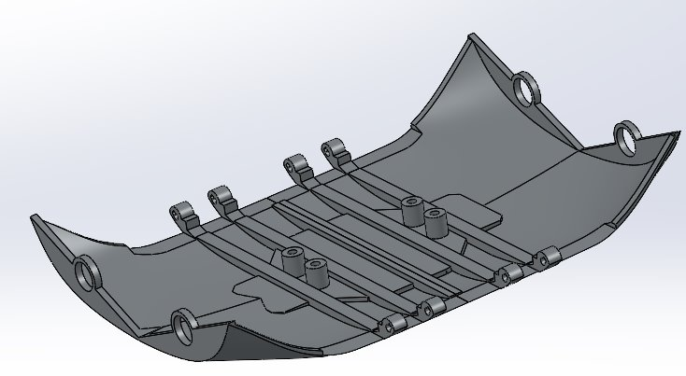
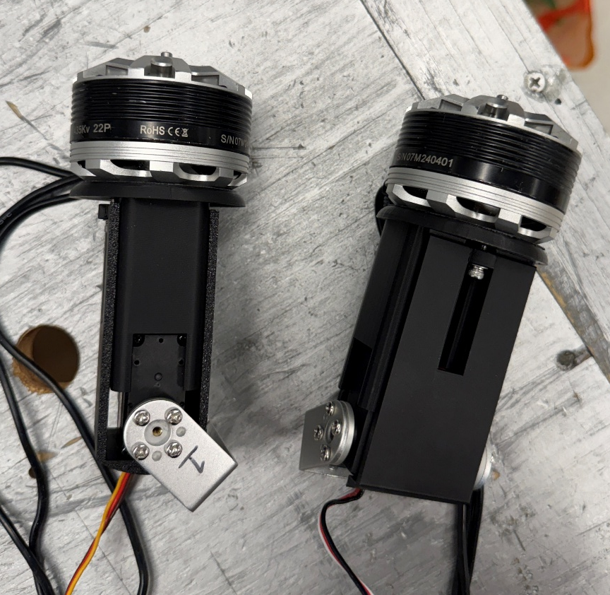
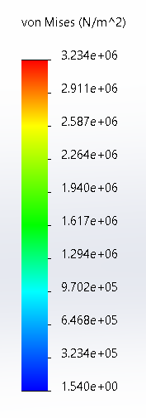
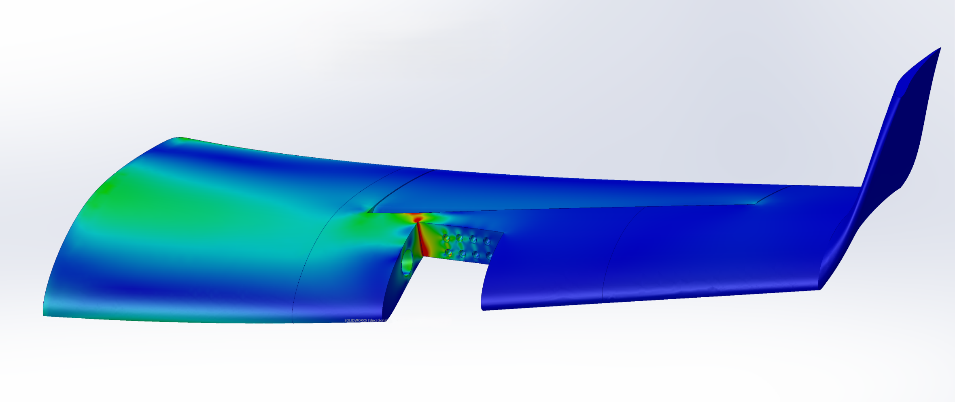
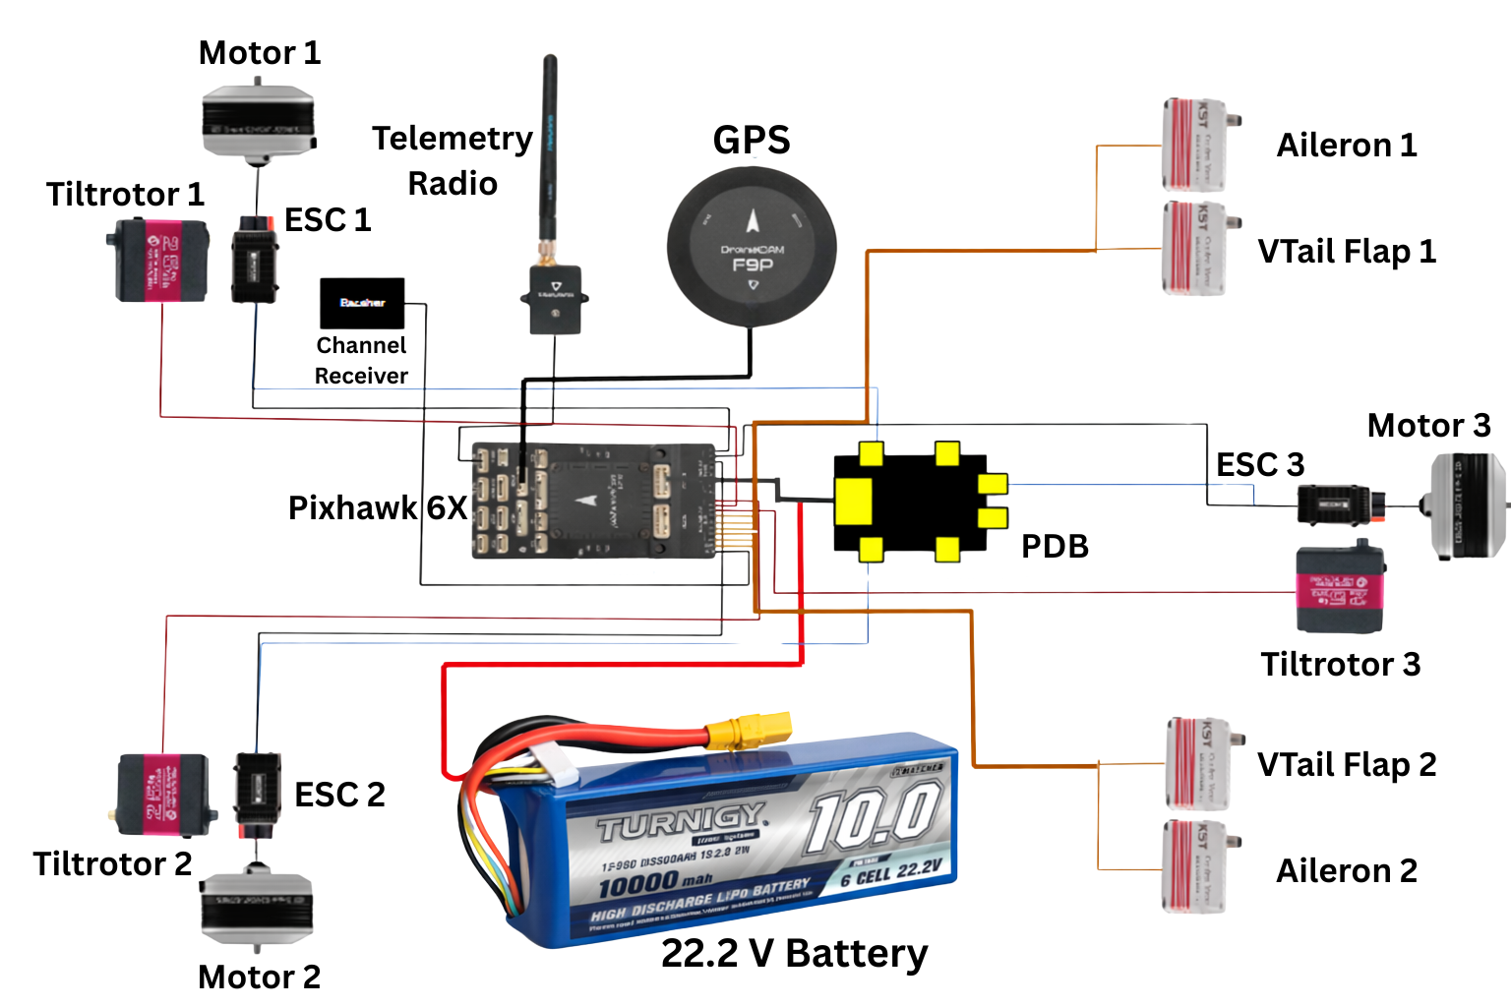

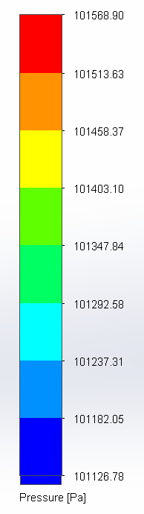
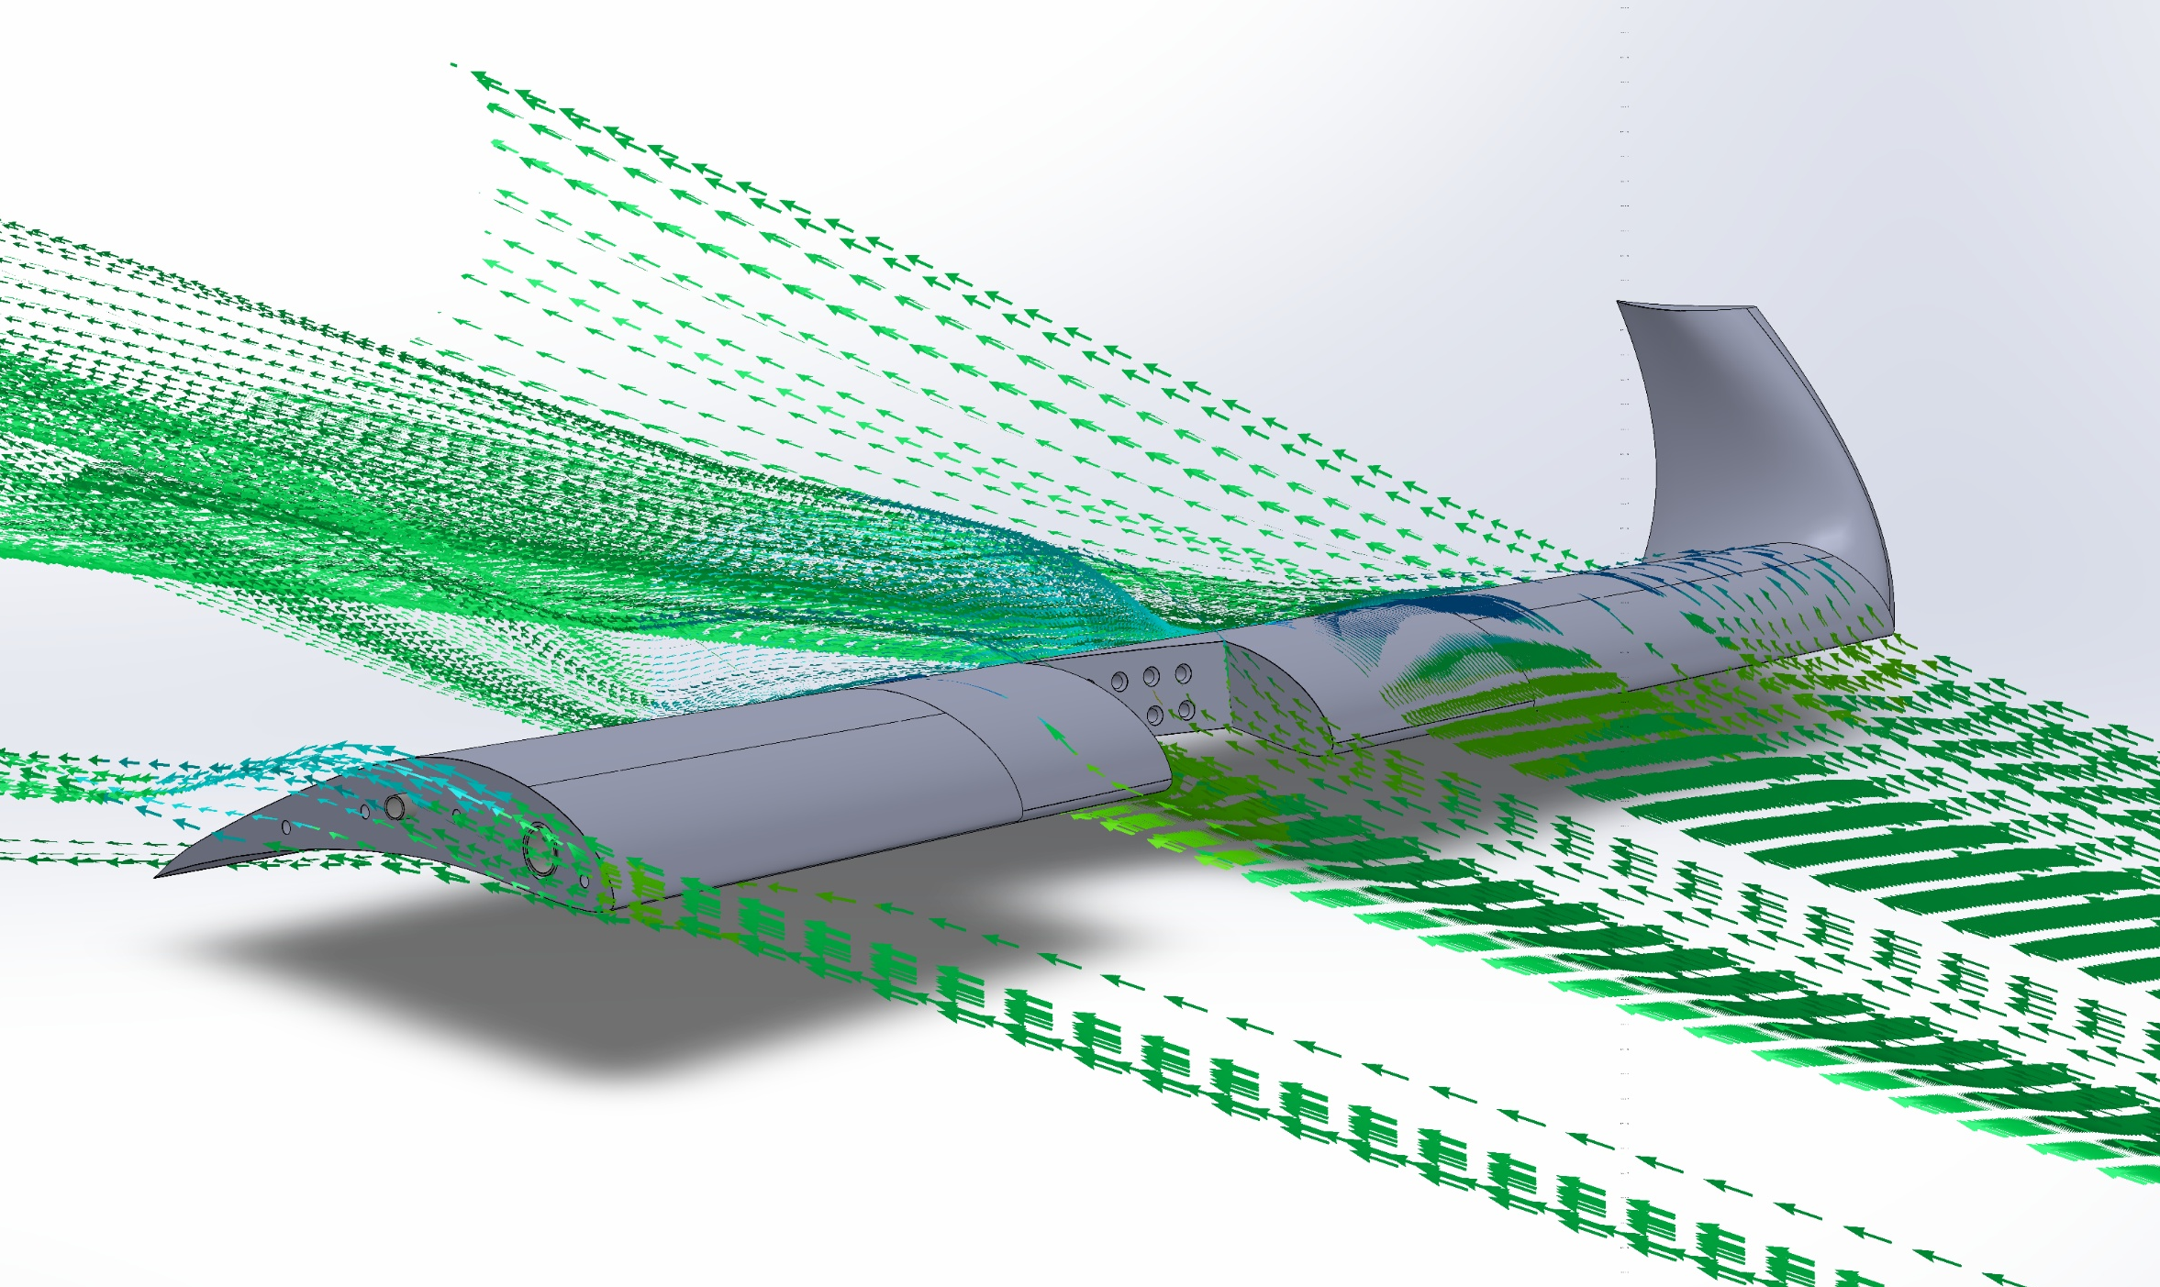


Paul Marino, Patrick DeAnna, Noah McCandless, Jameson Solomon, Brian Truong
Department of Mechanical Engineering, University of New Hampshire
Project Statement
PX4 VTOL Tiltrotor Airframe
Pixhawk 6X Flight Controller
Assembly Composition
This project consists of designing and operating an autonomous Unmanned Aerial Vehicle (UAV) with Vertical Take-Off & Landing (VTOL) capabilities.
Max Package Volume: 3.5" x 8.5" x 12“ (357 in³)
Goal Package Weight: > 5lbs
Goal Delivery Radius: 5 miles
PETG: Primary Material
5 - 15% infill
Strong, durable base
Aero PLA: Non-Load Bearing Components
Minimizes overall UAV weight
10% infill
Nose cone, ailerons
Threaded inserts + screws
Plastic super glue
Aluminum rods
Magnet-mounted panels
Real-World Applications
Last-mile delivery for urban &
suburban areas
More sustainable, versatile, and cost
effective than traditional methods
Future of major delivery corporations
(Amazon, FedEx, etc.)
Testing & Analysis
SolidWorks Wing Simulations
Motor Test Stand:
Current Draw, Thrust, Voltage vs. Throttle %
Max Current Draw: 100 A → 75 A
System Calibration:
Sensor accuracy, motor response, control inputs
Custom Test Stand:
Identify center of gravity, motor stabilization
*refined
Test Stand
Door Redesign
KDE Direct Motors
w/ Housing
Control System Wiring Diagram
Flight Mission Programming
Von Mises Stress Contour Plot
Firmware: PX4
Flight stabilization, sensor tuning
Programmed for VTOL airframe
Control Program: QGroundControl
GPS tracking w/ real-time display
Waypoint programming
Remote Control: Flysky FS-i6X
Manual flight control
Telemetry radio connection
Testing and tuning
Original Mesh: 1.39 MPa
Refined Mesh: 3.17 MPa
FOS: 3.23
Up to spec
(for our purposes)!
Acknowledgments
Flow Trajectory Plot
Dr. May-Win Thein Project Advisor
Shahab Shokouhi, Tamer Ellamushi Faculty Assistance
CEPS & ME Department Project Funding
Lift Coeff. = 0.686 Drag Coeff. = 0.201
Up to spec (for our purposes)!

