Slide 1

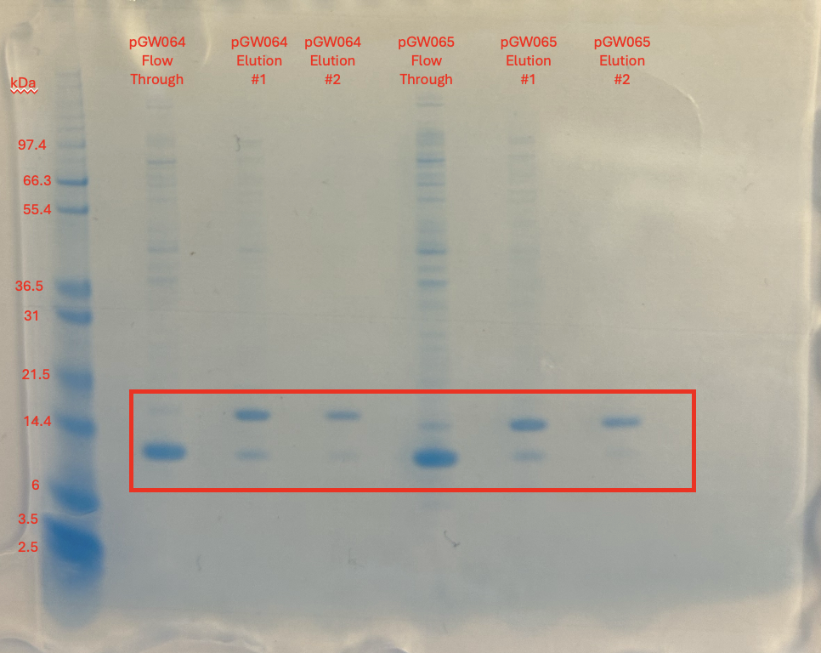
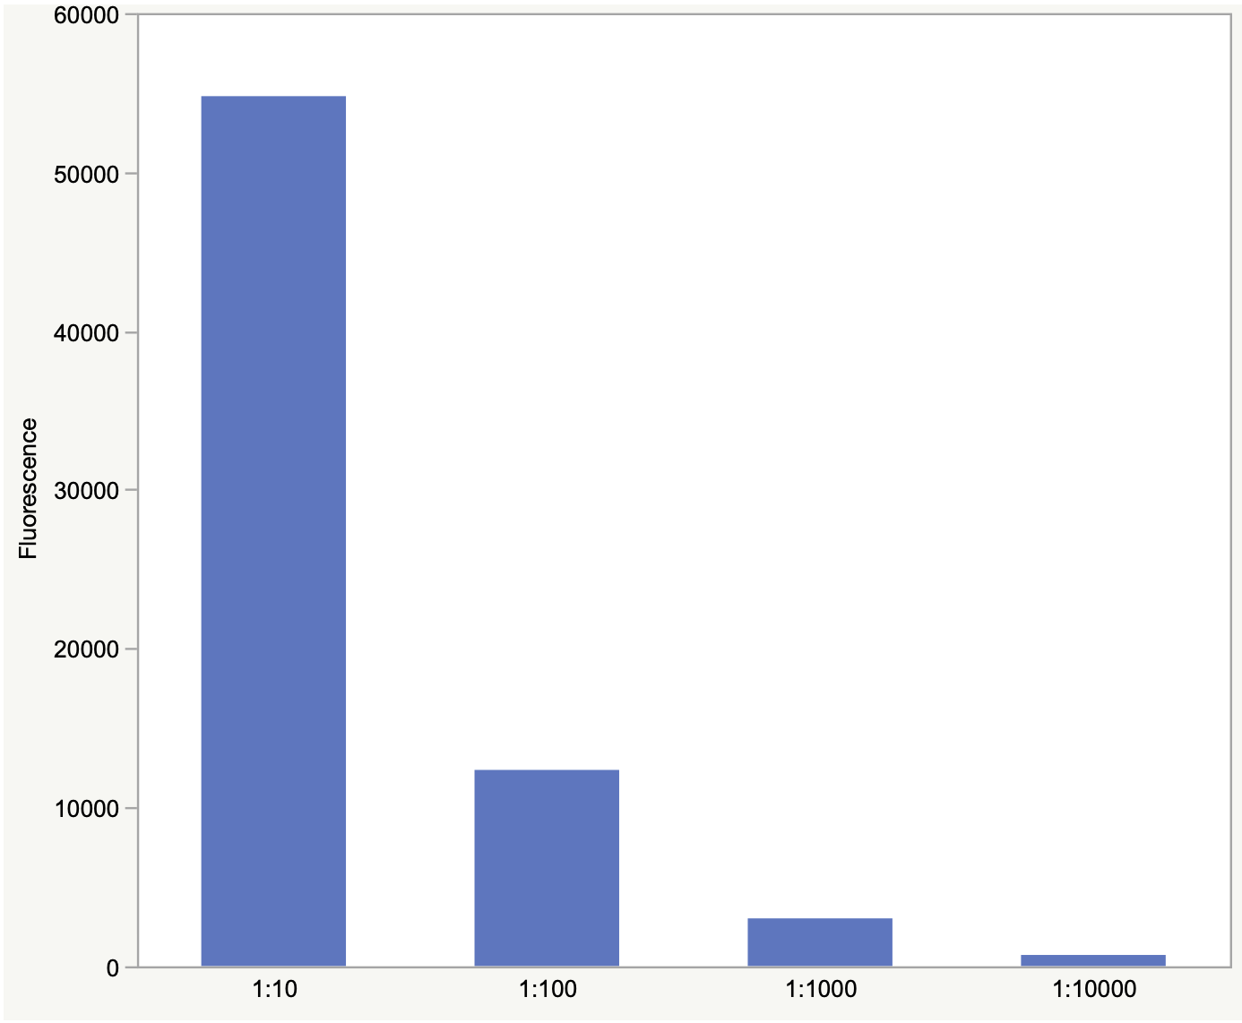
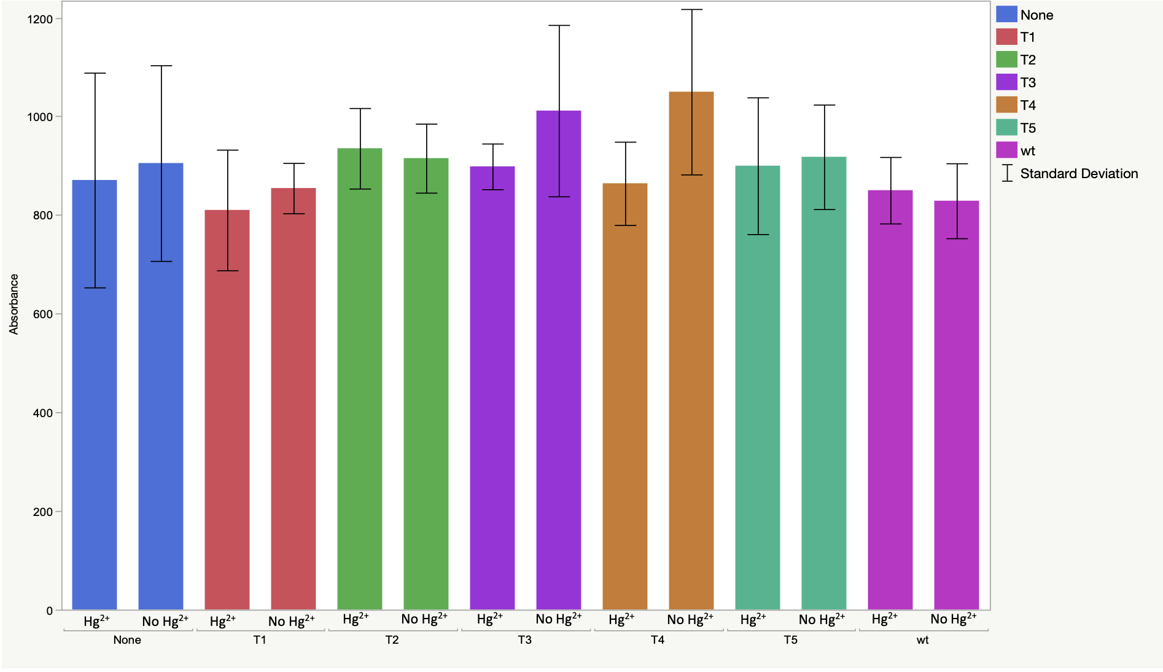
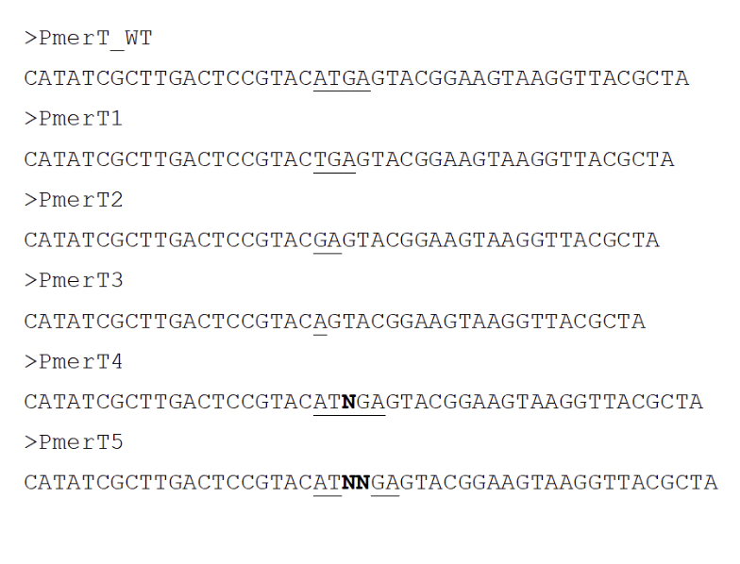
Engineering the Interaction Between Regulators and Their Cognate DNA for the Detection of Heavy Metals
Allison Kish and Kang Wu
Department of Chemical Engineering and Bioengineering, University of New Hampshire, Durham, NH 03824
Introduction
Production of MerR Protein
Confirmation of Fluorescence
Biosensors can be designed using regulator proteins and their cognate DNA promoters, as their interaction is modulated by external stimulus, as long as the interaction pattern/strength can be quantified and correlated with the input signal.
The MerR protein is a dimeric regulator protein that activates the expression of heavy metal clearance genes in presence of Hg²⁺, but it is continuously being bound to the promoter regardless of the concentration of Hg²⁺. To develop interaction-based biosensors, we designed DNA mutants and engineered the promoter for conditional interaction with MerR. Our hypothesis is that the distance between the –35 and –10 elements on the promoter impacts its binding affinity to MerR or MerR+Hg²⁺.
Figure 2. Verification of the presence of MerR protein on a NuPAGE SDS after successful purification from E. coli
Figure 4. Graph depicting the fluorescence of the T1 DNA mutant after a successful serial dilution
Preliminary Results
Next Steps
Methodology
Repurifying the MerR protein
Repeating and optimizing the procedure
Generation of a standard curve
Quantification of heavy metals in samples
Greater understanding of MerR protein and DNA interaction
Synthesis of DNA mutants with a fluorescent dye at 5'
Production of MerR protein in Escherichia coli BL21
Purification of MerR
Immobilization of MerR on a microplate
Adding samples with each DNA mutant ±Hg²⁺
Measurement of fluorescence
Acknowledgements
Thank you to Dr. Wu for her continued mentorship and to the Hamel Center for Undergraduate Research for allowing me to conduct research during the summer of 2025 through a SURF grant.
(-1)
Figure 1. The design of promoter mutants. The spacer region of the DNA was changed based off the addition/subtraction of nucleotides. N= 25% chance of A,G,T, or C
(-2)
Literature
(-3)
Figure 3. Graph depicting the fluorescence of the five mutants, wild type, and negative control with and without Hg²⁺
(+1)
Initial data showed there was no significant difference between groups treated with and without mercury, as well as no significant difference between different DNA mutants and the negative control group.
Tulin, G., Figueroa, N. R., Checa, S. K., & Soncini, F. C. (2024). The multifarious MerR family of transcriptional regulators. Molecular Microbiology, 121(2), 230-242. https://doi.org/10.1111/mmi.15212
Chen, S., Chen, X., Su, H., Guo, M., & Liu, H. (2023). Advances in Synthetic-Biology-Based Whole-Cell Biosensors: Principles, Genetic Modules, and Applications in Food Safety. International Journal of Molecular Sciences, 24(9), 7989. https://doi.org/10.3390/ijms24097989
(+2)

