Slide 1

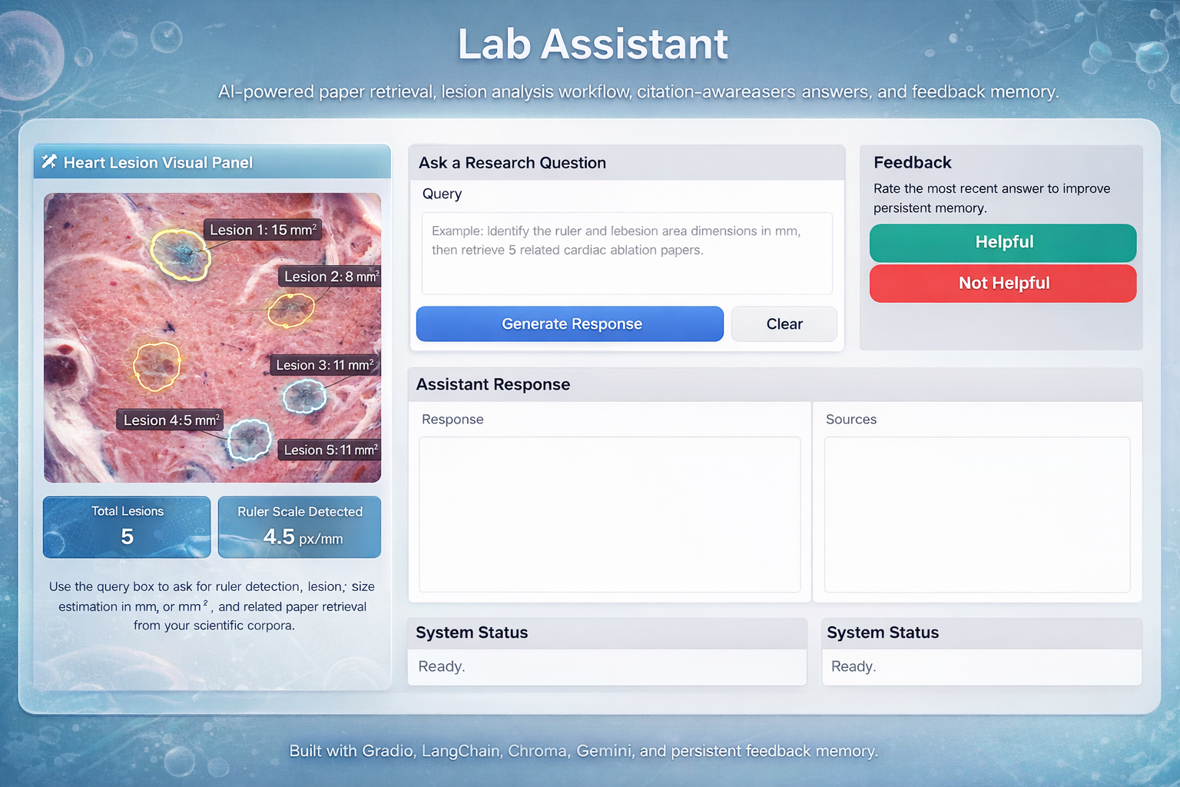
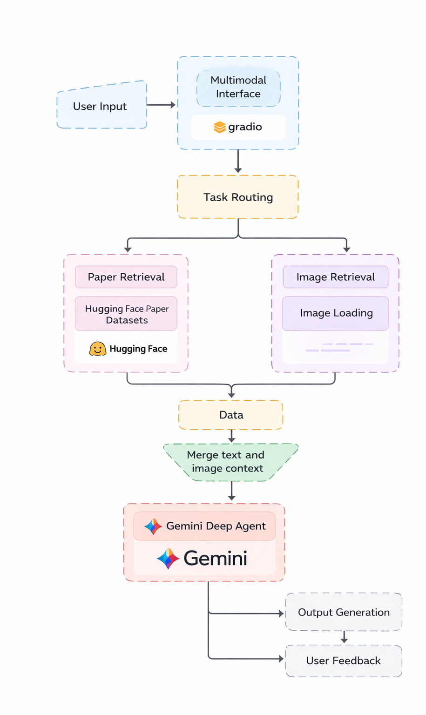
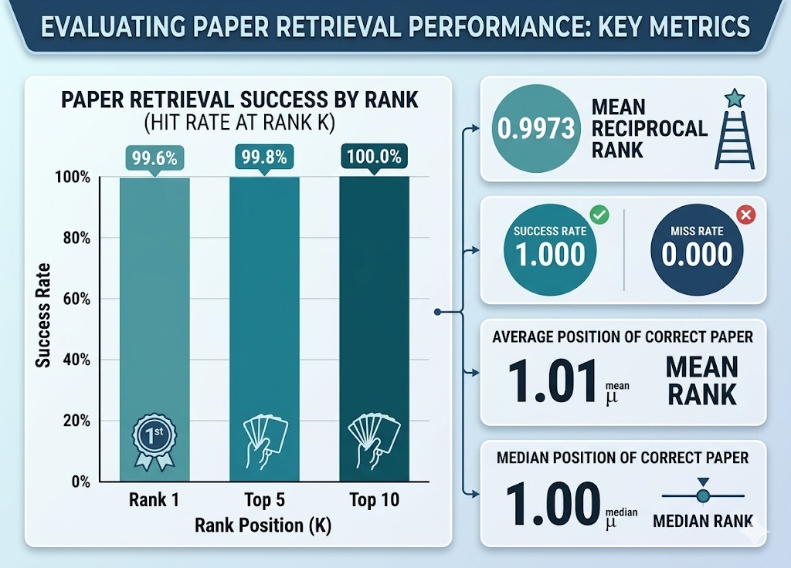
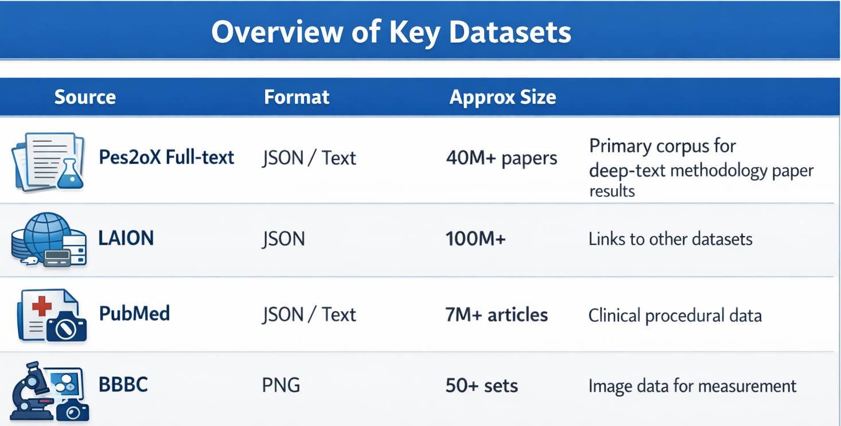
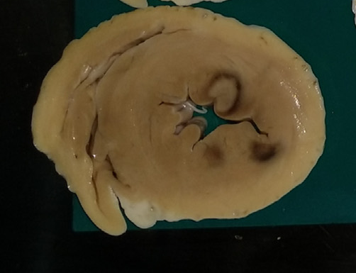
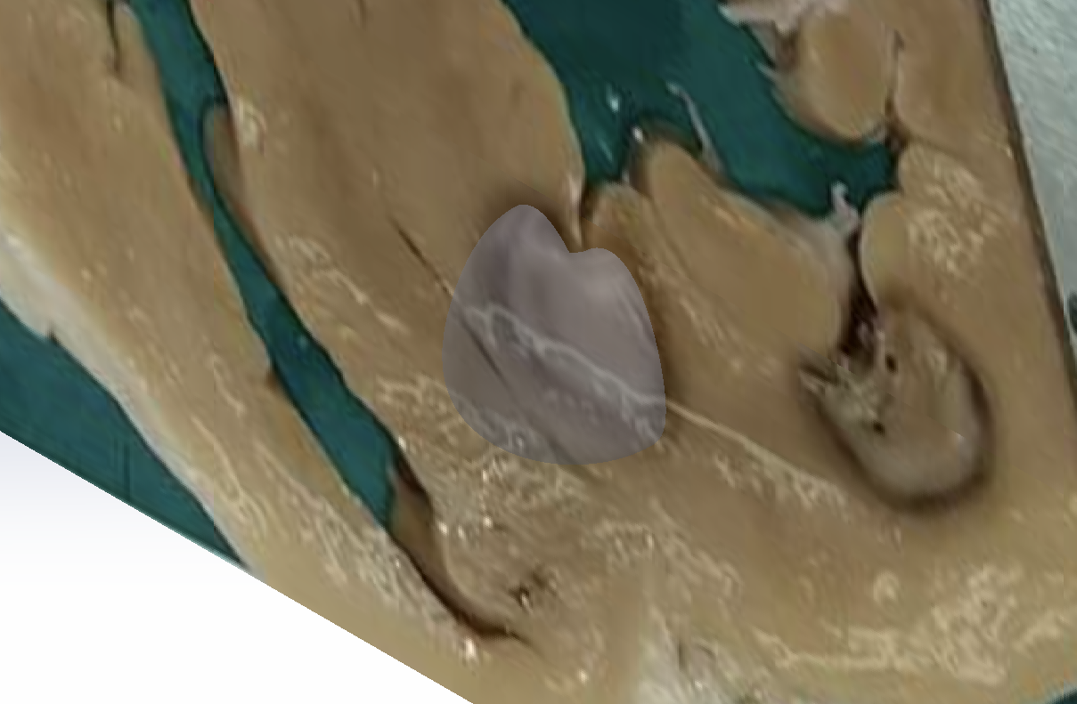
Multimodal Agentic Lab Assistant for Scientific Research and Cardiac Image Analysis
Andrew Lester¹, Gordon Chau¹, Matthew Magnusson (Advisor)¹
Department of Computer Science, University of New Hampshire
Introduction
Design
Results
Our agent does not just answer questions or analyze images, it connects scientific evidence, lesion analysis, and user feedback into one practical research workflow.
Demonstrates how an AI agent can support faster, more interpretable, and more practical biomedical research workflows
Provide practical support for real-world research and translational analysis
Core Capabilities
Searches scientific literature for relevant evidence
Analyzes biomedical images to detect visible lesions
Calculates lesion size and automatically detects a ruler to scaling information when available
Generates annotated outputs and structured reports
Role of the Agent
Orchestrates the workflow between tools
Decides what scientific evidence is useful
Connects measurements with relevant prior research
Uses feedback memory to improve future responses
Lesion Analysis
Successfully detects cardiac ablation lesions
Calculates physical measurements in millimeters or pixels if scaling information is not available
Uses lesion geometry to calculate the extruded area of the lesion
Measurement Accuracy
Images-based measurements reached a resolution of 10 pixels, corresponding to 0.25mm of physical precision
Automated lesion measurements were consistent each time as opposed to hand measurement which introduces variability
Retrieval Performance
Targeted subset of 500 indexed papers for evaluation
Applied content-based self-retrieval, using the 40 words of context as the query
Fig 6. Multimodal Agentic Lab Assistant User Interface
Methods
Conclusions
Core Platform
Interactive Gradio interface
ChromaDB for persistent vector storage
Gemini 2.5 Flash for language and vision-based reasoning
Scientific Query Answering
Retrieved from PeS2oX, PubMed, and COREX-18
Papers are chunked, embedded, and indexed
Supports source-based question answering with RAG
Feedback Memory
Stores prior yes/no user feedback
Past feedback to improve future responses
Biomedical Image Analysis
Detect visible cardiac ablation lesions
Estimates lesion width, depth, and area
Detects ruler information
Annotates images and measurement reports
System Integration
Successfully merged literature retrieval, user feedback, and image analysis into one interface
Implications
Enables automated lesion measurement in clinical workflows, reducing manual error
Supports faster decision-making in cardiac ablation research
Connects biomedical image findings to scientific evidence
Demonstrates how agent-based systems can assist in education for clinical research
Corpus Limitations
Restricted to sampled subsets of datasets, rather than the complete 100M+ scientific paper corpus
Future Development
Future work will focus on improving computer vision accuracy through redundancy
Expanding the system's knowledge domains
Polishing the user interface outputs
Fig 3. Data Pipeline for Multimodal Agent
Fig. 4 Paper Retrieval Key Metrics
References
Photo of the 3D rendering of the area on a lesion
Gemini 2.5-flash/pro, Hugging face embeddings (sentence-transformers/all-MiniLM-L6-v2), Vector store: Chroma DB, LangChain, DeepAgents, Gradio, HuggingFace Datasets, NumPy, SciPy
Data: laion/Pes2oX-fulltext, common-pile/pubmed, laion/COREX-18text, https://pmc.ncbi.nlm.nih.gov/articles/PMC10886553/?utm_source=chatgpt.comLinks to an external site., Odehnalová, Eva & Valíková, Lucia & Caluori, Guido & Kulík, Tomáš & Římalová, Veronika & Jadczyk, Tomasz & Drazanova, Eva & Harastova-Pavlova, Iveta & Pesl, Martin & Kubes, Vaclav & Stárek, Zdeněk. (2022). Comparison of gross pathology inspection and 9.4 T magnetic resonance imaging in the evaluation of radiofrequency ablation lesions in the left ventricle of the swine heart. Frontiers in Physiology. 13. 10.3389/fphys.2022.834328.
Fig 1. Key Datasets for Scientific Evidence Retrieval
Fig 5. Cardiac Ablation in a Pig Heart
Fig 6. 3D representation of Extruded Lesion

