Slide 1
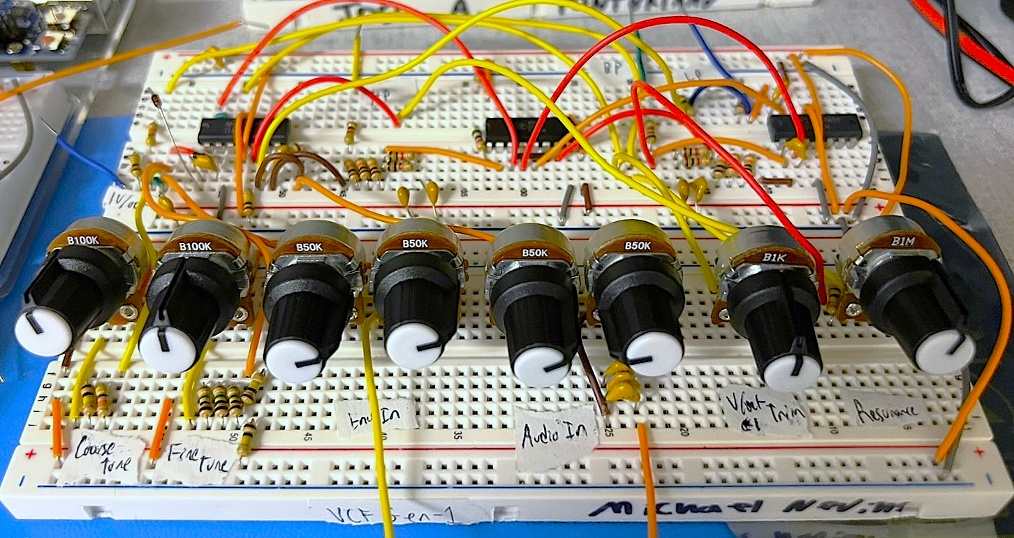
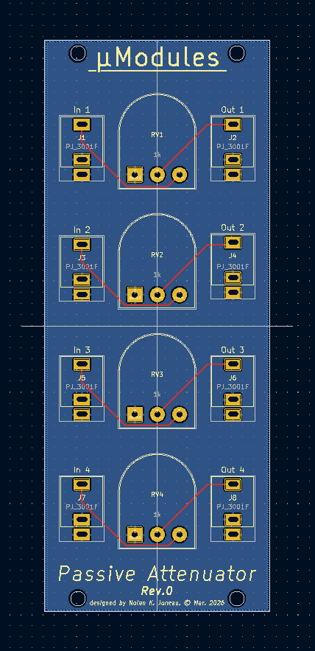
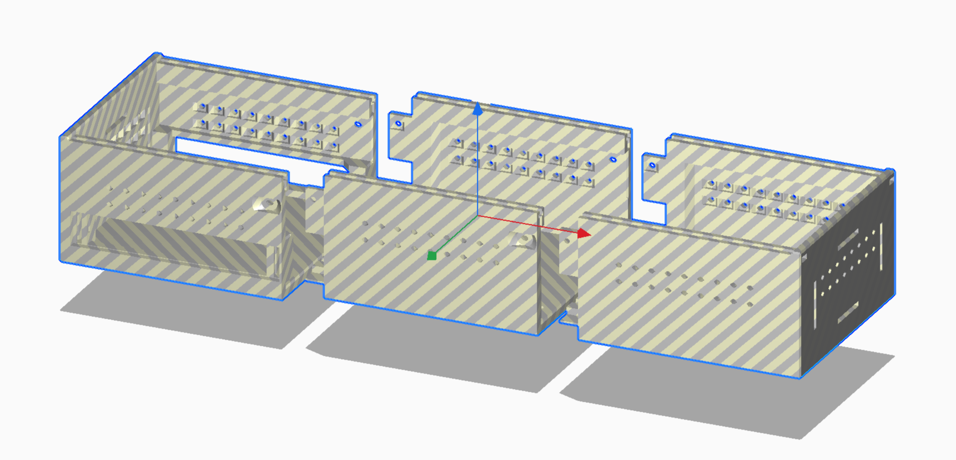
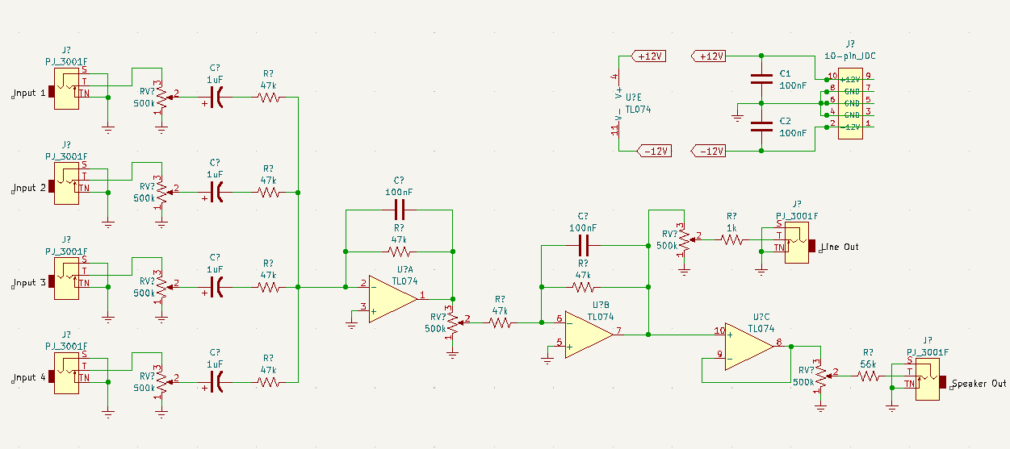
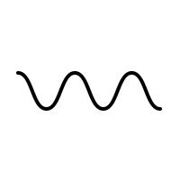
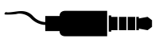

μModules: A Low-Cost, Eurorack-Compatible Modular Audio Synthesis System
Nolan K. Juneau (nkj1006@usnh.edu)
Faculty Advisor: Dr. Wayne Smith, Ph.D.
Department of Electrical and Computer Engineering, University of New Hampshire
Introduction
Approach
Outcomes
Background:
Modular synthesis is one of the fastest-growing fields in current-day music technology due to its tonal versatility, extensive customizability, and unique musical workflow.
Problem:
Far too expensive for independent musicians (>$3000):
  Modules: $300-600 each
  Cases/Power Supplies: $200-1000
Goals:
μModules must have at least 6 modules + power supply.
μModules must be compatible with the Eurorack standard.
μModules’ total cost per unit must be no greater than $500.
Electronic Schematics:
Designed & simulated in Multisim using simple, open-source designs.
Prototyped each module on a breadboard to confirm operation.
Module PCB Design:
KiCAD design, JLCPCB fabrication.
  PCBs double as mounting panels.
Compatible with existing Eurorack specifications & power connectors.
Modular Case Design:
Assembled with M3 screws/nuts:
Manufactured with 3D-printed PLA.
(design by Jinja, license via Cults3D)
Seven fully-functional modules completed (details below).
Case, power supply, and modules fully compatible with Eurorack standard.
  Extra case and power supply connections allow for future expandability.
Total materials cost of $281.56.
Cost Breakdown
Synthesizer Module Block Diagram
Item: | Cost (per system):
PCB Manufacturing (plus shipping) | $80.12
Specialized Active Componentry (ICs for VCO, VCA, etc.) | $43.48
General Active Componentry (op-amps, linear regulators, etc.) | $11.86
Passive Componentry (resistors, capacitors, diodes, etc.) | $14.81
Module Hardware (TS jacks, mounting screws, heat sinks, etc.) | $31.57
PLA Filament for 3D Printing ($0.05/gram) | $46.21
12VAC Power Cable + Barrel Jack Connector | $14.49
Modular Case Design License | $9.03
Eurorack Patch Cables (12-pack) | $29.99
Total Cost: | $281.56
Voltage Controlled Oscillator
(VCO)
Low Frequency Oscillator
(LFO)
Voltage Controlled Amplifier
(VCA)
Voltage Controlled Filter
(VCF)
Envelope Generator (ADSR)
Passive Attenuator
Audio Mixer & Output Amplifier
Audio Signal
CV Signal
A
D
S
R
1.
2.
Power Signal
Sine, Triangle, Saw, or Square
f = 20Hz-20kHz
Sine, Triangle, Saw, or Square
f = 0Hz-20Hz
Difference Amp: CV Controls Amplitude
LP, HP, or BP Filter, Adjustable Envelope
Adjustable Attack, Decay, Sustain, & Release
Reduces Audio & CV Signals
Mixes Multiple Audio Inputs into Speaker & Line Outputs
V/Oct (Pitch) In
V/Oct (Pitch) In
Audio In 1
Audio In
Audio/CV In 1
Line Output
Volume In 1
Envelope In
Gate/Trigger In
Audio/CV Out 1
Sine Out
Sine Out
Audio Out 1
Audio/CV In 2
Audio In 1
Square Out
Square Out
V/Oct (Pitch) In
Envelope Out
Audio/CV Out 2
Audio In 2
Future Work
Pulse Out
Pulse Out
Audio In 2
Low-Pass Out
Audio/CV In 3
Audio In 3
Speaker Output
High-Pass Out
Negative Envelope Out
Audio/CV Out 3
Triangle Out
Triangle Out
Volume In 2
Band-Pass Out
Audio/CV In 4
Audio In 4
Module Designs:
Quantizer: digital sampling to snap notes to musical scales.
Digital Effects Unit: adds reverb, delay, etc. to audio input.
Upgraded VCO/LFO: improve stability & tuning across different environments, add PWM & sync inputs.
Case Design:
Redesign to increase structural durability with laser-cut wood, milled aluminum, and screw-mount hardware.
Sawtooth Out
Sawtooth Out
Audio Out 2
Audio/CV Out 4
±12VDC
&
±5VDC
±12VDC
&
±5VDC
±12VDC
±12VDC
±12VDC
±12VDC
Power Supply Unit
(inside case)
12VAC Input
(from wall power)

