Slide 1

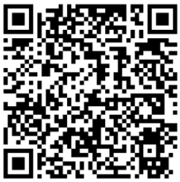
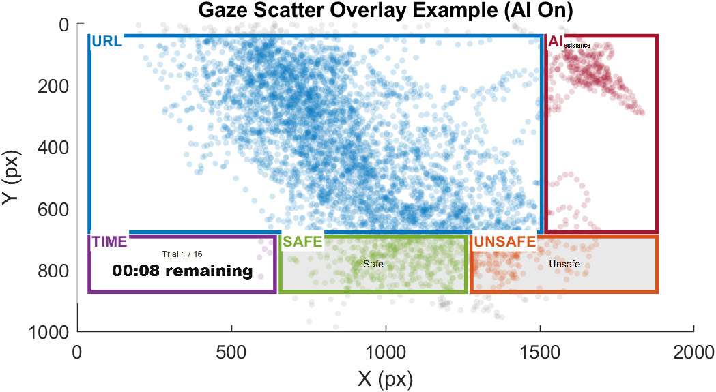
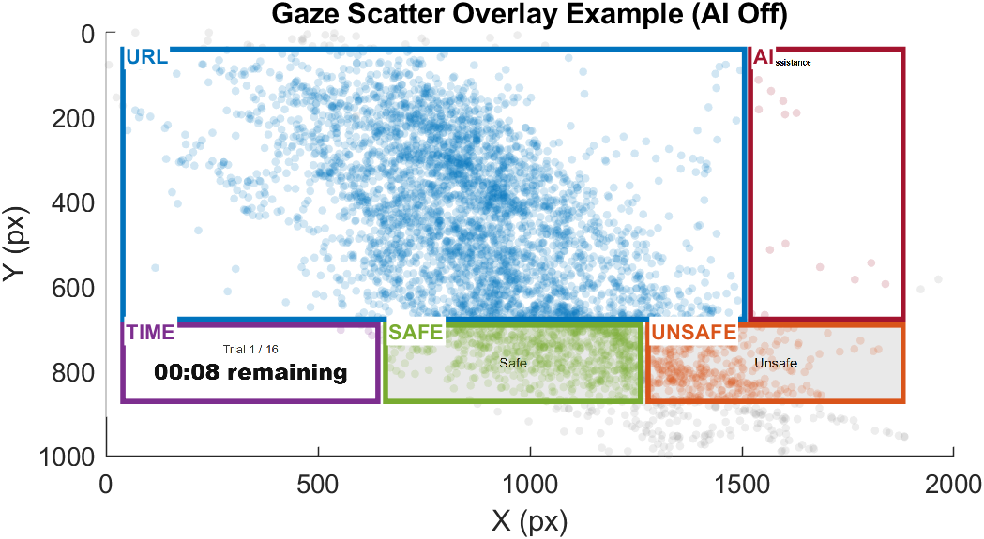
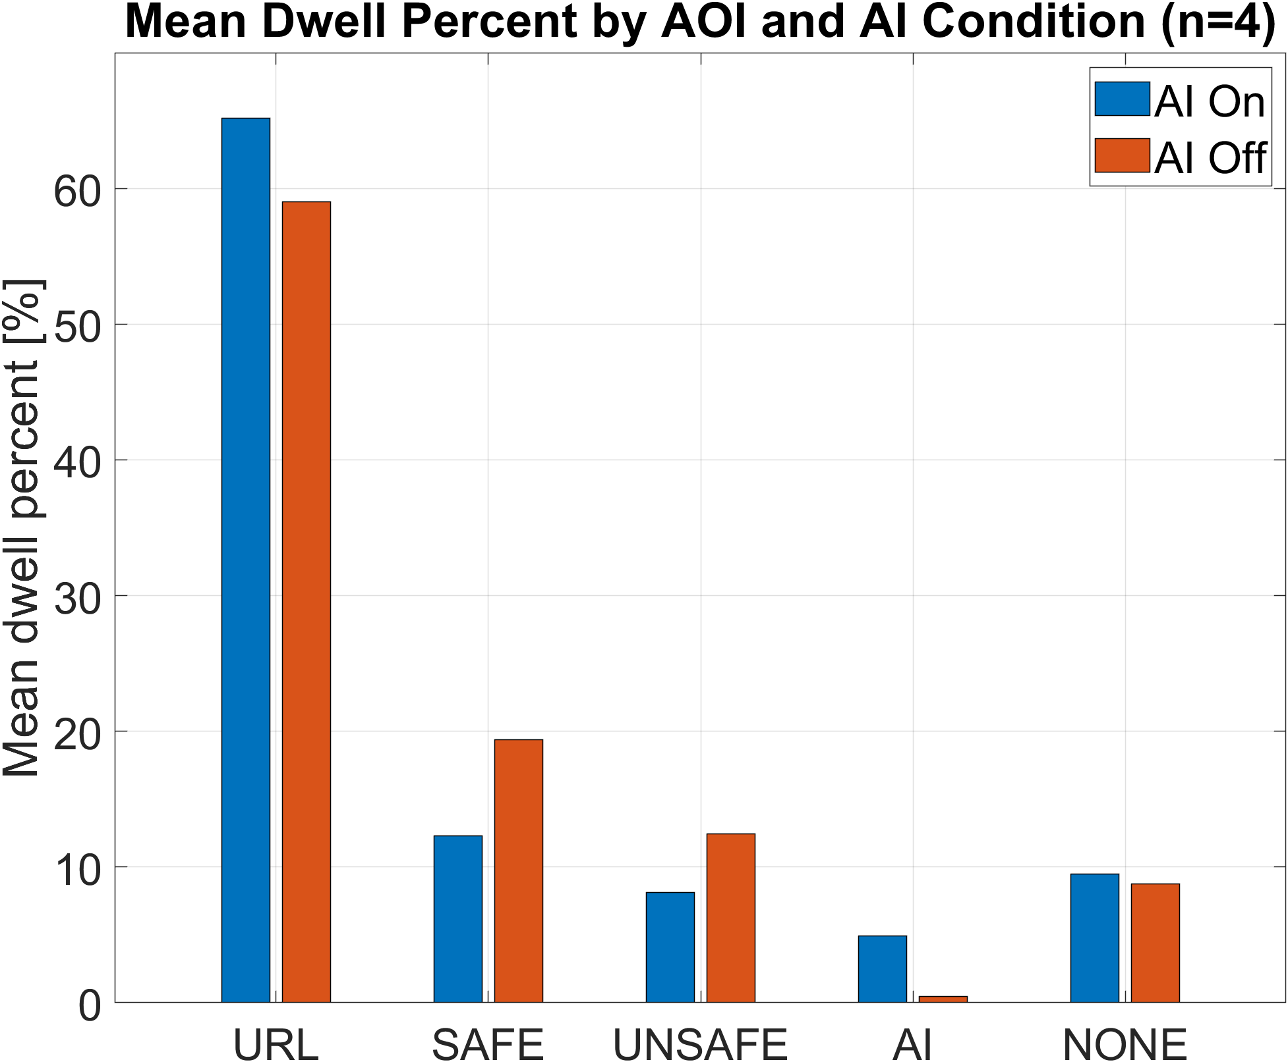
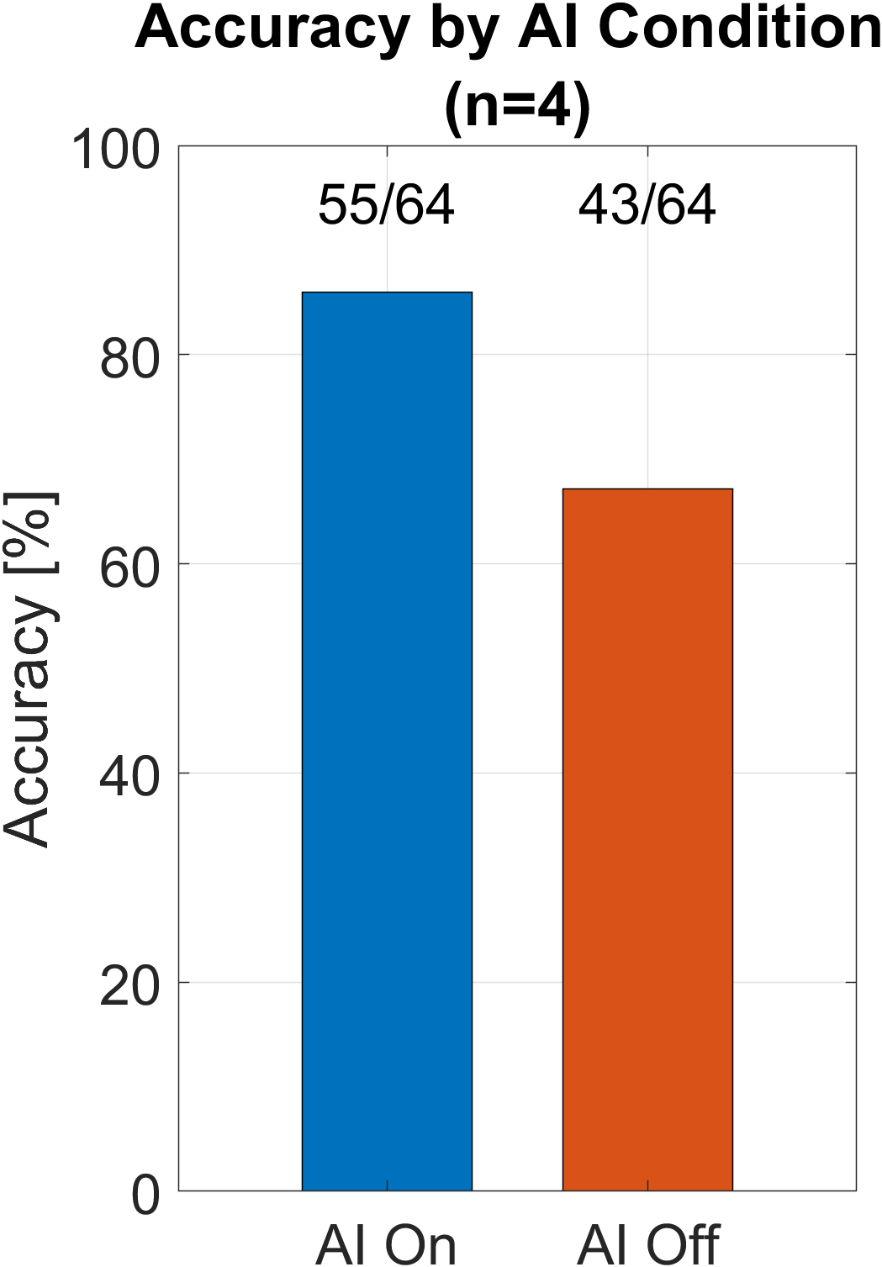
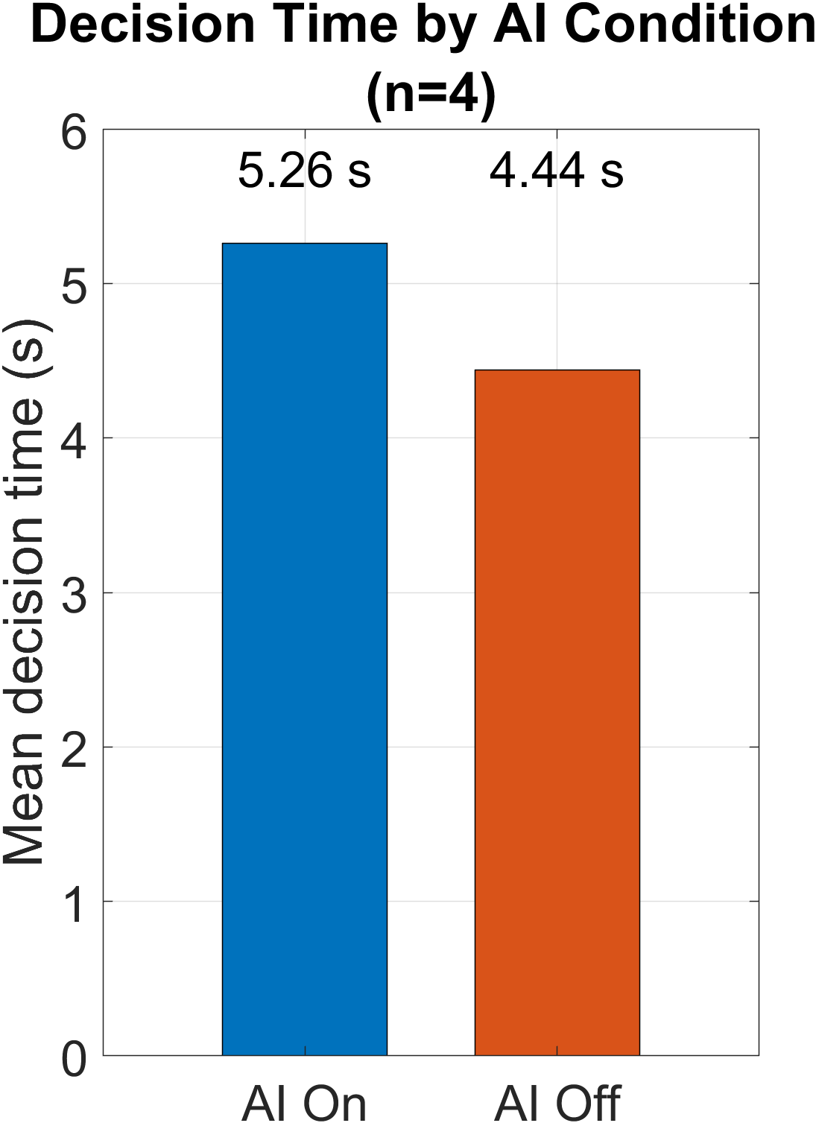
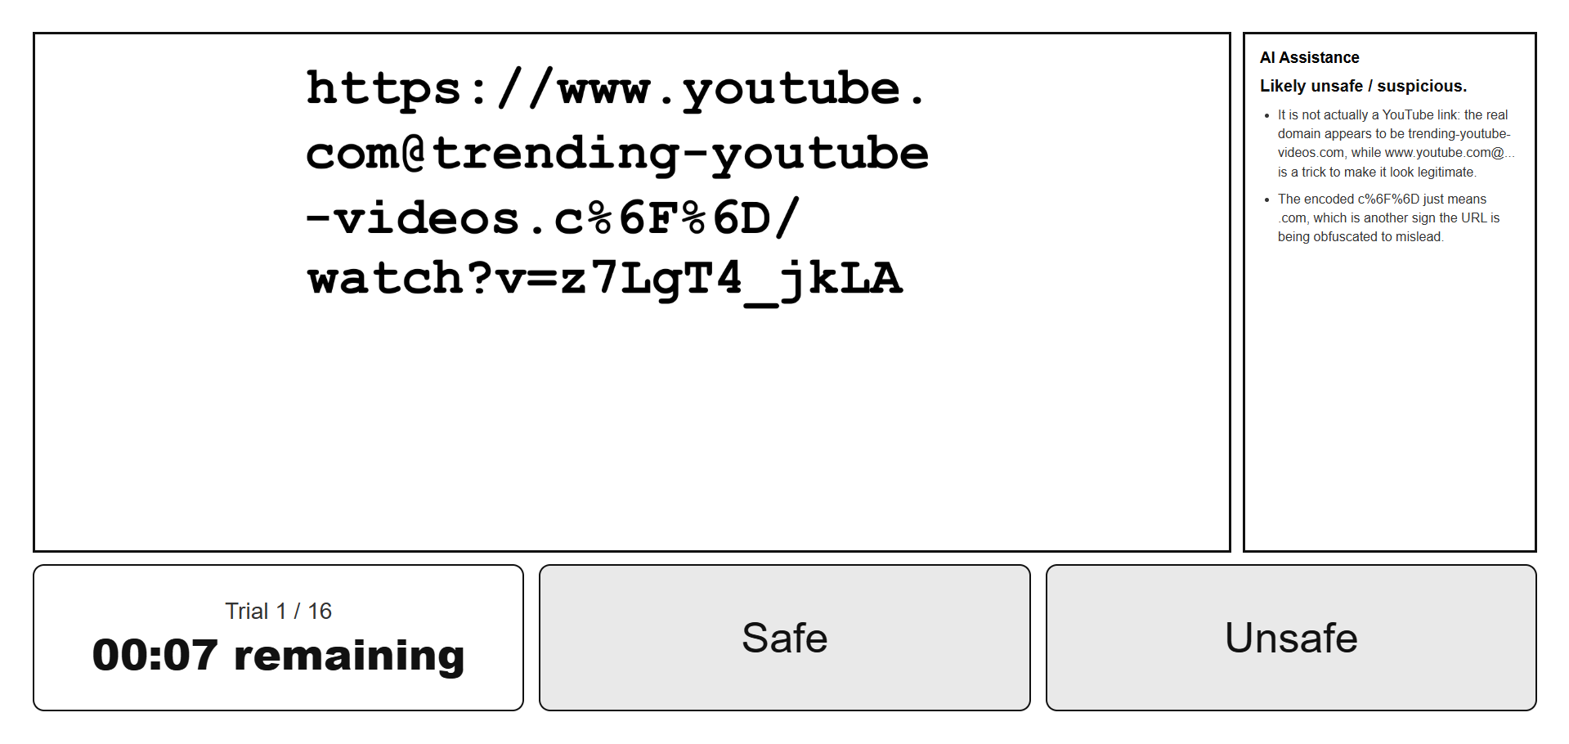
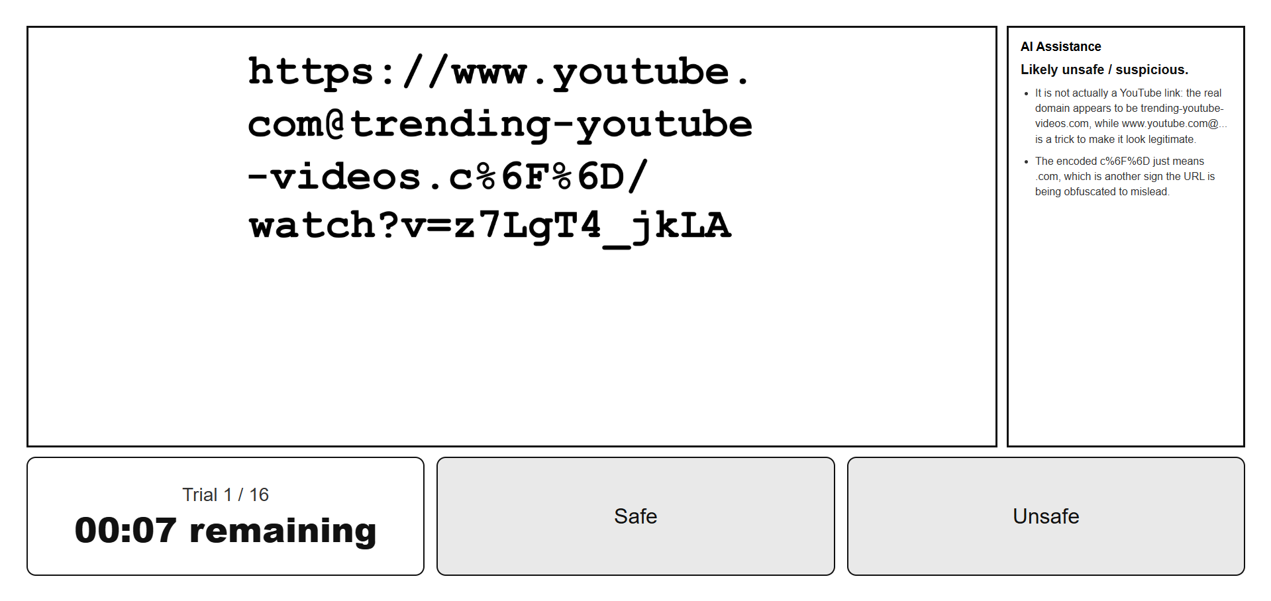
LLM-Supported Decisions
Parker Reed
Advisor: Andrew Kun
Additional
Results
Problem
Results
Judge URL safety under time pressure
  Safe: https://store.hp.com/us/en/mdp/laptops/hp-spectre-folio-13-3074457345617323169--1#!&tab=vao
  Unsafe: https://www.youtube.com@trending-youtube-videos.c%6F%6D/watch?v=z7LgT4_jkLA
LLM suggestions may alter how attention is allocated
Does AI improve decisions and/or reduce independent evaluation?
Goal
How does LLM assistance affect visual attention and performance for URL classification under time-pressure?
Approach
Participants classify URLs’ safety under time limits
Four counterbalanced conditions: AI-assisted and no AI; safe URL and unsafe URL
  16 AI-assisted URLs (8 safe; 8 unsafe)
  16 unassisted URLs (8 safe; 8 unsafe)
Time-pressure: 10 seconds per URL classification
Analyze gaze using Areas of Interest (AOIs)
Task in browser; eye-tracking via WebGazer
AI-Assistance
URL Safety Classification Task UI
Future Work
Identical prompt to ChatGPT 5.4 for each URL
Example assistance (for unsafe example above):
  Likely unsafe / suspicious.
  It is not actually a YouTube link: the real domain appears to be trending-youtube-videos.com, while www.youtube.com@... is a trick to make it look legitimate.
  The encoded c%6F%6D just means .com, which is another sign the URL is being obfuscated to mislead.
Increase participant sample size
Extend to additional workplace-relevant tasks under time pressure
Acknowledgement
We used the URL Corpus from:
Niveta Ramkumar et al. 2020. Eyes on URLs: Relating
visual behavior to safety decisions. ACM ETRA.

