Slide 1


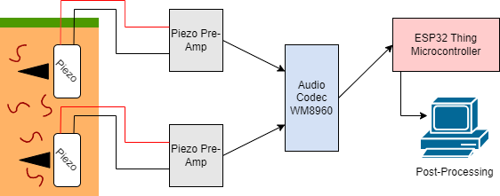
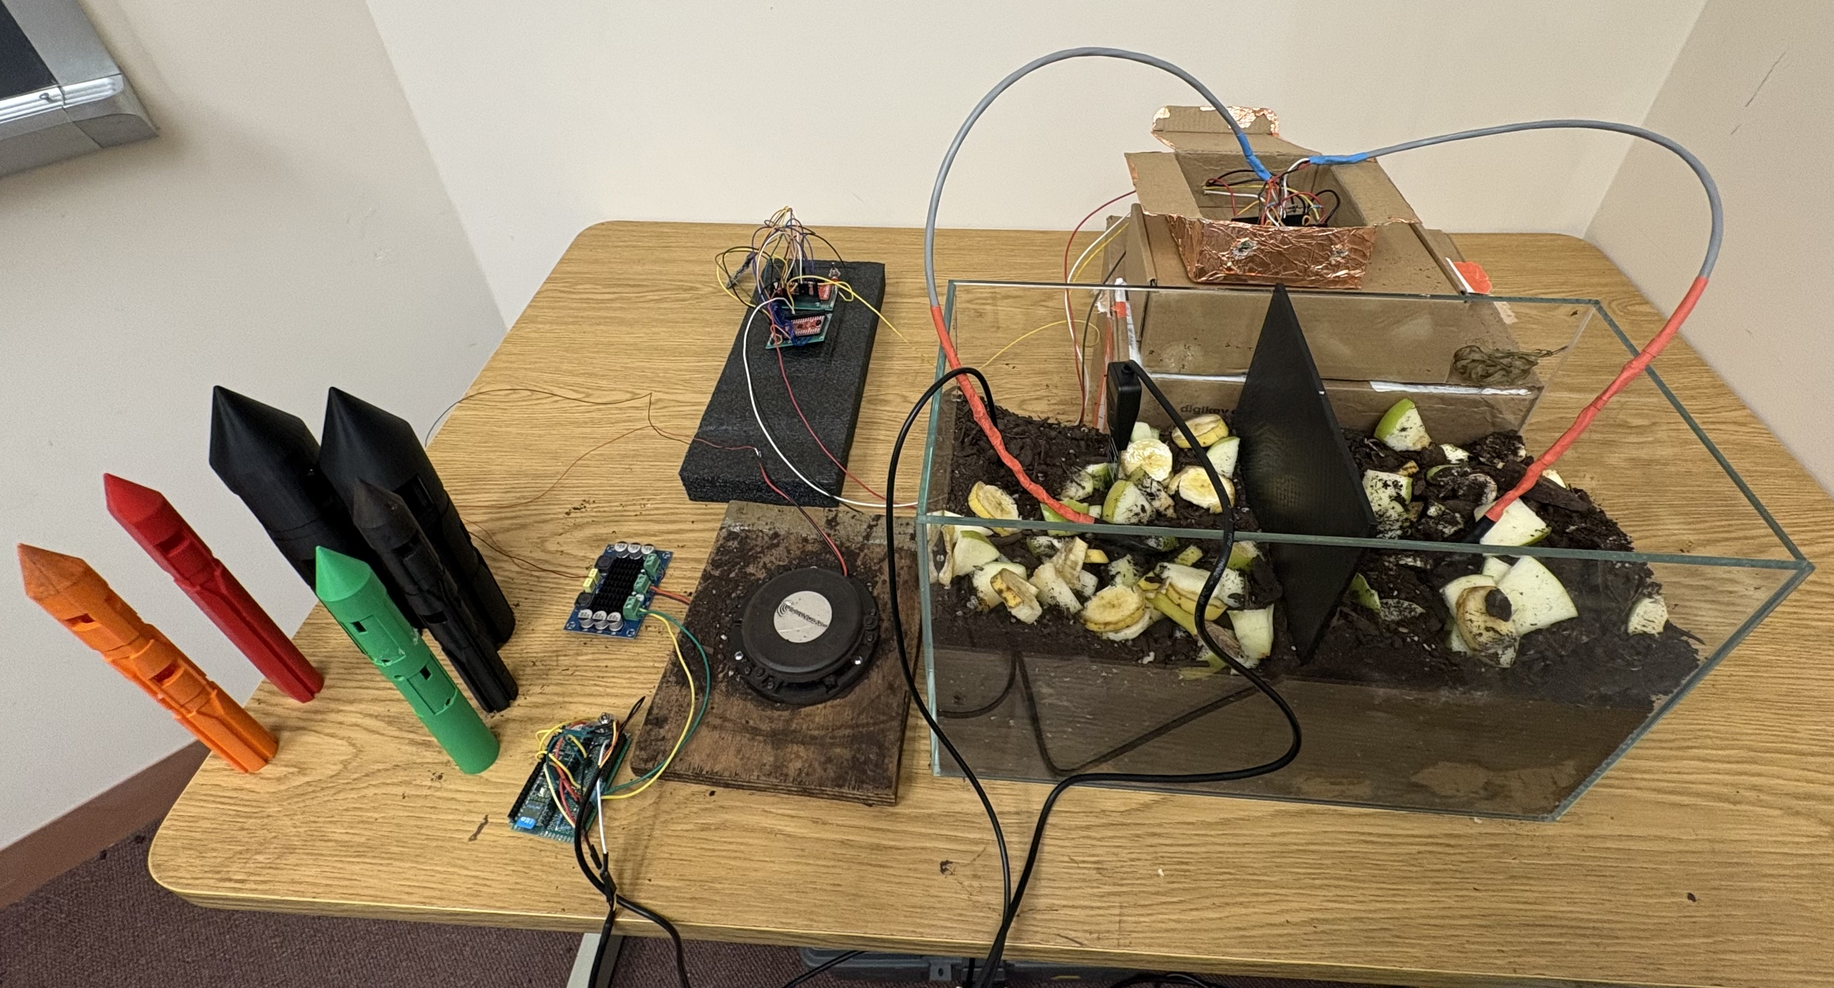
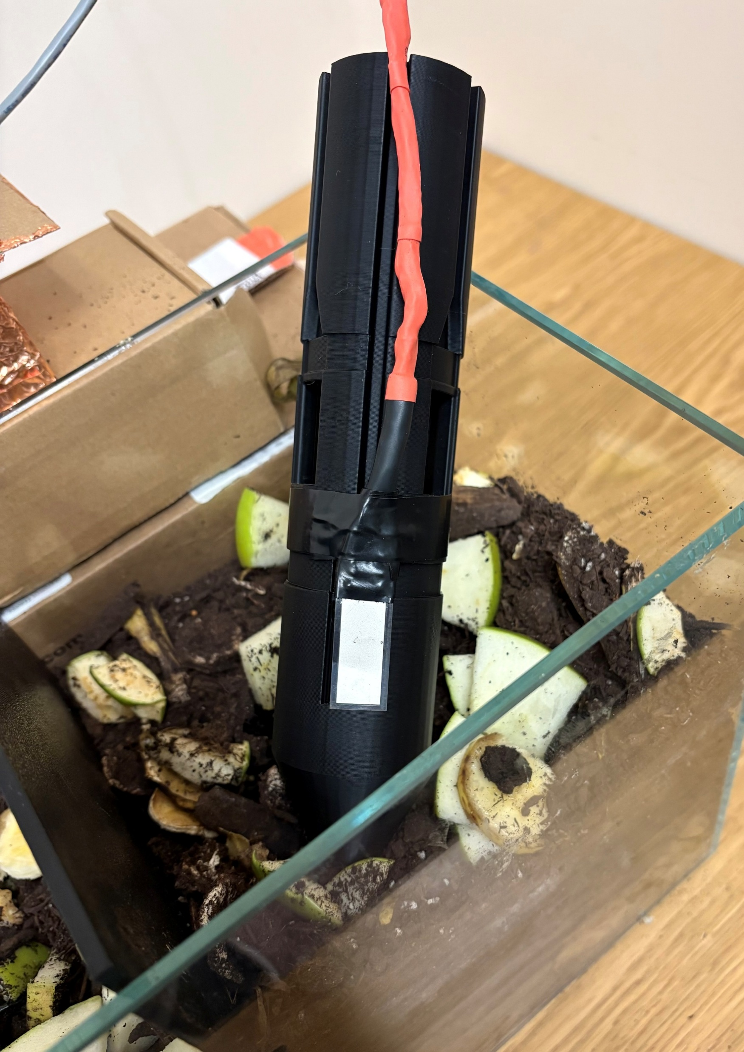
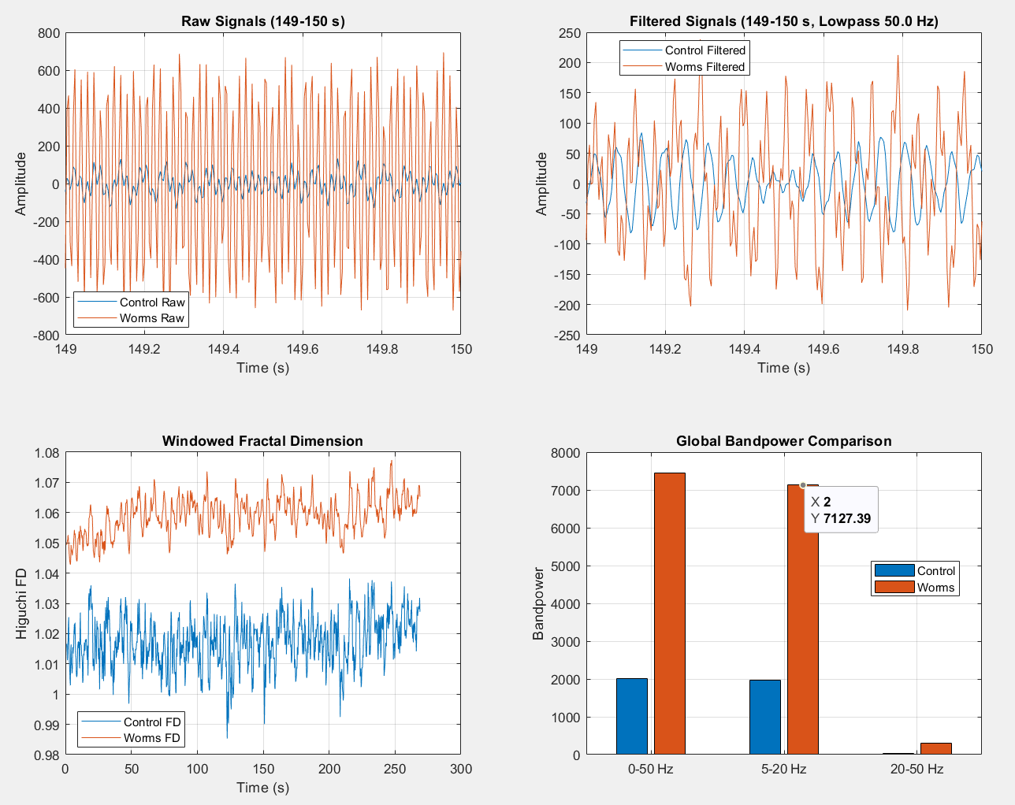
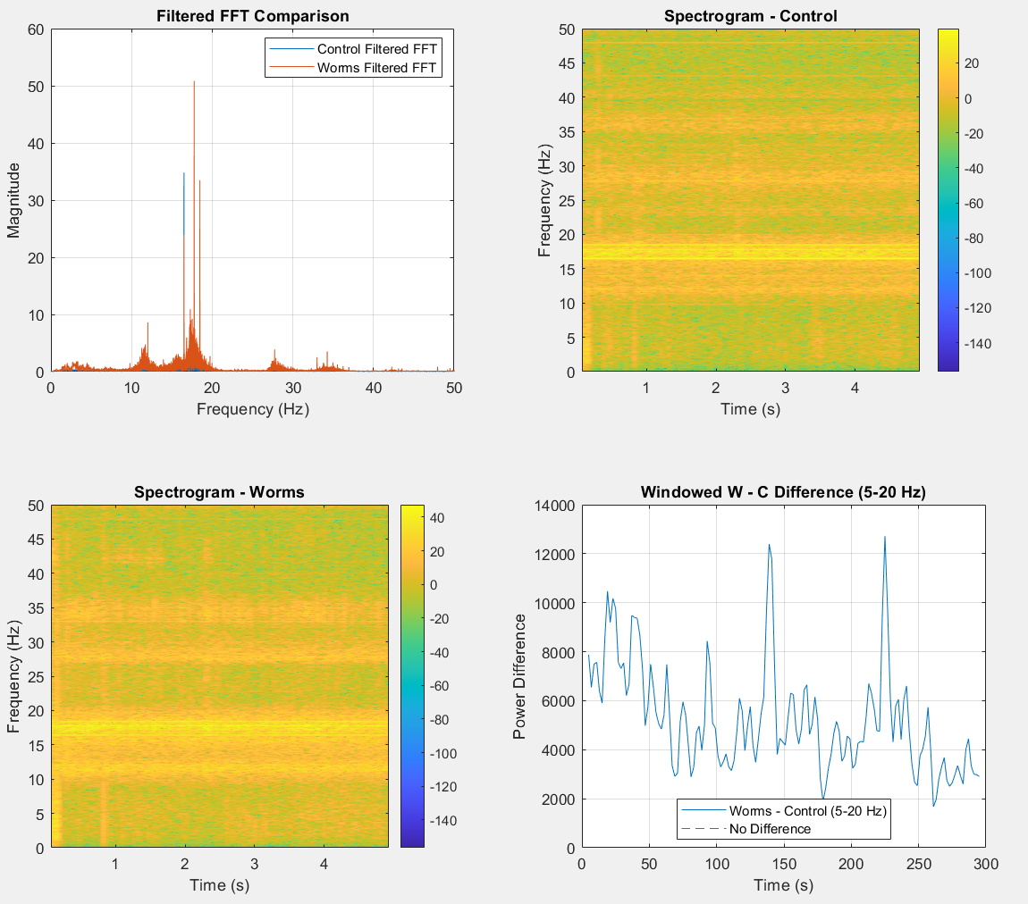
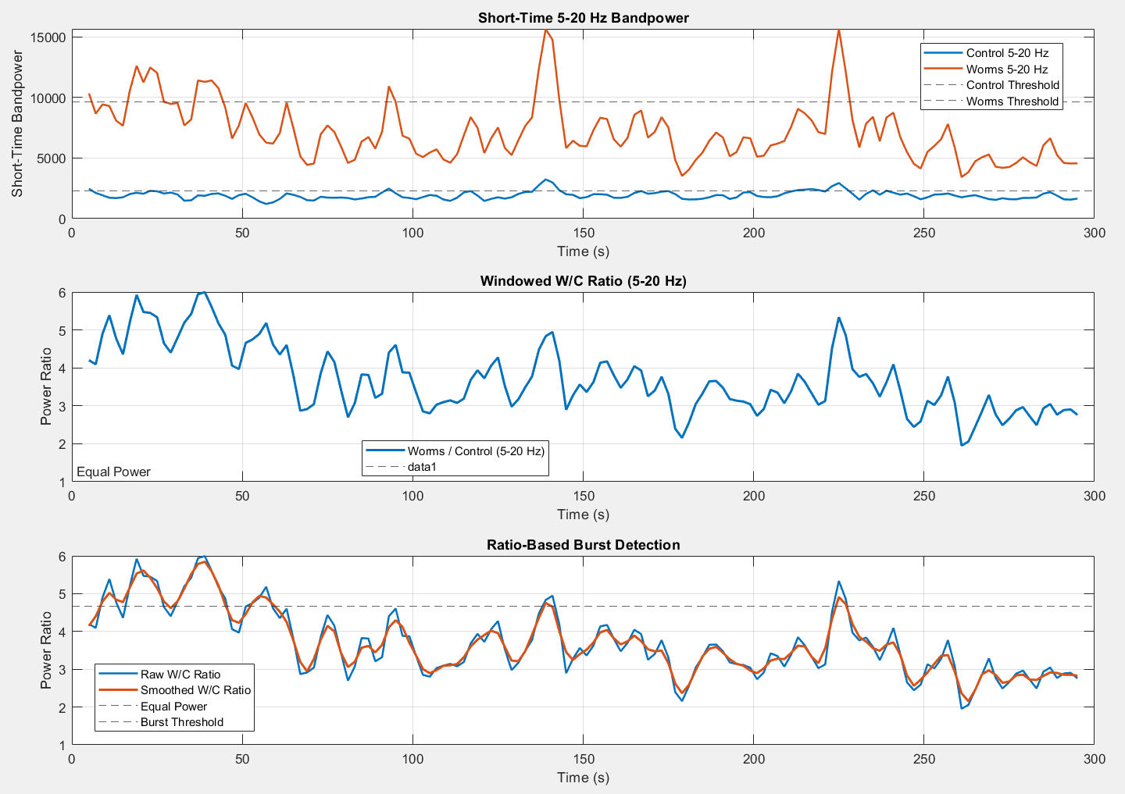
Underground Piezo Pest Detection and Identification
Nicholas Rioux and Gavin Campbell
Advised by Dr. Wayne Smith
In association with Dr. Md Shaad Mahmud’s Wireless Biosensing Lab
Credit to Sam Fauteux for Probe Design
Problem
Background
The Goal
The Approach
Novelty
How to detect and identify underground ecosystems without disturbing it?
Piezoelectric sensors have been used before to monitor organism activity in soil [1].
Fractal dimension and other signal analysis have been used to identify larvae in soil [2].
Design and implement a system to detect and classify underground organisms using low-frequency vibrations, providing a non-invasive method that prevents destructive digging and preserves plants, animals, soil integrity, and terrain.
Next Steps: Explore and implement machine learning algorithms for the classification of vibrations.
Utilize passive piezo sensors, high impedance piezo preamp, codec WM8960 (ADC), and ESP32 Thing microcontroller to detect and process mechanical ground vibrations.
Test the system under varying soil conditions (moisture, temperature, compaction) and feed representative signals into a feature extraction method to identify organism presence.
Detection and identification of various organisms at different soil depths and directions with piezo sensors and fractal dimensionality.
Circuit Model
Data Analysis
References
[1] Robinson, J. M., Taylor, A., Fickling, N., Sun, X., & Breed, M. F. (2024). Sounds of the underground reflect soil biodiversity dynamics across a grassy woodland restoration chronosequence. Journal of Applied Ecology, 61, 2047–2060.
[2] Görres, CM., Chesmore, D. Active sound production of scarab beetle larvae opens up new possibilities for species-specific pest monitoring in soils. Sci Rep 9, 10115 (2019).

