Slide 1


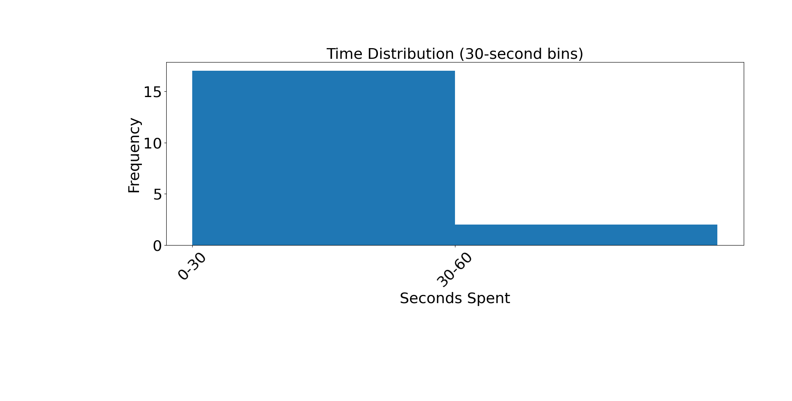
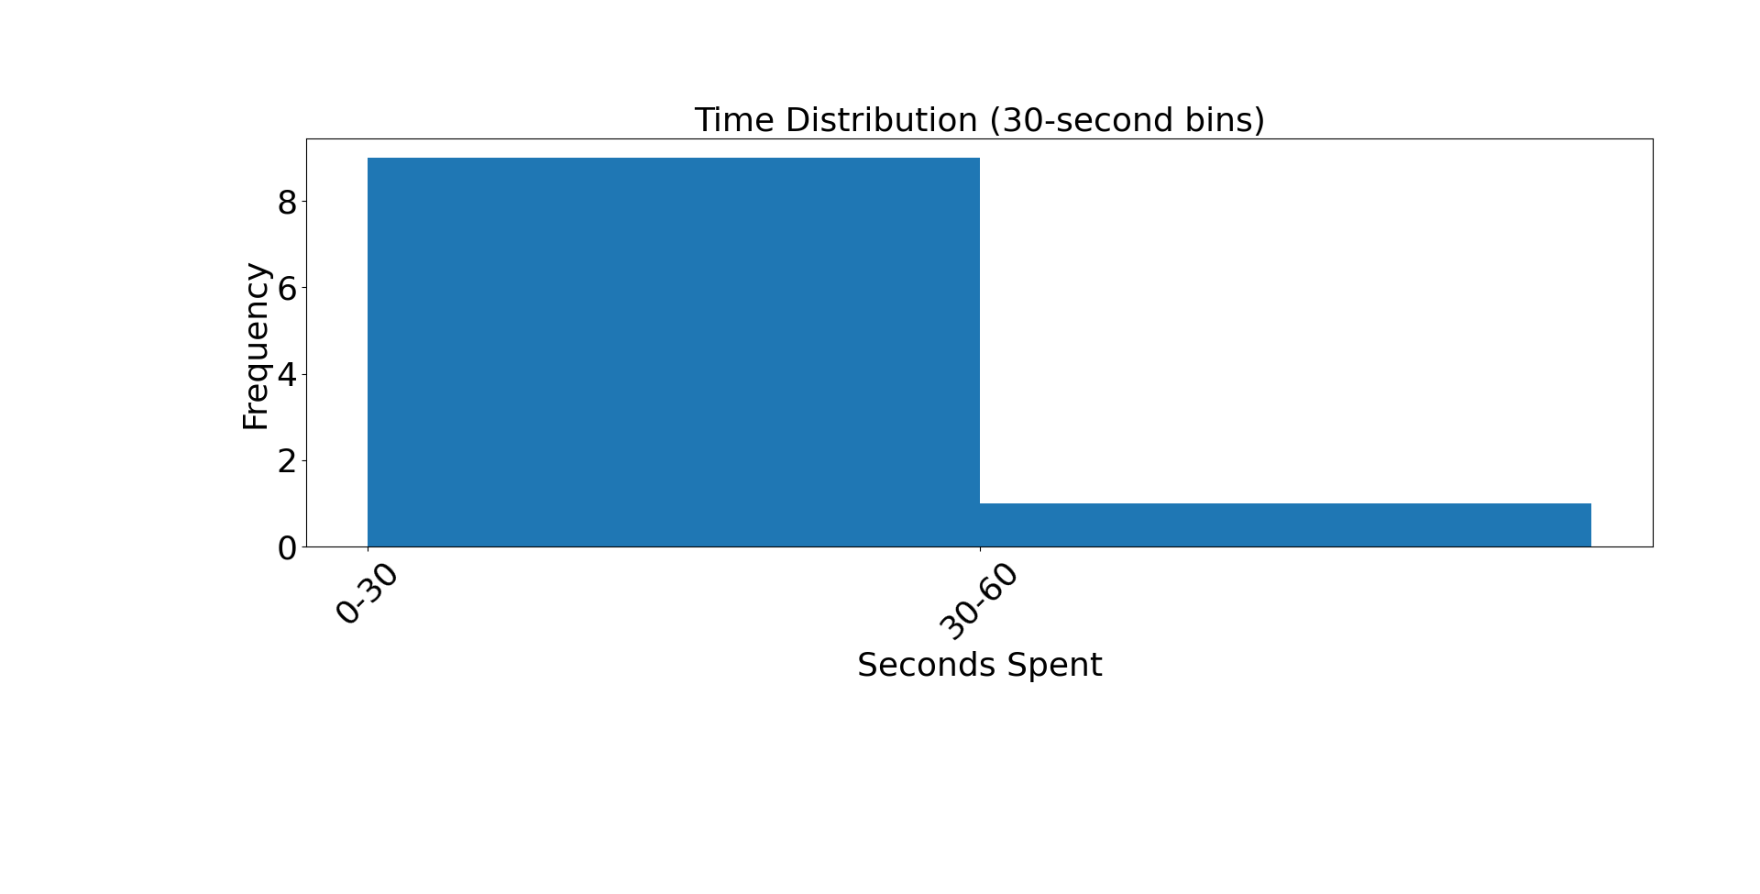
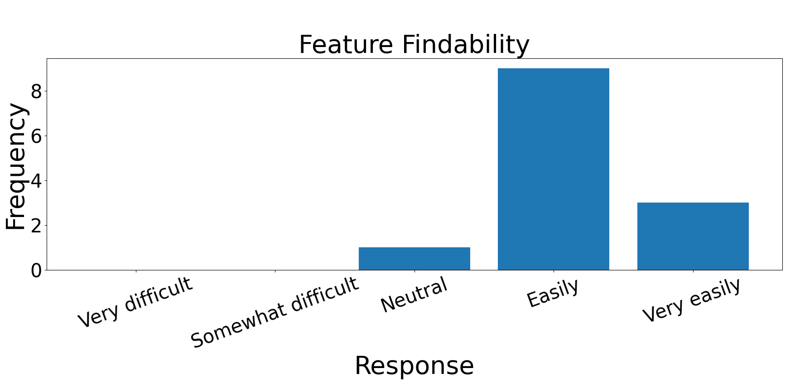
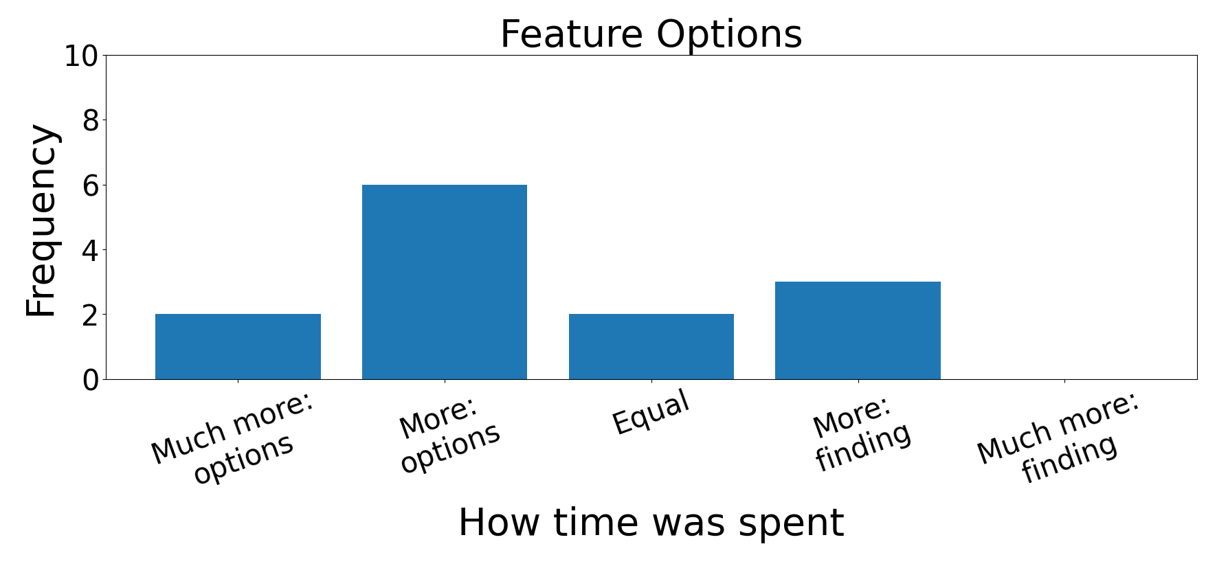
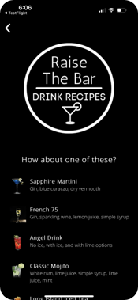
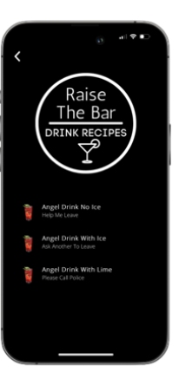
Assessing the Efficacy of a College Campus Safety and Wellness App, uSafeUS®
Cameron Green
Advisors: Sharyn Potter and Radim Bartos
College of Engineering and Physical Sciences and College of Liberal Arts
University of New Hampshire, Durham, NH 03824
IRB Study #: IRB-FY2026-72
Introduction
uSafeUS Stay Safe Feature Response Times
Results
The uSafeUS® College Campus Safety and Wellness app was developed to equip college students with resources to address uncomfortable and unsafe situations. There is limited research assessing the efficacy of uSafeUS® in real-world situations.
My research gathered data to inform this assessment and improve the app's development.
Scenario #1 Angel Drink time
Scenario #3 Time to Leave time
Participants found solutions that did not always match the solutions expected when I designed the research. The extra time participants spent was usually a result of multiple options within the app to address a given scenario.
Most participants found the app easy to navigate and confusion appeared when there was more than one choice of features. Some variation in the chosen solution was found across participants for scenarios that could be addressed by multiple categories within a feature they were reviewing.
Data Collection
I recruited UNH Undergraduate students to participate in a research study where I conduct simulations of real-world scenarios that uSafeUS® features are intended to address.
The intent is to collect data on how effective the app is in addressing two types of situations:
Exiting or getting help in uncomfortable situations
Directing users to appropriate resources to help themselves or a friend
Most participants took less than 30 seconds to find Angel Drink
Most participants took less than 30 seconds to find TTL
uSafeUS Find Help Feature Likert Scales
Conclusions
Scale #1 Feature Findability
Scale #2 Feature Options
The app UI design and layout need minimal modifications as most content in the app was easily findable by participants.
The Angel Drink feature and the "hidden eye" icon in the bottom right may benefit from additional explanation in the app demo video so users know they have built-in discretion to protect them from onlookers.
Some categories that appear similar in Find Help and Helpful Answers could benefit from more concise naming to help distinguish them.
Data
I recruited 20 UNH undergraduate students who were at least 18 years of age. Each participant installed uSafeUS® on their phone prior to the interview.
In each interview, participants were presented 6 different scenarios and asked questions and follow-up questions to determine how easily they navigated to the app content they needed for the scenario at hand.
Participants were also timed and asked open-ended questions regarding app features.
Most participants found Find Help easily but not perfectly
Most participants spent more time reviewing options in Find Help once they navigated to it
uSafeUS Open-ended feedback
References
Some participants expressed they were initially confused on the Angel Drink display page. The first page displays a realistic drink menu so users can discreetly use the Angel Drink feature to seek help from a bartender/server.
(1) Bulovec, T.; Eman, K. Safer Nights Out: The Role of Mobile Apps in Preventing Sexual Violence. Urban Sci. 2025, 9, 276. https://doi.org/ 10.3390/urbansci9070276
(2) Department of Justice, Office of Justice Programs, Bureau of Justice Statistics, Rape and Sexual Victimization Among College-Aged Females, 1995-2013 (2014).
(3) Potter, S. J., Moschella, E. A., Demers, J. M., & Lynch, M. (2021). Using Mobile Technology to Enhance College Sexual Violence Response, Prevention, and Risk Reduction Efforts. Journal of Technology in Human Services, 40(1), 25–46. https://doi.org/10.1080/15228835.2021.1929665
Acknowledgements
Professors Radim Bartos and Sharyn Potter for guidance, the UNH Honors and CS departments for funding, Professor Laura South for interview structure advice, and UNH CS Research Librarian CJ Wong for providing background literature and related resources.

