Slide 1

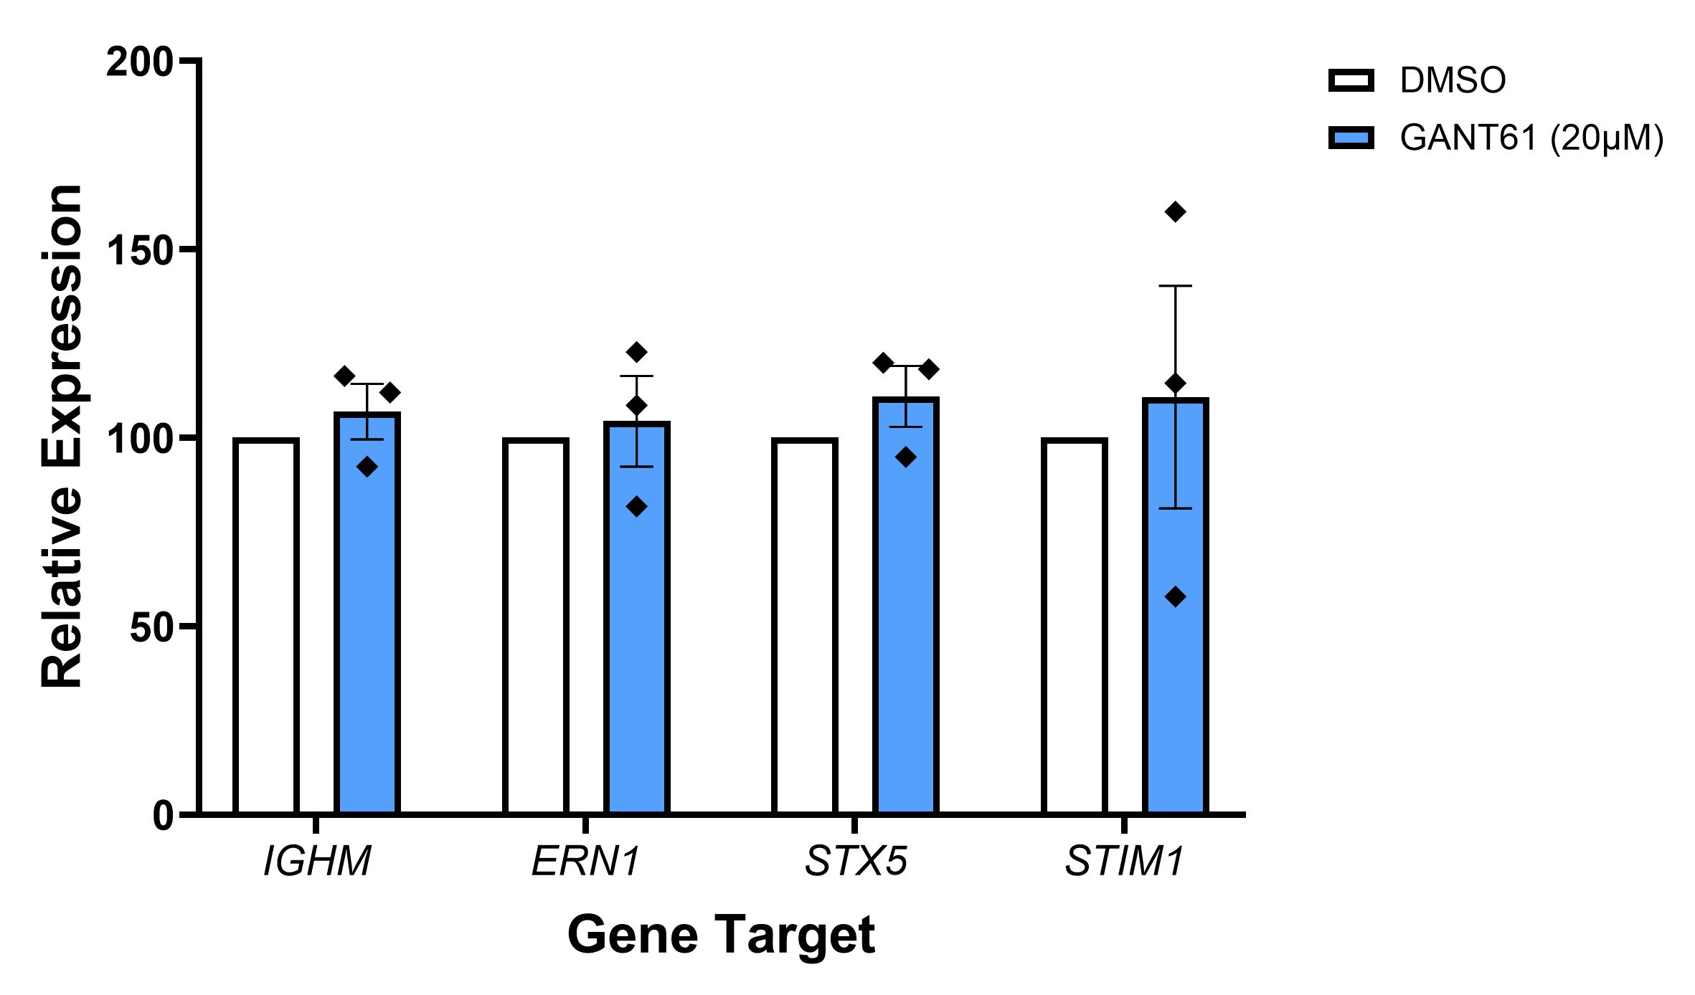




Identifying Novel GLI2-Associated Secretory Targets in Waldenström's Macroglobulinemia
Tyler Hamel and Sherine F. Elsawa
Department of Molecular, Cellular and Biomedical Sciences, University of New Hampshire, Durham, NH 03824
Introduction
Results
Summary
Waldenström’s macroglobulinemia (WM) is a low-grade B-cell lymphoma characterized by the overproduction of monoclonal immunoglobin M (IgM).¹
WM cells exist along the spectrum of B-lymphocyte → plasma cell differentiation
Pharmacological inhibition of the Hedgehog transcription factor GLI2 was shown to decrease IgM secretion in the WM cell line MWCL-1.
  GANT61: small molecule inhibitor of GLI2
Previous work showed that GLI2 does not regulate IgM through transcriptional regulation via heavy chain expression (IGHM).
Goals: use bioinformatics to identify genes that support GLI2-regulated IgM secretion in WM and perform gene expression profiling for validation
Identified secretory pathways as a potential enhanced function of WM differentiation. Then identified GLI2-correlated secretory genes relevant to IgM secretion. Identified genes were then tested in a biological system to validate correlation.
WM upregulated genes in BL → PC differentiation showed increased enrichment of secretory processes compared to healthy.
GLI2 was ~1.57x more likely to correlate with secretory genes than immunological genes.
Correlations derived from WM patient expression profiling did not carry forward in the GLI2 perturbation in-vitro testing. However, IGHM remained unchanged as predicted.
Future Directions
Optimization of qPCR primers for STX5 and STIM1 to reduce noise and increase accuracy.
Assess BL → PC differentiation and GLI2 correlation with secretory genes in a recently accessible WM scRNA-seq dataset (GSE296167). Allowing for more statistically robust analysis cell-cell heterogeneity that otherwise would be lost in microarray.
Overlay the patient-derived scRNA-seq data with paired scATAC-seq to characterize the heterogeneous transcriptome and epigenome of WM.
Methodology
Figure 2. GLI2 Pearson Correlation Plot of WM Plasma cell Samples. Literature curated sets of immunological (left) and secretory (right) genes were tested for GLI2 expression correlation. Dual-panel bar chart representing the correlation (R) of each gene with GLI2. Genes with positive correlation are directed right (R > 0) and negative directed left (R < 0). False discovery rate (FDR) was employed for statistical significance because multiple correlation tests were performed simultaneously (grey = not significant, † = nominal p-value < 0.05, ‡ = FDR < 0.05).
GSE6691 microarray: expression profiles from unpaired healthy B-lymphocytes (8) and plasma cells (5), and paired WM B-lymphocytes and plasma cells (10).²
Limma: differential expression to assess differentiation; gene ontology (GO) enrichment of upregulated genes filtered for secretory terms.
Correlation analysis: Pearson correlation of GLI2 vs 32 Classical immunological and 32 secretory machinery genes.
Quantitative PCR: Treat MWCL-1 cells with GANT61 (20µM); RNA isolation → cDNA synthesis → qPCR
ns
ns
ns
ns
Acknowledgements
All members of the Elsawa Lab
Stephen Ansell, Mayo Clinic (MWCL-1 cell line)
References
Figure 3. Expression of Secretory Target Genes in MWCL-1 Treated with GANT61. GLI2 inhibition with GANT61 (blue) was performed in MWCL-1 (n=3) with DMSO control (white). Expression from qPCR was calculated using the ∆∆CT method for IGHM, ERN1, STX5, and STIM1 (±SEM). Gene targets were chosen for functional validation based on WM patient ATAC-seq cross reference which identified GLI2-correlated genes that contained GLI2 binding motifs in the promoter-proximal region. Two-tailed paired T-tests on ∆CT values were performed for statistical analysis (ns = not significant).
Jackson, D. A., Smith, T. D., Amarsaikhan, N., Han, W., Neil, M. S., Boi, S. K., Vrabel, A. M., Tolosa, E. J., Almada, L. L., Fernandez-Zapico, M. E., & Elsawa, S. F. (2015). Modulation of the IL-6 Receptor α Underlies GLI2-Mediated Regulation of Ig Secretion in Waldenström Macroglobulinemia Cells. Journal of immunology (Baltimore, Md. : 1950), 195(6), 2908–2916. https://doi.org/10.4049/jimmunol.1402974.
Gutiérrez NC, Ocio EM, de Las Rivas J, Maiso P et al. Gene expression profiling of B lymphocytes and plasma cells from Waldenström's macroglobulinemia: comparison with expression patterns of the same cell counterparts from chronic lymphocytic leukemia, multiple myeloma and normal individuals. Leukemia 2007 Mar;21(3):541-9. PMID: 17252022
Figure 1. GO Enrichment and Upregulated Genes Filtered for Secretion. Initial GO plots were dominated by secretion terms. These GO plots filter for secretion terminology (left), and enriched genes associated with GO terms (right).

